Slide 1
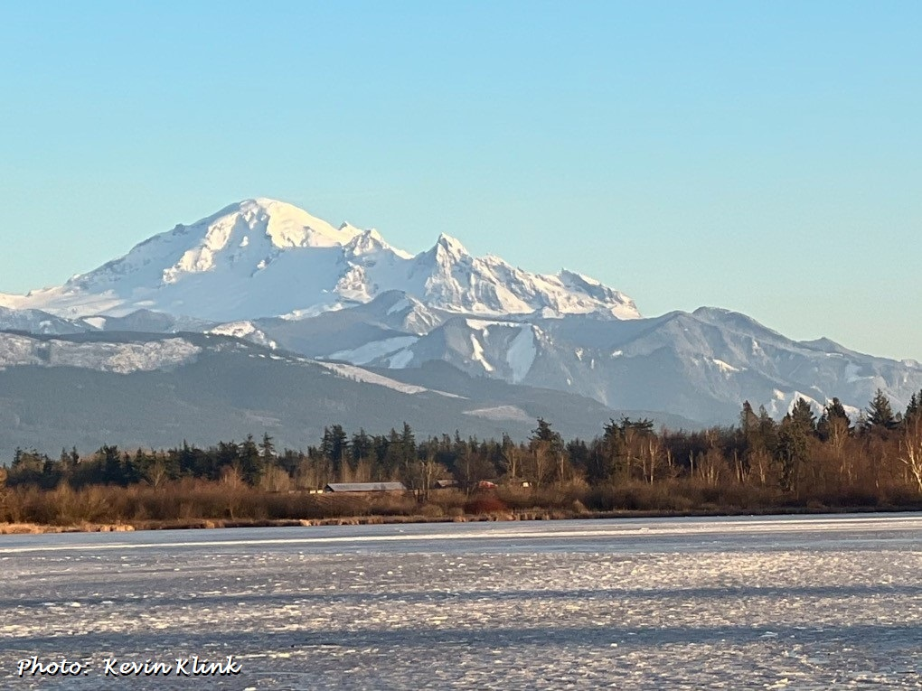
Seasonal Climate Forecast Verification February – April 2024 Issued: May 15, 2024
Contact: Pete Parsons, ODF Lead Meteorologist
503-945-7448 or peter.gj.parsons@odf.oregon.gov
Production - ODA: Diana Walker; Andy Zimmerman; Jenn Ambrose; Taylor Harding Production - ODF: Julie Vondrachek; Kristin Cody

Slide 2
Format and Purpose:
A side-by-side comparison of the “Seasonal Climate Forecast” vs. what (Actually Occurred) is done for both the 1-month & 3-month forecasts.*
The accuracy of each forecast is reviewed, and the need for analog-year updates is examined.
This is part of an ongoing assessment of the utility of this forecast method.**
*Utilizes 1991-2020 long-term averages
**See “Forecasting Methods…” at:
https://oda.direct/Weather

Slide 4
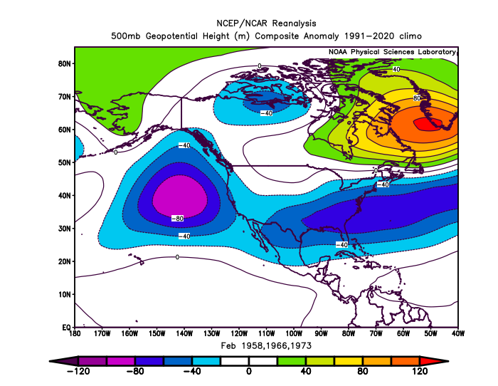
February 2024 (Forecast Issued January 18, 2024)/(Actual)
Forecast Upper-Air Anomalies
Actual Upper-Air Anomalies
Analogs (left) showed anomalous troughing over the eastern Pacific Ocean (El Niño signature). The February 2024 pattern (right) had strong negative anomalies centered just off the California Coast. Mostly a “forecast hit.”

Slide 5
February 2024 (Forecast Issued January 18, 2024)/(Actual)
Forecast Temperatures
Actual Temperatures
Data courtesy of the National Centers for Environmental Information (NCEI)
Notes:
Temp Data: ftp://ftp.ncdc.noaa.gov/pub/data/cirs/drd964x.tmp.txt Precip Data: ftp://ftp.ncdc.noaa.gov/pub/data/cirs/drd964x.pcp.txt

Slide 6
February 2024 (Forecast Issued January 18, 2024)/(Actual)
Forecast Precipitation
Actual Precipitation
Data courtesy of the National Centers for Environmental Information (NCEI)
Notes:
Temp Data: ftp://ftp.ncdc.noaa.gov/pub/data/cirs/drd964x.tmp.txt Precip Data: ftp://ftp.ncdc.noaa.gov/pub/data/cirs/drd964x.pcp.txt

Slide 7
February 2024 (Forecast Issued January 18, 2024)/(Actual)
Above-average temperatures but with short-duration cool periods. (A split-flow jet stream pattern brought generally benign weather with above-average temperatures statewide. There were only two relatively cool periods, each lasting just a couple of days.) A “forecast hit.”
Precipitation near average south and slightly below average north. (Storms generally weakened, as they came ashore. While there were many days with some precipitation, amounts were mostly light until the very end of the month. Overall, rain and mountain snow were near or slightly above average.) A “partial forecast hit.”

Slide 8
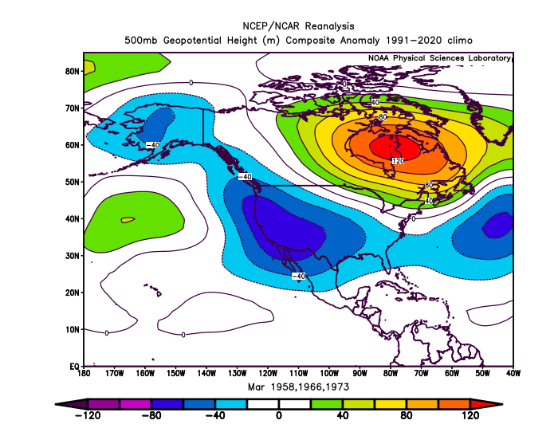
March 2024 (Forecast Issued February 15, 2024)/(Actual)
Forecast Upper-Air Anomalies
Actual Upper-Air Anomalies
Analog forecast (left) and observed pattern (right) both had negative anomalies along the west coast...centered over California (El Niño signature). A “forecast hit.”

Slide 9
March 2024 (Forecast Issued February 15, 2024)/(Actual)
Forecast Temperatures
Actual Temperatures
Data courtesy of the National Centers for Environmental Information (NCEI)
Notes:
Temp Data: ftp://ftp.ncdc.noaa.gov/pub/data/cirs/drd964x.tmp.txt Precip Data: ftp://ftp.ncdc.noaa.gov/pub/data/cirs/drd964x.pcp.txt

Slide 10
March 2024 (Forecast Issued February 15, 2024)/(Actual)
Forecast Precipitation
Actual Precipitation
Data courtesy of the National Centers for Environmental Information (NCEI)
Notes:
Temp Data: ftp://ftp.ncdc.noaa.gov/pub/data/cirs/drd964x.tmp.txt Precip Data: ftp://ftp.ncdc.noaa.gov/pub/data/cirs/drd964x.pcp.txt

Slide 11
March 2024 (Forecast Issued February 15, 2024)/(Actual)
All three analog years experienced near or below-average temperatures with a general “split-flow” jet stream pattern directing the punch of incoming storms towards California. (A pervasive “split-flow” jet stream pattern directed significant storm activity into California...keeping Oregon’s temperatures generally near or below average.) A “forecast hit.”
Precipitation expected most days, but with the “split-flow” jet stream pattern centering the impacts over California. (There were more wet days than dry days across the state. As expected, the El Niño “split-flow” jet stream pattern brought more precipitation, relative to average, to the southern zones.) A “forecast hit.”

Slide 12
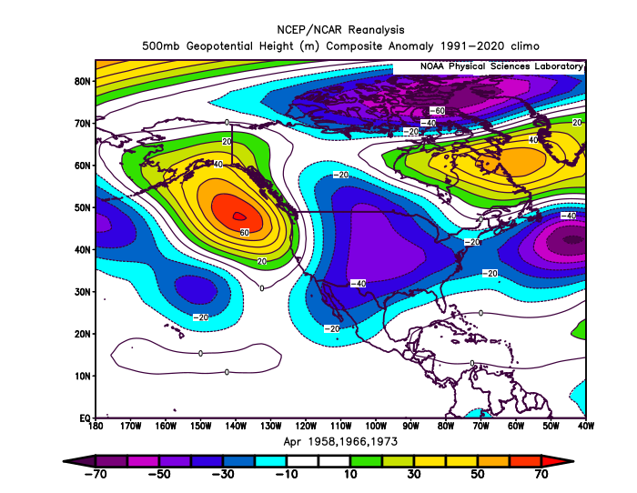
April 2024 (Forecast Issued March 21, 2024)/(Actual)
Forecast Upper-Air Anomalies
Actual Upper-Air Anomalies
Anomalous ridging was predicted in the Gulf of Alaska...extending to the Pacific NW Coast (left). The observed anomalies (right) resembled those predicted. Both showed near-average conditions over Oregon. Mostly a “forecast hit.”

Slide 13
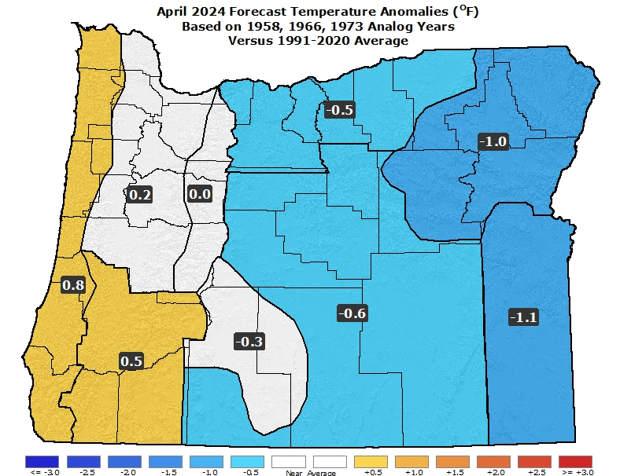
April 2024 (Forecast Issued March 21, 2024)/(Actual)
Forecast Temperatures
Actual Temperatures
Data courtesy of the National Centers for Environmental Information (NCEI)
Notes:
Temp Data: ftp://ftp.ncdc.noaa.gov/pub/data/cirs/drd964x.tmp.txt Precip Data: ftp://ftp.ncdc.noaa.gov/pub/data/cirs/drd964x.pcp.txt

Slide 14
April 2024 (Forecast Issued March 21, 2024)/(Actual)
Forecast Precipitation
Actual Precipitation
Data courtesy of the National Centers for Environmental Information (NCEI)
Notes:
Temp Data: ftp://ftp.ncdc.noaa.gov/pub/data/cirs/drd964x.tmp.txt Precip Data: ftp://ftp.ncdc.noaa.gov/pub/data/cirs/drd964x.pcp.txt

Slide 15
April 2024 (Forecast Issued March 21, 2024)/(Actual)
Analogs mostly had near-average temperatures, but 1966 had a significant cold snap with fruit-tree damage. (Temperatures were generally near or slightly above average. However, there were cool periods at the beginning and middle of the month with local western valley frost.) A “forecast hit.”
Precipitation varied among the analogs. 1958 was wet, but 1966 & 1973 were drier than average. The latter skewed the forecast dry but with reduced forecast confidence. (Most of the rain and mountain snow fell at the beginning and end of the month. Overall, precipitation was below average, especially north.) A “forecast hit.”

Slide 16
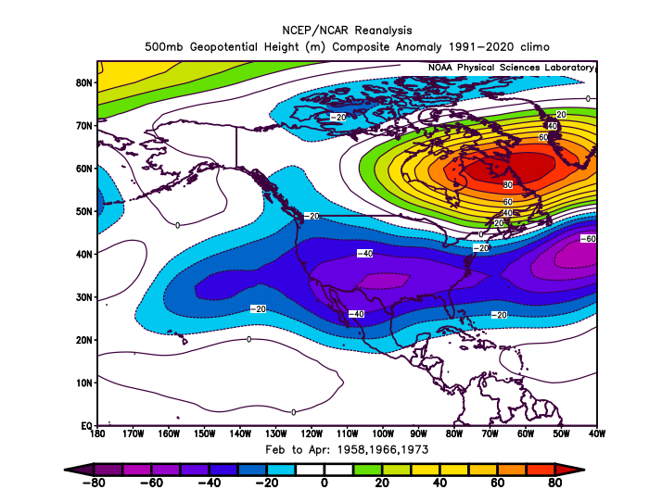
February – April 2024 (Forecast Issued January 18, 2024)/(Actual)
Forecast Upper-Air Anomalies
Actual Upper-Air Anomalies
Both the analog blend (left) and the observed pattern (right) exhibited a pervasive “split-flow” upper-air pattern (typical during an El Niño) with anomalous troughing along the west coast. A “forecast hit.”

Slide 17
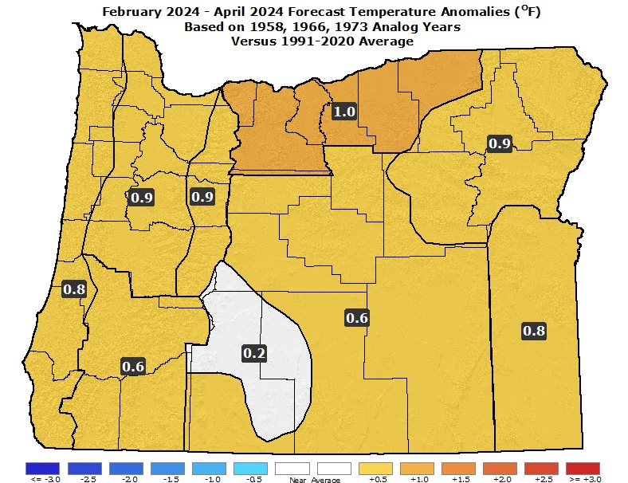
February – April 2024 (Forecast Issued January 18, 2024)/(Actual)
Forecast Temperatures
Actual Temperatures
Data courtesy of the National Centers for Environmental Information (NCEI)
Notes:
Temp Data: ftp://ftp.ncdc.noaa.gov/pub/data/cirs/drd964x.tmp.txt Precip Data: ftp://ftp.ncdc.noaa.gov/pub/data/cirs/drd964x.pcp.txt

Slide 18
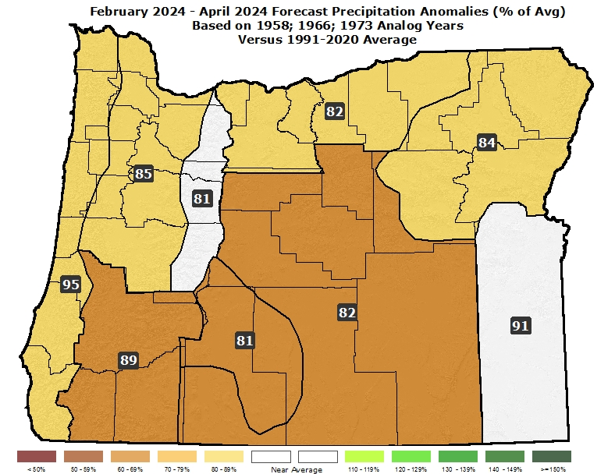
February – April 2024 (Forecast Issued January 18, 2024)/(Actual)
Forecast Precipitation
Actual Precipitation
Data courtesy of the National Centers for Environmental Information (NCEI)
Notes:
Temp Data: ftp://ftp.ncdc.noaa.gov/pub/data/cirs/drd964x.tmp.txt Precip Data: ftp://ftp.ncdc.noaa.gov/pub/data/cirs/drd964x.pcp.txt

Slide 19
February – April 2024 (Forecast Issued January 18, 2024)/(Actual)
Near or above-average temperatures. (As expected, a mild pattern emerged in February with March bringing some cooling, relative to average. April had slightly warmer-than-average temperatures. Overall, temperatures were slightly above average.) A “forecast hit.”
An abundance of days with precipitation but overall values near or slightly below average. The greatest chances for positive departures in the southern zones. (Above-average rain and mountain snow in February was tempered by a transition to drier-than-average conditions by April. Overall, precipitation was near average. Mountain snowpacks peaked at near normal north and above normal south.) A “forecast hit.”

Slide 20
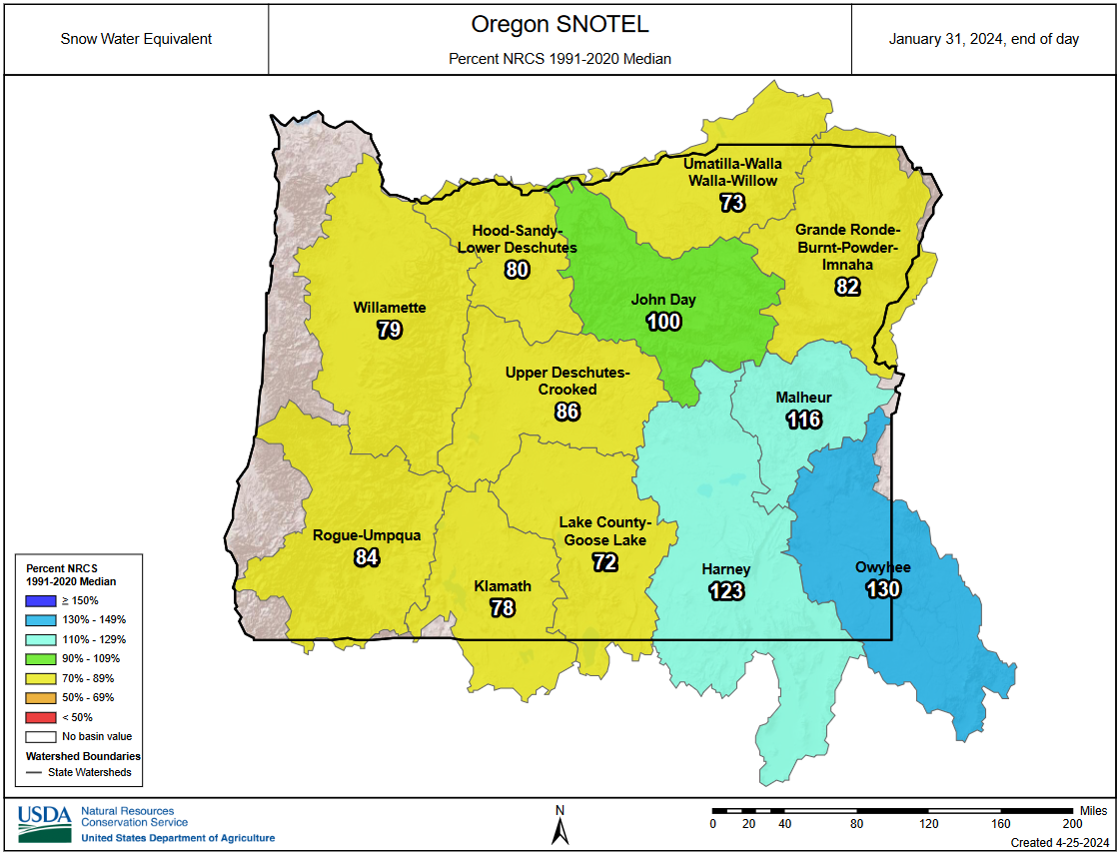
Oregon Snowpacks Started Slowly...
(Beginning of February 2024)

Slide 21
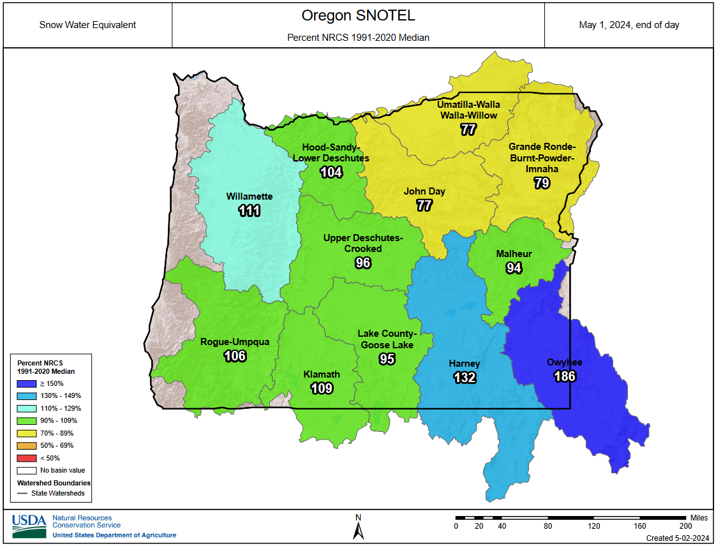
Increases in Snowpacks...Mainly South
(Beginning of May 2024)

Slide 22
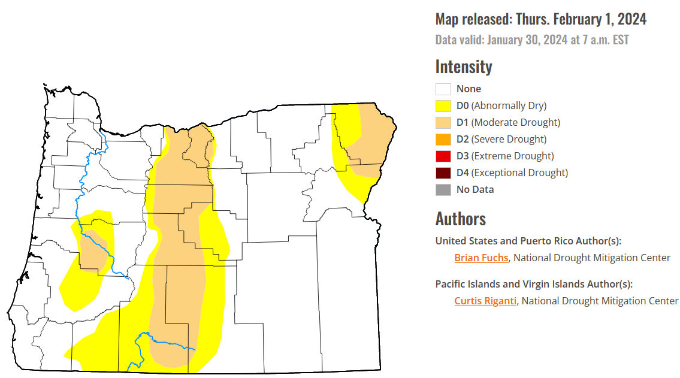
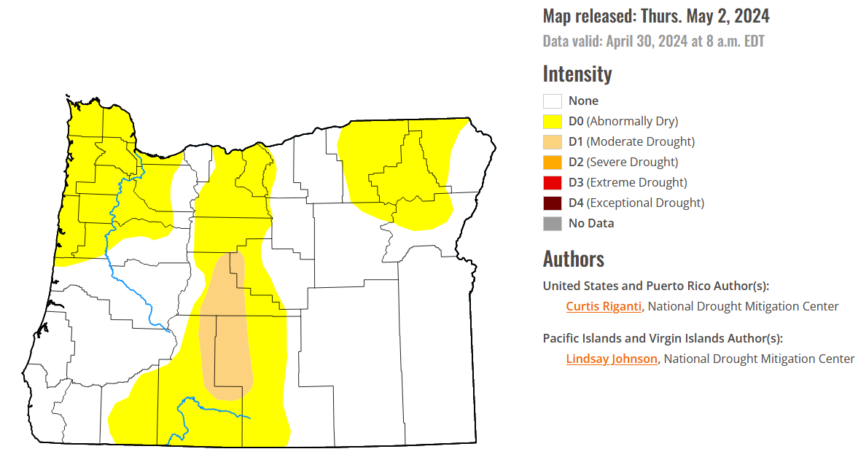
Continued Drought Improvement
(over the past 3 months)
January 30, 2024
April 30, 2024
Courtesy: National Drought Mitigation Center (NDMC)
https://droughtmonitor.unl.edu/

Slide 23
Forecast Resources
ODA Seasonal Climate Forecast Home:
https://www.oregon.gov/ODA/programs/NaturalResources/Pages/Weather.aspx
CPC Official US Three-Month Forecasts (Graphics):
https://www.cpc.ncep.noaa.gov/products/predictions/long_range/seasonal.php?lead=01
CPC US 30-Day & 90-Day Forecasts (Discussions):
https://www.cpc.ncep.noaa.gov/products/predictions/long_range/fxus07.html
CPC Weekly & Monthly ENSO Discussions: https://www.cpc.ncep.noaa.gov/products/analysis_monitoring/enso_advisory
Australian Government Climate Model Summary:
http://www.bom.gov.au/climate/model-summary/#region=NINO34&tabs=Overview
Australian Government ENSO Wrap-Up:
http://www.bom.gov.au/climate/enso
IRI ENSO Quick Look:
https://iri.columbia.edu/our-expertise/climate/forecasts/enso/current/

Slide 24
Water Supply / Fire-Potential Outlook
CPC U.S. Seasonal Drought Outlook:
https://www.cpc.ncep.noaa.gov/products/expert_assessment/season_drought.png
NRCS Snow Water Equivalent Oregon Map:
https://www.wcc.nrcs.usda.gov/ftpref/data/water/wcs/gis/maps/or_swepctnormal_update.pdf
NRCS/USDA Snow Water Equivalent Products:
https://www.nrcs.usda.gov/wps/portal/wcc/home/snowClimateMonitoring/snowpack/
NDMC U.S. Drought Monitor:
https://droughtmonitor.unl.edu/
NIDIS North American Drought Portal:
https://www.drought.gov/nadm/content/percent-average-precipitation
WRCC WestWideDroughtTracker:
https://www.wrcc.dri.edu/wwdt/
NWCC Northwest Interagency Coordination Center (video)
https://gacc.nifc.gov/nwcc/predict/outlook.aspx

Slide 25
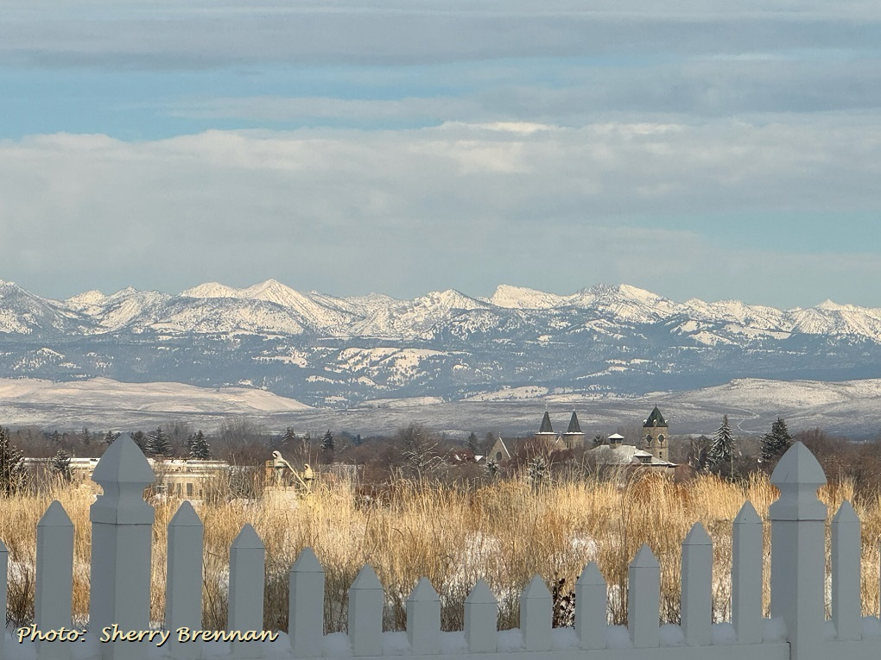
Updated Mid-Month
Your Feedback is Welcome!
Sign-up for Email notification of updates at:
https://oda.fyi/SubscribeSCF
Contact: Pete Parsons, ODF Lead Meteorologist
at 503-945-7448 or peter.gj.parsons@odf.oregon.gov

