Slide 1
Data Collections in 2023-24
September 2023

Slide 2
Goals and Purpose
The purpose for the EL Data Collection is to collect data on Oregon’s English Learners for:
Federal Title III allocation determinations
Federal required EL data submissions
Review by ODE state fiscal (ADM) staff to ensure the appropriate dissemination of state weighted EL funding
The goals for today’s EL data collection presentation are:
Assist districts with learning how to submit the EL collection data
Provide support on frequently asked EL data collection questions

Slide 3
Dates for the Calendar
Name of Collection | Open Date | Close Date | Review Window (Y/N) | Data validation (Y/N
Fall EL Data Collection | 10/12/23 | 12/01/23 | N | Yes, Informal – in Feb/Mar to assist with Spring data submission (Fall Critical Validation)
Spring EL Data Collection | 4/11/24 | 5/24/24 | Y | 6/6/24 - 6/21/24

Slide 4
Where do I go?
ODE District Secure web page
Sign in to your applications
Choose Consolidated Collections
ESEA – Title III English Learners – Fall
What if I don’t see this application?
Contact your District Security Administrator for permission
You can find your district security administrator on the ODE District web page – link

Slide 5
How to Access the Collection

Slide 6
What do I need to report?

Slide 7
Required EL Collection Fields
ELRecTypCd – Code that describes the student’s EL status
ELFlg – Flag that shows the student is an EL or not
ELPrgMdlTyp (1, 2, and 3) – Description of the EL instructional program and access to core support
ELStrtDt – Date the student was first identified as an EL
ELExitDt – Date the student exited the EL program as proficient
ELProfTstNmCd – Code for the EL proficiency test
EL Domain scores – Score for each language domain for ELPA screener
SIFEFg – Flag showing the student is a student with interrupted formal education

Slide 8
Any changes to the requirements for 2023-24?

Slide 9
Change in collection dates
ODE has changed the collection effective dates beginning with the 2023-24 EL data collections in order to support some schools beginning the school year prior to mid-August.
New beginning effective date is - August 1, 2023.
This means the district could use the 8/1 date to:
Enter start dates for any incoming kindergartner identified with EL status during Roundup earlier.
Enter an exit date that was inadvertently missed in the 22-23 Spring Collection prior to the start of the school year.
Note these student records will remain in exit status the entire 23-24 school year and enter monitor year 1 status (in ODE systems) beginning the 24-25 school year.

Slide 10
Section 504 flag
This flag is required beginning the 23-24 school year.
ODE uses this flag to review students who have domain exemptions for ELPA summative assessments.

Slide 11
Honoring EL designations from other states
During the 2023 Multilingual/English Learner Alliance conference, ODE made a decision to honor EL designations from other states.
This means that students enrolling in Oregon from another state, holding EL status (current, monitor, or former) is entered into Oregon schools with that status and do not have to be administered the ELPA screener;
As long as the enrolling district/school is able to obtain the student’s EL start date and exit date (where appropriate).
If the date(s) are not obtained by the federal timeline to identity the student for EL status, the student must be administered the ELPA screener.
Regardless of data received after the administration of the ELPA screener, the most recent assessment determination, establishes the student’s EL designation.

Slide 12
New Proficiency Test Code – 11 for students who were identified as an EL in the current school year in another state
Coding for 1-A students – served by EL Program
Coding for 4-N students – parent waiver for EL program participation
Served by the EL program
ELRecTypCd - 1-A
EL start date – use date from the other state
ELPrfTstAdmDt – use EL Start date for this field
ELPrfTstCd – 11
Leave Domain scores blank
EL flag is set to Yes
Parent signed waiver for EL instructional program
ELRecTypCd – 4-N
EL start date – use date from the other state
ELPrfTstAdmDt – use EL Start date for this field
Leave Domain scores blank
Waiver date required
EL flag is set to Yes

Slide 13
Coding for current ELs identified prior to the current school year
Served by the EL instructional program
Waiver from participation in the EL instructional program
Served by the EL program
ELRecTypCd - 1-B (this could change depending on ELPA participation or proficient ELPA score)
EL start date – use date from the other state
ELPrfTstCd –ELPA summative (06, 09, or 10 – whichever is most appropriate for student).
EL flag is set to Yes
Parent signed waiver for EL instructional program
ELRecTypCd – 4-N (this could change if student does not participate in ELPA)
EL start date – use date from the other state
ELPrfTstCd –ELPA summative (06, 09, or 10 – whichever is most appropriate for student).
Waiver date required
EL flag is set to Yes

Slide 14
Coding students who have demonstrated English proficiency prior to enrolling in Oregon.
Monitored status – Code 5M
Former EL status – Code 5F
If the exit date is within the last four (4) school years – code as 5-M (monitored))
report EL start date
report EL exit date
EL flag is set to No
If the exit date is more than four (4) school years – code as 5-F (former)
report EL start date
report EL exit date
EL flag is set to No

Slide 15
Honoring EL designation from other states, FAQs
What if we do not have the student’s EL dates (EL start date and/or exit date)?
The district has 30 calendar days at the beginning of the school year to identify a student as an EL or 14 calendar days after the school year has started. If the district is unable to determine the student’s EL status (EL status is “unknown”) by the federal timeline then the district will need to follow the EL identification process based on the responses to the Language Use Survey.
This may result in the student being administered the ELPA Screener.

Slide 16
Additional FAQ
What if we receive the student’s records after we administer the ELPA screener and have determined the student’s EL status based on that assessment?
The district is to use the most recently administered assessment in determining the student’s EL status. In the case above the scores from the ELPA screener are more recent than an assessment taken prior to the student’s enrollment in Oregon, therefore the results of the ELPA screener determine the student’s EL status.

Slide 17
Alt-ELPA participants 2022-23
ODE anticipates the Oregon State School Board will adopt the Alt ELPA scores later this Fall.
Once those scores are adopted, ODE will share these scores with districts.
These scores will be used to make exiting decisions for students.
ODE will update the Test Administration Manual to reflect that students scoring proficient on the Alt ELPA that are exited from EL status; will not be required to participate in the Alt ELPA in the 23-24 school year.
Test Administration Manual is posted here

Slide 18
How do I determine what code to use for my student’s record?

Slide 19
Student is new to school and was given the ELPA screener this year, how do I code the student?
Students identified as ELs for the first time in the US are coded as either
1-A – Identified and provided EL instructional services or
4-N – Identified and parent/guardian has waived EL instructional services
With either coding (1-A or 4-N) the following information must be include:
Proficiency test code 07 – ELPA screener
Proficiency test administration date – within the current school year
For kindergarteners administered the ELPA screener during Kindergartner Round-up please use the first day the student attends school.
ELPA screener domain scores
Please see ELPA screener administration guidance

Slide 20
Student was given ELPA screener and scored proficient, how do I code the student?
Students found ineligible for ELD services on the district’s initial language assessment are coded as a 3-H.
These students are entered into the EL Data Collection the year they are assessed for identification.
Entering these students assists in tracking student language proficiency and mobility.
These records must include the ELPA screener assessment test administration date and the domain scores received.
ODE tracks this information and will contact districts who may not have submitted this data.

Slide 21
Parent/guardian has waived EL instructional services, how do I code the student?
4-N waived services and the district administered the ELPA summative (in-person, remote, or Alt)
4-O waived services and did not participate in ELPA summative (in-person, remote, or Alt)
How do I code the student if the student has scored proficient on the ELPA summative (in-person, remote, or Alt)?
Use code 4-N – waiver with assessment participation
Enter an EL Exit Date in the exit date field.
These students are included in all accountability reports as ELs

Slide 22
How do I submit the data?

Slide 23
How do I submit the data to ODE?
In the data collection. . .
Select Data Submission, then either:
File Upload - Districts have the option of uploading the data directly to ODE using the CSV template
Web Submission - District will upload the students’ records individually

Slide 24
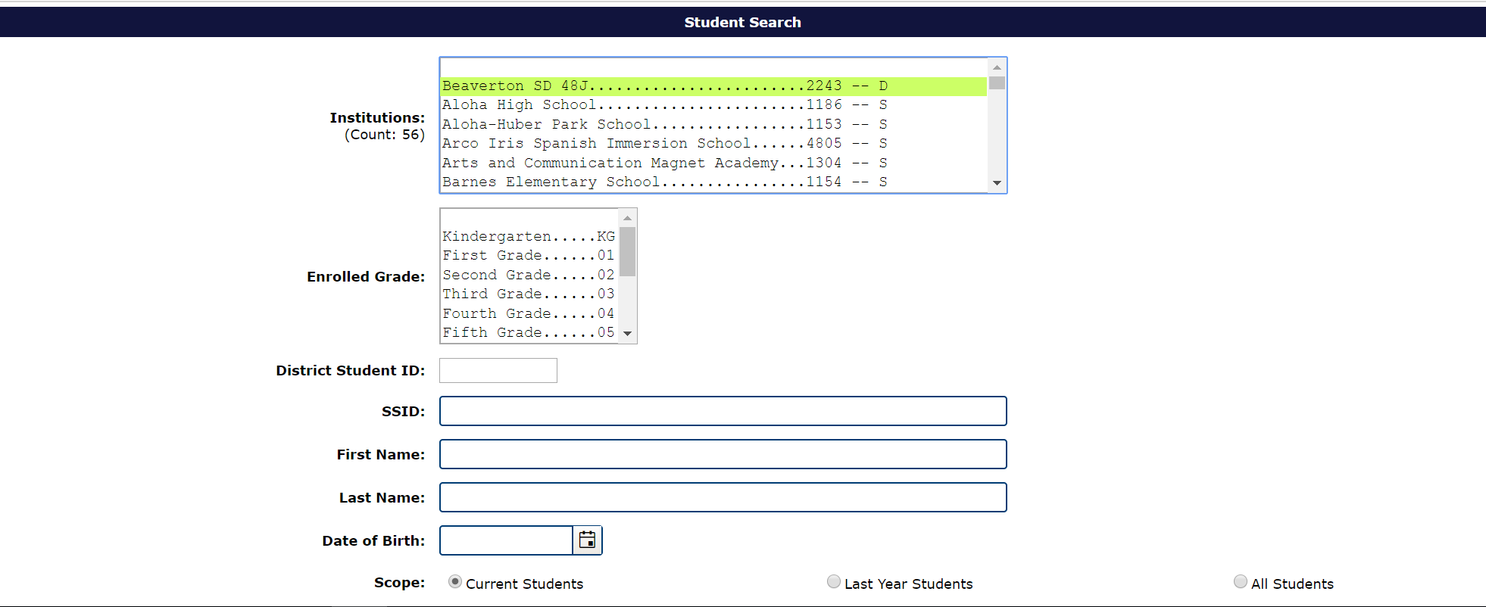
Web Submission Screen
If you are selecting to upload data individually by each student, you will use the search box below to locate the student’s record in the ODE data server.

Slide 25
Student Information System Uploads
Your student information system (i.e. Synergy) may have created a file creation to assist you in uploading to ODE.
Please check with your student information system provide for assistance with a file upload support.

Slide 26
Key Items to Remember

Slide 27
Errors
Please note – Errors in submissions occur
Carefully check the error description information, many times this language will assist you in determining how to correct the error.
Look for red boxes around the fields in the student’s record, these boxes highlight the areas that have triggered an error.
You can download your errors from the Error Management tab
This way you will get a CSV files with all the records in error
You can correct the errors on this CSV file and reload it into the EL data collection.

Slide 28
Common Errors in the EL Data Collection
Language of Origin
Each year students are reported with English in their language of origin field without the allowable ethnic code for this language. This results in a data collection error.
To fix this error, please check English and ethnic codes; English is only permissible when the ethnic code is American Indian/Alaska Native.
EL Start Date Error
When a district enters a start date that is more recent than the start date in the ODE system, a data collection error is triggered.
In the error code narrative the ODE data system will provide the start date from the ODE data system.

Slide 29
How can I check that all my records are submitted to ODE?
Production Download:
This download is a copy of all records accepted by the ODE data collection. Any record in error is not included in this report.
Production Downloads are located under the Reports section of the Consolidated Collections.
ODE will send you an email with a link to a secure file download for your records.
ODE staff strongly recommend getting a Production Download and comparing the data accepted by the ODE data system and the district EL data.

Slide 30
Validation Check Box
After you review the production download with your records, please click the verification check box on the EL Collection status tracking page.
Click on the small triangle next to the collection dates
This opens the validation check box
This check box is a way of tracking that a district has reviewed their submitted records
Each year, districts inform ODE staff that the records in their student information system do not match ODE’s records in the EL collection. By comparing the production download to your records, and clicking the verification box, will help alleviate this issue.

Slide 31
Where can I go to get historical EL data for enrolling students?

Slide 32
EL Student History
EL start date
EL exit date
Last language of origin
Last EL Collection submission
Last EL program models
SIFE flag
Last district submitting to EL data collection
Most recent ELP score(s) and test date
The Wavier Effective Date field
SSIDs that have been merged are included
Note: The 23-24 Fall History Report on the list will open with this opening of the Fall EL collection

Slide 33
So how do I get there?

Slide 34
Reports Tab

Slide 35
Report Year Selection
Scroll across from the collection to the report year to the report.

Slide 36
Report Selection

Slide 37
What will I get?
A spreadsheet on the screen with a button.

Slide 38
How do I use it?
You can download a CSV report and see information on your students.
The report links to SSID, Assessment, and EL Collection information (as well as the start/exit date override tables).
NOTE: This report is linked to SSID, if the SSID is not linked to your district, then the student will not be included on this report.

Slide 39
If you export this file . . .
You can search by:
SSID
Last name
First name
Middle name
Date of birth
And you will find:
EL start date
EL exit date
Last EL collection
Last ELP date
Last ELP score
Last language of origin
Last district submitting to EL data collection
Waiver date

Slide 40
Next Steps and Help Documents

Slide 41
Documents to Help You
EL file layout
This document lays out all required fields for each student.
EL FAQ
This document answers many of the daily questions ODE receives while the collection is open.
EL Submission Guide
This spreadsheet is divided by each ELRecTypCd to assist districts in responding to the various programmatic data elements in the collection.
EL Definitions
This is a technical manual for the specific definitions used the EL data collection.

Slide 42
Who do I call?
I can’t see the collection in my applications – contact your District Security Administrator
How do I upload a CSV file – contact the ODE Helpdesk
How need help with the data collection – contact Kim Miller – data owner
I need help with administering the assessment – contact Ben Wolcott – ELPA Assessment Specialist

