Slide 1
Agency Security Officer Training
Thursday, April 27, 2017

Slide 2
Content
Internal Control
RACF ID
Passwords
Agency Security Officers (ASO)
Security Review
R*STARS
Datamart
OSPS
ADPICS
Contacts

Slide 3
Internal Control
Statewide Accounting & Reporting Services
Systems Security
A process effected by management and other personnel, designed to provide reasonable assurance regarding the achievement of objectives in the following categories:
Effectiveness and efficiency of operations
Reliability of financial reporting
Compliance with applicable laws and regulations
* OAM 10.10.00 PO

Slide 4
Internal Control
Statewide Accounting & Reporting Services
Systems Security
Oregon’s internal control framework is based on the standards set by The Committee of Sponsoring Organizations of the Treadway Commission (COSO).
According to the COSO model, internal control consists of five interrelated components, which are:
Control environment
Risk assessment
Control activities
Information and communication
Monitoring
* OAM 10.10.00 PO

Slide 5
Internal Control
Statewide Accounting & Reporting Services
Systems Security
Management of the State is responsible for:
Establishing and maintaining internal control
Developing control procedures that ensure the systems access granted to each user is appropriate and consistent with the user’s job duties.
As part of the management, Systems Security must perform activities in the form of directive (policies and procedures), preventive (verifying and validating requests), and detective (Semi-annual Security Review) controls in order to achieve effectiveness and efficient resource usage.
* OAM 10.10.00 PO
OAM 10.70.00

Slide 6
RACF ID Resource Access Control Facility ID
Needed to access financial systems
Components
3 letters – Agy
2 additional letters
2 numbers ……… AGYXX##
Temporary Service Workers
Job rotations
2nd concurrent agency position
Any temporary worker, contractor, student, or volunteer

Slide 7
RACF Requests
Request is to be from the agency personnel security officer or an HR appointing authority
Email to:
Group.PPDB@Oregon.gov

Slide 8
Passwords
No sharing of passwords or User ID’s
Shared passwords or User ID’s will cause revoking from all financial systems
Resume vs. Reset
Resume – knows password but entered incorrectly
Reset – password was forgotten or expired
Who can ask for password?
Only the owner of the User ID

Slide 9
Password Resets
Where to send password reset requests
Mainframe (SFMA and OSPA)
DAS.RacfUserAdm@Oregon.gov
User includes name, RACF Id, and system name
Datamart
https://dasapp.state.or.us/DatamartApp

Slide 10
Agency Security Officers (ASO)
Establishing ASO – minimum 2 per system
ASO Responsibilities
Sending Requests
Email List for Security Officers

Slide 11
Establishing ASO
Agency CFO or designate completes and sends Agency Security Officer Notification Form to Systems Security:
Designate new security officer
Change authorization rights
Revoke authorization
Done within one business day of the change event
Appointment effective when form is received

Slide 12
Establishing ASO - continued
Grants authorization rights for financial systems:
R*STARS
ADPICS
OSPA
Datamart
Assigns semi-annual review responsibilities

Slide 13
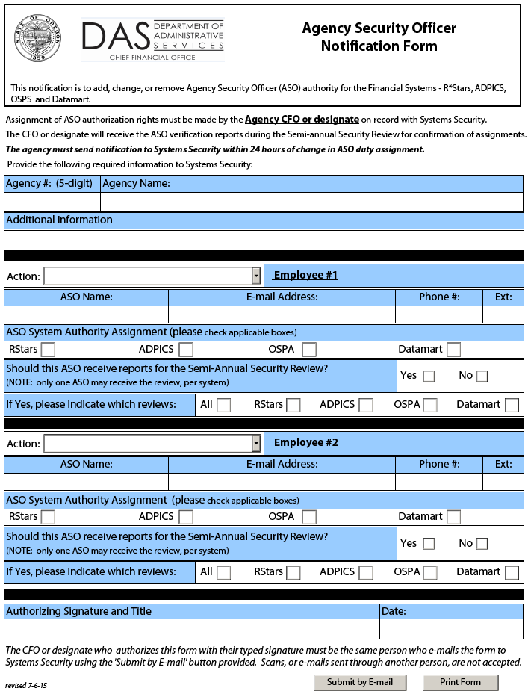
Establishing ASO - continued
ASO Notification
Form
OAM 10.70.00

Slide 14
ASO Responsibilities
To maximize system security by minimizing the access of each user while preserving a reasonable degree of operational efficiency
To the best of each security officer’s knowledge, provide assurance of no unnecessary access through timely completion of security reviews

Slide 15
ASO Responsibilities – cont.
Receive information from management
Verify current and requested access is compatible and necessary
Inactivate access no longer needed
Communicate with SSO
Retain documentation of all requests for 3 years

Slide 16
Sending Requests
Questions to consider and discuss with the manager requesting access.
What are the individual’s duties?
Any current access?
What kind of transactions need to be processed?
Does request support sound internal controls?

Slide 17
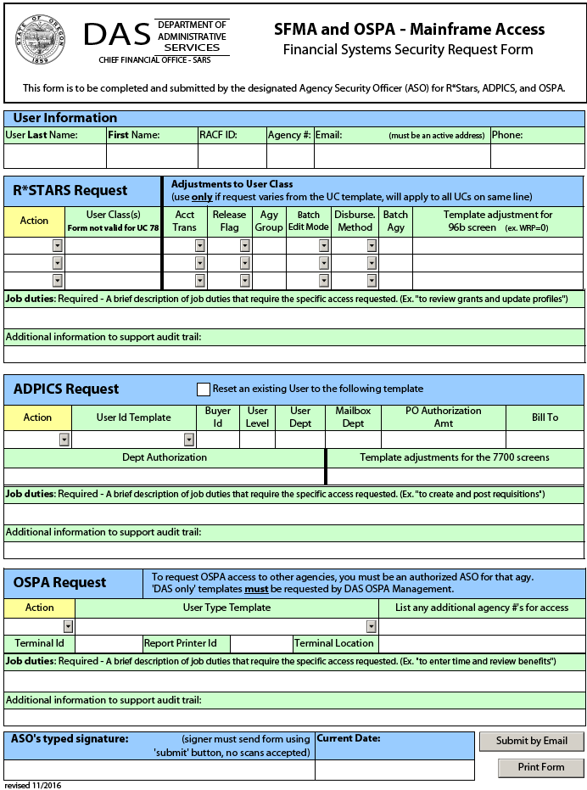
Sending Requests - continued
Use this form to make security requests for
R*Stars
ADPICS
OSPA
(Adobe Reader 8 or higher required to send form)

Slide 18
Sending Requests - continued
Adjustments to UC section – only complete if you need something different than the UC template provides.

Slide 19
Sending Requests - continued
Job Duties – Required – A brief description of job duties to justify the specific access requested.
Justifies access and is part of audit trail.
Good – review grants and update profiles, analyze and reconcile revenues, to post purchase orders, enter time and review benefits.
Not sufficient – a position title, to perform daily duties, new employee, to match XXX’s access, or change in RACF.

Slide 20
Sending Requests - continued
Mirroring of access no longer allowed for SFMA requests.
RStars
ADPICS
Gave excessive, unnecessary, or unknown access.
History lost.
For ADPICS help, contact Darcene.French@Oregon.gov

Slide 21
Sending Requests - continued
Sent from authorized ASO
ASO can not make requests for themselves
Datamart requested separately
Access requests sent to Security.Systems@Oregon.gov

Slide 22
EMail List for Security Officers
Subscribe
http://listsmart.osl.state.or.us/mailman/listinfo/sfma-ospa_agy_security_officers

Slide 23
Semi-annual Security Review
Statewide Accounting & Reporting Services
Systems Security
Comply with the Internal Control guidelines, monitor and provide reasonable assurance that current user access is appropriate and consistent with the user’s job duties.
February and August of each year.
Two-part process:
SSO verifies ASO assignments with each agency’s CFO or designate. SSO provides the ASO contact list for review along with verification forms. CFOs must complete the verification forms by signing, dating, and recording any change and return them to the SSO by the specified due date (only the verification forms).
ASO verifies the correctness of the access granted to the agency’s users and checks with the users’ managers to determine if the level of access is still appropriate. SSO provides system-specific reports for review and analysis along with verification forms. ASOs must complete the verification forms by signing, dating, and recording any change and return them to the SSO by the specified due date (only the verification forms).
Agencies should retain copies of the ASO contact list and system-specific reports for reference purposes.

Slide 24
Semi-annual Security Review
Statewide Accounting & Reporting Services
Systems Security
System-specific Reports.
R*STARS
RSTARS 96A. User’s security profile (all active users).
RSTARS 96B. List of the individual screens the user have authority to view or update (Blank, 0, 1, 2, 3). This report includes only those users of which access differs from the Standard UC Templates.
ADPICS
ADPICS 7600 & 7650. User’s security profile.
ADPICS 7700. List of the individual screens the user have authority to view or update (X, I, U, D).
ADPICS Approval Path. List of documents, amounts and approval levels by department.
OSPA
OSPA PTAU. User’s security profile.
OSPA PUSC. List of the individual screens the user have authority to view or update (N, D, U).
Datamart
Datamart Standard View. User’s access to SFMA tables, OSPA tables and OSPA groups.
Datamart Special View. User’s access to the different special view groups (Only a few agencies have access to this groups).

Slide 25
Semi-annual Security Review
Statewide Accounting & Reporting Services
Systems Security
A comprehensive and detailed review of all the reports is the only way to ensure that each agency user has the appropriate level of access
Some recommendations when performing the review:
R*STARS
Pay special attention to Statewide User classes (01 - 10, 36, 38, 39, 46, 50, 59, 65, 70, 79 – 81) and All Agency View Access (UC78).
Check for redundancy (Refer to Redundant User Classes list).
Consider the User Class Templates as the “ideal” level of access (R*STARS Security Manual).
Since the 96B report shows only those users of which access differs from the Standard UC Templates, all of them require a careful review.
OSPA
Pay special attention to those users with “old” user type set-up (00, 01). Discuss with OSPS alternatives to migrate those users to the new user type templates (48, 49, 68, 69, 79).
ADPICS
Since there is a high level of customization, it requires a detailed review.
DATAMART
Pay special attention to OSPA Agency Groups (“All Agencies & DAS Payroll).
Confirm that the user’s current duties still require Datamart.
For all the Systems: higher indicator means higher level of access (Quick Reference Guide).

Slide 26
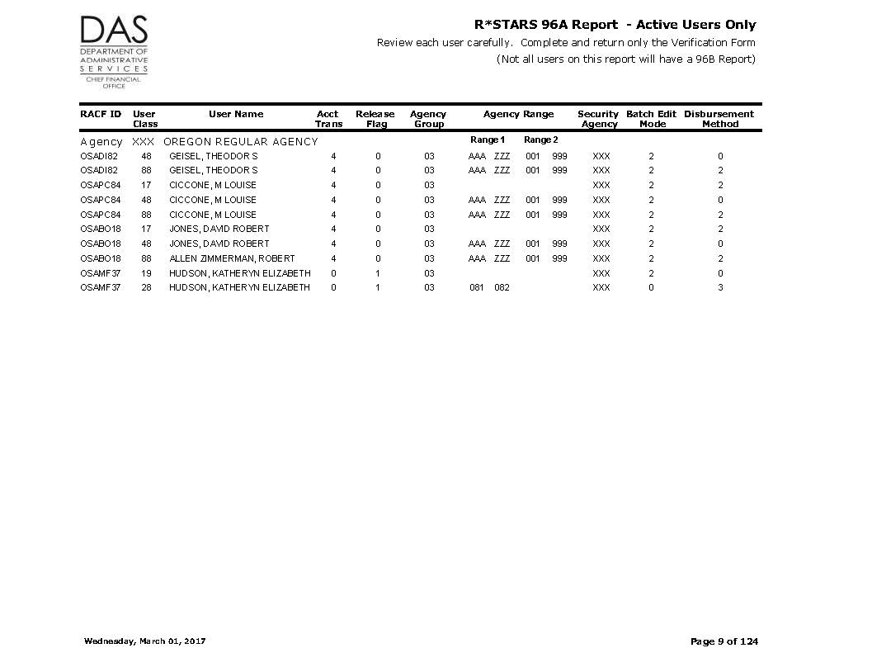

Slide 27
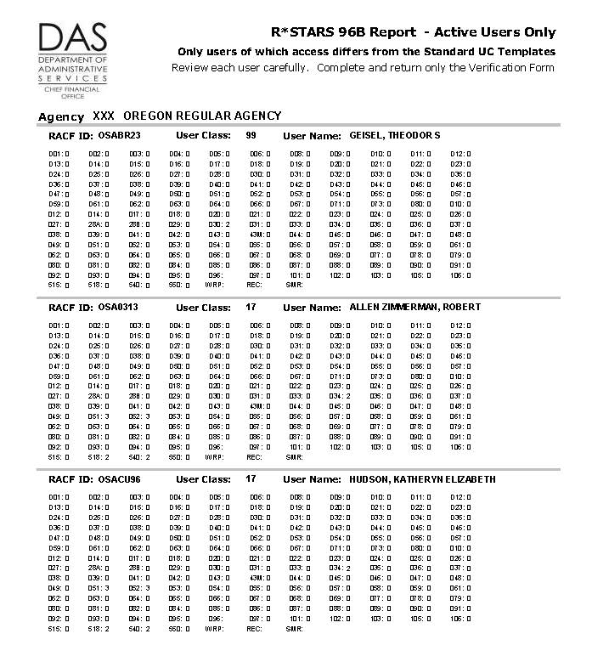

Slide 28
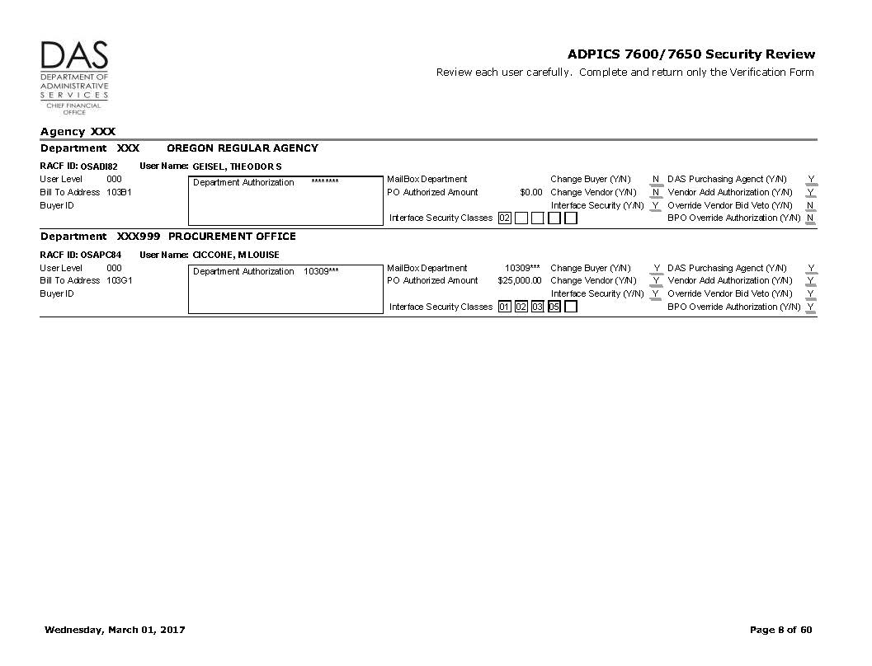

Slide 29
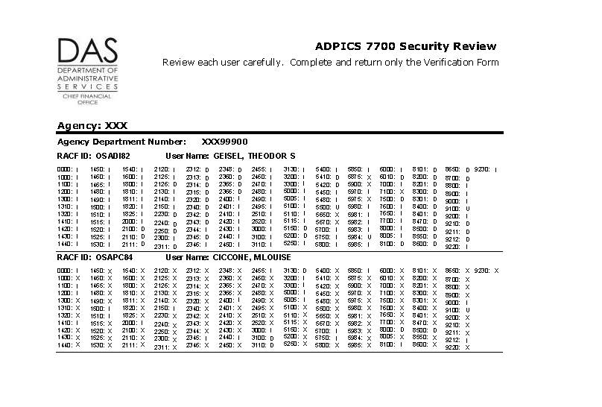

Slide 35
R*STARS Relational Statewide Accounting & Reporting System
Security Manual
SFMA / OSPA Form guide – pg 2
User Class descriptions – pg 3-7
Redundant User Classes, Special forms – pg 8
Screen 96 A/B & D66 – pg 9-15

Slide 36
96 A – USER SECURITY PROFILE
USER ID/CLASS: USER17 17 AGENCY: 107 NAME: FULL EXPENDITURE
ACCOUNTING TRANS: 1 BATCH EDIT MODE: 2
RELEASE FLAG: 0 DISBURSEMENT METHOD: 2
AGENCY GROUP: WORK HOUR: 0000 2400
AGENCY RANGE 1: WORK DAY: A
AGENCY RANGE 2: PRINTER ID:
SECURITY AGENCY: 107 DEFAULT
SECURITY ORG: ACTION CODE AGENCY:
SECURITY ORG: ACTION CODE:
PRIOR MO POST IND: Y
PRIOR YR POST IND: Y VIEW BANK INFO: N (Y/N)
FUND OVERRIDE: STATEWIDE REPORTING: N (Y/N)
Accounting Trans and Release Flag – page 10 – RStars Security Manual
Disbursement Method – page 11

Slide 37
96 B – USER SECURITY PROFILE
USER ID/CLASS: USER17 17 AGY: 107 NAME: FULL EXPENDITURE
D01 0 D02 0 D03 0 D04 0 D05 0 D06 0 D08 0 D09 0 D10 0 D11 0 D12 0
D13 0 D14 0 D15 0 D16 0 D17 0 D18 0 D19 0 D20 0 D21 0 D22 0 D23 0
D24 0 D25 0 D26 0 D27 0 D28 0 D30 0 D31 0 D32 0 D33 0 D34 0 D35 0
D36 0 D37 0 D38 0 D39 0 D40 0 D41 0 D42 0 D43 0 D44 0 D45 0 D46 0
D47 0 D48 0 D49 0 D50 0 D51 0 D52 0 D53 0 D54 0 D55 0 D56 0 D57 0
D59 0 D61 0 D62 0 D63 0 D64 0 D66 0 D67 0 D71 0 D73 0 D80 0 010 0
012 0 014 0 017 0 018 0 020 0 021 0 022 0 023 0 024 0 025 0 026 0
027 0 28A 0 28B 0 029 0 030 0 031 0 033 0 034 2 035 0 036 0 037 0
038 0 039 0 041 0 042 0 043 0 43M 0 044 0 045 0 046 0 047 0 048 0
049 0 051 3 052 3 053 0 054 0 055 0 056 0 057 0 058 0 059 0 061 0
062 0 063 0 064 0 065 0 066 0 067 0 068 0 069 0 077 0 078 0 079 0
080 0 081 0 082 0 084 0 085 0 086 0 087 0 088 0 089 0 090 0 091 0
092 0 093 0 094 0 095 0 096 097 0 101 0 102 0 103 0 105 0 106 0
515 0 518 2 540 2 550 2 WRP REC SMR
Screens accessible to most UC – pg 14

Slide 38
D66 – USER CLASS PROFILE
USER CLASS: 17
TITLE: FULL EXPENDITURE CYCLE
I/E (I=INCLUDE,E=EXCLUDE)
ENTER TRANSACTION CODES SEPARATED WITH EITHER "-" OR ",".
I 167 , 200 - 212 , 217 - 290 , 295 , 402 - 405 , 409 -
420 , 434 - 435 , 438 - 439 , 468 - 469 , 599 , 696 -
697

Slide 39
R*STARS cont.
UC 78 All Agency View Access Request
Online at SARS Security website http://www.oregon.gov/das/Financial/Acctng/Pages/Syst-security.aspx
UC 47 – ASO requests inactive UC
BAM analyst requests activation when needed

Slide 40
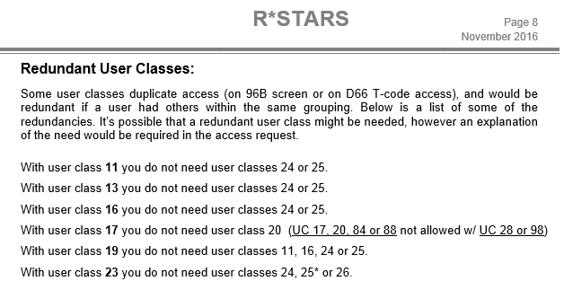
R*STARS cont.
Too little or too much access?
Too little – won’t be able to perform job duties
Too much – will have access that’s never used

Slide 41
Datamart
Statewide Accounting & Reporting Services
Systems Security
-Datamart is the platform where all the data from SFMA and OSPA is available for reporting and analysis (Hyperion -a.k.a. Brio, Studio, etc.).
Access to SFMA Tables.
Standard View Access.
Requires completion of the Datamart Standard View Access Request Form.
Submitted electronically by the agency’s ASO.
Users with this level of access are able to pull information originated in R*STARS and ADPICS at a statewide level.
Access to OSPA Tables.
Standard View Access.
Requires completion of the Datamart Standard View Access Request Form.
Submitted electronically by the agency’s ASO.
Users with this level of access are able to pull information originated in OSPA at a agency or group agency level.
To get this level of access, SFMA Tables must be requested too.
Once the request is completed, users must allow 24 hours to be able to access the OSPA tables (servers require overnight process to update the access).

Slide 42
Datamart
Statewide Accounting & Reporting Services
Systems Security
Access to Sensitive Information.
Special View Access.
Requires completion of the Datamart - Special View Access Form.
Requests must be authorized by the requesting agency's Senior Fiscal Officer.
Forms must be printed, signed, scanned and submitted electronically by the agency’s ASO.
Information at this level includes vendor numbers, addresses and other sensitive information classified as level 4, “Critical” by the Statewide Policy Information Asset Classification (107-004-050).
Access to this information is managed trough specific Datamart Groups.

Slide 43
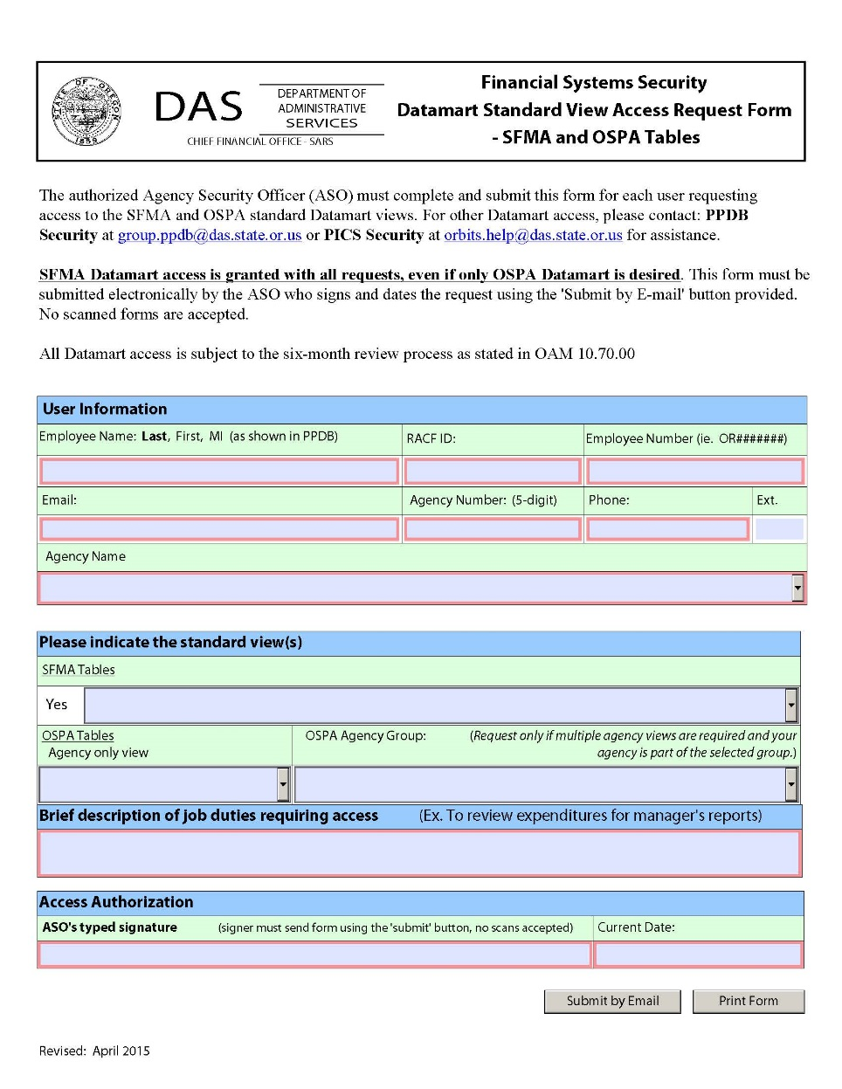
Datamart
Statewide Accounting & Reporting Services
Systems Security
Examples and Exercises

Slide 44
Datamart
Statewide Accounting & Reporting Services
Systems Security
Examples and Exercises

Slide 45
Datamart
Statewide Accounting & Reporting Services
Systems Security
Examples and Exercises
New access to SFMA Tables
New access to SFMA Tables and OSPA Tables

Slide 46
Datamart
Statewide Accounting & Reporting Services
Systems Security
New access to OSPA tables to a current Datamart user
Examples and Exercises
Revoking access to OSPA Tables but leaving SFMA Tables active

Slide 47
Datamart
Statewide Accounting & Reporting Services
Systems Security
When revokes are processed as result of a personnel action, any access linked to the RACF ID is revoked (SFMS, OSPS & Datamart).
When the revoke is requested by an ASO, by requesting the revoke of the Datamart Standard View, any access to any other Datamart group is deleted too (OSPA tables, Special View Groups).
Examples and Exercises
Revoking Datamart access

Slide 48
OSPA Security Oregon State Payroll Application
Requesting User Access
Required information on form
OSPA User types
Requesting Terminal Access
Terminal Id information
Dual update access in OSPA & PPDB – not allowed

Slide 49
Requesting User Access
Time of transition
Significant changes
Sections (TME, ADJ, DED) changed to
User Types (48, 49, 69, 79)
http://www.oregon.gov/das/Financial/Payroll/Pages/referencemanual.aspx
Introduction to OSPA Security document

Slide 50
Requesting User Access – cont.
Two new form fields
User Type
Additional Agency #’s for access

Slide 51
OSPS User Security Screen
RACFID: USER49 AGNCY-GP: USRTP NAME: NOT FOUND USER TYPE: 49
ADB1 N ADB2 N ADD1 N ADD2 N ADD3 N ADW1 N ADW2 N D910 N PACH N PCHG N PDTC N
PMNT N PMSG D PPRM N PRPT N PSEC N PSYP N PTAU N PTB1 N PTB2 N PTD1 N PTD2 N
PTD3 N PTW1 N PTW2 N PTX1 N PTX2 N PUSC N P001 U P002 D P003 U P004 U P005 U
P006 D P007 D P009 N P010 D P020 U P030 D P031 N P032 D P050 D P060 N P070 D
P071 N P090 N P130 N P140 N P160 D P190 D P191 D P192 D P300 N P310 N P320 N
P370 D P420 N P430 D P435 N WARP N WCRP N WETM N WRDB N
Gain access to Report screens only through OSPS.Helpdesk@Oregon.gov
WARP
WCRP
WETM
WRDB

Slide 52
OSPS by User Type
Agency View Only
UT 79 - Designed for non-payroll staff - non processing
Payroll Technician / Manager
UT 69 and 68 – For processing payroll
Timekeeper
UT 49 and 48 - Time entry but full system access not required
Contact OSPS.Help@Oregon.gov for UT assistance

Slide 53
Requesting Terminal Access

Slide 54
Terminal ID Information
When adding a new or changing a current Terminal Id include:
Terminal Id
Access Indicator (U, D)
Report Printer (optional)
Location (up to 25 characters)

Slide 55
How to Find the Terminal ID
Be on mainframe main menu
Enter menu option (ex. E23)
Clear screen
Type “name” (no quotes) and <enter>
If fields don’t populate, hit Esc key
Terminal ID = 4 digits
NAME TERM = E4WV VTAMID= ET63A021
IN = OUT = ERRS=

Slide 56
Dual Update Access in OSPA & PPDB
Update access to both OSPA & PPDB is prohibited.
Allowed:
Update in one system and view only in the other
or…
View only in both systems.
OAM policy 45.30.00

Slide 57
ADPICS
Statewide Accounting & Reporting Services
Systems Security
ADvanced Purchasing & Inventory Control System.
Security is managed though three different screens:
7600 – Primary User Security (user profile)
7650 – Secondary User Security (interfaces, printing devices, capabilities)
7700 – User Program Security (access control)
19 standard user shells. A detailed description of each shell is included in the ADPICS Security Manual (Pages 12-73).
Approval Paths:
5981 – Document approval path
5982 – Department approval path table
5983 – Commodity approval path table
5985 – Initiating department path table
Electronic Signatures.
5984 – Signature table maintenance.
No form is required.
Requests to reset ADPICS signature must be emailed by the ASO (include user’s name and RACF ID).

Slide 58
ADPICS
Statewide Accounting & Reporting Services
Systems Security
Buyer ID
When request this field, make sure the Buyer ID was previously added by SFMA. Contact your SFMA Analyst about the procedure.
Mirroring users is no longer available
The option of adding new users by replicating an existing one is no longer available (November 2016).
Using standard shells guarantees an appropriate access level (users with same duties have same access level) and comply with the agency’s internal controls.
Custom set-up can be requested anytime.
If your agency has specific needs, discuss alternatives with the SFMS Management.
Example

Slide 59
Additional Resources
Statewide Accounting & Reporting Services
Systems Security
Systems Security website
http://www.oregon.gov/das/Financial/Acctng/Pages/Syst-security.aspx
SFMA Security Manuals
ADPICS Security Manual and R*STARS Security Manual are available by request (email to Security.SYSTEMS@oregon.gov to get a copy).
OSPA Security Manual
http://www.oregon.gov/das/Financial/Payroll/Documents/Introsecurity.pdf
Datamart Maintenance Website
https://dasapp.state.or.us/DatamartApp
HR Systems & Services website
http://www.oregon.gov/das/HR/pages/index.aspx

Slide 60
Contacts
Statewide Accounting & Reporting Services
Systems Security
Systems Security
Systems Security
Security.SYSTEMS@oregon.gov
Systems Security Officer
Alex Medina
Alex.MEDINA@oregon.gov
(503) 373-2167
OSPS
OSPS Help Desk
OSPS.HELP@oregon.gov
(503) 378-6777
Datamart
Datamart Support
Datamart.Support@oregon.gov
Mainframe Password Reset
DAS RACF Administrator
DAS.RACFUserAdm@oregon.gov

