Slide 1
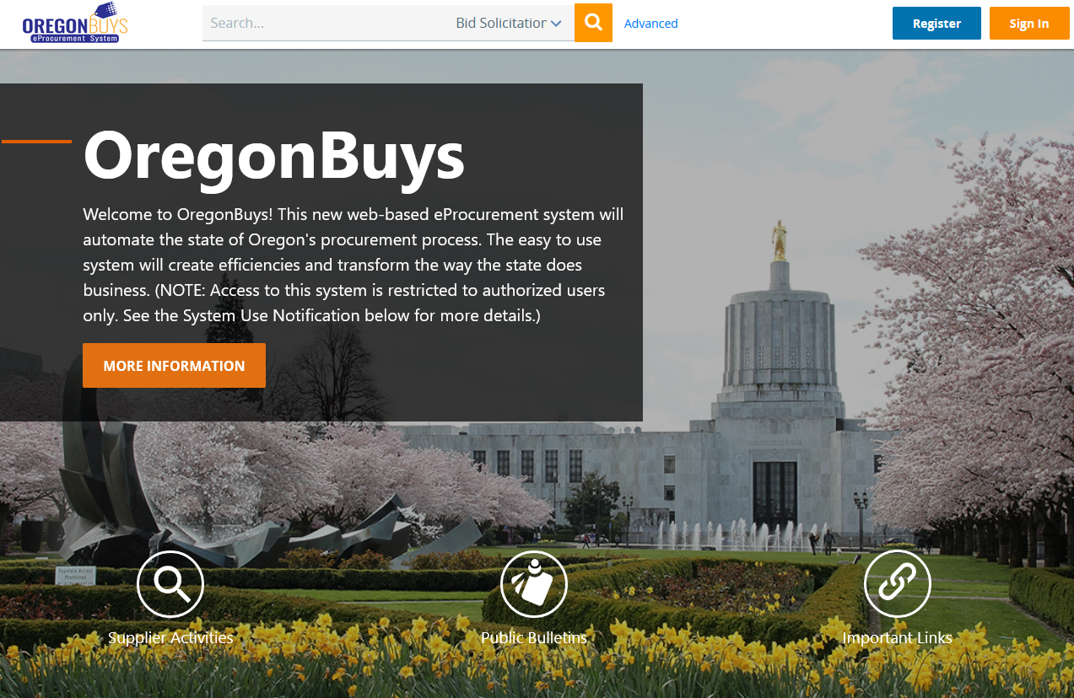
OregonBuys
PMUG Presentation
September 20, 2023

Slide 2
What is OregonBuys?
OregonBuys is a procure-to-pay eProcurement solution which automates the procurement processes using web-based applications. It is a technology-enabled solution that allows the state to procure goods and services at the best value.
OregonBuys: One unified system—modernizing state procurement

Slide 3
Five Project goals
State agencies adopt and use OregonBuys.
Procurement-related spend data is captured and reported on through OregonBuys.
Strategic sourcing plans are in place for how the state will identify strategic sourcing opportunities to optimize state spend.
Prompt payment of invoices results in increased discounts for the state.
Increased competition for state contracts results in better contract terms and potential cost savings.

Slide 4
TWO PHASED PROJECT
July 1, 2021
Go-live
PHASE I
Replace ORPIN
PHASE II
Procure-to-Pay functionality released to agencies in three waves 2021-2023
Wave 1
Oct 2021 – June 2022
Wave 2
June 2022 – Jan 2023
Wave 3
Feb 2023 – Sept 2023
Planning
Designing
Validation
Training
Go-live
Planning
Designing
Validation
Training
Go-live
Planning
Designing
Validation
Training
Go-live
Enterprise
Future Process Design Work
Notes:
Snapshot of project phases

Slide 5
WAVE 3 AGENCIES
INDIVIDUAL | ​Department of Transportation Department of Human Services/Oregon Health Authority
GROUP 1 | ​Oregon Department of Fish and Wildlife
GROUP 2 | Department of Environmental Quality; Department of Justice; Oregon Youth Authority; Department of Land Conservation and Development; District Attorneys and their Deputies
GROUP 3 | Bureau of Labor and Industries; Department of Aviation; Department of Veterans' Affairs; Oregon Forest Resources Institute; Public Defense Services Commission
GROUP 4 | Commission for the Blind; Oregon Board of Dentistry; Department of Early Learning and Care; Department of State Fire Marshal
GROUP 5 | Public Records Advocate; Oregon Department of Emergency Management; Mortuary and Cemetery Board; Occupational Therapy Licensing Board; Office of the Governor; Office of the Long-Term Care Ombudsman; Oregon Advocacy Commissions Office; Oregon Board of Medical Imaging; Real Estate Agency; Speech Pathology & Audiology Board of Examiners; Oregon Board of Naturopathic Medicine; Veterinary Medical Examining Board; Construction Contractors Board; Oregon Board of Accountancy; State Board of Tax Practitioners; State Board of Parole and Post-Prison Supervision; Oregon Criminal Justice Commission; Oregon Board of Chiropractic Examiners; Oregon Racing Commission; Mental Health Regulatory Agency

Slide 6
Project status
With Phase I (ORPIN Replacement) complete, we’re now in project Phase II
Phase II rolls out added functionality to groups of agencies in a series of three waves
Currently in Wave 3 of Phase II (Go-live scheduled 9/19)
When agencies went through their wave, it opened an accounts payable interface from R*STARS to OregonBuys for processing payments
Notes:
Phase I replaced the Oregon Procurement Information Network (ORPIN)

Slide 7
What does Procure-to-pay mean?
Requisitions
Purchase Orders
Receipts
Invoices
R*STARS / ODOT Teams
Includes:
Internal request
Release against Price Agreement
Request to Pay Vendor for work
not recorded in OregonBuys
Includes:
Open market
Electronic order sent to Vendor
Work Order Contract
Includes:
Includes:
Full
Partial
Returns
Vendor submitted
Agency created
Pay Vendor for work not recorded in OregonBuys
Credit Memo

Slide 8
4 points of integration
OREGONBUYS
R*STARS
1. Vendor Remits
2. Account Codes
3. Expenditures
4. Check/Payment Data
Notes:
We’re also working on the TEAMS interface with ODOT

Slide 9
Shift in process statewide
SFMS remains the financial system of record
Invoices for goods and services are approved through OregonBuys
Transactions interface to R*STARS in batches, in on hold status, ready for approved release of payments
What does this mean to my agency?
By the end of Phase II all state agencies will use OregonBuys to perform the following tasks:
Submit requisitions for approval
Issue purchase orders
Receiving
Invoices
Release for payment (in R*STARS or TEAMS)
Notes:
Only T-code 222 transactions

Slide 10
What to process in OregonBuys
Agencies are expected to process all procurement-related activities and spend through OregonBuys regardless of dollar value
Non-procurement spend should not be captured in the system
Items that aren’t procurement-related will continue to be processed using existing agency methods
The graphics above show examples of what this does and does not include
Notes:
*SPOTS purchases are not currently tracked (next slide explains more)

Slide 11
SPOTS Card Purchases
Tracking all procurement spend is one of the goals of OregonBuys - this includes capturing the procurement purchases made on SPOTS cards
DAS is now determining the best option to capture the procurement SPOTS card purchases
Our stakeholder groups and governance bodies have provided feedback on the options
We’re standing up a subject matter expert workgroup to further analyze the options.
The workgroup will make recommendations to our Business Owner, Project Sponsor, and the DAS Director for the final decision
Once we have the decision, we will share it broadly
We'll offer enterprise guidance and training on the new process to all OregonBuys users

Slide 12
Single sign On information
SSO requires that state employees sign into OregonBuys using a state device
SSO Released in OregonBuys version 18.2
State Agencies Only – Does not apply to Suppliers or OrCPPs
Rollout process for agencies is still being determined

Slide 13
Main User Roles in OregonBuys
User roles determine the tasks that can be performed in OregonBuys
Department Access
(DA)
Shop from existing contracts
Create and process requisitions
Typically End Users
Basic Purchasing
(BP)
All DA functions
Receiving
Create or process POs
Typically, Buyers or Procurement Specialists
Accounts Payable
(AP)
Create or process Invoices
Create or process Credit Memos
Typically, Accounts Payable Clerks & Supervisors
Organization Administrator
(OA)
Manages OregonBuys internal controls
Manages agency users
Creates/updates approval paths, roles, etc.

Slide 14
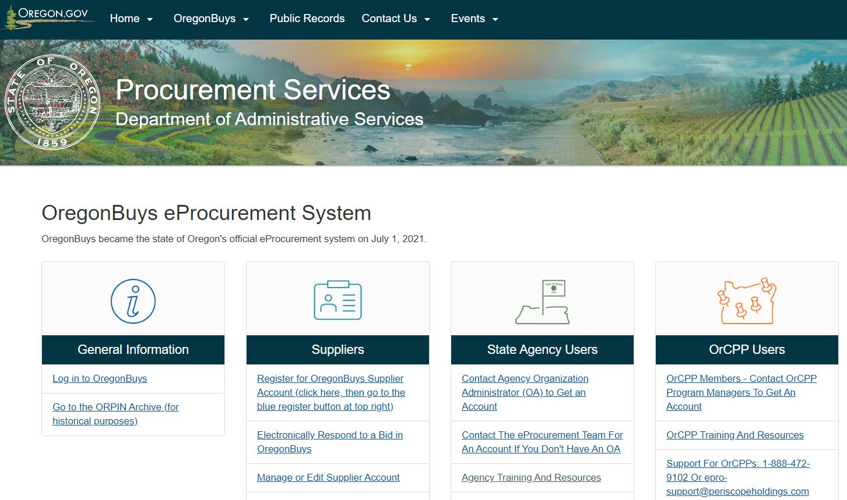
how to request an OregonBuys account
Contact your agency Organization Administrator (OA) to request an account
If you don’t know your OA visit this webpage and review the OA list:
Department of Administrative Services : OregonBuys eProcurement System Information : Procurement Services : State of Oregon

Slide 15
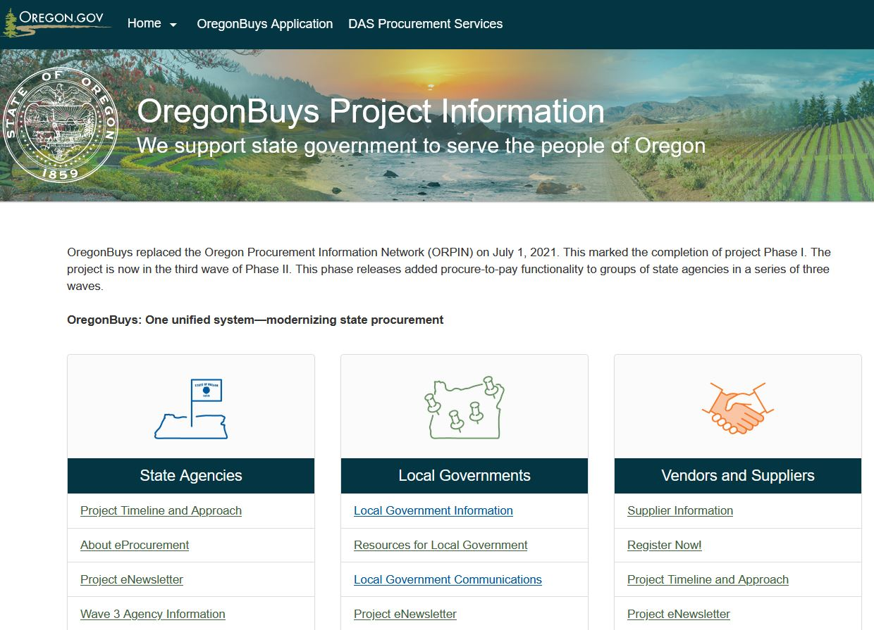
OregonBuys resources
Visit the OregonBuys project website for resources:
https://oregonbuys.oregon.gov
State agency section includes FAQ and agency training page with self-guided courses and instruction guides
Local government resources section
Vendor and supplier resources includes tutorials and instructions

Slide 16
Program governance
Advisory Council
Champions User Group
Financial Leadership Council Subcommittee
SFMS / R*STARS Coordination
ODOT TEAMS Coordination

Slide 17
Operational support
Supplier Help Desk
Please contact us at support.oregonbuys@das.oregon.gov or 1-855-800-5046 for assistance.
State Agency / OrCPP User Help Desk
Please contact us at epro-support@periscopeholdings.com or 1-888-472-9102 for assistance.
PHI provided supplier support
PHI provided agency support
State agencies
OrCPP support
DAS eProcurement team – for internal issues only
Support escalation
Business process

Slide 18
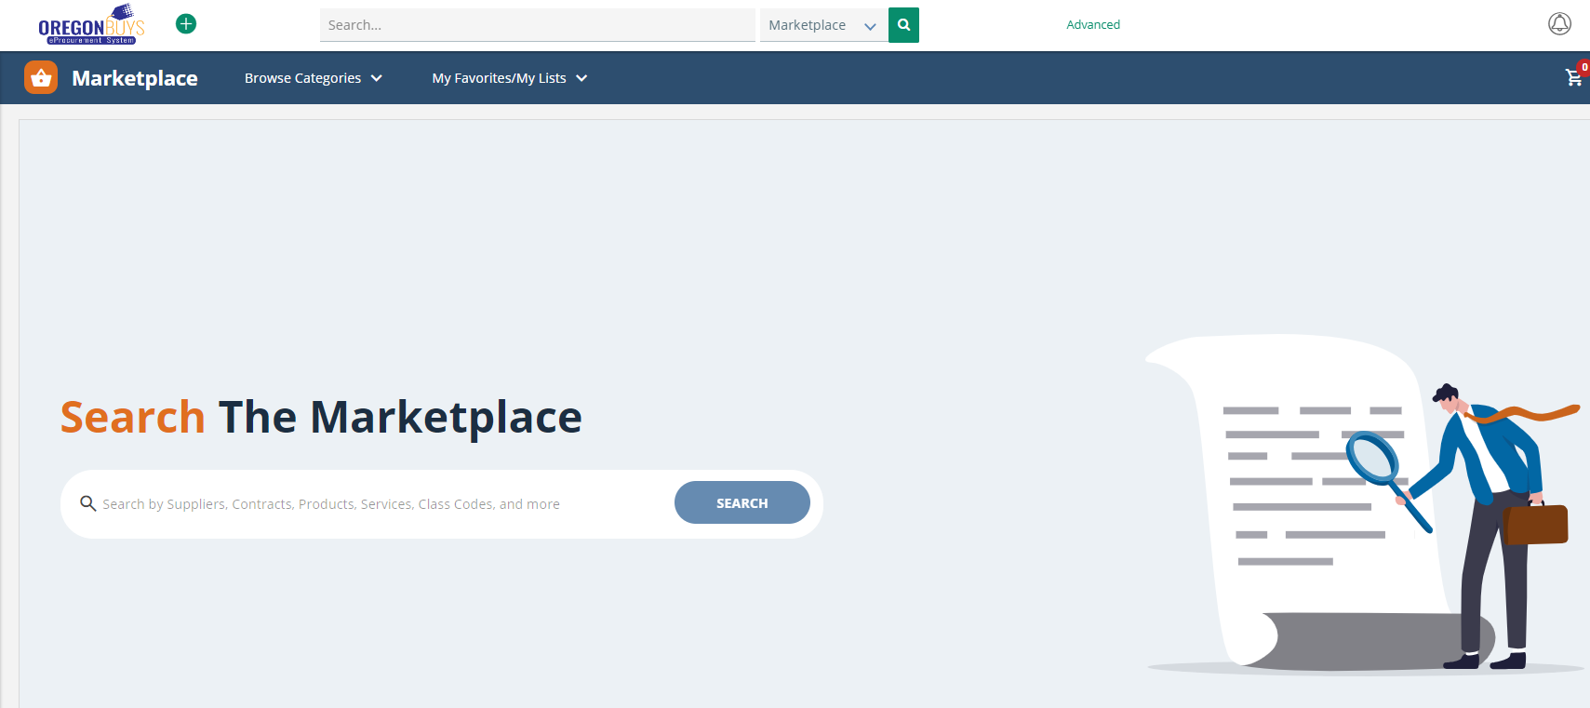
Marketplace
Agency and local government users can search for statewide price agreements in the OregonBuys Marketplace
Marketplace allows users to search for and compare goods and services across catalogs, place items into a cart, and convert the cart into a Purchase Order

Slide 19
punchouts
Punchouts allow users to temporarily 'punch out' of OregonBuys to a statewide price agreement vendor's website, view items with agency-specific pricing, put items into a cart, and then pull the cart back into OregonBuys to process and purchase.
To access punchouts, click the 'Settings' Gear icon, select G2B Punchout, and choose the vendor you want to search

Slide 20
Oregonbuys increases transparency
You don’t need a system login to search for and find Statewide Price Agreements. Try these easy steps for searching:
Navigate to https://oregonbuys.gov, then
Click the word “Advanced” next to the top search bar
Select “Blankets” in the Document Type drop-down
Enter keywords or info into the search fields (Description or other fields) and select Department of Administrative Services in the Organization field
Click the “Search” button

Slide 21
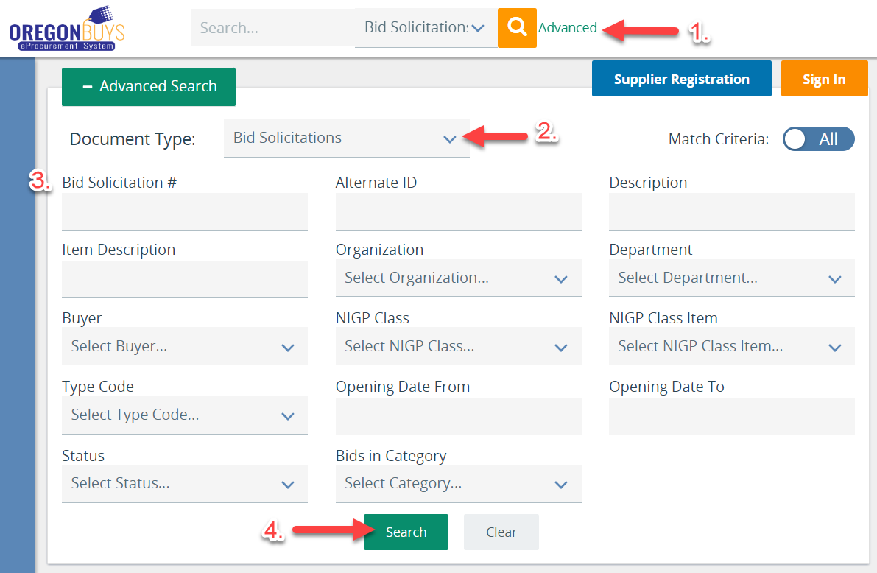
easy visibility of bids for vendors and general public
Vendors and members of the general public can view bids (and their attachments) without a login.
To do so, they would navigate to https://oregonbuys.gov, then
Click the word “Advanced” next to the top search bar
Select “Bids” in the Document Type drop-down
Enter keywords or info into the search fields
Click the “Search” button

Slide 22
Questions?
Open discussion

Slide 23
Thank you
Oregonbuys.info@das.oregon.gov
https://oregonbuys.Oregon.gov

