Slide 1
Project Manager User Group REALD/SOGI
November 15, 2023
Bryant Lister, CISSP, PMP, CCSP, CDMP
Notes:
Bryant Lister is a strategic and forward-thinking IT Director at the Oregon Health Authority (OHA), where he has led the Health & Service Equity Transformation Program since June 2022. The portfolio of projects for REALD/SOGI ensures the alignment of initiatives with legislative requirements, specifically House Bill 3159, and effectively collaborates with a range of stakeholders from top executives to community partners.
Prior to his current role, Bryant served as the IT Director of Information Security and Privacy Office at OHA from 2019 to 2022, where he was responsible for information security and privacy risk management and compliance. He has also held the roles of OIS Manager of Strategic Initiatives, an IT Development Manager, and Senior IT Project Manager at OHA.
Bryant's educational background includes a Doctor of Chiropractic from the University of Western States and a Bachelor of Science in Biochemistry from the University of California, Riverside. He is also a certified professional with credentials such as CISSP, CCSP, PMP, and ITIL Foundation, and has a Certificate in Public Management from Willamette University, reflecting his commitment to continual learning and professional development. Just achieved Certified Data Management Professional.
I’m not an equity and inclusion expert, we have a whole team dedicated to that work within the Oregon Health Authority.
I have worked in IT for over 20 years, so please understand that is the lens through which I will be looking at this.
Please let me know if you have questions as we go along or if there are topic areas you would like to dive deeper into.

Slide 2
What I’ll talk about today
What is REALD & SOGI and Health Equity
How is Project Management impacted
HSET portfolio of projects
What other projects will include REALD & SOGI
How will REALD & SOGI affect your project
Notes:
What is REALD & SOGI and Health Equity
How is Project Management impacted
HSET Portfolio of Projects
What other projects will include REALD & SOGI
How will REALD & SOGI affect your project

Slide 3
REALD
(Race, Ethnicity, and Language Disability)
SOGI
(Sexual Orientation and Gender Identity)
House Bill (HB) 2134 proposed and passed 2013
Came from communities most impacted by health inequities
Asian Pacific American Network of Oregon (APANO)
Oregon Health Equity Alliance (OHEA)
Requires ODHS and OHA develop data collection standards in all programs that collect, record, or report demographic data.
House Bill (HB) 3159 proposed and passed 2021
Requires providers and insurers to submit REALD & SOGI data to OHA
Notes:
REALD - Race, Ethnicity, Language, Disability
SOGI – Sexual Orientation & Gender Identity
2013 – House Bill 2134, community led effort to address health inequities
- requires ODHS & OHA to develop standards to collect REALD data and providing reporting on health inequities
2121 – House Bill 3159, updated 2134, specifically requiring providers and insurers to submit REALD & SOGI data to OHA
Race and ethnicity – about 140 different options for individuals to select
Language – about 7000
Disability – focus on the level of ability and how they are impacted by it, not a medical definition of diagnosis
Sexual Orientation – Gender Identity – expanded options
Everyone is represented and can find the appropriate options for themselves
The COVID pandemic increased the urgency for submitting this data and directly led to the current requirements.

Slide 4
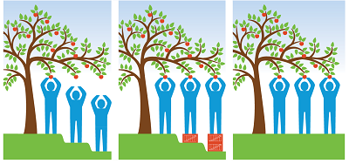
REALD & SOGI standards address OHA’s 2030 goal of eliminating health inequities
Health & Equity
What is health
How do we define it
How do we measure it
Why Data Justice
Why representation in the data matters
Notes:
The REALD & SOGI data standards are intended to help OHA achieve its 2030 goal of eliminating inequities with better data to identify and address inequities.
The Office of Equity and Inclusion works with diverse communities to eliminate health gaps and promote optimal health in Oregon. By connecting people and programs, we can make substantial, measurable progress in improving the health of all Oregonians.
Health & Equity
what is health – does everyone consider health to be the same thing, old vs young
how do we define it – longevity, capabilities, access to care, infant mortality, etc.
how do we measure it – lifespan at birth, disease rates (incidence and prevalence), physical activity, disability
Access to care, cost, outcomes
Data Justice
Data justice supports communities using data to elevate their voice and reveal the systemic inequities they experience
Data justice moves beyond just equity where we see modification used to achieve equality in outcomes and attempts to remove the original/systemic barriers
Representation in the data
Include data for all areas of the community
As project managers, you know the Drucker quote: “what gets measured, gets improved.” We can’t measure what we can’t see, so representation is critical to improvement.

Slide 5
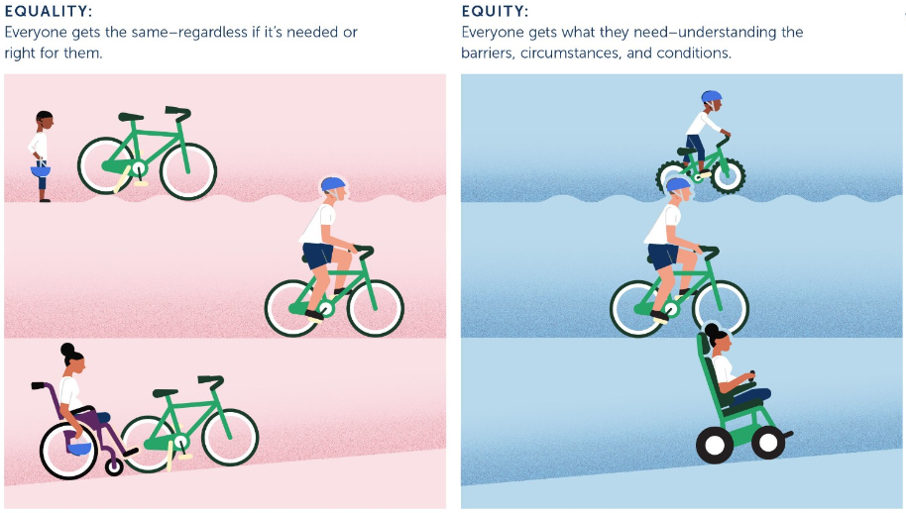
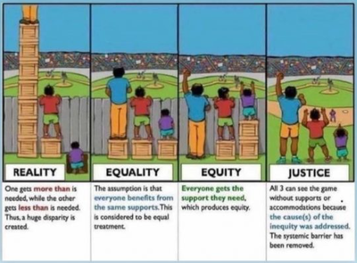
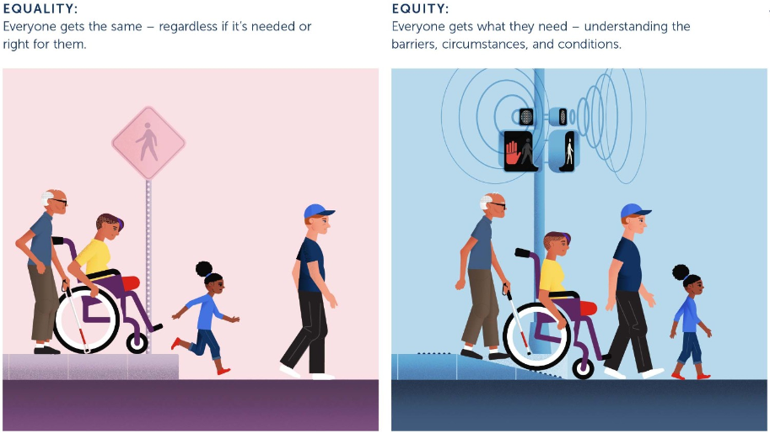
Equality & Equity
Notes:
Health equity is about more than just equality.
There are many ways to represent the differences between equality and equity.
The important thing is to recognize that there is no one solution for everyone.
For solutions to address the problems for people, we first must hear what those problems are.
Then we need to listen to how people need those problems addressed, not assume we know what is best for others.
If you focus on changing the person to fit a standard, i.e. giving sight to a blind person, might miss the actual need.
Studies have found that some people who have been blind or deaf for a majority of their life have a difficult time adapting to reversing that. For many, their brain has developed and adapted to who they are and it can be a significant challenge to overcome.

Slide 6
Project Management Concerns
Inclusivity and Diversity
Legal and Ethical Compliance
Talent Acquisition
Enhanced Problem Solving
Improved Stakeholder Relations
Notes:
Inclusivity and Diversity: Embracing diversity in project teams fosters innovation and creativity. When project managers prioritize REALD/SOGI issues, they create an inclusive environment where individuals from various backgrounds feel valued, leading to a richer pool of ideas and perspectives. Inclusive teams are often more successful in problem-solving and decision-making.
Legal and Ethical Compliance: The U.S. and Oregon have laws and regulations in place to protect individuals from discrimination based on REALD/SOGI factors. Project managers must ensure that their projects comply with these laws to avoid legal repercussions. Beyond compliance, adhering to ethical principles of fairness and respect is essential.
Talent Acquisition and Retention: Project managers depend on a talented and diverse workforce to deliver successful projects. By promoting REALD/SOGI inclusion, project managers can attract a wider range of candidates, retain top talent, and improve employee morale and satisfaction. A diverse team is more likely to stay engaged and committed to project goals.
Enhanced Problem-Solving: Diverse teams bring different perspectives to the table, which can lead to more robust problem-solving and decision-making. REALD/SOGI diversity can help project managers identify and address potential issues from a broader range of angles, leading to more effective project outcomes.
Improved Stakeholder Relations: Projects often involve various stakeholders, including clients, customers, and the public. Demonstrating commitment to REALD/SOGI issues can enhance an organization's reputation and relationships with stakeholders who value diversity and inclusivity. It can also help mitigate reputational risks associated with discrimination or exclusion.

Slide 7
Perspectives for Project Management
Forms & other missed opportunities
Rules & Constraints
Future Proofing
New Technology
Notes:
Forms & other missed opportunities
Forms lock us into ‘the way we’ve always done it’
Many past projects in IT were just recreate a paper form on the web
This locks us into the limitations for forms and the selections that were determined years ago
Every new project is an opportunity to question how it was previously done
Rules & Constraints
Every unchangeable rule or constraint binds the future to the ignorance of the present.
Rules and constraints should be periodically reevaluated and changed as necessary
We are still learning, growing, and progressing…our computer systems need to reflect this.
Future Proofing
Recognize the changes of the past and that there will be changes in the future.
Most applications had two or three options for gender or six to ten options for race.
Retain context, when data is stored it needs to include metadata that supplies the context (what options were available)
New Technology
New doesn’t always mean better and doesn’t always mean that is without the bias of the past
Gen AI was built using existing collections of documents, images, algorithms, etc., it contains the foundations of systemic racism
New implementations need to be screened for bias by having use cases that reflect the diversity of the population and equally diverse testers.

Slide 8
HSET Portfolio of Projects
Initial Repository
– Store the data
Patient Facing Survey Tool
– Collect individual’s data
Centralized Registry
– Interface with the data
Collect data from other sources
Sharing data:
within the agency
with providers
with community partners
Notes:
Health & Service Equity Transformation
Initial Repository – Store the data
Cloud data system focused on data for analysis and reporting
Tools like Power BI, Tableau and other statistical programs will be utilized
Patient Facing Survey Tool – Collect the data
Web application allowing users to enter their REALD/SOGI data
Future might include a mobile application
Centralized Registry – Interface with the data
Collect data from other sources
Large agency applications
Electronic Health Records (EHR)
Sharing data:
within the agency – reports to federal partners, legislature, decision makers
with providers – address issues within their organizations
with community partners – conduct their own analysis, identify solutions or approaches to the problem

Slide 9
REALD & SOGI implementation aligns with OIS Strategic Plan
Goal 4: Interoperability and data
Create and implement a framework for data governance
Create an enterprise integration strategy including processes and tools
Create and implement an enterprise data strategy
Notes:
Goal 4: Interoperability and data
Key Strategies:
Strategy 4.1 Improve the management and governance of data
Strategy 4.2 Promote interoperable exchange of data
Strategy 4.3 Expand user engagement through improved usability and accessibility of systems and data
Key Initiatives:
Create and implement a framework for data governance.
Create an enterprise integration strategy including processes and tools.
Create and implement an enterprise data strategy.

Slide 10
Data collection is insufficient without context and connection
Racism and prejudice have a detrimental effect on health
Infants who are black have over twice the mortality rate of infants who are white in the U.S.
Pregnant parents who are black in the U.S. experience infant mortality and low birth weight equivalent to that of pregnant service people on active duty military deployment
The Office Of Equity and Inclusion leads OHA’s efforts to identify and address these issues
Notes:
Collecting the data is very important, but the data isn’t the story
Numbers on a page need context and connection
Infant mortality of infants who are black is over twice that of infants who are white in the U.S.
Knowing this does nothing to fix the problem or point to even a cause
The data was analyzed to determine that there were not sufficient differences in diet, obesity, smoking, drinking, prenatal care to account for the gap
What researchers did find is elevated stress hormones during pregnancy in many of these cases
Researchers were able to see a connection in the data between elevated stress from the environment – segregated neighborhoods, limited opportunities, social pressures, etc – and the health risk to newborns
The rate of infant mortality and low birth weight of black mothers in the U.S. is equivalent to that of mothers on active duty military deployment
So, the stress of living in this country as a black mother might be comparable to the stress of active duty military deployment.
The Office Of Equity and Inclusion (OEI) employs Data Analysts and specialists in researching these issues.

Slide 11
Questions

