Slide 1
ESSA:
1% Participation Cap Requirement

Slide 2
OBJECTIVES
To review the ESSA 1% participation cap requirement for the alternate assessment based on alternate academic achievement standards (AA-AAAS)—Oregon’s Extended Assessment (ORExt).
To describe ODE supports to districts related to this new requirement.
To describe the ODE protocol for districts (who are projected to exceed the 1% participation cap) to follow in submitting a justification to ODE.

Slide 3
ESSA Participation Requirement
In 2015 Congress reauthorized ESEA as the Every Student Succeeds Act (ESSA).
With this reauthorization the requirement changed for the alternate assessment based on alternate academic achievement standards (AA-AAAS).

Slide 4
ESSA Participation Requirement
ESSA reaffirmed that the alternate assessment is the appropriate assessment for students with the most significant cognitive disabilities to demonstrate their knowledge and skills. However, in using this assessment…

Slide 5
ESSA Participation Requirement (cont.)
ESSA changed 1% cap to be based on the participation rate rather than the proficient rate.
ESSA placed the 1% cap on the state participation rate for each content area, based on the total number of all students in the state assessed in the content area.

Slide 6
ESSA Participation Requirement (cont.)
States cannot place a cap on participation rates of districts.
State must make district data publicly available (as long as no Personally Identifiable Information is shown).
Notes:
(iii) Provide appropriate oversight, as determined by the State, of an LEA that is required to submit information to the State;
(B) The State will take additional steps to support and provide appropriate oversight to each LEA that the State anticipates will assess more than 1.0 percent of its assessed students in a given subject in a school year using an alternate assessment aligned with alternate academic achievement standards to ensure that only students with the most significant cognitive disabilities take an alternate assessment aligned with alternate academic achievement standards. The State must describe how it will monitor and regularly evaluate each such LEA to ensure that the LEA provides sufficient training such that school staff who participate as members of an IEP team or other placement team understand and implement the guidelines established by the State under paragraph (d) of this section so that all students are appropriately assessed; and (C) The State will address any disproportionality in the percentage of students taking an alternate assessment aligned with alternate academic achievement standards as identified through the data provided in accordance with paragraph (c)(4)(ii)(A) of this section; and

Slide 7
ESSA Participation Requirement (cont.)
Districts exceeding the cap must submit information justifying the need to exceed the cap and the state must provide oversight of districts.
Notes:
(iii) Provide appropriate oversight, as determined by the State, of an LEA that is required to submit information to the State;
(B) The State will take additional steps to support and provide appropriate oversight to each LEA that the State anticipates will assess more than 1.0 percent of its assessed students in a given subject in a school year using an alternate assessment aligned with alternate academic achievement standards to ensure that only students with the most significant cognitive disabilities take an alternate assessment aligned with alternate academic achievement standards. The State must describe how it will monitor and regularly evaluate each such LEA to ensure that the LEA provides sufficient training such that school staff who participate as members of an IEP team or other placement team understand and implement the guidelines established by the State under paragraph (d) of this section so that all students are appropriately assessed; and (C) The State will address any disproportionality in the percentage of students taking an alternate assessment aligned with alternate academic achievement standards as identified through the data provided in accordance with paragraph (c)(4)(ii)(A) of this section; and

Slide 8
ESSA Participation Requirement (cont.)
Parents of students being considered for participation in the alternate assessment (as part of the IEP process) must be clearly informed:
That their child’s academic achievement will be measured based on alternate achievement standards.
How participation in the alternate assessment may delay or otherwise affect completing requirements for a regular high school diploma.

Slide 9
ESSA Participation Requirement (cont.)
States can apply for a waiver of the 1% cap requirement if the participation of students with disabilities on statewide assessments is 95% or greater.
Since Oregon’s participation rate for students with disabilities on statewide assessments is lower than 95%, Oregon does not qualify to exercise the waiver option.

Slide 10
Oregon Participation Requirement Supports
To support the selection process used by Oregon’s IEP teams in determining whether a student should take Oregon’s Alternate (Extended) Assessment, the Oregon Department of Education developed (2015) and posted updated guidance in 2015 that can be found at:
http://www.oregon.gov/ode/educator-resources/assessment/AltAssessment/Documents/orextassessguidance.pdf

Slide 11
Oregon Justification Submission Protocol
ODE has developed an online, secure form to expedite the process for districts to submit a justification(s) by February 15, 2018 if projected to exceed the 1% participation cap at https://app.smartsheet.com/b/form/4984541f40d8493ab8ec02c54f6658c2 (cf. next three slides).

Slide 12
Oregon Justification Submission Protocol
On this form, districts will find a link to their 1% participation rate by subject areas (ELA, Math, and Science) and disability codes (http://www.oregon.gov/ode/schools-and-districts/reportcards/reportcards/Documents/Extended_1Pct_DisabilityCodes.xlsx)

Slide 13
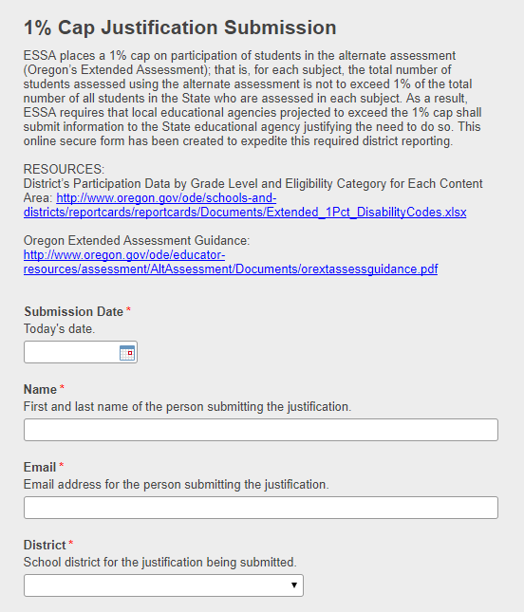

Slide 14
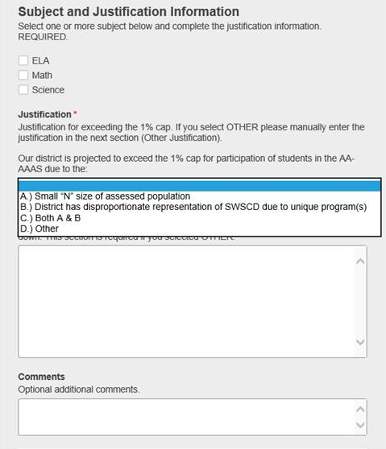

Slide 15
Regulations
Every Student Succeeds Act
https://www2.ed.gov/documents/essa-act-of-1965.pdf (See Section 1111(b)(2)(D), beginning p. 27)
Assessment Regulations
https://www.gpo.gov/fdsys/pkg/FR-2016-12-08/pdf/2016-29128.pdf (See Sections 200.6(c) and 200.6(d) on pp. 88934-88936)
ESSA Participation Requirement
https://nceo.umn.edu/docs/OnlinePubs/NCEOBrief12OnePercentCap.pdf

Slide 16
ODE Contacts
Office of Student Services:
Brad Lenhardt at Brad.Lenhardt@state.or.us
Accountability, Research, and Information Services:
Cindy Barrick at Cindy.Barrick@state.or.us

