Slide 1
Alt ELPA Informational Webinar
January 5 and 6, 2023
Mason Rivers, Special Education Assessment Specialist
Ben Wolcott, English Language Proficiency Assessment Specialist
Notes:
Welcome to the Alt ELPA Informational Webinar. As a reminder, this is an optional engagement where ODE will summarize important information about the Alt ELPA and give districts a chance to ask questions and answers. This webinar will not be recorded; instead, a scripted version, as well as an accompanying Q&A document, will be posted to the ODE website.

Slide 2
Webinar Agenda
Overview
Before Testing
During Testing
After Testing
Questions and Answers
Image source
Notes:
During today’s webinar, we will first outline the purpose and structure of the Alt ELPA. Then we will walk through issues relevant to administration of the test, following a rough chronology of before, during, and after testing. Finally, we will open the webinar up for questions and answers.

Slide 3
Overview
Notes:
Mason: Let’s begin with some general information about the Alt ELPA.

Slide 4
What is Alt ELPA?
Alt ELPA stands for Alternate English Language Proficiency Assessment
New Oregon Statewide Assessment System (OSAS) test
Operational field test in 2022-23 testing season
Required for all eligible students
Test window Feb 1 – Mar 24, 2023
Developed by the Collaborative for Alternate Assessment of English Language Proficiency (CAAELP)
Federal assessment grant project led by the Iowa Department of Education
Collaboration of ELPA21 and multiple states (both in and outside the ELPA21 consortium)
Notes:
The Alt ELPA, or Alternate English Language Proficiency Assessment, is new to the Oregon Statewide Assessment System. During this operational pilot year, districts are required to administer this test to all eligible students. The Alt ELPA test window, which you can also find in the published ODE test schedule, is just under two months.
This test was developed under a federal assessment grant. The development was led by the Iowa Department of Education, in collaboration with states both inside and outside the ELPA21 consortium.

Slide 5
Purpose
The Alt ELPA measures English language proficiency for students who meet both of the following criteria:
Have English status
Are experiencing a most significant cognitive disability
Primary purpose: Measures English language proficiency, to determine whether tested student is ready to engage with challenging grade- and ability-level content that will be delivered to them in English.
Notes:
The Alt ELPA was developed to meet the needs of students who have English learner status and are experiencing the most significant cognitive disabilities. Until now, this unique student population has had no appropriate ELP assessment option in Oregon. As with the ELPA Summative, the results of the Alt ELPA will help determine which students have developed sufficient English language proficiency and are ready to exit EL status, and which students will benefit from further language supports, and need to remain in EL status.
Federal policy requires yearly ELP assessment of all students with EL status, regardless of disability status. Access to appropriate language services is a civil right for these students, which a valid and appropriate ELP assessment helps guarantee.

Slide 6
Student Eligibility
Decided by IEP teams
ODE neither reviews nor approves this decision
Not sure? Consult the Alt ELPA Decision Making Resource
Still not sure? See next slide
Students take either ELPA Summative or Alt ELPA, not both
Note:
The Alt ELPA is not for every student who has a disability
The Alt ELPA is not for students who perform poorly on the ELPA Summative
The Alt ELPA is not a replacement for existing supports and accommodations (including domain exemptions)
Image source
Notes:
Great care must be taken to ensure that this assessment is administered to the appropriate student population. This decision can only be made by district Individual Education Program teams, who have the most complete and immediate information on the nature of the student’s disability. ODE has developed a decision making resource to help guide IEP team discussions in this area, but the final decision lies with the local team. The default test for a given student should be the ELPA Summative; the Alt ELPA should only be administered after the IEP team has decided that the student meets all the eligibility criteria for participation in the Alt ELPA and has recorded that decision in the student’s IEP plan.
Be very careful not to overly broaden participation in the Alt ELPA. This test is not intended for every student with a disability, domain exemption, or who may perform poorly on the ELPA Summative. This test is not a backup or second chance at the ELPA Summative. It is an independent test for students with EL status who are experiencing the most significant cognitive disabilities. We will discuss that definition in more detail on the next slide.
https://www.oregon.gov/ode/educator-resources/assessment/Documents/Alt_ELPA_Decision_Making_Resource.pdf

Slide 7
“Most Significant Cognitive Disability”
Intelligence test scores 2 or more SD below the mean and
Commensurate deficits in adaptive behavior
Impact on educational performance and ability to generalize learning
Typically need the following to access educational program:
Highly specialized education
Social supports
Psychological services
Assistive technology devices
Medical services to access education
Adults support for safety, personal care and physical/verbal supports
Supports and services provided across all settings.
Notes:
As stated in the Alt ELPA Decision Making Resource, students who “experience the most significant cognitive disabilities” commonly have test scores two or more standard deviations below the mean on a standardized individually administered intelligence test and also demonstrate commensurate deficits in adaptive behavior.
The cognitive disability must significantly impact the student’s educational performance and ability to generalize learning from one setting to another.
Students experiencing significant cognitive disabilities typically need highly specialized education and/or social support, psychological services, assistive technology devices, and/or medical services to access an educational program. They may also rely on adults for safety, personal care or hygiene and physical or verbal supports.
These intensive and on-going supports and services are typically provided directly by educators and are delivered across all educational and community settings.

Slide 8
Structure
All administrations 1:1 in a separate setting
Testing time will differ by domain and student
Delivered online, via the OSAS Test Delivery System
Domains administered as individual “domain tests”
Domains can be administered in any order
11 items per domain: one warm-up, 10 scored
Reading and Listening: machine-scored (but not AI scored)
Speaking and Writing: Some constructed response items that will be scored on site by Test Administrator
No recording, no off-site human scoring
Supports and accommodations available (including domain exemptions)
Notes:
Because the student population which participates in the Alt ELPA is highly diverse, all administrations of the Alt ELPA will take place in a separate setting, with one TA and one student. District personnel who are familiar with both the ELPA Screener and the ELPA Summative will recognize some features of the Alt ELPA. The test has a similar look and feel to Oregon’s other ELPA tests, and will sometimes require the TA to enter information using the student’s computer. Like Oregon’s remote ELPA Summative, the four domains of the Alt ELPA are broken out into separate domain tests, each of which is opened and completed independently of the others. Every domain test has 11 items. The first item is not scored, and helps establish student participation. The following 10 items are scored. In the Writing and Speaking domains, some or even all of the items will require in-the-moment TA scoring. There is no off-site human scoring, and therefore no recording; any student performance which requires human scoring will be scored by the administering TA.
As with all of Oregon’s tests, the Alt ELPA offers many supports and accommodations, including domain exemptions. Consult the Oregon Accessibility Manual for more information.

Slide 9
Outcomes
Alt ELPA scores can be used to make decisions about exiting from or continuing in EL status.
Note that unlike other tests, participation in an alternate test like the Alt ELPA or ORExt marks a permanent shift in the student’s educational trajectory.
Image source
Notes:
Even though scores from this operational pilot will take longer to arrive in 2023 than in future years, they will still be usable to make exiting decisions for participating students. As a reminder, students will EL status will participate in either the ELPA Summative or the Alt ELPA, but not both.
Educators should also be aware that regardless of how the student scores, the decision to participate in the Alt ELPA, like a decision to participate in Oregon Extended assessments, marks a significant shift in the student’s educational career. This decision may, for instance, place the student on a track to earn a modified rather than a regular high school diploma. For this and other reasons, the decision should not be taken lightly.

Slide 10
Who Administers?
Every district administering this test will need access to at least one trained Test Administrator (TA)
In addition, for each TA who administers at least one Speaking or Writing test, a second educator will need to complete the same TA training, to serve as a “second scorer”
Best practices:
TA is an educator who knows the student well and is familiar and proficient with the student’s mode(s) of communication
TA / second scorer team has both special education and English language proficiency expertise (ideally educators who deliver these services to the student)
Notes:
The Alt ELPA must be administered by a trained Test Administrator, or TA. TA qualifications are outline in the Alt ELPA User Guide, and training requirements are detailed in a future slide. While it is possible for a single TA to serve across districts, a productive test session is most likely when the TA is an educator familiar with the student, their needs and preferences, and their mode or modes of communication. In addition, to confirm that scoring rubrics are being used with fidelity, a TA’s first Speaking and Writing test or tests will be observed by a second scorer who has completed the same training. Where possible, this team of TA and second scorer should include educators with both special education and English language development expertise.

Slide 11
Before Testing
Notes:
Ben: Now that we’ve completed our high level overview, we’ll zoom in on some specific information regarding testing.

Slide 12
Training
Required of all TAs and second scorers
Complete “base” Test Administrator (TA) training as outlined in the Test Administration Manual Section 1.5.
Read Sections 1-7 and Appendix A of the TAM
Read ELPA Section of the OAM
Review Modules 2-4 (TA training, accessibility, and test security)
Sign TA Assurance of Test Security Form
In addition:
Fully review the Alt ELPA User Guide
District Test Coordinators (DTCs) and School Test Coordinators (STCs) in districts where the Alt ELPA will be administered need to review this resource as well.
Notes:
All personnel who will be serving as a Test Administrator or second scorer need to complete the full Alt ELPA training. (The role of the second scorer will be explained later in this presentation.) This slide lists all required training elements related to the Alt ELPA. The first four bullets are common elements required of all TAs; the final bullet (reviewing the Alt ELPA User Guide) is unique to the Alt ELPA. In districts where the Alt ELPA will be administered, District Test Coordinators and School Test Coordinators also need to review the Alt ELPA User Guide so that they understand the structure and demands of the test, and are ready to support TAs as needed.
https://www.oregon.gov/ode/educator-resources/assessment/Documents/test_admin_manual.pdf#page=13

Slide 13
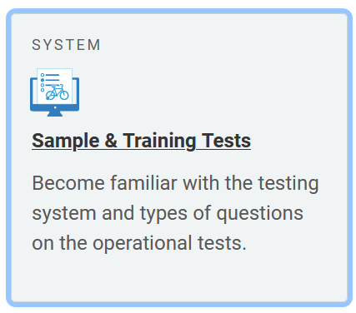
Can TAs Preview the Test?
There is no stand-alone TA “training” version of the Alt ELPA.
Use Alt ELPA User Guide to preview test progression
Use Alt ELPA Sample Test to preview item types and necessary student interactions (see Sample and Training Tests card on OSAS Portal)
Use Alt ELPA Sample Test TA directions or Test Administrator Directions and Scoring Rubrics Booklets to preview scoring rubrics
Notes:
While there is no standalone version of the Alt ELPA specifically designed with TA training in mind, there are numerous resources available which provide an advance look at all ingredients of the test. The Alt ELPA User Guide provides step-by-step instructions for proceeding through the test. The Alt ELPA Sample Test and sample test instructions preview the types of items that TAs and students will encounter in all four domains, including the types of items which require TA scoring. Both the TA directions for the sample test and the Test Administrator Directions and Scoring Rubrics Booklets that accompany the full Alt ELPA contain scoring rubrics that TAs will need to use to evaluate student performance in the Speaking and Writing domains. By consulting a combination of these resources, TAs should be able to build a solid picture of the Alt ELPA experience prior to opening their first test.
https://osasportal.org/

Slide 14
Test Environment
All administrations 1:1 in a separate setting
Computer required
Headphones not required
Microphone not needed
TA will need to use student computer to enter Speaking and Writing scores
Many students will need TA assistance navigating test platform
During the TA’s first administration of a Speaking domain and/or Writing domain, a “second scorer” will observe (and score) alongside the TA, to establish calibration (see future slide)
The second scorer must also complete all required TA training
The second scorer must be a licensed educator
Notes:
As mentioned earlier, every administration of the Alt ELPA will take place in a separate setting, with one TA and one student. Many if not all students in this population will need to test in an environment that aids their concentration tailored to their unique needs, and will require close supervision by the TA which is simply not possible in a group setting.
This test is delivered online. A computer, tablet, or similar device will be needed. Headphones are not required, although some students may wish to use them anyway as a concentration aid or sensory filter. Because the TA scores all student Speaking responses on site and in the moment, there is no need for a microphone. Note that for some items, the TA will need to use the student computer to enter data for TA-scored items.
Many students in this population need extensive support, and may need the TA’s assistance navigating through the test.
Finally, every district administering Alt ELPA Speaking or Writing domain tests will need access to both a trained TA and a “second scorer” who has completed the same TA training, so as to establish TA scoring calibration. We will explain this process in detail in a future slide.

Slide 15
OSAS Test Delivery System
OSAS Portal
Access, login, etc. similar to ELPA Summative
Student profile managed in Test Information Delivery Engine (TIDE)
Supports and accommodations found in Oregon Accessibility Manual (OAM)
Domain exemptions available on Alt ELPA
For an exempted domain, do not administer individual domain test
Technical support available before, during, and after testing: OSAS Helpdesk, Regional ESD Partners
Notes:
The Alt ELPA is delivered through the same Test Delivery System as the ELPA Screener and ELPA Summative. This system is accessed through the Oregon Statewide Assessment System (or OSAS) Portal. The student’s testing profile and test settings are managed in the Test Information Delivery Engine (TIDE). Likewise, available supports and accommodations for the test are detailed in the Oregon Accessibility Manual. This includes domain exemptions, which are a specific kind of accommodation.
As with other tests in Oregon’s assessment system, technical support for the Alt ELPA is available through the OSAS Helpdesk and Regional ESD Partners.
https://osasportal.org/contact.html

Slide 16
Administration Materials
Alt ELPA User Guide
TA Directions and Scoring Rubrics Booklet
Retrieved from General Resources pulldown in Test Information Delivery Engine (TIDE)
Secure: booklet does not leave test environment (see Secure Materials slide later)
Optional resources as needed
Translated directions for administration
Alt ELPA tool button sheet
Notes:
To administer the Alt ELPA, two main resources will be needed. The Alt ELPA User Guide contains step by step instructions on how to administer the Alt ELPA. This vendor-created resource has been customized with Oregon-specific information. In addition, administrators will need TA Directions and Scoring Rubrics Booklets, which can be retrieved from TIDE using the General Resources pulldown. These booklets contain scoring rubrics, scoring sheets, and also reproductions of Alt ELPA items. They are secure, so they should not be reproduced or displayed outside the test environment, and should be securely destroyed at the conclusion of testing.
https://osasportal.org/-/media/project/client-portals/oregon/pdf/2022/alt-elpa-user-guide.pdf

Slide 17
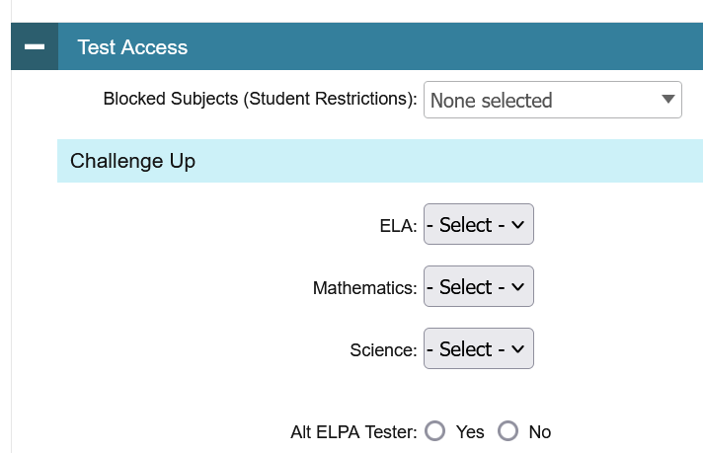
Test Information Delivery Engine (TIDE)
“Alt ELPA Tester” flag
Set accommodations and supports (including domain exemptions)
Recommend making modifications in TIDE at least 24 hours before testing
Notes:
In order for a student to be able to see the Alt ELPA on their list of available tests, the student’s profile must be marked using the “Alt ELPA Tester” setting in TIDE. Other embedded supports and accommodations, including domain exemptions, must also be set in TIDE. While the system is designed to honor such settings immediately, it is recommended they be set at least 24 hours in advance of testing.

Slide 18
Domain Exemptions
Based on disability
For students who cannot “access” that domain
Ex. Listening for deaf student
Maximum of 3
For exempted domains, do not administer that domain test
Enter in TIDE
Considerations:
Expectation or likelihood of poor performance does not justify a domain exemption
Domain Exemptions on ELPA: Definitions and Examples applies (even though it does not discuss Alt ELPA explicitly)
Notes:
Up to three domains maximum may be exempted on the Alt ELPA and serve the same purpose as on the ELPA Screener and Summative. Use of this accommodation is rare and should be reserved for situations where the impact of a disability means the test cannot measure a student’s proficiency in the given domain. Domain exemptions are not for domains where the student has performed, or is expected to perform, poorly.
The information in the guidance document Domain Exemptions on ELPA remains accurate and applies to the Alt ELPA.
https://www.oregon.gov/ode/educator-resources/assessment/Documents/Domain_Exemptions_on_ELPA.pdf

Slide 19
During Testing
Notes:
Mason: At this point, we will discuss important factors at play during test administration.

Slide 20
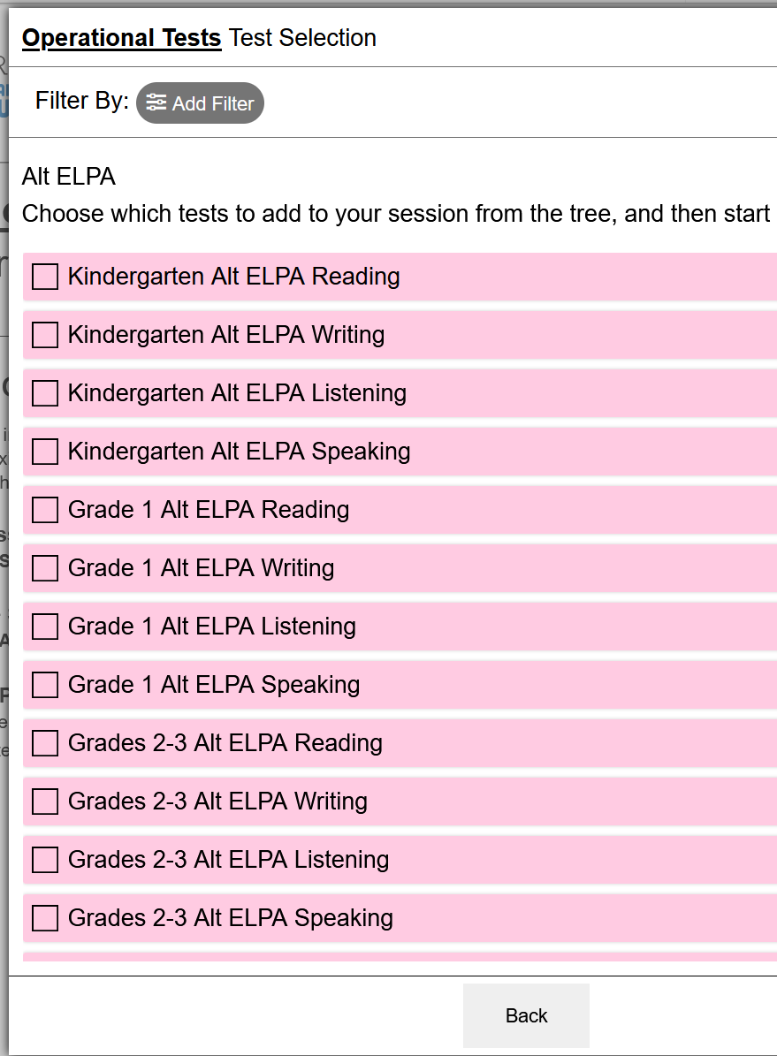
Similarities to ELPA Summative
Test delivered through OSAS Portal
Student profile in TIDE
Supports and accommodations in OAM
Exiting decisions and supporting test results reported to ODE in the same manner as the ELPA Summative (through EL Data Collection)
Notes:
This slide quickly reviews some facets of the Alt ELPA which mirror the ELPA Summative. Information on reporting Alt ELPA results via the EL Data Collection will be available as scores begin to arrive.

Slide 21
Administration
Test window: February 1 through March 24
All eligible domains need to be completed during this time
Tests do not expire
…but plan ahead–open tests with enough time to complete
Double check IEP
Only open an Alt ELPA test if specifically indicated on student’s IEP
Otherwise, test student using ELPA Summative
Notes:
The Alt ELPA test window is published in ODE’s test schedule. Any eligibility decisions regarding the Alt ELPA need to be made prior to opening the test. IEP plans are legally binding documents. If a decision cannot be made in time and the Alt ELPA is not noted in a student’s IEP plan, test the student using the ELPA Summative instead. If participation in the Alt ELPA is recorded in a student’s IEP plan, administer that test only (not the ELPA Summative).

Slide 22
Student Response Check and Early Stop Rule
Before logging in, confirm that student has a consistent communication system or response mode (student response check). Alt ELPA User Guide pg. 49
Yes: administer the entire test
No: begin by administering first four items (early stop rule)
If the student DOES NOT have a consistent communication system: during first four items (including warm-up item), does student engage with test?
Yes: continue testing
No: mark No Response (NR) for first four items. Stop testing
There may be more than one place to mark NR on a given item; a visual indicator should appear when NR is marked
Report using appropriate codes in EL data collection (training will be provided in fall 2023)
Notes:
The beginning of each test includes steps to ensure that the TA understands the student’s response method and that the student is engaging with the test. If a student does not have a consistent or comprehensible communication system, AND is not engaging with the test during the first four items, end the test. This is called the “early stop rule” and ONLY applies to students who do not have a consistent communication system and do not engage with the test. Do not open further domain tests for the student. The student’s test, which stopped early, can be reported later using appropriate codes in the EL data collection.

Slide 23
What is “Engagement”?
“Engagement” means the student understands that they are being asked to respond to test items, and responds to items. This could manifest in a wide variety of ways, given the diversity of this student population (see page 54 of the Alt ELPA User Guide).
Some examples:
Engagement | Non-engagement
Responding in language other than English “I don’t know” Pointing, gesturing, eye gaze, vocalizing, personal communication device, manipulating testing computer Listening or reading with attention and responding to test items | Student has no consistent communication system AND does not engage with test.
Notes:
Engagement includes a range of behaviors. A student who understands that the test is asking for responses, and responds to test items, is engaging in the test. Incorrect responses due to a lack of English proficiency (including no English proficiency whatsoever), count as engagement. Incorrect responses stemming from lack of understanding that a test is occurring, or that the manipulating the computer and associated objects has meaning, are not engagement. Other examples of engagement appear on this slide. The more familiar a TA is with a given student and their modes of communication, the more likely they will be able to accurately identify engagement behaviors.

Slide 24
Domains
Each a separate “domain test”
New login
Submitted individually
11 items per domain: one warm-up, 10 scored
Four forms (A-D); form indicated on student computer immediately after completing login (prior to warm-up item)
May be administered in any order
May be administered in sequence or individually (to avoid test fatigue)
TA Directions and Scoring Rubrics Booklet required for each domain
Notes:
Each domain on the Alt ELPA forms a separate domain test, similarly to the remote ELPA Summative. Domain tests must be opened and completed individually. They may be administered in any order. There are four variants for each domain test, labeled forms A-D. Neither students nor TAs will know ahead of time which form will appear for a given student. This information appears immediately after a successful login, prior to displaying any test items. TAs will need this information in order to consult the appropriate section of the TA Directions and Scoring Rubrics Booklet.
Every domain test begins with a warm-up or practice item. This item is not scored. As of most recent ODE review, the warm-up item is indistinguishable from the scoring items that follow it. There is no information or visual indicator inside the test indicating that this item is for warm-up only.

Slide 25
Reading and Listening
No TA scored items
However, TA may still need to enter or facilitate student responses
Follow TA directions
Examples: TA may need to read some item content aloud, or describe some content for students with visual impairments
Note that many students in this population will need individualized TA supports beyond procedures described in test administration instructions
Image source
Notes:
The reading and listening domains consist entirely of machine-scored items. TA responsibilities in this domain may involve narrating or describing some item elements. TAs may also have responsibilities that are unique to the student taking the test (such as monitoring a medical device, supporting the student’s physical position, or similar).

Slide 26
Writing and Speaking
Follow TA directions
TA may need to read some item content aloud, or describe some content for students with visual impairments
Some machine-scored items
Some constructed response items which will be scored in the moment by TA
Scores entered using student computer
To the extent possible, enter scores out of student’s perceptual range (perhaps by turning screen away from student)
If administration includes calibration, TA and second scorer take a moment to compare scores before entering (see future slide)
Note that many students in this population will need individualized TA supports beyond procedures described in test administration instructions
Notes:
The Writing and Speaking domains include machine-scored and TA-scored items. In addition to the responsibilities we mentioned just now for Reading and Listening, the TA will also need to use the student computer to enter scores. In general, students should not be aware of the scores they are receiving mid-test, as this might have both emotional and performance impacts. This includes the brief score comparison needed for scoring calibration (to be explained in a few slides).

Slide 27
Adjustments and Modifications
TAs have great freedom to adjust general test instructions and system messages.
TAs may accommodate, but may not modify, item content that they are to read aloud (item-level instructions, item prompts, response choices, and other item content not explicitly included in Directions For Administration).
Accommodation (permitted) | Modification (not permitted)
Use student’s communication method Repeat Adjust general rate or volume | Translate Reword, paraphrase, or clarify Simplify Emphasize key words or phrases so as to suggest a correct response Underline or highlight
Notes:
Students participating in the Alt ELPA may have a wide range of communication needs, styles, and preferences. In general, TAs may make nearly any alteration to general test instructions or system messages that is needed to help students understand how to navigate and respond to the test. TAs may not modify, translate, reword, or otherwise alter item content (including item-level instructions). The table on this slide provides a non-exhaustive list of examples differentiating between accommodating read-aloud content (which is permitted), and modifying said content (which is not permitted).

Slide 28
Test Navigation
The higher the zoom level, the less of the item will fit on screen.
Available screen space will also vary by device.
Some items require clicking and dragging responses a significant distance.
To drag an item to an offscreen response space, click/tap and hold. Drag off the edge of the display area. If using a desktop computer, you may also click and hold and use the arrow keys to scroll up and down.
Notes:
Some items require that responses be dragged across the screen to a response space. These items may pose a difficulty for students who have dexterity challenges; this difficulty will likely increase with the zoom level, due to increasing drag distance. At certain levels of zoom, it may not be possible to see all the response choices and response areas on the same screen at the same time.

Slide 29
Streamlined Mode and Full Screen Mode
Streamlined mode
On by default
Slightly simplifies screen by “stacking” test in a single vertical column (i.e. no side-by-side presentation)
Full screen mode
Off by default (turn on in TIDE)
Further simplifies screen by removing most buttons and controls
Requires password to exit (student’s first name)
You must exit full screen mode to end the test
Notes:
The Alt ELPA offers several options for reducing clutter or business on the testing screen. In most tests, the stimulus is presented on the left side of the screen and the answer space appears on the right side of the screen. Streamlined mode, which is on by default for the Alt ELPA, presents test content in a single vertical column. TAs also have the option to activate full screen mode. This option significantly simplifies the test interface by removing nearly all buttons and controls except the Next button. Leaving full screen mode requires entering a password (the student’s first name). Note that you must exit full screen mode to end the test.

Slide 30
Scoring Calibration
Applies to first Speaking and first Writing test administered by each TA in the 2022-23 school year
Improves standardization and accurate application of scoring rubric
Calibration established separately for each domain
Once calibration is established, observation is no longer required for that domain
Calibration applies across grade bands (i.e. calibration does not need to be independently established for every grade band)
Second scorer also needs to complete full TA training
DTCs track calibration (confirmation and need for recalibration)
Notes:
Because some items are scored by the TA in the moment, it is important to ensure that the TA is applying the scoring rubrics in a standardized manner. For this reason, the first Speaking test and the first Writing test administered by a given TA will observed by a credentialed educator who has completed the same required training elements as the TA. This observer is called a “second scorer”. If the TA demonstrates calibration during this observed test, they do not need to be observed again for future tests in that domain. Otherwise, recalibration will be needed for that domain. Calibration is tracked separately for Speaking and Writing. A TA who demonstrates calibration in Speaking will not need to be observed for future Speaking tests, but would still need to demonstrate calibration in Writing domain. DTCs are responsible to track calibration or the need for calibration for all TAs administering the Alt ELPA in their district.

Slide 31
Scoring Calibration Procedure
Second scorer observes live test administration and scores student constructed responses alongside TA (Alt ELPA User Guide appendix B)
TA and second scorer compare scores outside student field of perception
If scores agree: no action needed
If scores disagree: resolve quickly (within 10 sec) or, if longer discussion is needed, pause test
If agreement cannot be reached: TA has “casting vote”
Record score and move on to next item
If TA and second scorer disagree two or more “scoring” items during the second scored Speaking or Writing test, recalibration is needed (see Recalibration slide in After Testing)
Notes:
During calibration, both the TA and the second scorer are present in the test environment and observe the student’s performance. For each TA-scored item, they first independently score the student’s performance using the TA scoring rubric for that item, then compare scores (preferably outside the student’s field of perception). If they agree, the TA enters the student’s score and the test proceeds. Otherwise, the TA and second scorer take a moment to resolve the disagreement. The test may be paused if a longer discussion is necessary, but in general, a swift resolution is preferable both out of courtesy and respect for the testing student and to reduce testing fatigue. Should the TA and scorer find they cannot resolve the disagreement, the TA’s chosen score will be entered and the test will proceed. If the TA and second scorer disagree on two or more scoring items, recalibration will be needed.

Slide 32
After Testing
Notes:
Ben: The next few slides discuss issues that come into play after the test has been completed and submitted.

Slide 33
Secure Materials
If observed session with second scorer:
Was calibration demonstrated? Submit scoring worksheets to DTC
Is recalibration needed? Retain scoring worksheets, then submit to DTC after recalibration
DTCs track Speaking and Writing calibration for all TAs
After completing the above, securely destroy copies of TA Directions and Scoring Rubrics Booklets (delete from device and empty trash)
Notes:
The scoring worksheets used during observed test sessions are important for demonstrating calibration or the need for recalibration. If calibration was demonstrated, scoring worksheets should be submitted to the DTC. If recalibration is needed, the scoring worksheets should be retained and used during the recalibration process, then submitted to the DTC.
The TA Directions and Scoring Rubrics Booklets are a secure material. Once the test is complete, the booklets should be securely destroyed. The Alt ELPA User Guide directs users to store these booklets on a secure electronic device, so destruction involves deleting from the device and emptying the device’s trash if necessary.

Slide 34
Recalibration
Required when TA and second scorer cannot reach agreement on two or more items in a single domain test (Speaking or Writing)
Tracked independently for Speaking and Writing
TA and second scorer review relevant portions of scoring booklets and training materials
Compare student performance against scoring rubric and come to consensus regarding appropriate score for performances where there was disagreement
Next test in that domain will be observed to establish TA calibration
Notes:
Recalibration occurs when the TA and the second scorer find they disagree on two or more items during a single observed test administration. Recalibration should occur soon after the relevant test, while memories of the student’s performance are fresh. During recalibration, the TA and the second scorer review relevant training materials and scoring rubrics. They then compare notes on the student performance and reach consensus regarding the appropriate score for the student performance on the items in question. The goal of this process is to ensure that the scoring rubrics are being applied in a standardized manner.
Following recalibration, the next test in that same domain will be observed to demonstrate TA calibration. Note that recalibration does not result in rescoring of already submitted tests.

Slide 35
Scores and Exiting Decisions
Test will undergo standard setting during summer 2023
Scores should arrive in late 2023
Will be reported by modality (Receptive and Productive)
Users will also be able to see student performance at the domain level
Exiting decisions can be made based on 2023 scores
ODE will issue communications on how to report Alt ELPA performance for the EL data collection
Information forthcoming on how Alt ELPA will factor into the On Track to ELP measure
Notes:
Because 2022-23 is the operational pilot year for the Alt ELPA, standard setting will be needed before scores can be reported on the test. No definitive date has been provided for score reporting, but as standard setting will take place during summer 2023, it is likely that scores will arrive in fall or winter 2023. Proficiency will be determined based on modality (receptive and productive), but users will be able to see data on student performance at the domain level.
Scores received in 2023 can be used to make decisions about exiting participating students from EL status. Instructions on how to report such late exits will be provided by the Title III team at ODE, and will likely mirror existing procedures for reporting late exits.

Slide 36
Questions and Answers
Notes:
At this point, we will pause to handle questions and answers.

Slide 37
Thank You!
Mason Rivers
Special Education Specialist
Ben Wolcott
ELPA Specialist
Image source
Notes:
Thank you for you attention and participation in this webinar. We will capture questions and answers from from both sessions of this webinar in an accompanying document that will be available asynchronously next to this set of slides.

