Slide 1

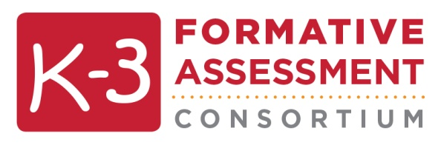
Assessing all children
Notes:
Note to Trainers:
These slides should accompany the teacher training and be incorporated after the slides on the assessment content (Domain & Construct Overview) and process (Formative Assessment Process). There is an accompanying handout “Assessment Overview and Directions that Apply to All Constructs.”

Slide 2
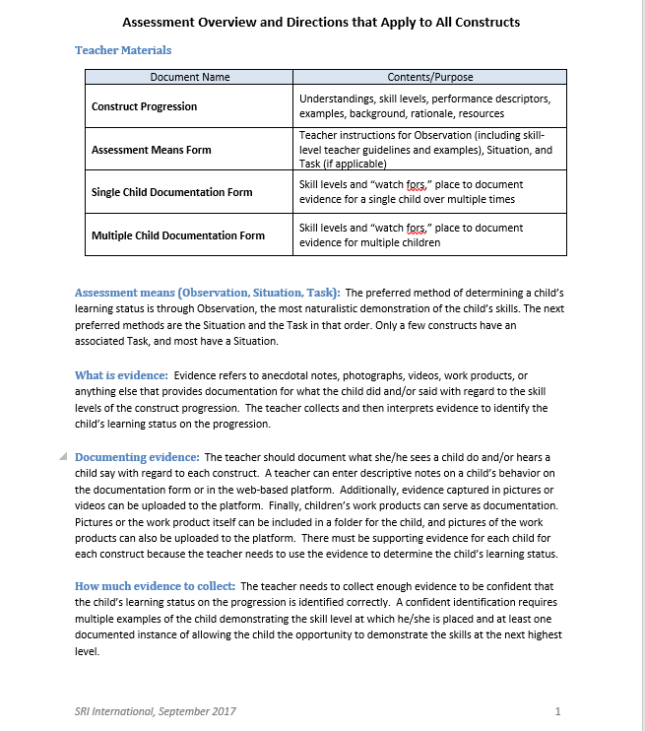
Assessment Overview
Instructions for:
Assessing all constructs
Assessing all children
Notes:
Script:
The assessment materials include a 2-page overview document that provides guidance on how to assess all of the constructs and some considerations for assessing all children, including children with disabilities, English learners, and children form diverse racial and cultural backgrounds.

Slide 3
Assessment Overview
The assessment is based on authentic interaction.
Alternative means of communication are acceptable.
Supports can be offered to the child.
Accommodations are acknowledged and acceptable, along with flexible administration/ collection of evidence (e.g., positioning support, various times of the day).
Notes:
Script:
Because the assessment is based on observation of authentic interaction in typical classroom activities, there are no strict administration guidelines that might make it more difficult to assess all children, including a child with disability, a child learning English, or a child from a racial or cultural background different from your own.

Slide 4

Assessing Children with Disabilities
Communicate in a method the child understands and can respond in.
Incorporate any accommodations, specialized equipment or other assistive technology the child uses in daily classroom activities, into the Observation, Situation, or Task for that child.
Provide appropriate support with positioning for children who need it.
  The various situations developed to help a teacher pinpoint a child’s skill level should be used as appropriate given the child’s disabilities.
  e.g., For a child with a visual impairment, make sure the lighting is good, the materials are large enough, and marks on the paper are big enough for the child to see.
Notes:
Script:
Here are some considerations in assessing young children with disabilities.
Communicate in a method the child understands and can respond in. This could be sign language, picture cards, electronic communication devices, or any augmentative or alternative communication system that allows a teacher to gain insight into what the child knows and can do.
Incorporate any accommodations, specialized equipment or other assistive technology the child uses in daily classroom activities, into the Observation, Situation, or Task for that child.
Provide appropriate support with positioning for children who need it.

Slide 5
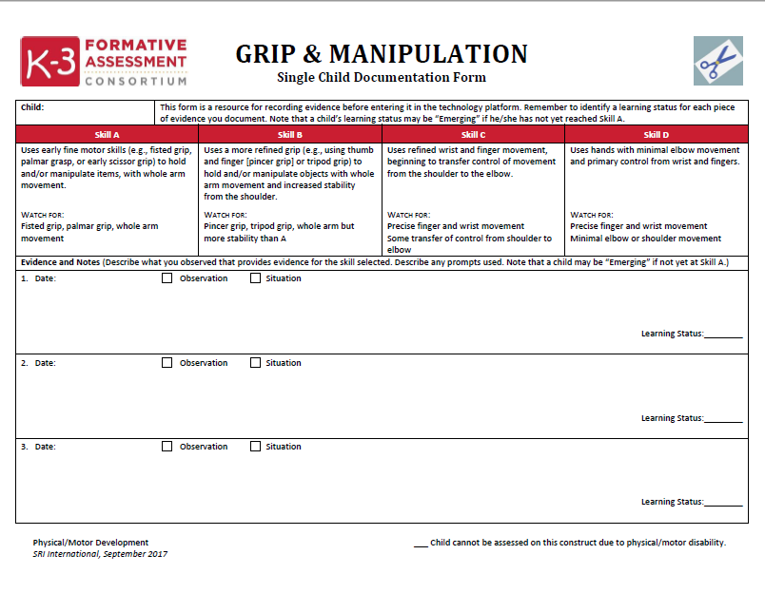
Assessing Children with Disabilities
Assessment Features
Included examples of children with disabilities throughout the Construct Progression documents to help teachers see children with disabilities reflected in the assessment materials.
Provided a space on the Single Child Documentation Forms to indicate when the assessment of a construct is not appropriate for that child based on his/her disability (explains why child not assessed on the construct).*
*Recommend that there also be a place where teachers can indicate such information on the technology platform used to support this assessment.
Notes:
Script:
And here are some features of the assessment to make it easier for teachers to assess children with disabilities:
There are examples of children with disabilities throughout the Construct Progression documents to help teachers see children with disabilities reflected in the assessment materials.
And there is a space on the Single Child Documentation Forms to indicate when the assessment of a construct is not appropriate for that child based on his/her disability. This hleps the teacher to account for any child not assessed on the construct.

Slide 6
Assessing English Learners
Communicate in a language the child understands and can respond in. This could be a language other than English and involve an interpreter.
Involve an adult who speaks the child’s language in collecting observational data, especially for those constructs that rely more heavily on language and communication.
Repeat a question if needed or use different words to make a question more understandable (as long as the words do not tell the child how to do the skill being assessed).
Notes:
Script:
Here are some suggestions for assessing English learners. Again, this assessment does not have strict instructions for how each construct is assessed so the teacher should communicate with the child in a language the child understands, use an interpreter as needed, and recruit other adults who speak the child’s language to collect the observational data needed to assess the child. And since there are no strict guidelines on the wording of assessment questions, prompts used throughout the assessment can be reworded as needed to ensure the child understands.

Slide 7
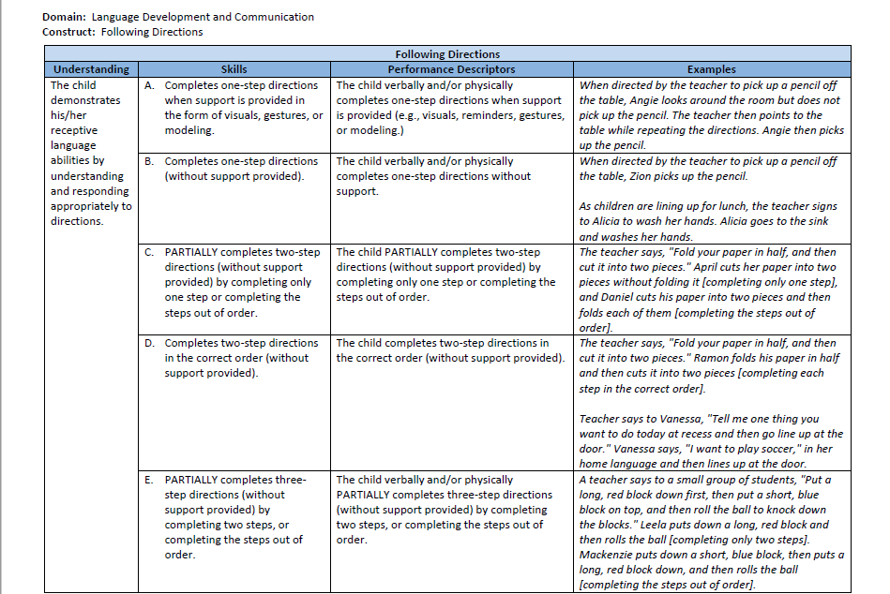
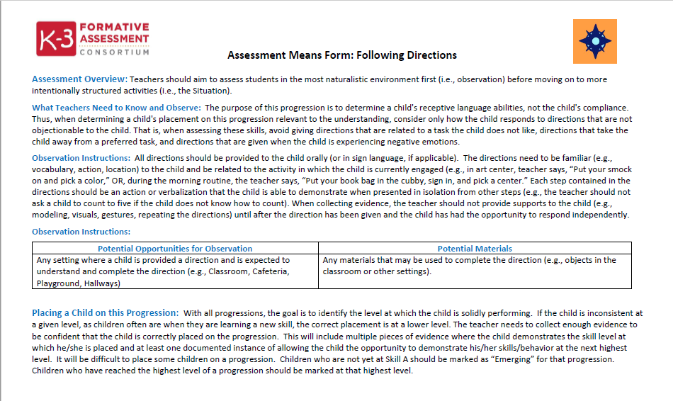
Assessing English Learners
Assessment Features
If possible, teacher should communicate in the child’s language
As needed, teacher should recruit an adult who speaks the child’s language to collect observational data.
The Construct Progression and Assessment Means Forms provide examples of children who are acquiring English so teachers can see these children being assessed.
Notes:
Script:
As for children with disabilities, there are some features of this assessment that will help the teacher assess English learners.

Slide 8
Considering Diversity
Interact with children as teacher normally would.
Unless the directions with the assessment means for a particular construct indicate specific restrictions, the teacher should:
  Use or modify activities and materials to make them interesting and engaging for the child, given his or her background and individual interests.
  Repeat a question if needed or use different words to make a question more understandable (as long as the words do not tell the child how to do the skill being assessed).
  Modify the situation or task directions as appropriate to reflect the racial and cultural norms of children in the classroom.
Notes:
Script:
Similarly, teachers should consider the diversity of the children in their classroom as they use this assessment. The assessment provides the flexibility for teachers to interact with their students as they normally would, and use or modify activities and materials that are interesting and engaging for the child and reflect the racial and cultural norms in the classroom.

Slide 9
Assessing Diverse Children
Assessment Features
Names of children that appear in the examples in the Construct Progression Documents and Assessment Means Forms reflect racial and cultural diversity.
Teachers can modify the situation or task directions as appropriate to reflect the racial and cultural norms of children in their classroom.
Teachers can use activities or tasks that are likely to be engaging for the child given his or her background and individual interests and can modify tasks if they are not engaging.
Notes:
Script:
Teachers should be able to see all of the children in their classroom in the assessment materials. Consequently, there are children with names that reflect racial and cultural diversity in the assessment materials, specifically in the examples that appear in the construct progression and assessment means forms.

