Slide 1
DTC Webinar
January 8, 2020
Welcome! Thank you for joining us. We will begin shortly.
Notes:
Good morning and welcome to our January DTC webinar. My name is Renee and in the room I am joined by ____
We also have our Math Specialist Andy Byerley remotely participating today.

Slide 2
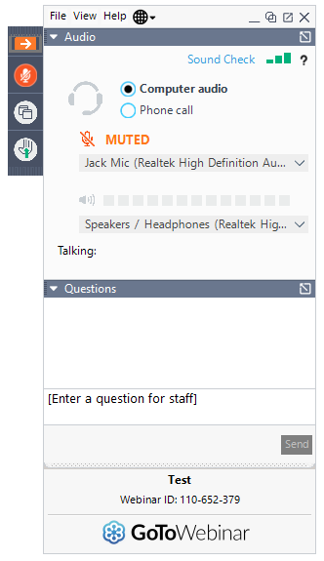
Before We Begin
To ask questions:
use the question box and your question will be read aloud and answered by ODE staff.
select the “raise hand” icon and you will be unmuted and able to ask your question.
Notes:
As a reminder, when we get to the Q&A portion of the webinar there are two ways that you may participate. You may use the question feature and the presenter will see your question, read it aloud, and either answer it online or respond offline depending on who is present to respond. You may also use the raise hand feature and the presenter will unmute you so that you can verbally ask your question.

Slide 3
Quick Reminders
ELA, ELPA, Math, and Science test windows opened 1/7/20
Oregon Extended Assessment Braille and Large Print order window CLOSES for English Language Arts, Mathematics, & Science 1/10/20
OSAS Online Test Delivery System (including Practice Tests), TIDE, and Online Reporting System (ORS) offline for scheduled maintenance 1/10-1/12/20
Report Validation Window CLOSES for Kindergarten Assessment 2019-20 1/17/20
ODE is closed 1/20/20
Notes:
ELA, ELPA, Math, and Science test windows opened yesterday
Oregon Extended Assessment Braille and Large Print order window CLOSES for ELA, Math, & Science Friday January 10th
OSAS Online Test Delivery System (including Practice Tests), TIDE, and Online Reporting System (ORS) will be offline for scheduled maintenance Friday January 10th – Sunday January 12th
Report Validation Window CLOSES for Kindergarten Assessment 2019-20 on Friday January 17th
ODE is closed Monday January 20th
This concludes our quick reminders, we will now begin answering questions that were submitted by DTCs for ODE to address

Slide 4
Pausing Tests
Could I get some clarification about pausing tests, and tests that are paused for longer than 4 days will be automatically submitted? And if that happens you will need to file an appeal for that students test?
Notes:
The test is not automatically submitted after 4 days of being paused. The student would either have 45 calendar days from the day they began their test for the Math and ELA CAT, Science, and ELPA Summative or 20 calendar days for the Math PT and ELA PT. ODE may reopen a test that has expired or that was submitted accidentally, allowing the student to resume the test. If an expired test is reopened, the test will reopen at the location at which the student stopped the assessment. The student will be able to review items within the current segment of the assessment but cannot return to previous segments. If the test expires and is not eligible for reopening, then ODE does automatically push through for scoring as a partial once the statewide test window closes in June.

Slide 5
Opt-out Communication
Can you reiterate the expectations and timeline for the Opt out communication to families.
Notes:
Districts and public charter schools must provide parents with the ODE-developed annual notice at the beginning of each school year. In addition, districts and public charter schools must provide parents with separate notice at least 30 days prior to administering the statewide summative assessments in Math and ELA using the ODE-provided 30-day notice and opt-out form (available through ODE’s Test Administration webpage). School districts and public charter schools must use the 30-day notice and opt-out form provided by ODE to communicate with all parents about state testing requirements and their right to opt-out by December 8, 2019. For more information, please refer to section 5.3 Opt-outs and parent requests for exemption from state testing in the TAM.

Slide 6
Opt-out Communication
Examples of Appropriate Communications | Examples of Inappropriate Communications
Posting ODE’s opt-out form on district/school website | Making repeated announcements to non-adult students (e.g., over school intercom systems, assemblies) during working hours reminding students to pick up ODE’s opt-out form
Sending ODE’s opt-out form through Parent emails or a Parent newsletter | Initiating a discussion of ODE’s opt-out form or process with non-adult students during working hours
Making ODE’s opt-out form available during public meetings | Repeatedly reminding non-adult students to submit ODE’s opt-out form during working hours
Providing adult students with ODE’s opt-out form at the end of class | Encouraging students to submit ODE’s opt-out form during working hours
Notes:
While districts may communicate with parents using existing communication protocols, including but not limited to fall registration materials, parent conferences, electronic media, or letters home, ODE encourages districts to ensure accurate, consistent communication across classrooms and schools within the district through means such as establishing a district policy around the administration of the statewide assessments required under both federal and state law, and communicating this policy to all district and school staff to ensure consistent understanding and communicating to all district and school staff about the purpose of the statewide assessments to ensure consistent understanding about the role these assessments play in systems accountability and ensuring equitable opportunities for all Oregon students.

Slide 7
Suppress Score in TIDE - Science
I don't see the ability to "Suppress Score" in TIDE for the Science test, as outlined on page 35 of the OAM. Is this something that is only available in the TA Interface? Or is it possible that there is no such thing as "Suppress Score" anymore? That is, does the Science test include items that must be human-scored before a total score is calculated (similar to the ELA and Math)?
Notes:
Scores will not be immediately available for any students immediately following completion of the OSAS Science and for that reason there is no need to ‘suppress scores’. It is yet to be determined if immediate scores will be available in any future administrations of the OSAS Science Assessment.

Slide 8
Illustration Glossary in Math
Embedded designated support, like other non-English languages
Works in stacked Spanish, as well
If enabled, student will take fixed-form versions of both CAT and PT
If deemed a necessary support, the glossary MUST be enabled in TIDE for both the CAT and PT
Notes:
As an enhancement for 2019-20, students will be able to access an Illustration Glossary for selected non-math-specific terms on Math CAT and Math PT assessments. An Illustration Glossary is an embedded designated support that provides definitions for certain words or phrases in the form of an image. While it was published in this year’s OAM (see table 2.3), we are just learning more administration details due to delays in the development cycle.
If deemed a necessary support for a student, the Illustration Glossary must be enabled in TIDE prior to the student beginning any part of the test, and must stay enabled throughout the student’s administration. If not, the student’s test will need to be reset through the test impropriety process.
Also, if the Illustration Glossary is enabled, the student will take fixed-form versions of both the Math CAT and Math PT. There are no implications either on other designated supports and/or accommodations or test length; however, students who would normally experience items at lower grade levels may have a different test experience without the adaptivity.

Slide 9
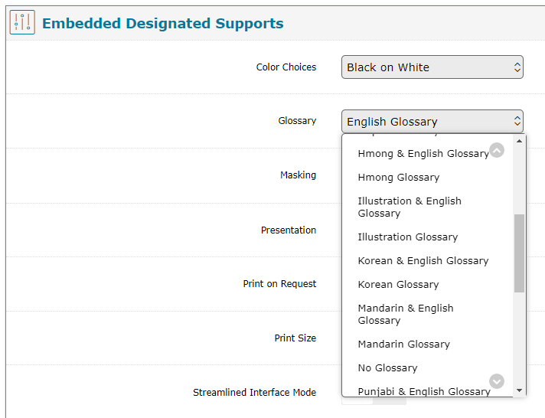
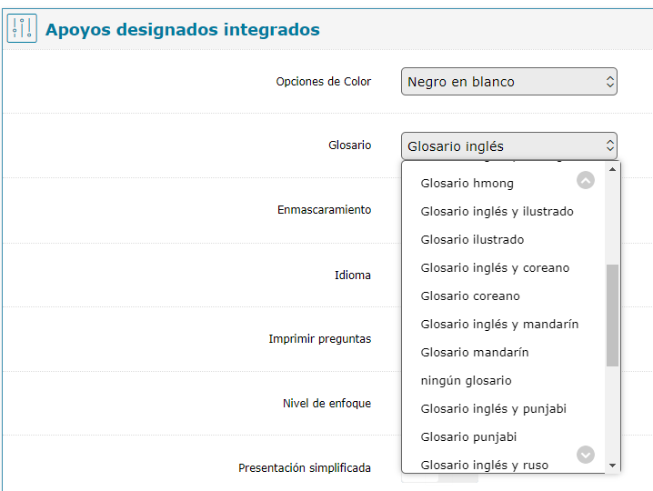
Illustration Glossary in Math
Notes:
Illustration Glossary must be set in TIDE for both the Math CAT and PT. It is available as a standalone support or coupled with English, and is available in the Spanish administration as well.

Slide 10
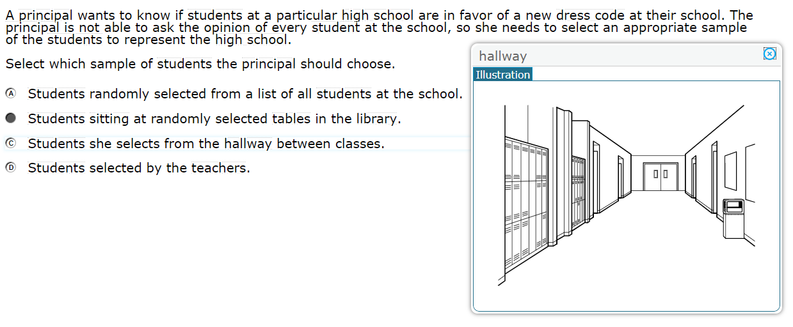
Illustration Glossary in Math
Figure 1: English Administration
Figure 2: Illustration & English Glossaries
Notes:
Here are two examples of what the Illustration Glossary looks like. Figure 1 shows the illustration of the term “hallway”. Keep in mind that the terms included in the Illustration Glossary are non-math-specific. Figure 2 shows how a term for which both an English definition and illustration will appear. Note the two tabs on top.

Slide 11
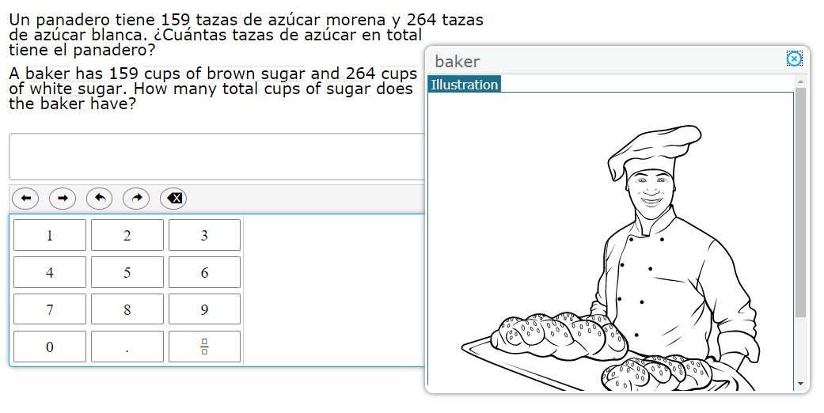
Illustration Glossary in Math
Figure 3: Spanish Administration
Notes:
Here is a third example showing what the Illustration Glossary looks like in the stacked Spanish administration. Note that terms available are ONLY in the English text at this time.

Slide 12
Spanish Read Aloud Guidance in Math
New guidance for 2019-20 conforms to spoken language conventions
“247” is read “doscientos cuarenta y siete” rather than “dos cuatro siete”
No changes to requirements for readers
Full guidance is available from Smarter Balanced.

Slide 13
Long-Term Vision/Planning
Student Investment Account Sensemaking
3rd Grade ELA Composite Score
Local Metrics
Balanced assessment system supports:
Formative assessment practices supports
Interim system supports
Target reports as an initial lever

Slide 14
Question & Answer
*Intentionally left blank*

Slide 15
Next Steps & Adjourn
A Q/A document will be posted to the Testing Resources page

