Slide 1
DTC Webinar
February 10, 2021
Welcome! Thank you for joining us. We will begin shortly.
Notes:
Renee

Slide 2
Quick Reminders
2/9/21 - Testing Window for English Language Proficiency Assessment (ELPA) opened
2/15/21 - ODE is closed for the President’s Day holiday
Notes:
Renee

Slide 3
ELPA Cohorts
Can we get clarification about the cohorts for ELPA if given through Limited In-Person? There are two recommendations in the LIPI Guidance, and I wasn't sure which one applies to ELPA if it is given on an individual basis.
Ready Schools, Safe Learners defines a stable cohort as “a group of students that are consistently in contact with each other or in multiple cohort groups.” One student working with a teacher, by definition, does not constitute a cohort. If teachers are involved in individual 1 to 1 interactions and not cohorts of multiple students, they should limit interactions to no more than 60 total students a day.
If an educator is administering special education assessments or evaluations (e.g., school psychologist, speech language pathologists, etc.) and is working only with individual students, not cohorts, each assessment can be thought of more as total contacts. The upper limit for any staff would be 30 individual students or three cohorts (of 10 or fewer students) in a week. They should account for that while keeping distance and facial coverings. Family never needs to be closer than 6 feet for any evaluation except ages 0-3.
Notes:
Ben
We must first be clear that limited in-person guidance applies only in schools who are implementing Comprehensive Distance Learning (CDL) instructional models. The bullets listed here are also recommendations. We will focus today’s discussion on what is required within LIPI if using such a resource to administer the ELPA summative assessment. We must also emphasize that parents or guardians most opt in to participate in the ELPA summative if administered within LIPI contexts.
All schools must try to establish stable cohorts, which in LIPI are limited to no more than 20 students. Students cannot be part of more than two cohorts in a school week. In terms of time, students cannot spend more than two consecutive hours per day that are not intermittent receiving LIPI services. Those are the parameters that apply to the ELPA summative.
[To Post in the chat: https://www.oregon.gov/ode/students-and-family/healthsafety/Documents/Guidance%20for%20Limited%20In-Person%20instruction%20during%20CDL.pdf]
If the TA administering the ELPA Summative is delivering on-site instruction, via hybrid or in-person models, to the students in question (ELD or otherwise), the students would belong to a stable cohort as defined in RSSL and reflected here [RSSL, Section 1a, Page 21].
The ELPA Summative is not a special education test and does not require the same degree or variety of interactions as, for example, speech language pathology. The second bullet therefore does not apply in this situation.

Slide 4
ELPA Testing
If we bring students in to take the ELPA summative during LIPI, can they come in during class time? Can they miss a CDL class to come in to take the ELPA?
Notes:
Ben
I consulted with Kim Miller on this question.
If possible, students should not miss synchronous core instruction to participate in summative ELP testing, whether that instruction is in-person or remote.
It is permissible to schedule summative ELP testing during an asynchronous learning time, since the student may access this prerecorded instruction at any time.

Slide 5
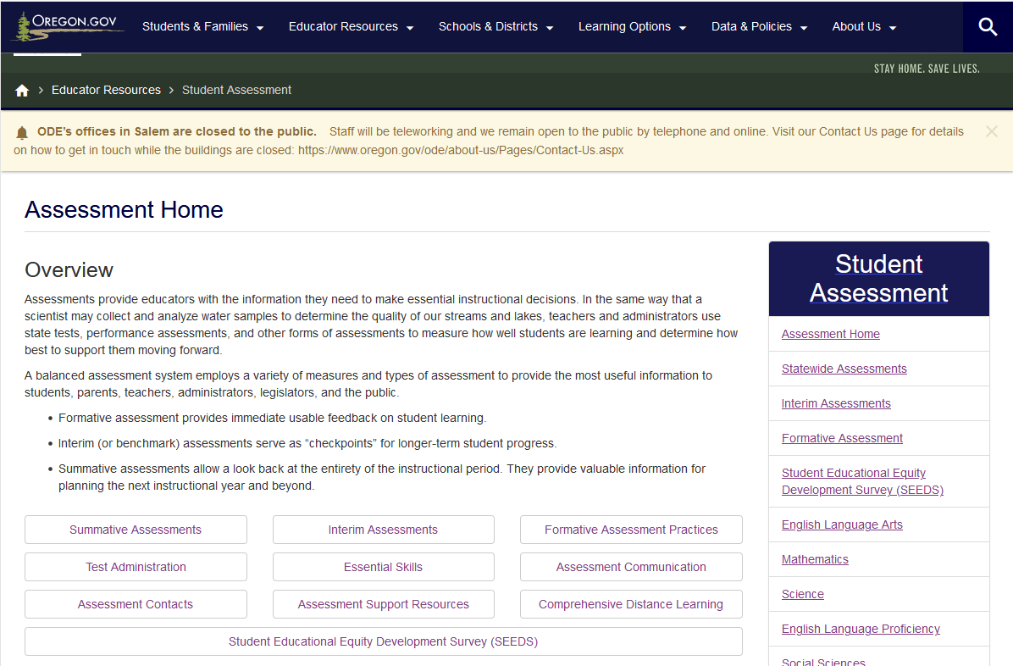
SEED Survey
Can you provide more information on the implementation and logistics?
Would SEED survey necessarily be administered via a secure browser?
Would students with i-pads be able to access the survey?
Would we have to download a secure browser to iPads for a student to take the survey?
If a teacher wanted to go through the survey questions as a class together, how would they access the survey? Will there be a PDF, slides, or printable survey that they could read from/show? Or would they be able to access the survey with just their teacher log-in?
Notes:
Dan/Noelle
Comprehensive information regarding the pilot Student Educational Equity Development Survey (SEED Survey) will be posted on the large button on the assessment team homepage by February 19, 2021. This will include a User Guide that provides needed information regarding implementation and logistics. At present, a copy of the DTC SEED Survey communication we made available last week is the only resource that is posted.
The SEED surveys will be administered remotely or in person via the secure browser within the Test Delivery System, or TAs can generate URL links that they can share with each student in their class to participate remotely. Students can access the survey with any tool that has internet access, including iPads.
Though class time can be used to allow students to complete a SEED survey, it is not appropriate for teachers to lead students through the SEED survey as an interactive classroom activity. The student’s individual responses must be collected in a manner that is not influenced by peers or educators. Student responses must reflect their personal perception. That said, we will be making some practice survey items available for educators who want to practice with students prior to participating in the pilot. We know that many of our 3rd and 4th grade students have yet to experience any interactions with our Test Delivery System. In order to allow parents to make informed decisions regarding participation, ODE will publish all survey items so parents, educators, and the general public know what we are asking students by February 19, 2021.

Slide 6
State Student Identification Numbers
Still looking for other districts' ideas to get SSIDs into the hands of students...I think we have it figured out for the most part, but I'm always looking for better options we may not have thought of. We will likely be handing note cards out at weekly packet pickups for the elementary level. But still not sure for the high school kids.
Notes:
Ben
Our recently updated Secure Transmission of Secure Student Data updates the list of secure transmission methods. However, it does not give specific examples of how to leverage these methods. Districts may wish to share strategies in the chat (or if there is time, verbally).

Slide 7
Tools for Teachers Access
Any educator may have access to Tools for Teachers
Coaches, TOSAs, administrators, support staff for LIPI…
No training is required to gain access to Tools for Teachers
Tools for Teachers training is available from ODE
Interim access DOES require the completion of training modules
DTCs should use the “TFT_SC” user role in TIDE
TA users already have access
Notes:
Andy/Tony

Slide 8
Interim Training Requirements
Were you a Test Administrator in
2019-20?
Complete Module 8
DTC assigns “Interim” test group in TIDE
YES
Yes, but in a different district/state
NO
1. Reading requirements from Table 5 of Oregon’s
Test Administration Manual (TAM)
2. Complete Modules 2, 3, and 4 as posted to the
Assessment Training Materials webpage
Notes:
Slide 9: Interim Training Requirements (Facilitator 1)
ODE has worked to reduce the work of our district testing coordinators, and this year we have implemented a roll-over process where educators from last year have already been populated in the OSAS Portal TIDE Account and will automatically have access to the Tools for Teachers resources, which launch on September 20, 2020.
Therefore, [Click Animation] if you were an educators who completed the 2019-20 TA requirements, you would only need to provide evidence they have completed Module 8 - Interim Assessment Remote Administration and Test Security in order for the Interim Assessment test group to be assigned.
However, [Click Animation] if an educator did not have a TA user account from the 2019-20 instructional year or if the educator has transitioned to a new district which is different from last year.
[Click Animation] They must complete the reading requirements in Table 5 of the Test Administration Manual and also complete training modules 2, 3, and 4.
Once these requirements had been fulfilled [Click Animation] the final step would be completing Module 8 to have the interim assessment test group assigned.
Note These training modules have already been updated for the 2020 -21 instructional year, and have been beed posted to the ODE Training web page.
Resources:
Module 8 - Interims: Remote Administration and Test Security
Facilitation Guide​​​, Powe​rPoint and PowerPoint with Audio​ ​
Assessment Training Materials

Slide 9
Question & Answer
Thoughts?
Feelings?
Concerns?
Wonderings?

Slide 10
Next Steps & Adjourn
A Q/A document will be posted to the Test Administration Resources page
Please contact Dan Farley at dan.farley@state.or.us if you have any subsequent questions or concerns.
Thank you!

