Slide 1
DTC Webinar
December 9, 2020
Welcome! Thank you for joining us. We will begin shortly.
Notes:
Renee

Slide 2
Intro to the Format
Overview
ODE-provided Quick Reminders + DTC Topics
ODE & DTC Question/Answer Session
All questions will be addressed during the Q/A section.
The meeting is recorded to facilitate the creation of a Q&A document after each meeting
We will provide each Webinar PowerPoint on the Test Administration Resources webpage along with a Q&A document
Notes:
Renee

Slide 3
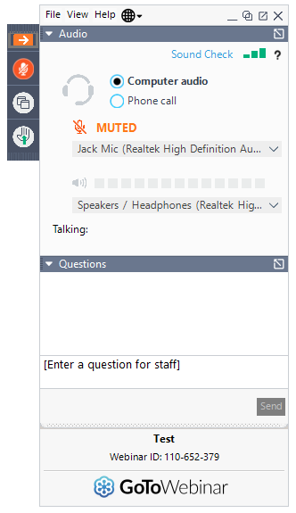
Before We Begin
To ask questions:
use the question box and your question will be read aloud and answered by ODE staff.
select the “raise hand” icon and you will be unmuted and able to ask your question.
Notes:
Renee

Slide 4
Quick Reminders
12/11 Report Validation Window CLOSES for NCES Dropout, Graduation Cohort Reporting 2019-20
12/11-12/13 OSAS Test Delivery System (including Practice Tests), TIDE, and ORS offline for scheduled maintenance
12/25 ODE is closed for the holiday
12/31 PREVIEW of Final 2019-20 Dropout and Cohort Graduation Rate reports on the ODE district secure website
Notes:
Renee

Slide 5
ELPA
If the ELPA Summative is not included in the waiver submitted to US Dept of ED, but we can't (current LIPI guidance) bring "special classes" of students into buildings (i.e. EL identified students), how will we assess students if we are not in-person learning in the spring? Will there be additional guidance to provide for this opportunity for students required to participate in the ELPA Summative?
Limited, In-Person Guidance
Notes:
DAN
One of the categories that LIPI is available for is as an access assessment. In addition, families and students would have the option of participating in ELPA summative testing using LIPI (it would not be required). As such, it would not be making LIPI services available exclusively for the “special class” of students based on their EL status. Others can also use LIPI services, which the waiver makes clear. And, only a small subgroup of EL students might use LIPI to take the ELPA summative.

Slide 6
Policy Guidance
I'm curious if there is a timeline for additional policy guidance regarding Title III funds and assessing private school students for ELPA Screener/Summative? I believe I heard that guidance is in the works?
Notes:
BEN
Districts need to offer in-person testing opportunities depending on local health and safety contexts. Parents also have the right to decline. Any students who miss testing will get a unique screening opportunity. ODE is developing guidance that we are vetting with internal and district education partners, which we hope to publish in the new year.

Slide 7
Test Administration Manual
What changes are anticipated for the TAM with the expectation of a potential waiver? For example, would there be adjustments for training expectations for STCs due to the potential removal of required subjects like ELA/math/science for 20-21?
Notes:
We have reviewed the flag for articulated changes related to the test window. We will also develop a TAM that addresses concerns such as training requirements. I have to name that the timing of this process will be challenging. We will try to get you information related to the waiver request as soon as we can, including any potential updates that are needed in the TAM. We are also trying not to provide multiple iterations; we want a single, final update published prior to spring testing windows.

Slide 8
Waiver
What does the waiver mean for the Extended Assessment?
When will we know about the waiver outcome?
Notes:
Dan

Slide 9
Survey
Dan mentioned that there would be an OSAS survey to be distributed to students. When would this take place? Would we see the questions in advance? When would we get the results?
Notes:
Dan

Slide 10
Opt-out Notices
When do we send out the 30 day opt-out notices?
Notes:
It would be 30 days before the start of the statewide test window. The window is currently scheduled to open 3/4/21. 30 days prior would be 2/2/21.

Slide 11
Question & Answer
*Intentionally left blank*

Slide 12
Next Steps & Adjourn
A Q/A document will be posted to the Test Administration Resources page
Please contact Dan Farley at dan.farley@state.or.us if you have any subsequent questions or concerns.
Thank you!

