Slide 1
Informal DTC Webinar
DECEMBER 14, 2016
Welcome! Thank you for joining us. We will begin shortly.

Slide 2
Intro to the Format
Overview
ODE-provided Quick Reminders + Topics (25 min.)
ODE & DTC Question/Answer Session + Sharespace (25 min.)
All questions will be addressed during the Q/A section.
We will provide each Webinar PowerPoint here

Slide 3
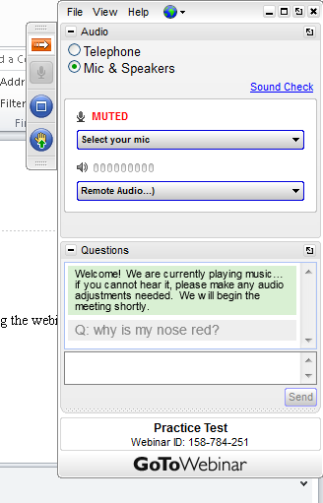
Before We Begin…
To ask questions, use the question or click the “raise box or click the “raise hand” icon.

Slide 4
Quick Reminders
School-level Test Window Feature in TIDE Opens 12/16
OAKS Science/Social Sciences Window Opens 01/10
Extended Assessment Braille & Large Print Order Window Closes 01/13
ELPA21 and Smarter Balanced ELA and Math Windows Open 02/07
Extended assessment Administration Window Opens 02/16

Slide 5
Quick Reminders (cont.)
The ODE recommendation for the distribution of opt out forms is for schools and districts to use locally established channels of communication that are typically used to communicate important information to parents/families. The only requirement for distribution is that it must be distributed no fewer than 30 days before testing begins.
Ensure folks have completed the required test security and administration training before OAKS Portal accounts are granted to DLU, STC, TA, and TT users. There is no required training for DRV or SRV users beyond what should be covered in standard school employee student information confidentiality agreements.

Slide 6
Assessment Help
ESD Partners
Information found here
Technical Help
Assistance: AIR Helpdesk
Technical Requirements

Slide 7
Major Updates for 2016-17
General
New ODE website on December 20th – oregon.gov/ode
ELPA21
No k-1 paper/pencil component
Test format will return back to semi-adaptive format (no separate domain tests)
ELPA21 2016-17 scores are back to the previous batch schedule that we had for the Oregon ELPA. With the new test window dates, there will be a batch in April and 2 batches in May
Smarter Balanced
New calculator for math

Slide 8
TIDE Redesign
Additions/Enhancements:
The TIDE Help is now an interactive guide that is searchable, and is set up so that you automatically go to the page of the guide associated with the module/page of the site in which you are working.
Search by SSID function in the top right hand side of the screen for quick searches.
For Windows users, the upload student settings template includes dropdown menus to assist in entering values into the template.
When in the student module, once you have a list of students pulled up, you can select student(s) checkboxes and then go to the Print icon above, you have the option to print a print-friendly student test settings summary page.
In the student test settings details page, options for Presentation and TTS are labeled with either designated support or accommodation, to help users easily determine which option applied to the student.

Slide 9
TIDE Redesign (cont.)
Changes:
The student test settings detail page is organized by embedded designated supports, embedded accommodations, and test access.
This year TTS can only be set in TIDE.
The Language accommodation has been renamed "Presentation" to align with the National Federation of the Blind guidelines.
Plan & Manage Testing (was formerly a part of the Online Reporting System) is now in TIDE.

Slide 10
Setting Text-to-Speech in TIDE
Test-to-Speech(TTS) is an Embedded Designated Support for items and stimuli on all OAKS and Smarter Balanced Tests EXCEPT stimuli in English languages arts (for which it is an embedded accommodation requiring documentation in an IEP or 504 plan). Both items, stimuli, and stimuli & items are all located under the same drop-down menu under Embedded Designated Supports.
Please make sure to exercise extreme caution when selecting this support for students to avoid a testing impropriety.

Slide 11
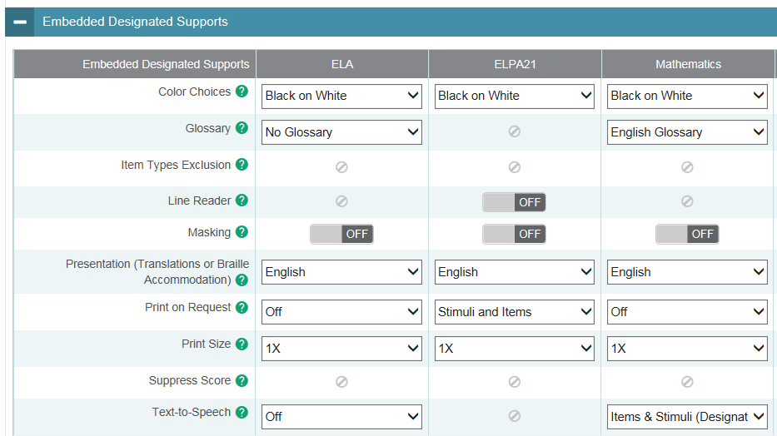
Setting Text-to-Speech in TIDE (cont.)

Slide 12
Question & Answer
*Intentionally left blank*

Slide 13
Sharespace Topics

