Slide 1
K-3 formative assessment domain & Construct overviewS
Notes:
Script:
We are going to dive deeper into each of the domains, highlighting potential areas of challenge for each domain and/or construct. We will begin by providing an overview of the different domains and constructs. We are calling these “mini-modules.” These are condensed versions of the full construct modules.

Slide 2
K-3 Construct Passport
Notes:
Script:
Before we begin our domain overviews, we want to introduce you to a form you will be completing throughout this part of the presentation. This “passport” provides you space to jot down at least two things about each of the constructs that you will be learning about. Try and distill what you’ve learned about that construct into two short sentences/phrases that will help you remember this construct or provide ideas for assessing it in your classroom!
Notes to Trainer:
This is an optional activity to help keep the content manageable and keep participants engaged during the domain overviews. If you are only focusing on a specific domain or construct(s), you may consider removing or modifying this activity.
Associated Handout: Handout - Constructs Passport

Slide 3
K-3 Domain Overview
Approaches to Learning
Cognitive Development
Language Development
& Communication
Physical/Motor Development
Social-Emotional Development
Notes:
Script:
Let’s begin with a reminder of the 5 school readiness domains that have been shown to be predictive of school success.

Slide 4
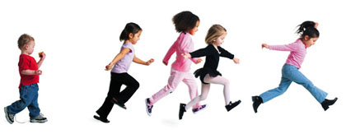
K-3 Domain Overview: Physical/Motor Development
Neuroscience research stresses the importance of facilitating both motor and academic development as the two are linked
Positive correlation between physical activity and seven categories of cognitive performance among school-aged children.
When comparing gross motor skills of age matched children with and without learning disabilities, researchers found the greater the learning delay, the poorer the motor skills.
Notes:
Script:
We are going to start with the Physical/Motor Development domain. In this assessment, there are four constructs in this Domain. We are going to talk about two of these constructs in depth today. We will start with a very brief overview highlighting why these constructs are so critical to children’s development and how they are related to academic success:
Since the mid-50’s, researchers have found links between motor skill development and improvements in perceptual and cognitive development. These two areas of development (motor and cognitive functioning) tend to follow a similar timeline with intensified development between the ages of five and ten, meaning they are developing simultaneously. Recent research stresses the importance of facilitating both motor and academic development as the two continue to be linked in neuroscience research.
Researchers have also found a positive correlation between physical activity and seven categories of cognitive performance (perceptual skills, intelligence quotient, achievement, verbal tests, mathematics tests, developmental level/academic readiness, and other) among school-aged children.

Slide 5
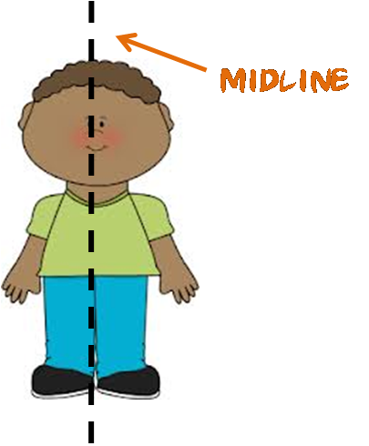
K-3 Domain Overview: Crossing Midline
The Midline is the invisible line running from our head to our toes, dividing the body into left and right halves.
Notes:
Script:
Let’s review a few examples in the Physical/Motor Development Domain, starting with Crossing the Midline. The midline is the invisible line running from our head to our toes, dividing the body into left and right halves.
Crossing the midline is an important milestone of development, reflecting integration of the bodily midline, which allows for bilateral coordination. Difficulty crossing the midline has been linked to a number of sensory, perceptual and motor difficulties. Research suggests that failure of children between the ages of three and four to cross the midline could predict later potential problems in development.

Slide 6
K-3 Domain Overview: Crossing Midline Construct
Notes:
Script:
We are going to show you a video of a teacher discussing the importance of the crossing midline construct in helping her better understand her students.
Play Video:
Right click image, select “Open Hyperlink,” or copy and paste https://youtu.be/z2Gi58Md-H4 to your browser.

Slide 7
K-3 Domain Overview: Gross Motor Construct
Notes:
Script:
Next we are going to discuss the Gross Motor construct.
Play Audio:
Right click image, select “Open Hyperlink”, or copy and paste https://youtu.be/FcAD1XQrLyk into your browser.

Slide 8
K-3 Domain Overview: Gross Motor Construct
Why is assessing this construct important?
Skills that are essential for involvement in everyday classroom activities
Skills essential for locomotion
Linked to perceptual, cognitive and emotional development
Influences children’s mental health, social skill development and performance in school
Notes:
Script:
As discussed in the overview, gross motor skills are movements that use the body’s large muscle groups in the arms, legs, and trunk. These skills are essential for involvement in everyday classroom activities and are linked to multiple domains of development.

Slide 9
K-3 Domain Overview: Gross Motor Construct
What do I do if a child doesn’t know what galloping is? Can I show him/her?
Practice opportunities, modeling, instruction, and reminders of gross motor skills may be provided after documenting a child’s ability.
Record evidence based on the child’s performance before the support was given.
Be aware that modeling for one child provides support to all other children in the vicinity.
Notes:
Script:
One area of clarification we need to make is around galloping. If you look at the assessment means form for this construct, you’ll notice that there is a note in relation to modeling/demonstrating skills in this progression. Can someone read the paragraph on page 2 of the assessment means form “Observation Prompts to Avoid”?
This means that you may model this skill for a child, but in regards to documenting their ability, if they can’t gallop initially, you need to document that before you model for them. Then once you show them, you will need to wait to observe again on another day to see if they are able to gallop. This is particularly relevant for children who may not understand the word “gallop,” meaning that if you asked them to gallop, they wouldn’t look like they know how to do it or don’t do it at all.
Also keep in mind that if you model for one child, but other students are around that you would also want to document those children’s abilities prior to the demonstration as well.
This guidance is not meant to penalize children for not knowing how to gallop, rather it’s providing them the knowledge base for this skill and then checking at a later date whether the child has mastered that skill or not. It is important to know exactly where a child is on the progression so that the right kinds of supports to get them to the next level are provided.

Slide 10
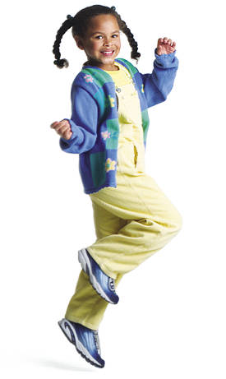
K-3 Domain Overview: Gross Motor Construct
What do I do if a child can skip, but not gallop?
Developmentally, if a child has the balance, strength and coordination required to skip, they should also be able to gallop
If a child is skipping, he/she should be placed at that level on the progression, regardless of whether or not he/she can also gallop.
If you are unsure or need more information, collecting more evidence over multiple days is encouraged.
Notes:
Script:
You might also have a case where there are children in your classroom who can skip, but not gallop. It’s important to note that developmentally, if a child has the balance, strength and coordination to skip, they have the ability to gallop. If a child is skipping smoothly (with coordination and arms and legs swinging in opposition), they should be placed at this level on the progression, regardless of whether or not they can also gallop.
As always, if you are not sure where a child is, it’s also best to collect more evidence until you are confident of a child’s placement on the progression.

Slide 11
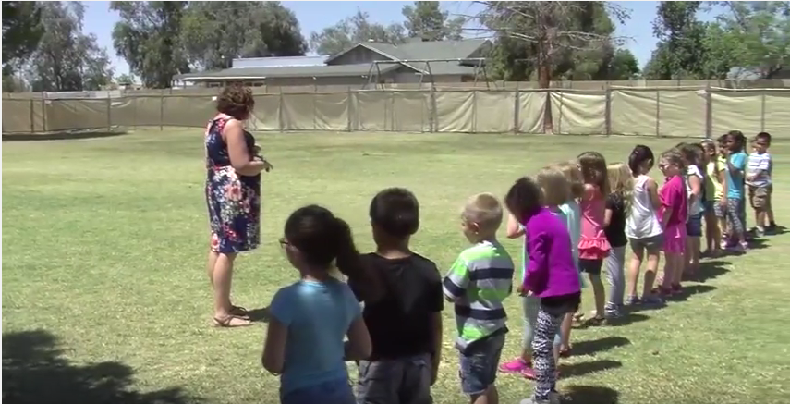
K-3 Domain Overview: Gross Motor
Notes:
Script:
Let’s look at a quick example of the difference between galloping and skipping. This teacher begins the video asking a child to model galloping, then she asks some of the kids to skip and some to gallop. The video will prompt you to watch 3 children in particular who demonstrate both of these skills.
Play Video:
Right click image, select “Open Hyperlink”, or copy and paste https://youtu.be/708drOCtJA0 into your browser.

Slide 12
K-3 Domain Overview: Physical/Motor Development
Questions about the constructs we highlighted or this domain in general?
Notes:
Script:
Questions about the constructs we just highlighted or this domain in general?

Slide 13
K-3 Domain Overview: Language Development & Communication
Constructs in this domain:
Complement the work K-3 teachers are doing in language and literacy to support a balanced assessment system
Are typically assessed in other literacy assessments
Notes:
Script:
We will now review the next domain, Language Development & Communication. This is our largest domain, with 7 constructs included.
These constructs complement the work teachers are already doing in language and literacy, and thus support a balanced assessment system. It is also likely that you are already looking at several of these constructs in other literacy assessments and can use the information from these other assessments to inform where you place children on these progressions.

Slide 14
K-3 Domain Overview: Language Development & Communication
Construct | Focus | Grades
Book Orientation | Holding and using a book properly | K
Print Awareness | Knowledge of print features | K
Letter Naming | Alphabet knowledge | K - 1
Reading Comprehension Strategies | Strategies to monitor for meaning | K - 3
Writing | Emergent writing, written communication as it reflects thinking | K - 3
Vocabulary Concepts | Vocabulary concepts, how our language works | K - 3
Following Directions | Receptive language | K - 3
Notes:
Script:
Before going into these 2 takeaways and the Reading Comprehension Strategies construct in more detail, let’s quickly review the 7 constructs in the language development and communication domain. These 7 constructs were selected to give teachers a broad overview of the most salient skills they can assess to meaningfully inform instruction in this domain. One factor we considered in determining which pre-literacy constructs to include is whether a construct can be effectively assessed through authentic observation.
There are 3 pre-reading constructs: Book Orientation, Print Awareness and Letter Naming. Other language and literacy skills that are typically the focus of instruction in the early elementary grades are also included as constructs in this assessment: Reading Comprehension Strategies, Writing, and Vocabulary Concepts.
Finally, this domain also includes following directions as a measure of children’s receptive language skills in the Following Directions construct.

Slide 15
K-3 Domain Overview: Language Development & Communication
Notes:
Script:
Let’s take a closer look at the reading comprehension construct.
Play Audio:
Right click image, select “Open Hyperlink”, or copy and paste https://www.youtube.com/watch?v=FaDQiNs0AkA&feature=youtu.be into your browser.

Slide 16
K-3 Domain Overview: Language Development & Communication
Reading Comprehension Strategies
Focuses on the strategies children use to monitor for meaning
Complements other important reading skills children are working in grades K-3: decoding, fluency and comprehension
Resulting in a more balanced assessment system
Notes:
Script:
The Reading Comprehension Strategies construct focuses on the strategies children use to monitor what they are reading for meaning and to know when something they are reading does not make sense, for example when they miscue.
Thus, it complements the other important reading skills children are working on in the early grades and that teachers are assessing, namely decoding, reading with fluency, and general comprehension. By focusing on the strategies children use to monitor what they are reading for meaning, in combination with the other reading assessments teachers use such as running records and developmental reading inventories, the assessment of this construct contributes to a more balanced assessment system.
In a similar fashion, the Vocabulary Concepts construct also complements typical language arts instruction. That is, while K-3 teachers more typically work with children to learn words on grade-level vocabulary lists, the Vocabulary Concepts construct in the K-3 Formative Assessment complements that work by focusing on the concepts and structure involved in the way words work in our language, for example words that have more than one meaning, literal and non-literal meanings of words, and root words. We will talk more about the Vocabulary Concepts construct later in the training.

Slide 17
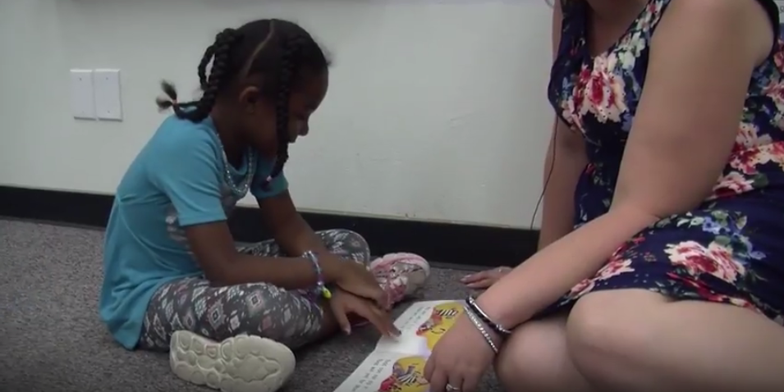
K-3 Domain Overview: Language Development & Communication
Notes:
Script:
Let’s take a look at what the Reading Comprehension Strategies construct looks like in the classroom.
Play Video:
Right click image, select “Open Hyperlink”, or copy and paste https://www.youtube.com/watch?v=jykuDHQHAk8&feature=youtu.be into your browser.
This is an example of what early elementary teachers do every day with their students. They ask children to read aloud and then support any problems children have with reading fluency or miscues. In this case, the girl is reading along smoothly and obviously monitoring for meaning. You can clearly see she understands what she is reading by her amusement at the cat trying to go with the boy on his trip by hiding in his bat bag. When she miscues, reading the word “mitten” for “mitt,” she looks to the teacher for help, realizing that “mitten” doesn’t make sense in the story. This is Skill G on the Reading Comprehension Strategies progression, because she is monitoring her reading and trying to repair meaning by asking for a comprehension strategy. She looks to the teacher for help, and the teacher quickly supplies a strategy, to look at the picture for support. The next time the child miscues, the teacher might want to wait before she intervenes to see if the child might select her own comprehension strategy to figure out the miscue and improve the meaning of what she is reading by correcting the word herself. This would be Skill H, the highest skill on this progression.

Slide 18
K-3 Domain Overview: Language Development & Communication
Pre-Literacy Skills from Other Assessments* | K-3 Formative Assessment Construct and Skills
Print Concepts: holds the book upright, front cover of book | Book Orientation: Skills B - C
Print Concepts: directionality, return sweep, concept of letter/word, 1:1 match | Print Awareness: Skills C - G
Letter Identification: distinguishes letters from other symbols, identifies upper and lower case letters | Letter Naming: Skills A, E - G
Letter Naming Fluency | Letter Naming: Skills D – G
Reading Behaviors: uses picture support | Reading Comprehension Strategies: Skill B
*From frequently used pre-literacy assessments, e.g., mCLASS Reading 3D & DIBELS; FAST
Notes:
Script:
The other lesson or take-away for this domain is that teachers are already looking at several of these constructs with other literacy assessments already in use in their classroom and can use the information from these other assessments to inform where to place children on the K-3 construct progressions. For example, you might be using the mCLASS DIBELS or Reading 3D, or some other required district assessment. Such assessments have become especially important in identifying children who are struggling with foundational reading skills given recent legislation in many states regarding reading by grade 3.
As you can see in this table, there is considerable overlap or alignment between the pre-literacy skills typically covered on these assessments and the constructs and skills in the K-3 Formative Assessment.
For example, as part of Reading 3D, teachers assess print concepts such as top to bottom and left to right directionality, and return sweep. These same concepts are reflected in skills on the K-3 Print Awareness construct progression.
Another example, both FAST and DIBELS assess letter identification or letter naming fluency. These same skills are found on the K-3 Letter Naming progression.
Since the K-3 Formative Assessment involves collecting multiple pieces of evidence to determine a child’s placement on any given progression, we encourage you to use evidence from these other assessments to help you place children on the progressions. One important difference is that while typical pre-literacy assessments require that you assess print concepts, letter naming fluency, and reading behaviors in a structured situation, the K-3 Formative Assessment allows you to observe children demonstrating these same skills in the context of everyday classroom instruction.
Used together, the K-3 Formative Assessment and other literacy assessments can provide a more complete picture of what a child knows and is able to do.

Slide 19
K-3 Domain Overview: Language Development & Communication
Notes:
Script:
We are going to watch a brief portion of a panel of teachers discussing their use of the assessment in conjunction with other assessments they are using in their classrooms. Here’s a brief clip from a Kindergarten teacher talking about her use of DIBELS and other pre-literacy assessments as evidence to upload for progressions in the K-3 Formative Assessment.
Play Video:
Right click image, select “Open Hyperlink”, or copy and paste https://youtu.be/nW3dhAj2Eq8 into your browser.

Slide 20
K-3 Domain Overview: Language Development & Communication
Questions about the construct we highlighted or this domain in general?
Notes:
Script:
Questions about the constructs we highlighted or this domain in general?

Slide 21
K-3 Domain Overview: Social-Emotional Development
Notes:
Script:
The next domain is Social-Emotional Development. For this domain, we are going to handle it a little differently. Due to these constructs sometimes being a bit more challenging for teachers, we are going to briefly introduce you to all three of the constructs, and then spend some time discussing
the nuances of each construct and how this aligns with what you are already doing in your classroom.
Play Audio:
Right click image, select “Open Hyperlink”, or copy and paste https://www.youtube.com/watch?v=aPr5d5YwXoo&feature=youtu.be into your browser.

Slide 22
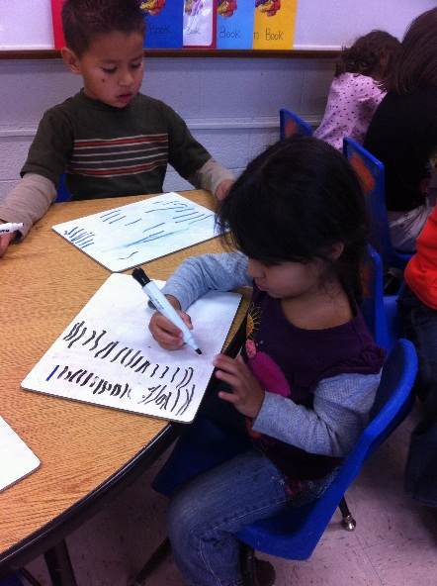
K-3 Domain Overview: Social-Emotional Development
Teachers are particularly instrumental in promoting optimal social-emotional growth.
In some schools and/or classes, instruction in emotion is intentional and explicit (e.g., Responsive Classroom, PATHS, Tools of the Mind)
In ALL classes, instruction in emotion occurs (whether you intend it to or not!)
Notes:
Script:
Instruction in social-emotional development isn’t always explicit or even intentional. Teachers are constantly reminding students what the expectations are inside the classroom, how to talk to their classmates when there is conflict, how to think about and relate to fictional and historical characters in the books they read. All of these things promote some aspect of social-emotional development.
Some schools and districts have formal programs in place, such as the PATHS, which focuses on handling emotions, empathizing with others and making responsible decisions. Many others do not. Regardless of what your school engages in, the need to support children in developing these skills is always present and you are always providing support and guidance to your students in some way.

Slide 23
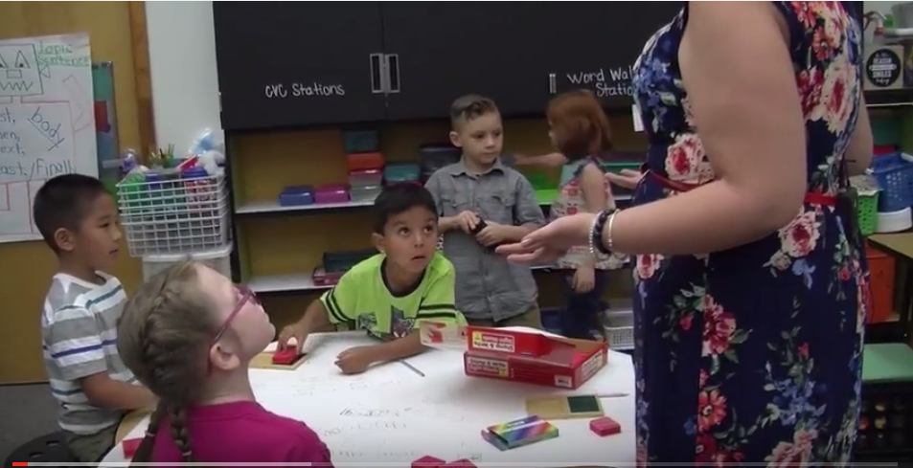
K-3 Domain Overview: Social-Emotional Development
What Kind of Instruction Do You See?
Notes:
Script:
We are going to watch a few clips of teachers interacting with their children, and then I want to tell me what you see the teacher doing. This exercise is not intended for you to focus on specific skills, but rather demonstrate the kinds of things that you will see in your classroom and opportunities for both observation and instruction in emotion.
Play Video:
Right click image, select “Open Hyperlink”, or copy and paste https://youtu.be/EWfyKS0Wf84 into your browser.
Notes on the video:
If you need to recap or help teachers out, the teacher was helping…
The children find words to express their feelings
The boy form his response and an apology
Talk through their social problem
Steer “drama” away, to let them know that it’s not appropriate behavior

Slide 24
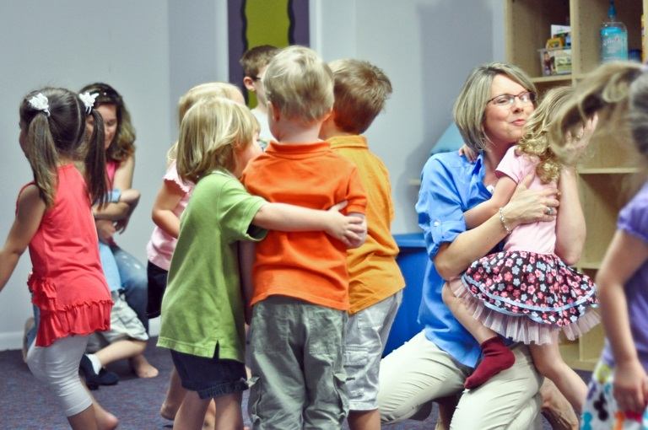
K-3 Domain Overview: Emotion Expression Construct
This construct is about communicating with others using emotion.
Initially, children are in reaction mode
Then children begin expressing emotions in prosocial ways
Finally, children who are expressively skilled are able to not only be prosocial, but also reflect on this knowledge
Notes:
Script:
Before we review each construct within this domain, let’s have the construct progressions themselves handy as we refer to specific skills.
The first construct in the Social-Emotional Development Domain is Emotion Expression. This construct is about communicating with others through the use of emotions.
At the beginning of the progression in skills A through C, children are in “reaction” mode and their expression of emotions are not meant to meet the needs of others even if they appear to be friendly or getting along with others. They are thinking more about themselves and meeting their own needs in these early stages of emotion expression development.
For example, have you ever met a child that refused to share something, but then smiled after he or she was done and offered it to you?
In Skills D/E, children are expressing emotions in prosocial ways that often put others needs first or they find a way to solve their social problem in a way that other children find to be acceptable. This doesn’t mean that children are always friendly, or always being a good citizen of the classroom, but when you look across your observations, you see general patterns of behavior that others in the classroom find acceptable, such as taking turns, comforting their friends or doing things to make them feel better when they are upset.
At the end of the progression, children who are expressively skilled are able to not only be prosocial, but are also able to reflect on this knowledge (Skills F/G). This is really best seen when children get feedback on their behavior, and then you are able to observe a related change in their behavior going forward.

Slide 25
K-3 Domain Overview: Emotion Regulation Strategies Construct
This construct is about managing emotions through the use of learned “strategies”
Strategies are the ways in which children learn to manage their own emotions:
Distraction/Avoidance
Problem-solving
Thinking about things differently
Skilled emotion regulators use a variety of strategies and across settings.
Notes:
Script:
This construct is about managing emotions through the use of what we call learned strategies, which are essentially the ways in which children learn to manage their own emotions. They might learn them (from self-discovery, peers, parents, and you as the teacher. Strategies will involve behavioral, cognitive, and/or physical action or change, such as:
Distraction or Avoidance: A child finds something else to do or leaves a situation
Problem-solving: trying to find an alternative solution or resolution to an argument or issue
Thinking about things differently: taking a different perspective on a situation
Children who are able to effectively regulate their emotions will typically use a variety of strategies across settings.

Slide 26
K-3 Domain Overview: Emotion Regulation Strategies Construct
Initially, children need either a lot or some support to manage their emotions
Sometimes they will try out new things on their own and get it (and sometimes they won’t)
Eventually, they learn how to manage emotions across activities and settings
Notes:
Script:
When children are very young they rely on caregivers around them to help them manage their emotions. Over time, the intensity and nature of this support changes as they learn how to control their emotions. In this progression, we start with children needing support – either quite a bit of support or a little bit in Skills A and B.
As you see children start to try to find ways to manage their emotions on their own, we say that sometimes they are able to use learned strategies to manage their emotions. This doesn’t necessarily mean that they will be successful – they still need adults or peers to intervene to help them out (Skill C).
In the latter part of the progression, children learn how to manage emotions across activities and settings (Skills D/E). We use these skills to capture a child’s ability overall – children may occasionally need help regulating emotions for many years to come, which is why repeated observation is necessary.

Slide 27
K-3 Domain Overview: Emotion Regulation Strategies Construct
Some children are “even keeled” or are difficult to place on the progression.
In your observations, you can contrast…
Behavior of other children in the same situation (e.g., Desmond remained in his seat when kids around him were jumping up and down despite repeated requests for the class to be quiet).
Previously observed behavior (e.g., Desmond used to jump up and down when he had a question, today he sat quietly with his hand in the air until it was his turn to speak)
What you might expect to happen with what actually occurred (e.g., When the fire alarm went off, I expected Desmond to get upset that he couldn’t finish his art project, but instead he set down his brush and reminded the other children they needed to line up).
Notes:
Script:
You might find that some children are difficult to place on the progression, especially those kids who don’t really have any outbursts, that appear to be “even keeled” or just seem to avoid the kinds of situations that might get children emotionally amped up. These children are difficult to place on the progression because there’s no clear or obvious emotion that needs to be regulated. That doesn’t mean that they aren’t regulating emotions, it just means its not obvious or no need to intervene.
If you are trying to observe a child, and you find that you don’t need to support the child in regulating, you can rule out the first three skills on the progression. If you don’t see the child in any kind of disruptive or emotionally taxing event, you cant’ really say they are or are not at Skill E. Which means many of these children will likely be placed minimally at Skill D.
You still will need to document why you think they are at Skill D. We suggest contrasting what you do or don’t observe about the child with what the other children in the class are doing, what you might expect the child to do based on previous behavior and how that is similar or different, or what you might expect to happen just given the child’s age and situation.

Slide 28
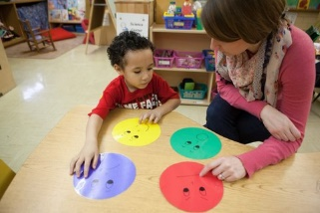
K-3 Domain Overview: Emotional Literacy Construct
Emotional literacy is about understanding emotions in the environment (in oneself and others).
Children begin with a limited ability to communicate about emotions with accuracy, or beyond labeling emotions.
Then children begin to not only identify cause and effect of emotion, but can interpret complex emotions.
Eventually children use contextual information even when other emotional information is vague or conflicting.
Notes:
Script:
Recall that the Emotion Expression construct was about communicating with others using emotion and that Emotion Regulation Strategies was about managing one’s emotions. The Emotional Literacy construct is about understanding emotions in oneself and others.
Children earlier on the progression have little emotion language or ability to communicate what they or others are feeling with accuracy (e.g., “I feel spooky” is not the same thing as feeling scared) (Skills A/B). They may have a sense of what others are feeling and be able to convey that, but its not quite accurate or complete. When they begin to communicate about basic feeling states, such as “I’m sad today” or “He’s happy” we can place them at C or D.
When children are able to tie feeling states to specific, discrete events, we know they can identify causes and effects of emotions (Skill E). When they begin to distinguish that other children can have different emotions than themselves even in response to the same event, we say that they are at Skill F. As children begin to use the context around them to make inferences about emotions, we place them at Skill G. Finally, when children use only the context and their knowledge about emotions to interpret or predict feeling states, we place them at Skills H or I.
I would suggest paying attention to the understandings for these skills as you begin to think about where to place a child on this progression.
Finally, remember that any time you have to assist a child to do one of these skills with support, that means they have not mastered this skill and should at most be placed in the next lowest skill on the progression if you can observe to be at that skill.

Slide 29
K-3 Domain Overview: Social-Emotional Development
Questions about the constructs we highlighted or this domain in general?
Notes:
Script:
Questions about the constructs we highlighted or this domain in general?

Slide 30
K-3 Domain Overview: Cognitive Development
Notes:
Script:
Now we will review the Cognitive Development Domain. There are three constructs in the cognitive development domain: Object counting, problem solving, and mathematical patterns. Today we will highlight the mathematical patterns construct. First, let’s listen to an overview of the mathematical patterns construct.
Play Audio:
Right click image, select “Open Hyperlink”, or copy and paste https://youtu.be/JTWxs60Wfqo into your browser.

Slide 31
K-3 Domain Overview: Mathematical Patterns Construct
Alignment with the Common Core
3.OA.9—Identify arithmetic patterns (including patterns in the addition or multiplication tables) and explain them using properties of operations.
4.OA.5—Generate a number or shape pattern that follows a given rule. Identify apparent features of the pattern that were not explicit in the rule itself.
Notes:
Script:
We know alignment to the Common Core is very important, so we want to highlight how mathematical patterns is aligned. And we recognize that CC doesn’t explicitly bring up patterns to Grade 3. This construct helps students get to the CC standard that is expected at third and fourth grade.
The importance of mathematical patterns is reflected in the Common Core State Standards, both implicitly as building blocks in Grades K-2 and more explicitly in Grades 3 and 4. For example, the following CCSS are reflected in this progression:
3.OA.9—Identify arithmetic patterns (including patterns in the addition table or multiplication table) and explain them using properties of operations.
4.OA.5—Generate a number or shape pattern that follows a given rule. Identify apparent features of the pattern that were not explicit in the rule itself.

Slide 32
K-3 Domain Overview: Mathematical Patterns Construct
Alignment with the Common Core
Standards for Mathematical Practices
“Describe varieties of expertise that mathematics educators at all levels should seek to develop in their students.”
Notes:
Script:
Additionally, in the Common Core, eight mathematical practices are identified that cut across standards for students at all grade levels. Five of these mathematical practices apply directly to mathematical patterns:
CCSS.Math.Practice.MP2 – Reason abstractly and quantitatively.
This is demonstrated in the progression by: Children representing variables and quantities using symbols and moving back and forth between symbols and their referents.
CCSS.Math.Practice.MP3 – Construct viable arguments and critique the reasoning of others.
This is demonstrated in the progression by: Children constructing rules (recursive and functional) and communicating them to others.
CCSS.Math.Practice.MP4 – Model with mathematics.
This is demonstrated in the progression by: Children creating T-charts and equations to model spatial growing patterns.
CCSS.Math.Practice.MP5 – Use appropriate tools strategically.
This is demonstrated in the progression by: Using pencil and paper to create T-charts, using calculators to apply rule to determine far steps.
CCSS.Math.Practice.MP7 – Look for and make use of structure.
This is demonstrated in the progression by: Recognizing repeating patterns, recognizing spatial growing patterns, and recognizing numerical growing patterns.
These practices are especially relevant in the later skills in the progression, which include children communicating about and symbolizing relationships between two variables.

Slide 33
K-3 Domain Overview: Mathematical Patterns Construct
Alignment with the Common Core
Mathematical practice | How this is shown in mathematical patterns
CCSS.Math.Practice.MP2 – Reason abstractly and quantitatively. | Children represent variables and quantities using symbols and move back and forth between symbols and their referents.
CCSS.Math.Practice.MP3 – Construct viable arguments and critique the reasoning of others. | Construct rules (recursive and functional) and communicate them to others.
CCSS.Math.Practice.MP4 – Model with mathematics. | Create T-charts and equations to model spatial growing patterns.
CCSS.Math.Practice.MP5 – Use appropriate tools strategically. | Use pencil and paper to create T-charts, use calculators to apply rules to determine far steps.
CCSS.Math.Practice.MP7 – Look for and make use of structure. | Recognize repeating patterns, recognize spatial growing patterns, and recognize numerical growing patterns.
Notes:
CCSS.Math.Practice.MP2 – Reason abstractly and quantitatively.
This is demonstrated in the progression by: Children representing variables and quantities using symbols and moving back and forth between symbols and their referents.
CCSS.Math.Practice.MP3 – Construct viable arguments and critique the reasoning of others.
This is demonstrated in the progression by: Children constructing rules (recursive and functional) and communicating them to others.
CCSS.Math.Practice.MP4 – Model with mathematics.
This is demonstrated in the progression by: Children creating T-charts and equations to model spatial growing patterns.
CCSS.Math.Practice.MP5 – Use appropriate tools strategically.
This is demonstrated in the progression by: Using pencil and paper to create T-charts, using calculators to apply rule to determine far steps.
CCSS.Math.Practice.MP7 – Look for and make use of structure.
This is demonstrated in the progression by: Recognizing repeating patterns, recognizing spatial growing patterns, and recognizing numerical growing patterns.
These practices are especially relevant in the later skills in the progression, which include children communicating about and symbolizing relationships between two variables.

Slide 34
K-3 Domain Overview: Mathematical Patterns Construct
Understanding 1
Children can look for and make use of structure in sequential patterns to understand they consist of repeating units that can be duplicated, extended, and abstracted.
Understanding 2
Children can look for and make use of structure in growing patterns to understand they are governed by rules that can be represented verbally and symbolically.
Notes:
Script:
Let’s look a little bit deeper at mathematical patterns. There are two understandings covered in this progression. The first is about sequential patterns, and the second is about growing patterns.

Slide 35
K-3 Domain Overview: Mathematical Patterns Construct
Understanding 1 - Sequential Patterns
What types of skills are we measuring?
Duplicating
Extending
Pattern abstraction
Identifying the repeating unit
Notes:
Script:
For sequential patterns, the focus is on duplicating, extending, and abstracting patterns, as well as identifying the repeating unit in patterns

Slide 36
K-3 Domain Overview: Mathematical Patterns Construct
A Closer Look at Duplicating
Copy the pattern I made with these blocks!
Notes:
Script:
Let’s take a closer look at duplicating. Here, the teacher is saying, “Copy the pattern I made with these blocks.”
[Click for Animation] Animation displays blocks one at a time. While laying out the blocks, point out that the teacher is making a simple AB pattern. When the hand image displays, that indicates the child is duplicating the pattern.

Slide 37
K-3 Domain Overview: Mathematical Patterns Construct
A Closer Look at Extending
Make my pattern longer, please!
Notes:
Script:
Children can also extend patterns, including simple AB patterns and 3-element patterns like the one here. In this example, the teacher tells the child, “Make my pattern longer, please.”
[Click for Animation] Animation displays blocks one at a time. When the hand imagine displays, that indicates the child is extending the pattern.

Slide 38
K-3 Domain Overview: Mathematical Patterns Construct
A Closer Look at Identifying the Unit
Look at these blocks. What is the unit that you see repeating over and over?
I see gray, gray, and yellow.
Notes:
Script:
We also want children to be able to identify the repeating unit in a pattern. In this example, the teacher asks, “What is the unit that you see repeating over and over? “ The child answers with, “I see blue, blue, and orange.” The child could also say, “AAB.” Both answers are correct examples of this skill.
[Click for Animation] Animation displays blocks one at a time. When the hand imagine displays, that indicates the child is extending the pattern.

Slide 39
K-3 Domain Overview: Mathematical Patterns Construct
Notes:
Script:
Let’s look at a video example of some children patterning.
Play Video:
Right click image, select “Open Hyperlink”, or copy and paste https://youtu.be/yu1CAo3Bbq8 into your browser.
Script/Notes on the Video:
She says “green-green-red purple” once, which is skill F on the progression.
For the identifying the unit. Note that if the child had repeated the unit over and over again, saying, “green-green-red-purple, green-green-red-purple, green-green-red-purple,” that would NOT be this skill. Because the child has to realize there is just one unit that repeats over and over again and to understand that they have to isolate the repeating unit.

Slide 40
K-3 Domain Overview: Mathematical Patterns Construct
Understanding 2 – Growing Patterns
What types of skills are we measuring?
Determining the missing step
Communicating recursive rules in growing patterns
Using T-charts to document relationship between variables
Communicating functional rules governing growing patterns
Creating equations to symbolize functional rules
Notes:
Script:
Now let’s look at the second understanding. For growing patterns, the focus is on applying, communicating, and symbolizing the rules that govern these patterns and relationships.

Slide 41
K-3 Domain Overview: Mathematical Patterns Construct
A Closer Look at Identifying the Recursive Rule
Look at these blocks. How is this pattern growing?
You add two every time.
Notes:
Script:
One of the skills is being able to identify the recursive rule. This is a rule for determining the next step in a growing pattern based on the previous step.
[Click for animation] In this example, the teacher asks, “How is this pattern growing?” and the child is able to identify the recursive rule by saying, “You add two every time.”

Slide 42
A Closer Look at Creating a T-Chart
Make a t-chart for this growing pattern
Step | Number of blocks
1 | 2
2 | 4
3 | 6
Here it is!
Notes:
Script:
Creating t-charts is another important skill in this progression. [Continue clicking for animation] Here is t-chart the child in the example made for this pattern. The step is in the left column, and the number of blocks at each step is in the right column.

Slide 43
A Closer Look at Writing an Equation
Write an equation that shows the rule for finding the value of any step in the pattern.
Step | Number of blocks
1 | 2
2 | 4
3 | 6
Well, I see from the t-chart that I just double each step. The equation for that rule is Blocks = 2 X Step.
Notes:
Script:
Finally, we want children to identify the functional rule. The functional rule is a rule for determining a step in a growing pattern based on its ordinal position in the pattern (e.g., "you multiply its position by two"). A functional rule describes the relationship between two variables: (1) the ordinal position of the step (hidden variable) and (2) the number of elements in that step. In this example, the child notes that he just doubled each step to get the number of blocks and comes up with the equation Blocks = 2 X Step.

Slide 44
K-3 Domain Overview: Cognitive Development
Questions about the construct we highlighted or this domain in general?
Notes:
Script:
Questions about the constructs we highlighted or this domain in general?

Slide 45
K-3 Domain Overview: Approaches to Learning
Notes:
Script:
Finally, there is the Approaches to Learning domain. There is one construct within this domain, Perseverance. Let’s listen to the overview.
Play Audio:
Right click image, select “Open Hyperlink”, or copy and paste https://youtu.be/TKyMyOlZxcc into your browser.

Slide 46
K-3 Domain Overview: Approaches to Learning
Perseverance can be measured across the day in a variety of activities.
It can also be assessed at the same time as other constructs.
Notes:
Script:
Perseverance can be measured across the day in a variety of activities.
It can also be assessed at the same time as other constructs. For example, problem solving activities could be great opportunities to assess children’s perseverance, as could many other activities in other constructs.
It’s important to keep in mind with this assessment that there are many opportunities to assess for multiple constructs at the same time, and you should look for those opportunities to help save you time!

Slide 47
K-3 Domain Overview: Approaches to Learning
Notes:
Script:
Let’s take a look at a child persevering through a mathematical patterns task. Observe the child on the right.
Play Video:
Right click image, select “Open Hyperlink”, or copy and paste https://youtu.be/3RkxtF7MdCE into your browser.
Notes on Video:
The child’s manipulatives kept falling apart. The child was able to keep going, despite these challenges. She persisted in the task.

Slide 48
K-3 Domain Overview: Approaches to Learning
Questions about the construct we highlighted or this domain in general?
Notes:
Script:
Questions about the constructs we highlighted or this domain in general?

