Slide 1
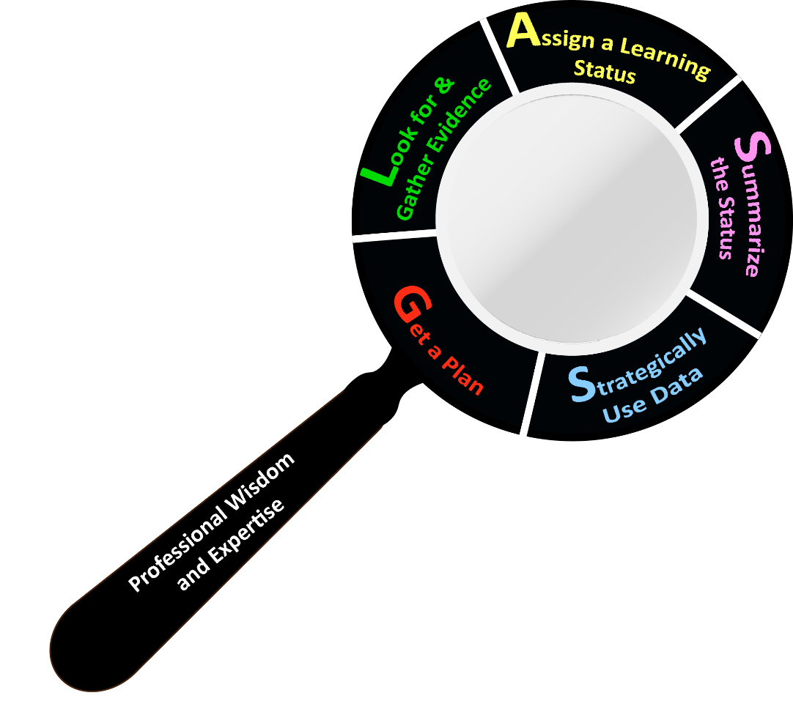
K-3 Formative Assessment Process
Get a plan
Look for and gather evidence
Assign a learning status
Summarize the status
Strategically use data
Notes:
Script:
This is the formative assessment lens. The K-3 Formative Assessment Process is cyclical, and each step of the process is essential. We’re going to explain each step in the process and then give you time to practice each step in small groups.

Slide 2
Get a Plan
Notes:
Script:
The first step in the process is to get a plan--a plan for how you will assess the constructs in your classroom is essential.

Slide 3
Look for & Gather Evidence
Notes:
Script:
The second step in the process is to look for and gather evidence. You must use good observation strategies and collect evidence that provides you with information about the child.

Slide 4
Assign a Learning Status
Notes:
Script:
The third step in the process is to assign a learning status. After you observe a child and document what you see, you need to determine the learning status for that piece of evidence—what skill was the child demonstrating?

Slide 5
Summarize the Status
Notes:
Script:
The fourth step is to summarize the status. After collecting multiple pieces of evidence, you look across the evidence to determine what the status summary is for the child. The difference between the learning status and the status summary is that the learning status is for an individual piece of evidence, while the status summary is for the child.

Slide 6
Strategically Use Data
Notes:
Script:
The fifth step is to strategically use data. This is an essential step—how do you take the information you have learned about the whole child and use it to inform your planning and instruction? It is also important to note that this process occurs over and over again as you engage in assessment and instruction. It is not a one and done!

Slide 7
GLASS
Get a plan
Look for and gather evidence
Assign a learning status
Summarize the status
Strategically use data
Notes:
Script:
The magnifying glass we’ve shown you here, and the acronym “GLASS” will help you remember the strategies you use to uncover clues.

Slide 8
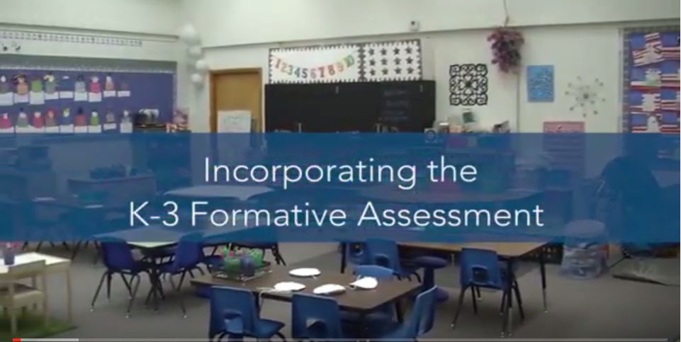
Incorporating the K-3 Formative Assessment
Notes:
Script:
Let’s watch a video of a teacher talking about how she incorporates the assessment into her daily routine.
Play Video:
Right click image, select “Open Hyperlink”, or copy and paste https://youtu.be/x32TWwtFsKI into your browser.

Slide 9
K-3 Formative Assessment Process Topic #1: Get a Plan
Notes:
Script:
We’re going to do some activities that focus on each step of the formative assessment process, starting with getting a plan.
Note to the Trainer:
Consider using a transition slide to introduce the activities in the format you have chosen to distribute. For example, some trainers might have activities organized by topic or “topic packets.” Other trainers might opt to distribute the entire topic packet.

Slide 10
Get a Plan
Notes:
Script:
The first step in the formative assessment process is to get a plan. There are a variety of things to consider when planning.

Slide 11
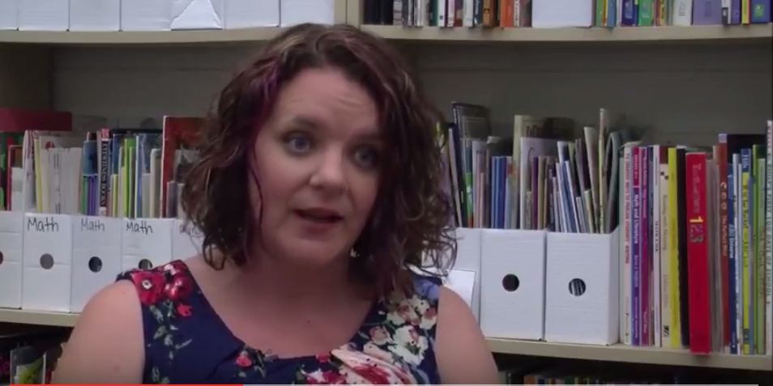
Why is a Plan Important?
Notes:
Script:
First, let’s think about why a plan is important. Here is a kindergarten teacher again talking specifically about planning. You saw this clip in the last video, but we wanted to highlight this clip specifically.
Play Video:
Right click image, select “Open Hyperlink,” or copy and paste https://youtu.be/tSmx9aOPiuw into your browser.

Slide 12
Planning Components
Activities/times of day
Constructs to focus on
Children you will focus on
Notes:
Script:
Teachers need to think about what activities or times of the day can be used to capture data on students’ skills. You also need to think about which constructs in the assessment to focus on any given day. And you need to consider which children you will assess.

Slide 13
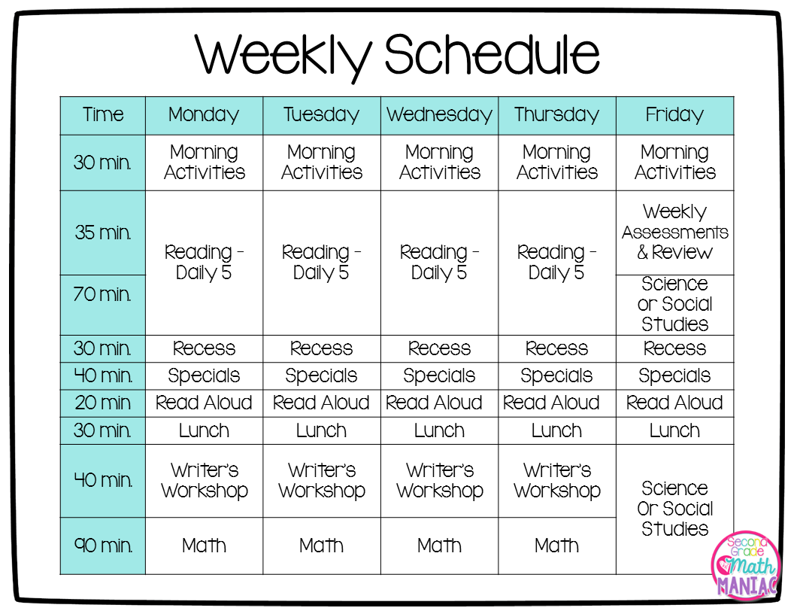
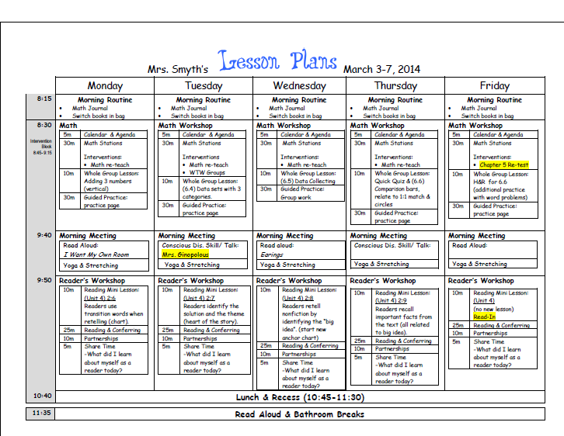
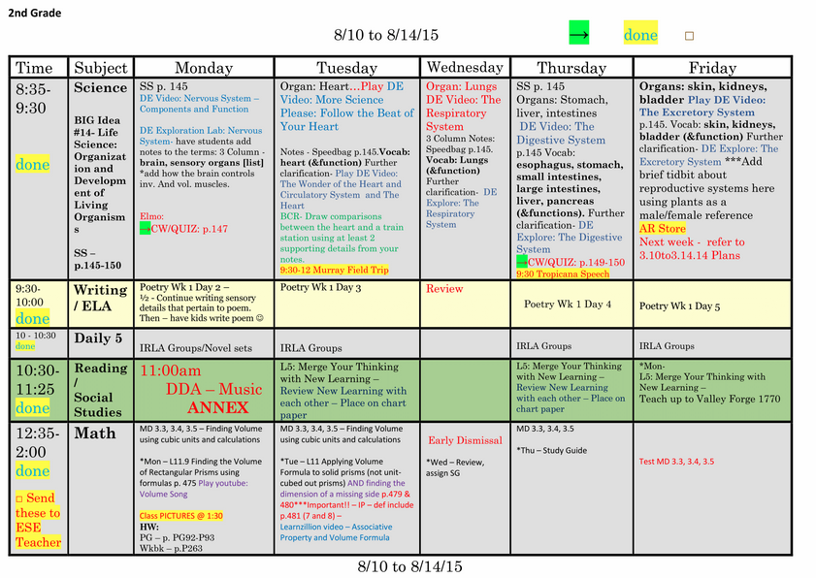
Using a Weekly Plan
Notes:
Script:
As you all know, there are a lot of different options for how teachers can plan their weekly activities. It doesn’t matter what type of plan you use—you can easily tweak any of them to add assessment plans.

Slide 14
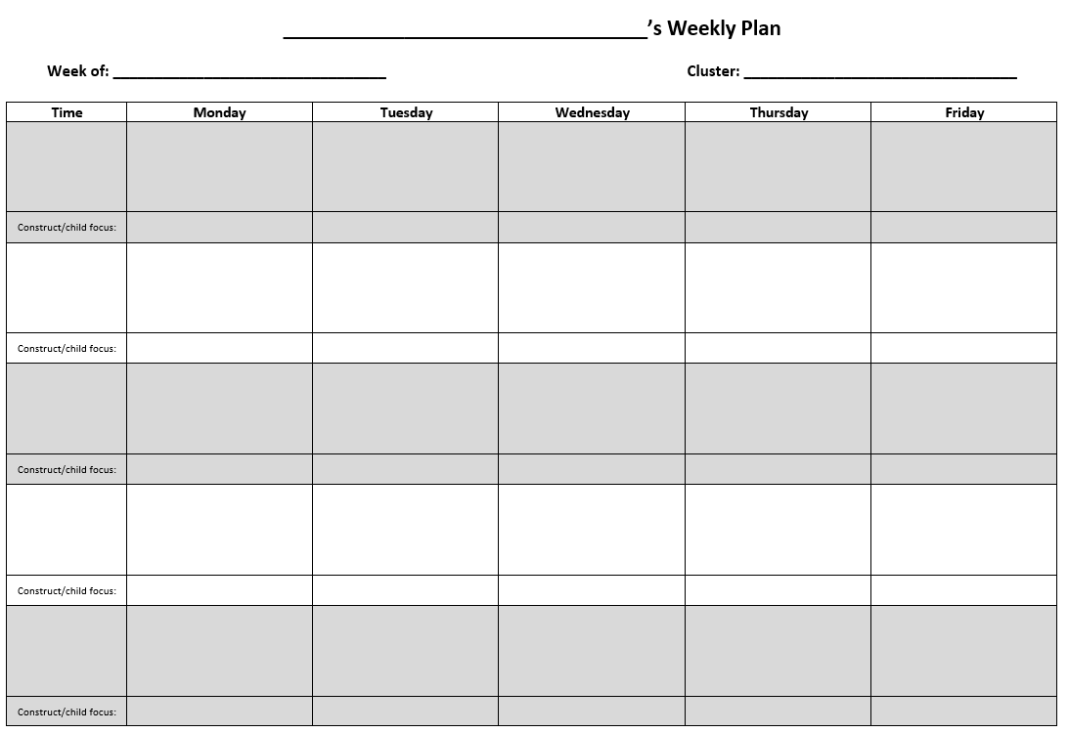
Using a Weekly Plan: Template
Notes:
Script:
Here is a template located in your activity packet you can use as a weekly planning tool. It has the standard components you find on most weekly plans, but it also has a spot for you to note which construct and children you are focusing on in a given activity/time of day.

Slide 15
Using a Weekly Plan: Example
Notes:
Script:
Here is an example of a completed one, also located in our handout packet.

Slide 16
Building Assessment Opportunities into Your Day
In addition to thinking about how you can note assessment opportunities in your existing plans, you can also think about how to build new opportunities into your day to assess and teach.
Notes:
Script:
In addition to thinking about how you can note assessment opportunities in your existing plans, you can also think about how to create new opportunities into your day to assess and teach.

Slide 17
Building Assessment Opportunities into Your Day
Notes:
Script:
Let’s look at an example of how one teacher built assessment opportunities into her day.
Play Video:
Right click image, select “Open Hyperlink,” or copy and paste https://youtu.be/xSELfPtXN6s into your browser.
Script/Notes on Video:
What construct do you think she was thinking of when she set up this transition activity? (Crossing Midline). You will notice that she identified two children who needed to practice crossing midline, and was able to create an opportunity for them to practice. And this practice opportunity serves as a great assessment opportunity, too! She can quickly note a few students’ skill levels.

Slide 18
Activity 1.1: Get a Plan
As a group, brainstorm 5-6 common activities/times of day that occur throughout a typical school day. List them out on the first column of the Assessment Opportunity Chart.
As a group, go through each of your listed activities one-by-one and think about how vocabulary could be assessed in the context of that activity/time of day (if appropriate).
The example, “Transition to Recess,” is provided to get you started.
Use vocabulary documents in your binder as a reference.
Notes:
Script:
Locate the first activity [in your topic packets, your activity guide, etc.]

Slide 19
Activity 1.1: Get a Plan - Debrief
What were your activities/times of the day?
What are some examples of how you planned to assess vocabulary?
How can you use this process when you are back in your classrooms?

Slide 20
K-3 Formative Assessment Process Topic #2: Look for and Gather Evidence
Notes:
We’re going to do some activities that focus on each step of the formative assessment process, starting with getting a plan.

Slide 21
Look for and Gather Evidence
How can you look for and gather evidence?
OBSERVATION
DOCUMENTATION
Notes:
Script:
There are two components of looking for and gathering evidence. The first is observation, and the second is documentation. We’re going to talk about each of these skills, which are critical to this assessment.

Slide 22
Observation
This assessment relies heavily on observation.
Observation is a powerful strategy for learning more about children’s abilities.
Direct assessment is not the only way to assess.
Observation can be spontaneous, but it can also be intentionally planned.
Notes:
Script:
This assessment relies heavily on observation. Direct assessment is often used to assess what children know and can do, but observation is a powerful strategy for learning about children’s abilities, as well. Observation is something that can happen spontaneously, but it also can involve intentional planning by the teacher. You can create opportunities to observe what you need to know.

Slide 23
The Power of Observation
Observation is more than watching and supervising young children.
How does observation help you to understand what children know and can do?
It occurs in natural settings and in the context of relationships (with the teacher, peers, and the content to be learned).
This provides the most accurate picture of a child’s abilities.
Notes:
Script:
Observation involves more than just watching children or supervising children. Observation occurs in the context of natural settings and relationships with others. When you observe children in this context, you get the most accurate picture of what children can do.

Slide 24
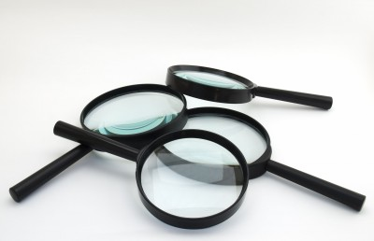
Using the Assessment as a Lens
This assessment is a lens through which to observe your children.
The assessment helps you focus on specific constructs and skills, which you use to refine what and how you observe.
Notes:
Script:
Observation can occur through a variety of different lenses. The K-3 Formative Assessment is one lens through which to observe children. Using this assessment as a lens allows you to focus on specific constructs and skills, which, in turn, you can use to focus your observations.

Slide 25
Activity 2.1: The Power of Observation
Let’s explore the power of observation!
We are going to view a video three times.
The video is of a boy reading. In your packet, there is a handout that has the text of what he is reading (“Book Text”).
Use the “Observation Notes” document. The first time you watch the video, write down what you observe.
Notes:
Script:
We’re going to do an activity that will bring home the power of observation and the power of using this assessment as a lens. We’re going to view a video three times. The video is of a boy reading, and there is a document entitled “Book Text” in your packet that has the text of what he is reading. The first time you view this video, simply write down what you observe on the “Observation Notes” document.

Slide 26
Activity 2.1: Power of Observation - Observation 1
Notes:
Script:
We’re going to watch this video and then you’ll have a couple minutes to write down what you observed.
Play Video:
Right click image, select “Open Hyperlink,” or copy and paste
https://youtu.be/0vrL-CAz6W8 into your browser.

Slide 27
Activity 2.1: Power of Observation - Observation 2
We are going to view the video again.
Now, view the video and take notes on the child’s reading comprehension skills. Use the same “Observation Notes” document.
Notes:
Script:
Now we’re going to view the video a second time. This time, write down what you observe about the child’s reading comprehension skills. Use the same document to take notes.
Play Video:
Right click image, select “Open Hyperlink,” or copy and paste https://youtu.be/0vrL-CAz6W8 into your browser.

Slide 28
Activity 2.1: Power of Observation - Observation 2
Notes:
Script:
Again, we’ll give you a couple minutes after the video to write your notes.
Play Video:
Right click image, select “Open Hyperlink,” or copy and paste https://youtu.be/0vrL-CAz6W8 into your browser.

Slide 29
Activity 2.1: Power of Observation - Observation 3
We are going to view the video one final time.
You are again going to take notes on the child’s Reading Comprehension Strategy skills. But, first, let’s use our K-3 Formative Assessment lens.
Reading Comprehension Strategies Construct Progression
Notes:
Script:
Now, we’re going to view the video one final time. You’re going to take notes on the child’s reading comprehension skills again, but this time, we want you to use your K-3 Formative Assessment lens. Let’s take a few minutes to review the progression, which is on the screen and can also be found in your binder under tab 13. Does anyone want to volunteer to read Skill A? [Continue through Skill H.]

Slide 30
Activity 2.1: Power of Observation - Observation 3
Notes:
Script:
With your K-3 Formative Assessment lens in place, watch this video and write down what you observe.
Play Video:
Right click image, select “Open Hyperlink,” or copy and paste https://youtu.be/0vrL-CAz6W8 into your browser.

Slide 31
Activity 2.1: Power of Observation - Video Debrief
Did your observation notes change?
How did they change?
Notes:
Script:
Let’s discuss what you observed.
Did your observation notes change based on the viewing of the video you did? How did they change?
What did you observe differently in observation 3 compared to the other two observations?

Slide 32
Power of Observation: Takeaway Messages
Observation on its own provides a wealth of information about a child’s abilities.
Direct assessment is not the only way to assess.
Observation can be spontaneous, but it can also be intentional.
For example, a teacher can…
Plan to listen to a child read aloud during independent reading time.
Plan to observe a child’s perseverance as the child engages in a challenging activity.
Plan to watch a child demonstrate gross motor skills at recess during a game of Simon Says.
Notes:
Script:
There are a few key points we want to emphasize about the power of observation. Observation on its own provides a lot of information about a child’s abilities. Remember, direct assessment is not the only way to assess! Observation can be spontaneous, but it can also be intentional. For example, a teacher can plan to listen t0 a child read aloud during independent reading time. Or a teacher can plan to observe a child’s perseverance as the child engages in a challenging activity. The teacher can also plan to watch a child demonstrate gross motor skills at recess during a game of Simon Says. We know there are many opportunities in your classrooms and throughout each day where children are using their skills in authentic ways. This assessment provides a system for capturing what children can do.

Slide 33
Utilizing Observations
Now that you have explored how observation can be helpful and have seen how the K-3 Formative Assessment lens can impact your observation, what is the next step?
High-Quality Documentation!
Notes:
Script:
The next component of looking for and gathering evidence is to utilize observations. You can do this through high-quality documentation.

Slide 34
Turning Observations into Documentation
Good observational skills must be paired with high-quality documentation.
These are two different skills, and you need to be able to do them both for this assessment.
Notes:
Script:
It is not enough to be a good observer. You must also be able to document what you observe accurately. These are different skills, and they are both critical to this assessment.

Slide 35
High-Quality Documentation: Five Components
Targeted
Objective
Descriptive
Concise
Varied
Notes:
Script:
High-quality documentation has five components. It should be targeted, objective, descriptive, concise, and varied. We are going to talk about each of these in turn.

Slide 36
High-Quality Documentation: Component 1
Targeted
Related to one or more constructs.
Related to the specific skills in each construct.
Consider how your observation notes changed after you viewed the reading comprehension construct progression.
Notes:
Script:
By targeted, we mean that documentation must be related to one or more constructs. Beyond that, they must be related to the specific skills in each construct. Consider how your observation notes changed after you viewed the reading comprehension construct progression. Another example is the writing construct. Writing involves a lot of skills, but it is measured in a specific way in this assessment. For the purposes of this assessment, the mechanics of writing are not relevant, so you would want to keep that in mind when documenting a child’s writing.

Slide 37
High-Quality Documentation: Component 2
Objective
Be fact-based.
Include who, what, where, when, how.
But NOT why!
Record only what you observe.
Don’t Judge!
Notes:
Script:
Documentation must also be objective. By that, we mean it must be fact-based and include critical information such as who, what, where, when, and how. It should not include WHY! You can make sure documentation is objective by recording only what you observe.

Slide 38
High-Quality Documentation: Component 3
Descriptive
Describe gestures, actions, words, facial expressions.
Your documentation should “paint a picture.”
Notes:
Script:
Documentation must be descriptive—it should paint a picture of what a child did. You can describe gestures, actions, words, and facial expressions, depending on the constructs you are observing.

Slide 39
High-Quality Documentation: Component 4
Concise
Exclude irrelevant details.
Consider using bullet points, incomplete sentences, and even abbreviations.
The idea needs to be complete, but not necessarily your sentences!
Notes:
Script:
Your documentation should be concise. You should exclude irrelevant details—don’t make it harder than it needs to be. Your documentation is for you, so write it in a way that you can understand it later, but also consider using bullet points, incomplete sentences, and abbreviations. The idea needs to be complete, but not necessarily your sentences!
Remember, being concise is relative to the construct you are documenting evidence on—some might need more explanation/context than others.

Slide 40
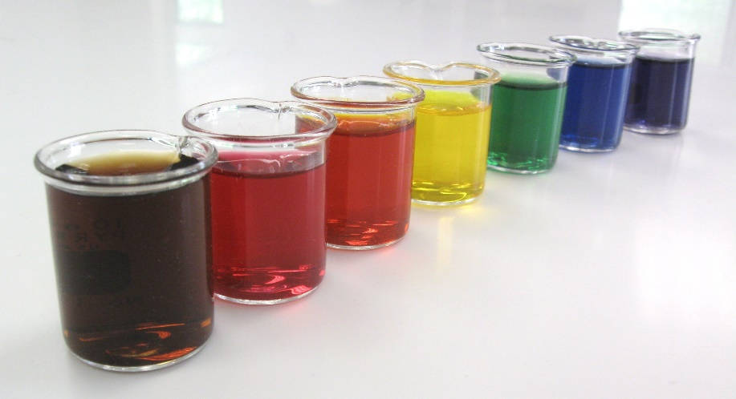
High-Quality Documentation: Component 5
Varied
Relevant to looking at multiple pieces of documentation.
Document observations from different contexts, times of day, and activities, as well as with different people.
For example, if all your documentation for emotion regulation is based on how the child regulates emotions when interacting with adults, then you don’t have a complete picture of the child’s skills.
Notes:
Script:
The fifth component is a little different than the rest. It is that the documentation should be varied. It is different because this component applies to multiple pieces of documentation. By varied, we mean that when you are observing for a construct, consider how you can document observations across different contexts, times of day, and activities, as well as with different people.
For example, if all your documentation for emotion regulation is based on how the child regulates emotions when interacting with adults, then you don’t have a complete picture of the child’s skills. So, evaluate your documentation to make sure it is varied.

Slide 41
Activities 2.2 & 2.3 - Let’s Practice!
Activity 2.2: Determining Relevance
View videos and determine if they are relevant to a particular construct.
Activity 2.3: Five Components Review
View, evaluate, and fix documentation examples.
Notes:
Script:
Now you’re going to practice your observation and documentation skills. First, you’re going to work at your tables to view videos and determine if they are relevant to particular constructs. You will need a tablet or laptop for this activity. Then you are going to evaluate and fix documentation examples based on whether the five components are present.
Remember:
Each table will work at its own pace. However, we recommend you consult your training agenda and the approximate times allotted for each topic.
We will be walking around the room and listening in as tables work.
First, we’ll do a large group activity to get us started on “Look for and Gather Evidence.”

Slide 42
Activities 2.2 & 2.3: Debrief
Were you able to correctly guess which video clips were relevant or not?
Were any of them more difficult than the others?
Did you agree with the answers/justifications
When you were writing documentation, which of the 5 components was hardest to find or re-write? Why?
Which component is your strength and which do you need to work on more?
Notes:
Script:
Were you able to correctly guess which video clips were relevant or not?
Were any of them more difficult than the others?
Did you agree with the answers/justifications
When you were writing documentation, which of the 5 components was hardest to find or re-write? Why?
Which component is your strength and which do you need to work on more?

Slide 43
K-3 Formative Assessment Process Topic #3: Assign a Learning Status
Notes:
Script:
We’re going to do some activities that focus on each step of the formative assessment process, starting with getting a plan.

Slide 44
Activity 3.1: Assign a Learning Status
Let’s practice how to use evidence to identify a skill on a construct progression!
Work in pairs.
Use the 3 pieces of evidence for 3 different children provided and place each in the column of the laminated chart that best aligns with the content of that particular piece of evidence.
*Note: Not every skill level will be covered!

Slide 45
Activity 3.2: Match the Skill
Let’s practice matching skill levels on a construct progression to a piece of evidence!
With your group, place the corresponding Skill Level Identifiers for Pacey and Amy under the skill level that best aligns to their behavior, skills and/or knowledge described in the anecdotal note.
The example evidence is on the next slide.

Slide 46
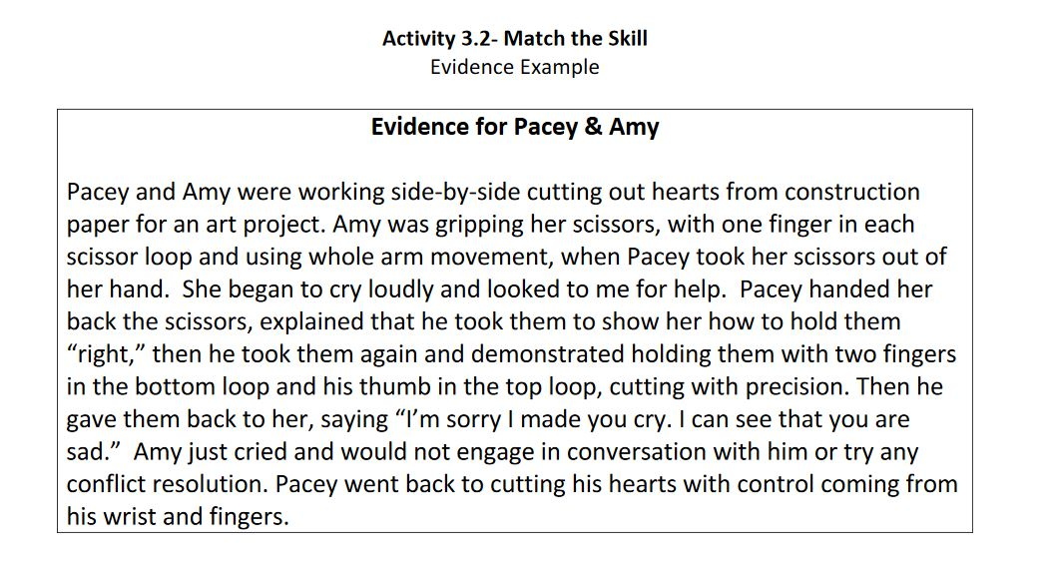
Activity 3.2: Match the Skill

Slide 47
Activities 3.1 & 3.2
Activity Debrief
What was the most challenging aspect of assigning evidence to a skill level on the construct progressions?
Which piece of evidence was the most difficult to place on the progression?
Why do you think that was the case?
Did you use or learn about any strategies that could help you address those challenges?
Notes:
Script:
Let’s discuss about what you observed.
What was the most challenging aspect of assigning evidence to a skill level on the construct progressions?
Which piece of evidence was the most difficult to place on the progression?
Why do you think that was the case?
Did you use or learn about any strategies that could help you address those challenges?

Slide 48
K-3 Formative Assessment Process Topic #4: Summarize the Status
Notes:
Script:
We’re going to do some activities that focus on each step of the formative assessment process, starting with getting a plan.

Slide 49
Activity 4.1: Summarize the Status
Let’s practice determining the status summary level!
Work in partners to complete steps 1-3.
Step 1: Select 2 of the 3 portfolios. Identify 3 constructs represented in your portfolio and review the K-3 formative assessment materials. Each partner should review their own portfolio independently.
Step 2: Read the evidence in the child’s portfolio to determine the appropriate learning statuses.
Step 3: Use these data and your assessment materials to select a final status summary
Now, repeat steps 1-3 for your other portfolio.

Slide 50
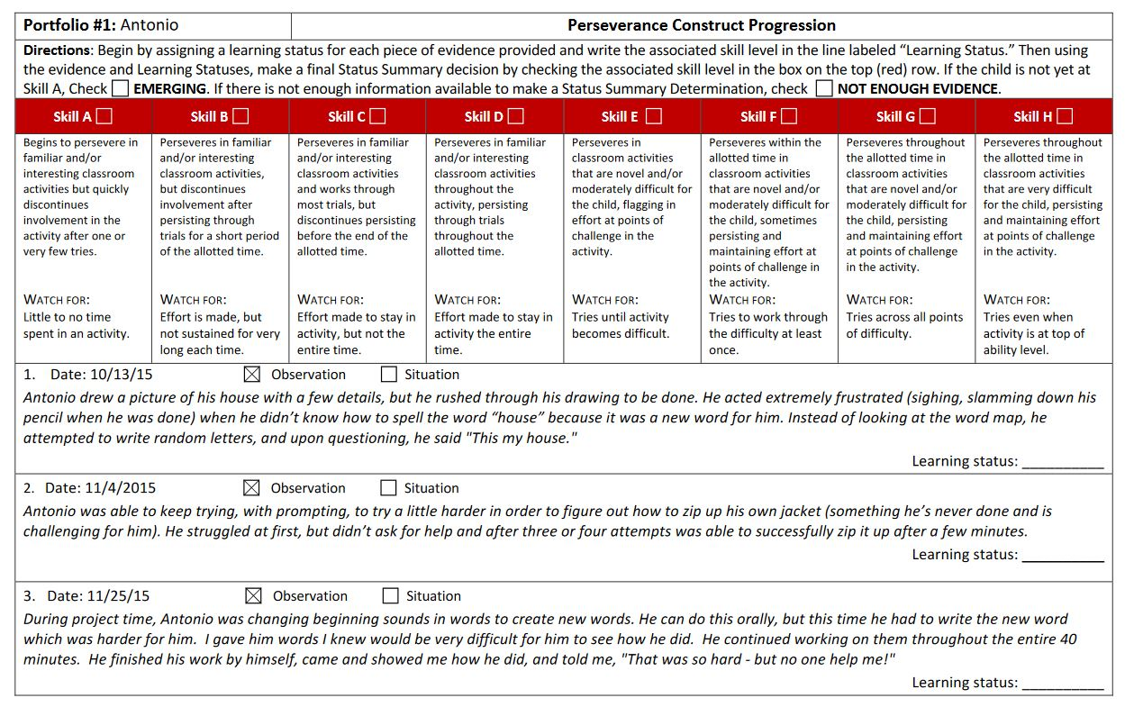
Activity 4.1: Summarize the Status

Slide 51
Activity 4.1: Summarize the Status

Slide 52
Activity 4.1: Summarize the Status

Slide 53
Activity 4.1: Summarize the Status
Share your rationale for the selection of the status summaries with your partner and talk through any discrepancies.
Look at the master codes in “Top Secret” Answer Sheet and discuss the results

Slide 54
Activity 4.1 Summarizing a Status
Activity Debrief
Which portfolio was the most difficult?
Was there a construct or piece of evidence in particular that made it hard?
What else would you know about your students that you didn’t know from these portfolios?
Did you or your group always agree on what status summary to assign a child? How do you plan to handle any data discrepancies you may have in your classroom?
Notes:
Script:
Let’s discuss about what you observed:
Which portfolio was the most difficult?
Was there a construct or piece of evidence in particular that made it hard?
What else would you know about your students that you didn’t know from these portfolios?
Did you or your group always agree on what status summary to assign a child? How do you plan to handle any data discrepancies (e.g., conflicting pieces of evidence, learning statuses from all over the progression, insufficient information, etc.) you may have in your classroom?

Slide 55
K-3 Formative Assessment Process Topic #5: Strategically Use Data
Notes:
Script:
We’re going to do some activities that focus on each step of the formative assessment process, starting with getting a plan.

Slide 56
Activity 5.1: Classroom Planning
Let’s develop practical ideas for how a classroom report can inform your planning and instruction!
Work with a partner. Review the Classroom Report and then complete the Classroom Planning questions
Consider how you would use the data to inform instruction and plan next steps for your classroom.

Slide 57
Activity 5.1: Classroom Planning

Slide 58
Activity 5.1: Classroom Planning
Answer the following questions using your Classroom Report
What is the range of skill levels of the children?
How would you differentiate instruction for your children based on their skill levels? Consider:
How to group children
What times of the day to plan instruction
What specific activities to provide to address children’s needs.
What types of instruction to use (e.g., modeling the skill, providing opportunities to practice with support, providing specific feedback)

Slide 59
Activity 5.2: Child Planning
Working individually, review the individual child report.
Choose 2 constructs to focus on and then answer the questions found on the next slide.
After you complete your plan, get with a partner. Read each other’s plans and share additional ideas about your plans with each other.

Slide 60
Activity 5.2: Child Planning
Answer the following questions using your classroom report.
What two constructs did you select?
What are the next steps for this child (for each construct)?
Based on your response to the question above (#2), what specific strategies could be used to help the child develop the skills in these progressions?

Slide 61
Activities 5.1-5.2 Strategically Using Data
Activity Debrief
How do you currently use data in your school/classrooms? How does the K-3 Formative Assessment Process fit in?
How would you use these reports in your classroom?
Is there another way you would like to see the data displayed?
How does this step relate to the “Get a Plan” step?
Notes:
Script:
[Additional questions/prompts]
Which report was easier for you to read?
What are some strategies for systematically using data to inform your instruction?

