Slide 1
Essential Skills: Math Work Samples
Notes:
The session will provide participants with an in-depth training and calibration to the Official Mathematics Scoring Guide; including scoring student work samples to meet the Essential Skills requirement. Discussion will focus on the Essential Skills requirement and the procedures for work sample administration. Participants will apply the new Essential Skills work sample guidance template to develop an Essential Skills work sample. Participants are encouraged to bring a high school math textbook, calculator and a laptop.

Slide 2
Agenda
Official Scoring Guide
Work Sample Development
Scoring Calibration
Work Sample Administration

Slide 3
Official Scoring Guide
Making Sense of the Task
Representing and Solving the Task
Communicating Reasoning
Accuracy
Reflecting and Evaluating
Notes:
In use since 1988, the latest revision completed in 2011, Powerful instructional tool. 5 Process Dimensions
MS: The student translates the words from the problem into appropriate mathematics. The key concepts are addressed. Evidence that makes a paper more thoroughly developed or insightful may include extending their thinking to other mathematical ideas or making connections to other contexts.
RS: The strategies chosen by the student are effective and complete for this task. Evidence that makes a paper more thoroughly developed or insightful may include generalizing a strategy using an algebraic representation versus a numeric or tabular representation.
CR: Communication of the reasoning refers to the connections among all of the dimensions, and the identifiable solution – allowing the flow of the paper to help the reader understand the path from one part to another. A clear path does not require a linear sequence of thoughts or communication. The student uses math vocabulary and labels appropriately. A significant gap is when the reader is using his/her own knowledge about the problem and mathematics to infer why a student might have moved from one part of the work to another.
A: The student’s solution is correct, mathematically justified, and supported by the work. It is critical that students who are “close” to having a proficient response, with minor errors or partial answers, be given an opportunity to rework the problem given the scoring feedback, but no further instruction. Evidence that makes a paper more thoroughly developed or insightful may include extending the solution by asking new questions leading to new problems. Although possible, it is a rare occurrence to get a 5 or 6 in accuracy.
RE: The student states the solution within the context of the problem. This requires the student to review the task and reflect on what was asked. There should be evidence on the student has reviewed ALL the dimensions in solving the task. The reflection (a second look) could be embedded in the original work or after arriving at a solution and/or a combination of both. Evidence that makes a paper more thoroughly developed or insightful may include solving the task from a different perspective. Students evaluating their approaches may include addressing the efficiency of an approach or the relative use of a procedure.

Slide 4
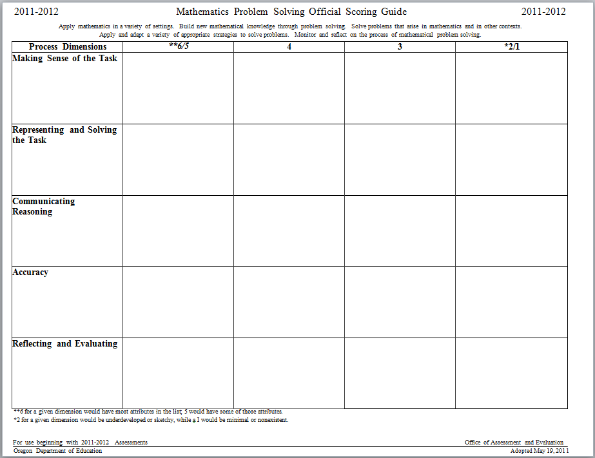
Scoring Guide
Notes:
Close Reading: Scoring Guide – Proficient - vs - Not quite Proficient • Participants review scoring guide 4 for Each Dimension • They should identify words and phrases that distinguish a four for each dimension • Facilitator then clarifies the factors that usually differentiate a 3 from a 4 in each dimension
Explain that this part of the training will focus on applying the math scoring guide to student work, with an emphasis on the differences between the 3 and 4 score points for all dimensions and whether or not the student work meets the essential skill requirement for an Oregon diploma. Distinguishing between the 3 and 4 scores points is important for three main reasons: 1) the 3/4 call is the most critical one for students because it determines whether or not they earn passing scores; 2) it is most likely the decision that will have to be made most frequently--most papers fall into this category; 3) it is relatively easy to identify papers that both exceed the standard and those that fall far below the standard. It isn’t worth the investment of limited time to debate the 5 versus 6 or the 1 versus 2 score points. An additional concern at the high school level is whether or not a passing work sample meets the essential skill requirement for graduation. In order to qualify, the student work must reflect high school level standards.

Slide 5
Work Sample Template

Slide 6
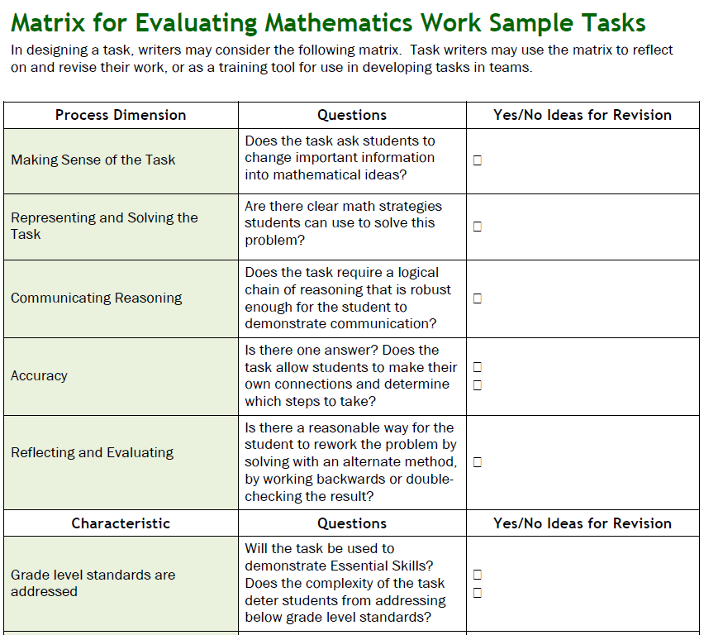
Work Sample Template
Notes:
There is not an “official” position on guess and check, but would point out that work samples are one acceptable source of evidence that a student has demonstrated proficiency in the Essential Skills. If a student has used the “guess and check” method to complete a work sample, how confident would the rater/teacher/district/school board be that the student has acquired the knowledge and skills certified by awarding a diploma?
That’s what this issue can really be boiled down to: does the rater feel confident that the work sample(s) are reflective of independent student work and are sufficient evidence to support the student has demonstrated proficiency in the Essential Skill? If so, and the other graduation requirements have been completed, the student should be awarded a diploma to certify the knowledge and skills they’ve acquired/demonstrated.
There are situations where “guess and check” is acceptable in the problem solving process. If so, and the student has used the method in an appropriate manner (as part of a systematic process) and can justify their thinking, then it is acceptable. In cases where the student is clearly guessing (correctly) but not basing it on any clear understanding of content, there is less confidence in making a diploma decision. At the local level, it is recommended to develop a local performance assessment policy that clearly describes how these and other issues will be managed.

Slide 7
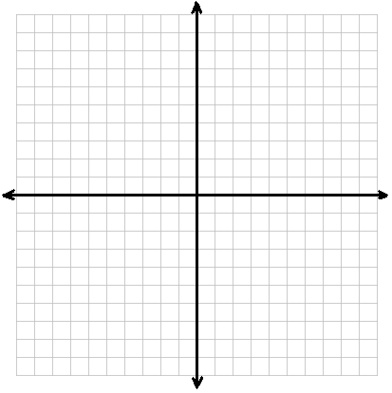
Quadrilateral ABCD
Quadrilateral ABCD has the points
A(1, 1), B(3, 3), C(3, 5), D(1, 6). If ABCD is reflected across the y-axis and then the x-axis, what is the location of the points A’, B’, C’, and D’?
https://web.archive.org/web/20130805204002/http://www.ode.state.or.us/search/page/?id=281

Slide 8
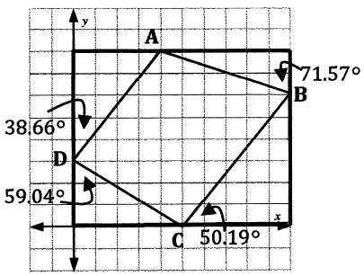
Gopher Security
Gopher Security Company has been hired to create a security system for the Portland Museum to guard the famous Hope Diamond. They will be installing a laser beam triggered security system. You will help them determine the distance the beam will travel around the room to protect the diamond. If the beam is broken, the alarm will be triggered.
The display box will be placed in the center of the room.
The beam travels from the sensor at point A to sensor B to sensor C to sensor D and back to sensor A.
What is the total distance the beam will travel around the room?
Show all work and reasoning to complete the task.

Slide 9
Blank title
Gopher Security Company has been…
8.G.7 Apply the Pythagorean Theorem to determine unknown side lengths in right triangles in real-world and mathematical problems in two and three dimensions.
G.SRT.8 Use trigonometric ratios and the Pythagorean Theorem to solve right triangles in applied problems.★
http://www.oregon.gov/ode/educator-resources/essentialskills/Pages/Math-PS-Tasks-HighSchool.aspx
Notes:
★Modeling is best interpreted not as a collection of isolated topics but in relation to other standards.
Making mathematical models is a Standard for Mathematical Practice, and specific modeling standards
appear throughout the high school standards indicated by a star symbol (★). The star symbol sometimes
appears on the heading for a group of standards; in that case, it should be understood to apply to all
standards in that group.

Slide 10
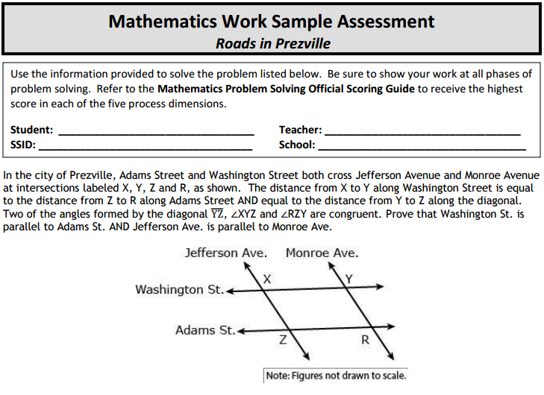
Roads in Prezville
Notes:
First individually solve this task, then share with a partner, then share with your table.
CCSS – G.CO.9 Prove geometric theorems
Although different scorers may use different styles, here is a typical process for using the scoring guide:
Possibly sort the student work so that you will score all work with similar approaches one after another.
Read the criteria for a score of 3 on one dimension.
Review the student work again. If it seems stronger than a 3, read the 4 through 6 criteria. If is weaker than a 3, consider the 1 and 2 criteria.
Assign a score for that dimension.
Repeat the process for the other 4 dimensions
Additional scoring hints or considerations include the following:
Any scores that you are uncertain about should be set aside to look at again after scoring the rest of the papers (these papers might also be good candidates for collegial discussions). A score of 4 meets the standard, and a 3 nearly meets – so this is a critical distinction.
As a way of validating your scores, it is very helpful to have a colleague score a few of your papers without seeing the scores you gave, then having a discussion about any differences in your scores.
When double scoring, as a general rule, scores that are within 1 point in any given dimension are considered “aligned” but a discussion to agree on the same score can help to “calibrate” your scoring.

Slide 11
Score the First anchor paper
Making Sense of the Task | Representing and Solving the Task | Communicating and Reasoning | Accuracy | Reflecting and Evaluating
4 | 3 | 3 | 3 | 3
Paper #J-5
Notes:
Paper #J-5
MS 4: The student correctly marks the figure with the given information and begins to use the given information to create a paragraph proof.
RS 3: The strategy is only partially effective. The student initiates the proof with an unsupported statement and uses this unsupported
claim to establish proof.
CR 3: There are significant gaps in the communication of the reasoning.
AC 3: The solution is partially complete. The parallelogram opposite angles theorem and opposite sides theorem could be used to
prove the streets form a parallelogram, however, the foundational supports for these claims are missing.
RE 3: The embedded reflection only partially justifies the outcome due to the missing support for the initial SAS triangle conjecture.

Slide 12
Score the Second anchor paper
Making Sense of the Task | Representing and Solving the Task | Communicating and Reasoning | Accuracy | Reflecting and Evaluating
5 | 5 | 5 | 5 | 5
Paper #J-12
Notes:
Paper #J-12
MS 5: The interpretation is thoroughly developed. The student translates the task into the symbolic representation of a formal proof.
RS 5: The strategy selected is insightful and complex through the formal structure and detail of the proof.
CR 5: The communication is enhanced through the use of detail in both the statements and the reasons. The reasons also reference
previous steps in the argument, allowing the reader to move easily through the work.
AC 5: The solution is enhanced by making a connection between each step in the proof and the specific steps that lead to and support it.
RE 5: Each step is completely justified throughout the two column proof. The proof is also argued a second way in paragraph form.
The second representation utilizes many of the reasons given earlier in the two column proof. Since the student does not actually complete the formal argumentation in the paragraph proof this is an example of a weak 5.

Slide 13
Score the Third anchor paper
Making Sense of the Task | Representing and Solving the Task | Communicating and Reasoning | Accuracy | Reflecting and Evaluating
3 | 3 | 3 | 2 | 2
Paper #J-15
Notes:
Paper #J-15
MS 3: The interpretation is only partially developed. There are some correct statements but these are not effectively connected
to the conclusion. There is also a misinterpretation by using ASA instead of SAS.
RS 3: The strategy is only partially effective and partially complete. The student arrives at congruent triangles, but makes an
unsupported leap to get to that conclusion.
CR 3: There are significant gaps in the reasoning in both the initial solution and the review.
AC 2: The conclusion is not adequately supported by the work. Mistakes amount to more than minor making this is an example of a strong 2.
RE 2: Reflection is embedded in the reasoning of a proof, however the reasons given are infective and the review contradicts the initial attempt.

Slide 14
Score the Fourth anchor paper
Making Sense of the Task | Representing and Solving the Task | Communicating and Reasoning | Accuracy | Reflecting and Evaluating
2 | 2 | 2 | 2 | 1
Paper #J-27
Notes:
Paper #J-27
MS 2: The translation of the task is underdeveloped. The figure is marked incorrectly and angles are improperly referenced in the Work Sample. RS 2: The strategy is underdeveloped and the reasoning required to support the given statements is missing.
CR 2: The communication of the reasoning is significantly underdeveloped.
AC 2: The solution given is incomplete and not supported by the work.
RE 1: The reflection is not evident.

Slide 15
Score the Fifth anchor paper
Making Sense of the Task | Representing and Solving the Task | Communicating and Reasoning | Accuracy | Reflecting and Evaluating
3 | 3 | 3 | 2 | 2
Paper #J-28
Notes:
Paper #J-28
MS 3: The translation is only partially developed. The student shows an understanding of some of the key concepts but does not
show an understanding of the criteria for a parallelogram or alternate interior angles.
RS 3: The strategy is only partially effective and partially displayed. The student begins well, but misses the connections needed
to reach a correct solution.
CR 3: Significant gaps are present in the argument and the communication. The student ambiguously names angles X, Y, Z and R.
AC 2: The given solution is incomplete. The student draws correct conclusions, but does not support them.
RE 2: The reflection is only partial. Some of the reflection is embedded but not enough to justify the given conclusion.

Slide 16
Homework and Grades
Notes:
First individually solve this task, then share with a partner, then share with your table.
CCSS – S.ID.5 Summarize, represent, and interpret data on two categorical and quantitative variables (frequency tables)
Although different scorers may use different styles, here is a typical process for using the scoring guide:
Possibly sort the student work so that you will score all work with similar approaches one after another.
Read the criteria for a score of 3 on one dimension.
Review the student work again. If it seems stronger than a 3, read the 4 through 6 criteria. If is weaker than a 3, consider the 1 and 2 criteria.
Assign a score for that dimension.
Repeat the process for the other 4 dimensions
Additional scoring hints or considerations include the following:
Any scores that you are uncertain about should be set aside to look at again after scoring the rest of the papers (these papers might also be good candidates for collegial discussions). A score of 4 meets the standard, and a 3 nearly meets – so this is a critical distinction.
As a way of validating your scores, it is very helpful to have a colleague score a few of your papers without seeing the scores you gave, then having a discussion about any differences in your scores.
When double scoring, as a general rule, scores that are within 1 point in any given dimension are considered “aligned” but a discussion to agree on the same score can help to “calibrate” your scoring.

Slide 17
Score the First anchor paper
Making Sense of the Task | Representing and Solving the Task | Communicating and Reasoning | Accuracy | Reflecting and Evaluating
5 | 6 | 6 | 5 | 6
Paper #M-6
Notes:
Paper #M-6
MS 5: The student looks at the task through two distinct approaches. Both are thoroughly developed by the use of models and
probability notation.
RS 6: The strategies used are complex. The student employs Bayes’ Theorem as a strategy and then uses the joint and marginal
probabilities to answer the question a second time.
CR 6: The use of mathematical language and formal probability notation are both insightful and enhanced. The use of models makes
it easy for the reader to move from one thought to another.
AC 5: Correct answers are reached by using conditional probabilities and joint probabilities. The student connects the two solutions by
recognizing that joint probabilities support the claim and the conditional probability provides strong “overwhelming” evidence for the claim.
RE 6: The student reworks the task using a different method and evaluates the relative efficiency of different approaches taken,
“Here is a Venn diagram, which is an easier way.”

Slide 18
Score the Second anchor paper
Making Sense of the Task | Representing and Solving the Task | Communicating and Reasoning | Accuracy | Reflecting and Evaluating
3 | 2 | 3 | 2 | 1
Paper #M-8
Notes:
Paper #M-8
MS 3: The interpretation of the task is only partially developed. The student displays the correct joint probabilities, but does not support
the joint probabilities with correct mathematics.
RS 2: The student attempts to estimate the distribution of students by using a theoretical class of 30 students creating rounding issues that
are in conflict with the solution. The student is missing the critical probability of homework and a B average in math. This Work Sample represents a strong 2.
CR 3: The communication contains significant gaps and is hard to follow. The student never addresses the implications of rounding given
the estimate of only 30 students. The final claim asserts proof, but it is disjointed and not supported by mathematics.
AC 2: The solution is incomplete and not justified with mathematics.
RE 1: The reflection is not evident.

Slide 19
Score the Third anchor paper
Making Sense of the Task | Representing and Solving the Task | Communicating and Reasoning | Accuracy | Reflecting and Evaluating
4 | 4 | 4 | 4 | 4
Paper #M-10
Notes:
Paper #M-10
MS 4: The interpretation is both effective and complete. The student shows an understanding of the key concepts and how the given
information is related by translating percentages into a sample size of 100.
RS 4: The strategy is effective and complete. The table provides a simple way to compute the missing probabilities and the commentary
interprets the results correctly.
CR 4: All of the important elements are in place and the path through the work is clear. The student supports the conclusion by comparing the
joint probabilities two different ways.
AC 4: The solutions given are correct and supported by the work.
RE 4: All of the values in the table are justified by the equations below. The conclusion is drawn by looking at the data two different ways. This
Work Sample represents a strong 4.

Slide 20
Score the Fourth anchor paper
Making Sense of the Task | Representing and Solving the Task | Communicating and Reasoning | Accuracy | Reflecting and Evaluating
2 | 2 | 3 | 2 | 1
Paper #M-22
Notes:
Paper #M-22
MS 2: The interpretation is partially developed. The use of ratios is applied inappropriately.
RS 2: The strategy selected is sketchy and underdeveloped. The student correctly computes one missing marginal probability and two
missing joint probabilities, but does not compute the required probabilities to support the claim.
CR 3: The communication contains significant gaps. The description of the probabilities lacks precision and contains errors.
AC 2: The solution given is incomplete and incorrect.
RE 1: The ratios as a reflection of the concepts and strategies are ineffective, and it is not particularly evident that the use of ratios
represents the student reflecting on their claim.

Slide 21
Score the Fifth anchor paper
Making Sense of the Task | Representing and Solving the Task | Communicating and Reasoning | Accuracy | Reflecting and Evaluating
4 | 4 | 3 | 3 | 2
Paper #M-29
Notes:
Paper #M-29
MS 4: The student correctly interprets the task and computes and displays all of the joint and marginal probabilities.
RS 4: The strategy selected is effective, complete and could lead to a correct solution.
CR 3: The communication of the reasoning has significant gaps and is only partially displayed forcing the reader to assemble the solution path.
AC 3: The solution is partially correct and not justified with mathematics.
RE 2: The initial work is repeated, but it is not clear if this is done as a review making the reflection very sketchy.

Slide 22
Don’t hit the ceiling
Notes:
First individually solve this task, then share with a partner, then share with your table.
CCSS – F.IF.4 Interpret functions that arise in applications in terms of the context
Although different scorers may use different styles, here is a typical process for using the scoring guide:
Possibly sort the student work so that you will score all work with similar approaches one after another.
Read the criteria for a score of 3 on one dimension.
Review the student work again. If it seems stronger than a 3, read the 4 through 6 criteria. If is weaker than a 3, consider the 1 and 2 criteria.
Assign a score for that dimension.
Repeat the process for the other 4 dimensions
Additional scoring hints or considerations include the following:
Any scores that you are uncertain about should be set aside to look at again after scoring the rest of the papers (these papers might also be good candidates for collegial discussions). A score of 4 meets the standard, and a 3 nearly meets – so this is a critical distinction.
As a way of validating your scores, it is very helpful to have a colleague score a few of your papers without seeing the scores you gave, then having a discussion about any differences in your scores.
When double scoring, as a general rule, scores that are within 1 point in any given dimension are considered “aligned” but a discussion to agree on the same score can help to “calibrate” your scoring.

Slide 23
Score the First anchor paper
Making Sense of the Task | Representing and Solving the Task | Communicating and Reasoning | Accuracy | Reflecting and Evaluating
2 | 3 | 3 | 2 | 1
Paper #B-1
Notes:
Paper #B-1
MS 2: The student inappropriately uses b/2a to find the t coordinate of the vertex instead of –b/2a. The student does not address the computation of negative heights in the context of the problem.
RS 3: A correct formula would have generated a strategy that would be effective. As it is, the strategy is only partially effective.
CR 3: The student work is easy to follow and the computations shown are complete and done correctly, but the student never addresses the question asked.
AC 2: The solution is incorrect and incomplete.
RE 1: The solution is not stated within the context of the problem and no reflection is evident.

Slide 24
Score the Second anchor paper
Making Sense of the Task | Representing and Solving the Task | Communicating and Reasoning | Accuracy | Reflecting and Evaluating
3 | 4 | 4 | 2 | 2
Paper #B-7
Notes:
Paper #B-7
MS 3: The translation into mathematics is partially developed. The student never gains an awareness of transposing height and time.
RS 4: The strategy is effective and would lead to a correct solution had the student not transposed height and time.
CR 4: The communication is clear and coherent and leads to a clearly identified solution.
AC 2: The solution is incorrect. The ceiling is 30 feet high and the identified solution has Jake throwing the ball 2 feet above the ground.
RE 2: The student restates the vertices found earlier making the reflection minimal.

Slide 25
Score the Third anchor paper
Making Sense of the Task | Representing and Solving the Task | Communicating and Reasoning | Accuracy | Reflecting and Evaluating
5 | 4 | 5 | 4 | 5
Paper #B-11
Notes:
Paper #B-11
MS 5: The interpretation is enhanced by the student recognizing that the mathematical model is the center of the ball’s path. To eliminate the
effect of the radius one must consider the ball to have an infinitesimally small radius.
RS 4: The strategy is effective and will lead to a correct solution.
CR 5: The communication of the reasoning is clear, insightful and leads to a clearly identified solution.
AC 4: The given solution is correct and supported by the work.
RE 5: The student solves the problem explicitly and graphically. The graphical solution would have been stronger had the student graphed
y = 30 to represent the ceiling. This is an example of a weak 5.

Slide 26
Score the Fourth anchor paper
Making Sense of the Task | Representing and Solving the Task | Communicating and Reasoning | Accuracy | Reflecting and Evaluating
3 | 4 | 4 | 3 | 2
Paper #B-24
Notes:
Paper #B-24
MS 3: The interpretation of the task is only partially developed. The student does not address the 30 foot ceiling height.
RS 4: The strategy selected is both effective and complete. The strategy would have led to a correct solution had the results been
interpreted correctly.
CR 4: The student work follows a clear path throughout. The reasoning is questionable with the statement “times by 2 because of
the square root”. This flaw is minor compared to the rest of the work.
AC 3: The solution is partially correct. All work leading to the final answer is correct, but the results are misinterpreted in the end.
RE 2: There is some justification evident in the commentary, but it only addresses part of the strategy and does not review
concepts, calculations or reasonableness.

Slide 27
Score the Fifth anchor paper
Making Sense of the Task | Representing and Solving the Task | Communicating and Reasoning | Accuracy | Reflecting and Evaluating
3 | 3 | 3 | 3 | 1
Paper #B-28
Notes:
Paper #B-28
MS 3: The interpretation of the task is partially developed. The student creates a table of values from the given equations but then
incorrectly graphs Hannah’s equation. The ceiling constraint is misrepresented by the student.
RS 3: The strategy is partially effective. The graph representing Hannah’s throw is incorrect and does not match the table.
CR 3: The communication of the reasoning contains gaps. No computations are shown and the graph of Hannah’s throw is
not helpful, nor is it connected to the solution.
AC 3: The solution is partially correct. The student correctly computes both the y coordinates of the vertices, but states that Hannah
won with a height of 32 feet.
RE 1: The reflection is not evident.

Slide 28
Work Sample Administration
Notes:
Refer to ES manual for recommendations and requirements.

Slide 29
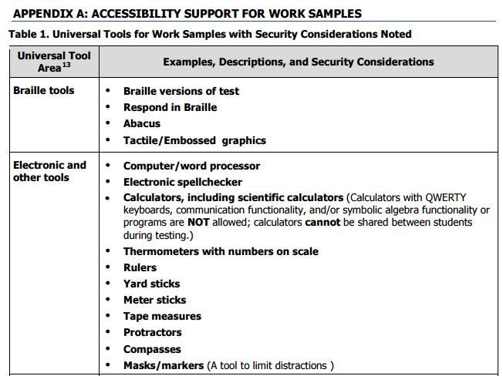
Work Sample Administration

Slide 30
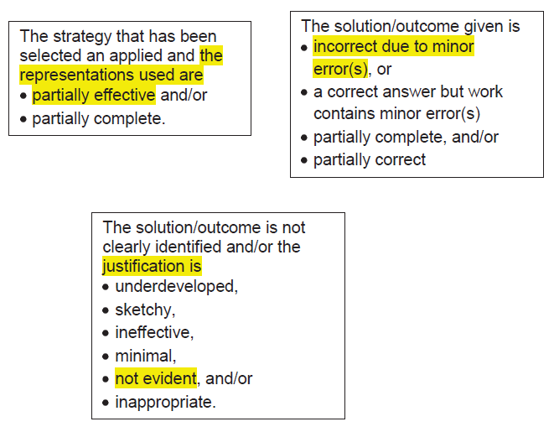
Work Sample Administration Appropriate Feedback

Slide 31
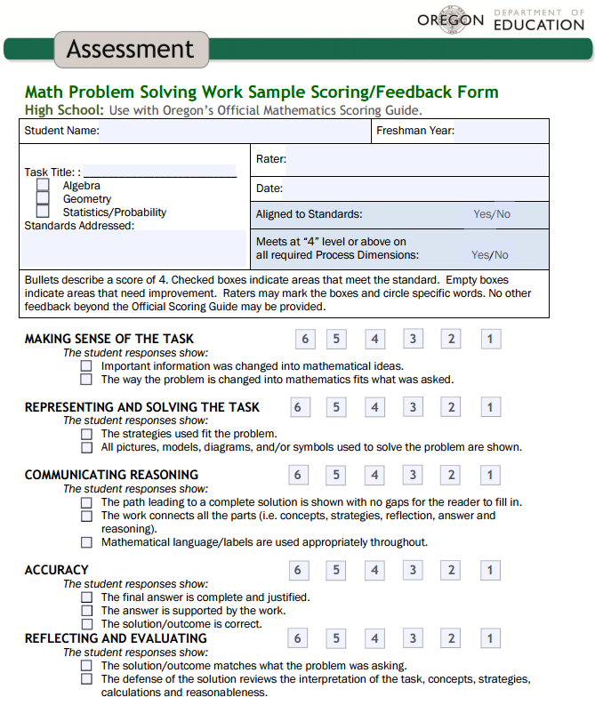
Work Sample Administration Appropriate Feedback (Essential Skills)

Slide 32
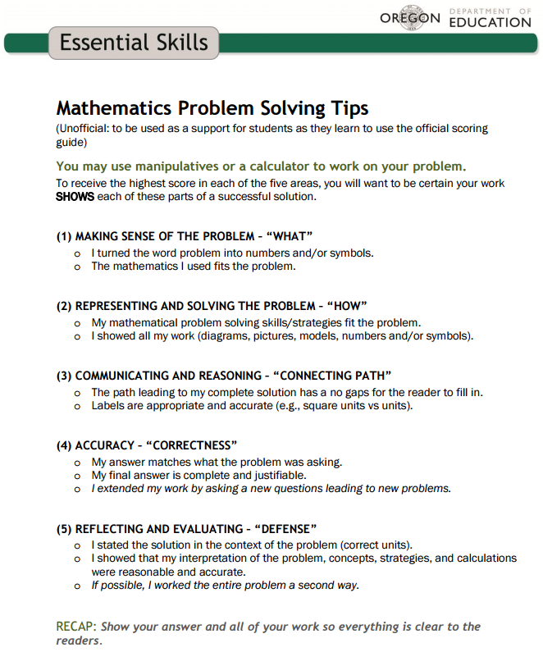
Work Sample Resource Universal Tool

Slide 33
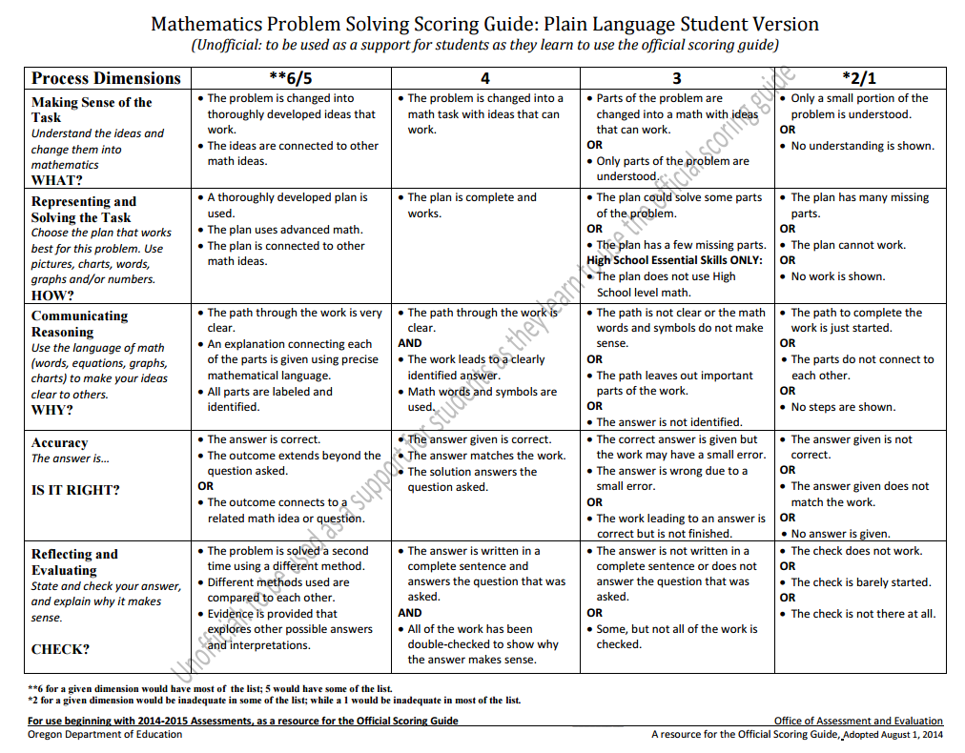
Work Sample Resource Universal Tool

Slide 34
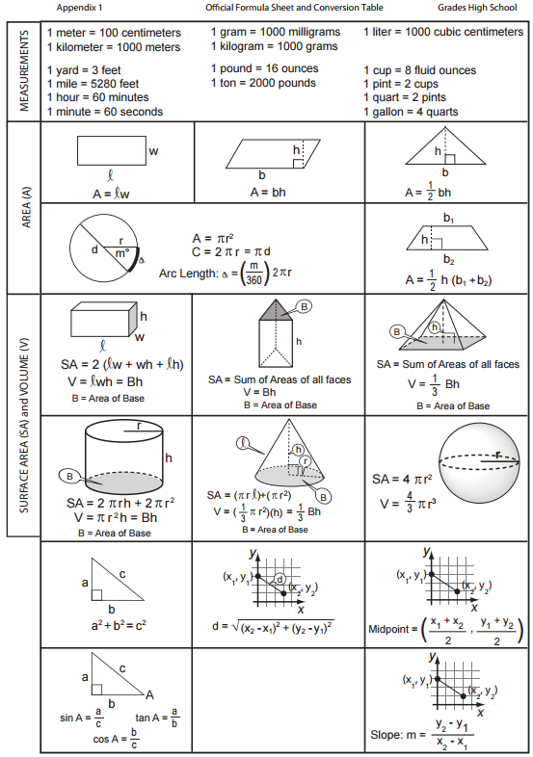
Work Sample Resource Universal Tool

Slide 35
Work Sample Resource Task Bank and Scoring

Slide 36
Thank You!

