Slide 1
Accessibility Supports Training
Oregon Statewide Assessment System
Required for DTCs, STCs, & TAs
Notes:
This is the accessibility supports training module for Oregon’s statewide assessment system, required for all district and school test coordinators, as well as test administrators.

Slide 2
Topics
Overview of Accessibility Supports
Resources that support appropriate:
Selection of Accessibility Supports
Administration of Accessibility Supports
Evaluation of Accessibility Supports
Oregon Accessibility Manual (OAM)
Notes:
This training is designed to provide an overview of Oregon’s statewide assessment accessibility supports. Resources that support the selection, administration, and evaluation of these supports are also discussed.

Slide 3
Resources
The Oregon Accessibility Manual (OAM) contains all final accessibility policies and supports for Oregon’s Statewide Assessments.
Notes:
The Oregon Accessibility Manual (OAM) was developed to guide the selection and administration of universal tools, designated supports, and accommodations for the current statewide summative assessments. Including:
Mathematics
English Language Arts
Science
As well as,
Social Sciences
English Language Proficiency
The Oregon Extended Assessments, and the
SEED Survey
Only those supports included in the OAM may be provided to students during the administration of Oregon’s statewide assessments.

Slide 4
Provision of supports
All accessibility supports a student receives on Oregon statewide assessments should mirror the supports currently being provided to that student in their learning environment.
Notes:
When selecting an accessibility support for testing, keep in mind that they should mirror the supports currently being provided to that student in their classroom instruction and assessments. It is never appropriate to introduce a support to a student for the first time during statewide testing.

Slide 5
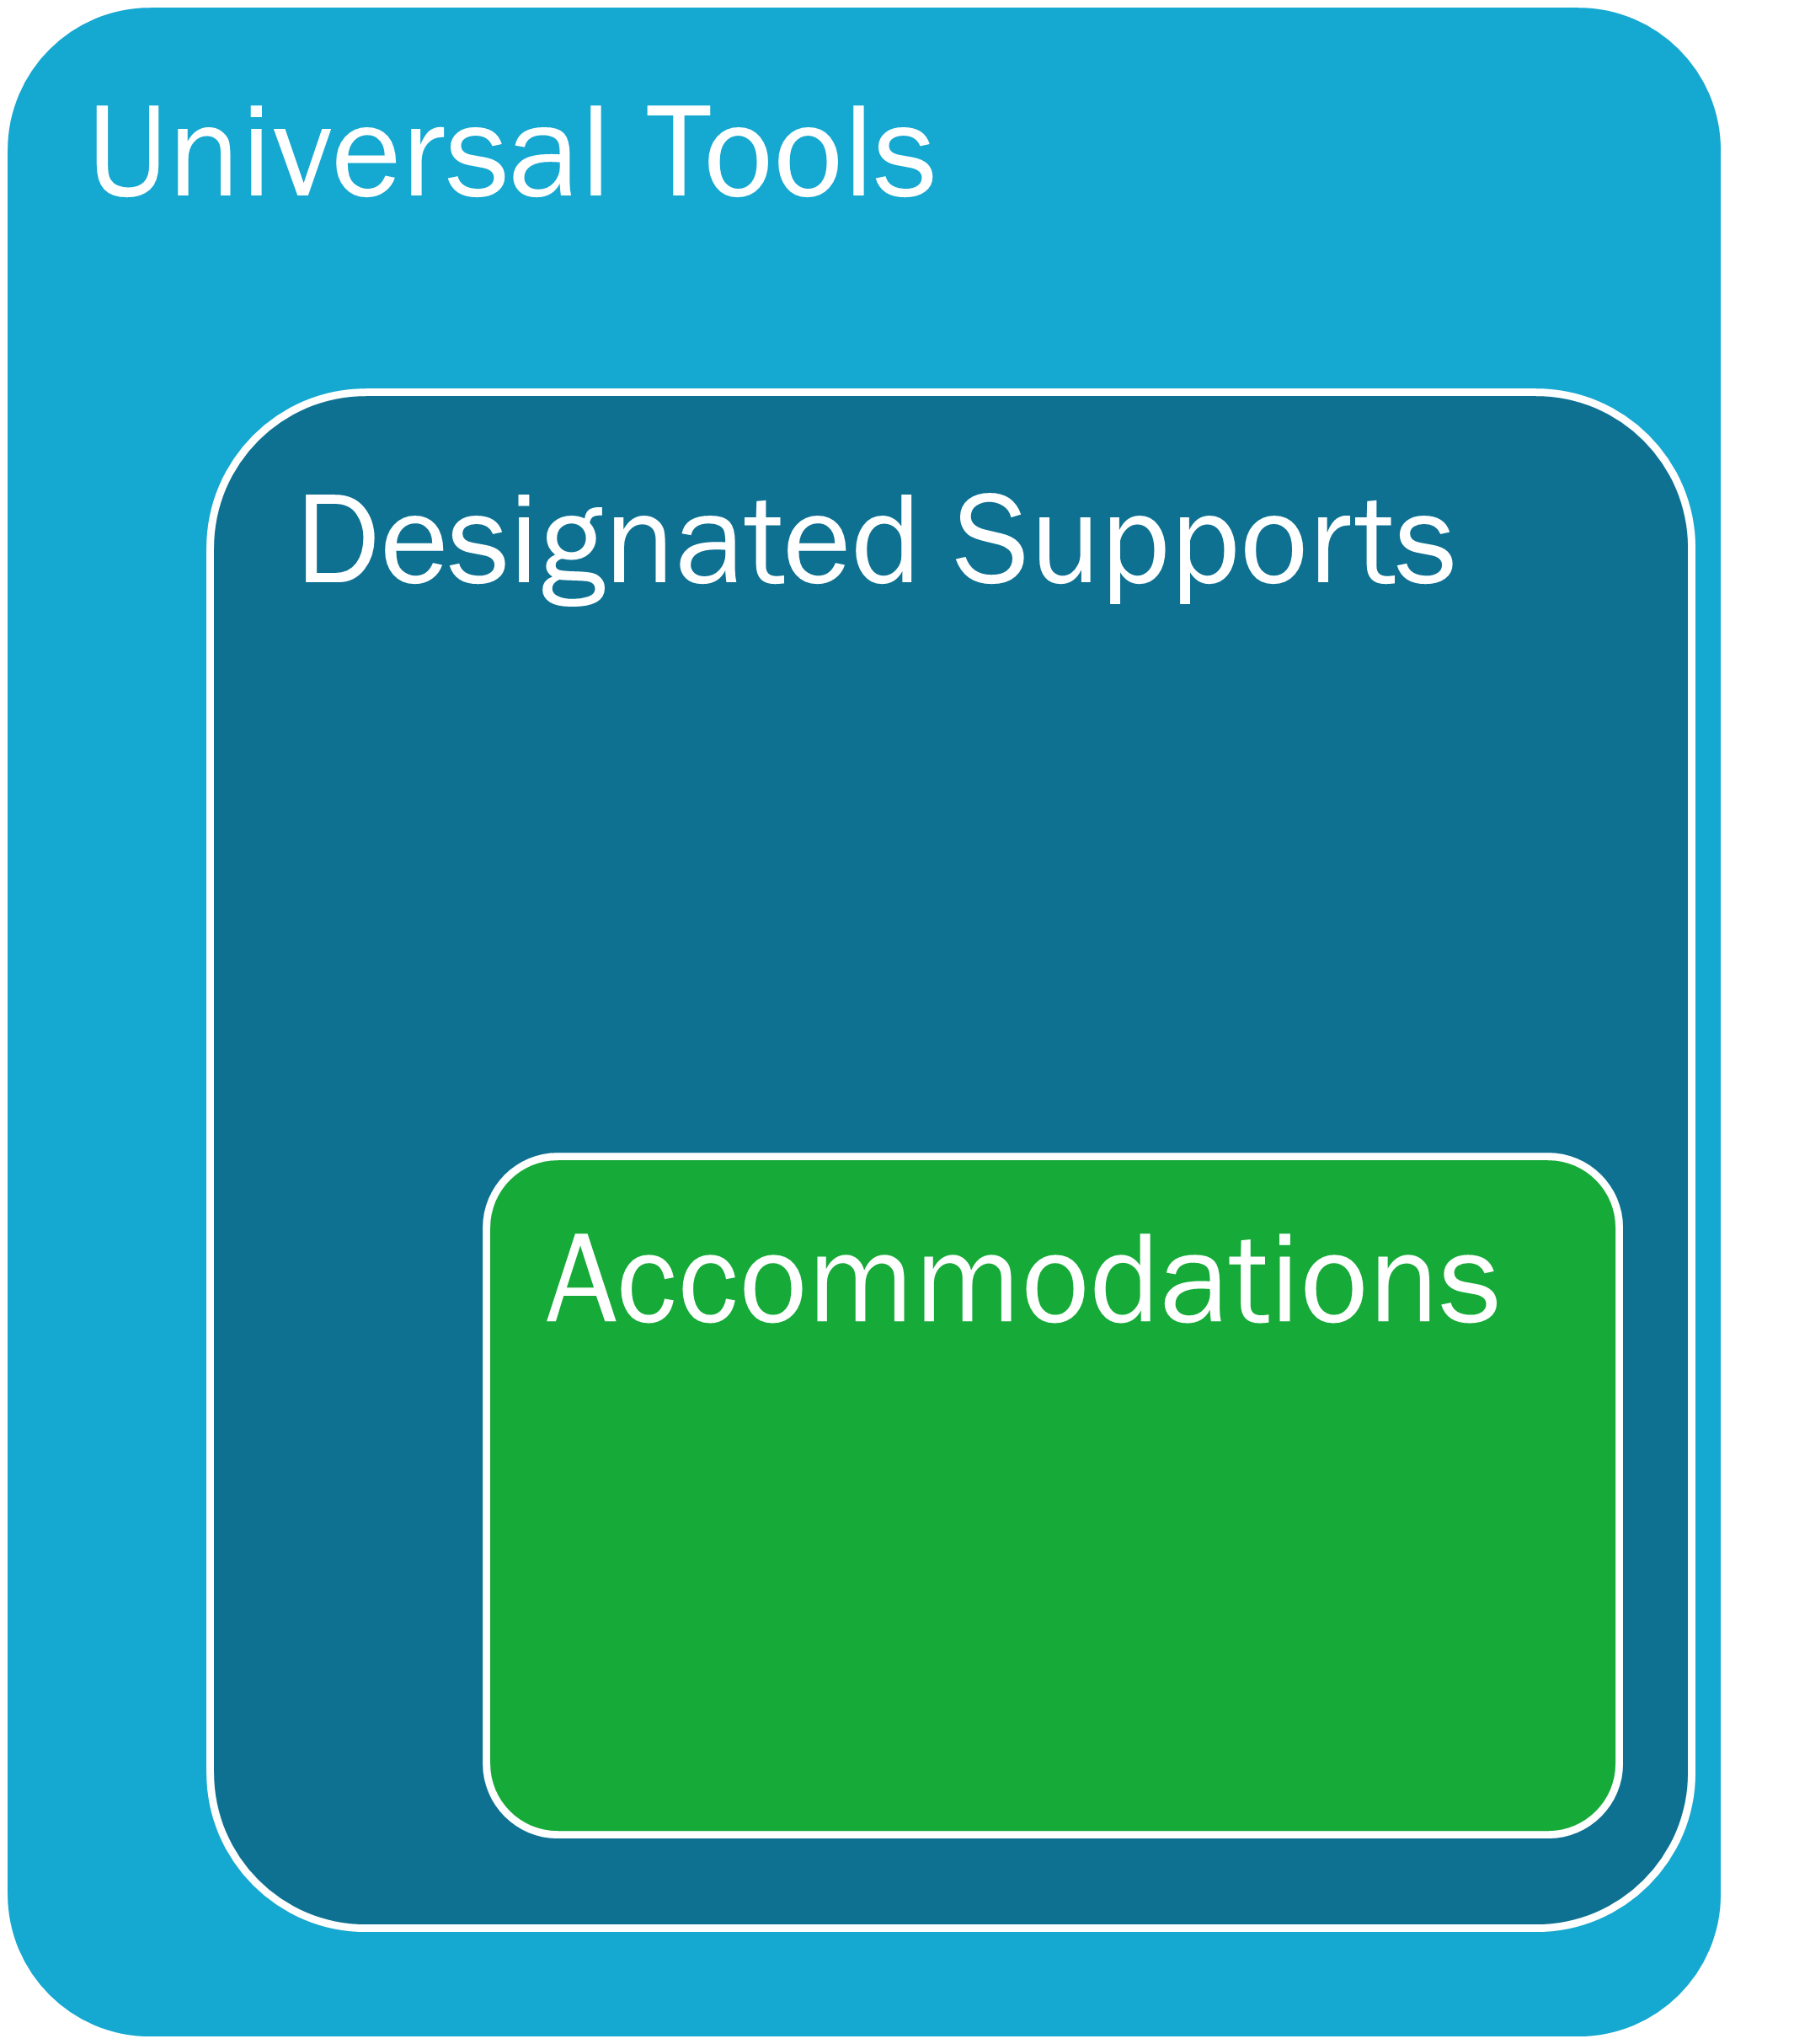
Accessibility Options
Oregon’s Statewide Assessment System provide three tiers of accessibility supports:
Universal Tools
Designated Supports
Accommodations
Notes:
It is critical to know the differences between each tier of statewide assessment accessibility supports. Specifically, there are three tiers of support: Universal Tools, Designated Supports, and Accommodations.
Each of the three tiers of support have different rules for implementation. Universal tools are automatically available to all students and can be student-selected.
Designated supports are set in TIDE by test administrators and are available to any student based upon identified need.
Accommodations are also set in TIDE by TA’s and are available to students who have that support documented in their IEP or 504 plan. Within each of these tiers, any specific support may be embedded, or incorporated in the testing interface (such as text-to-speech), or they may be non-embedded, or outside of the testing interface (such as the use of scratch paper).
For more details of each tier of support, consult Table 1.1 in the OAM.

Slide 6
Modification
Any practice or procedure that changes the construct being measured and is not listed in Oregon’s Accessibility Manual (OAM) is considered a modification.
Students taking assessments with any modified conditions are counted as non-participants in all federal and state accountability measures.
Notes:
A modification is any practice or procedure that changes the construct being measured on an assessment such as changes to the content, the level of cognitive demand, or the expected performance or outcome. Any support that is not listed in the OAM is considered a modification. Assessments taken under any modified condition are counted as non-participants in all federal and state accountability measures and reports.

Slide 7
Accessibility Guidance
Guidance related to identification, administration, and evaluation of the use of accessibility supports for instruction and assessment of all students is found in the Council of Chief State School Officers’ (CCSSO) Accessibility Manual.
The process described in this manual is designed for use by general education teachers, teachers of students who are English Learners, special education teachers, test administrators, district level assessment staff, Individualized Education Program (IEP) teams, Section 504 Plan committees, or any other school team as they work with students to select and use appropriate supports during participation in Oregon’s Statewide Assessments.
Notes:
Having familiarized your student teams with the requirements associated with the use of the three tiers of accessibility supports, we turn our attention to some of the practical tasks involved in the process: the identification or selection, administration, and evaluation of accessibility supports. For those purposes, we recommend that teams consult the Council of Chief State School Officers’ Accessibility Manual—specifically, Section III – The Five-step Decision-making Process and the Tools section.

Slide 8
Identification of Accessibility Supports
Increase equitable access to grade-level content assessments and supporting students in demonstrating what they know and can do.
Notes:
The identification of whether a particular support is offered as a universal tool, designated support, or accommodation is determined independently for each assessment based on the construct that assessment is designed to measure.

Slide 9
Sample Tests
The Sample Tests on the OSAS portal can assist IEP/504 teams to determine which universal tools, designated supports, and accommodations are needed for each individual student to be able to demonstrate what they know and can do.
Notes:
As part of the identification of accessibility supports process, ODE highly recommends using the sample tests to familiarize TAs and students to the tests and accessibility supports.
In order to enable any available embedded support in a sample test, a proctored test session will need to be set up. For directions on how to set up a proctored sample test, consult the Online Test Administrator User Guide. Please note that it is never appropriate to initiate an operational assessment for this purpose.

Slide 10
Decision-Making Process
The decision-making process for providing accessibility supports should consider at least three factors:
Student characteristics
Classroom instruction and assessment tasks
Accessibility policy
If multiple accessibility supports are employed for a student, educators should also be cognizant of the possible interactions of these accessibility supports.
Notes:
CCSSO’s Accessibility Manual contains assistance in identifying or selecting various types of accessibility supports for students—including consideration of at least three factors:
1. Student characteristics - disabilities, language proficiency, accessibility supports used in classroom instruction and on assessments in order to access and perform with academic standards and state tests.
2. Classroom instruction and assessment tasks – knowledge about what tasks are required in instruction and on state assessments and ways to remove physical and other barriers inhibiting a student’s ability to perform those tasks.
3. Accessibility policy – accessibility policy for an assessment or for part of an assessment and consequences of those decisions.

Slide 11
Documenting Accessibility Supports
Cumulative File
Individualized Education Program (Statewide Assessments page)
Section 504 Plan
Local Documentation Processes
Notes:
Having identified the accessibility supports that each student needs, the next step is to ensure that these supports are documented according to federal and/or state requirements. For example, in the documenting accessibility supports section of a student’s IEP, there are potentially three areas in which accessibility supports can be addressed:
First, “Consideration of Special Factors” [Sec. 614(d)(3)(B)]. This is where communication and assistive technology supports are considered.
Second, “Supplementary Aids and Services” [Sec. 602(33) and Sec. 614(d)(1)(A)(i)]. This area of the IEP includes “aids, services, and other supports that are provided in regular education classes or other education-related settings to enable children with disabilities to be educated with nondisabled children to the maximum extent appropriate.”
Finally, and most relevant to our purposes, the “Participation in Assessments” [Sec. 612(a)(16)]. This section of the IEP documents the accommodations needed to facilitate the participation of students with disabilities in general state and district-wide assessments.
[TCs may insert local policies/protocols for documentation at this point in the training.]

Slide 12
Administration of Accessibility Supports
Ensure reliable and valid administration of the assessment.
Notes:
On the following slides we’ll discuss the Administration of Accessibility Supports.

Slide 13
Requirements
For accessibility supports to be used during administration of an Oregon Statewide Assessment, the support must also be:
previously approved by the Accessibility Panel
listed in the appropriate OAM accessibility supports tables
implemented during instruction, and
familiar to the student prior to use during assessment.
Notes:
For accessibility supports to be used during administration of an Oregon statewide assessment, the support must be: previously approved by the Accessibility Panel; listed in the appropriate accessibility supports table in the OAM; implemented during instruction; and familiar to the student prior to testing.

Slide 14
Administration Logistics
Identify accessibility supports and develop a plan for implementation and evaluation
Become familiar with the online accessibility support options
Test administrators must verify that the correct accessibility supports have been selected in TIDE and know how to enter and validate this information
Administration guidelines ensure that test results reflect actual student knowledge and skills
Test security expectations remain intact
Notes:
Once decisions have been made about providing accessibility supports to meet individual student needs, the logistics of providing the actual accessibility supports during state assessments must be mapped out. With the move to providing assessments on technology-based platforms, educators must make sure that students have opportunities to become familiar with the technological aspects of the assessment process. Prior to the day of a test, teachers should ensure that test administrators know what accessibility supports each student will be using and how to administer them properly. Adherence to guidelines detailing instructions and procedures for the administration of accessibility supports is necessary to ensure that test results reflect actual student knowledge. Test security involves maintaining the confidentiality of test questions and answers, and is critical in ensuring the integrity of a test and validity of test results. Test security expectations therefore remain intact for administration of accessibility supports.

Slide 15
Evaluation of Accessibility Supports
Ensure the meaningful participation of all students who use supports during statewide assessments.
Notes:
On the following slides we’ll discuss the evaluation of accessibility supports.

Slide 16
Reasons to Evaluate
Ensure meaningful participation of students with IEPs and Section 504 Plans
Data may reveal patterns of use that can be evaluated
Data may indicate the need for additional training and support
Notes:
There are multiple reasons to evaluate the use of accessibility supports. Collecting and analyzing data on the use and effectiveness of supports ensures the meaningful participation of students with disabilities in statewide assessments. Data on the use and impact of supports during assessments may reveal patterns of use that can inform future decision-making. An evaluation may also indicate areas in which the IEP team, Section 504 plan committee, or TAs need additional training and support.

Slide 17
Reasons to Evaluate (cont.)
Districts may supplement implementation data
Observations and interviews during may yield data that supports improvement of practice
Notes:
In order to identify systemic patterns, districts may decide to gather information on the implementation of supports during assessment from all schools. Finally, observations conducted during test administration, such as interviews with TAs or students after testing sessions, may yield information that can be used to guide future evaluation processes.

Slide 18
Q & A Discussion
What are the local considerations and challenges around the identification, administration, and/or evaluation of accessibility supports within your school or district?
What are some effective approaches you could use to support effective identification, administration, and/or evaluation of accessibility supports use in your school or district?
What resources do you plan to use to assist you in developing and/or implementing effective approaches to the identification, administration, and/or evaluation of accessibility supports?
Notes:
This is an optional point in the required training to pause and discuss the questions provided or a locally developed set of relevant questions. If you would like to pause, please pause now.
Suggested activities:
-Small groups: use post-its to capture local considerations and challenges, one per sheet. Mount post-its.
-Large group: facilitate review/summary of considerations/challenges from across the large group
-Small groups: share effective approaches, look at artifacts
-Large group: facilitate share out, writing down approaches via chart pack
-Small group or individual: use note organizer to capture take-homes, next steps

Slide 19
Online Resources
Oregon Test Administration Manual and Webpage
Oregon’s Statewide Assessment Accessibility Webpage & Manual
Sample Tests
Promising Practices
TA User Guide
Notes:
Finally, the links to the resources listed on previous slides are provided here. This concludes the Accessibility Support training module.

