Slide 1
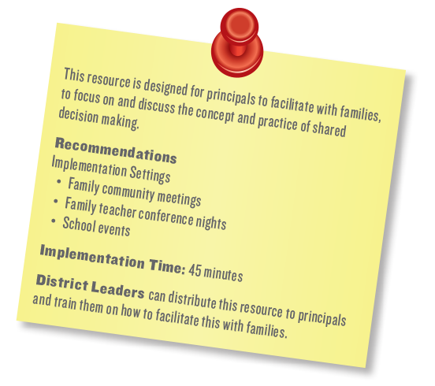
Shared Decision Making for Principals: Building Powerful Partnerships Between Families and Teachers

Slide 2
Learning ObjectivesObjectives
Participants will:
Understand what shared decision-making means;
Explore shared decision-making within the formative assessment; and
Identify ways parents can collaborate with teachers in shared decision-making processes.
Notes:
This resource was designed to be facilitated with families to help them better understand the concept and practice of shared decision-making. Depending on the size of the group, your pacing, the need for language interpretation, and the amount of time you want to allow for activities with discussion, you will need approximately 45 minutes to facilitate the session.
What to do:
Welcome. I’m pleased to see so many of you and excited that we’ll be thinking about how we can work together to make the important decisions that impact your children’s development and learning. This session is about shared decision-making, and we will learn about this process over the next 90 minutes.
2

Slide 3
Decision Making
A decision is made when you have many choices and you choose one as your focus. You make lots of decisions everyday!
Notes:
What to do:
Say
As a parent you make decisions everyday. Little ones….cereal or eggs for breakfast… and big ones….buy a new tire for the car or get it repaired again?
You have choices and you exercise your choice when you make a decision.

Slide 4
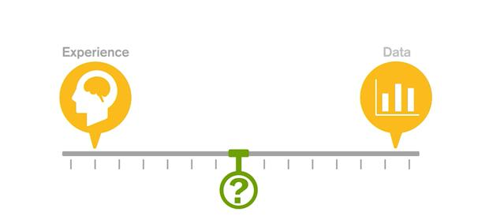
Decision-Making Spectrum
Notes:
What to do:
Ask
How do you go about making a decision for yourself? For your child?
What are the similarities and differences in your decision-making process when you are deciding something for yourself compared to deciding something for your child? Take a minute and think about your process.
Ask
Would anyone like to share their decision-making process with us?
Say
As you heard, people make decisions in all sorts of ways:
They gather information from the internet, books, television, etc.
Ask trusted others for their opinions
Do what just ‘feels’ right
Rely on their own past experiences –positive and negative
Rely on an ‘experts’ advice
Flip a coin
Never decide and go with whatever happens
Decision-making lies somewhere between our experiences (what we know about something or think we know), our hopes and dreams (what we are wishing to happen) and the data (different forms of evidence that we’ve gathered).
In education, we also make decisions, big and small, every day and they all impact your child in some way or another. While we use our experience with your child to help us make decisions, we also rely heavily on the data--- information and knowledge we have of your child as a learner and how he or she has experienced being a student.
At our school, we rely on parents to partner with us in making the decisions that impact their child’s learning and development. We don’t want to be the sole decision-maker when the stakes are so high, especially when families have specific hopes and dreams for their child that need to be included in the child’s learning goals. We want you to help us make the best decision that we can, based on the information we’ve gathered and knowledge we’ve constructed, about your child as a learner and a person.
That process of making decisions together is called shared decision-making or SDM. The information you offer and your knowledge of your child is the data we use to make those instructional decisions with you.

Slide 5
What is Shred Decision Making?
Notes:
What to do: Have paper and pens available for participants to use Have timer ready to set to 3 minutes for the turn-and-talk Say Take a moment and consider these words, ‘shared’ and ‘decision making.’ What images or experiences come to mind as you think about them separately and then together? Separately, the word ‘sharing’ may conjure up images of you and a friend or loved one sharing a warm blanket and cup of hot chocolate as it rained or snowed outdoors; crying or laughing together as you watched a movie; or snuggling with a child as you read a favorite bedtime story book together. It may also bring up for you some not-so-pleasant experiences of, as a child, being forced to share a favorite toy or loved possession with another child; sharing a favorite item of clothing or a bed or room with a sibling or relative, or even as an adult, the requirement to share office or desk space with a colleague. What about ‘decision making?’ Does that word make you feel powerful… someone able to wield authority and make things happen or possibly anxious and concerned about how you will be perceived by others, as well as, the ‘correctness’ of your decisions? How burdensome does it feel to you to ensure that you are making the ‘right’ decision? One relevant definition of ‘sharing’ is to participate in, use, enjoy, or experience jointly. The Merriam-Webster dictionary defines ‘decision-making’ as the act or process of deciding something especially with a group of people. Now put those words together- ‘shared’ and ‘decision-making.’ Let’s do a 3 minute turn-and talk with your elbow partner and come up with a written, shared definition of this concept.

Slide 6
Shared Decision Making
is a process that provides opportunities for families and educators to work together to set learning and development goals on behalf of the children.
Shared decision-making benefits schools and families.
Notes:
What to do: Have an easel pad and markers or whiteboard available Read the slide Ask By a show of hands, how many of you had some or all of the words in bold as a part of your definition? Any other words you thought were important to include in your shared definition? Do If yes, list the words on a whiteboard or easel pad Working with the group, re-read the definition aloud and insert any new words Write on an easel pad or whiteboard the edited definition to capture any words, core values or beliefs about the concept of shared decision-making or partnering with teachers that the group determines is essential moving forward. Display the new definition where everyone can see it and refer to it over the course of the session Say: The purpose of shared decision-making is to create a shared process where everyone makes decisions together. These decisions are discussed and agreed upon. These decisions are an effort to support and enhance student achievement and success in both the school and home contexts, through improvement of instructional programs and delivery of support services

Slide 7
What Does Shared Decision Making Look Like With Teachers?
Notes:
What to say: We’ll now talk about how shared decision-making within your child’s learning can be possible in our school.

Slide 8
Formative assessment provides teachers with an unfolding picture of your child as a learner and person. Formative assessment help teachers identify concepts that students are struggling to understand, skills they are having difficulty acquiring, or learning standards they have not yet achieved so that adjustments can be made to lessons, instructional techniques, and academic support.
http://edglossary.org/formative-assessment/
Notes:
What to do:
Teachers gather planned observations and other informal and formal assessments which help them to appreciate your child’s unique qualities and strengths, to develop the right goals, and to plan, implement, and evaluate effective teaching. Pre-Kindergarten through 3rd grade teachers then use those assessments to guide student learning and support growth as your child develops in school.
Source: National Board for Professional Teaching Standards, Standard 3: Early Childhood Generalist Standards, 2012
image: opalschoolblog.typepad.com
8

Slide 9
Parental Input
My dream for Stephen is to be a great student, a great athlete, but primarily a great person. For him to be a very educated child, responsible with his things, and very humble. In a few words, I would like him to be an exemplary child.
- Stephen’s Father
Notes:
What to do:
Say
Who better to help ‘paint that picture’ of your child, than you?
Read the slide
Say
You and other family members bring a broad array of information, feelings, beliefs and expectations relevant to your child’s experience at school:
the child’s temperament, health history, and behavior at home;
family expectations, fears, hopes and dreams about the child’s success or failure;
culturally-rooted beliefs about child-rearing;
your experiences of school and beliefs about your role in relation to school professionals;
your sense of control and authority, and other personal and familial influences.
You can provide teachers with your initial ‘assessment data’-- information about your child’s strengths and needs, as well as, who your child is as an individual, family member, and member of your cultural and linguistic community.
Say
Formative assessment gathered by both the teacher and parent is an opportunity AND a strategy for teachers and families to paint a fuller, more comprehensive and realistic picture of your child. From there, decisions can be made jointly as to the direction and next steps in your child’s development and learning.
Source: Office of Head Start, National Center on Parent, Family and Community Engagement. (2011). Family Engagement and Ongoing
Child Assessment series.
9

Slide 10
A Detailed Picture of Your Child
Notes:
What to say:
We’ll now talk about how shared decision-making within your child’s learning can be possible in our school.
10

Slide 11
A shared decision-making process involves…
Recognizing your strengths;
Solving problems together;
Developing a course of action; and
Collaborating with the teacher.
Notes:
What to do:
Anything else you think may be important in the shared decision-making process with teachers?
Read the slide
What might be some strengths that you or other families bring to the decision-making process on behalf of your child’s learning?
(Examples: good listeners, have extensive knowledge of the child’s role within the family; or have deep understanding of the cultural expectations for the child.)
What challenges might you or other families face while participating in the process? (Examples: work schedule and responsibilities, language differences, transportation needs, conflicting schedules with older and younger siblings.)
What needs to be in place to support you or other families in shared decision-making with the school? (Examples: child care offered at meetings, evening meetings with teachers, ride-share, interpreters)
11

Slide 12
Things You Need to Know
3
Notes:
What to do:
There are 3 essential elements to consider in order for you to engage meaningfully in the shared decision-making process with your child’s teacher or other support staff:
You have access to your child’s individual learning and development information.
Information that is shared by teachers is understandable and meaningful to you.
3) You put the information you receive and share into action
Let’s discuss each of them in turn.
Source: OHS National Center on Parent, Family and Community Engagement. (2011). Family Engagement and Ongoing
Child Assessment series. Retrieved from the Office of Head Start Early Childhood Learning Knowledge Center.
12

Slide 13
You have access to your child’s development information
1
Notes:
What to do: Read the slide This means that both families and staff have important information to share about a child’s development. Parent observations inform teaching at various points in the assessment cycle, while teacher-conducted assessments provide parents a comprehensive picture of their child’s progress at school. Source: OHS National Center on Parent, Family and Community Engagement. (2011). Family Engagement and Ongoing Child Assessment series. Retrieved from the Office of Head Start Early Childhood Learning Knowledge Center. Image: Latimes.com

Slide 14
You can share your expert knowledge with schools by:
Sharing what you see your child do and what he or she works on outside of school;
Communicating with teachers through school visits, parent–teacher meetings, phone calls, text messaging, and secure online platforms; and
Discussing with your child’s teacher what you’ve learned at parenting education sessions.
Notes:
What to do:
Read the slide or have 3 participants read each bullet in turn
Which of these strategies do you currently use with teachers?
What could you add to your list of information sharing strategies? What has been a struggle?
14

Slide 15
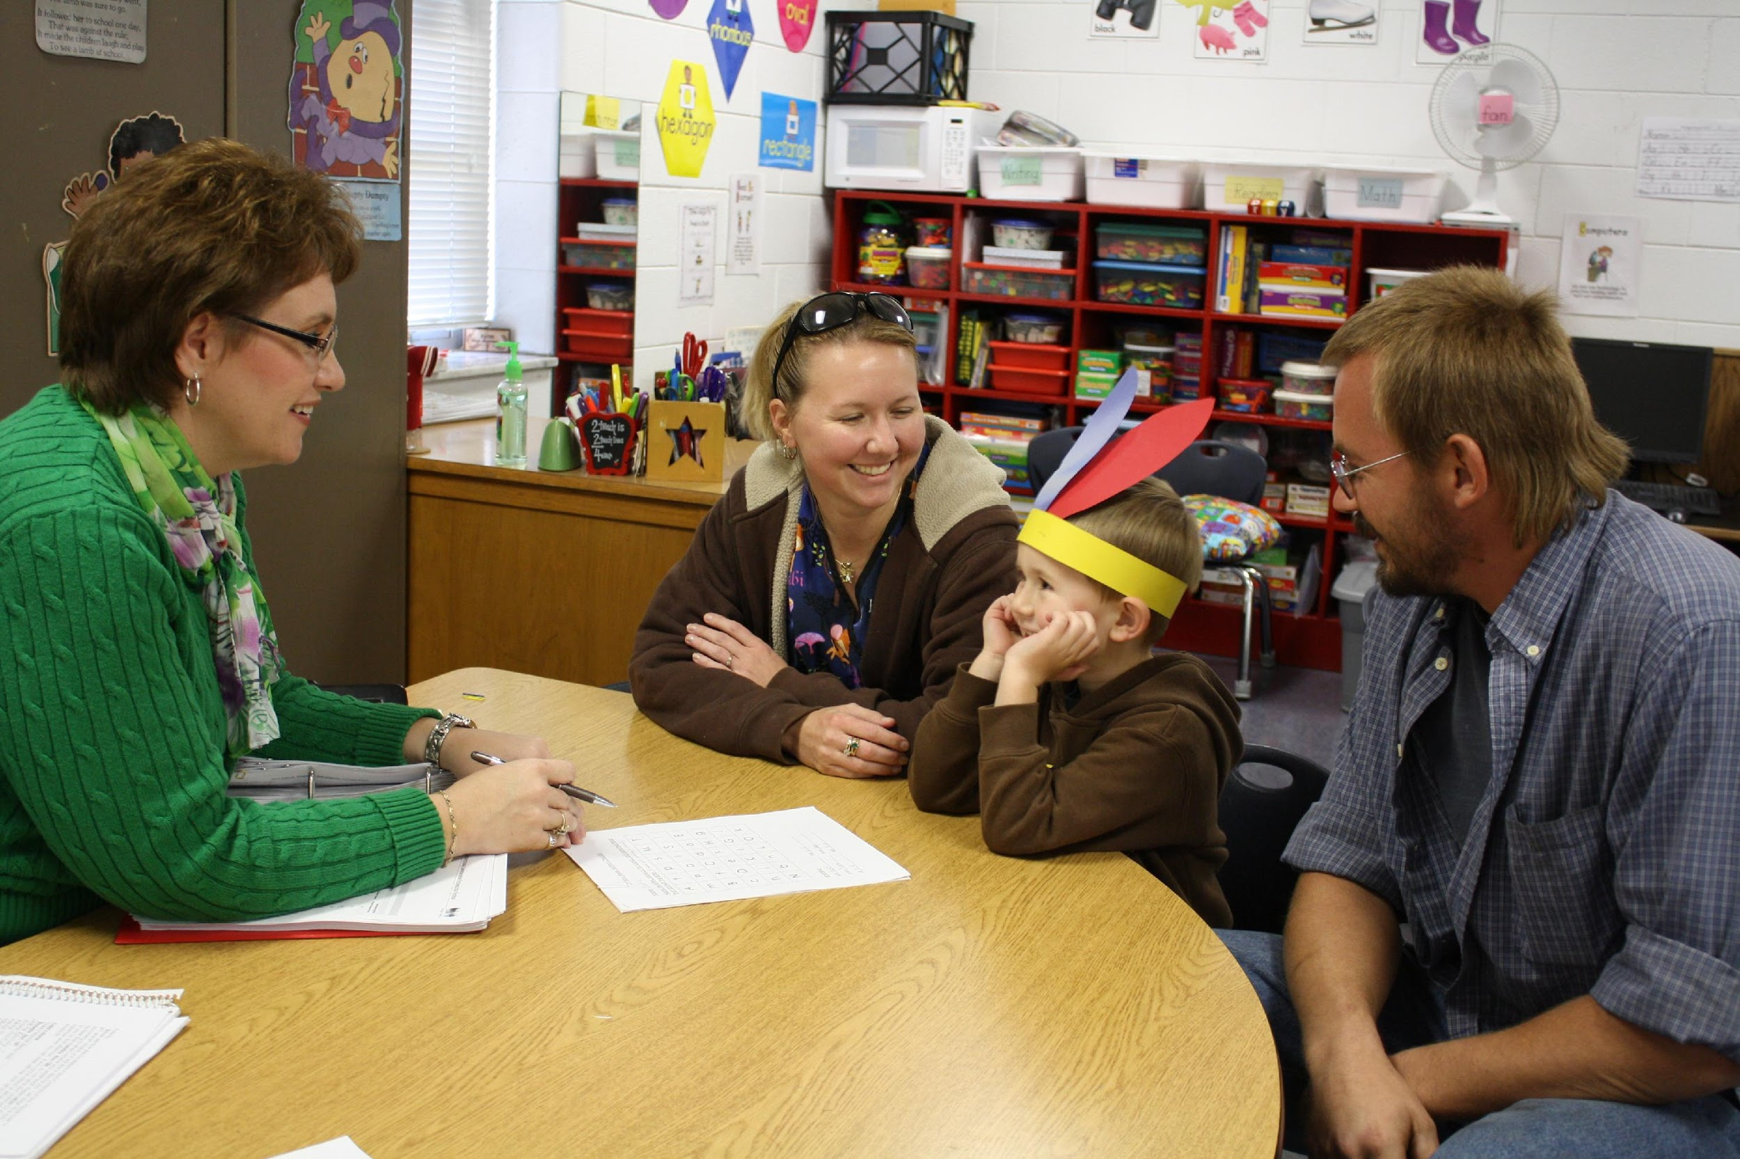
Information that is shared must be understandable and meaningful to you
2
Notes:
What to do:
Read the slide
This means that child assessment information must be made clear and meaningful to families. Teachers need to help you understand what their assessment information means about your child’s learning and development. Families need to help teachers understand their assessment information in light of their observations of their child at home and in other settings.
15

Slide 16
Ways that school staff can ensure that child information is meaningful to you include:
Discussing the purposes of assessment;
Sharing what the next stage of learning will be; and
Listening to your hopes, concerns, and questions.
Notes:
What to do:
Read the slide or have 3 participants read each bullet in turn
What to say:
The general goal of formative assessment is to collect detailed information that can be used to improve instruction and student learning while it’s happening. http://edglossary.org/formative-assessment/
It can help you understand what the next stage of learning will be (e.g., kindergartener is about to write their full name, 1st grader is about to decode 2-syllable words), so you can anticipate and look to support that next stage.
Share your hopes, concerns, and questions about how and whether your child’s development and learning will move forward.
16

Slide 17
Parents should be supported by teachers, the principal, and other parents in putting the information into action
Notes:
What to do: Read the slide Children greatly benefit when teachers and parents share information in order to co-design activities that parents can do at home and in the community to support learning. School effectiveness and children’s school readiness will be enhanced when data is shared and acted upon. Sharing data helps to focus conversations on what is and isn’t working, and on action steps that support children’s learning, parent engagement, improved teaching, and improved program quality.

Slide 18
Some ways that staff and families can jointly put information into action:
Translating information into daily activities;
Sharing information with each other; and
Supporting transitions from preschool to school and between grade levels.
Notes:
What to say: - Translating assessment information from different areas of learning into every day activities. - Sharing information with each other about resources within the community that can support children’s learning, such as programs at the library or community center. - Supporting transitions from preschool to school and between grade levels by helping families feel comfortable in communicating and describing their child’s accomplishments, strengths, and challenges. There are many things all of you are already doing to put into action the information that you’ve shared and learned about your child. These may be some other things for you to consider, such as ideas for bullet #1. For example, every day literacy can be advanced with parent–child conversations about directional signs as they travel together or labels on food items at the grocery store. Every day math skills can be reinforced when parents and children sort through socks, counting them and organizing them into colors, before selecting a pair to wear. A shared decision-making conversation focuses on: Progress Assignments and assessments Your thoughts about your child Supporting learning at home Supporting learning at school What to do: During shared decision-making conversations you will want to focus on the following: Progress: Find out how your child is doing by asking questions like: Is my child performing at grade level? How is he or she doing compared to the rest of the class? What do you see as his or her strengths? How could he or she improve? Assignments and assessments: Ask to see examples of your child’s work. Ask how the teacher gives grades. Your thoughts about your child: Be sure to share your thoughts and feelings about your child. Tell the teacher what you think your child is good at. Explain what he or she needs more help with. Support learning at home: Ask what you can do at home to help your child learn. Ask if the teacher knows of other programs or services in the community that could also help your child. Support learning at school: Find out what services are available at the school to help your child. Ask how the teacher will both challenge your child and support your child when he or she needs it.

Slide 19
Shared decision-making conversations work best when they:
Are a two-way conversation;
Focus on learning; and
Highlight opportunities and challenges.
Notes:
What to do:
Say
A two-way conversation:
Like all good conversations, shared decision-making conversations are best when both people talk and listen. When you tell the teacher about your child’s skills, interests, needs, and dreams, the teacher can help your child more.
Emphasis on learning:
Good shared decision-making conversations focus on how well the child is doing in school. They also talk about how the child can do even better. Be sure to bring a list of questions that you would like to ask the teacher.
Opportunities and challenges:
Just like you, teachers want your child to succeed. You will probably hear positive feedback about your child’s progress and discuss areas where there is room for improvement. Be ready to ask questions about ways you and the teacher can help your child with some of his or her challenges.
Source: Parent–Teacher Conference Tip Sheets for Principals, Teachers, and Parents. Harvard Family Research Project, October 2010
These tips are based on the following resources:
Henderson, A., Mapp, K. L., Johnson, V., & Davies, D. (2007). Beyond the bake sale: The essential guide to family-school partnerships. New York: The New
Press.
Lawrence-Lightfoot, S. (2003). The essential conversation: What parents and teachers can learn from each other. New York: Ballantine Books.
Pappano, L. (2007). Meeting of the minds. Harvard Education Letter, 23(4), 1–3.
19

Slide 20
Reflections and Closing
Notes:
20

