Slide 1

2011-12
State Scoring Guide
Professional Development:
Assessing the Essential Skill of Reading
Level 3 – In-Depth Training for English Language Arts Teachers
Information provided by
Oregon Department of Education
2011-12
Notes:
This PowerPoint presentation is intended to be used as part of a 4 to 4 ½ hour in-depth training session for English Language Arts teachers. Ideally, participants should have attended an introductory training session previously, although that is not mandatory.

Slide 2
Goals
Participants will
Understand current information about Adolescent Literacy Instruction and Assessment
Be able to apply the Official Reading Scoring Guide to Student Work accurately
Be aware of Common Core State Standard for Reading and for Literacy in the Content areas.
Know about resources & further professional development available
Notes:
Goals for the training session

Slide 3

Adolescent Literacy
Notes:
Section 1 – corresponds to Goal 1: Understand current information about Adolescent Literacy Instruction and Assessment

Slide 4
Information Sources
CCSS
Assessments - Adolescent Literacy
Oregon Literacy Framework
Oregon Literacy Framework
Common Core State Standards for English Language Arts & Literacy in Science, Social Studies and Technical Subjects
Assessments to Guide Adolescent Literacy Instruction (Center on Instruction)
Notes:
These 3 documents inform much of the material in this section of the workshop. All three resources are interconnected and support the same concepts in adolescent literacy instruction and assessment.

Slide 5

What is Adolescent Academic Literacy?
The ability to construct meaning in content-area texts and literature including the following:
Notes:
From Assessments to Guide Adolescent Literacy Instruction by Center on Instruction. The full document is available at http://www.centeroninstruction.org/files/Assessment%20Guide.pdf

Slide 6
Slide 6 Blank Title
Ability to
  Make inferences
  Learn new vocabulary from context
  Link ideas across texts
  Identify & summarize important ideas
  Read for initial understanding and think about meaning in order to make inferences or draw conclusions
Torgesen, Houston, Rissman, et al., 2007
Assessments to Guide Adolescent
Literacy Instruction
Center on Instruction
Notes:
Important reading skills for high school students – not all students have these skills.

Slide 7
Three Goals for Adolescent Literacy Instruction
To increase overall levels of reading proficiency
To help students meet increasingly difficult standards in middle and high school.
To assist students who are reading below grade-level to acquire the skills and knowledge necessary to reach high school standards.
Assessments to Guide Adolescent
Literacy Instruction
Center on Instruction
Notes:
There is evidence that current average reading levels of students graduating from high school are not sufficient to meet post-secondary literacy demands, both in many workplace settings and at community colleges and universities (Biancarosa & Snow, 2006; Williamson, 2004).
The practical translation of reaching this goal in the current accountability environment is to have ever higher numbers of students achieve the highest levels of proficiency on state end-of-year reading examinations.
Students must acquire many additional reading skills after third grade in order to be proficient readers in high school. Many students are able to meet grade-level standards in late elementary or middle school, but cannot meet them in high school (Leach, Scarborough, & Rescorla, 2003).
This will require instruction sufficiently powerful to accelerate reading development so that students make more than one year’s progress during one year of school.

Slide 8
Four Components of Assessment/Instruction Cycle
Assess
Instruct
Monitor
Intervene
Notes:
Most high school teachers are familiar with the Assess and Instruct components. And some schools offer intervention, but often it is not tied to assessment and instruction in meaningful ways or is limited to particular programs such as Special Education. Typically, other than for students in special programs, high schools do not adequately monitor student progress and adjust interventions and instruction.

Slide 9

Which students are at risk for not meeting grade-level reading goals?
Assessment data help determine the level of reading risk.
Oregon Literacy Framework
Notes:
Important information – especially because the earlier students are identified and provided with interventions, the more successful they are likely to be.

Slide 10
Reading Assessment Plan
Beginning of Year
Screening & diagnostic assessments
Throughout Year
Benchmark formative assessments
End of Year
Standards-based accountability measures
Assessments to Guide Adolescent Literacy Instruction
Center on Instruction
Notes:
How can reading work samples, scored with the Official Reading Scoring Guide, fit into this type of system? (They can be used for screening and broad level diagnostic purposes, as formative assessments throughout the year, and even as standards-based accountability when used to demonstrate proficiency for the Essential Skill of Reading.) As we heard from teacher quotes in Level 2 Introduction to the Scoring Guide, many students who learned the rubric and practiced completing reading work samples increased their scores on the OAKS assessment as well.

Slide 11

Which high school students do you screen at the beginning of 9th grade?
Notes:
Use raise hands or thumbs up.
Do you screen all 9th graders – how? (what instrument or data set is used?)
Do you screen some 9th graders – which ones?
How do you feel about your current screening plan?
Are you assessing comprehension and fluency? Should you be?

Slide 12
Slide 12 Blank Title
What data are available?
  8th grade OAKS scores !
  Other district data (Easy CBM?)
What data need to be gathered?
  Data for students w/o OAKS scores
  Other screening data as needed
What resources do we have?
  OAKS
  Other district measures
  Reading Work Samples
Notes:
Participants could pair/share and report out on which of these are in use and which they want to know more about. This workshop will provide more practice in scoring work samples and show some curriculum embedded work samples. Information about Easy CBM (a free computer-based test) is available at http://easycbm.com/ Currently, Easy CBM covers up through grade 8, but for many high school students, tests at grade 8 would be appropriate for screening at the beginning of the year, and tests at grades 7 & 8 – or possibly lower could be used to check progress during the year.

Slide 13
Slide 13 Blank Title
Reading Performance | Grade 11 Students Statewide | Percent | OAKS Score Range
Meets or Exceeds | 33,421 | 83.2%
Exceeds | 9704 | 23% | 248 - 300
Meets | 20,691 | 49% | 236 - 247
Nearly Meets | 3170 | 7.9% | 231-235
Low | 3321 | 8.3% | 217 - 230
Very Low | 281 | 0.70% | Below 216
Notes:
These are the state level data from the latest 2010-11 OAKS Reading/Literature test. Participants have a handout which shows data from 2009-10 and 2010-11. Allow time for them to analyze data and have a short discussion. There is much to feel positive about in the increases in student performance at high school over the last 2 years.

Slide 14
Slide 14 Blank Title
Reading Performance | Grade 8 Students Sample District | Percent | OAKS Score Range
Meets or Exceeds | 478 | 64.9%
Exceeds | 143 | 19.4% | 241 - 295
Meets | 335 | 45.5% | 231 - 240
Nearly Meets | 192 | 26.1% | 224-230
Low | 65 | 8.8% | 213 - 223
Very Low | 2 | 0.3% | Below 212
Notes:
Here’s 2010-11 8th grade data from a mid-sized sample district.
What screening plans would you make if these were the data for your incoming 9th graders? (Remember that students may have taken the OAKS test at various times during the school year as 8th graders.) Take a few minutes to discuss these data with a partner or small group. Use the handout “What actions would you recommend if these data reflected your incoming 9th graders?” in the Participant Packet for a small group activity.

Slide 15

The role of Reading Work Samples
Notes:
Transition to how reading work samples can provide valuable information in addition to being a way for students to demonstrate proficiency in the Essential Skill of Reading
Begins Goal 2: Be able to apply the Official Reading Scoring Guide to Student Work accurately

Slide 16
Demonstrating Proficiency in Reading
1. OAKS Reading/Literature Assessment
Score of 236
2. Other Options
ACT or PLAN | 18
WorkKeys | 5
Compass | 81
Asset | 42
Accuplacer | 86
SAT/PSAT | 440/44
AP & IB | various
Notes:
This should be information participants have seen before in earlier workshops. It is just a reminder of the options for demonstrating proficiency: 1. OAKS assessment and 2. other standardized assessments, with required scores. Some of these may be helpful to some students, but more are likely to benefit from the next option: Reading Work Samples
On March 11, 2011 the State Board of Education adopted additional tests and scores for proficiency in the Essential Skill of Reading. They are listed below:
AP English Literature & Composition, AP Macroeconomics, AP Microeconomics, AP Psychology, AP United States History, AP World History, AP European History, AP United States Government & Politics, AP Comparative Government & Politics
All AP tests require a score of 3 or higher to meet proficiency requirements for the Essential Skill of Reading.
IB English Language , IB History of Americas, IB History of Europe, IB 20th Century Topics, IB Economics, IB Psychology, IB Social Anthropology
All IB tests require a score of 4 or higher to meet proficiency requirements for the Essential Skill of Reading.

Slide 17

Local Work Sample
Reading Work Sample scored
using Official State Scoring Guide
Two Reading Work Samples Required
Students must earn a score of 12 or higher on each work sample
Notes:
Option 3 -- Reading Work Samples and the requirements

Slide 18

Level of Rigor
Work samples must meet the level of rigor required on the OAKS assessment.
Work samples provide an optional means to demonstrate proficiency not an easier means.
Notes:
Work Samples require equal rigor but provide a different format to demonstrate proficiency. Workshop Level 4 deals with reading work sample development and how to assure reading selections are at an appropriate level of difficulty.

Slide 19

Four Purposes of an Assessment System
Screen students for reading problems
Monitor Progress
Determine level of reading proficiency compared to high school standards
Diagnose sources of reading difficulty
Oregon Literacy Framework
Notes:
This is from Assessments to Guide Adolescent Literacy Instruction.
Page included in Participant Handouts has the detailed description of each purpose.
Ask Participants: What areas do you feel are missing, or need to be strengthened in your school? Pair & Share or small group.
Additional Handouts include Purposes of Reading Assessments in Grades 4 – 12 from Assessments to Guide Adolescent Literacy Instruction.

Slide 20

Next Steps:
Students on track for success receive literacy instruction and support from classroom and/or content area teachers
Students who need support focused primarily on grade-level vocabulary and comprehension skills
Students at-risk receive further targeted screening tests of basic reading skills
Students needing intensive support
Notes:
Yellow group would be students in the “Nearly Meets” (231 – 235) or whose scores are close to the “Nearly Meets” score of 231.
Red group would be students in the Low (217 to high 220’s) or Very Low category below 216.
Important to note that students in green group still need reading instruction and support in ELA classes and content area classes.

Slide 21

Reading Work Samples
Reading work samples may provide the opportunity that some students need to show their reading skills.
    Most students need instruction and practice in completing reading work samples
    Some students may need additional instruction or targeted coaching to demonstrate proficiency in all three traits
Notes:
Using work samples for Essential Skills proficiency is most appropriate for students who Nearly Meet the standard. However, all students can benefit from learning to explain their reading and using the scoring guide. Some students may increase their proficiency as a result of work samples and the scoring guide which may lead to meeting the standard using work samples or increasing their scores on the OAKS test to meet the standard.

Slide 22

Official Scoring Guide Traits
Demonstrate understanding
Develop an interpretation
Analyze text
Notes:
This is a review opportunity. Have participants use highlighters to mark key words and phrases as you go through each trait in the next set of slides.
Remember, there are 2 versions of the Scoring Guide, one to be used with Informational text and one to be used with Literary text. Demonstrate Understanding has a few differences and Analyze Text differs between the two types of reading selections, which is why there are two scoring guides.

Slide 23

Demonstrate Understanding
“Getting the gist”
Main ideas, relevant details, sequence of events, relationship among ideas, facts/opinions
Literal Comprehension
Notes:
Overview of Demonstrate Understanding. This trait is focused on literal comprehension. Students demonstrate understanding by explaining things like main ideas, details, fact versus opinion, etc.

Slide 24

Develop an Interpretation
“Reading between the lines”
Unstated main ideas/themes
Inferences, interpretations, conclusions, generalizations, and predictions
Inferential Comprehension
Notes:
Overview of Develop an Interpretation. This trait focuses on deriving meaning by inference. Students demonstrate this trait by explaining how they came up with an interpretation, generalization, inference, etc.

Slide 25

Analyze Text ― Informational
“Looking at the author’s craft”
Author’s purpose, ideas
and reasoning
Writer’s Strategies
Textual evidence
Notes:
Overview of Analyze Text. For informational text, students are asked to analyze the author’s purpose and reasoning and the use of various stylistic techniques. The focus is always on the effect of the author’s decisions on the impact of the writing. Students must give specific examples from the text.

Slide 26

Analyze Text ― Literary
“Applying Knowledge of Literature”
Author’s stylistic decisions
Literary elements
Literary devices
Textual evidence
Notes:
Overview of Analyze Text. In Literary selections, students are asked to analyze the author’s stylistic techniques and they may use knowledge of literature to explain the impact on the text. For example, a student might explain how a particular sentence creates a visual picture – with or without using the term imagery. Again, emphasis is on student identifying and explaining examples from the text.

Slide 27

Let’s Score Some Student Papers!
Notes:
The next activity will be scoring 12 student papers. The PowerPoint presentation should be paused during the scoring session and training. Refer to the Facilitator’s Packet for guidance in leading participants through the scoring activity. This important activity, and some of previous slides, support Goal 2: Be able to apply the Official Reading Scoring Guide to Student Work accurately

Slide 28
Demonstrate Understanding
Example
This article is about kids from the western U.S. competing in a robotics team representing their school. Each team of high schoolers must design their own robot and compete against others. This article also gets the message across that we need to work together all the time to solve our problems.
It’s kind of like being a “good sport.” Everyone is helping everyone and cheering on everyone. An example of this is when Eric and Ian were helping the Spokane team so they could compete.
Notes:
Information in Facilitator’s Guide to Leading the Scoring Session.
These are examples of responses to “Robotics” that are at a score level of 4.

Slide 29
Develop an Interpretation
Example
3.) From Venn diagram:
Athletic sports | Similarities | Robotics competitions
Doing whatever it takes to put your competition at a disadvantage | Trying to beat your Competition | Helping your competition
Physical conditioning | Trying to get better | Mental conditioning
Mostly female or male, not mixed | Working as a team | Mixed gender
Most teams the same size | Traveling to face Opponents | Different sized teams
 | Playoff system
 | Rely on teammates
Notes:
Instructions are included in Facilitator’s Guide to Leading the Scoring Session.
This is an example of some responses that different students made to Question #3. All reflect level 4 interpretation.

Slide 30
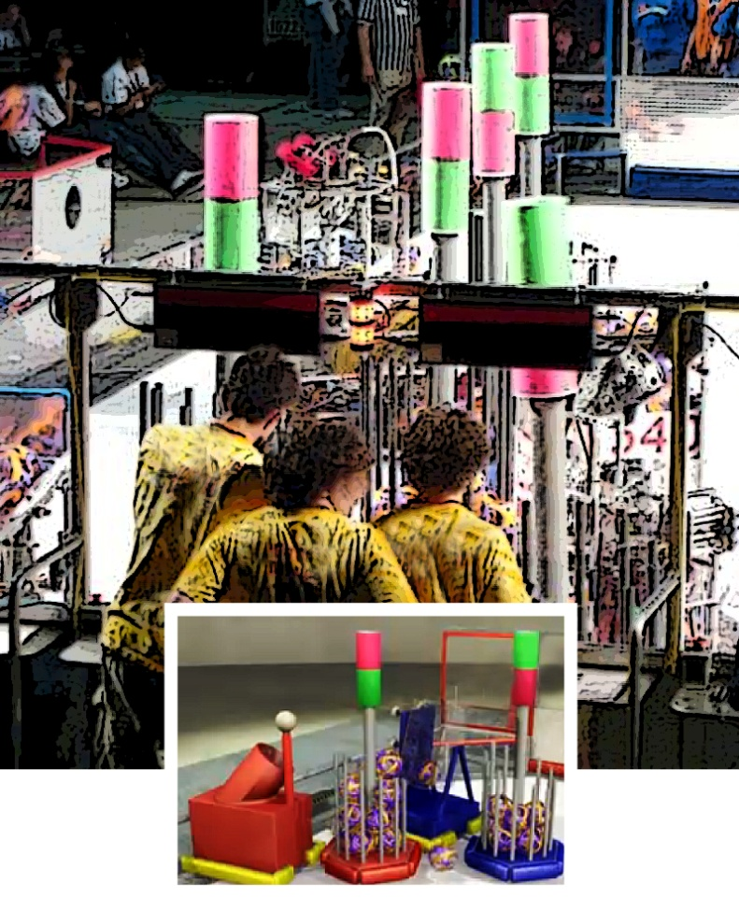
Develop an Interpretation
Example cont.
4.) I think she likes the concept but not fierce competition and the emotions that come with it. “but we took out the bad part…” “…the trying to crush your opponent”
Notes:
Info in facilitator’s packet. Another example of level 4 Develop an Interpretation

Slide 31
Analyze Text: Informational
Question 5
Text from article | How it makes the writing effective
“just as the modern workplace does” | Shows how it will be preparing you for how things will be used when you’re older working a real job
“Robots battle for supremacy in Portland this weekend” | Makes the role of the robots more exciting
Notes:
Directions in facilitator’s packet. Examples of level 4 responses

Slide 32
Analyze Text: Informational
Example
6.) The author makes the robot competition more exciting by calling it a battle. The word battle makes people think about fighting which is more exciting than how they later explain that they will be “moving soccer sized balls into their opponents trailers.” He also uses people who he knows will have nothing but good things to say about the subject like Erica Smith did.
Notes:
Information in Facilitator’s Packet: Example of 4 level response to Analyze Text

Slide 33

How do Work Samples Fit into the big picture?
Notes:
Intro to talking about using the scoring guide in classrooms for multiple purposes.
Supports Goals 1 & 2:
Understand current information about Adolescent Literacy Instruction and Assessment
Be able to apply the Official Reading Scoring Guide to Student Work accurately

Slide 34
Multiple Uses for the Scoring Guide
Screening /Monitoring Tool
  Help determine likelihood of reaching proficiency – on target, need assistance, at risk
  Help determine which students need additional instruction and coaching
Instructional Tool
  Makes targets explicit to students
  Opportunities to show students models from website or other examples
Notes:
This slide is a repeat from the Intro Level 2 Workshop. Issue here is for participants to talk specifically about how they could use the Reading Work Samples & Scoring Guide as a screening/monitoring tool if their school does not have another assessment in place. One concern may be where to get work samples. Developing effective work samples is covered in Level 4 Training on Task Development. More focus on progress monitoring will follow later in these slides.
Remind teachers that they can use the scoring guide in instructional settings with the materials they are already teaching. Have students respond to some questions about a chapter they just read. For instruction, it is very effective to focus on just one or two of the three traits. Teachers do not have to hit all traits all the time.

Slide 35
Multiple Uses for the Scoring Guide
Formative & Interim Assessments
  Inform instructional strategies
  Provide data on student progress
Classroom/ Summative Assessment
  End of unit, course, etc. or Essential Skills
Notes:
Teachers can use Reading Work Samples to determine student progress throughout their courses or on a planned schedule. They do not have to assign all parts of the work sample or score all elements – for example, after a lesson on text analysis, having students respond to only questions on text analysis would be an appropriate use of the scoring guide. As students become increasingly familiar with the Scoring Guide, (student language version was provided in Intro Level 2 workshop and is available on ODE website) they will better understand what good readers do and how to demonstrate those skills so a rater can see the student’s proficiency.

Slide 36

Slide 36 Blank Title
“Clearly, increasing student performance through the use of formative assessments involves much more than simply adding assessments to the educational program; …
. . . it is likely to involve fundamental changes in teacher instructional practice as well.”
Assessments to Guide Adolescent Literacy Instruction
Center on Instruction
Notes:
This is an important point. Especially as the CCSS call for more use of various assessments and the SMARTER Balanced Assessment (the consortium Oregon belongs to) will use many performance tasks.

Slide 37

High School
Reading Progress Monitoring
Notes:
Continues depth in Goal 1: Understand current information about Adolescent Literacy Instruction and Assessment
Deliberate, methodical monitoring of student progress in reading skills is a relatively new concept for high school teachers – previously the domain of Title 1 teachers or Reading Specialists.

Slide 38
Slide 38 Blank Title
“In order to target instruction effectively, to re-teach when necessary, to offer needed support, and to provide appropriately challenging assignments, teachers must have an ongoing and accurate understanding of their students’ literacy capabilities.”
Torgesen & Miller, 2009
Notes:
From Assessments to Guide Adolescent Literacy Instruction
How are you addressing the needs of your diverse readers?
How do you know what their needs are so that you can begin to address them?
How strategic are you in the use of your team time to address the reading needs of all students in your school?

Slide 39
Initial Issues
Students in Regular Program
Students w/ Supplemental Support
Students in Special Programs
Blank for accesibility
How is reading instruction provided?
How is progress monitored?
What additional support is provided/needed?
How is progress monitored?
What is end of school plan?
How is progress monitored?
Notes:
Walk through the three groups of students. In most high schools, students in the regular program are not receiving reading instruction or progress monitoring. Good discussion point. This could be a participant activity.
Are students in your high school who need additional supplemental support receiving it? Are ELA teachers responsible for this instruction or are there supplemental programs or teachers? How is student progress monitored?
Which students are enrolled in special programs? There are probably several programs including various levels of Special Education, ELL, and possibly other programs. What are end of school (diploma) plans? What kind of instruction and progress monitoring is being done there?

Slide 40

Why Monitor Progress?
Schools need timely information on whether students are making enough progress to reach the outcomes in the timeframe for which the outcome goals are set.
Oregon Literacy Framework
Notes:
The key is looking at the student’s trajectory. Based on the current progress, chart future goals and timelines and check frequently to see if student is making progress toward those goals.

Slide 41
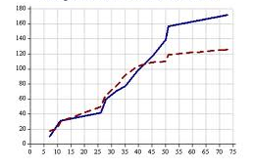
Progress-monitoring Considerations
Schools need to analyze and interpret progress-monitoring data as soon as it is collected…in order to compare the rate of student progress to the rate needed to reach the goal…
Oregon Literacy Framework
Notes:
Many schools gather a variety of student performance information and many more will begin using Reading Work Samples. But is this information gathered in one data system? And is it analyzed and results used to make decisions about student instruction on group or individual bases?

Slide 42

Types of Measures for Progress-Monitoring
Classroom assessments
Reading Work Samples
Other measures
Notes:
Progress monitoring can be done on a planned cycle (especially important for students who are reading below grade level/ Essential Skill proficiency level). But classroom assignments, including reading work samples, can give valuable information on student progress also. Have participants use handout “How is progress monitoring going in your school?” to pair/share, work in small groups etc. and report out.

Slide 43
How do we monitor student progress?
“Policymakers often hope that data will automatically lead to improved practice.
However, experience shows that data must be accompanied by the reporting systems, professional development, support structures, and management practices that will impact teacher and student beliefs and behaviors”
Perie, Marion, & Gong, Brian, 2007
Assessments to Guide Adolescent Literacy Instruction
Center on Instruction
Notes:
4 specific needs: Reporting System; Professional Development Plan; Support Structure; Management Practices.

Slide 44

Slide 44 Blank Title
What are the Common Core State Standards for Reading?
How do they fit in with reading work samples and the scoring guide?
Notes:
Goal 3: Be aware of Common Core State Standard for Reading and for Literacy in the Content areas.
Teachers should be aware of the new Common Core State Standards. Many districts are beginning curriculum alignment to the standards.
In the participant packet is a handout listing a summary of the core standards for reading for High School. Standards listed under Key Ideas and Details link to Demonstrate Understanding and Develop Interpretation, while Craft and Structure relate to Analyze Text. Facilitator’s have the full document for grades 6 – 12 Reading CCSS.

Slide 45
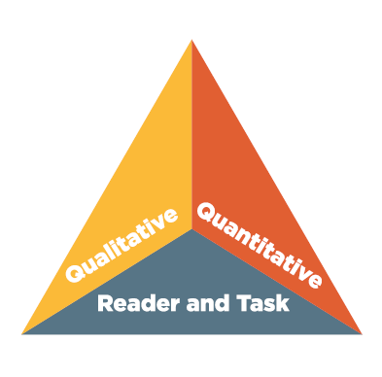
Measuring Text Complexity: Three Factors
Qualitative evaluation of the text:
  Levels of meaning, structure, language conventionality and clarity, and knowledge demands
Quantitative evaluation of the text:
  Readability measures and other scores of text complexity
Matching reader to text and task:
  Reader variables (such as motivation, knowledge, and experiences) and task variables (such as purpose and the complexity generated by the task and questions)
Notes:
Handout in Participant Packet explains this further. Next slide shows effect of increased reading level demands.

Slide 46
Changes in Text Complexity Requirements
Text Complexity Grade Band in the Standards | Old Lexile Ranges | Lexile Ranges Aligned to CCSS expectations
K–1 | N/A | N/A
2–3 | 450–725 | 450–790
4–5 | 645–845 | 770–980
6–8 | 860–1010 | 955–1155
9–10 | 960–1115 | 1080–1305
11–CCR | 1070–1220 | 1215–1355
Notes:
An important change in the CCSS is the level of text complexity students are expected to be able to read independently. Note that the current target score for high school reading work sample text (1070) is at the low end of 11th grade expectations. In the new CCSS expectations, it is below expected reading level for grade 9, and well below expectations for grades 11 – College & Career Ready. This chart is also in Participant’s Packet.

Slide 47

Goals for Reading levels in CCSS
By the end of grade 9, read and comprehend
  in the grades 9–10 text complexity band proficiently, with scaffolding as needed at the high end of the range.
By the end of grade 12, read and comprehend
  at the high end of the grades 11–CCR text complexity band independently and proficiently.
Notes:
These goals will require high school teachers of all subjects to pay attention to student reading skills and provide instruction and support in ways they have not previously been called upon to do.
Texts are defined as literature, informational texts, history/social studies texts, science/technical texts

Slide 48
Three Challenges
Educators Must Address
the need for fundamental change in attitudes and instructional practices,
the need to resolve tensions between teachers and administrators about the types of formative assessments each prefer, and
the need to change educators’ attitudes and beliefs about indicators of student success.
All will require new thinking about the purposes of assessment, student abilities, and teaching methods; attention to new instructional resources; and the
development of new assessment and pedagogical skills.
Assessments to Guide Adolescent
Literacy Instruction, pg 4
Notes:
This information is on a handout in the Participants’ Packet

Slide 49
Resources
Oregon Literacy Framework:
Assessment Section
http://www.ode.state.or.us/search/page/?id=2834
Work Samples
www.ode.state.or.us/go/worksamples
Oregon Data Project:
http://www.oregondataproject.org/
Assessment of Essential Skills Toolkit:
http://assessment.oregonk-12.net/
Notes:
Goal 4: Know about resources & further professional development available (handout in packet has more resources listed)
Here are some site for reading assessment resources. The go/worksamples address does not work as a link, but if you type /go/worksamples in the address line of your browser on the ODE homepage following www.ode.state.or.us, it will take you directly to a page of information on work samples. You can also use the search feature and type in worksamples as one word. Many resources are available in the Resources and Promising Practices section for Reading Work Samples and more are added frequently.
Oregon Data Project provides training in establishing assessment systems and analyzing data, as well as in the specific Essential Skills of Reading, Writing and Mathematics.
The Assessment of Essential Skills Toolkit provides a step by step approach to designing a district assessment system geared to students meeting diploma requirements.

Slide 50
Future Reading Work Sample Trainings
Reading Work Sample Task Development
    Dates:
Contact Information:
Notes:
Fill in any workshop dates you have scheduled and your contact information here.

