Slide 1
The Essential Skill of Writing
Sentence Fluency & Conventions
For Content Area Teachers
An In-Depth Training Session
Notes:
Intro slide – get participants comfortable and oriented.
This is the second in a series of 3 in-depth training sessions. For Content Area teachers, this session will focus on increasing their comfort in scoring Sentence Fluency and Conventions by emphasizing the key components of each trait.
The purpose of this session is to assure that teachers around the state are operating from the same reference for each score point on the scale, but especially in distinguishing between a score of 3 and a 4 for the purpose of establishing proficiency in the Essential Skill of Writing.

Slide 2
Goals for this Workshop
Participants will
Understand the key components of the traits of Sentence Fluency and Conventions
Recognize student performance at different score levels for Sentence Fluency and Conventions
Develop expertise in scoring student writing for classroom and Essential Skills purposes in Sentence Fluency and Conventions
Notes:
These are the main goals for this session. Emphasis is on becoming comfortable and accurate in scoring Sentence Fluency and Conventions.
Remind participants that there are other sessions for Voice and Word Choice (optional).

Slide 3
Sentence Fluency
Notes:
Time to dig into the meat of the session! Use your experience and skills to help participants internalize the important considerations in Sentence Fluency.

Slide 4
Sentence Fluency 1
Is the writing fairly easy to read aloud? (Supply punctuation wherever natural)
Enough variety of:
sentence structures?
sentence beginnings?
sentence lengths?
Notes:
These are key elements addressed in the 4 level of the scoring guide. It is important for participants to see that a paper that scores a 4 in Sentence Fluency is not perfect – but it has more strengths than weaknesses.
Use this slide and the next as you walk participants carefully through the key concepts in Sentence Fluency.
Recommended: Teachers use highlighters to mark words or phrases that help them understand this trait. Refer to Facilitator’s Instructions for Scoring Student Papers.
General Comments about Sentence Fluency:
• Looking for natural flow of language and variety within sentences. For most native speakers of English, the flow within an individual sentence will come fairly naturally, but some effort is needed to avoid repetitious sentence patterns. Beware of leaping to judgment about Sentence Fluency because of weak Conventions -- many students often have more command of Sentence Fluency than we expect due to oral language and a natural sense story-telling.

Slide 5
Sentence Fluency 2
Marking punctuation is scored under conventions. “Sense of sentence” shows when reading aloud.
Missing words can affect fluency
Inverted word order can affect fluency
Notes:
Key Concepts are listed on slide
VERY IMPORTANT to read through punctuation errors. Reading aloud, even if done “in your head,” really helps. Fragments usually connect easily to a sentence before or after. Run-on sentences connected by a comma allow for a natural pause. Other run-ons are more problematic; some provide a natural stopping point because of the structure, but others do not permit a reader to pause, especially those with endless “and,” “so,” “and then,” etc. The error in correctly marking the end of the sentence with a punctuation mark (or not) is scored in conventions, not in sentence fluency.
Point out the value of short, punchy sentences at meaningful points (suspense, excitement, etc.). Watch for examples in training papers. (This helps illustrate bullet regarding variety of sentence length)
Missing words affect fluency--one or two OK (copying errors), but pattern of repeatedly leaving out words is not OK (or consistently missing articles--a, an, the)
Inverted word order also affects fluency.
Sample Papers to score have examples of all of these.

Slide 6
Let’s Review the Scoring Guide
Highlight words and phrases that help distinguish a score of 3 from a 4 in Sentence Fluency
Notes:
The most critical differentiation occurs at the 3 and 4 score points. Don’t neglect the other scores, however.

Slide 7
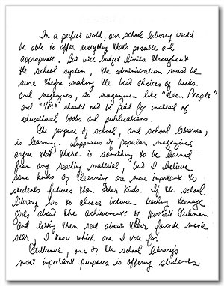
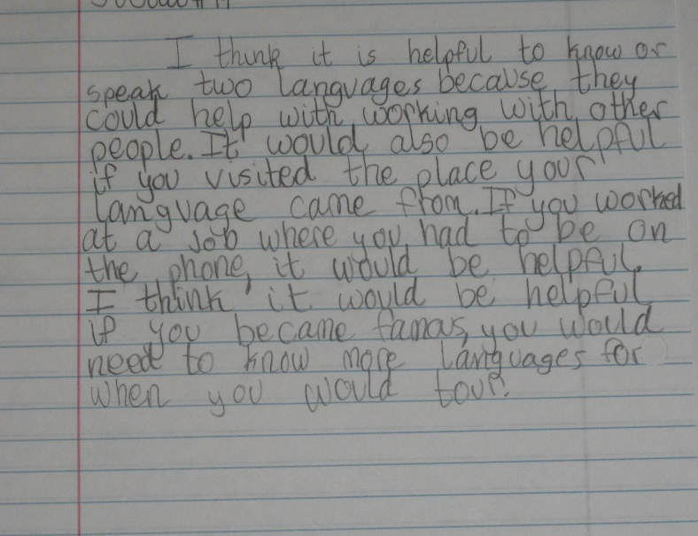
Let’s Score some Papers!
Notes:
You have a set of papers with scores and commentary. Suggestions are included in the facilitator’s packet for which papers to score for Sentence Fluency. Participants have the student papers, but no commentary. Some of these papers may have been used in the previous in-depth training session on Ideas & Content and Organization. Others may be referenced again and scored during subsequent training sessions on Voice and Word Choice.
Recommended: do not provide commentary to participants until all training sessions have been completed – A. Ideas/Content and Organization; B. Sentence Fluency and Conventions; C. (optional) Voice and Word Choice.

Slide 8
Conventions
Notes:
Introduction to Conventions

Slide 9
Conventions 1
Run-on sentences
Spelling
Capitalization
Noun/verb agreement
Fragments
Quotation marks
Notes:
Conventions contains many details. Generally, content area teachers feel comfortable scoring basic conventions such as spelling, run on sentences, and end of sentence punctuation.
This session will focus on increasing comfort and expertise in scoring some of these important basics. Reassure teachers that they are not expected to become “English Teachers,” but that they will easily recognize many of the most common errors in Conventions. If, in the future, when scoring a paper for an Essential Skill work sample, a question arises about a detail in Conventions, an expert rater can be called on to resolve the question.

Slide 10
Conventions 2
Analyze:
Kinds of errors
Significance of errors (refer to grade-level expectations in Skill Level Guidelines)
Proportion of errors relative to overall text length and complexity
Notes:
These are key points to consider with Conventions. The following slides add more about Conventions, including good examples to illustrate the points under discussion.

Slide 11
Conventions 3
Correct end-of-sentence punctuation?
Run-on sentences (none or very few)
Fragments (none or just a few effective ones)
Correct spelling of common words? (grade level appropriate)
Correct capitalization
Notes:
This slide lays out questions to ask about common Conventions in a given paper. Answers of “yes” mean the paper is most likely a 4.
• Tell raters they’ll be looking more closely at end-of-sentence punctuation in slides that follow.
• No magic spelling list; tell raters to trust their judgment about grade level common words.

Slide 12
End of Sentence Punctuation
Notes:
Emphasize the importance of end-of-sentence punctuation in order to earn a 4. At a 3 level the key word is “usually.” A paper could earn a 3 even with a couple of end of sentence punctuation errors, but other conventions would have to be fairly solid.
Examples of run-on sentences and fragments follow. For the purpose of discussion here, a “comma splice” is a type of run-on sentence where two sentences are joined by a period. Participants should just focus on the concept of a run-on sentence.

Slide 13
Run-on Sentences
Notes:
Read examples or have a participant read them aloud. Do not assume participants know these terms and rules. This review is to really solidify their understanding of what terms in the scoring guide mean and how they might appear in student work.

Slide 14
Sentence Fragments
Notes:
Fragments can be very effective. Do not to penalize a paper that includes effective use of fragments. Watch dialogue as it may be an appropriate place for fragment use.
Continue to read and discuss examples aloud.

Slide 15
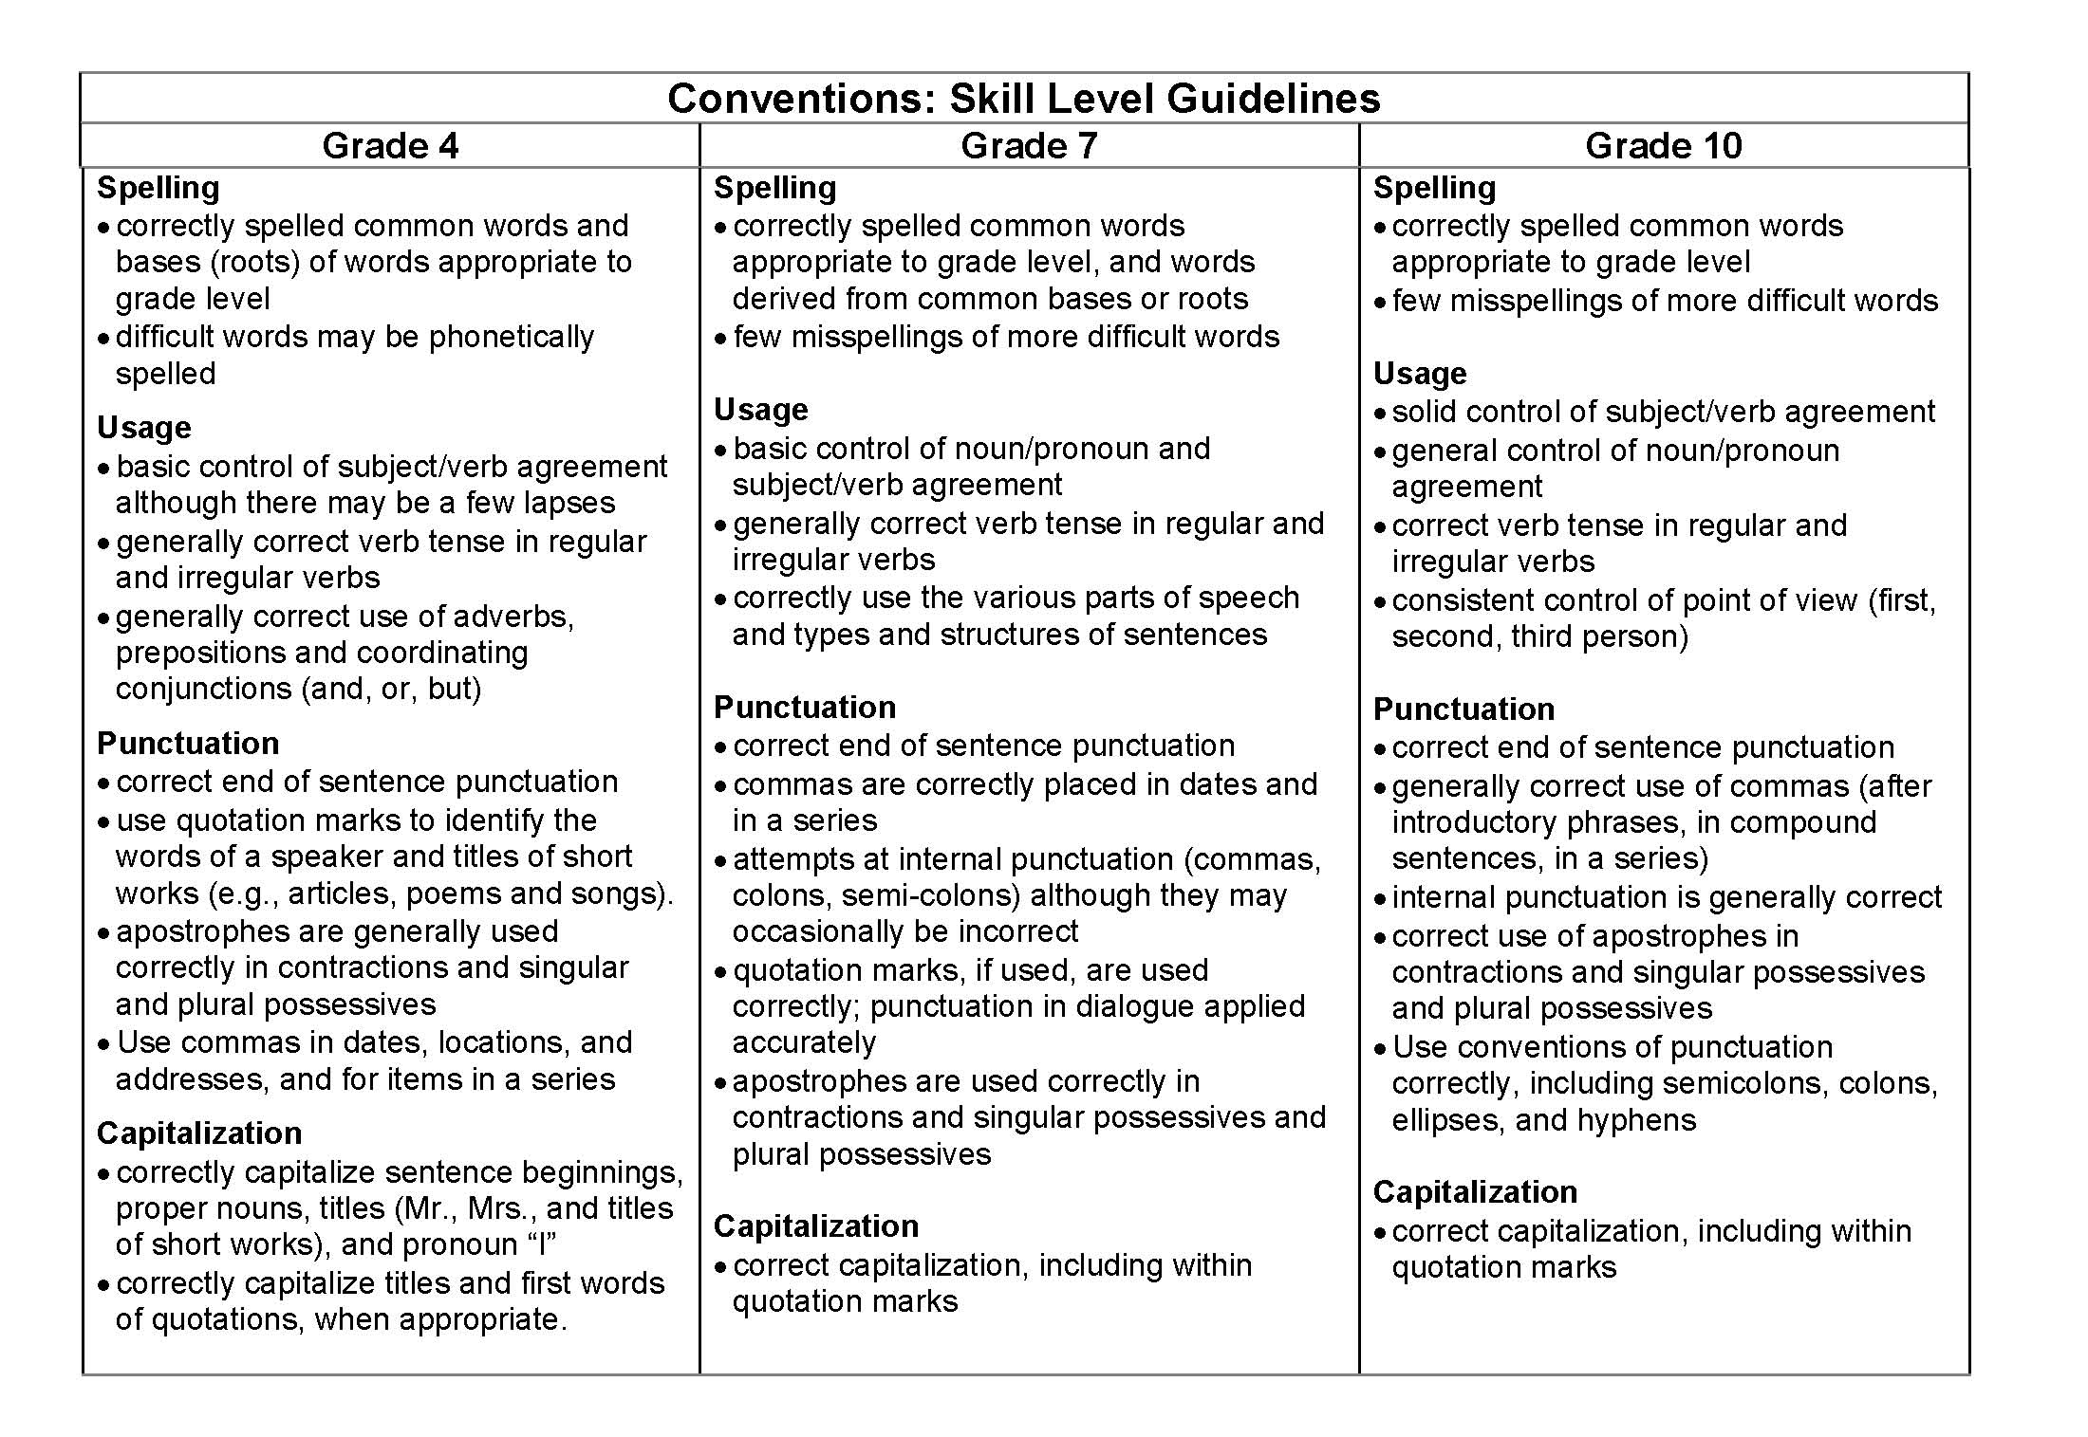
Conventions 4
Notes:
Have participants refer to their handout packet for this chart. It is a useful reference when scoring student papers. Note that we are scoring Usage, not Grammar. We are not scoring a student’s knowledge of parts of speech; rather we are looking for the student’s ability use language correctly. The next slide will help to illustrate this point.
IMPORTANT: Ask participants to make particular note of the adjectives that describe each skill (e.g., “general control of...” is less important than “solid control of...”). These adjectives will help raters understand which skills are considered really important to have mastered at the given grade level.
Relative importance of the skill at the grade level is a significant factor in assigning a score.

Slide 16
Blank for accessibility
Correct usage?
10th: subject-verb agreement
My brother is a nutritionist and my sisters are mathematicians.
Each of the girls sings well.
On the wall were several posters.
Notes:
Subject/verb agreement comes naturally to most native English speakers. Problems are most likely to occur when collective verbs (like class, staff, club) are used or when the sentence is inverted with the subject following the verb.
Next slide illustrate this point with examples from student writing.

Slide 17
Verb Tense: correct? consistent?
Notes:
Verb tense switches often occur in narrative papers that begin in past tense. Then, when the action becomes exciting or suspenseful, students switch to present and begin to switch back and forth between past and present. This would result in a score of 3 or lower, depending on the degree to which the subject/ verb inconsistencies affect the ability to read and understand the paper without re-reading for clarity.
Participants should be alert to verb tense switches.

Slide 18
Consistent Point of View
Notes:
Typically, narrative papers are written in 1st person (I, me, etc.). Expository and persuasive papers are often written in 3rd person (he, she, they, one). “How-to” expository papers may be written in second person (you, your).
It is ok to be somewhat forgiving of a switch to second person when the writer is trying to generalize about something or is attempting to give generic directions for something as in the example in the slide.
Weigh the effectiveness in that case; if the switches don’t occur too often, the paper is generally consistent in point of view, and conventions are otherwise fairly clean, it could still earn a 4.

Slide 19
Quotations, Apostrophes, etc.
If dialogue present, correctly punctuated & paragraphed?
Use quotation marks [ “ ” ] to set off material that represents quoted or spoken language.
In the United States, periods and commas always go inside quotation marks regardless of logic.
Quotation marks used around words to give special effect or to indicate irony are usually unnecessary.
Notes:
This slide is to allow a quick review of quotation marks – another place where students are likely to make errors. Again, the purpose is to reinforce what Content Teachers already know – that quotation marks are used to set off actual words spoken or written by another.
The second bullet is to clarify the correct placement of punctuation in quoted material.
The third misuse of quotation marks occurs so commonly in media and other public forums that a student probably would not be penalized unless this affectation was over-used in a paper.
The next slide quickly reviews the difference between a direct quotation and an indirect quotation.

Slide 20
Direct vs. Indirect Quotations
Mr. Johnson, who was working in his field that morning, said, "The alien spaceship appeared right before my own two eyes."
Mr. Johnson, a local farmer, reported last night that he saw an alien spaceship on his own property.
Notes:
First example is a direct quotation – the exact words the person said.
Second example is an indirect quotation – the general idea of what the person said.
Remember – your participants know this information; this is a review. Be sure you don’t appear to be “talking down” to your colleagues!

Slide 21
Slide 21 Blank Title
Notes:
Refer to this handout in the participants’ packet.
These errors often occur with ELL papers. The purpose of this handout is to be sure participants are being thoughtful about the kinds of errors they’re seeing and assigning lower scores in only the appropriate trait.
Review the examples, which were drawn from real student writing for the statewide writing assessment. Emphasize which trait is affected and discuss why so that participants feel comfortable that they can recognize and correctly score these types of errors.
Papers for the statewide assessment and for Essential Skills worksamples, must be scored for Standard Written English. Note that an occasional error can be overlooked – it is the pattern of repeated error that lowers the score.

Slide 22
Let’s Review the Scoring Guide again
Highlight words and phrases that help distinguish a score of 3 from a 4 in Conventions
Notes:
Again, focus is on helping participants distinguish between a 3 and 4, but go over other score points as well.

Slide 23
Let’s Score some Papers! again
Notes:
Time to rate student papers. Again, your facilitator list will identify papers that would be good exemplars of conventions.

Slide 24
Resources to Practice Scoring
ODE High School Writing Samples: http://www.ode.state.or.us/search/page/?=527
OPEN Scoring Site: http://www.openc.k12.or.us/scoring/
Clackamas ESD Writing Samples http://www.clackesd.k12.or.us/cie/writing.html
Notes:
These are three resources where teachers can find papers to score for Sentence Fluency and Conventions (and all other traits) and then compare their scores with the official scores.

Slide 25
Thank you for your attention!
Notes:
Final slide – Remind participants of training sessions on Voice & Word Choice (optional). If you have scheduled this session, give the dates and encourage participation.

