Slide 1
The Essential Skill of Writing
Voice and Word Choice
For Content Area Teachers
An In-Depth Training Session
Notes:
Intro slide – get participants comfortable and oriented.
This is the third in a series of 3 in-depth training sessions. For Content Area teachers, this session will focus on increasing their comfort in scoring Voice and Word Choice by emphasizing the key components of each trait.
Some content teachers may not currently value the traits of Voice and Word Choice, especially because they appear to be “devalued” by virtue of not counting for Essential Skill proficiency. One goal for this session is to help teachers see the value of including these traits in their content instruction and in classroom assessments.
The purpose of this session is to assure that teachers around the state are operating from the same reference for each score point on the scale, but especially in distinguishing between a score of 3 and a 4 which tends to be the balancing point in these traits as well. It is easy to recognize a high paper (5 or 6) and low papers (1 or 2) are often low in these traits because they are so short that it is difficult to see enough evidence of the trait to award a 3. The majority of papers fall into the 3 versus 4 category.

Slide 2
Goals for this Workshop
Participants will
Understand the key components of the traits of Voice and Word Choice
Recognize student performance at different score levels for Voice and Word Choice
Develop expertise in scoring student writing for classroom purposes in Voice and Word Choice.
Notes:
These are the main goals for this session. Emphasis is on becoming comfortable and accurate in scoring Voice and Word Choice.
Remind teachers that Voice and Word Choice do not have required scores for Essential Skills proficiency, but that they are both critical skills for students to develop as part of becoming capable writers.

Slide 3
VOICE
Notes:
Time to dig into the meat of the session! Use your experience and skills to help participants internalize the important considerations in Voice.

Slide 4
Slide 4 Blank Title
The position of a writer and his or her concept of the audience impose style constraints on the writing.
Scholarly writing, for example, usually avoids figures of speech and prefers precise descriptions to colloquial terms that might be found more often in more familiar forms of writing, such as text messages or personal blogs.
News reporting requires precise words, even if colloquial, and shorter sentences, to be easy to read by a general audience.
Notes:
This and the next slide offer examples of different approaches to Voice based on the type of writing.
Point out that Style here includes both Voice and Word Choice.

Slide 5
Slide 5 Blank Title
Fiction writing, in contrast, is designed to entertain and arouse the reader and is improved by the judicious use of figures of speech.
A judge's verdict needs to explain how the verdict corresponds to other rulings, but often uses literary devices to persuade the reader of its correctness.
Wikipedia
Notes:
Ask participants: What type of writing do students do most frequently in your classes? What type of voice is most appropriate in those assignments? How do your students know what “voice” to use in writing for you?

Slide 6
Voice 1
Voice is the author's style, the quality that makes his or her writing unique, and which conveys the author's attitude, personality, and character; OR
Voice is the characteristic speech and thought patterns of a first-person narrator; a persona
Notes:
Basic definition -- overview

Slide 7
Voice 2
Voice present? (commitment to topic, sincerity, other possible indicators in Scoring Guide)
Voice appropriate for topic, mode, writing situation?
Voice consistent enough?
Notes:
These are key elements addressed in the 4 level of the scoring guide. It is important for participants to see that a paper that scores a 4 in Voice may not reach emotional heights of grandeur – but it has more strengths than weaknesses.
Recommended: Teachers use highlighters to mark words or phrases that help them understand this trait here or later in this training.
General Comments about VOICE:
• Be VERY aware of mode before assigning score; straightforward tone appropriate for expository and persuasive
• When students are not allowed to use outside resources, a personal voice is usually appropriate. A formal, more academic voice is usually more appropriate for classroom work samples in which outside resources are utilized.
• On the state assessment, it is common to see a 3 given when a narrative that should be exciting or suspenseful is conveyed in a flat tone

Slide 8
Slide 8 Blank Title
Notes:
Participants have this handout in their packets. Have them pair and share or work in small groups and report out to explain the 4 purposes (modes). You could divide the group into 4 and give them chart paper and have each group explain what characteristics that mode calls for in Voice.
Be sure to discuss point #2. Many expository papers in content areas call for the writer to take a more distant, objective stance.

Slide 9
Slide 9 Blank Title
“Writing with no voice is dead, mechanical, faceless. It lacks any sound.
Writing with no voice may be saying something true, important, or new; it may be logically organized; it may even be a work of genius. But it is as though the words came through some kind of mixer rather than being uttered by a person.
Notes:
First part of quote on importance of voice – especially as it relates to informational (non-literary) writing.

Slide 10
Slide 10 Blank Title
Extreme lack of voice is characteristic of bureaucratic memos, technical engineering writing, much sociology, many textbooks.”
Peter Elbow
Notes:
Conclusion of quote – ready to move into scoring papers

Slide 11
Let’s Review the Scoring Guide
Highlight words and phrases that help distinguish a score of 3 from a 4 in Voice
Notes:
The most critical differentiation occurs at the 3 and 4 score points. Don’t neglect the other scores, however.

Slide 12
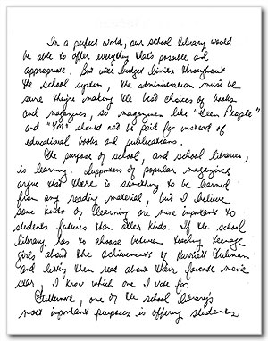
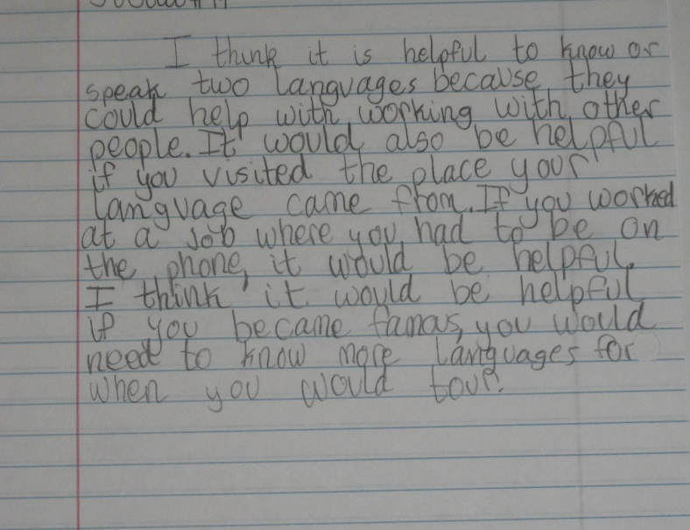
Let’s Score some Papers!
Notes:
You have a set of papers with scores and commentary. Suggestions are included in the facilitator’s packet for which papers to score for Voice. Participants have the student papers, but no commentary. Some of these papers may have been used in the previous in-depth training session on Ideas & Content and Organization and Sentence Fluency & Conventions.
Refer to Facilitator’s Instructions for Scoring Student Papers.
You may wish to provide the written commentary on the papers to participants who have now completed all training sessions – A. Ideas/Content and Organization; B. Sentence Fluency and Conventions; C. (optional) Voice and Word Choice.

Slide 13
Word Choice
Notes:
Introduction to Word Choice

Slide 14
Slide 14 Blank Title
“The difference between the almost right word & the right word is really a large matter--it's the difference between the lightning bug and the lightning.”
Mark Twain
Notes:
Famous, often used quote – but to the point about word choice.
Have participants discuss the importance of using correct technical terms related to their subject area – this is part of word choice also.

Slide 15
Let’s Review the Scoring Guide again
Highlight words and phrases that help distinguish a score of 3 from a 4 in Word Choice
Notes:
Again, focus is on helping participants distinguish between a 3 and 4, but go over other score points as well.

Slide 16
Let’s Score some Papers! again
Notes:
You have a set of papers with scores and commentary. Suggestions are included in the facilitator’s packet for which papers to score for Word Choice. Participants have the student papers, but no commentary. Papers may be referenced again during other in-depth training session on the traits.
You may wish to provide commentaries on scores and papers to participants who have completed all three in-depth training sessions – A. Ideas/Content and Organization; B. Sentence Fluency and Conventions; C. (optional) Voice and Word Choice.

Slide 17
Resources to Practice Scoring
ODE High School Writing Samples: http://www.ode.state.or.us/search/page/?=527
OPEN Scoring Site: http://www.openc.k12.or.us/scoring/
Clackamas ESD Writing Samples http://www.clackesd.k12.or.us/cie/writing.html
Notes:
These are three resources where teachers can find papers to score for all traits and then compare their scores with the official scores.

Slide 18
Thank you for your attention!
Notes:
Final slide
Recommendation of an excellent book on writing for content teachers – Writing to Learn: How to Write – and Think – Clearly About Any Subject At All by William Zinsser. It is out of current printing, but can be purchased on Amazon.com

