Slide 1
Access to Linguistic Inclusion
(HB 2056)
Overview
Tina Roberts and Ben Wolcott
Notes:
(presenter introduces themselves)
The following slide deck summarizes the new law Access to Linguistic Inclusion, also known as HB 2056. This slide deck provides an introductory overview only; those wishing for more detailed information should consult Access to Linguistic Inclusion Guidance and Explanation document, linked in a later slide.

Slide 2
Access to Linguistic Inclusion
Passed in the 2021 legislative session
Introduced as HB 2056
Effect date January 1, 2022
flicker.com
Notes:
Access to Linguistic Inclusion was one of a number of equity-focused bills passed in the 2021 legislative session. The bill was introduced as HB 2056 and took effect on January 1, 2022.

Slide 3
Three Main Effects
English Language Arts → Language Arts
Language Arts definition expanded
World Language definition expanded
Repeals requirement that all instruction (with some exceptions) be delivered in English
freesvg.org
Notes:
Access to Linguistic Inclusion changes a number of Oregon Revised Statutes. These changes fall in three main categories:
Relabeling English Language Arts as Language Arts, and updating its definition.
Updating the definition of World Languages.
Repealing the statute that required nearly all instruction in Oregon to be delivered in English. This creates opportunities for districts to offer courses from all content areas in languages other than English.

Slide 4
Students Are the Center
Access to Linguistic Inclusion is about students, particularly multilingual students (who may or may not have English learner status).
Recognizing student achievement
Honoring student knowledge and skills
Broadening student opportunities
publicdomainvectors.org
Notes:
Access to Linguistic Inclusion creates opportunities and removes barriers for multilingual students. Some of these students may have English learner status, but English learner status is not necessary to benefit from the law. The law focuses on a student’s linguistic identity and the achievement, knowledge, and skills that multilingual students are already demonstrating, but which are not recognized in the current system.

Slide 5
Opportunities, Not Requirements
Access to Linguistic Inclusion does...
...increase opportunities for schools and districts to recognize and honor student achievement
...expand options for earning high school credit
...allow instruction in languages other than English
…but it does not…
...change any content standards
...require schools to teach new or different content
...require schools to change their language(s) of instruction
...change any statewide assessment
flickr.com
Notes:
As mentioned in the previous slide, Access to Linguistic Inclusion is student-focused, not district-focused. The law is about increasing opportunities, not about imposing new requirements or restructuring course offerings. All existing content standards, accountability requirements, and content assessments continue as in prior years.

Slide 6
Language Arts: Instruction
New definition: “Language Arts” includes reading, writing and other communications in any language, including English.
Creates opportunity for Language Arts classes in languages other than English
Applies in Grades K-12, even though the impact will be felt most in Grades 9-12.
pxhere.com
Notes:
The Language Arts label has been redefined to include any language. Note that this change is additive, not subtractive. English is not being removed from the Language Arts field; other languages are joining it. Therefore, course titles such as “English Language Arts” should be retained where they accurately describe the course content (composition and literature via the English language). Course titles and naming conventions are revisited in a later slide.

Slide 7
Language Arts: High School Credit
Awarding criterion: covers appropriate content described in Oregon’s adopted English Language Arts and Literacy standards.
Use Oregon’s adopted English Language Arts standards, but interpret English-specific references according to language of instruction
In rare cases, students may earn Language Arts credit for previously non-Language Arts classes, such as advanced English Language Development or advanced World Language classes
pxhere.com
Notes:
Oregon’s adopted English Language Arts and Literacy standards, or ELA standards, remain in force under Access to Linguistic Inclusion. The ELA standards make very few direct references to the English language or features unique to English. Language Arts courses in a language other than English, such as Spanish Language Arts, must still cover the ELA standards. In such cases, interpret English-specific references according to the language of instruction. For example, read references to “English grammar and usage” as “Spanish grammar and usage” for a Spanish Language Arts course. Note that Oregon’s summative Language Arts assessment remains an English Language Arts assessment.
Due to the expanded definitions of Language Arts or World Language, it is now possible that some formerly non-Language Arts courses may be eligible to award high school Language Arts credit. Any such course must cover appropriate grade-level content as described in Oregon’s adopted ELA standards, and course planning or delivery must involve an appropriately endorsed teacher.

Slide 8
World Language: Instruction
New definition: “World Language” includes sign language, heritage languages and any language other than a student’s primary language.
Definition based on student linguistic identity
“Heritage language” means a language that has cultural or familial significance to a student, going beyond personal preference. A student’s primary language cannot be a heritage language if it is also the language of the dominant culture in the student’s educational environment.
This means English is not a heritage language for most students.
Applies in Grades K-12; greatest impact in Grades 9-12
wikimedia.com
Notes:
Access to Linguistic Inclusion updates the definition for World Languages based on student linguistic identity. This means that the same course might qualify as a World Language course for one student, but not for another student.
The enrolled text of Access to Linguistic Inclusion does not define the term “heritage language”. Under the implementation definition, shown on this slide, a student’s primary language may also be a heritage language (as may be the case for many Spanish speakers). A language may also be a heritage language for certain students even if they have not yet begun learning that language (as may be the case for students with tribal heritage).

Slide 9
World Language: High School Credit
Awarding criterion: course covers appropriate content described in Oregon’s adopted World Language standards
Receiving criterion: focal language is a World Language for the student
Some students may earn World Language credit for previously non-World Language classes, such as English Language Development or Language Arts classes
pixabay.com
Notes:
In order for a student to earn World Language credit, the course must meet both the awarding and the receiving criteria listed on this slide. This means the course must cover appropriate World Language standards, and the language of the course must be a World Language for the student. Among other things, these criteria help distinguish which students may earn World Language credit for courses delivered in English.

Slide 10
English Learners and Multilingual Students
Access to Linguistic Inclusion makes no direct changes to definitions or requirements regarding students with English learner status. However, new definitions of Language Arts and World Languages (and new credit earning options) will matter greatly to students with English learner status.
Students do not need current or former English learner status to benefit from this law.
pikrepo.com
Notes:
Access to Linguistic Inclusion does not modify any statutes regarding students with English learner status. Since students with English learner status are by definition multilingual, they are eligible to benefit from many of the expanded opportunities available under this law. However, neither current nor former English learner status is required to benefit from Access to Linguistic Inclusion.

Slide 11
Multilingual Opportunities
New World Language definition means that students may earn credit in World Language: English
For some students, all their languages may meet the definition of a World Language
New definitions also apply to international transcripts, increasing district latitude to record credits for courses taken abroad
pixnio.com
Notes:
As mentioned earlier, the new definition of World Language means that English may count as a World Language for some students. When combined with the implementation definition of heritage languages, it is possible that all of a student’s languages may count as World Languages. The new definitions for Language Arts and World Language will also help districts interpret international high school transcripts.
Additional multilingual opportunities not listed on this slide include:
The potential for course offerings in a student’s preferred language
More options for meeting high school diploma requirements

Slide 12
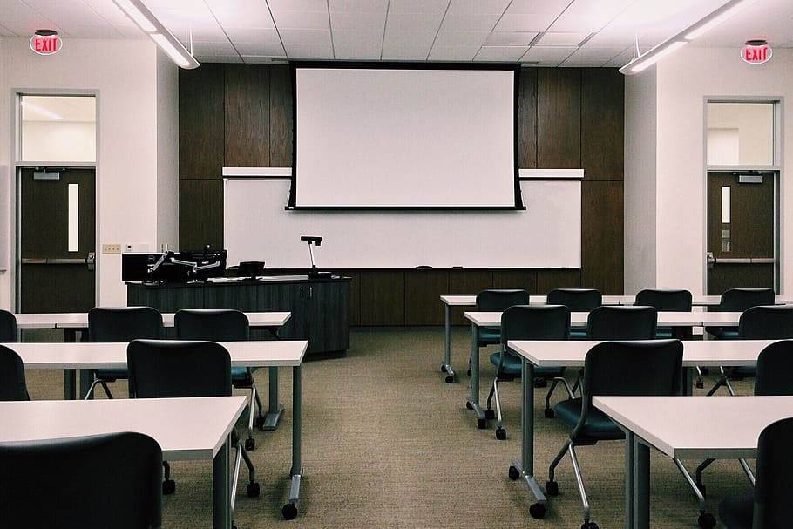
Multiple Credits
Some students may be able to earn more than one credit for a single course
Course must be eligible to award credit, but students must also be eligible to receive credit
Awarding criterion based on standards and content
Receiving criterion based on new Language Arts and World Language definitions
pxfuel.com
Notes:
Under current Oregon law, high school credit is linked to demonstration of knowledge and skills according to state-adopted content standards, not seat time. Access to Linguistic Inclusion does not modify laws governing earning of high school credit in Oregon, but those laws may apply to existing courses differently based on the new definitions for Language Arts and World Language.
As we mentioned earlier, the new World Language definition is based on student linguistic identity. Access to Linguistic Inclusion guidance therefore defines both awarding and receiving criteria to help clarify which credit can be awarded to which students. The awarding criterion is based on course content and standards coverage. The receiving criterion is based on the new definitions for Language Arts and World Language.

Slide 13
Licensure and Credentialing
Teacher Standards and Practices Commission (TSPC)
No planned changes to teacher preparation
Exercises authority over teacher preparation and licensure, not credit
Find information about connections between courses and teacher endorsements on the Teacher Licensure page.
Notes:
Access to Linguistic Inclusion makes no changes to existing rules governing teacher credentialing and licensure. The Teacher Standards and Practices Commission does not anticipate that any changes will be needed to teacher preparation programs or licensure procedures as a result of the law. The teacher licensure link on this slide leads to an ODE page with more information about courses and teacher credentialing.

Slide 14
Important Considerations
pxfuel.com
Decisions regarding high school credit, course offerings, international transcript interpretation, and language of instruction lie with districts
However, be sure to consider the student’s post-secondary plans
Students need to be prepared for next steps after graduation
Credits in “English Language Arts” may be needed for university admission, NCAA participation, or other
Notes:
Districts should enact policies and procedures which will ensure equitable implementation of new flexibilities under Access to Linguistic Inclusion. Districts should be wary of any approach that treats the law as a way to simply provide students with “more credits”. The goal of Access to Linguistic Inclusion is to recognize knowledge and skills that students are already demonstrating through their rich linguistic identities, so decisions about high school credit should begin with those demonstrations of knowledge and skills. “More credits”, while a valid and valuable recognition of student achievement, do not in and of themselves prepare students for post-secondary next steps. Also, districts should be careful not to close off some opportunities while opening others. For example, some post secondary plans may require credits in English Language Arts.

Slide 15
Potential Concerns 1
“Do schools need to eliminate the word ‘English’ from course titles and departments?”
Eliminating the word “English” is neither the goal nor the effect of Access to Linguistic Inclusion
Districts are not required to rename any course or department
In most cases, the current title is the most accurate and should be retained
Districts may choose to retitle select courses or departments in order to most accurately convey area of study and credit to be awarded
wikimedia.org
Notes:
As mentioned earlier, Access to Linguistic Inclusion relabels “English Language Arts” as “Language Arts” in multiple Oregon statutes. It would be easy to misinterpret this as an attempt to remove or reduce the role of English in Oregon’s education system. This is a misunderstanding of both the intent and effect of the law. While this label change does bring other languages onto a more equal footing with English, it should not be over-interpreted as a directive for wholesale removal of the word “English” wherever it occurs. In the vast majority of cases, the “English” tag in an English Language Arts course provides accurate and necessary information about course content. “English Language Arts” is an entirely appropriate description for courses which satisfy the English Language Arts standards via study of literature, composition, and other communications in English. In contrast, the title “Spanish Language Arts” clearly conveys that the course is covering those same standards via study of literature, composition, and other communications in Spanish.

Slide 16
Potential Concerns 2
“Will students still study English language and literature?”
Oregon’s English Language Arts summative assessment will continue to test student knowledge and skills, in English.
Accountability measures linked to Oregon’s statewide assessments remain in place.
Oregon’s English Language Arts and Literacy standards remain in place.
English still matters! Access to Linguistic Inclusion simply recognizes that other languages also matter.
pixabay.com
Notes:
In the last slide, we discussed the label change from “English Language Arts” to “Language Arts”. While this creates the possibility that some students may satisfy graduation requirements with one or more Language Arts classes in a language other than English, it will not lead to widespread abandonment of the study of English language and literature. Federal accountability requirements regarding English Language Arts remain in place, as does the ELA summative test, which is the measurement instrument for those accountability requirements. Also, it is important to remember that a Language Arts course in a language other than English requires not only students with sufficient mastery to engage with grade-level content in the target language, but also teachers with sufficient mastery to deliver grade-level content in the target language.

Slide 17
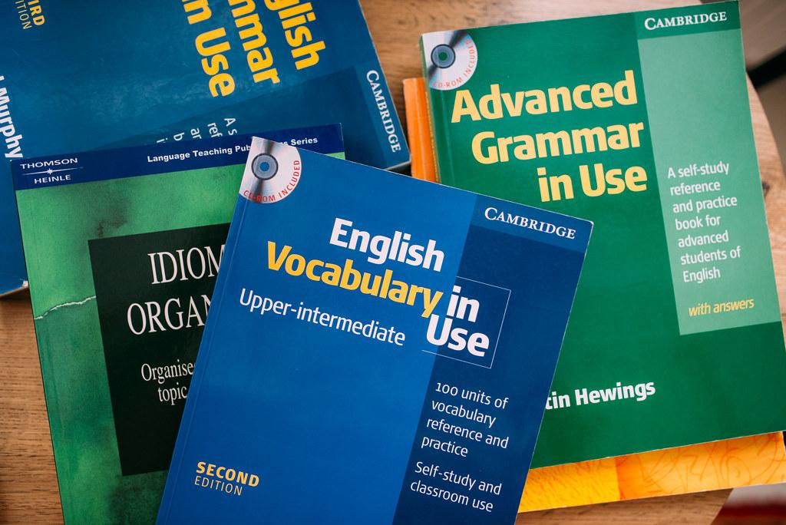
Potential Concerns 3
“Is learning English still important for students with English learner status?”
Oregon’s English Language Proficiency Assessment will continue to test student proficiency in English.
English language proficiency services remain a federally guaranteed civil right. Access to Linguistic Inclusion adds options for recognizing the rigorous and multifaceted study that students with English learner status are already performing.
flickr.com
Notes:
Appropriate English instruction for students with English learner status is a federally guaranteed civil right. Access to Linguistic Inclusion makes no changes to federal English learner regulations. Assessment and accountability requirements for developing student English language proficiency remain in force. Districts now have the ability to recognize student mastery and achievement in languages other than English, but they must continue to fulfill their responsibility to help students gain the necessary English language proficiency to successfully engage with challenging grade-level academic content in English.

Slide 18
Potential Concerns 4
“Are graduation standards being lowered?”
Oregon’s credit requirements for a high school diploma are among the highest in the nation.
Credit requirements for a high school diploma, including 4 credits of Language Arts, remain in place.
Access to Linguistic Inclusion provides increased options for earning high school credit, while maintaining instructional rigor.
publicdomainpictures.net
Notes:
Access to Linguistic Inclusion makes no changes to the number or content area of required high school credits for graduation. It provides students who are demonstrating mastery of Oregon’s rigorous academic standards with additional options for satisfying those requirements, but they must meet all the same requirements, to the same level of rigor, that were in place prior to the new law. The only difference is that additional paths have become available for satisfying some of these requirements.

Slide 19
Potential Concerns 5
“Are schools moving away from English as a language of instruction?”
English is the primary language of business and government in Oregon and will remain the principal language of instruction.
Under Access to Linguistic Inclusion, some schools may offer some courses in languages other than English. This is a district decision.
The central intent of Access to Linguistic Inclusion is to recognize and honor student achievement. It broadens options rather than imposing new requirements.
wikipedia.org
Notes:
It is possible that some may view Access to Linguistic Inclusion as a sign of shifting priorities in Oregon’s education system. This is partially true, insofar as there is a shift towards recognizing a wider range of student achievement. However, reducing the role or presence of English in Oregon schools and society is neither an intent nor an effect of the law. Oregon has no official state language, but English is spoken by a large majority of its residents and is the principal language of business, government, and instruction.

Slide 20
Learn More About Access to Linguistic Inclusion
The following resources are also available in the Access to Linguistic Inclusion expandable on the English Language Arts page
Guidance and Explanation document
One-page summary
These slides!
HB 2056 Oregon Legislative Information System page: contains legislative history and enrolled text
pxhere.com
Notes:
This slide deck is one of several resources available to help explain Access to Linguistic Inclusion. Consult the linked resources on this slide to learn more!

Slide 21
Thank You!
Questions about Access to Linguistic Inclusion? Contact both Tina and Ben!
Tina Roberts
Language Arts Education Specialist
tina.roberts@ode.oregon.gov
503-947-5603
Ben Wolcott
ELPA Specialist
ben.wolcott@ode.oregon.gov
503-947-5835
pxfuel.com
Notes:
Thank you for your attention. We hope these slides have helped increase your understanding of Access to Linguistic Inclusion. Please contact Tina Roberts and Ben Wolcott at ODE to continue the conversation.

