Slide 1
Module 2
Part 2: What ambitious math teaching looks like at the unit level

Slide 2
Facilitator Guide: Welcome to Module 2, Part 2!
In Module 2, we will dig deeper into ambitious math instruction and our day-to-day work as teachers. We will explore:
What does ambitious math instruction look like at the unit, lesson, and task levels?
How do we value and build on the mathematical strengths of students who are often excluded by schooling?
In Module 2, Part 2, we focus especially on deepening our understanding of what ambitious math instruction looks like at the unit level.
Notes:
Facilitator Notes:
Orange Facilitator Guide slides orient facilitators in making sense of upcoming sections.
These slides are intended to be hidden from the deck during sessions.

Slide 3
Facilitator Guide: Professional learning activity types
Setting and maintaining norms: These activities support participants to establish norms that will guide participation in sessions.
Doing math together: These activities engage participants in a mathematics task.
Studying teaching: These activities involve analysis of video, vignettes, live teaching, or instructional tools.
Connecting to research: These activities involve unpacking and understanding the research in mathematics education underpinning focal ideas and concepts.
Planning for action: These activities involve making links between session content and our own practice and contexts.
Notes:
Facilitator Notes:
Icons appear on section header slides throughout the slide deck, both for facilitators and participants

Slide 4
Facilitator Guide: Table of contents
Session 10, Ambitious math teaching at the unit level: Planning to support students in accessing grade level content (~75 min)
Doing math together: Experiencing an activity which can engage all students in grade level content (“Which one is unique and why?”; Algebra)
Connecting to research: Scaffolding and supporting to give students access to grade level content
Planning for action: Applying our learning to our work in the classroom
Session 11, Ambitious math teaching at the unit level: Planning a unit that supports ambitious math teaching (~90-120 min)
Connecting to research: Using the Oregon Math Standards to plan units which support students in accessing grade level content
Planning for action: Using a unit planning protocol to plan units of instruction which support students in accessing grade level content
Notes:
Facilitator Notes:
Each of the sessions is designed to be enacted within a professional learning meeting.
We suggest that the sessions and activities within session be enacted in order if possible, as some of the content and ideas build on one another.

Slide 5
Essential Questions of the Modules
Module 1: Foundations of High School Math Instruction | What is ambitious math teaching? Why is a 2 + 1 model important for equitable outcomes in mathematics?
Module 2: Principles and Practices of Ambitious Math Teaching | What does ambitious math teaching look like at the unit, lesson, and task levels? How do we value and build on the mathematical strengths of students who are often excluded by schooling?
Module 3: Principles and Practices of Sustainability | What planning, teaching, and assessment practices can be used to sustain ambitious math teaching?
Notes:
Facilitator Notes:
You might say: Let’s ground ourselves in the Essential Questions that drive the Ambitious Math Teaching Professional Learning Modules.

Slide 6
Reconnecting to our thinking from the previous sessions
Notes:
Facilitator Notes:
Optional: Paste excerpts of participants’ reflections from previous sessions to support the group in reconnecting with the work you’ve done together previously.
You might ask: What learning from our previous sessions are you excited to or hoping to build on today?

Slide 7
Ambitious math teaching at the unit level: Planning to support students in accessing grade level content
Session 10
The focus of this session is to consider how we might plan in ways that engage students in rich grade level content.
Agenda for this session:
Setting and maintaining norms: Reconnect with and revise our norms for interacting together
Doing math together: Experiencing an activity which can engage all students in grade level content (“Which one is unique and why?”; Algebra)
Connecting to research: Scaffolding and supporting to give students access to grade level content
Planning for action: Applying our learning to our work in the classroom
Time estimate: 75 minutes
M2 P2 Table of Contents
Notes:
Facilitator Notes:
This session especially supports our thinking around the second essential question of this module: Why is a 2 + 1 model important for equitable outcomes in mathematics?
We estimate this session will take 75 minutes. If you need to break the section into smaller pieces, please note the activities listed in the agenda are intended to be enacted in this order.

Slide 8
Setting and maintaining norms
Reconnect with and revise our norms for interacting together

Slide 9
Facilitator Guide: Setting and Maintaining Norms
Rationale for setting and maintaining norms:
To create spaces where we can vulnerably share about our teaching, learning and mathematics (Elliott et al., 2009; Little, 2002; Horn, 2010)
To support us in sharing in-process, “rough draft” ideas (Thanheiser & Jansen, 2016)
To foster a community where all members are valued (Grossman et al., 2001)
Recommendations for setting and maintaining norms:
Include everyone’s ideas and perspectives when setting norms
Regularly revisit norms and adjust norms as needed
Notes:
Upholding norms is a responsibility of participants and leaders/facilitators. It may be helpful to come up with a protocol that supports participants in naming and problem solving in the event that norms are breached.
Additional resources: If you are interested in learning more about setting and maintaining norms check out these resources.
TEDD.org: Setting norms for collaborative work
References
Elliott, R. & Lesseig, K., & Kazemi, E.. (2009). Sociomathematical norms in professional development: Examining leaders’ use of justification and its implication for practice. The Montana Mathematics Enthusiast Journal monograph, 7.
Grossman, P., Wineburg, S., & Woolworth, S. (2001). Toward a theory of teacher community. Teachers College Record, 103, 942–1012.
Horn, I. S. (2010). Teaching replays, teaching rehearsals, and re-visions of practice: Learning from colleagues in a mathematics teacher community. Teachers College Record, 112(1), 225–259.
Little, J. W. (2002). Professional community and the problem of high school reform. International Journal of Educational Research, 37(8), 693–714.
Thanheiser, E. & Jansen, A. (2016). Inviting prospective teachers to share rough draft mathematical thinking. Mathematics Teacher Educator, 4(2), 145–163.

Slide 10
Revisiting norms
[Insert your group norms]
Rights of a Learner
You have the right to:
Be confused
Make mistakes
Say what makes sense to you
Share unfinished or rough draft thinking and not be judged
(Kalinec-Craig, 2017)
Notes:
Facilitator Notes:
Orient participants to the norms you set in Session 1 and Rights of the Learner
You might ask questions like:
How do the productive norms and Rights of the Learner support our learning together?
Choose one of our norms that you want to focus on in particular. Why does that norm feel important for your learning today?
Invite participants to revise or add onto existing norms as needed
Remind participants of the importance of norms in developing a community of learners.
You might say: As we have opportunities to get to know each other better and better it allows for us to develop trust and feel more and more comfortable asking questions and asking for and receiving help.

Slide 11
Doing math together:
“Which one is unique and why?”
Experiencing an activity which can engage all students in grade level content.
Notes:
Facilitator Notes:
In this Habit Activator “Which One is Unique? Why?” we will compare and contrast different parabolas and identify unique properties of each. This process will activate the SMP 3 “construct viable arguments and critique the reasoning of others” *and/or the habit of “Critique and Debate” as we use the key features of a parabola to justify our claims. It will also reactivate our reasoning about appropriate scales for the x and y axis and gives us an opportunity to use technology in order to explore and justify different claims.
Engaging in this math activity also gives us the opportunity to discuss how this routine supports ambitious teaching and gives students access to grade level content.

Slide 12
Facilitator Guide: Doing Math Together
Rationale for doing math together:
Deepens our own specialized mathematical content knowledge so we can better support and respond to students (Kazemi & Franke, 2004)
Gives us a shared context for the study of teaching (Kazemi et al., 2018)
Helps us think about the experiences of our students
To foster joy for doing and learning mathematics (Su, 2020)
Recommendations for doing math together:
Establish norms for doing math together (see slide notes for examples) (Elliott et al., 2009; Yackel & Cobb; 1998).
Support participants in engaging with the task as learners and as teachers. Be explicit about when/how participants should take up each of these roles.
Notes:
Example norms for doing mathematics together:
Engage with each other’s thinking with curiosity
Support everyone to experience joy for mathematics
Use partial understandings, mistakes, and errors as an opportunity to examine further questions about mathematics
Additional resources: If you are interested in learning more ideas about doing math together check out these resources.
TEDD.org: Mathematics Instructional Activities
TEDD.org: Setting norms for collaborative work
Mathematics For Human Flourishing (book)
References
Ball, D. L., & Cohen, D. K. (1999). Developing practice, developing practitioners: Toward a practice-based theory of professional education. In L. Darling-Hammond & G. Sykes (Eds.), Teaching as the learning profession: Handbook of policy and practice (pp. 3–22). Jossey Bass.
Elliott, R., Lesseig, K., & Kazemi, E.. (2009). Sociomathematical norms in professional development: Examining leaders’ use of justification and its implication for practice. The Montana Mathematics Enthusiast Journal monograph, 7.
Kazemi, E., & Franke, M. L. (2004). Teacher learning in mathematics: Using student work to promote collective inquiry. Journal of Mathematics Teacher Education, 7(3), 203–235.
Su, F. (2021). Mathematics for Human Flourishing. Yale University Press.
Yackel E., & Cobb, P. (1998) Sociomathematical norms, argumentation, and autonomy in mathematics. Journal for Research in Mathematics Education, 27(4), 458-477.

Slide 13
“Which one is unique and why?”
Goals for us as math learners:
Mathematical goal: Use key features of parabolas to create equations.
Equity goal: Use reasoning, technology, and rough draft thinking to give learners opportunities for higher level thinking when finding the unique properties of different parabolas.
Notes:
Facilitator Notes:
This slide frames the purpose of the math task and orients participants of the goals we have for them as math learners. The slide appears again at the end of this section to support debriefing participants’ experiences doing the task.
Emphasize that there will be times in this activity where participants are asked to take on the perspective of a math learner and other times where they are take on the perspective of a teacher.

Slide 14
“Which one is unique and why?”
Goals for us as teachers:
Equity goal: Understand how structures like “Which One is Unique? Why?” provide access to grade level content and make space for multiple perspectives which helps us elevate the status of students who are often excluded by schooling.
Pedagogical goal: Notice how teachers can use structure to support justification and mathematical thinking.
Notes:
Facilitator Notes:
This slide frames the purpose of a math task and orients participants to the goals we have for them as educators. The slide appears again at the end of this section to support debriefing participants’ experiences doing the task.
Emphasize that there will be times in this activity where participants are asked to take the perspective of math learners and other times where they are asked to take the perspective of math teachers.

Slide 15
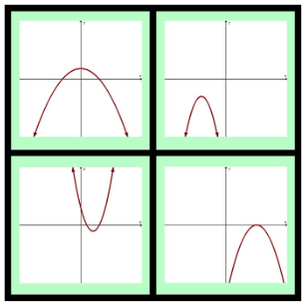
Which one is unique? Why?
A
B
C
D
Notes:
Facilitator Notes:
Project the image on the slide and ask, “Which one is unique? Why?”
Which one do you feel most strongly about not including or which one is unique and why?
Which one do you feel least strongly about not including or which one is not unique and why?
Give Private Reasoning Time
Compare and contrast different parabolas and identify unique properties of each.
Possible responses for A-D
Only parabola whose vertex is on the y-axis-- y-axis is the line of symmetry. Only graph that enters all 4 quadrants.
Only graph that has no real roots - only complex roots. Only graph that has no x-intercept, Only graph with vertex shifted to the left.
Only graph that is opening up. Only one with positive coefficient on x^2 term.Only graph that enters 3 quadrants - never enters quadrant 3. Only graph with two positive x-intercepts
Only graph with exactly one real root. Only graph with one x-intercept.

Slide 16
Small Group Activity
Directions: Work with your group to justify why each image could be considered unique.
Notes:
Facilitator Notes:
Orient participants to their workspace slide (make copies of this slide for each group/pair, or make a paper version)
Aspects of small group directions you might consider:
It may be helpful to specify roles for participants in the small groups. For example, you might:
Specify who will go first and in what order participants will share. For example, in a virtual session, you might say, “The second person who enters the breakout room will share first, and sharing will move counterclockwise until everyone has shared.”
Specify who will record. For example, in a virtual session, you might say, “The first person who enters the breakout room will be the recorder and jot down ideas from the group onto the workspace slide.
Specify who will keep time. For example, in a virtual session, you might say, “The third person will be the time keeper and let each team member know if airtime goes over a minute and how much time is left.”
It may be helpful to specify where participants will record and show them how to access it. As we have suggested, you might have an assigned Google Slide for each group which is a copy of this activity’s workspace slide.
It may be helpful to specify how much time participants will have in their small group.
It may be helpful to preview what their workspace will look like.

Slide 17
Which One is Unique? Why?
Justify why each of the following graphs could be the one that is unique?
A
A
B
B
C
C
D
D

Slide 18
Which One is Unique? Why?
Justify why each of the following graphs could be the one that is unique?
A: INSERT IDEAS FROM SMALL GROUPS
B: INSERT IDEAS FROM SMALL GROUPS
A
B
C: INSERT IDEAS FROM SMALL GROUPS
C
D
D: INSERT IDEAS FROM SMALL GROUPS
Notes:
Facilitator Notes:
Paste in different ideas from each of the small groups onto this slide. Then, facilitate a discussion about how participants justified why each graph could be considered unique.
Select one or two groups to share (use ideas from “anticipated responses” list below as a reference as needed)
As group members share:
Press participants to share their reasoning
Press participants using “Listen to Understand”
I heard you say ….
I understand….
I would like to add on ….
I wonder…
Possible responses for A-D
Only parabola whose vertex is on the y-axis-- y-axis is the line of symmetry. Only graph that enters all 4 quadrants.
Only graph that has no real roots - only complex roots. Only graph that has no x-intercept, Only graph with vertex shifted to the left.
Only graph that is opening up. Only one with positive coefficient on x^2 term.Only graph that enters 3 quadrants - never enters quadrant 3. Only graph with two positive x-intercepts
Only graph with exactly one real root. Only graph with one x-intercept.

Slide 19
What might the equations for each graphs look like?
A
B
C
D
Notes:
Facilitator Notes:
Extend the work participants did by asking them to consider what the equations for each graph might look like.
You might say: You have discussed the characteristics of the graphs, so now find the possible equations.
Give Private Reasoning Time, then breakout into small groups to discuss.

Slide 20
Small Group Activity
Directions: Work with your team to use Desmos or a graphing calculator to find an “approximate equation” for each graph.
Notes:
Facilitator Notes:
Orient participants to their workspace slide (make copies of this slide for each group/pair, or make a paper version)
Aspects of small group directions you might consider:
It may be helpful to specify roles for participants in the small groups. For example, you might:
Specify who will go first and in what order participants will share. For example, in a virtual session, you might say, “The second person who enters the breakout room will share first, and sharing will move counterclockwise until everyone has shared.”
Specify who will record. For example, in a virtual session, you might say, “The first person who enters the breakout room will be the recorder and jot down ideas from the group onto the workspace slide.
Specify who will keep time. For example, in a virtual session, you might say, “The third person will be the time keeper and let each team member know if airtime goes over a minute and how much time is left.”
It may be helpful to specify where participants will record and show them how to access it. As we have suggested, you might have an assigned Google Slide for each group which is a copy of this activity’s workspace slide.
It may be helpful to specify how much time participants will have in their small group.
It may be helpful to preview what their workspace will look like.

Slide 21
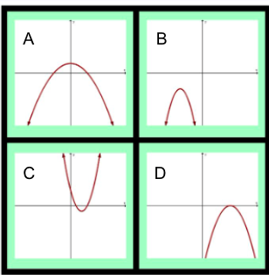
Use Desmos or a graphing calculator to find an “approximate equation” for each of the following. Be prepared to share your mathematical reasoning.
Preview of Workspace Slide
Desmos https://www.desmos.com/calculator
Be ready to share…
Your equations and your strategies for finding them.
A:
B:
C:
D:
One new insight you have as a result of investigating this.
Notes:
Facilitator Notes:
Extend the task again using Desmos. You might say: We know the characteristics of the graphs, so now find some possible equations
Pose the task using Desmos
1 minute of Private Reasoning Time
Move into small groups (~7 min)
Circulate between groups and select one or two groups to share (see slide 26 for “anticipated responses” to reference as needed)
As group members share:
Press on Reasoning
Press on Participants using “Listen to Understand”
I heard you say ….
I understand….
I would like to add on ….
I wonder…
Facilitate a whole group discussion to share key ideas from the small groups

Slide 22
Anticipated Responses
Notes:
Notes:
Use the anticipated responses to reflect on how you might respond to participants’ ideas/reasoning and/or select and sequence participants’ ideas in the whole group discussion.

Slide 23
Debriefing “Which one is unique and why?”
Goals for us as math learners:
Mathematical goal: Use key features of parabolas to create equations.
Equity goal: Use reasoning, technology, and rough draft thinking to give learners opportunities for higher level thinking when finding the unique properties of different parabolas.
Discuss:
How did you see me working on each of these goals during the lesson?
What moves was I making as a teacher of mathematics?
What moves could have been made to support our work on these goals even more?
Notes:
Facilitator Notes:
This slide returns to the purpose of math task and orients participants of the goals we have had for them as learners.
Emphasize that we are now asking them to debrief their experience with the task as learners using the questions on the slide.

Slide 24
Debriefing “Which one is unique and why?”
Goals for us as teachers:
Equity goal: Understand how structures like “Which One is Unique? Why?” provide access to grade level content and make space for multiple perspectives which helps us elevate the status of students who are often excluded from rich mathematics by schooling.
Pedagogical goal: Notice how teachers can use structure to support justification and mathematical thinking.
Discuss:
What new ideas do you have about what reasoning and sensemaking look like and sounds like?
What questions do you have about supporting students’ reasoning and sensemaking?
Notes:
Facilitator Notes:
This slide returns to the purpose of math task and orients participants to the goals we have had for them as educators.
Emphasize that we are now asking them to to debrief their experience with the task as teachers using the questions on the slide.

Slide 25
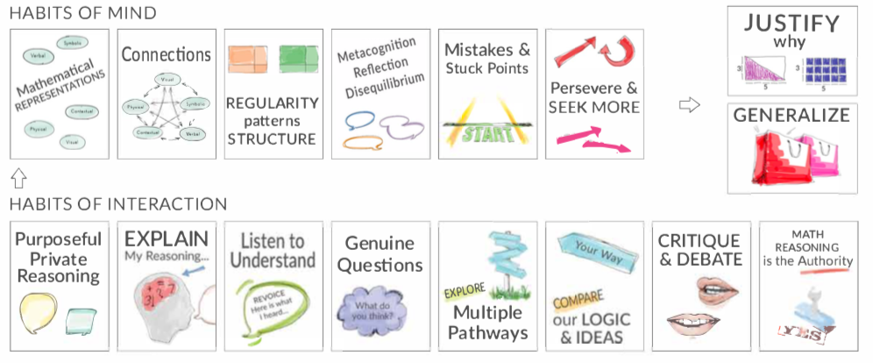
Debrief: Habits of mind and interaction
Which of these habits did you notice? What others could have been highlighted? In what ways?
Habits of Mind: Things we do as individual mathematicians when solving problems.
Habits of Interaction: Things that we do when working with others to make sense of the math.
(TDG, 2020)
Notes:
Facilitator Notes:
Option 2: Debrief “Doing Math Together” or “Studying Teaching” through the lens of TDG’s Habits & Routines tool.
If you’re facilitating online, you might offer an opportunity to “stamp” the habits participants notice and discuss trends or questions that emerge.
If you’re facilitating in person, you might offer a turn and talk so participants can discuss what they noticed with a partner/group and then come back to share trends or questions that emerge.
During the discussion, press for examples/evidence from the shared moment of teaching. This might sound like: “Where/when did you see an example of this practice?”

Slide 26
Debrief: Practices of ambitious mathematics teaching
Which of these 8 practices did you notice? What others could have been highlighted? In what ways?
Establish mathematical goals to focus learning
Implement tasks that promote reasoning and problem solving
Use and connect mathematical representations
Facilitate meaningful mathematical discourse
Pose purposeful questions
Build on procedural fluency from conceptual understanding
Support productive struggle in learning mathematics
Elicit and use evidence of student thinking
(NCTM, 2014)
Notes:
Facilitator Notes:
Option 1: Debrief “Doing Math Together” or “Studying Teaching” through the lens of NCTM’s 8 practices of ambitious instruction.
If you’re facilitating online, you might offer an opportunity to “stamp” the practices participants notice and discuss trends or questions that emerge.
If you’re facilitating in person, you might offer a turn and talk so participants can discuss what they noticed with a partner/group and then come back to share trends or questions that emerge.
During the discussion, press for examples/evidence from the shared moment of teaching. This might sound like: “Where/when did you see an example of this practice?”

Slide 27
Connecting to research
Scaffolding and supporting to give students access to grade level content
Notes:
Facilitator Notes:
The purpose of Session 10 is to consider how we can plan in ways that give students access to grade level content. In this activity we look to research that distinguishes scaffolding from remediation and discuss how scaffolding better supports students in having opportunities to engage with grade level content.

Slide 28
Facilitator Guide: Connecting to Research
Rationale for connecting to research:
To infuse new ideas into our conversations about instruction and challenge or deepen our existing understandings (Cain, 2015).
To support us in using evidence to inform our professional learning
Recommendations for connecting to research:
Honor and make space for participants’ existing knowledge and expertise.
Support participants to collectively grapple with the complexity of what the research offers and carefully consider how the research relates to their own teaching context and work.
Closely pair opportunities to connect to research with opportunities to plan for action on the basis of what they’ve read.
Notes:
Additional resources: If you’re interested in digging more into these ideas, check out these resources.
Module 0, Resource 1:
References
Cain, T (2015). Teachers’ engagement with research texts: beyond instrumental, conceptual or strategic use. Journal of Education for Teaching, 41(5), 478-492.

Slide 29
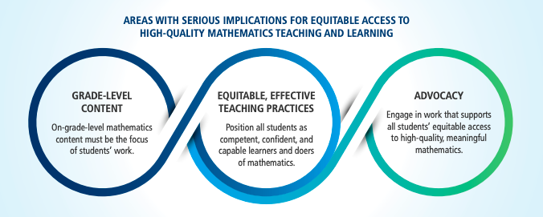
Continuing the Journey:
Mathematics Learning 2021 and Beyond
Let’s create greater opportunities for all students to learn and have access to grade level content.
(NCTM, NCSM, 2021)
Notes:
Facilitator Notes:
Frame the article and explain why we are reading it.
You might say: We are about to start unit planning, and this article will give background information on ideas that are related to effective unit and lesson planning. The article provides leaders and teachers with clear guidance on how to build on students’ strengths and create an environment for safe and supportive mathematics teaching and learning. The resource highlights actions in three core areas: Grade-level Content, Equitable Effective Teaching Practices, and Advocacy.

Slide 30
Mathematics Learning & Beyond
In teams of 3, read pages 2-4, 5-6, 7-9 and jigsaw what you learned.
Consider while you read:
What additional work do teachers need to do when planning units and lessons to ensure that students who are often excluded from rich mathematics by schooling have access to the grade level content?
(NCTM, NCSM, 2021)
Notes:
Facilitator Notes:
Break participants into groups to “jigsaw” this article.
Orient participants to the prompts on the slide to guide their reading
What additional work do teachers need to do when planning units and lessons to ensure that students who are often excluded from rich mathematics by schooling have access to the grade level content?
Have participants open 6 NCTM_NCSM Continuing the Journey Report and privately read to dig a bit deeper into the rationale and detail of the cornerstones.

Slide 31
Small Group Activity
Directions: Spend 10 min privately to read your section of “Continuing the Journey” and then spend 3 minutes each to share key ideas referring to specific paragraphs.
Notes:
Facilitator Notes:
Orient participants to their workspace slide (make copies of this slide for each group/pair, or make a paper version)
Aspects of small group directions you might consider:
It may be helpful to specify roles for participants in the small groups. For example, you might:
Specify who will go first and in what order participants will share. For example, in a virtual session, you might say, “The second person who enters the breakout room will share first, and sharing will move counterclockwise until everyone has shared.”
Specify who will record. For example, in a virtual session, you might say, “The first person who enters the breakout room will be the recorder and jot down ideas from the group onto the workspace slide.
Specify who will keep time. For example, in a virtual session, you might say, “The third person will be the time keeper and let each team member know if airtime goes over a minute and how much time is left.”
It may be helpful to specify where participants will record and show them how to access it. As we have suggested, you might have an assigned Google Slide for each group which is a copy of this activity’s workspace slide.
It may be helpful to specify how much time participants will have in their small group.
It may be helpful to preview what their workspace will look like.

Slide 32
Team Names:
Preview of workspace slide
For each section of the article, jot down notes related to the following prompt: What additional work do teachers need to do when planning units and lessons to ensure that students who are often excluded from rich mathematics by schooling have access to the grade level content?
Key ideas from pages 2-4 | Key ideas from pages 5-6 | Key ideas from pages 7-9
Notes:
Facilitator Notes:
Small groups / breakout rooms: Participants should work in groups on the workspace slide for ~20 minutes.
Whole group discussion: Select 1 group to share out and then invite each group to add on

Slide 33
Key ideas from “Continuing the Journey”
The role and relationship between mathematical content and practices in supporting students’ learning
Shifting away from “remediation” and instead offering supports and scaffolding
The differences between remediation and supports/scaffolding
Notes:
Facilitator Notes:
After participants have the opportunity to discuss “Continuing the Journey” in small groups, highlight key ideas from the reading with the group (the following 4 slides, cover what is described on this slide. You might pick and choose which of these key ideas feel most relevant based on your particular participants and/or the discussions you heard in small groups.

Slide 34
Mathematical content, process, and practices
Students’ opportunities to engage in mathematical practices and processes are “co-equal partners” with the specific content priorities for a course or a grade level (NCTM, 2021).
Students should therefore have opportunities to:
make sense of mathematical problems and persevere in solving them;
reason abstractly and quantitatively;
construct viable arguments and critique the reasoning of others using precise language;
use mathematics to model the world; and
develop generalizations
(NCTM, NCSM, 2021)
Notes:
Facilitator Notes:
Discuss the importance of content standards working together alongside practice standards.
You might ask the group “How do practice standards support our work enacting ambitious teaching?”

Slide 35
Shifting from remediation to supporting
and scaffolding
Students who are viewed as “struggling” often never “get to” more engaging rigorous mathematics.
When teachers believe that certain knowledge is a prerequisite in order to engage with grade level content, students may miss out on important content and practices because they are constantly engaged in “remediation” instead.
When teachers leverage students’ strengths and existing knowledge to help them make sense of and access mathematical concepts and contexts they can support all students in engaging with rich grade level mathematics.
(NCTM, NCSM, 2021)
Notes:
Facilitator Notes:
Ask participants to silently read, then select a few points to discuss based on what feels relevant to this group.
You might ask, “what feels tricky about the information on this slide?”

Slide 36
What do we mean by scaffolding?
Scaffolding:
Supports the immediate construction of knowledge by the learner;
Provides the basis for the future independent learning of the individual
Make tasks accessible without lowering the cognitive demand, the type of questioning used, or ways of promoting mathematical discourse.
Scaffolding vs. Remediation
Research shows that just-in-case remediation increases, rather than decreases, gaps in student achievement, whereas just-in time scaffolding supports and values student knowledge while being intentional to ensure success with grade-level content (TNTP 2018).
Begin the year with grade-level content and instruction and include opportunities for just-in-time scaffolds and support.
Rather than thinking about what students need “before” they can do grade level work, ask “What do students know about the world/mathematics that can help them make sense of this grade level idea?”
Weave in content from prior grade levels as needed.
(NCTM, NCSM, 2021)
Notes:
Facilitator Notes:
Support participants to make sense of the difference between scaffolding and remediation.
Prior to sharing this slide, if time permits, you might consider eliciting participants current conceptions about the differences between scaffolding and remediation.

Slide 37
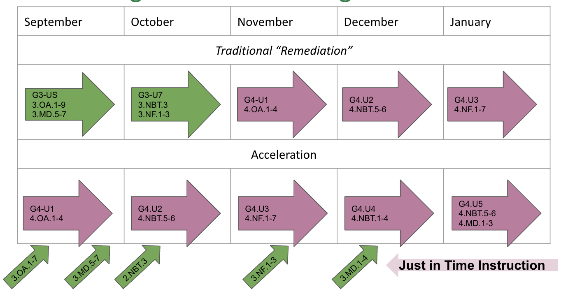
Addressing students’ needs
These are Elementary Standards.
Would this look differently if it were High School examples?
Why or why not?
(Adapted from TNTP, 2020)
Notes:
Facilitator Notes:
This slide could be useful in helping participants visualize how standards from previous grade levels can be addressed through engagement with grade level content rather than prior to grade level content.

Slide 38
Debrief: Principles of ambitious mathematics teaching
Which of these ideas are you thinking about in light of our work? What questions do you have?
“Ambitious teaching is teaching that deliberately aims for all students – across ethnic, racial, class, and gender categories – not only to acquire, but also to understand and use knowledge, and to use it to solve authentic problems.”
(Lampert & Graziani, 2009, p. 492)
Ambitious teaching:
Engages students in making sense of mathematical concepts
Centers students’ thinking and reasoning through discourse
Views students as capable of using their understandings and assets to solve authentic problems
Values students’ thinking, including emergent understanding and errors
Attends to student thinking in an equitable and responsive manner
(Anthony et al., 2015)
Notes:
Facilitator Notes:
Debrief “Connecting to Research” or “Planning for Action” through the lens of this definition from Lampert and Graziani (2009) and the five principles listed.
You might say: Take a couple of minutes and reflect on “Continuing the Journey: Mathematics Learning 2021 and Beyond” article…What new insights do you have related to ambitious teaching?
If you’re facilitating online, you might offer an opportunity to “stamp” the principles that are on participants’ minds and discuss trends or questions that emerge.
If you’re facilitating in person, you might offer a turn and talk so participants can discuss what principles are on their minds with a partner/group and then come back to share trends or questions that emerge.
[written reflection option]
References for these ideas: Anthony et al., 2015; Huinker & Bill, 2017; Lampert et al., 2011; Lampert & Graziani, 2009

Slide 39
Planning for action:
Applying our learning to our work in the classroom
Notes:
Facilitator Notes:
The purpose of Session 10 is to reflect on how teachers’ careful planning can support students in accessing grade level content. During this planning session support participants to consider how the ideas from the research they engaged with help them think about organizing learning so that students have opportunities to engage with grade level content instead of getting stuck in cycles of “reviewing.”

Slide 40
Facilitator Guide: Planning for Action
Rationale for planning for action:
To see connections to our contexts and goals (Putnam & Borko, 2000)
To apply new ideas to upcoming work (Horn & Kane, 2015)
To surface complexities when taking up new ideas
Recommendations for planning for action:
Use teachers’ own curricular resources when possible
Create space to discuss anticipated challenges and strategies for trying new ideas within those challenges
Follow up on teachers’ plans; return to them to build on and refine ideas
Notes:
Planning for action involves making links between session content and our own practice and contexts.
Additional resources: If you are interested learning more about these ideas, check out these resources.
Module 0, Resource 2: Sometimes, planning conversations can surface unproductive ideas about particular students or student groups that circulate in our schools or broader contexts. This resource is designed to support leaders preparing for difficult conversations, especially when unproductive language about students emerges.
References
Horn, I. S., & Kane, B. D. (2015). Opportunities for professional learning in mathematics teacher workgroup conversations: Relationships to instructional expertise. Journal of the Learning Sciences, 24(3), 1–46.
Putnam, R. T., & Borko, H. (2000). What do new views of knowledge and thinking have to say about research on teacher learning? Educational Researcher, 29(1), 4-15.

Slide 41
Applying our learning to our work in the classroom
Work with a partner/group or independently to reflect on the unit of instruction you are currently working on:
How do the ideas from the “Continuing the Journey” article relate to your work teaching this unit?
What new ideas do you have about remediation vs. scaffolding? How might these ideas apply to your current unit of instruction now or in the future?
Make at least one change to your current unit plan with a colleague based on your conversation.
Be sure you schedule time for a quick follow-up about how trying this idea out went between now and our next session (i.e., at your next PLC meeting)
Notes:
Facilitator Notes:
Support participants to apply their understandings from the “Continuing the Journey” article to a current unit of instruction.
As you circulate between groups, you might press participants to design short instructional activities (such as Which one is unique and why?) to scaffold key ideas that can give students access to grade level content.

Slide 42
Debriefing Session 10
Reflecting on our work in the activities in the session

Slide 43
Debriefing Session 10: Four cornerstone principles of the OMP
What connections do you see between any of the cornerstones and our work in this session?
Focus: Learning experiences in every grade and course are focused on core mathematical content and practices that progress purposefully across grade levels.
Engagement: Mathematical learning happens in environments that motivate all students to engage with relevant and meaningful issues in the world around them.
Pathways: All students are equipped with the mathematical knowledge and skills necessary to identify and productively pursue any postsecondary paths in their future. Students have agency to choose from a variety of courses, contexts, and applications they find relevant.
Belonging: Participation in mathematical learning builds students’ identities as capable math learners and fosters a positive self-concept. Students’ cultural and linguistic assets are valued in ways that contribute to a sense of belonging to a community of learners.
Any proposed instructional approach, curricular change, or system design element should be evaluated by the degree to which it builds on these four cornerstones. When new approaches are built within the framework of all four-cornerstone principles, we will be on our way to engineering a reimagined system.
(ODE, 2022)
Notes:
Facilitator Notes:
Option 1: Debrief the session through the lens of the four cornerstone principles of the Oregon Mathematics Project.

Slide 44
Debriefing Session 10: Focus of the session
What new insights do you have related to our session focus, planning to support students in accessing rich grade level content?
Take a couple of minutes to reflect on our work in the session.
Agenda for this session:
Setting and maintaining norms: Reconnect with and revise our norms for interacting together
Doing math together: Experiencing an activity which can engage all students in grade level content (“Which one is unique and why?”; Algebra)
Connecting to research: Scaffolding and supporting to give students access to grade level content
Planning for action: Applying our learning to our work in the classroom
Notes:
Facilitator Notes:
Option 2: Debrief the session through the lens of the focus of the session.
Module 2 Part 2 supports our thinking around both essential questions of this module: What does ambitious math teaching look like at the unit, lesson, and task levels? How do we value and build on the mathematical strengths of students who are often excluded by schooling?
The focus of this session in particular is to consider how we can plan in ways that support students in accessing grade level content.
You might offer participants time to think individually about new insights before sharing aloud.

Slide 45
Section 11
Ambitious math instruction at the unit level: Planning a unit that supports students in accessing grade level content
Goal: The purpose of this section is to practice planning ambitious units of instruction which support students in accessing grade level content.
Agenda for this section:
Connecting to research: Using the Oregon Math Standards to plan units which support students in accessing grade level content
Planning for Action: Using a unit planning protocol to plan units of instruction which support students in accessing grade level content
Time estimate: 90-120 minutes
Notes:
Facilitator Notes:
This session especially supports our thinking around the second essential question of this module: What does ambitious math teaching look like at the unit, lesson, and task levels?
We estimate this session will take 90-120 minutes depending on how much time you allot for unit planning.

Slide 46
Connecting to research:
Using the Oregon Math Standards to plan units which
support students in accessing grade level content
Notes:
Facilitator Notes:
The purpose of Session 11 is to practice planning an ambitious unit of instruction that supports students in accessing grade level content. In this activity, we explore the revised Oregon Mathematics Standards so that teachers can develop familiarity with the tools and resources that can support them in making sense of the standards as they plan.

Slide 47
Facilitator Guide: Connecting to Research
Rationale for connecting to research:
To infuse new ideas into our conversations about instruction and challenge or deepen our existing understandings (Cain, 2015).
To support us in using evidence to inform our professional learning
Recommendations for connecting to research:
Honor and make space for participants’ existing knowledge and expertise.
Support participants to collectively grapple with the complexity of what the research offers and carefully consider how the research relates to their own teaching context and work.
Closely pair opportunities to connect to research with opportunities to plan for action on the basis of what they have read.
Notes:
Additional resources: If you are interested in learning more about these ideas, check out these resources.
Module 0, Resource 1:
References
Cain, T (2015). Teachers’ engagement with research texts: beyond instrumental, conceptual or strategic use. Journal of Education for Teaching, 41(5), 478-492.

Slide 48
Start planning with the standards
The first step in planning a unit that supports ambitious instruction, is a acquiring a clear understanding of the mathematical content students will be working on.
In the slides that follow, explore the revised Oregon Mathematics Standards, in order to build familiarity with the tools and resources that can support you in making sense of the standards.
Notes:
Facilitator Notes:
Orient participants to the activity by explaining that they will be exploring the standards guidance documents that support our work planning and making sense of the standards for our state.

Slide 49
Revisions to the standards
Key revisions from the previously adopted mathematics standards as of October, 2021 include:
Addition of a K-12 Data Reasoning Domain
Merging of measurement content with Geometry content
Revision of K-12 domains to reflect the learning pathways of Algebraic Reasoning, Numeric Reasoning, Geometric Reasoning & Measurement, and Data Reasoning
Identification of a core two credit requirement in high school that aligns to the Oregon 2+1 course design
The transition from the 2010 standards to the 2021 standards will occur in the 2021-22 and 2022-23 school years, with updated materials used by students in the fall of the 2023-24 school year.”
Link to more information from the Oregon Department of Education regarding Mathematics Standards
Notes:
Facilitator Notes:
Highlight for participants that the standards guidance documents have recently been revised as of October 2021 and that there are new standards and new tools to support planning embedded in the documents.
Link to more information from the Oregon Department of Education regarding Mathematics Standards

Slide 50
Exploring the K-12 Math Standards Guidance Document
Link to the K-12 Math Standards with Clarifying Guidance
What is in the “Guidance Document?”
SECTION ONE: Introduction
SECTION TWO: Adopted 2021 Math Practices
SECTION THREE: Adopted 2021 Oregon Mathematics Standards
SECTION FOUR: Grade and Standards Level Guidance
SECTION FIVE: Oregon/CCSS Crosswalk
Notes:
Facilitator Notes:
Explain to participants that the slides they will explore with their partner/group support them in unpacking the first 4 sections of the “Guidance Document”

Slide 51
Small Group Activity
Directions: Explore the K-12 Standards Guidance Documents.
Notes:
Facilitator Notes:
Orient participants to their workspace slide and the exploration slides (which begin here)
Aspects of small group directions you might consider:
It may be helpful to specify roles for participants in the small groups. For example, you might:
Specify who will go first and in what order participants will share. For example, in a virtual session, you might say, “The second person who enters the breakout room will share first, and sharing will move counterclockwise until everyone has shared.”
Specify who will record. For example, in a virtual session, you might say, “The first person who enters the breakout room will be the recorder and jot down ideas from the group onto the workspace slide.
Specify who will keep time. For example, in a virtual session, you might say, “The third person will be the time keeper and let each team member know if airtime goes over a minute and how much time is left.”
It may be helpful to specify where participants will record and show them how to access it. As we have suggested, you might have an assigned Google Slide for each group which is a copy of this activity’s workspace slide.
It may be helpful to specify how much time participants will have in their small group.
It may be helpful to preview what their workspace will look like (e.g., share the next slide).
Before sending participants into groups, you might say: Share your rough draft thinking: you don’t have to have everything totally worked out yet, and it’s ok to change your mind after you shared.
Monitor slides while the groups are working in order to pre-select two slides to share whole-group.

Slide 52
Preview of Workspace Slide
Team Names:
Record any new ideas, a-has, or questions you have related to each section of the standards document:
SECTION 1:
SECTION 2:
SECTION 3:
SECTION 4:
SECTION 5:
Reflection: How do you see the standards as related to the Cornerstones?
Notes:
Facilitator Notes:
Groups / breakout rooms: Participants should work in groups on the workspace slide for ~20 minutes to explore the documents.
Note, you could shorten this activity by having groups “jigsaw” and work only on specific sections.
Whole group: After participants have had time to work in small groups, ask 1-2 groups to share an idea, an insight, or question related to each section of the standards guidance document.

Slide 53
Start at the BEGINNING
BEGIN Standards Guidance Document Exploration

Slide 54
Exploring the K-12 Math Standards Guidance Document
Link to the K-12 Math Standards with Clarifying Guidance
What is in the “Guidance Document?”
SECTION ONE: Introduction
SECTION TWO: Adopted 2021 Math Practices
SECTION THREE: Adopted 2021 Oregon Mathematics Standards
SECTION FOUR: Grade and Standards Level Guidance
SECTION FIVE: Oregon/CCSS Crosswalk

Slide 55
Exploring the K-12 Math Standards Guidance Document
Link to the K-12 Math Standards with Clarifying Guidance
What is in the “Guidance Document?”
SECTION ONE: Introduction
SECTION TWO: Adopted 2021 Math Practices
SECTION THREE: Adopted 2021 Oregon Mathematics Standards
SECTION FOUR: Grade and Standards Level Guidance
SECTION FIVE: Oregon/CCSS Crosswalk

Slide 56
SECTION TWO: 2021 Adopted Math Practice Standards (p. 17)
Link to the K-12 Math Standards with Clarifying Guidance
MP.1: Make sense of problems and persevere in solving them.
MP.2: Reason abstractly and quantitatively.
MP.3: Construct viable arguments and critique the reasoning of others.
MP.4: Model with mathematics.
MP.5: Use appropriate tools strategically.
MP.6: Attend to precision.
MP.7: Look for and make use of structure.
MP.8: Look for and express regularity in repeated reasoning
What connections do you see between the math practice standards and ambitious teaching?

Slide 57
Exploring the K-12 Math Standards Guidance Document
Link to the K-12 Math Standards with Clarifying Guidance
What is in the “Guidance Document?”
SECTION ONE: Introduction
SECTION TWO: Adopted 2021 Math Practices
SECTION THREE: Adopted 2021 Oregon Mathematics Standards
SECTION FOUR: Grade and Standards Level Guidance
SECTION FIVE: Oregon/CCSS Crosswalk

Slide 58
SECTION THREE: Adopted 2021 Oregon Mathematics Standards
The 2021 Oregon Mathematics Standards are organized into grade level content for K-8 and within the domains of algebra, geometry, and data science/statistics for high school.

Slide 59
SECTION THREE: Adopted 2021 Oregon Mathematics Standards (p. 6)
Link to the K-12 Math Standards with Clarifying Guidance
The 2021 Oregon Mathematics Standards are organized into grade level content for K-8 and within the domains of algebra, geometry, and data science/statistics for high school.
Key Definitions for unpacking the standards:
Standards define what students should understand and be able to do.
Clusters summarize groups of related standards. Note that standards from different clusters may sometimes be closely related, because mathematics is a connected subject.
Domains are larger groups of related standards. Standards from different domains may sometimes be closely related.

Slide 60
SECTION THREE: Adopted 2021 Oregon Mathematics Standards (p. 6)
Link to the K-12 Math Standards with Clarifying Guidance
The 2021 Oregon Mathematics Standards are organized into grade level content for K-8 and within the domains of algebra, geometry, and data science/statistics for high school.
Key Definitions for unpacking the standards:
Standards define what students should understand and be able to do.
Clusters summarize groups of related standards. Note that standards from different clusters may sometimes be closely related, because mathematics is a connected subject.
Domains are larger groups of related standards. Standards from different domains may sometimes be closely related.

Slide 61
SECTION THREE: Adopted 2021 Oregon Mathematics Standards
3J: High School Algebra Standards (2021)
Algebraic Reasoning: Expressions and Equations (HS.AEE)
HS.AEE.A Use algebraic reasoning to rewrite expressions in equivalent forms.
HS.AEE.A.1 Interpret an expression which models a quantity by viewing one or more of its parts as a single entity. Reason about how changes in parts of the expression impact the whole, and vice versa.
HS.AEE.A.2 Create and recognize an equivalent form of an expression to understand the quantity represented in an authentic context.
HS.AEE.A.3 Rearrange formulas and equations to highlight a specific quantity.
HS.AEE.B Use algebraic reasoning to find solutions to an equation, inequality, and systems of equations or inequalities.
HS.AEE.B.4 Define variables and create equations with two or more variables to represent relationships between quantities in order to solve problems in authentic contexts.
HS.AEE.B.5 Define variables and create inequalities with one or more variables and use them to solve problems in authentic contexts.
HS.AEE.B.6 Solve systems of linear equations and systems of linear inequalities in authentic contexts through reasoning, algebraic means, or strategically using technology.
Example list of HS Algebra Standards from pp. 40 in the guidance document.

Slide 62
Exploring the K-12 Math Standards Guidance Document
Link to the K-12 Math Standards with Clarifying Guidance
What is in the “Guidance Document?”
SECTION ONE: Introduction
SECTION TWO: Adopted 2021 Math Practices
SECTION THREE: Adopted 2021 Oregon Mathematics Standards
SECTION FOUR: Grade and Standards Level Guidance
SECTION FIVE: Oregon/CCSS Crosswalk

Slide 63
SECTION FOUR: Grade and Standards Level Guidance (p.8)
Link to the K-12 Math Standards with Clarifying Guidance
Guidance within section four:
The 2021 Oregon Math Standard
Content standards preceding and follow a given standards as well as cross domain connections
Cross domain connections to the standard
Links to the CCSS (2010) and the crosswalk in section five.
How might this tool support your work?

Slide 64
Reflect: How do the Cornerstones relate to the standards?
Provide students with the skills necessary to pursue learning throughout their lives in an ever-changing world. (ORS 329.015(2)(a))
Provide an environment that motivates students to have experience in applying knowledge and skills and demonstrating achievement. (ORS 329.015(2)(b))
Equip students with the academic and career skills and information necessary to pursue the future of their choice. (ORS 329.015(2)(a))
Provide an environment that motivates students to pursue serious scholarship. (ORS 329.015(2)(b))
ODE, 2022
Notes:
Facilitator Notes:
You might give participants a minute to read what is on the screen silently, or ask a participant to read it aloud.
You might say: These are the cornerstones of the Oregon Math Project and will ground our work in these modules.

Slide 65
Journey’s END
END Standards Guidance Document Exploration

Slide 66
Debrief: Principles of ambitious mathematics teaching
Which of these ideas are you thinking about in light of our work? What questions do you have?
“Ambitious teaching is teaching that deliberately aims for all students – across ethnic, racial, class, and gender categories – not only to acquire, but also to understand and use knowledge, and to use it to solve authentic problems.”
(Lampert & Graziani, 2009, p. 492)
Ambitious teaching:
Engages students in making sense of mathematical concepts
Centers students’ thinking and reasoning through discourse
Views students as capable of using their understandings and assets to solve authentic problems
Values students’ thinking, including emergent understanding and errors
Attends to student thinking in an equitable and responsive manner
(Anthony et al., 2015)
Notes:
Facilitator Notes:
Debrief “Connecting to Research” or “Planning for Action” through the lens of this definition from Lampert and Graziani (2009) and the five principles listed.
If you’re facilitating online, you might offer an opportunity to “stamp” the principles that are on participants’ minds and discuss trends or questions that emerge.
If you’re facilitating in person, you might offer a turn and talk so participants can discuss what principles are on their minds with a partner/group and then come back to share trends or questions that emerge.
[written reflection option]
References for these ideas: Anthony et al., 2015; Huinker & Bill, 2017; Lampert et al., 2011; Lampert & Graziani, 2009

Slide 67
Planning for action
Using a unit planning protocol to plan units of instruction which support students in accessing grade level content
Notes:
Facilitator Notes:
The purpose of Session 11 is to practice planning an ambitious unit of instruction that supports students in accessing grade level content. In this activity, we unpack and learn how to use a unit planning framework.
To frame this activity you might say: If we want to implement Ambitious Teaching practices, we have to explicitly plan for it to happen. This planning framework can support us in adapting and developing units of instruction that uphold the principles and practices of ambitious teaching.
Ask participants to open 7 Planning a Mathematical Topic or Unit_TDG
For this activity, you will need participants to bring an upcoming unit of instruction with them to use with the tool. If you are working with coaches/school leaders it may be helpful to use their school curriculum, or you can access an open source unit of instruction from Open Up Resources

Slide 68
Facilitator Guide: Planning for Action
Rationale for planning for action:
To see connections to our contexts and goals (Putnam & Borko, 2000)
To apply new ideas to upcoming work (Horn & Kane, 2015)
To surface complexities when taking up new ideas
Recommendations for planning for action:
Use teachers’ own curricular resources when possible
Create space to discuss anticipated challenges and strategies for trying new ideas within those challenges
Follow up on teachers’ plans; return to them to build on and refine ideas
Notes:
Planning for action involves making links between session content and our own practice and contexts.
Additional resources: If you are interested in learning more about these ideas, check out these resources.
Module 0, Resource 2: Sometimes, planning conversations can surface unproductive ideas about particular students or student groups that circulate in our schools or broader contexts. This resource is designed to support leaders preparing for difficult conversations, especially when unproductive language about students emerges.
References
Horn, I. S., & Kane, B. D. (2015). Opportunities for professional learning in mathematics teacher workgroup conversations: Relationships to instructional expertise. Journal of the Learning Sciences, 24(3), 1–46.
Putnam, R. T., & Borko, H. (2000). What do new views of knowledge and thinking have to say about research on teacher learning? Educational Researcher, 29(1), 4-15.

Slide 69
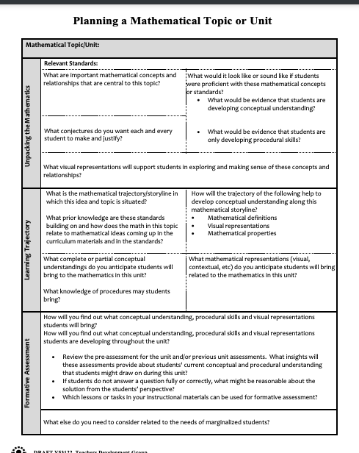
Introduction to the Unit Planning Tool
Take out the curriculum resources and materials for an upcoming unit of instruction
Read the first page of the “Planning a Mathematical Unit or Topic” tool
As you read, sketch your initial thoughts in response to the prompts
Check in with your group and share out what you are currently thinking and wondering.
(TDG, 2023)
Notes:
Facilitator Notes:
Move participants into grade level/content area teams
Ask participants to take out an upcoming unit of instruction with them to use with the tool.
If you are working with coaches/school leaders it may be helpful to use their school curriculum, or you can access an open source unit of instruction from Open Up Resources
Ask participants to open 7 Planning a Mathematical Topic or Unit_TDG and read page 1, look through the prompts with their unit in mind and share initial thoughts with their teammates (~15 min)

Slide 70
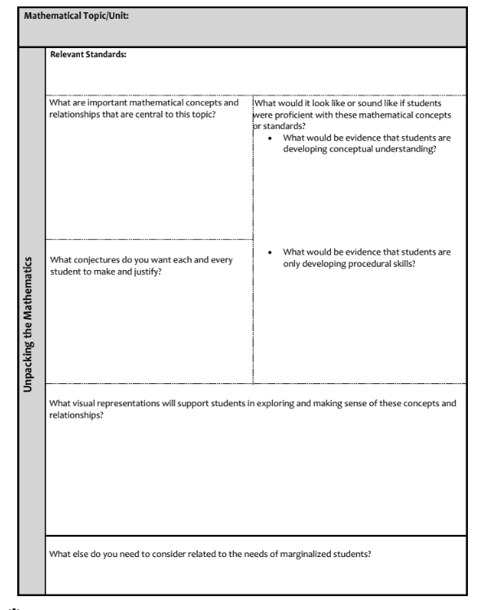
Trying out a Unit Planning Tool
(Part 1: Unpacking the Mathematics)
The tool breaks unit planning into three parts:
Unpacking the Mathematics
Learning Trajectory
Formative Assessment
(TDG, 2023)
Notes:
Facilitator Notes:
Let participants know the tool is made up of 3 parts and we will be unpacking each part, beginning with “Unpacking the Mathematics”
Ask participants to turn to page two in the 7 Planning a Mathematical Topic or Unit_TDG tool

Slide 71
Part 1: Unpacking the Mathematics
Which prompts on the “Unpacking the Mathematics”
Support Ambitious Teaching?
Support mathematical reasoning?
Which questions are a norm in your unit planning as a teacher or as a leader?
Which questions push your thinking?
What questions do you have about this part of the tool?
Be ready to share your rough draft thinking or questions.
Notes:
Facilitator Notes:
Ask participants to read through page two in the 7 Planning a Mathematical Topic or Unit_TDG tool and discuss the prompts on this slide with their content/grade level teams.
You might have participants share out key takeaways from their conversations.
Note, you may not want to linger too long on questions here since you will be going over each of the prompts in the tool as the session progresses.

Slide 72
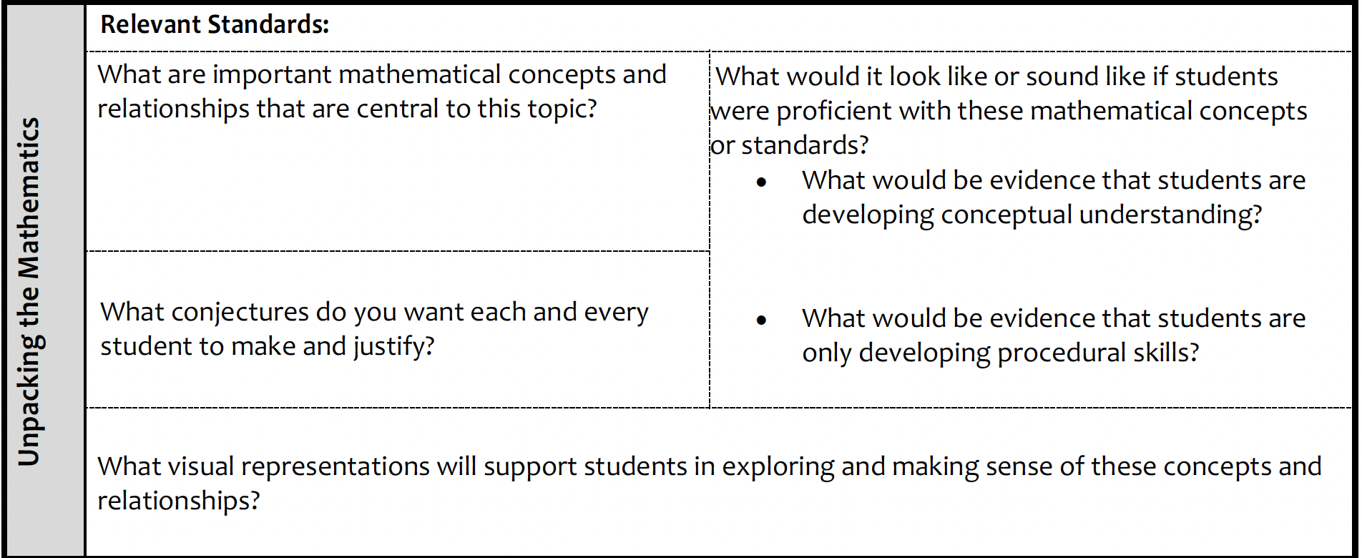
Unpacking the mathematics:
Concepts and Relationships
“Find the circumference and diameter of a circle.”
This is not a concept/relationship. It’s just what students will DO.
“Students will understand the length of the diameter of any circle will fit around the circumference a little more than three times (pi). This relationship holds true for all circles.”
This is a Concept/Relationship.
Notes:
Facilitator Notes:
Support participants in understanding what is meant by “concepts and relationships” and how this is different from what students will do.

Slide 73
Unpacking the mathematics:
Read the unit overview
Notes:
Facilitator Notes:
Ask participants, what resources do you draw on to make sense of the mathematical concepts and relationships in a unit?
Highlight the sample screenshot of a unit overview. You might say: Unit overviews can be useful for gathering information about the key concepts and relationships of a unit.
Ask participants to open up the unit overview for their unit.
You might ask: What information about important concepts and relationships are in your unit overview? Where else do you gather information about key concepts and relationships in your curriculum?
Ask participants to reconsider the prompt “What are important mathematical concepts and relationships that are central to this topic?”

Slide 74
Unpacking the mathematics:
The importance of visual representations and models
Why might we want to consider visual models in our planning?
How does use of visual models relate to what we know about ambitious math teaching?
Notes:
Facilitator Notes:
Ask participants to reflect on the prompt from the tool: “What visual representations will support students in exploring and making sense of these concepts and relationships?”
Then, discuss the prompts in the teal colored text box:
Why might we want to consider visual models in our planning?
How does use of visual models relate to what we know about ambitious math teaching?
Additional prompts to consider:
Does a visual model always produce conceptual understanding?
Can a visual model ever be used in a procedural way?

Slide 75
Quote about Mathematical Visuals
“Math drawings and other visual supports are of particular importance for English language learners, learners with special needs, or struggling learners, because they allow more students to participate meaningfully in the mathematical discourse in the classroom (Fuson & Murata 2007). The visuals assist students in following the reasoning of their classmates and in giving voice to their own explanations as they gesture to parts of their math drawings and other visual representations.”
(NCTM, 2014 p. 25)
Notes:
Facilitator Notes:
Optional slide, a quote from NCTM on the importance of math drawings for English language learners, learners with special needs or struggling learners.
You might use this slide to substantiate or add on to participants’ ideas about the importance of visuals on the previous slide.

Slide 76
Unpacking the mathematics:
a careful look at standards
NOTE: Use the ODE Standards Guidance Documents to support your work
Example: “The diameter of any circle is approximately ⅓ the length of the circumference.”
Notes:
Facilitator Notes:
Ask participants to reflect on the prompt from the tool: “What conjectures do you want each and every student to make and justify?”
Share the example on the slide
Suggest that participants use the ODE Standards Guidance Documents as a tool for thinking through what the relevant conjectures might be for their particular units of instruction.

Slide 77
Unpacking the mathematics:
a careful look at standards
NOTE: Use the ODE Standards Guidance Documents to support your work
Notes:
Facilitator Notes:
Ask participants to reflect on the prompt from the tool: “What would it look like or sound like if students were proficient with these mathematical concepts or standards?
Suggest that participants use the ODE Standards Guidance Documents as a tool for thinking through what it might look like or sound like if students were proficient with these mathematical concepts or standards?

Slide 78
Unpacking the mathematics
With your content team, work on the “unpacking the mathematics” page of the Planning a Mathematical Topic or Unit tool.
Be prepared to share your work and any questions that came up with the whole group.
(TDG, 2023)
Notes:
Facilitator Notes:
Give participants time to work on the “Unpacking the mathematics” part of 7 Planning a Mathematical Topic or Unit Tool_TDG with their content team/small group.

Slide 79
Small Group Activity
Directions: Work with your content team to complete the “Unpacking the Mathematics” section of the Planning a Mathematical Topic or Unit Tool
Notes:
Facilitator Notes:
Orient participants to the directions for this activity. Give ample time for the groups to make their way through the “Unpacking the Mathematics” part of the tool (at least 20 minutes).
If participants are working online, you may want to make a google slide with the prompts from 7 Planning a Mathematical Topic or Unit Tool_TDG on it, otherwise they can use paper/pencil at table groups.
Aspects of small group directions you might consider:
It may be helpful to specify roles for participants in the small groups. For example, you might:
Specify who will go first and in what order participants will share. For example, in a virtual session, you might say, “The second person who enters the breakout room will share first, and sharing will move counterclockwise until everyone has shared.”
Specify who will record. For example, in a virtual session, you might say, “The first person who enters the breakout room will be the recorder and jot down ideas from the group onto the workspace slide.
Specify who will keep time. For example, in a virtual session, you might say, “The third person will be the time keeper and let each team member know if airtime goes over a minute and how much time is left.”
It may be helpful to specify where participants will record and show them how to access it. As we have suggested, you might have an assigned Google Slide for each group which is a copy of this activity’s workspace slide.
It may be helpful to specify how much time participants will have in their small group.
It may be helpful to preview what their workspace will look like (e.g., share the next slide).
Before sending participants into groups, you might say: Share your rough draft thinking: you don’t have to have everything totally worked out yet, and it is ok to change your mind after you shared.
Monitor slides while the groups are working in order to pre-select two slides to share whole-group.

Slide 80
Reflecting on Part 1: “Unpacking the Mathematics”
What ideas from the “Unpacking the Math” part of the Unit Planning Tool are resonating with you? Why?
What ideas/questions do you want to celebrate?
What ideas or questions are creating disequilibrium for you?
Notes:
Facilitator Notes:
Use this slide to debrief participants experience planning the “Unpacking the mathematics” part of the tool.

Slide 81
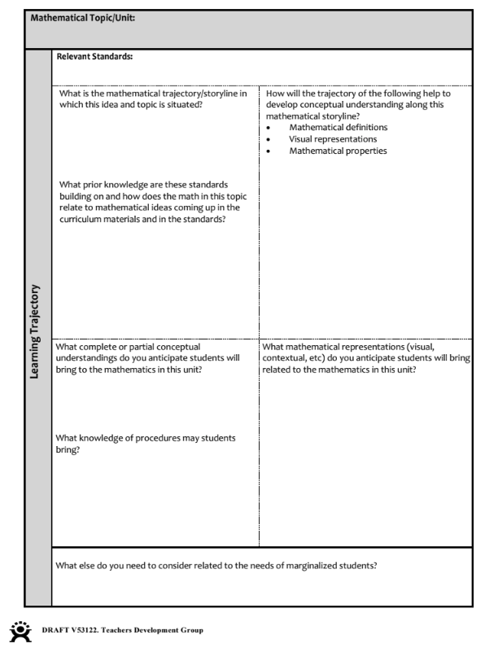
Trying out a Unit Planning Tool
(Part 2: Learning Trajectory)
The tool breaks unit planning into three parts:
Unpacking the Mathematics
Learning Trajectory
Formative Assessment
(TDG, 2023)
Notes:
Facilitator Notes:
Let participants know we are now moving to page 3 of the 7 Planning a Mathematical Topic or Unit_TDG tool and focusing on the “Learning Trajectory” for the unit.

Slide 82
Clarifying the Learning Trajectory in a unit plan
NOTE: Use the ODE Standards Guidance Documents (especially part 4) to support your planning here
Avoid making decisions based solely on past beliefs about what needs to be “covered” in this grade or course.
Notes:
Facilitator Notes:
Ask participants to reflect on the highlighted prompts from the tool:
What is the mathematical trajectory/storyline in which this idea and topic is situated?; What prior knowledge are these standards building on and how does the math in this topic relate to mathematical ideas coming up in the curriculum materials and in the standards?
How will the trajectory of the following help to develop conceptual understanding along this mathematical storyline?
Mathematical definitions
Visual representations
Ask participants what questions they have about these prompts
Remind participants to make use of the ODE Standards Guidance Documents (especially part 4) as a tool for thinking through learning trajectories.
Remind participants to avoid making decisions based solely on past beliefs about what needs to be “covered” in this grade or course.

Slide 83
Clarifying the Learning Trajectory in a unit plan
How does reflecting on students' prior experiences and understandings relate to our commitments to equity?
What assumptions might be operating when we reflect on students understandings?
Notes:
Facilitator Notes:
Ask participants to reflect on the highlighted prompts from the tool:
What complete or partial conceptual understandings do you anticipate students will bring to the mathematics in this unit? What knowledge of procedures may students bring?
What mathematical representations (visual, contextual, etc) do you anticipate students will bring related to the mathematics in this unit?
Ask participants what questions they have about these prompts
Orient participants to the follow-up questions on the slide:
What are the equity implications related to reflecting on students’ prior experiences and understandings?
What assumptions might be operating as you reflect on students understandings?

Slide 84
Learning Trajectory
With your content team, work on the “Learning Trajectory” page of the Planning a Mathematical Topic or Unit tool.
Be prepared to share your work and any questions that came up with the whole group.
(TDG, 2023)
Notes:
Facilitator Notes:
Give participants time to work on the “Unpacking the mathematics” part of 7 Planning a Mathematical Topic or Unit Tool_TDG with their content team/small group.

Slide 85
Small Group Activity
Directions: Work with your content team to complete the “Learning Trajectory” section of the Planning a Mathematical Topic or Unit Tool
Notes:
Facilitator Notes:
Orient participants to the directions for this activity. Give ample time for the groups to make their way through the “Learning Trajectory” part of the tool (at least 15 minutes).
If participants are working online, you may want to make a google slide with the prompts from 7 Planning a Mathematical Topic or Unit Tool_TDG on it, otherwise they can use paper/pencil at table groups.
Aspects of small group directions you might consider:
It may be helpful to specify roles for participants in the small groups. For example, you might:
Specify who will go first and in what order participants will share. For example, in a virtual session, you might say, “The second person who enters the breakout room will share first, and sharing will move counterclockwise until everyone has shared.”
Specify who will record. For example, in a virtual session, you might say, “The first person who enters the breakout room will be the recorder and jot down ideas from the group onto the workspace slide.
Specify who will keep time. For example, in a virtual session, you might say, “The third person will be the time keeper and let each team member know if airtime goes over a minute and how much time is left.”
It may be helpful to specify where participants will record and show them how to access it. As we have suggested, you might have an assigned Google Slide for each group which is a copy of this activity’s workspace slide.
It may be helpful to specify how much time participants will have in their small group.
It may be helpful to preview what their workspace will look like (e.g., share the next slide).
Before sending participants into groups, you might say: Share your rough draft thinking: you don’t have to have everything totally worked out yet, and it’s ok to change your mind after you shared.
Monitor slides while the groups are working in order to pre-select two slides to share whole-group.

Slide 86
Reflecting on Part 2: “Learning Trajectory”
What ideas from the “Learning Trajectory” part of the Unit Planning Tool are resonating with you? Why?
What ideas/questions do you want to celebrate?
What ideas or questions are creating disequilibrium for you?
Notes:
Facilitator Notes:
Use this slide to debrief participants experience planning the “Learning Trajectory” part of the tool.

Slide 87
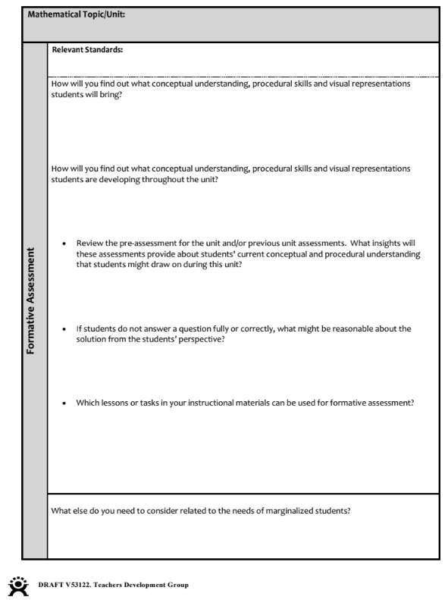
Trying out a Unit Planning Tool
(Part 3: Learning Trajectory)
The tool breaks unit planning into three parts:
Unpacking the Mathematics
Learning Trajectory
Formative Assessment
(TDG, 2023)
Notes:
Facilitator Notes:
Let participants know we are now moving to page 4 of the 7 Planning a Mathematical Topic or Unit_TDG tool and focusing on the “Formative Assessment” for the unit.

Slide 88
Trying out a Unit Planning Tool
(Part 4: Formative Assessment)
Consider all instructional materials as “assessment opportunities.” Make decisions about which tasks to highlight based on the following questions
Notes:
Facilitator Notes:
Ask participants to reflect on the highlighted prompts from the tool (with particular emphasis on the last question highlighted above with a teal text box):
How will you find out what conceptual understanding, procedural skills and visual representations students will bring?
How will you find out what conceptual understanding, procedural skills and visual representations students are developing throughout the unit?
Review the pre-assessment for the unit and/or previous unit assessments. What insights will these assessments provide about students' current conceptual and procedural understanding that students might draw on during this unit?
If students do not answer a question fully or correctly, what might be reasonable about the solution from the students’ perspective?
Which lessons or tasks in your instructional materials can be used for formative assessment?
Ask participants what questions they have about these prompts
Remind participants to Consider all instructional materials as “assessment opportunities.” and to make decisions about which tasks/opportunities to highlight based on the prompts in the tool.

Slide 89
Small Group Activity
Directions: Work with your content team to complete the “Learning Trajectory” section of the Planning a Mathematical Topic or Unit Tool
Notes:
Facilitator Notes:
Orient participants to the directions for this activity. Give ample time for the groups to make their way through the “Formative Assessment” part of the tool (at least 15 minutes).
If participants are working online, you may want to make a google slide with the prompts from 7 Planning a Mathematical Topic or Unit Tool_TDG on it, otherwise they can use paper/pencil at table groups.
Aspects of small group directions you might consider:
It may be helpful to specify roles for participants in the small groups. For example, you might:
Specify who will go first and in what order participants will share. For example, in a virtual session, you might say, “The second person who enters the breakout room will share first, and sharing will move counterclockwise until everyone has shared.”
Specify who will record. For example, in a virtual session, you might say, “The first person who enters the breakout room will be the recorder and jot down ideas from the group onto the workspace slide.
Specify who will keep time. For example, in a virtual session, you might say, “The third person will be the time keeper and let each team member know if airtime goes over a minute and how much time is left.”
It may be helpful to specify where participants will record and show them how to access it. As we have suggested, you might have an assigned Google Slide for each group which is a copy of this activity’s workspace slide.
It may be helpful to specify how much time participants will have in their small group.
It may be helpful to preview what their workspace will look like (e.g., share the next slide).
Before sending participants into groups, you might say: Share your rough draft thinking: you don’t have to have everything totally worked out yet, and it’s ok to change your mind after you shared.
Monitor slides while the groups are working in order to pre-select two slides to share whole-group.

Slide 90
Reflecting on Part 3: “Formative Assessment”
What ideas from the “Formative Assessment” part of the Unit Planning Tool are resonating with you? Why?
What ideas/questions do you want to celebrate?
What ideas or questions are creating disequilibrium for you?
Notes:
Facilitator Notes:
Use this slide to debrief participants’ experience planning with the “Formative Assessment” part of the tool.

Slide 91
Debrief: Principles of ambitious mathematics teaching
Which of these ideas are you thinking about in light of our work? What questions do you have?
“Ambitious teaching is teaching that deliberately aims for all students – across ethnic, racial, class, and gender categories – not only to acquire, but also to understand and use knowledge, and to use it to solve authentic problems.”
(Lampert & Graziani, 2009, p. 492)
Ambitious teaching:
Engages students in making sense of mathematical concepts
Centers students’ thinking and reasoning through discourse
Views students as capable of using their understandings and assets to solve authentic problems
Values students’ thinking, including emergent understanding and errors
Attends to student thinking in an equitable and responsive manner
(Anthony et al., 2015)
Notes:
Facilitator Notes:
Debrief “Connecting to Research” or “Planning for Action” through the lens of this definition from Lampert and Graziani (2009) and the five principles listed.
If you’re facilitating online, you might offer an opportunity to “stamp” the principles that are on participants’ minds and discuss trends or questions that emerge.
If you’re facilitating in person, you might offer a turn and talk so participants can discuss what principles are on their minds with a partner/group and then come back to share trends or questions that emerge.
[written reflection option]
References for these ideas: Anthony et al., 2015; Huinker & Bill, 2017; Lampert et al., 2011; Lampert & Graziani, 2009

Slide 92
Debriefing Session 11
Reflecting on our work in the activities in the session

Slide 93
Debriefing Session 11: Four cornerstone principles of the OMP
What connections do you see between any of the cornerstones and our work in this session?
Focus: Learning experiences in every grade and course are focused on core mathematical content and practices that progress purposefully across grade levels.
Engagement: Mathematical learning happens in environments that motivate all students to engage with relevant and meaningful issues in the world around them.
Pathways: All students are equipped with the mathematical knowledge and skills necessary to identify and productively pursue any postsecondary paths in their future. Students have agency to choose from a variety of courses, contexts, and applications they find relevant.
Belonging: Participation in mathematical learning builds students’ identities as capable math learners and fosters a positive self-concept. Students’ cultural and linguistic assets are valued in ways that contribute to a sense of belonging to a community of learners.
Any proposed instructional approach, curricular change, or system design element should be evaluated by the degree to which it builds on these four cornerstones. When new approaches are built within the framework of all four-cornerstone principles, we will be on our way to engineering a reimagined system.
(ODE, 2022)
Notes:
Facilitator Notes:
Option 1: Debrief the session through the lens of the four cornerstone principles of the Oregon Mathematics Project.

Slide 94
Debriefing Session 11: Focus of the session
What new insights do you have related to our session focus, planning ambitious units of instruction which support students in accessing grade level content?
Take a couple of minutes to reflect on our work in the session.
Agenda for this session:
Connecting to research: Using the Oregon Math Standards to plan units which support students in accessing grade level content
Planning for Action: Using a unit planning protocol to plan units of instruction which support students in accessing grade level content
Notes:
Facilitator Notes:
Option 2: Debrief the session through the lens of the focus of the session.
Module 2 Part 2 supports our thinking around both essential questions of this module: What does ambitious math teaching look like at the unit, lesson, and task levels? How do we value and build on the mathematical strengths of students who are often excluded by schooling?
The focus of this session in particular is to reflect on planning ambitious units of instruction that support students in accessing grade level content.
You might offer participants time to think individually about new insights before sharing aloud.

Slide 95
Debriefing Module 2 Part 2
Reflecting on our work in Sessions 10 & 11

Slide 96
Debriefing Module 2 Part 2: Important moments
Record important moments that impacted your thinking about ambitious math teaching and your hopes for students as learners.
Examples of important moments:
AHA! moments you experienced
Changes in your thinking
WOW! ideas that you hadn’t considered before
Contradictions to or affirmations of prior understandings

Slide 97
Debriefing Module 2 Part 2: Important moments
Take 5 minutes to refine the ideas you jotted.
Synthesize your important moments from Module 2 Part 2.
Based on the work and discussions in these sessions, what ideas do you have for how you’ll implement your learning?
What else, if anything, would you like to share with the facilitator?
Notes:
Facilitator Notes:
You might pose these questions in the form of a survey or exit card.

Slide 98
Acknowledgements
These Ambitious Teaching Modules exist because of the vision and hard work of a team led by the creative vision, development, and design offered by Kathy Pfaendler and Julie Fredericks, Math Professional Learning Specialists, Teachers Development Group, Cathy Martin, Denver, CO, Taylor Stafford, University of Washington, and Hannah Nieman, University of Washington. Their efforts were supported by the ongoing input and feedback of the entire staff of Teachers Development Group (TDG). These Modules, like all professional learning materials produced by our organization, are based on the collective knowledge, expertise, and ongoing learning of TDG’S Math Professional Learning Specialists and the teachers and leaders with whom we work. Thanks also go to Mark Freed, and Kama Almasi, Oregon Department of Education, and Rebekah Elliott, Oregon State University, who offered vision and feedback throughout the development and design process. Special thanks go to Sophia Vazquez, University of Washington, who did the accessibility formatting of these Modules.
Ruth Heaton, CEO, Teachers Development Group

Slide 99
Resources & Partnerships
Thank you for joining us!

