Slide 1
Module 3
Part 2: Planning and assessment practices that sustain ambitious teaching

Slide 2
Facilitator Guide: Welcome to Module 3, Part 2!
In Module 1, we worked to understand the foundations of high school math instruction, including what ambitious math instruction is and why a 2 + 1 is important for ambitious math instruction.
In Module 2, we dug deeper into ambitious math instruction and explored what does ambitious math instruction looks like at the unit, lesson, and task levels and considered how to value and build on the mathematical strengths of students who are often excluded by schooling.
In Module 3, Part 1, we deepened our understanding teaching practices that sustain ambitious teaching.
In Module 3, Part 2, we focus on planning and assessment practices that sustain ambitious teaching. We experience an ambitious geometry lesson which incorporates technology and use this experience to reflect on ways to infuse existing curricular resources with teacher moves, assessment practices and feedback structures which sustain ambitious teaching.
Notes:
Facilitator Notes:
Orange Facilitator Guide slides orient facilitators in making sense of upcoming sections.
These slides are intended to be hidden from the deck during sessions.

Slide 3
Facilitator Guide: Professional learning activity types
Setting and maintaining norms: These activities support participants to establish norms that will guide participation in sessions.
Doing math together: These activities engage participants in a mathematics task.
Studying teaching: These activities involve analysis of video, vignettes, live teaching, or instructional tools.
Connecting to research: These activities involve unpacking and understanding the research in mathematics education underpinning focal ideas and concepts.
Planning for action: These activities involve making links between session content and our own practice and contexts.
Notes:
Facilitator Notes:
Icons appear on section header slides throughout the slide deck, both for facilitators and participants

Slide 4
Facilitator Guide: Table of contents
Session 17: Planning practices to sustain ambitious teaching: Adapting curriculum and using technology to sustain ambitious teaching (~90 minutes)
Doing Math Together: Experiencing an ambitious math lesson using Geogebra
Planning for Action: Adapting a published lesson to include ambitious teaching practices
Session 18: Planning practices to sustain ambitious teaching: Selecting worthwhile tasks and adapting curriculum materials to enhance cognitive demand (~45 minutes)
Connecting to Research: Selecting rich worthwhile tasks
Planning for Action: Adapting tasks to enhance the cognitive demand of tasks
Session 19: Assessment practices to sustain ambitious teaching: Assessment and feedback structures that support deeper learning (~90 minutes)
Connecting to Research: Reviewing assessment and feedback structures to sustain ambitious teaching
Planning for Action: Designing assessment and feedback structures that sustain ambitious teaching
Notes:
Facilitator Notes:
Each of the sessions is designed to be enacted within a professional learning meeting.
We suggest that the sessions and activities within session be enacted in order if possible, as some of the content and ideas build on one another.

Slide 5
Essential Questions of the Modules
Module 1: Foundations of High School Math Instruction | What is ambitious math teaching? Why is a 2 + 1 model important for equitable outcomes in mathematics?
Module 2: Principles and Practices of Ambitious Math Teaching | What does ambitious math teaching look like at the unit, lesson, and task levels? How do we value and build on the mathematical strengths of students who are often excluded by schooling?
Module 3: Principles and Practices of Sustainability | What planning, teaching, and assessment practices can be used to sustain ambitious math teaching?
Notes:
Facilitator Notes:
You might say: Let’s ground ourselves in the Essential Questions that drive the Ambitious Math Teaching Professional Learning Modules.

Slide 6
Reconnecting to our thinking from the previous sessions
Notes:
Facilitator Notes:
Optional: Paste excerpts of participants’ reflections from previous sessions to support the group in reconnecting with the work you’ve done together previously.
You might ask: What learning from our previous sessions are you excited about or hoping to build on today?

Slide 7
Planning practices to sustain ambitious teaching: Adapting curriculum and using technology to sustain ambitious math teaching
Session 17
The focus of this session is adapting curriculum and using technology to sustain ambitious math teaching.
Agenda for this session:
Setting and maintaining norms: Reconnect with and revise our norms for interacting together
Doing Math Together: Experiencing an ambitious math lesson using Geogebra
Planning for action: Adapting a published lesson to include ambitious teaching practices
Time estimate: 90 minutes
M3 P2 Table of Contents
Notes:
Facilitator Notes:
This session especially supports our thinking around the essential question of this module: What does ambitious math instruction look like at the unit, lesson, and task levels?
We estimate this session will take 90 minutes. If you need to break the section into smaller pieces, please note the activities listed in the agenda are intended to be enacted in this order.
Resources for this session are in the Module 3 Resources folder, but you and participants will need to make an Open Up Resources account here. Accounts are free.

Slide 8
Setting and maintaining norms
Reconnect with and revise our norms for interacting together

Slide 9
Revisiting norms
[Insert your group norms]
Rights of a Learner
You have the right to:
Be confused
Make mistakes
Say what makes sense to you
Share unfinished or rough draft thinking and not be judged
(Kalinec-Craig, C. A., 2017)

Slide 10
Doing math together:
Experiencing an ambitious math lesson using Geogebra
Notes:
Facilitator Notes:
The focus of Session 17 adapting curriculum and using technology to sustain ambitious math teaching. In this activity we experience an ambitious math lesson using a technology resource (Geogebra)

Slide 11
Facilitator Guide: Doing Math Together
Rationale for doing math together:
Deepens our own specialized mathematical content knowledge so we can better support and respond to students (Kazemi & Franke, 2004)
Gives us a shared context for the study of teaching (Kazemi et al., 2018)
Helps us think about the experiences of our students
To foster joy for doing and learning mathematics (Su, 2020)
Recommendations for doing math together:
Establish norms for doing math together (see slide notes for examples) (Elliott et al., 2009; Yackel & Cobb; 1998).
Support participants in engaging with the task as learners and as teachers. Be explicit about when/how participants should take up each of these roles.
Notes:
Example norms for doing mathematics together:
Engage with each other’s thinking with curiosity
Support everyone to experience joy for mathematics
Use partial understandings, mistakes, and errors as an opportunity to examine further questions about mathematics
Additional resources: If you are interested in learning more about doing math together check out these resources.
TEDD.org: Mathematics Instructional Activities
TEDD.org: Setting norms for collaborative work
Mathematics For Human Flourishing (book)
References
Ball, D. L., & Cohen, D. K. (1999). Developing practice, developing practitioners: Toward a practice-based theory of professional education. In L. Darling-Hammond & G. Sykes (Eds.), Teaching as the learning profession: Handbook of policy and practice (pp. 3–22). Jossey Bass.
Elliott, R., Lesseig, K., & Kazemi, E.. (2009). Sociomathematical norms in professional development: Examining leaders’ use of justification and its implication for practice. The Montana Mathematics Enthusiast Journal monograph, 7.
Kazemi, E., & Franke, M. L. (2004). Teacher learning in mathematics: Using student work to promote collective inquiry. Journal of Mathematics Teacher Education, 7(3), 203–235.
Su, F. (2021). Mathematics for Human Flourishing. Yale University Press.
Yackel E., & Cobb, P. (1998) Sociomathematical norms, argumentation, and autonomy in mathematics. Journal for Research in Mathematics Education, 27(4), 458-477.

Slide 12
Rigid Transformations using Geogebra
Goals for us as math learners:
Mathematical goal: Deepen our understanding of key features of rigid transformations (translations, rotations and reflections)
Equity goal: Support learners’ access to content through use of technology and just-in-time scaffolding.
Goals for us as teachers:
Pedagogical goal: Consider how technology sustains equitable and ambitious instruction. In what ways can technology provide access for learners? In what ways can technology function as a barrier for learners?
Notes:
Facilitator Notes:
This slide frames the purpose of math task and orients participants of the goals we have for them as learners and as educators. The slide appears again at the end of this section to support debriefing participants’ experiences doing the task. Emphasize that there will be times in this activity where participants are asked to put on their “math learner hat” and other times where they are asked to put on their “teacher hat.”
Orient participants to the goals for this math lesson
You might say: After this experience doing math together, we will debrief by reflecting on the goals we had for ourselves as math learners and as teachers.

Slide 13
Connection to Content Standards
Geometric Reasoning and Measurement (HS.GM)
HS.GM.A Apply geometric transformations to figures through analysis of graphs and understanding of functions.
HS.GM.A.1 Apply definitions of rotations, reflections, and translations to transform a figure and map between two congruent figures in authentic contexts.
HS.GM.A.2 Verify experimentally the properties of a dilation given a center and a scale factor. Solve problems in authentic contexts involving similar triangles or dilations.
HS.GM.A.3 Use the slopes of segments and the coordinates of the vertices of triangles, parallelograms, and trapezoids to solve problems in authentic contexts.
HS.GM.A.4 Use definitions of transformations and symmetry relationships to justify the solutions of problems in authentic contexts.
(ODE, 2022)
Notes:
Facilitator Notes:
Orient participants to the relevant Oregon Math Standards for this lesson

Slide 14
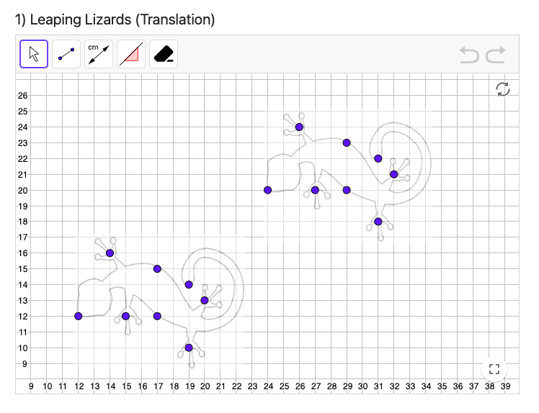
Activating our knowledge of Rigid Motion Transformations (translations, rotations & reflections) using GeoGebra
What is GeoGebra?
GeoGebra is an interactive math software for all levels of education that brings together geometry, algebra, spreadsheets, graphing, statistics and calculus. (You can learn more about GeoGebra here.)
Directions for this task:
Use this link to view the GeoGebra tasks
Complete Activities 1-4 and record your work on the workspace slides (there is one slide for each activity)
Notes:
Facilitator Notes:
Introduce the GeoGebra task. Explain that we are doing this activity to activate our knowledge of rigid motion transformations.
Ask participants to use the link to access the GeoGebra activities.
Break participants into small groups to work on Activities 1-4 and record their work on the workspace slides.
Facilitate a whole group discussion by asking one group to share their thinking for each activity.

Slide 15
Small Group Activity
Directions: Use Geogebra work on four rigid motion transformations.
Notes:
Facilitator Notes:
Support participants in accessing their workspace slides.
Aspects of small group directions you might consider:
It may be helpful to specify roles for participants in the small groups. For example, you might:
Specify who will go first and in what order participants will share. For example, in a virtual session, you might say, “The second person who enters the breakout room will share first, and sharing will move counterclockwise until everyone has shared.”
Specify who will record. For example, in a virtual session, you might say, “The first person who enters the breakout room will be the recorder and jot down ideas from the group onto the workspace slide.
Specify who will keep time. For example, in a virtual session, you might say, “The third person will be the time keeper and let each team member know if airtime goes over a minute and how much time is left.”
It may be helpful to specify where participants will record and show them how to access it. As we have suggested, you might have an assigned Google Slide for each group which is a copy of this activity’s workspace slide.
It may be helpful to specify how much time participants will have in their small group.
It may be helpful to preview what their workspace will look like.

Slide 16
Preview of Workspace Slide
Team Names:
Click here and complete part 1 “ Leaping Lizards (Translation).” Then develop a conjecture and justification & record below. Paste a screenshot of your completed work on top of the Leaping Lizards figure.
What is always true, sometimes true, or never true about characteristics of a pre-image sliding (translation) to image?
Justification:
(Roberts, 2020)
Notes:
Facilitator Notes:
Groups / breakout rooms: Participants should work in groups on the workspace slide for ~15 minutes.
Whole group: Select 1 group to share out for each transformation.

Slide 17
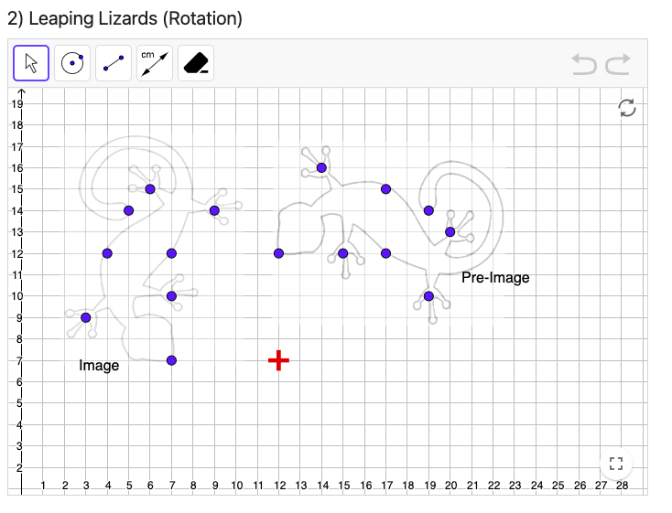
Preview of Workspace (2 of 4)
Team Names:
Click here and complete part 2 “ Leaping Lizards (Rotation).” Then develop a conjecture and justification & record below. Paste a screenshot of your completed work on top of the Leaping Lizards figure.
What is always true, sometimes true, or never true about characteristics of a pre-image sliding (Rotation) to image?
Justification:
(Roberts, 2020)

Slide 18
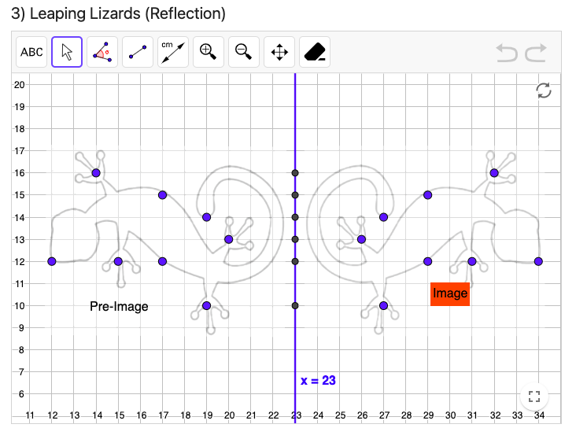
Preview of Workspace (3 of 4)
Team Names:
Click here and complete part 2 “ Leaping Lizards (Reflection).” Then develop a conjecture and justification & record below. Paste a screenshot of your completed work on top of the Leaping Lizards figure.
What is always true, sometimes true, or never true about characteristics of a pre-image sliding (Reflection) to image?
Justification:
(Roberts, 2020)

Slide 19
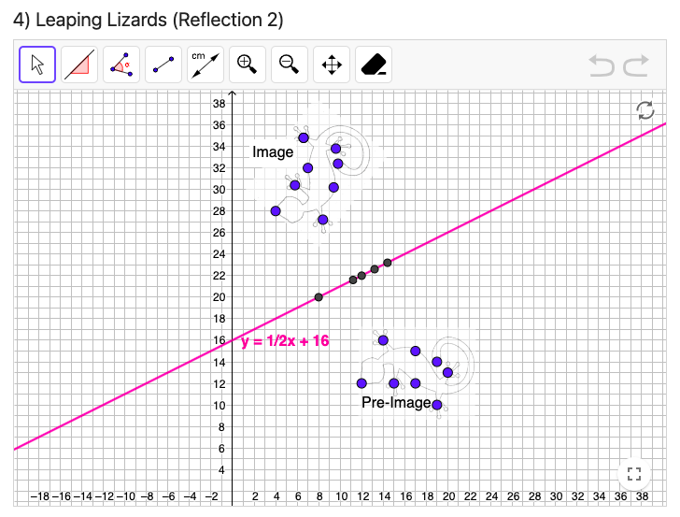
Preview of Workspace (4 of 4)
Team Names:
Click here and complete part 2 “ Leaping Lizards (Reflection 2).” Then develop a conjecture and justification & record below. Paste a screenshot of your completed work on top of the Leaping Lizards figure.
What is always true, sometimes true, or never true about characteristics of a pre-image sliding (Reflection) to image?
Justification:
(Roberts, 2020)

Slide 20
Let’s look at how technology is used in a Geometry Unit.
As we engage in Lesson 1 of Open Up in the Transformation Geometry Unit, keep both a student hat on and a teacher hat on and consider:
What is supporting or limiting your access? What would you adjust for your students?
How did the initial GeoGebra task we engaged in activate your knowledge of transformations from 8th grade and to acclimate everyone to GeoGebra Technology before starting the Open Up Lessons 1-3? Was this necessary or helpful?
Notes:
Facilitator Notes:
Frame our work looking at the Open-Up Resources Geometry Unit
Note, you will need to make an account and login to access the Open-Up Resources materials. Accounts are free.

Slide 21
Leaping Lizards! (Open-Up Resources)
Excerpt From Open-Up Resources Lesson Launch:
Animated films and cartoons are now usually produced using computer technology, rather than the hand-drawn images used in the past. Computer animation requires both artistic talent and mathematical knowledge.
Sometimes animators want to move an image around the computer screen without distorting the size and shape of the image in any way. This is done using geometric transformations such as translations (slides), reflections (flips), and rotations (turns), or perhaps some combination of the three. These transformations need to be precisely defined, so there is no doubt about where the final image will end up on the screen.
(Open-Up Resources, 2023)
Notes:
Facilitator Notes:
Read the task launch from the Open-Up Resources Geometry unit (Leaping Lizards, Lesson 1, Unit 1).
Note, you will need to make an account and login to access the Open-Up Resources materials. Accounts are free.

Slide 22
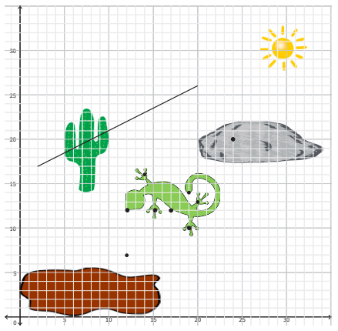
Lesson Launch Example
Leaping Lizards lesson launch, continued: Today you are the animator– the producers need the image of the lizard to move to the rock to sunbathe. What transformation(s) would you use to move it? Is there a second way? Is there a way to use translations, rotations, and reflections in combinations?
(Open-Up Resources, 2023)
Notes:
Facilitator Notes:
Continue reading the launch of the task.
Pause for questions, noticings/wonderings from the group.

Slide 23
Leaping Lizards! (Open-Up Resources)
Work on animating the Lizard using two of the resources below. Everyone will do option 1, and then select EITHER of options 2 or 3…
Option # 1 Hands on Materials
Compasses; patty paper, transparencies or parchment paper
Protractors
Rulers
Worksheet for Leaping Lizards
Option # 2 Google Workspace Slide
See Workspace
Option # 3 Geogebra
Geogebra Link
Notes:
Facilitator Notes:
Have participants open 5 Leaping Lizards_Open Up Resources
Break participants into small groups to begin working on this task using Option #1 AND Options #2 OR #3
The purpose of trying out two different options is for participants to compare how the technology/tools used in the two options they select supports or limits their access and learning opportunities.

Slide 24
Preview of OPTION #1 of Workspace Slide
Team Names:
Today you are the animator– the producers need the image of the lizard to move to the rock to sunbathe. What transformation(s) would you use to move it? Is there a second way? Is there a way to use translations, rotations, and reflections in combinations?
Original lizard anchor points:
{(12, 12), (15, 12), (17, 12),
(19, 10), (19, 14), (20, 13),
(17, 15), (14, 16)}
Explain your process & how you know this works. Conjectures? Add slides and screenshots as needed.
Use the materials below to work on moving the lizard to the rock:
Compasses; patty paper, transparencies or parchment paper
Protractors
Rulers
Worksheet for Leaping Lizards
After you complete the transformations, paste images of your work on the next slide.

Slide 25
Preview of OPTION #1 of Workspace Slide
Team Names:
Paste images of your translations below.

Slide 26
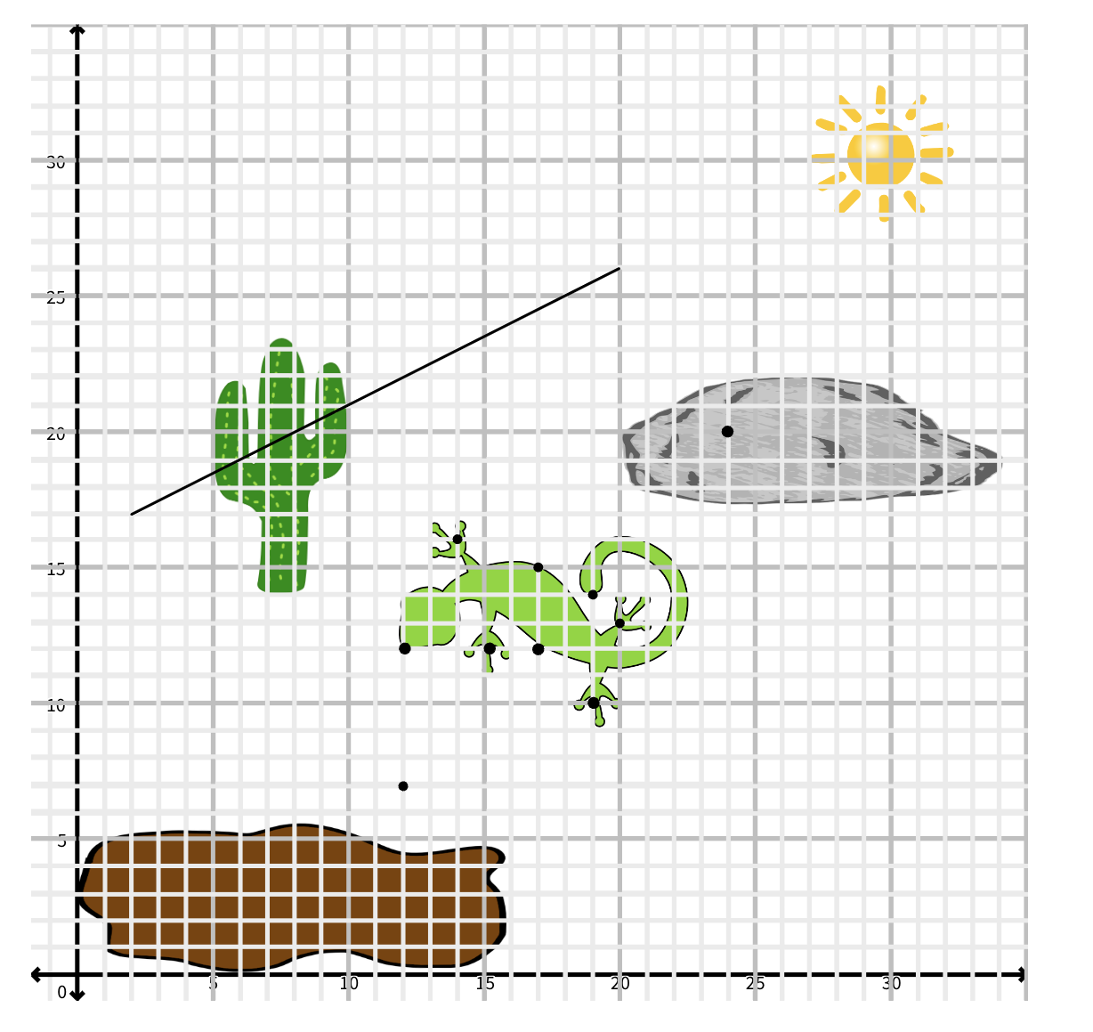
Preview of OPTION #2 Workspace Slide
Team Names:
Today you are the animator– the producers need the image of the lizard to move to the rock to sunbathe. What transformation(s) would you use to move it? Is there a second way? Is there a way to use translations, rotations, and reflections in combinations?
Explain your process & how you know this works. Conjectures? Add slides and screenshots as needed.
Drag this lizard onto the image
Original lizard anchor points:
{(12, 12), (15, 12), (17, 12),
(19, 10), (19, 14), (20, 13),
(17, 15), (14, 16)}

Slide 27
Preview of OPTION #2 of Workspace Slide
Team Names:
Paste screenshots/images of your translations below.

Slide 28
Preview of OPTION #3 of Workspace Slide
Team Names:
Lesson # 1: Follow this link to a 3-part geogebra activity. Spend some time on each task and then discuss as a group.
Discussion Prompt
What different strategies did your team use to accomplish the task? Why do you think those strategies worked? What is always going to be true?
Discussion Notes

Slide 29
Preview of OPTION #3 of Workspace Slide
Team Names:
Lesson # 1: Follow this link to a 3-part GeoGebra activity. Spend some time on each task and then discuss as a group.
Screenshots from GeoGebra activity:

Slide 30
Discuss the “Leaping Lizards” Task
What transformation(s) did you use to move the lizard to the rock?
How is what this group shared similar or different from how you moved the lizard?
Notes:
Facilitator Notes:
Facilitate a whole-group discussion about the task.
You might select and sequence different approaches and paste in screen shots or images of participants’ work and add them to this slide.
Debrief each of the three transformations.
Potential questions
What transformation(s) did you use to move the lizard to the rock?
How is what this group shared similar or different from how you moved the lizard?
Could you move the lizard to the rock only using reflection(s)? Only using rotations?

Slide 31
Debrief: Reflecting on the “Leaping Lizards” lesson as learners
Goals for us as math learners:
Mathematical goal: Deepen our understanding of key features of rigid transformations (translations, rotations and reflections)
Equity goal: Support learners’ access to content through use of technology and just-in-time scaffolding.
Debrief Questions:
How did you see me working on each of these goals during the lesson?
What moves could have been made to support our work on these goals even more?
Notes:
Facilitator Notes:
Debrief the math lesson through the lens of our goals as learners using the debrief questions on the slide.

Slide 32
Debrief: Reflecting on the “Leaping Lizards” as teachers
Goals for us as teachers:
Pedagogical goal: Consider how technology sustains equitable and ambitious instruction. In what ways can technology provide access for learners? In what ways can technology function as a barrier for learners?
Review the original Leaping Lizards lesson materials from Open-Up Resources:
What do you notice and wonder about how I adapted this lesson?
How did my adaptations relate to your ability to access key mathematical ideas?
How did my adaptations relate to your opportunities for reasoning and sensemaking?
How did my use of technology support and/or limit your access?
Notes:
Facilitator Notes:
Debrief the math lesson through the lens of our goals as teachers
Give participants 5 minutes to review the original Leaping Lizards lesson and compare it to the adaptations made in this version.

Slide 33
Debrief: Practices of ambitious mathematics teaching
Which of these 8 practices did you notice? What others could have been highlighted? In what ways?
Establish mathematical goals to focus learning
Implement tasks that promote reasoning and problem solving
Use and connect mathematical representations
Facilitate meaningful mathematical discourse
Pose purposeful questions
Build on procedural fluency from conceptual understanding
Support productive struggle in learning mathematics
Elicit and use evidence of student thinking
(NCTM, 2014)
Notes:
Facilitator Notes:
Option 1: Debrief “Doing Math Together” or “Studying Teaching” through the lens of NCTM’s 8 practices of ambitious instruction.
If you’re facilitating online, you might offer an opportunity to “stamp” the practices participants notice and discuss trends or questions that emerge.
If you’re facilitating in person, you might offer a turn and talk so participants can discuss what they noticed with a partner/group and then come back to share trends or questions that emerge.
During the discussion, press for examples/evidence from the shared moment of teaching. This might sound like: “Where/when did you see an example of this practice?”

Slide 34
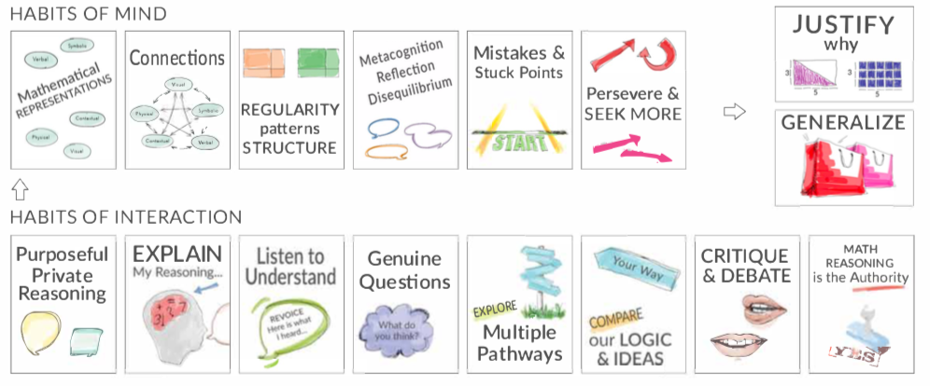
Debrief: Habits, routines, and actions
Which of these habits did you notice? What others could have been highlighted? In what ways?
Habits of Mind: Things we do as individual mathematicians when solving problems.
Habits of Interaction: Things that we do when working with others to make sense of the math.
(TDG, 2020)
Notes:
Facilitator Notes:
Option 2: Debrief “Doing Math Together” or “Studying Teaching” through the lens of TDG’s Habits & Routines tool.
If you’re facilitating online, you might offer an opportunity to “stamp” the habits participants notice and discuss trends or questions that emerge.
If you’re facilitating in person, you might offer a turn and talk so participants can discuss what they noticed with a partner/group and then come back to share trends or questions that emerge.
During the discussion, press for examples/evidence from the shared moment of teaching. This might sound like: “Where/when did you see an example of this practice?”

Slide 35
Planning for action
Adapting a published lesson to include ambitious teaching practices

Slide 36
Facilitator Guide: Planning for Action
Rationale for planning for action:
To see connections to our contexts and goals (Putnam & Borko, 2000)
To apply new ideas to upcoming work (Horn & Kane, 2015)
To surface complexities when taking up new ideas
Recommendations for planning for action:
Use teachers’ own curricular resources when possible
Create space to discuss anticipated challenges and strategies for trying new ideas within those challenges
Follow up on teachers’ plans; return to them to build on and refine ideas
Notes:
Planning for action involves making links between session content and our own practice and contexts.
Additional resources: If you’re interested in digging more into these ideas, check out these resources.
Module 0, Resource 2: Sometimes, planning conversations can surface unproductive ideas about particular students or student groups that circulate in our schools or broader contexts. This resource is designed to support leaders preparing for difficult conversations, especially when unproductive language about students emerges.
References
Horn, I. S., & Kane, B. D. (2015). Opportunities for professional learning in mathematics teacher workgroup conversations: Relationships to instructional expertise. Journal of the Learning Sciences, 24(3), 1–46.
Putnam, R. T., & Borko, H. (2000). What do new views of knowledge and thinking have to say about research on teacher learning? Educational Researcher, 29(1), 4-15.

Slide 37
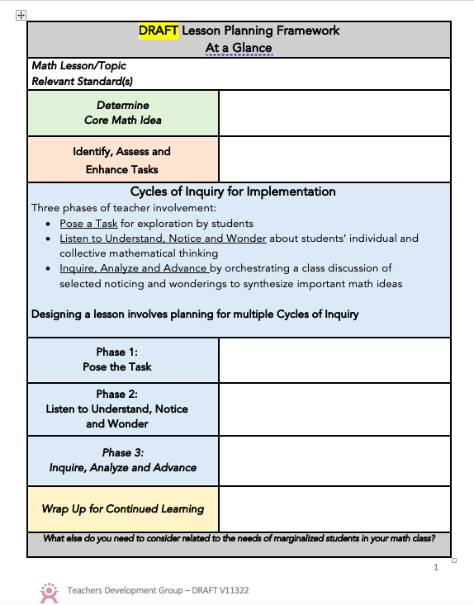
Using the “Lesson Planning Framework” to adapt a published lesson
Skim through the Lesson Planning Framework introduced in Module 2.
Identify 1-3 favorite questions that you feel you always want to ask yourself when planning a lesson.
Be prepared to share your favorite planning question(s)
Notes:
Facilitator Notes:
Ask participants to open 6 Lesson Planning Framework_TDG and identify 1-3 favorite planning prompts.
Ask participants to share their favorite planning prompts with a partner (if in-person) or in the chat (if online).

Slide 38
Adapting Lesson 3, “Leap Frog” from Open-Up Resources Geometry Unit
On your workspace slide:
Read Unit 1 Lesson 3 (Planning Section; 5 Practices; & Ready, Set, Go)
Use Lesson Planning Framework to reflect on how the lesson:
Gives students access;
Creates opportunities for reasoning and sensemaking
Promotes equitable discourse and engagement
Assesses students’ understanding and
Reflect on the teacher moves you might add and other adaptations that would make to foster ambitious math teaching
Notes:
Facilitator Notes:
Ask participants to access the “Open-Up Resources” Geometry unit, Lesson 3 “Leap Frog”
Note, you will need to login and create an account to access these free resources
Ask participants to silently reflect on Lesson 3 “Leap Frog” alongside the Lesson Planning Framework using the prompts on the slide
Soon, they will respond to each of these prompts in small groups, on a workspace slide.
Alternatively, you might ask participants to do this with a lesson from their current curriculum.

Slide 39
Small Group Activity
Directions: Respond to the prompts on the workspace slide to adapt and analyze Lesson 3 “Leap Frog”
Notes:
Facilitator Notes:
Orient participants to their workspace slide.
Ask participants to open:
7a Geometry Standards_ODE
7b GEO Standards Guidance_ODE
7c Habit Activators_TDG
7d Worked Examples Reasoning Prompts_TDG
Aspects of small group directions you might consider:
It may be helpful to specify roles for participants in the small groups. For example, you might:
Specify who will go first and in what order participants will share. For example, in a virtual session, you might say, “The second person who enters the breakout room will share first, and sharing will move counterclockwise until everyone has shared.”
Specify who will record. For example, in a virtual session, you might say, “The first person who enters the breakout room will be the recorder and jot down ideas from the group onto the workspace slide.
Specify who will keep time. For example, in a virtual session, you might say, “The third person will be the time keeper and let each team member know if airtime goes over a minute and how much time is left.”
It may be helpful to specify where participants will record and show them how to access it. As we have suggested, you might have an assigned Google Slide for each group which is a copy of this activity’s workspace slide.
It may be helpful to specify how much time participants will have in their small group.
It may be helpful to preview what their workspace will look like (e.g., share the next slide).

Slide 40
Preview of Workspace Slide
Team Names:
What places or ideas in the lesson ….
Give students access?
Press on reasoning and sense making?
Promote equitable sharing & engagement?
Could be used as formative assessment?
What additional teaching moves would you include to make the areas (to the left) more robust & why?
What else do you need to consider related to the needs of students who are often excluded from rich mathematics by schooling in this lesson for your class?
Notes:
Facilitator Notes:
Small group ~15 minutes to work on the prompts on the slide
Remind participants to make use of the following resources to support their work:
7a Geometry Standards_ODE
7b GEO Standards Guidance_ODE
7c Habit Activators_TDG
7d Worked Examples Reasoning Prompts_TDG
Whole group debrief ~5-7 minutes

Slide 41
Debrief: Principles of ambitious mathematics teaching
Which of these ideas are you thinking about in light of our work adapting published curriculum? What questions do you have?
“Ambitious teaching is teaching that deliberately aims for all students – across ethnic, racial, class, and gender categories – not only to acquire, but also to understand and use knowledge, and to use it to solve authentic problems.”
(Lampert & Graziani, 2009, p. 492)
Ambitious teaching:
Engages students in making sense of mathematical concepts
Centers students’ thinking and reasoning through discourse
Views students as capable of using their understandings and assets to solve authentic problems
Values students’ thinking, including emergent understanding and errors
Attends to student thinking in an equitable and responsive manner
(Anthony et al., 2015)
Notes:
Facilitator Notes:
Debrief “Connecting to Research” or “Planning for Action” through the lens of this definition from Lampert and Graziani (2009) and the five principles listed.
If you’re facilitating online, you might offer an opportunity to “stamp” the principles that are on participants’ minds and discuss trends or questions that emerge.
If you’re facilitating in person, you might offer a turn and talk so participants can discuss what principles are on their minds with a partner/group and then come back to share trends or questions that emerge.
[written reflection option]
References for these ideas: Anthony et al., 2015; Huinker & Bill, 2017; Lampert et al., 2011; Lampert & Graziani, 2009

Slide 42
Debriefing Session 17
Reflecting on our work in the activities in the session

Slide 43
Debriefing Session 17: Four cornerstone principles of the OMP
What connections do you see between any of the cornerstones and our work in this session?
Focus: Learning experiences in every grade and course are focused on core mathematical content and practices that progress purposefully across grade levels.
Engagement: Mathematical learning happens in environments that motivate all students to engage with relevant and meaningful issues in the world around them.
Pathways: All students are equipped with the mathematical knowledge and skills necessary to identify and productively pursue any postsecondary paths in their future. Students have agency to choose from a variety of courses, contexts, and applications they find relevant.
Belonging: Participation in mathematical learning builds students’ identities as capable math learners and fosters a positive self-concept. Students’ cultural and linguistic assets are valued in ways that contribute to a sense of belonging to a community of learners.
Any proposed instructional approach, curricular change, or system design element should be evaluated by the degree to which it builds on these four cornerstones. When new approaches are built within the framework of all four-cornerstone principles, we will be on our way to engineering a reimagined system.
(ODE, 2022)
Notes:
Facilitator Notes:
Option 1: Debrief the session through the lens of the four cornerstone principles of the Oregon Mathematics Project.

Slide 44
Debriefing Session 17: Focus of the session
What new insights do you have related to adapting curriculum and using technology to sustain ambitious math teaching?
Take a couple of minutes to reflect on our work in the session.
Activities in this session:
Setting and maintaining norms: Reconnect with and revise our norms for interacting together
Doing Math Together: Experiencing an ambitious math lesson using Geogebra
Planning for action: Adapting a published lesson to include ambitious teaching practices
Notes:
Facilitator Notes:
Option 2: Debrief the session through the lens of the focus of the session.
This session especially supports our thinking around the essential question of this module: What planning, teaching, and assessment practices can sustain ambitious math teaching?
The focus of this session in particular is to adapt curriculum and use technology to sustain ambitious math teaching.
You might offer participants time to think individually about new insights before sharing aloud.

Slide 45
Planning practices to sustain ambitious teaching: Selecting worthwhile tasks and adapting curriculum materials to enhance cognitive demand
Session 18
In this session we focus on how selecting worthwhile tasks and adapting existing curricular materials can sustain ambitious teaching.
Agenda for this session:
Setting and maintaining norms: Reconnect with and revise our norms for interacting together
Connecting to research: Developing strategies for enhancing the cognitive demand of tasks
Planning for action: Adapting tasks to enhance the cognitive demand
Time estimate: 45 minutes
M3 P2 Table of Contents
Notes:
Facilitator Notes:
This session especially supports our thinking around the essential question of this module: What planning, teaching, and assessment practices can sustain ambitious math teaching?
We estimate this session will take 45 minutes. If you need to break the session into smaller pieces, please note the activities listed in the agenda are intended to be enacted in this order.

Slide 46
Setting and maintaining norms
Reconnect with and revise our norms for interacting together

Slide 47
Facilitator Guide: Setting and Maintaining Norms
Rationale for setting and maintaining norms:
To create spaces where we can vulnerably share about our teaching, learning and mathematics (Elliott et al., 2009; Little, 2002; Horn, 2010)
To support us in sharing in-process, “rough draft” ideas (Thanheiser & Jansen, 2016)
To foster a community where all members are valued (Grossman et al., 2001)
Recommendations for setting and maintaining norms:
Include everyone’s ideas and perspectives when setting norms
Regularly revisit norms and adjust norms as needed
Notes:
Upholding norms is a responsibility of participants and leaders/facilitators. It may be helpful to come up with a protocol that supports participants in naming and problem solving in the event that norms are breached.
Additional resources: If you’re interested in digging more into ideas about setting and maintaining norms check out these resources.
TEDD.org: Setting norms for collaborative work
References
Elliott, R. & Lesseig, K., & Kazemi, E.. (2009). Sociomathematical norms in professional development: Examining leaders’ use of justification and its implication for practice. The Montana Mathematics Enthusiast Journal monograph, 7.
Grossman, P., Wineburg, S., & Woolworth, S. (2001). Toward a theory of teacher community. Teachers College Record, 103, 942–1012.
Horn, I. S. (2010). Teaching replays, teaching rehearsals, and re-visions of practice: Learning from colleagues in a mathematics teacher community. Teachers College Record, 112(1), 225–259.
Little, J. W. (2002). Professional community and the problem of high school reform. International Journal of Educational Research, 37(8), 693–714.
Thanheiser, E. & Jansen, A. (2016). Inviting prospective teachers to share rough draft mathematical thinking. Mathematics Teacher Educator, 4(2), 145–163.

Slide 48
Revisiting norms
[Insert your group norms]
Rights of a Learner
You have the right to:
Be confused
Make mistakes
Say what makes sense to you
Share unfinished or rough draft thinking and not be judged
(Kalinec-Craig, 2017)
Notes:
Facilitator Notes:
Orient participants to the norms you set in prior sessions and Rights of the Learner
You might ask questions like:
How do the productive norms and Rights of the Learner support our learning together?
Choose one of our norms that you want to focus on in particular. Why does that norm feel important for your learning today?
Invite participants to revise or add onto existing norms as needed
Remind participants of the importance of norms in developing a community of learners.
You might say: As we have opportunities to get to know each other better and better it allows for us to develop trust and feel more and more comfortable asking questions, getting help, revealing our shortcomings with others.

Slide 49
Connecting to research
Developing strategies for enhancing the cognitive demand of tasks
Notes:
Facilitator Notes:
The purpose of this session is to focus on how selecting worthwhile tasks and adapting existing curricular materials can sustain ambitious teaching. Here we review research and research based tools that support our work identifying features of cognitively demanding tasks so that we can develop strategies for enhancing the cognitive demand of existing tasks.

Slide 50
Facilitator Guide: Connecting to Research
Rationale for connecting to research:
To infuse new ideas into our conversations about instruction and challenge or deepen our existing understandings (Cain, 2015).
To support us in using evidence to inform our professional learning
Recommendations for connecting to research:
Honor and make space for participants’ existing knowledge and expertise.
Support participants to collectively grapple with the complexity of what the research offers and carefully consider how the research relates to their own teaching context and work.
Closely pair opportunities to connect to research with opportunities to plan for action on the basis of what they’ve read.
Notes:
Additional resources: If you are interested in learning more about these ideas, check out these resources.
Module 0, Resource 1:
References
Cain, T (2015). Teachers’ engagement with research texts: beyond instrumental, conceptual or strategic use. Journal of Education for Teaching, 41(5), 478-492.

Slide 51
Reviewing the importance of cognitive demand
To achieve the goal of implementing tasks that promote reasoning and problem solving, teachers need to consider several key findings from research:
Not all tasks provide the same opportunities for student thinking and learning.
Student learning is greatest in classrooms where the tasks consistently encourage high-level thinking and reasoning and least in classrooms where the tasks are routinely procedural in nature.
Tasks with high cognitive demands are the most difficult to implement well and are often enacted in ways that decrease cognitive demand during instruction.
(Boaler & Staples, 2008; Hiebert et al., 1997; Hiebert & Wearne, 1993; Stein et al., 2009; Stein et al., 1996; Stein & Lane, 1996; Stigler & Heibert 2004)
Notes:
Facilitator Notes:
Explain the rationale for returning to cognitive demand. You might say: In M1 we learned about the role of cognitive demand in supporting students’ learning. In M2, we planned lessons which maintained the cognitive demand of existing tasks. In M3, we will work on taking an existing task and enhancing the cognitive demand

Slide 52
Research-based resources on features of cognitively demanding tasks
Review the resource below:
Rigor of the Task Analysis Tool (from PMRR)
As you read consider:
How might you use this resource support you in enhancing the cognitive demand of existing tasks?
What strategies do you use/have you used to make a task more cognitively demanding?
(PMRR, 2018)
Notes:
Facilitator Notes:
Ask participants to open 8 Rigor of the Task Analysis Tool_PMRR
Alternatively, OR in addition you might consider asking participants to draw on either of the resources below to support their task analysis:
“The Task Analysis Guide” from (Stein, et al. 2000)
“Instructional Quality Assessment in Mathematics Toolkit” (Boston et al., 2009)
Ask participants to read through the tool(s) and consider strategies for enhancing the cognitive demand of tasks

Slide 53
Enhancing the cognitive demand of tasks
What other strategies are you thinking about that can enhance the cognitive demand of tasks?
Strategies for enhancing the cognitive demand of tasks:
Prompt students to represent the information another way (picture, table, graph, equation, context).
Eliminate components of the task that provide too much scaffolding.
Ask students to describe the meaning of the mathematics concept
Encourage students to generalize and provide justification for conjectures
Notes:
Facilitator Notes:
Ask participants to turn and talk with a partner/small group about strategies for enhancing the cognitive demand of tasks
Then facilitate a whole group discussion and ask participants to contribute other ideas to the list.

Slide 54
Debrief: Principles of ambitious mathematics teaching
Which of these ideas are you thinking about in light of our work? What questions do you have?
“Ambitious teaching is teaching that deliberately aims for all students – across ethnic, racial, class, and gender categories – not only to acquire, but also to understand and use knowledge, and to use it to solve authentic problems.”
(Lampert & Graziani, 2009, p. 492)
Ambitious teaching:
Engages students in making sense of mathematical concepts
Centers students’ thinking and reasoning through discourse
Views students as capable of using their understandings and assets to solve authentic problems
Values students’ thinking, including emergent understanding and errors
Attends to student thinking in an equitable and responsive manner
Notes:
Facilitator Notes:
Debrief “Connecting to Research” or “Planning for Action” through the lens of this definition from Lampert and Graziani (2009) and the five principles listed.
If you’re facilitating online, you might offer an opportunity to “stamp” the principles that are on participants’ minds and discuss trends or questions that emerge.
If you’re facilitating in person, you might offer a turn and talk so participants can discuss what principles are on their minds with a partner/group and then come back to share trends or questions that emerge.
[written reflection option]
References for these ideas: Anthony et al., 2015; Huinker & Bill, 2017; Lampert et al., 2011; Lampert & Graziani, 2009

Slide 55
Planning for action
Adapting tasks to enhance their cognitive demand
Notes:
Facilitator Notes:
The purpose of this session is to focus on how selecting worthwhile tasks and adapting existing curricular materials can sustain ambitious teaching. In this activity we practice adapting tasks to enhance cognitive demand.

Slide 56
Facilitator Guide: Planning for Action
Rationale for planning for action:
To see connections to our contexts and goals (Putnam & Borko, 2000)
To apply new ideas to upcoming work (Horn & Kane, 2015)
To surface complexities when taking up new ideas
Recommendations for planning for action:
Use teachers’ own curricular resources when possible
Create space to discuss anticipated challenges and strategies for trying new ideas within those challenges
Follow up on teachers’ plans; return to them to build on and refine ideas
Notes:
Planning for action involves making links between session content and our own practice and contexts.
Additional resources: If you are interested in learning more about these ideas, check out these resources.
Module 0, Resource 2: Sometimes, planning conversations can surface unproductive ideas about particular students or student groups that circulate in our schools or broader contexts. This resource is designed to support leaders preparing for difficult conversations, especially when unproductive language about students emerges.
References
Horn, I. S., & Kane, B. D. (2015). Opportunities for professional learning in mathematics teacher workgroup conversations: Relationships to instructional expertise. Journal of the Learning Sciences, 24(3), 1–46.
Putnam, R. T., & Borko, H. (2000). What do new views of knowledge and thinking have to say about research on teacher learning? Educational Researcher, 29(1), 4-15.

Slide 57
Examples of Enhanced Tasks
Review these examples of enhanced tasks that we have worked on so far across the Ambitious Teaching Modules.
What do you notice about how the tasks were adapted?
What do you wonder?
Notes:
Facilitator Notes:
Ask participants to open 9 Examples of Enhanced Tasks and reflect on the prompts on the slide.

Slide 58
Small Group Activity
Directions: Work with your group to enhance the cognitive demand of the provided tasks. Use the resources we reviewed and the strategies for enhancing cognitive demand we generated to support your work.
Notes:
Facilitator Notes:
Support participants in accessing a their workspace slides (there are three) to practice enhancing the cognitive demand of various math tasks.
NOTE: You might adapt this task by replacing the math problems here with tasks that are particularly relevant to your group of participants (for example, you might choose problems from the curriculum the group uses)
Aspects of small group directions you might consider:
It may be helpful to specify roles for participants in the small groups. For example, you might:
Specify who will go first and in what order participants will share. For example, in a virtual session, you might say, “The second person who enters the breakout room will share first, and sharing will move counterclockwise until everyone has shared.”
Specify who will record. For example, in a virtual session, you might say, “The first person who enters the breakout room will be the recorder and jot down ideas from the group onto the workspace slide.
Specify who will keep time. For example, in a virtual session, you might say, “The third person will be the time keeper and let each team member know if airtime goes over a minute and how much time is left.”
It may be helpful to specify where participants will record and show them how to access it. As we have suggested, you might have an assigned Google Slide for each group which is a copy of this activity’s workspace slide.
It may be helpful to specify how much time participants will have in their small group.
It may be helpful to preview what their workspace will look like.
If time permits, select an original problem from any curriculum and enhance it.

Slide 59
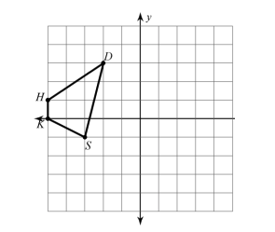
Preview of Workspace Slide (1 of 3)
Team Names
Original Task | Enhanced Task
1) Graph the image of quadrilateral SKHD under the following transformations: Reflect across the y-axis Then reflect across the x-axis
Notes:
Facilitator Notes:
Give participants 15-20 minutes to work on adapting these tasks
After participants complete their adaptations they will “meet up” with another group to offer one another feedback

Slide 60
Preview of Workspace Slide (2 of 3)
Team Names
Original Task | Enhanced Task
2.) Given: GH=JK, GH=x+10 HJ = 8, JK = 2x - 4. Find: GJ
3) Name all the ways to prove that two triangles are congruent.

Slide 61
Preview of Workspace Slide (3 of 3)
Team Names
Original Task | Enhanced Task
2.) AB has a slope of 52 . If A = (2, 7) and B = (12, c), what is the value of c?
3) Name all the ways to prove that two triangles are congruent.
5.) Is the following statement sometimes, always, or never true? The triangles are congruent if two sides and an angle of one are congruent to the corresponding parts of the other.

Slide 62
Small Group Activity
Directions: Meet up with another small group/pair and review one another’s work.
Notes:
Facilitator Notes:
Pair up groups so that each group can share their adaptations with another group and offer one another feedback (10 min, ~5 min per group).
See the next slide for elaborated participant directions.

Slide 63
Share your work, and offer feedback!
Meet up with another small group and share how each of you enhanced the tasks.
Use the Task Analysis Guide to analyze ONE of the tasks your colleagues adapted.
Offer feedback:
In what ways does the task seem more cognitively demanding than its original?
How might your colleagues enhance this task further to increase cognitive demand?
Notes:
Facilitator Notes:
Orient participants to this protocol for giving feedback on the adaptations each group worked on.

Slide 64
Debrief: Principles of ambitious mathematics teaching
Which of these ideas are you thinking about in light of our work enhancing the cognitive demand of tasks? What questions do you have?
Ambitious teaching:
Engages students in making sense of mathematical concepts
Centers students’ thinking and reasoning through discourse
Views students as capable of using their understandings and assets to solve authentic problems
Values students’ thinking, including emergent understanding and errors
Attends to student thinking in an equitable and responsive manner
“Ambitious teaching is teaching that deliberately aims for all students – across ethnic, racial, class, and gender categories – not only to acquire, but also to understand and use knowledge, and to use it to solve authentic problems.”
(Lampert & Graziani, 2009, p. 492)
(Anthony et al., 2015)
Notes:
Facilitator Notes:
Debrief “Connecting to Research” or “Planning for Action” through the lens of this definition from Lampert and Graziani (2009) and the five principles listed.
If you’re facilitating online, you might offer an opportunity to “stamp” the principles that are on participants’ minds and discuss trends or questions that emerge.
If you’re facilitating in person, you might offer a turn and talk so participants can discuss what principles are on their minds with a partner/group and then come back to share trends or questions that emerge.
[written reflection option]
References for these ideas: Anthony et al., 2015; Huinker & Bill, 2017; Lampert et al., 2011; Lampert & Graziani, 2009

Slide 65
Debriefing Session 18
Reflecting on our work in the activities in the session

Slide 66
Debriefing Session 18: Four cornerstone principles of the OMP
What connections do you see between any of the cornerstones and our work in this session?
Focus: Learning experiences in every grade and course are focused on core mathematical content and practices that progress purposefully across grade levels.
Engagement: Mathematical learning happens in environments that motivate all students to engage with relevant and meaningful issues in the world around them.
Pathways: All students are equipped with the mathematical knowledge and skills necessary to identify and productively pursue any postsecondary paths in their future. Students have agency to choose from a variety of courses, contexts, and applications they find relevant.
Belonging: Participation in mathematical learning builds students’ identities as capable math learners and fosters a positive self-concept. Students’ cultural and linguistic assets are valued in ways that contribute to a sense of belonging to a community of learners.
Any proposed instructional approach, curricular change, or system design element should be evaluated by the degree to which it builds on these four cornerstones. When new approaches are built within the framework of all four-cornerstone principles, we will be on our way to engineering a reimagined system.
(ODE, 2022)
Notes:
Facilitator Notes:
Option 1: Debrief the session through the lens of the four cornerstone principles of the Oregon Mathematics Project.

Slide 67
Debriefing Session 18: Focus of the session
What new insights do you have related to selecting worthwhile tasks and adapting existing curricular materials can sustain ambitious teaching?
Take a couple of minutes to reflect on our work in the session.
Activities in this session:
Connecting to research: Using the Oregon Math Standards to plan units which support students in accessing grade level content
Planning for Action: Using a unit planning protocol to plan units of instruction which support students in accessing grade level content
Notes:
Facilitator Notes:
Option 2: Debrief the session through the lens of the focus of the session.
Module 3 Part 2 especially supports our thinking around planning and assessment practices that sustain ambitious teaching.
The focus of this session in particular is on selecting worthwhile tasks and adapting existing curricular materials to sustain ambitious math teaching.
You might offer participants time to think individually about new insights before sharing aloud.

Slide 68
Assessment practices to sustain ambitious math teaching: Designing assessment and feedback structures.
Session 19
In this session we learn about assessment and feedback structures that sustain ambitious teaching.
Setting and maintaining norms: Reconnect with and revise our norms for interacting together
Connecting to research: Reviewing assessment and feedback structures to sustain ambitious teaching
Planning for action: Designing assessment and feedback structures that sustain ambitious teaching
Time estimate: 90 minutes
M3 P2 Table of Contents
Notes:
Facilitator Notes:
This session especially supports our thinking around the essential question of this module: What planning, teaching, and assessment practices can sustain ambitious math teaching?
We estimate this session will take 90 minutes. If you need to break the session into smaller pieces, please note the activities listed in the agenda are intended to be enacted in this order.
Resources for this session are in the Module 3 Resources folder with an exception. If you would like participants to engage with sample tasks from Open Up Resources in their planning, log into before the session, make .pdfs or copies of:
Lesson 4: Where is the Treasure Warm-up
Lesson 5: Student created Treasure Hunt Warm-up
Lesson 6: Let the Hunt Begin Warm-up

Slide 69
Setting and maintaining norms
Reconnect with and revise our norms for interacting together

Slide 70
Facilitator Guide: Setting and Maintaining Norms
Rationale for setting and maintaining norms:
To create spaces where we can vulnerably share about our teaching, learning and mathematics (Elliott et al., 2009; Little, 2002; Horn, 2010)
To support us in sharing in-process, “rough draft” ideas (Thanheiser & Jansen, 2016)
To foster a community where all members are valued (Grossman et al., 2001)
Recommendations for setting and maintaining norms:
Include everyone’s ideas and perspectives when setting norms
Regularly revisit norms and adjust norms as needed
Notes:
Upholding norms is a responsibility of participants and leaders/facilitators. It may be helpful to come up with a protocol that supports participants in naming and problem solving in the event that norms are breached.
Additional resources: If you are interested in learning more about setting and maintaining norms check out these resources.
TEDD.org: Setting norms for collaborative work
References
Elliott, R. & Lesseig, K., & Kazemi, E.. (2009). Sociomathematical norms in professional development: Examining leaders’ use of justification and its implication for practice. The Montana Mathematics Enthusiast Journal monograph, 7.
Grossman, P., Wineburg, S., & Woolworth, S. (2001). Toward a theory of teacher community. Teachers College Record, 103, 942–1012.
Horn, I. S. (2010). Teaching replays, teaching rehearsals, and re-visions of practice: Learning from colleagues in a mathematics teacher community. Teachers College Record, 112(1), 225–259.
Little, J. W. (2002). Professional community and the problem of high school reform. International Journal of Educational Research, 37(8), 693–714.
Thanheiser, E. & Jansen, A. (2016). Inviting prospective teachers to share rough draft mathematical thinking. Mathematics Teacher Educator, 4(2), 145–163.

Slide 71
Revisiting norms
[Insert your group norms]
Rights of a Learner
You have the right to:
Be confused
Make mistakes
Say what makes sense to you
Share unfinished or rough draft thinking and not be judged
(Kalinec-Craig, 2017)
Notes:
Facilitator Notes:
Orient participants to the norms you set in prior sessions and Rights of the Learner
You might ask questions like:
How do the productive norms and Rights of the Learner support our learning together?
Choose one of our norms that you want to focus on in particular. Why does that norm feel important for your learning today?
Invite participants to revise or add onto existing norms as needed
Remind participants of the importance of norms in developing a community of learners.
You might say: As we have opportunities to get to know each other better and better it allows for us to develop trust and feel more and more comfortable asking questions, getting help, revealing our shortcomings with others.

Slide 72
Connecting to research
Reviewing assessment and feedback structures
to sustain ambitious teaching
Notes:
Facilitator Notes:
The purpose of this session is to learn about assessment and feedback structures that sustain ambitious teaching. Here we learn about and analyze different assessment and feedback structures.

Slide 73
Facilitator Guide: Connecting to Research
Rationale for connecting to research:
To infuse new ideas into our conversations about instruction and challenge or deepen our existing understandings (Cain, 2015).
To support us in using evidence to inform our professional learning
Recommendations for connecting to research:
Honor and make space for participants’ existing knowledge and expertise.
Support participants to collectively grapple with the complexity of what the research offers and carefully consider how the research relates to their own teaching context and work.
Closely pair opportunities to connect to research with opportunities to plan for action on the basis of what they’ve read.
Notes:
Additional resources: If you are interested in learning more about these ideas, check out these resources.
Module 0, Resource 1:
References
Cain, T (2015). Teachers’ engagement with research texts: beyond instrumental, conceptual or strategic use. Journal of Education for Teaching, 41(5), 478-492.

Slide 74
Assessment & feedback
The aim of assessment should be “to educate and improve student performance, not merely to audit it” (Wiggins, 1998, p.7).
Effective feedback is vital if assessments are to support learning.
Placing the focus on feedback allows students to become reflective in their practices, develop a growth mindset, and establish the habits of a lifelong learner (Schimmer, 2018).
(Wiggins 1998; Schimmer, 2018)
Notes:
Facilitator Notes:
Read the slide, or ask participants to read the slide.
You might ask participants how the information on the slide relates to their current understandings and ideas about assessment/feedback
What resonates? What feels challenging?

Slide 75
Analyzing Assessments
Analyze the following four examples of different assessment on translations. Respond to the following prompts in your workspace:
What can I learn about students’ understanding from this task?
How does this task support or limit students’ ability to show what they understand? Why?
What would you change about this assessment task?
Notes:
Facilitator Notes:
Read the directions on the slide to launch participants into a small group activity.

Slide 76
Small Group Activity
Directions: Work with a partner/small group to analyze four assessment tasks.
Notes:
Facilitator Notes:
Support participants in accessing a their workspace slides (there are 5 slides total for this activity).
Aspects of small group directions you might consider:
It may be helpful to specify roles for participants in the small groups. For example, you might:
Specify who will go first and in what order participants will share. For example, in a virtual session, you might say, “The second person who enters the breakout room will share first, and sharing will move counterclockwise until everyone has shared.”
Specify who will record. For example, in a virtual session, you might say, “The first person who enters the breakout room will be the recorder and jot down ideas from the group onto the workspace slide.
Specify who will keep time. For example, in a virtual session, you might say, “The third person will be the time keeper and let each team member know if airtime goes over a minute and how much time is left.”
It may be helpful to specify where participants will record and show them how to access it. As we have suggested, you might have an assigned Google Slide for each group which is a copy of this activity’s workspace slide.
It may be helpful to specify how much time participants will have in their small group.
It may be helpful to preview what their workspace will look like.

Slide 77
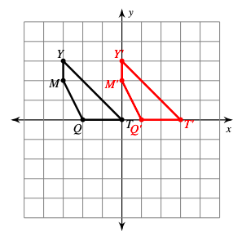
Preview of Workspace Slide (1 of 5)
Team Names:
Task 1 | Analysis
Write a rule for the following transformation (the black figure is the pre-image). | What can I learn about students’ understanding from this task? How does this task support or limit students’ ability to show what they understand? Why? What would you change about this assessment task?
Notes:
Facilitator Notes:
Small group time ~15 minutes
Whole group share out (choose ~3 tasks to discuss as a group)

Slide 78
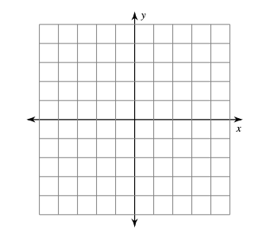
Preview of Workspace Slide (2 of 5)
Team Names:
Task 2 | Analysis
Find and plot the coordinates below of the vertices of the image figure after the given translation: 2 units left and 1 unit down to the pre-image figure with coordinates. Q(0, −1), D(−2, 2), V(2, 4), J(3,0) | What can I learn about students’ understanding from this task? How does this task support or limit students’ ability to show what they understand? Why? What would you change about this assessment task?

Slide 79
Preview of Workspace Slide (3 of 5)
Team Names:
Task 3 | Analysis
Write a guide explaining to a fellow classmate how to translate a figure and the geometry behind it. | What can I learn about students’ understanding from this task? How does this task support or limit students’ ability to show what they understand? Why? What would you change about this assessment task?

Slide 80
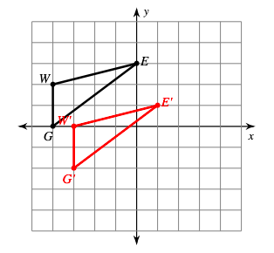
Preview of Workspace Slide (4 of 5)
Team Names:
Task 4
Graph the image of the figure using the transformation (translation: 1 unit right and 2 units down). Explain what you know about translations and explain your reasoning.
A student answered, “Most of what I wrote is correct but I have something wrong.” A translation moves a shape left, right, up, or down but does not turn the shape. The translated shape (or the image in black) is the same size as the original shape (pre-image in red), and they are congruent.
This translation shifts the shape 1 unit right and 2 units down, so I took each x value and added 1 and each y value and subtracted 2 to find the new points (Red). This is the only transformation you can do to get to the new shape.
G (-3, -2) → (-3+1, -2 + -2)
What is the error and why is it important? Correct their thinking by underlining ideas you would like to add onto then add your thoughts at the bottom.

Slide 81
Preview of Workspace Slide (5 of 5)
Team Names:
Analysis of Task 4
What can I learn about students’ understanding from this task? How does this task support or limit students’ ability to show what they understand? Why? What would you change about this assessment task?

Slide 82
Analyzing assessments debrief
What did you notice/wonder about the differences between the four assessment tasks you analyzed?
How did analyzing these assessment tasks help you think about the various kinds of assessment in your own classroom?
Notes:
Facilitator Notes:
Use the prompts on the slide to debrief the assessment analysis small group activity.

Slide 83
Feedback
Providing math students with positive feedback can help them clarify their thinking, take risks, and apply concepts in new contexts.
Feedback signals what we value and the strengths/areas of growth we see in the student’s work.
Take a look at the examples of feedback below. What disciplinary values might this positive feedback reinforce?
Your explanation here helps me see how you got from one step to the next.
The picture you drew helped me to understand how you are thinking about this.
When you defined the variable before using it, I was able to follow your reasoning.
The sentence at the end helped me to see that this is your final answer.
(Chiappetta, 2022)
Notes:
Facilitator Notes:
Share the information on the slide and ask participants to reflect on how the example feedback reinforces particular values.

Slide 84
Feedback Continued
There are many forms of feedback —conversations, written comments, oral feedback, digital feedback, peer feedback, well-written standards aligned rubrics, self-assessment, and more.
Key attributes of feedback that inspires further learning:
Goal Referenced: When providing feedback, keep the learning target at the forefront.
Actionable: Gives clear next steps to support improvement
Personal: Mentions the learner’s name, specific to this learner and their goals.
Timely: Feedback is best when shared shortly after the learning experience. If it’s been a while give students purposeful time to re-orient to the task/activity they are receiving feedback on.
User-friendly: Avoid technical jargon. Ask questions that inspire thinking.
Ongoing: Learners need to see feedback as a conversation between teachers and students.
Manageable: Easy to digest and act upon.
(Schimmer, 2018)
Notes:
Facilitator Notes:
Share the key attributes of feedback with participants.
You might pause to ask: Which of these attributes resonates? Which feels hard in practice for you?

Slide 85
Small Group Activity: Let’s look at some tools to support effective feedback
Peer Feedback
Role Cards (Academic Roles & Social) and/or Participation Quiz
Rubrics
For each of the above, consider the ways it supports qualities of effective feedback:
Goal Referenced
Actionable
Personal
Timely
User-friendly
Ongoing
Manageable
Notes:
Facilitator Notes:
Share the information on this slide to orient participants to the small group activity reflecting on different feedback tools.

Slide 86
Small Group Activity
Directions: Work with your group to review a set of tools that support feedback (Peer feedback, role cards and rubrics)
Notes:
Facilitator Notes:
Support participants to open up the workspace slides.
Aspects of small group directions you might consider:
It may be helpful to specify roles for participants in the small groups. For example, you might:
Specify who will go first and in what order participants will share. For example, in a virtual session, you might say, “The second person who enters the breakout room will share first, and sharing will move counterclockwise until everyone has shared.”
Specify who will record. For example, in a virtual session, you might say, “The first person who enters the breakout room will be the recorder and jot down ideas from the group onto the workspace slide.
Specify who will keep time. For example, in a virtual session, you might say, “The third person will be the time keeper and let each team member know if airtime goes over a minute and how much time is left.”
It may be helpful to specify where participants will record and show them how to access it. As we have suggested, you might have an assigned Google Slide for each group which is a copy of this activity’s workspace slide.
It may be helpful to specify how much time participants will have in their small group.
It may be helpful to preview what their workspace will look like (e.g., share the next slide).
Before sending participants into groups, you might say: Share your rough draft thinking: you don’t have to have everything totally worked out yet, and it’s ok to change your mind after you shared.
Monitor slides while the groups are working in order to pre-select two slides to share whole-group.

Slide 87
Peer Feedback
Team Names:
Preview of Workspace (1 of 3)
Read over this peer feedback checklist from an 8th grade class working on a geometry project:
How might this checklist support effective feedback?
2. Read the following article about peer feedback:
What are the affordances of peer feedback? What questions do you have?
Effective feedback is…
Goal Referenced
Actionable
Personal
Timely
User-friendly
Ongoing
Manageable

Slide 88
Peer Feedback Form Example
Geo Town Feedback Checklist
The name of your town.
Three streets that are parallel to each other
Two avenues that are perpendicular to the parallel lines
One boulevard that is NOT perpendicular
Two rectangles placed at corresponding angles
Two squares placed at alternate exterior angles
Two trapezoids placed at vertical angles
Two circles placed on each side of a supplementary angle
Two triangles placed on each side of a complementary angle
Be prepared to share with your partner how you know one item is properly placed, or not (feel free to use definitions and known facts to justify your thinking).
Feedback:
Comments:
What is one idea you would like to work on or make adjustments to and why?
Read over this peer feedback checklist from an 8th grade class working on a geometry project:
What do you notice what do you wonder about this form?

Slide 89
Role Cards & Participation Quizzes
Team Names:
Preview of Workspace (2 of 3)
Review the example of Role Card. How might role cards support effective feedback?
2. Review the example Participation “Quiz”. How might participation quizzes support effective feedback?
Effective feedback is…
Goal Referenced
Actionable
Personal
Timely
User-friendly
Ongoing
Manageable
(TDG, 2022a)
Notes:
Facilitator Notes:
Have participants open 10 Group Roles_TDG

Slide 90
Participation Quiz example
Participation Quiz - Group work feedback
Start with a rich “group-worthy” task. It should require students to read, talk and work together, and reason about the mathematics.
Decide what group norms (or Habits) you want to focus on for the activity.
Let the students know that while they are working on the task, you will be assessing the quality of their group work, specifically the ways students are learning to talk and work together as mathematicians. Be clear about what you are looking for - what you expect to see and what you expect to hear. Show/tell them where and how you will collect the data.
Throughout their work time, record what you see and hear & then share. Highlight some of your students’ words and actions that helped them be successful. Share and discuss high-quality engagement and discourse.
(Featherstone et al., 2011)

Slide 91
Rubrics
Team Names:
Preview of Workspace (3 of 3)
Review the example rubric from an activity on geometric transformations. How might rubrics support effective feedback?
Effective feedback is…
Goal Referenced
Actionable
Personal
Timely
User-friendly
Ongoing
Manageable

Slide 92
Planning for action
Designing assessment and feedback structures
that sustain ambitious teaching
Notes:
Facilitator Notes:
The purpose of this session is to learn about assessment and feedback structures that sustain ambitious teaching. In this activity participants design their own assessment and corresponding feedback structure.

Slide 93
Facilitator Guide: Planning for Action
Rationale for planning for action:
To see connections to our contexts and goals (Putnam & Borko, 2000)
To apply new ideas to upcoming work (Horn & Kane, 2015)
To surface complexities when taking up new ideas
Recommendations for planning for action:
Use teachers’ own curricular resources when possible
Create space to discuss anticipated challenges and strategies for trying new ideas within those challenges
Follow up on teachers’ plans; return to them to build on and refine ideas
Notes:
Planning for action involves making links between session content and our own practice and contexts.
Additional resources: If you are interested in learning more about these ideas, check out these resources.
Module 0, Resource 2: Sometimes, planning conversations can surface unproductive ideas about particular students or student groups that circulate in our schools or broader contexts. This resource is designed to support leaders preparing for difficult conversations, especially when unproductive language about students emerges.
References
Horn, I. S., & Kane, B. D. (2015). Opportunities for professional learning in mathematics teacher workgroup conversations: Relationships to instructional expertise. Journal of the Learning Sciences, 24(3), 1–46.
Putnam, R. T., & Borko, H. (2000). What do new views of knowledge and thinking have to say about research on teacher learning? Educational Researcher, 29(1), 4-15.

Slide 94
Create your own assessment
Create a short assessment or exit task (which aims “to educate and improve student performance, not merely to audit it”) to be used in one of the lessons in the Open-Up Resources geometry unit (lessons 4-6).
Do the #1 OR #2 and at least one other number of your choice for one of the lessons!
Build a Worked Example or Habit Activator to be used in place of one of the lesson Warm Ups.
Create a short exit task
Develop a peer feedback sheet to be used in Lesson 5 “Create a Sequence of Transformations that Move.“ (Could be for lesson 4 and lesson 6 as well)
Create/Adapt Role Cards and Participation Quiz (Feedback).
Create the criteria for a student rubric on rigid Geometric Transformations.
Identify any additions or modifications you might make to an assessment as you consider the needs of students who are often excluded from rich mathematics by schooling in these lessons.
Notes:
Facilitator Notes:
Share the directions for participants to work on their own assessment and feedback structure.
Ask participants to open 11 Assessment Revisions_TDG for a sample of a revised assessment task.
As needed, engage in a discussion about the revised assessment task in order to support participants’ work with this small group activity.
You might ask teachers to adapt an existing assessment from their own curriculum OR login to Open-Up Resources and use one of the tasks listed below from the Geometry unit on Transformations (facilitator-provided resources):
Lesson 4: Where is the Treasure Warm-up
Lesson 5: Student created Treasure Hunt Warm-up
Lesson 6: Let the Hunt Begin Warm-up

Slide 95
Small Group Activity
Directions: Work with a team/partner to create your own assessment task and feedback structure for a lesson

Slide 96
Create your own assessment task (click here for directions)
Team Names:
Preview of Workspace Slide
Worked Example / Habit Activator
Feedback Structure

Slide 97
Debriefing Session 19
Reflecting on our work learning about assessment and feedback structures that sustain ambitious teaching.

Slide 98
Debriefing Session 19: Four cornerstone principles of the OMP
What connections do you see between any of the cornerstones and our work in this session?
Focus: Learning experiences in every grade and course are focused on core mathematical content and practices that progress purposefully across grade levels.
Engagement: Mathematical learning happens in environments that motivate all students to engage with relevant and meaningful issues in the world around them.
Pathways: All students are equipped with the mathematical knowledge and skills necessary to identify and productively pursue any postsecondary paths in their future. Students have agency to choose from a variety of courses, contexts, and applications they find relevant.
Belonging: Participation in mathematical learning builds students’ identities as capable math learners and fosters a positive self-concept. Students’ cultural and linguistic assets are valued in ways that contribute to a sense of belonging to a community of learners.
Any proposed instructional approach, curricular change, or system design element should be evaluated by the degree to which it builds on these four cornerstones. When new approaches are built within the framework of all four-cornerstone principles, we will be on our way to engineering a reimagined system.
(ODE, 2022)
Notes:
Facilitator Notes:
Option 1: Debrief the session through the lens of the four cornerstone principles of the Oregon Mathematics Project.

Slide 99
Debriefing Session 19: Focus of the session
What new insights do you have related to assessment and feedback structures that sustain ambitious teaching?
Take a couple of minutes to reflect on our work in the session.
Activities in this session:
Setting and maintaining norms: Reconnect with and revise our norms for interacting together
Connecting to Research: Reviewing assessment and feedback structures to sustain ambitious teaching
Planning for Action: Designing assessment and feedback structures that sustain ambitious teaching
Notes:
Facilitator Notes:
Option 2: Debrief the session through the lens of the focus of the session.
Module 3 Part 2 especially supports our thinking around planning and assessment practices that sustain ambitious teaching.
The focus of this session in particular is assessment and feedback structures that sustain ambitious teaching.
You might offer participants time to think individually about new insights before sharing aloud.

Slide 100
Debriefing Module 3 Part 2
Reflecting on our work in Sessions 17 – 19

Slide 101
Debriefing Module 3 Part 2: Important moments
Record important moments that impacted your thinking about ambitious math teaching and your hopes for students as learners.
Examples of important moments:
AHA! moments you experienced
Changes in your thinking
WOW! ideas that you hadn’t considered before
Contradictions to or affirmations of prior understandings

Slide 102
Debriefing Module 3 Part 2: Important moments
Take 5 minutes to refine the ideas you jotted.
Synthesize your important moments from Module 3 Part 2.
Based on the work and discussions in these sessions, what ideas do you have for how you’ll implement your learning?
What else, if anything, would you like to share with the facilitator?
Notes:
Facilitator Notes:
You might pose these questions in the form of a survey or exit card.

Slide 103
Acknowledgements
These Ambitious Teaching Modules exist because of the vision and hard work of a team led by the creative vision, development, and design offered by Kathy Pfaendler and Julie Fredericks, Math Professional Learning Specialists, Teachers Development Group, Cathy Martin, Denver, CO, Taylor Stafford, University of Washington, and Hannah Nieman, University of Washington. Their efforts were supported by the ongoing input and feedback of the entire staff of Teachers Development Group (TDG). These Modules, like all professional learning materials produced by our organization, are based on the collective knowledge, expertise, and ongoing learning of TDG’S Math Professional Learning Specialists and the teachers and leaders with whom we work. Thanks also go to Mark Freed, and Kama Almasi, Oregon Department of Education, and Rebekah Elliott, Oregon State University, who offered vision and feedback throughout the development and design process. Special thanks go to Sophia Vazquez, University of Washington, who did the accessibility formatting of these Modules.
Ruth Heaton, CEO, Teachers Development Group

Slide 104
Resource Partners
Thank you for joining us!

