Slide 1
CTE Revitalization Grant - 2023-25
Technical Assistance Webinar #1
Application and Submission Process
Wednesday, October 11, 2023 | 3:00-4:00 p.m. via Zoom
This session will be recorded.

Slide 2
Welcome!
Please introduce yourself in the chat:
Name, school, and what you are thinking of doing with
CTE Revit Funds for 2023-2025

Slide 3
Application Overview
Create an action plan to address identified needs of historically and currently marginalized students within your community.
Identify specific outcomes and progress markers that will be used to gauge the impact of the project.
Describe the design of one or more CTE Programs of Study that will be developed or enhanced.
Describe how the project will help students meet the requirements of the Oregon Diploma while preparing them for further education, training, and/or career.
Describe how the project and partnerships will be sustained and expanded beyond the life of the grant.
Develop a timeline of activities that aligns with the stated outcomes.
Conduct an evaluation of the project based on the stated outcomes.
Develop active and engaged business, industry, labor, community organizations, and education (e.g., community college, private postsecondary) partnerships that will implement and sustain the project through a commitment of resources from all partners.
Create a budget that is aligned with project activities.

Slide 4
Eligibility/General
The CTE Revitalization Grant is a competitive grant. Eligible recipients are any:
Public school district
Education service district (ESD)
Public school
Public charter school (or combination)
in Oregon

Slide 5
Eligibility/Prior Recipients
Eligible recipients who received awards in a previous biennium are eligible during this round of funding under the following circumstances:
The application is submitted for a new project
OR
The recipient is a partner in a new collaborative grant project that is significantly different from the recipient’s previous project

Slide 6
Equity
How will this project increase participation, support, and retention of historically and currently marginalized students in your community?
Considerations:
Identify the specific activities within this project that are intended to recruit historically and currently marginalized students.
Identify specific activities within this project that are intended to provide support of historically and currently marginalized students.
Identify specific activities within this project that are intended to help retain historically and currently marginalized students.

Slide 7
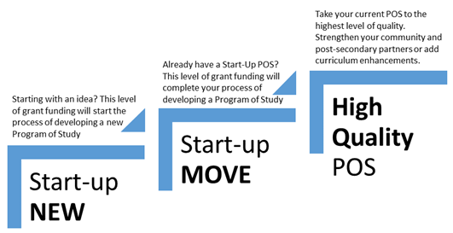
CTE POS Design

Slide 8
Use of Funds
If your grant involves…
Capital Construction (public contracting—improvements and related projects)
Buildings | Structures
Greenhouses |Temporary structures
OR
Vehicle Purchase
Trucks | Vans |Food Trucks
Mobile Labs | Trailers
Tractors | Airplanes | Drones
Buses | Ambulance
…please reach out to the ODE Revit Team to discuss your plans BEFORE submitting your CTE Revit RFA.

Slide 9
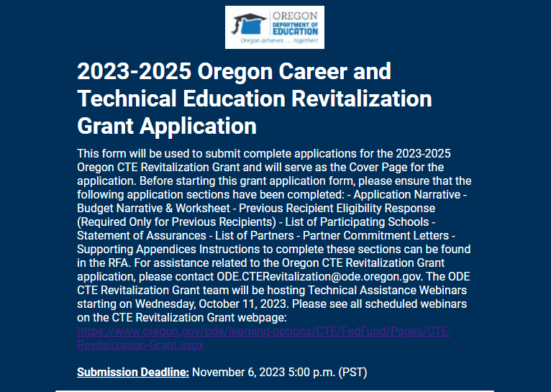
Application Submission Process

Slide 10
Submitting The Application
Completed applications will be submitted via the Smartsheet Form.
Before starting the submission form, please ensure that all sections of the application have been completed.
The submission form does not save progress and will need to completed in one sitting.
You will need the Project Name, Project Abstract, and Amount Requested information to complete the application.
You will also need Project Director, Fiscal Agent, Superintendent and Regional Coordinator contact information to complete the application.
All fields marked with a red asterisk (*) are required to submit the application.
Completed application sections can be uploaded as a collated document or as individual files (.pdf, .docx, .xlsx, etc.). Maximum file size of all files is 30mb.
Questions? Email us at ode.cterevitalization@ode.oregon.gov

Slide 11
Application Deadline
Application Submission Deadline:
-- Monday, November 6, 2023 --
No later than 5:00pm PST

Slide 12
Upcoming Webinars
Wednesday, October 18 – 3-4pm
CTE POS Design, Partnerships, Communication Strategies
Wednesday, October 25 – 3-4 pm
CTE and Equity, Reporting, Budget
Wednesday, November 1 – 3-4pm
Office Hours for Applicants

Slide 13
Contact Information
Contact the CTE Revit Grant Team:
Dan Findley | KC Andrew | Linda Catterall
ode.cterevitalization@ode.oregon.gov

Slide 14
Questions

