Slide 1
CTE Revitalization Grant 2023-25
Technical Assistance Webinar #2 – Wednesday, October 18, 2023 | 3:00-4:00 p.m. via Zoom
Building Your CTE Revitalization Application CTE POS Design, Partnerships, and Communication Strategies
This session will be recorded.
Notes:
https://docs.google.com/presentation/d/1ruL3GSUGIZVvQlqkXkTk8xihNcVEBO2ersfXfjdNOmg/edit?usp=sharing
Dan & Linda

Slide 2
Welcome!
Please introduce yourself in the chat-
Name, school, and what you are thinking of doing with CTE Revit Funds for 2023-2025

Slide 3
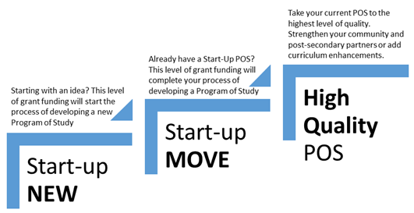
CTE POS Design
Notes:
Dan
Pages 6 and 7, Start-up NEW: How will outcomes and activities in this grant support the development of a CTE Program of Study?
This type of competitive grant is designed for starting a CTE Program of Study (CTE POS) through all of the steps toward the three-year development of a program of study. Working in close coordination with your Regional CTE Coordinator, an example might include funding for the development of:
● Needs assessment ● Advisory committee ● Community partnerships ● Teacher recruitment and retention ● Curriculum development ● Postsecondary collaboration ● Equipment * Facilities construction and vehicle purchases (please see section F-Use of Funds)
Start-up MOVE: How will outcomes and activities in this grant support the development of a CTE Program of Study?
Applicants for this competitive grant will have an existing start-up program of study. The goal for this type of grant is to move the existing start-up toward the approval process as a CTE POS with additional funding and resources. Expect to be working closely with your Regional CTE Coordinator and ODE Education Specialist. Funding uses may include but are not limited to:
● Continued development and implementation of an advisory committee ● Sustaining community partnerships ● Teacher recruitment and retention ● Curriculum development ● Postsecondary collaboration ● Equipment ● Facilities construction and vehicle purchases (please see section F-Use of Funds)* ● Professional development
High Quality Program of Study: How will outcomes and activities in this grant support the enhancement of a CTE Program of Study?
Grants in this category are designed to take existing programs of study through processes that include all of the elements of a HQPOS: https://www.oregon.gov/ode/learning-options/CTE/resources/Pages/High-Quality-CTE-Program-of-Study-Rubric.aspx
● Establishing Career Connected Learning experiences ● Expanding CTE POS ● Teacher recruitment and retention ● Evaluating and updating curriculum ● Postsecondary collaboration including community colleges, business, industry, and community professionals ● Equipment ● Facilities construction and vehicle purchases (please see section F-Use of Funds)* ● Professional development

Slide 4
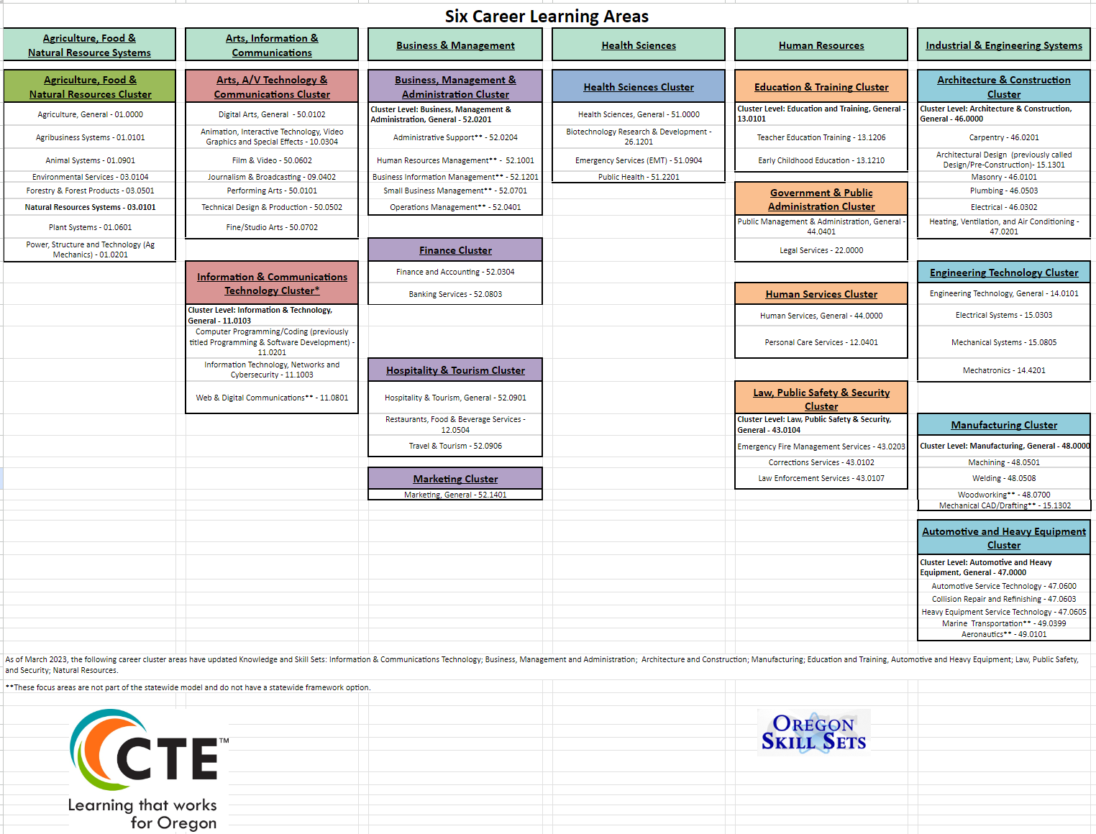
Six Career Learning Areas
Click chart to download file

Slide 5
POS Elements
High Wage & In Demand
The Oregon Employment Department identifies occupations as high wage if they pay more than the regional 2015 median wage of $48,797 per year (approx. $23.46 per hour).
An in-demand occupation has more than the median number of total openings for 2021-2031 (n>733 openings).
Resources
In-Demand Occupations
Spreadsheet Data from Oregon Employment
May 2022 Oregon Wage Statistics-BLS
Notes:
https://www.oregon.gov/ode/learning-options/CTE/resources/Documents/High%20Wage%20High%20Demand%20Careers%20by%20Cluster.docx [this is OLD]
August 11, 2023: Oregon Wage Information: https://www.qualityinfo.org/documents/20126/110715/Oregon+Wage+Information/3cf4c26e-a0dc-559d-b33c-726c8fb3a4c6?version=1.24

Slide 6
POS Elements
Start-up POS
MOVE from Start-up
Resources
Oregon CTE Policy Guidebook 2023-2024
Notes:
Not a substitute for reviewing the guidelines and requirements for HQPOS
1. Access and Equity
a. Provides all students and their families with appropriate knowledge and experiences to help make informed education and career decisions.
b. CTE programs are a central part of the school’s equity strategy, and demographics in CTE should mirror school demographics and positively impact local industry representation of historically and currently marginalized groups. CTE student outcomes contribute to the elimination of opportunity gaps and institutional discrimination.
2. Standards and Content Oregon Department of Education | Oregon CTE Policy Guidebook 26 Revised August 2023
a. Rigorous Integrated Content: CTE students have access to rigorous core academic coursework relevant to their career interests and the opportunity to apply academic, technical, and professional skills in both CTE courses and academic courses.
b. Engaged Learning: Learning is centered on the student’s interests, strengths, and needed areas of growth. Engaged learning involves opportunities to engage in meaningful projects connected to the community and is supported by the school, college, and community. Assessment of learning addresses industry based standards and provides feedback to students and instructors that drives program improvement.
c. Coherent Curriculum: Sequence of courses that align to Oregon’s industry identified knowledge and skill sets and progresses from introductory to advanced content.
3. Alignment and Articulation
a. Partnerships: Formalized agreements exist with partners—including secondary and postsecondary education institutions, business and industry, and workforce development—around program development, design, implementation, and evaluation.
b. Credentials: CTE program concentrators can participate in work-based learning opportunities and earn industry recognized credentials, certificates, and degrees that increase their employability and ability to advance in their career of choice.
c. Facilities and Equipment: CTE programs maintain equipment that meets industry standards, and facilities follow safety and cleanliness standards of the industry and create a safe, welcoming, and accessible environment so all students may participate.
4. Accountability and Evaluation
a. Continuous Improvement: Oregon’s HQPOS Rubric is a tool that can be used regularly for program evaluation and continuous improvement goals. Programs are continually revised based on advisory committee/industry partner input, as well as student participation and performance.
b. Reporting: Schools and institutions that have CTE programs collect and submit CTE data annually to the state in a two-part data cycle. These data points are used to inform program design and improvement and cumulate the Oregon report for federal requirements.
5. Student Support Services
a. Career Development: There is a coordinated and sequenced career development system to support students before, during, and after participation in the CTE program. This can be accomplished by using a variety of tools, curriculum, resources, and advising practices. Each CTE student creates a personalized career and education plan to inform and guide their decision-making in the selection of coursework, career, and/or postsecondary goals. In collaboration with educators Oregon Department of Education | Oregon CTE Policy Guidebook 27 Revised August 2023 and families, CTE students are informed of opportunities for CTE education and training in high school, college, apprenticeships, and other opportunities beyond the secondary classroom experience.
b. Education for Employability: Students develop employability skills through classroom and course aligned work-based learning opportunities. Students actively develop leadership skills through student leadership opportunities (e.g., Career and Technical Student Organizations [CTSOs], school-based enterprises, etc.) tied to the CTE program. This may take the shape of one of the nine State Board recognized CTSOs; alternatively, this leadership expectation may be accomplished by meeting the Criteria for Developing Student Leadership.
6. CTE Professional Development: Each CTE educator has a Professional Development Plan (PDP) in place with goals related to the implementation of the POS. The plan should have connection to the local/regional needs assessment, ensure an equity focus, and be developed with input from the advisory committees. Any PDP adjustments reflect the continuous improvement design of the CTE POS.

Slide 7
POS Elements
High Quality POS
Resources
Oregon CTE Policy Guidebook 2023-2024

Slide 8
PARTNERSHIPS

Slide 9
Partnerships - Definition

Slide 10
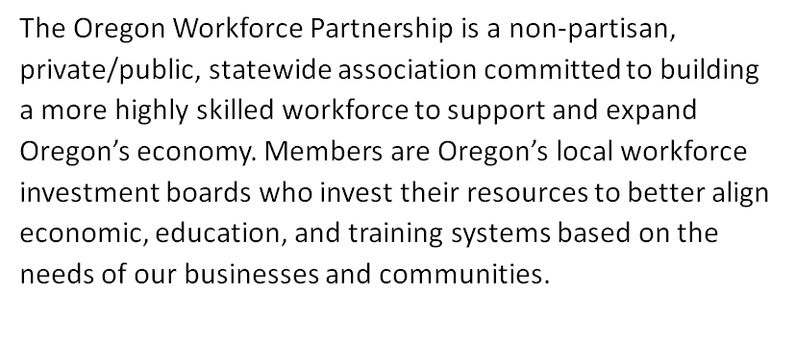
Workforce Development
Resources
Workforce & Talent Development Board

Slide 11
Industry Partners & Associations
Resources
Workforce & Talent Development Board
Oregon Manufacturing Extension Partnership
Tooling U (SME)
Manufacturing Institute
Technology Association of Oregon
OREGON CTE Student Leadership Foundation
Oregon Entrepreneurs Network
Outreach Coordinators/Hospital Auxiliary
Oregon CTE-STEM Employer Coalition
2021-2025 STEM Education Plan
Notes:
Put note in about OCTESL and dollars available for industry experiences $$$ (This year the CTSO Chapter grant program will be a competitive process, and the Foundation will be looking to fund projects that support student connections with industry. If students need help with travel, expenses, or other fiscal needs related to these industry experiences, this might be one good use of Chapter Grant funds.)
DECA: Distributive Education Clubs of America….an association of Emerging leaders and entrepreneurs
FBLA: Future Business Leaders of America…..bring business and education together
FCCLA: Family, Career, and Community Leaders of America….promote personal growth and leadership development through family and consumer sciences education
FFA: Future Farmers of America….national organization
HOSA: Health Occupation Students of America….future health professionals
SkillsUSA: association of students in Technical, Skilled, and Service Studies
Good area to connect with workforce analysts for assistance

Slide 12
COMMUNICATION STRATEGIES
Notes:
LINDA

Slide 13
Spreading the Good News About CTE
Parents
Community members
Educators/schools
Community partners
Legislators
Notes:
LINDA

Slide 14
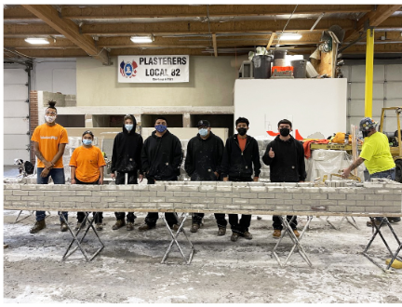
Spreading the Good News Feels Good
Notes:
LINDA

Slide 15
Communication Resources
Media in Oregon
Newspapers
Radio
Magazines
Social Media Resources
X (Twitter) Oregon CTE
@OregonCTE #CTEWorksInOregon
Facebook Oregon CTE
@OregonCte
Community
Chamber of Commerce
Kiwanis International,
Rotary, Lions
Nonprofits & Charities
Legislative
Find Your Legislator in Oregon
Notes:
LINDA

Slide 16
Application Deadline
Application Submission Deadline:
Monday, November 6, 2023
No later than 5:00 p.m. PST
Notes:
LINDA

Slide 17
Upcoming Webinars
Wednesday, October 25 – 3-4 pm
CTE and Equity, Reporting, Budget
Wednesday, November 1 – 3-4pm
Office Hours for Applicants
Notes:
LINDA

Slide 18
Contact Information
Contact the CTE Revit Grant Team:
Dan Findley | KC Andrew | Linda Catterall
ode.cterevitalization@ode.oregon.gov
Notes:
LINDA

Slide 19
Questions
Notes:
DAN

