Slide 1
Unpacking Partnership & Supports
November 2018

Slide 2
Learning Outcomes
Learning Outcomes
Inspire a clear spirit of partnership;
Reinforce the Four Key Commitments of Oregon’s Plan (ESSA);
Outline ODE’s collaborative approach to strengthen district systems, differentiate supports, and lead for equitable student outcomes;
Build awareness of the at-a-glance district and school profiles as conversation drivers.

Slide 3
Shared Responsibility for Improving Student Outcomes
Shared Responsibility for
Improving Student Outcomes

Slide 4
Our Four Commitments
Our Four Commitments
Advance Equity
Promote a Well-Rounded Education
Strengthen District Systems
Foster Ongoing Engagement

Slide 5
Supporting All Students
Supporting All Students
A well-rounded education provides the foundational knowledge and skills to live, learn, work, and contribute and ensures that each and every student is known, heard, and supported.

Slide 6
BIG SHIFTS
Where we’ve been and where we’re headed

Slide 7
Federal Education Law
No Child Left Behind (NCLB), 2002
Every Student Succeeds Act (ESSA), December 10, 2015
ESEA Flexibility Waiver, 2012
Expired Aug 1, 2016
Elementary and Secondary Education Act (ESEA), 1965

Slide 8
Shifts in Approach & Mindset
NCLB | ESSA
Rating of schools (1-5) | Rating of individual measures
Focusing school improvement supports directly at school level | Focusing school improvement supports on schools as part of a larger district system
Identifying & labeling low-performing schools | Describing and differentiating supports for schools based on need & in concert with district engagement
Promoting top-down, hierarchical accountability | Encouraging mutual, shared accountability
Engaging few stakeholders in improvement planning process | Broadly engaging stakeholders in improvement planning and implementation process

Slide 9
Oregon’s Accountability Model
Oregon’s Accountability Model
Oregon’s accountability model represents available state-level data to convey student outcomes and provide a broad picture of school performance over time. The following indicators are being used in the accountability system:
Regular Attenders
ELA and Math Achievement
ELA and Math Growth (grades 3-8 only)
English Learners On Track to Proficiency
9th Grade on Track
Four-year Graduation Rate
Five-year Completion Rate (includes GEDs)

Slide 10
STRENGTHENING DISTRICT SYSTEMS

Slide 11
A New Approach
A New Approach
Districts will serve as the hub for improving systems that are not working for students.
Oregon will move away from the ineffective model under No Child Left Behind (NCLB) of shaming and blaming schools.
ODE will partner with local districts to ensure relevant and timely supports are delivered to meet student needs within each diverse local context.
Districts will, with support from ODE, lead, support and monitor their efforts to improve student outcomes in schools.

Slide 12
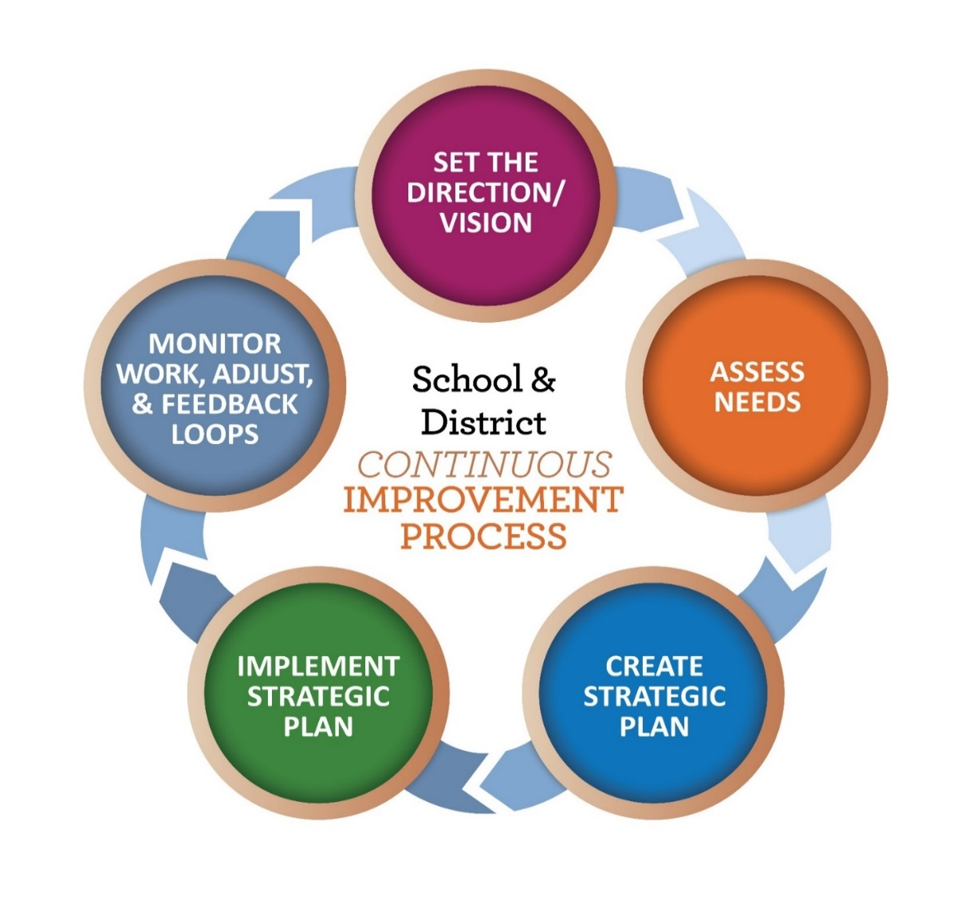
Promoting Continuous Improvement for ALL
Promoting Continuous
Improvement for ALL

Slide 13
A Spirit of Partnership
A SPIRIT OF PARTNERSHIP

Slide 14
Differentiated Supports
With stakeholder input, ODE developed an accountability model designed to surface schools and districts who might benefit from additional supports
Local data, information and context is essential in determining how to approach continuous improvement efforts

Slide 15
Meaningfully Differentiated Supports
Meaningfully Differentiated Supports
Under the new model, each indicator will be ranked by levels (1-5). Level 3 represents the state average. Schools identified for Comprehensive and Targeted Supports for Improvement are defined as:
Comprehensive Supports for Improvement – These include schools in the bottom 5 percent of all schools in the state and schools with a four-year graduation rate below 67 percent.
Targeted Supports for Improvement – Any school with a specific group of students with a Level 1 in at least half of the rated indicators, which include the four-year graduation rate and five-year completer rate.

Slide 16
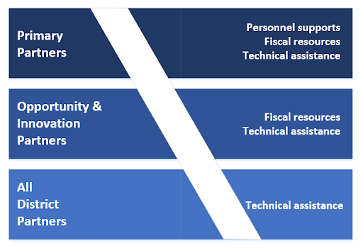
Responsive Partnerships
Responsive Partnership

Slide 17
ODE Aims to Provide:
Opportunities to listen and understand local context, successes, and challenges
Needs assessments at district and school level
Improved planning tools
Fiscal resources
Personnel supports: coaching, facilitation and technical assistance
Emphasis on implementation, monitoring and adjustments
Learning network structures
Professional development opportunities

Slide 18
TOOLS & RESOURCES

Slide 19
At-A-Glance Profiles
ODE produces school performance reports designed to:
inform parents, caregivers, communities, & educators; and
improve schools and districts
New reports are data rich, reader friendly, and personalized to reflect local programs and areas of strength.

Slide 20
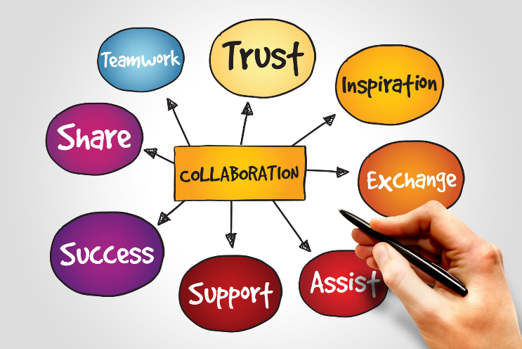
Goals for At-A-Glance Redesign
Design reports that are meaningful, especially for parents from historically underserved communities;
Show relevant state-level data to help foster family and community engagement;
Create a tool that provides schools and districts a platform to highlight areas of success and growth, while also clarifying potential areas for improvement.

Slide 21
At-A-Glance Stakeholder Engagement: What we Heard
To know how their school/district creates a welcoming, safe & inclusive environment.
A design that is simple, multi-colored, and easy to read and understand.
A report that emphasizes progress through relevant and actionable data.

Slide 22
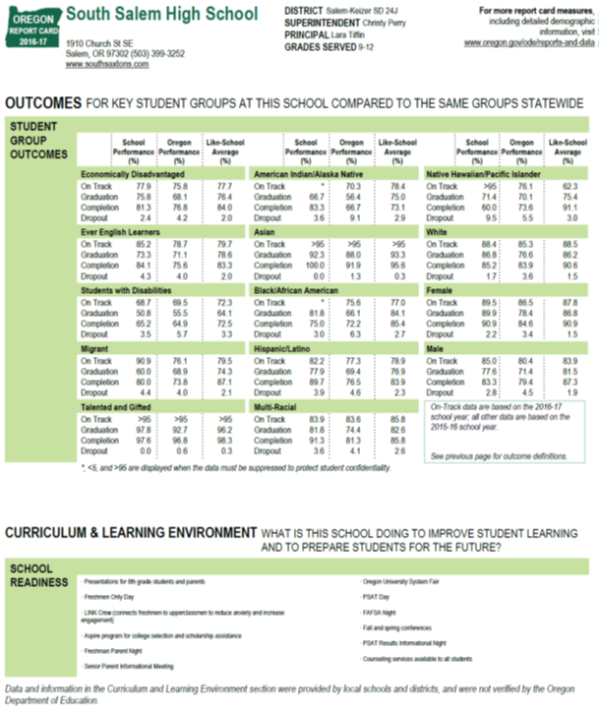
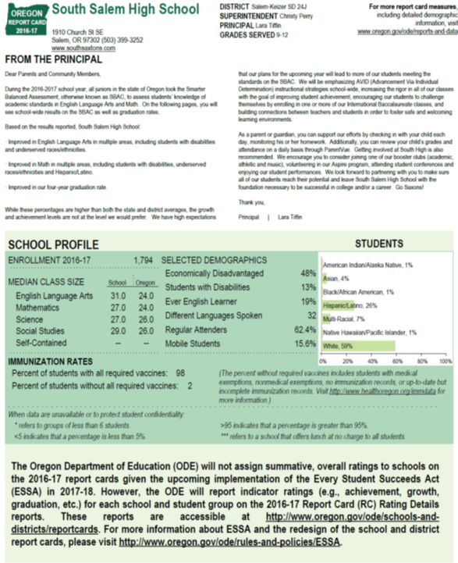
Remember these?

Slide 23
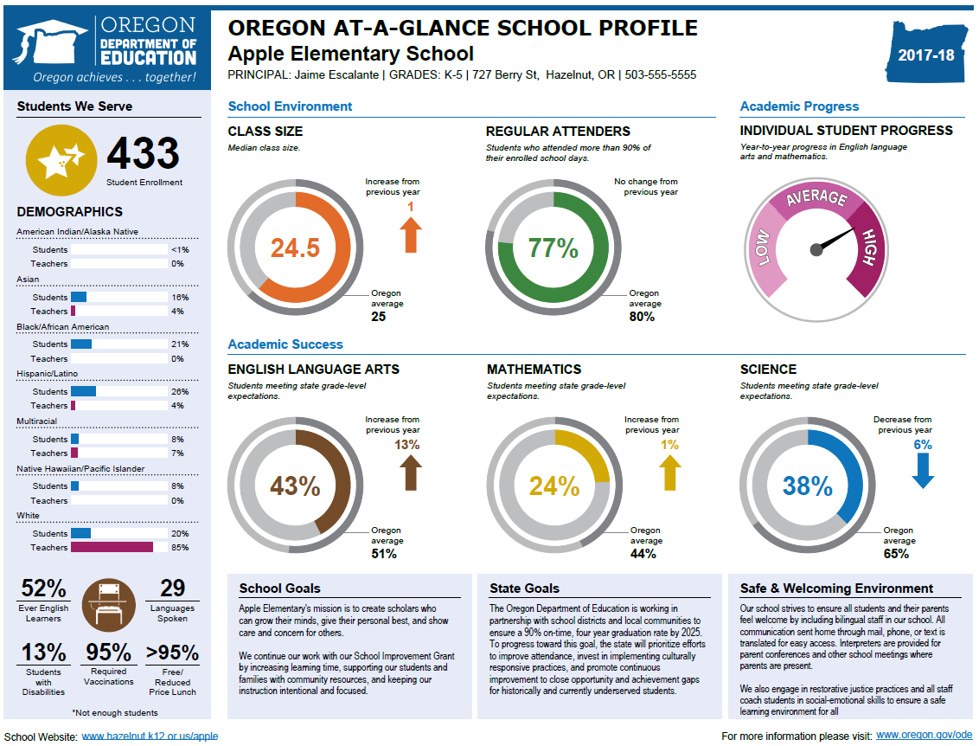
At a glance

Slide 24
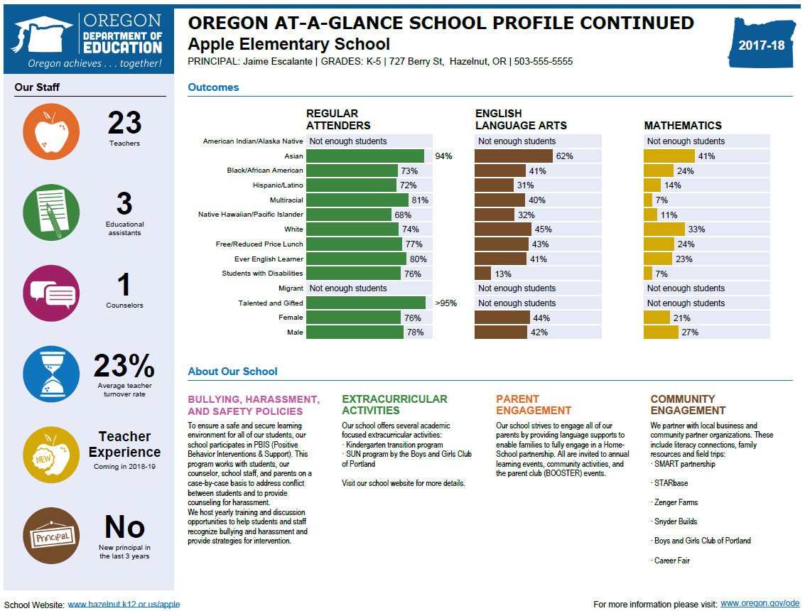
Flip side at a glance
Add snapshot of side 2 of the at-a-glance for elementary / middle

Slide 25
ORIS

Slide 26
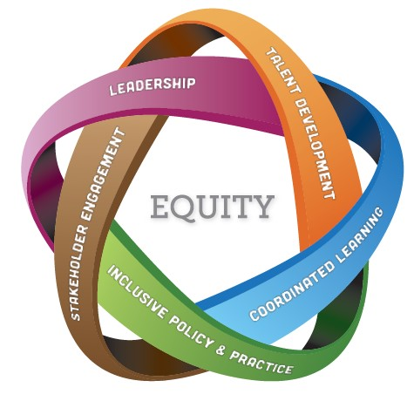
Tool to improve systems
A Tool to Improve Systems
Oregon’s Integrated Systems Framework consists of five domains for all school districts to assess and address the health of their systems. The domains include:
Leadership
Talent Development
Stakeholder Engagement & Partnerships
Inclusive Policies, Structures & Practices
Well-Rounded, Coordinated Learning Principles

Slide 27
Start a Conversation!
Build Awareness by Using these Toolkit Items
Oregon Plan 1-pager
Frequently Asked Questions
Key Messages
Question Starters for District and School Leaders
Presentation Slides -- A Quick Overview on Supports, Partnership, & Profiles
Explore our Web Pages for More Resources!
Continuous Improvement
Every Student Succeeds Act
District and School Improvement
At-A-Glance Profiles

Slide 28
If you want to go fast, go alone.
If you want to go far, go together.

Slide 29
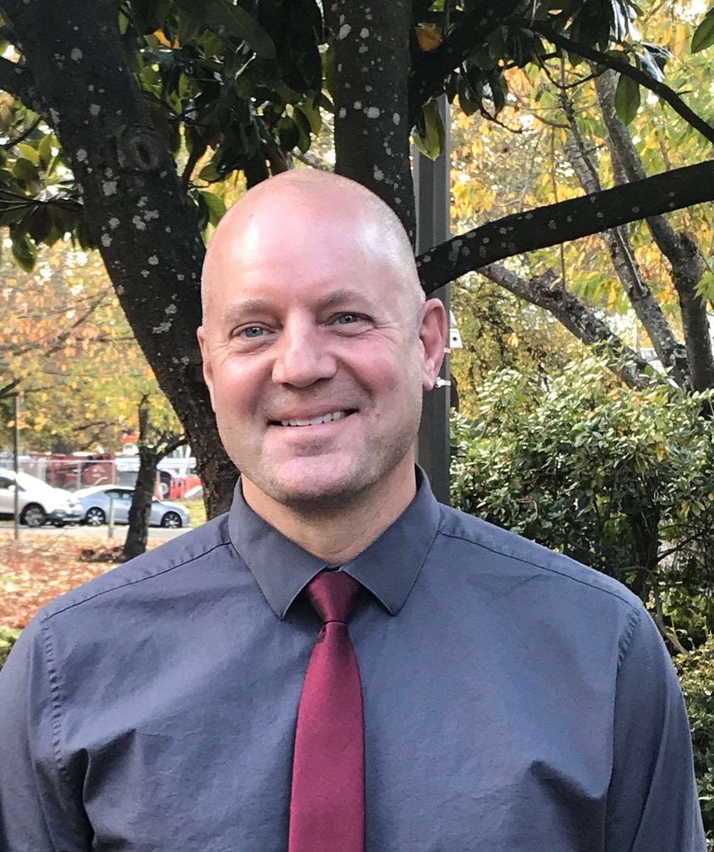
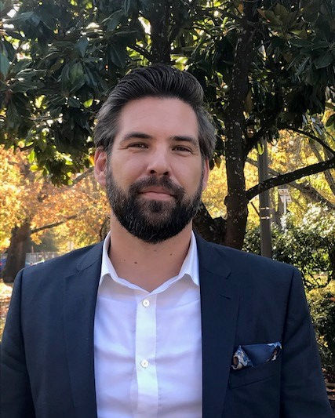
Please Contact Us With Questions
Jon Wiens, PhD
Director of Accountability & Reporting
jon.wiens@state.or.us
Tim Boyd
Director of District
& School Effectiveness
tim.boyd@state.or.us

Slide 30
Thank you

