Slide 1
SUMMER LEARNING BEST PRACTICE GUIDE
Session 1 - The Big Picture:
An Overview of the Summer Learning Best Practice Guide
October 26 & 29, 2021

Slide 2
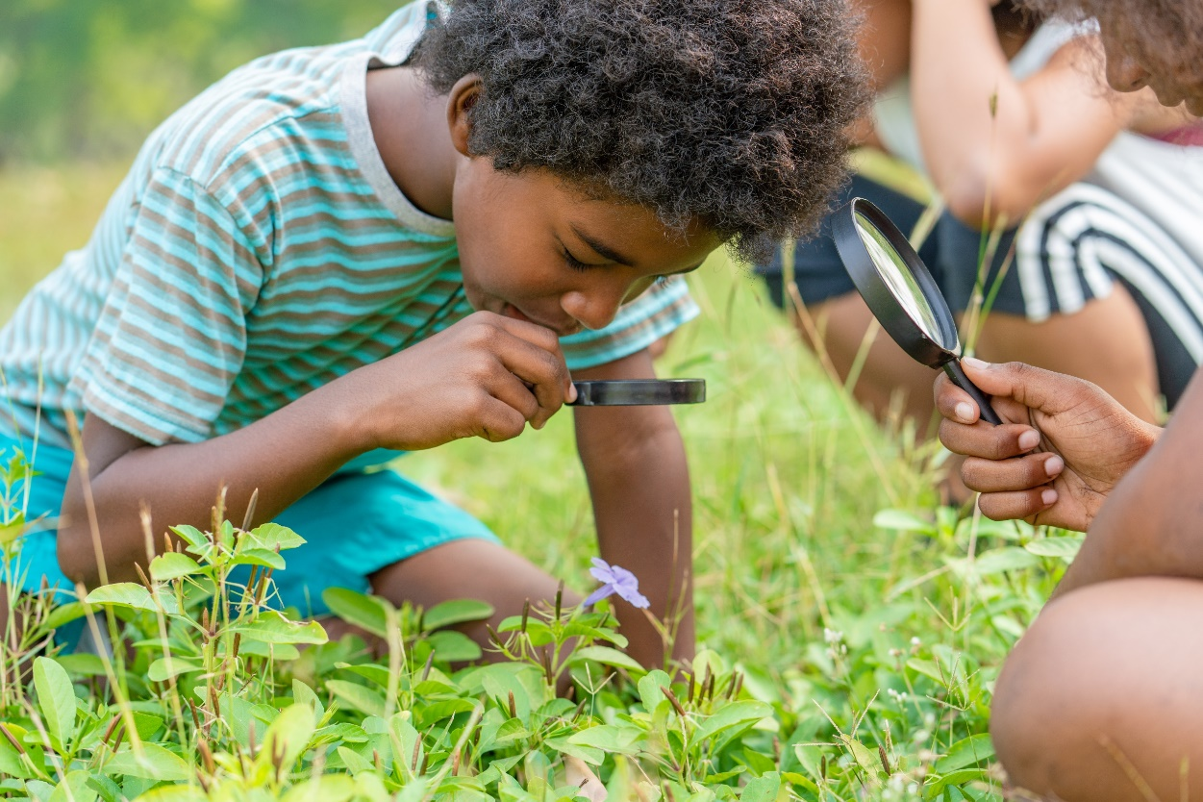
Cultivating Joy, Connection & Curiosity
Introduce yourself in the Chat Box and…
What image comes to mind when you think of joyful, curious students who feel deeply connected?
OR
What is peaking your curiosity about Summer Learning?
Notes:
This tag line, cultivating joy, connection and curiosity through well-rounded summer learning on the front cover of the 2022 Summer Learning Best Practice guide deserves more than a passing glance. It really embodies the vision of quality summer programming. So to start this session, on a Tuesday afternoon when you probably have a million tasks to accomplish, Let’s start by hooking into why we all get up everyday to do this work.
In the chat box, please introduce yourself and where you are from in Oregon. Then answer one of the following questions.
What image come to mind when you think of joyful , curious students who feel deeply connected? What comes to my mind is when I was principal of Spring Creek Elementary one of our kindergarten teachers had her students in front of the school studying leaves in the fall they all had magnifying glasses much like this picture and the kids were 100% engaged in learning and discovering, there was talking, smilies and excitement about learning.
The second question is about curiosity. Curiosity and knowledge building grow together, the more we know, the more we want to know about something. George Lowenstein a professor of psychology at Carnegie Mellon University, proposed that curiosity is the feeling of deprivation we experience when we identify and focus on a gap in our knowledge. What is important about this perspective is that is means we have to have some level of knowledge or awareness before we can get curious. Lowenstein goes on to say, in order to induce curiosity we must prime the pump! This is one of the goals of quality summer programs. So to begin, let’s tap into our collective educator curiosity about summer programs.

Slide 3
Today’s Goals
Upon the conclusion of today’s presentation, participants will be able to:
Understand the key elements of equity-driven summer programs.
Utilize the Summer Learning Best Practice Guide to aide in planning high-quality summer programs.
Dream, conceptualize and remain curious about the possibilities of summer programming.

Slide 4
Agenda
2:00 Welcome and Introductions
2:05 Equity-Driven Programs as a Vision for Summer Learning
2:25 Key Elements of Quality Summer Programs
Planning Early & Funding
2:35 Review the 2022 Summer Learning Best Practice Guide
2:50 Next Steps, Summer Learning Webinar Series, Questions
3:00 Thank you!

Slide 5
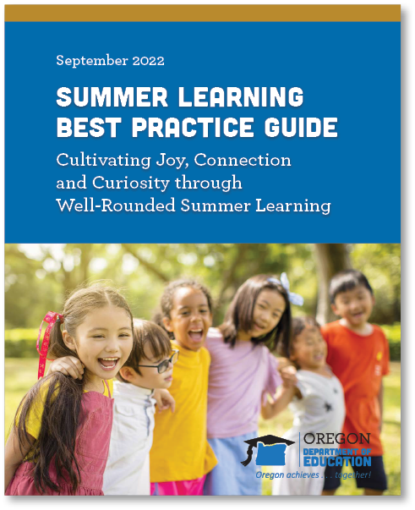
Summer Learning Engagement
Acknowledgement
We wish to acknowledge that this guide has been informed by summer program staff, educators, caregivers, tribal members, OregonASK, Oregon Summer Learning Collaborative, community-based organizations, and out-of-school time leaders in Oregon, the National Summer Learning Association (NSLA), Council of Chief of State School Officers (CCSSO), United States Department of Education and State Education Agency (SEA) leadership across the nation who have been critical thought partners. The information provided in this document is the result of ongoing engagement sessions and direct feedback from our partners. In the context of shared thinking and problem solving, our thinking and planning has been enhanced through these processes. We appreciate the challenge of serving our students and families. We are indeed stronger together.

Slide 6
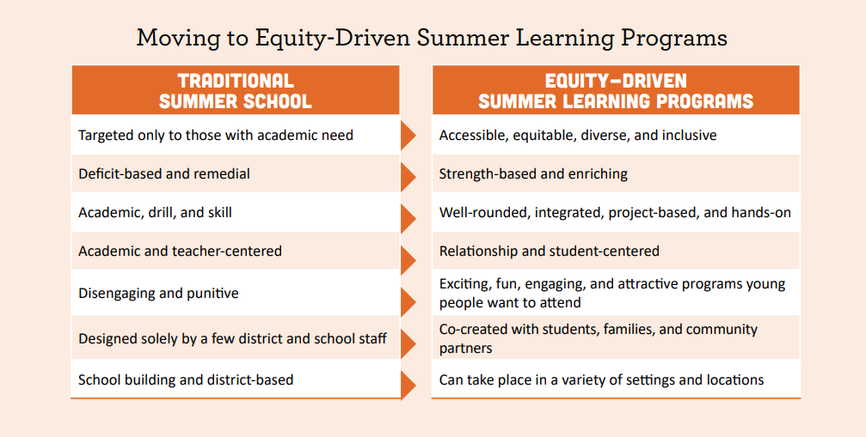
Centering Equity

Slide 7
Opportunity Gaps
Virtually all of the advantage that wealthy students have over poor students is the result of differences in the way privileged kids learn when they are not in school… America doesn’t have a school problem. It has a summer vacation problem.
-Malcolm Gladwell
Outliers: The Story of Success (pp. 258-260)

Slide 8
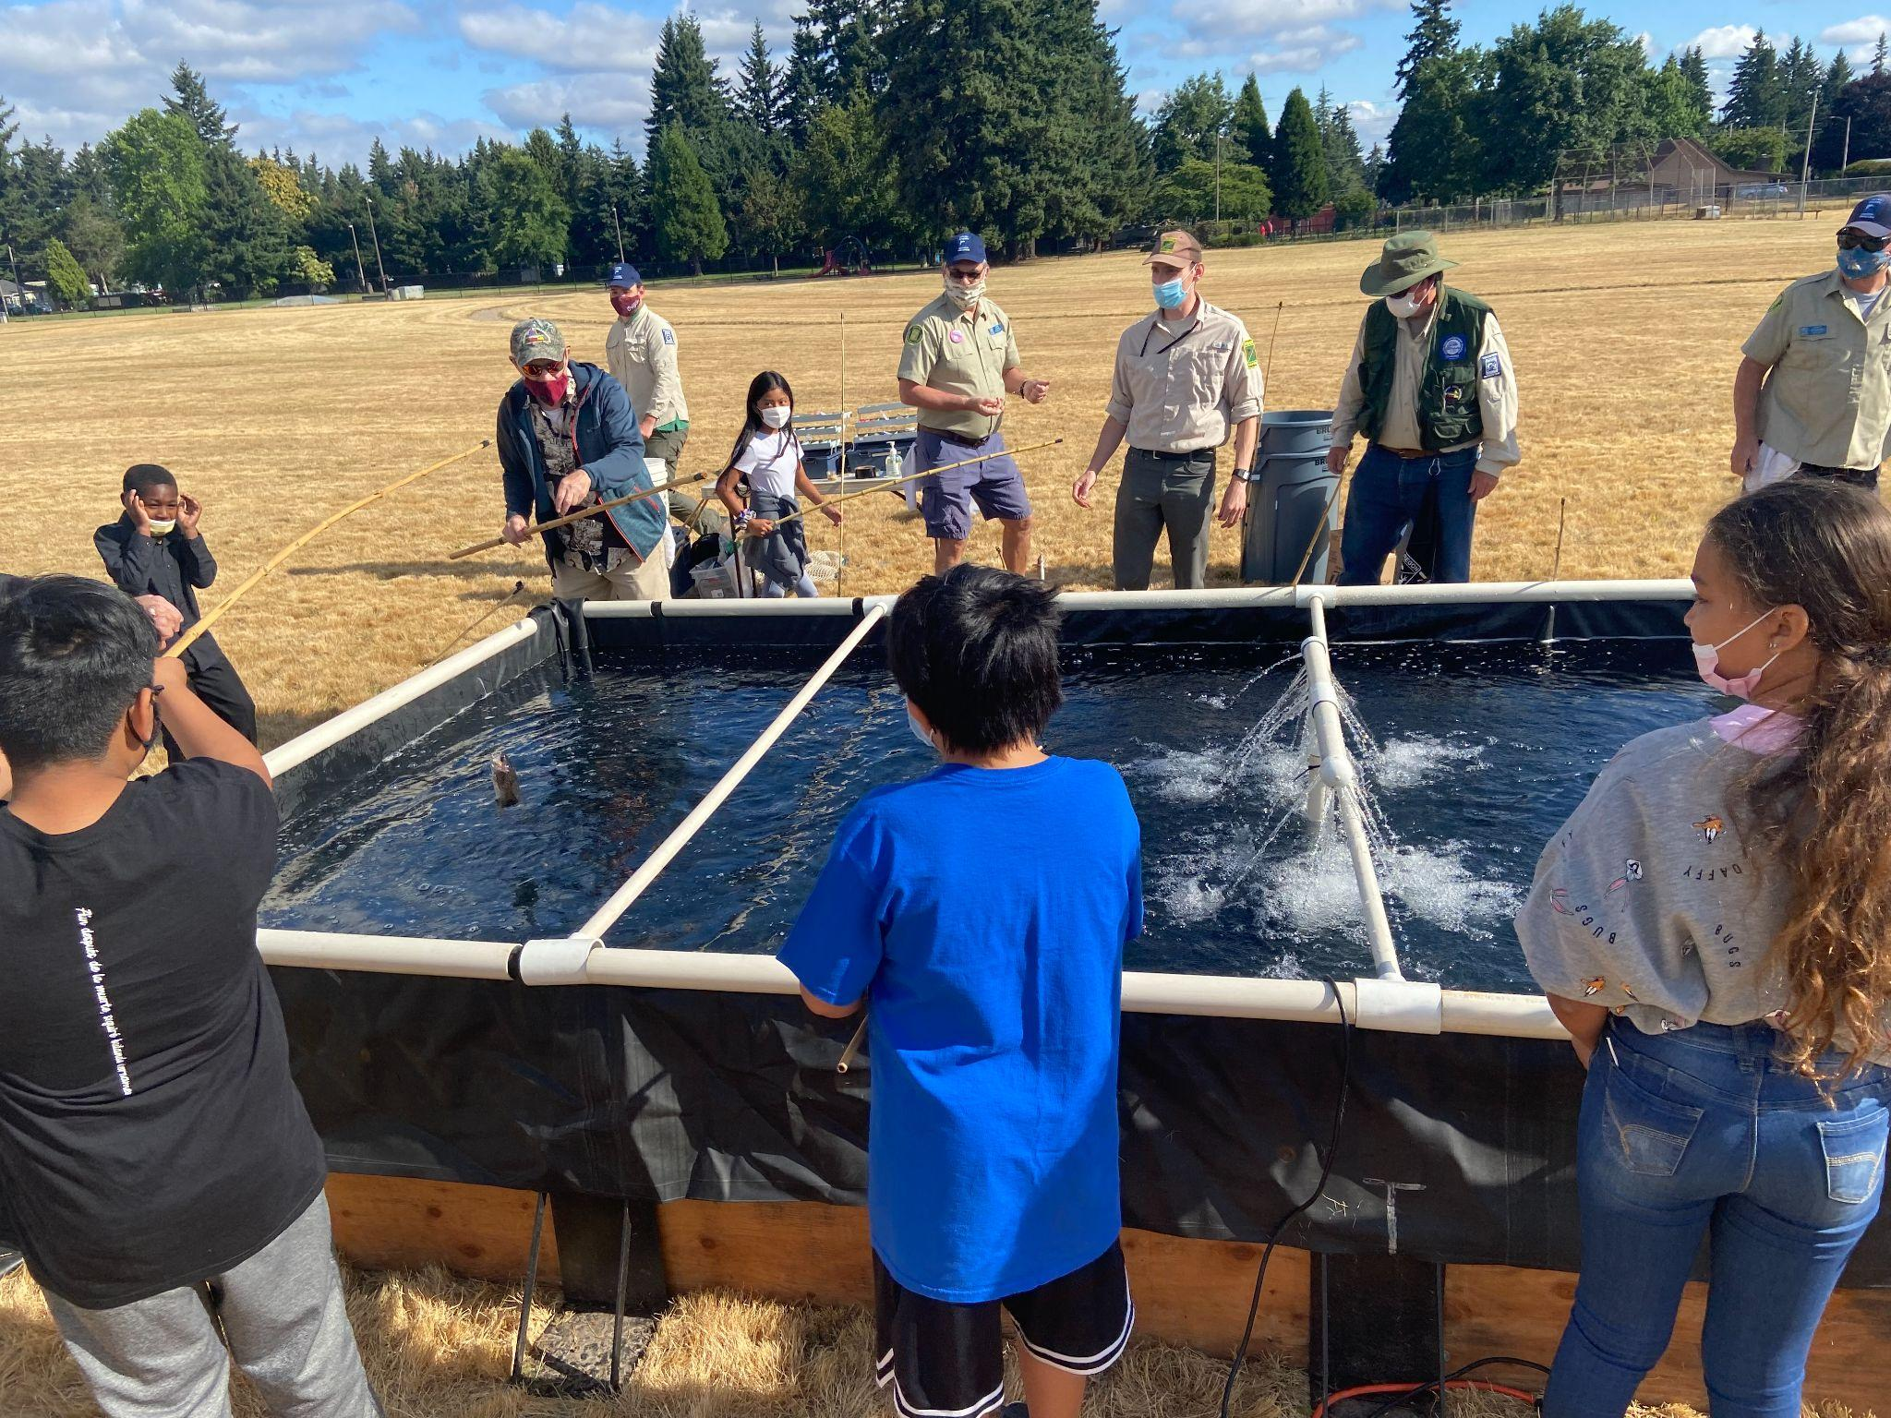
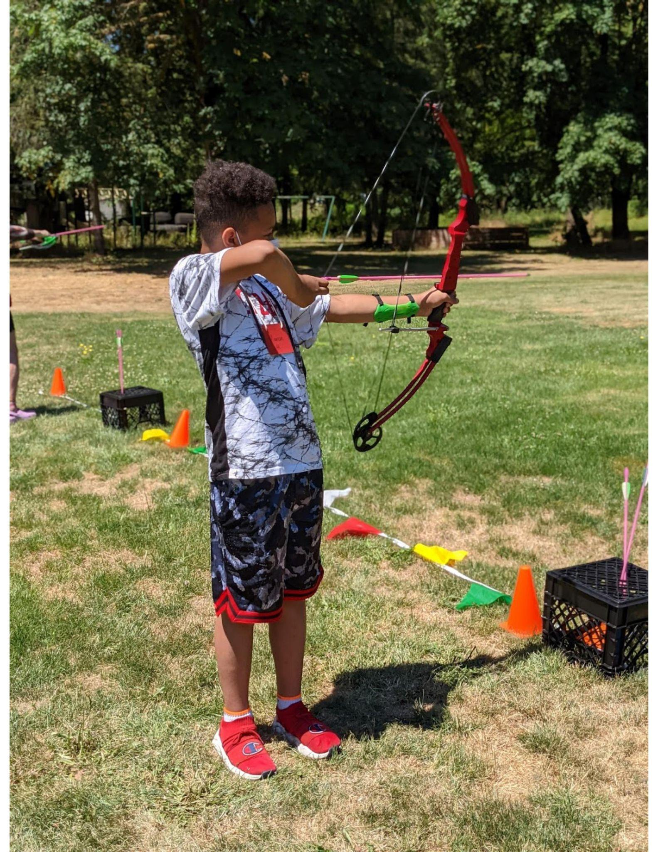
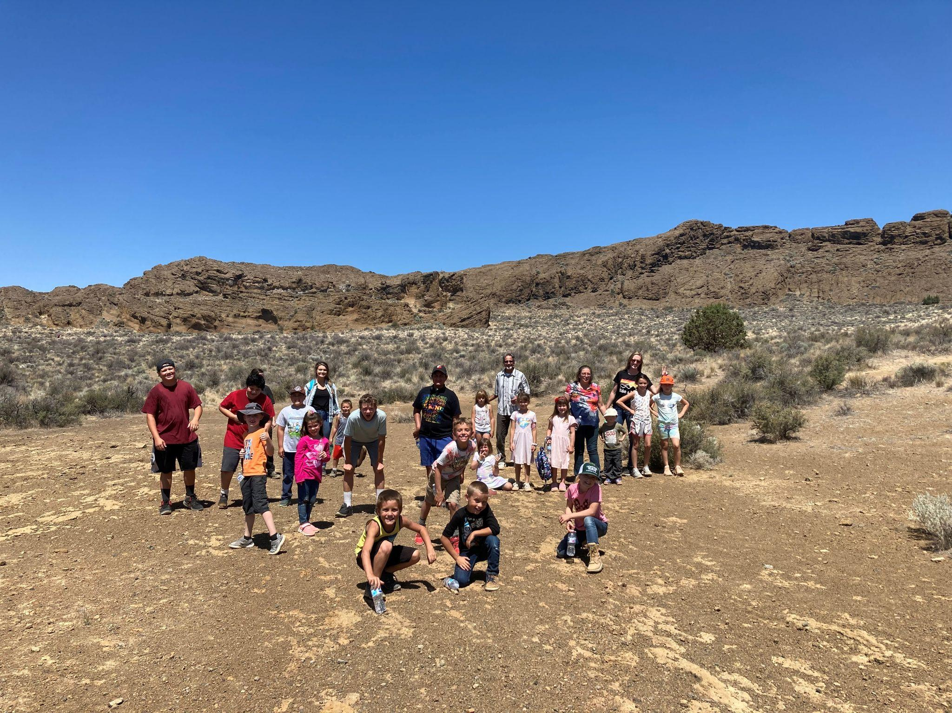
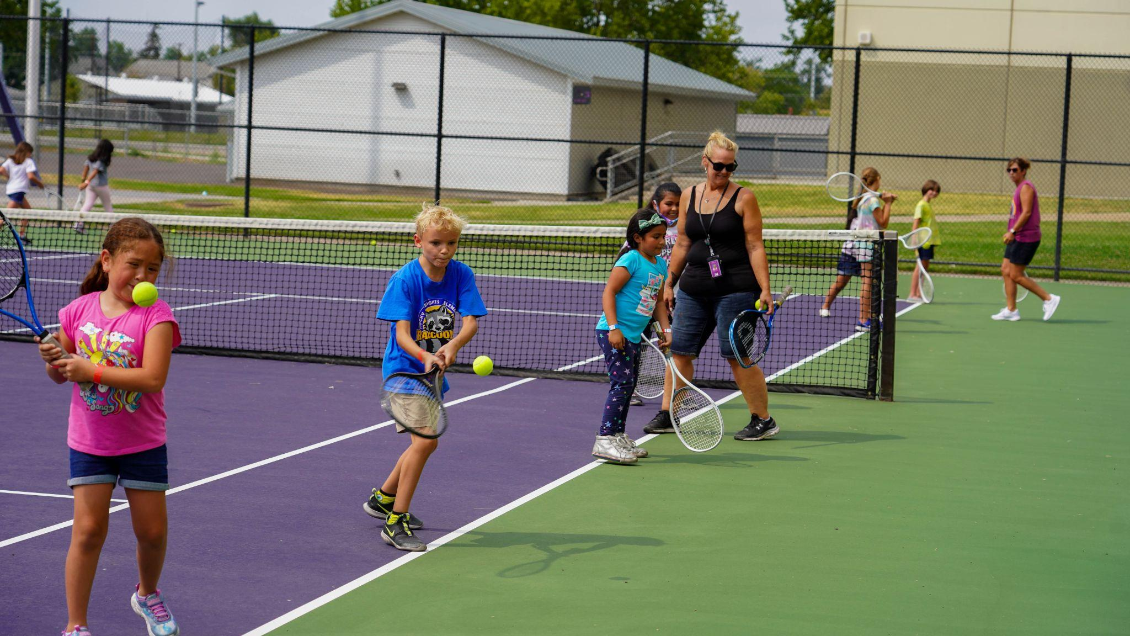
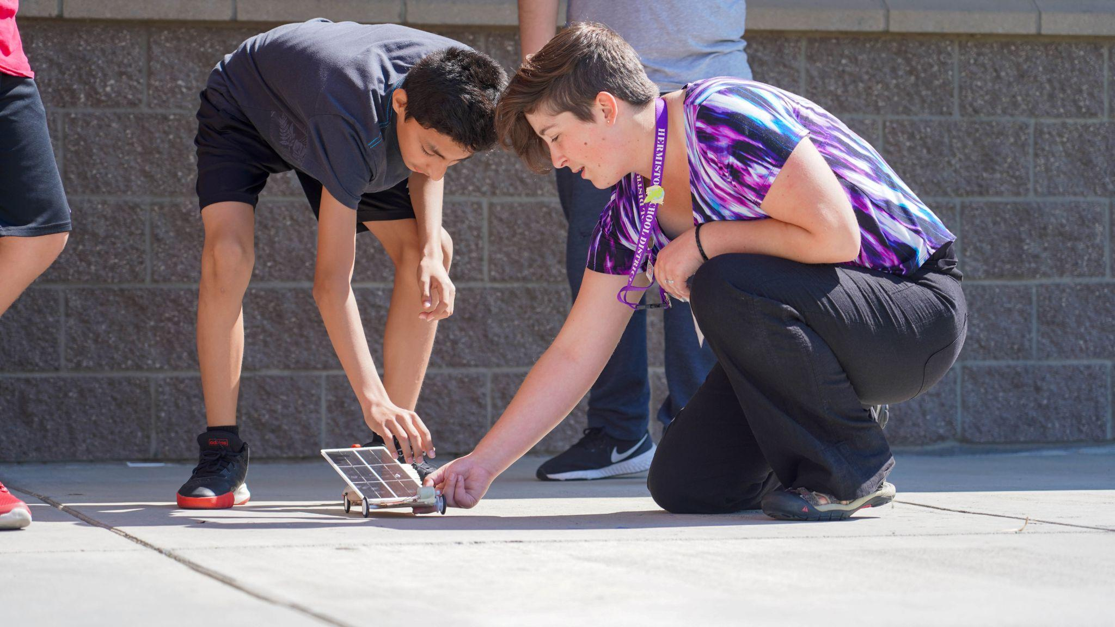
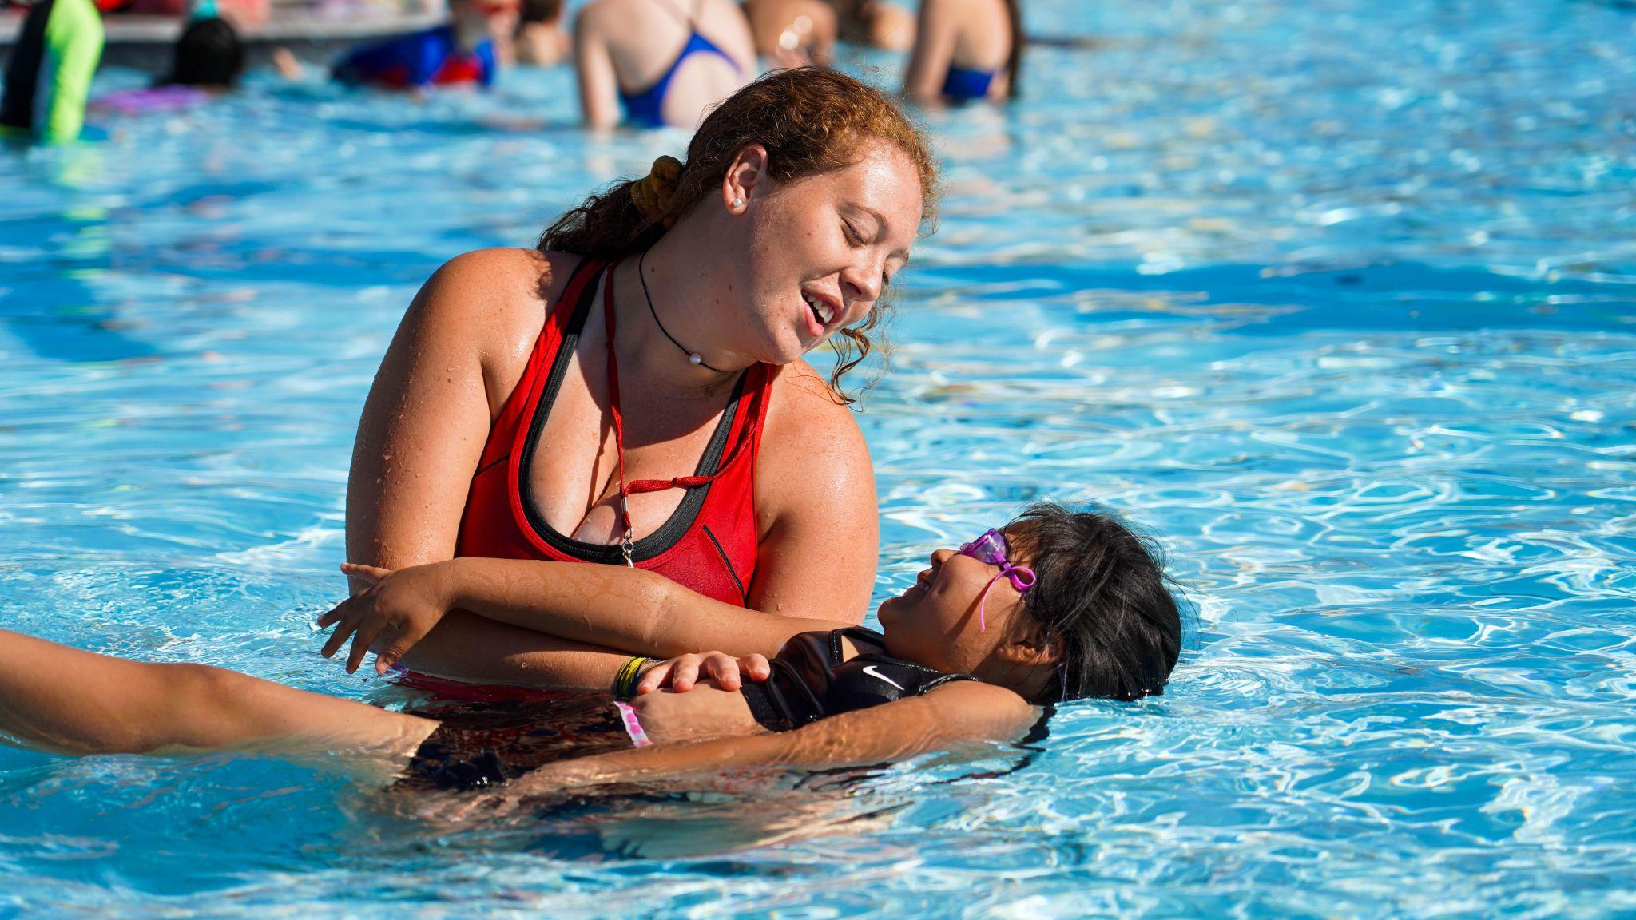
Summer 2021
“In all my 35 years of teaching, this has been the number one educational experience with students and staff” - Oregon Middle School Teacher
Photos: Left to Right: (top) Trout Farm Reynolds SD - Davis Elementary at Trout Farm, North Lake Elementary at Fort Rock, MESD Outdoor School - Reynolds Middle School
(bottom) Hermison SD Summer Program

Slide 9
A Vision for Equity-Driven Summer Learning
Shared Voice Activity
We need 3 volunteers to read two slides out loud to the whole group...

Slide 10
Connection as the Foundation for Learning
Summer provides a unique opportunity to allow educators additional time and space to:
focus on building deep interpersonal relationships where students are well-known, cared for, and connected,
create identity-affirming learning environments that sustain cultural knowledge, and
integrate relevant, hands-on learning experiences that foster joy, creativity, and curiosity

Slide 11
Connection Before Content
Relationships are the foundation of quality summer programs. Summer programs should not be solely based on the delivery of content, but rather driven by developing relationships, community, and a sense of belonging that youth can then use to explore and master content.

Slide 12
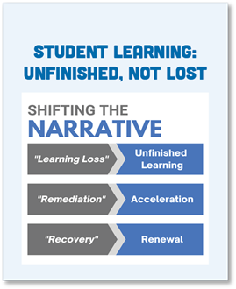
Building on Student Strengths
Students come with a wide range of experiences, beliefs, skills, values, and interests. Learning is an integrated endeavor where students make sense of new experiences in relation to previous experiences and knowledge. Learning happens best when educators actively engage a student’s prior knowledge and view it as an asset for learning rather than a problem to overcome.

Slide 13
Student Voice & Choice
Ask youth to be a part of a focus group, leadership committee or planning team to help co-create the activities that would be meaningful and engaging to them. This is a great opportunity to practice problem solving and leadership skills.
Leader Beware: It is better to not ask, then to ask and dismiss or not incorporate any of their ideas into the program. It is about youth seeing their ideas come to fruition.

Slide 14
Co-Creation and Innovation
Co-creation and continued co-learning with students, families and local partners ensures the specific context of the community; its history and culture(s), assets and challenges, needs, and dreams are integrated within the program. The program offerings should be as diverse as the community itself and reflect the voice, choice, and interests of its students and families.

Slide 15
Engaged Well-Rounded Learning
Sometimes we focus so much on the academic elements, we forget that physical activity or an art project is just the right medium. Let us not lose sight that our biggest purpose is to engage with youth in life-affirming ways. If we stay focused on meaningful engagement with students, it provides opportunities for them to play an active role in their growth and development.

Slide 16
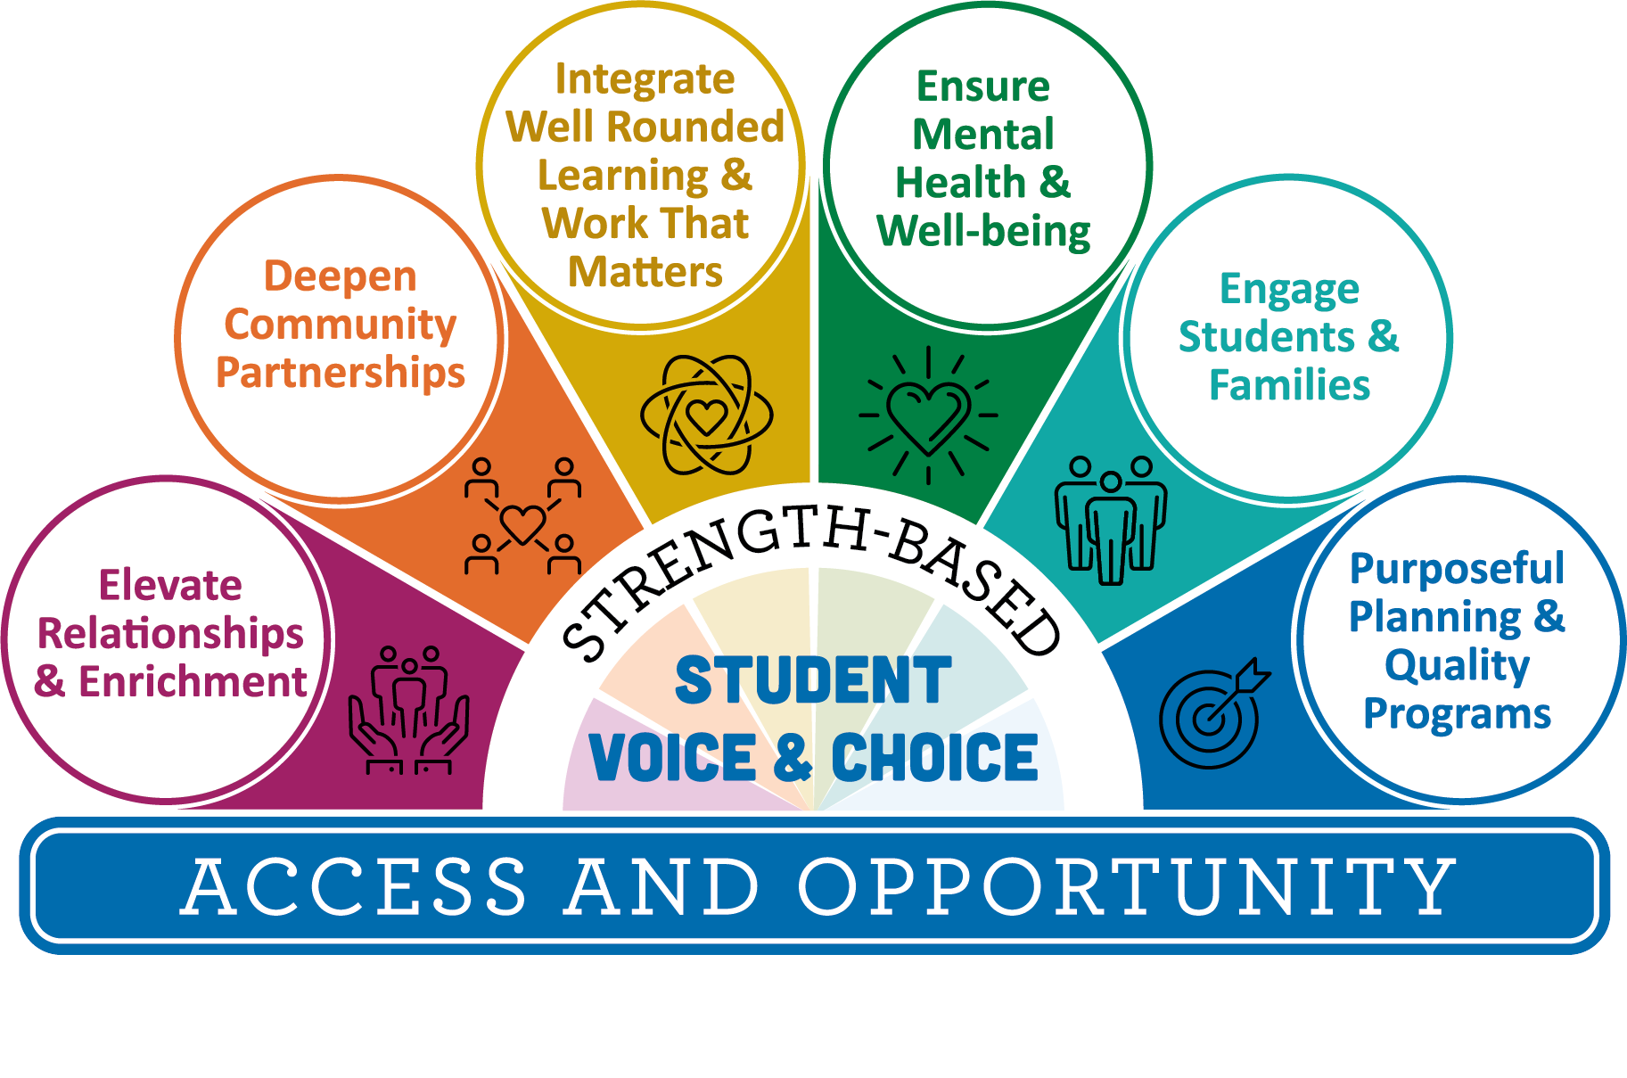
Key Elements of Quality Summer Programs

Slide 17
Silent Observation Activity
Activity
Writing utensil/paper to jot down reactions
We will use chat when video clip is finished
Remember this is a silent observation - No sound

Slide 18
Every Opportunity Counts
Do you want to learn how to make your school or classroom one that gives every child the opportunity to find their voice?
We believe language is the key to unlocking every child’s potential.
This is demonstrated in the following video:
Atlanta Speech School – Every Opportunity

Slide 19
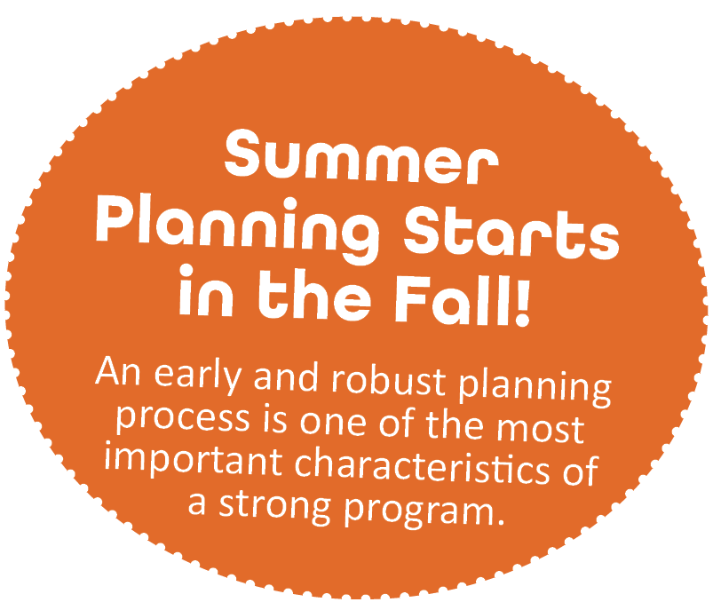
Start Planning Early
In order to realize the best of what summer has to offer, it is important to start planning early. Launching a summer program is akin to starting a new school year and ending it within weeks. Quality summer programming requires advanced planning that typically starts the prior school year in fall.

Slide 20
Representation Matters
It’s important to make sure that we are recruiting and investing in talent that reflects the young people that we are serving. We cannot be what we cannot see. When youth see themselves in their teachers and administrative staff it can be transformational.

Slide 21
Braiding Funds
State Programs​
Student Success Act (SSA) Summer Programs
Federal Programs​
Elementary and Secondary School Emergency Relief Funds (ESSER III) - American Rescue Plan (ARP)​
Every Student Succeeds Act (ESSA)​
21st Century Community Learning Centers (Title IV-B)​
Migrant Education Program (Title I-C)​
Individuals with Disabilities Education Act (IDEA) ​

Slide 22
Contents
Notes:
Give participants time to look at the guide and ask questions
Bring group back, quick

Slide 23
Check out the 2022 Summer Learning Best Practice Guide
Options to consider as you check out the guide:
Use table of contents to navigate guide
Sign up for the listserv!
Find relevant resources/references
Take 5-7 minutes to explore through the guide!

Slide 24
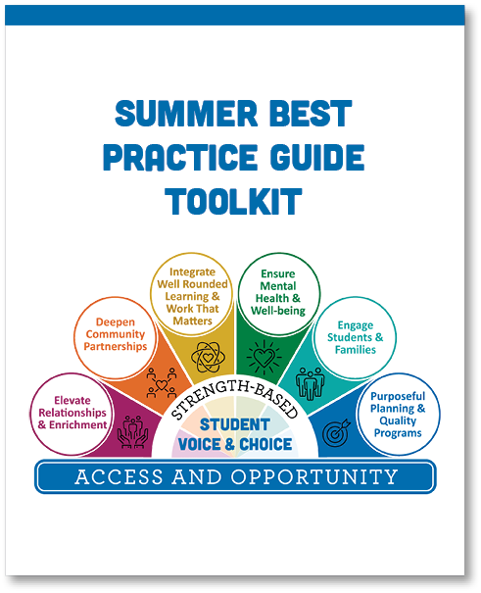
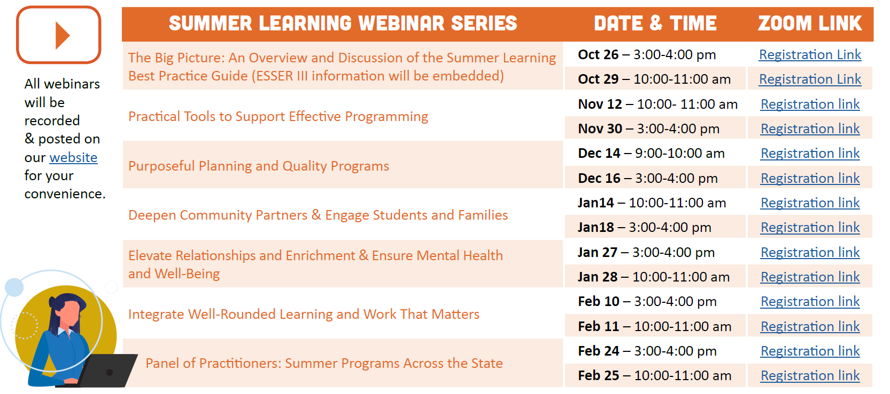
Summer Learning Webinar Series
Coming Soon!
Notes:
Framing the series, discourse,

Slide 25
What If...
What would happen if we truly lived into our vision?
Connection as the Foundation for Learning
Strength-based Student Voice & Choice
Co-creation and Innovation

Slide 26
Thank you!
Raquel Gwynn, Education Specialist
Office of Teaching, Learning and Assessment
raquel.gwynn@state.or.us
Sophie Hilton, Program Analyst
Office of Teaching, Learning and Assessment
sophie.hilton@state.or.us

