Slide 1
Title II, Part A: Basics
Building Systems of Support for Excellent Teaching and Leading

Slide 2
Oregon Department of Education – Our “Why”
Equity and Excellence for Every Learner
The Oregon Department of Education works in partnership with school districts, education service districts and community partners;
Together, we serve over 580,000 K-12 students;
We believe every student should have access to a high-quality, well-rounded learning experience;
We work to achieve the Governor’s vision that every Oregon student graduates with a plan for their future.

Slide 3
Outcomes for Today
Overview of Title II, Part A
Allowable Uses of Funds
Eligibility and Funding
Resources
Notes:
This presentation will provide an overview of the basic components and requirements of Title II-A including funding & eligibility, timelines and major milestones, as well as a discussion of the requirements for providing equitable services to private schools.
We’ll also discuss requirements for submitting the Title IIA application, allowable uses of funds and how Title IIA funds can be used to support district continuous improvement plans and goals.

Slide 4
Purpose of Title II-A
The purpose of Title II-A is to improve teacher and leader quality and focuses on preparing, training, and recruiting high-quality teachers and principals.
Participants can include:
Teachers
Principals/Assistant Principals
Paraprofessionals
Other School Leaders
Notes:
The purpose of Title II-A is to improve teacher and leader quality and focuses on preparing, training, and recruiting high-quality eachers and principals.
The Title II-A program is intended to provide historically underserved students, particularly students of color and students experiencing poverty with greater access to effective educators. While the goal of Title IIA is to improve outcomes for students, the focus is on supporting educators to become more effective practitioners.

Slide 5
Who are “other school leaders”?
According to ESEA §8101(A)(44):
“The term ‘school leader’ means a principal, assistant principal, or other individual who is:
(A) an employee or officer of an elementary school or secondary school, local education agency, or other entity operating an elementary school or secondary school; and
(B) responsible for the daily instructional leadership and managerial operations in the elementary school or secondary school building.”
Notes:
Not all educators meet the definition of “other school leaders”.

Slide 6
Consultation
Districts must meaningfully consult with a wide array of partners when determining the use of Title II-A funds
Administrators
Teachers
Paraprofessionals
Instructional support personnel
Families
Community members and partners
Tribes and tribal organizations

Slide 7
Equitable Services
Private schools are eligible for equitable services under Title II-A
Timely, meaningful, annual consultation
Activities based on the needs of the private school
Most activities allowable for the district are allowable for the private school
Must be secular, neutral, non-ideological
No salaries, benefits, or substitute costs
ESSA Quick Reference Brief: Equitable Services
Notes:
It is important to note that private schools are eligible for equitable services under Title IIA. Districts must engage in consultation with private schools within district boundaries annually to determine if they wish to participate. As a result of completing the Private School information linked in the district’s CIP Budget narrative dashboard an equitable services worksheet will automatically be generated. When calculating total enrollment on the ES worksheet – all students in the district and PS are included which is different from the Title IA calculation.
The amount a district must reserve to provide equitable services for private school teachers and other educational personnel is based on the district’s total Title II allocation less administrative costs.
The district can deduct costs for administering IIA to private schools, which means costs that are incurred in operating the grant. This includes things like conducting meetings, negotiating contracts, processing purchase orders, accounting activities, file maintenance, conference registration, etc. However, the total for administrative costs for the purpose of calculating the equitable share cannot exceed the district’s indirect rate.

Slide 8
Prioritizing High Needs Schools
LEAs must prioritize funds to schools that:
Have the greatest need, as determined by the LEA
Have the highest percentages or numbers of children whose families are navigating poverty
Are identified for CSI or TSI support

Slide 9
Allowable Uses

Slide 10
Allowable Costs under Title II-A*
Evaluation and support systems
Collaborative learning
Teacher leadership (coaching, mentoring)
Recruitment and retention strategies
Endorsements in areas of district need
Technology integration
Class size reduction
Using data to inform instruction
Differentiating instruction for focal student groups
Early learning
Needs and evidenced based professional learning
PL focused on abuse, trauma, or mental health supports
STEM and CTE
* Not an exclusive list
Notes:
Let’s talk for a minute about what Title IIA can fund. LEAs can use Title II-A funds for a wide range of strategies and activities to support the quality and effectiveness of teachers, principals and other school leaders. Activities supported with these funds must:
Be consistent with the purpose of Title II-A and
Address the learning needs of all students, including children with disabilities, English learners, and gifted and talented students.
This is not an exclusive list, but it demonstrates that there are many things Title IIA can fund related to improving teacher and leader quality. Something to consider is the emphasis the USED non-regulatory guidance places on systems- systems designed to support educators across the continuum of their career as well as systems designed to support students in accessing effective educators. In other words, how can Title IIA funds be used “more strategically and for greater impact”?

Slide 11
Common Uses
Job-embedded Professional Learning
Data teams/PLCs
Instructional coaching
Learning Walks
Supporting Student Needs
Universal Design for Learning principles (UDL)
Culturally responsive teaching
Trauma-informed practices
SEL and mental health
Recruitment and Retention
Endorsements in areas of need (e.g. SPED, ESOL)
Induction and mentoring
“Grow Your Own” programs

Slide 12
Meeting ESSA’s Professional Learning Definition
ESSA defines professional learning as:
“… high quality, sustained, intensive, and classroom-focused in order to have a positive and lasting impact on classroom instruction and the teacher’s performance in the classroom and not 1-day or short-term workshops or conferences.” [ESEA Section 8101(42)] ”
Conferences and workshops are approvable when they are included as part of larger strategy, not as an end in themselves.
Notes:
Whatever PL the district chooses, it must meet the definition in ESSA, meaning it is ongoing, job-embedded, differentiated, and classroom-based. This definition is intended to remind states and districts that one-day conferences and workshops, when done in isolation, do not meet this requirement. Districts that would like to fund workshops or conferences should include a description of how it is part of a sustained, job-embedded plan for professional learning in its CIP Budget Narrative application.
Some questions to consider when thinking about conference attendance include:
What is the role of the conference in meeting the prioritized need? How is it part of a sustained, job-embedded plan for professional learning?
What is the plan for delivering the content so that the learning extends beyond those who attended?
If you include conference attendance as an activity and do not articulate how it will be part of a larger strategy (what will the follow up be?) your reviewer will ask you.

Slide 13
Supplement Not Supplant
Federal funds cannot be used to supplant, or take the place of, state and local funds that would have been spent if Title II-A funds were not available
Test I: Are the services that the district wants to fund with ESEA funds required under state, local, or another federal law? If they are, there could be the presumption of supplanting.
Test II: Were state or local funds used in the last year to pay for these services? If they were, there could be a presumption of supplanting.
ESSA Quick Reference Brief: Supplement Not Supplant
Notes:
There is a federal provision of supplement, not supplant in Title II, Part A: Funds received under this subpart shall be used to supplement, and not supplant, non-Federal funds that would otherwise be used for activities authorized under this subpart.
To determine whether a fiscal expenditure supplements and does not supplant, school districts must run the following tests:
Test I: Are the services that the district wants to fund with ESEA funds required under state, local, or another federal law? If they are, there could be a presumption of supplanting.
Test II: Were state or local funds used in the past to pay for these services? If they were, there could be a presumption of supplanting.
It is possible for districts to overcome the presumption of supplanting. Overcoming the presumption of supplanting requires that districts keep documentation (e.g., budget information, planning documents, or other materials). In general, a district must determine what educational activities it would support if no ESEA funds were available. If it is clear that no State or local funds remain available to fund certain activities that previously were funded with State or local resources, then the district may be able to use ESEA funds for those activities.

Slide 14
Eligibility and Funding

Slide 15
Eligibility and Funding
All districts are eligible to receive Title II, Part A funds
Formula funded grant
20% based on enrollment
80% based on poverty
REAP districts have flexibility in the use of II-A funds
Notes:
All Oregon districts are eligible to receive Title IIA funds. It is a formula funded grant in which 20% of the district allocation is based on enrollment (number of children ages 5-17 who reside in the district) and 80% is based on poverty (number of children ages 5-17 who reside in the district and who are from families with incomes below the poverty line)
(ESEA section 2102(a).)
Those districts that qualify for REAP (Rural Education Achievement Program) also receive Title IIA funds, but have flexibility to spend their funds to carry out activities authorized under several other title programs in addition to IIA, namely IA, IIIA, or IVA.

Slide 16
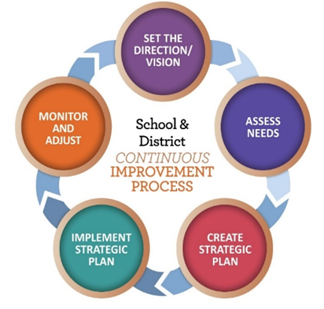
Funding Process
U.S. Census Bureau calculates annual poverty estimates for all public school districts
The U.S. Department of Education allocates program funding to states based on poverty percentages
Congress passes appropriations to federal education programs
The Oregon Department of Education finalizes allocations for all Oregon School Districts
Notes:
First: Federal funds originate in Congress
Second: The U.S. Department of Education calculates state level allocations
Third: ODE calculates each district’s allocation
Title I-A is comprised of four separate formulas. Some districts are eligible to receive funding in all four areas, while others are eligible in only a few. There are different criteria for each formula, though all are based on census poverty.

Slide 17
2022-23 FEDERAL FUNDS TIMELINE
JULY
2022
AUG 2022
NOV 2022
BEGINNING OF 2022-23 GRANT PERIOD
2022-23 BUDGET NARRATIVE APPLICATION OPENS
2022-23 BUDGET NARRATIVES DUE
NOV 2023
SEPT 2023
FINAL DATE FOR ALL 2022-23 CLAIMS FOR *INITIAL GRANT PERIOD
FINAL DATE FOR OBLIGATION OF 2022-23 FUNDS FOR *INTIAL GRANT PERIOD
*INITIAL GRANT PERIOD: 7/1/22 – 9/30/23
(15 MONTHS)
NOV 2023
UNCLAIMED FUNDS BECOME “CARRYOVER”
NOV 2023
SEPT 2024
NOV 2024
CARRYOVER APPLICATIONS FOR 2022-23 FUNDS OPEN
FINAL DATE FOR OBLIGATION OF 2022-23 FUNDS
FINAL DATE FOR ALL 2022-23 GRANT CLAIMS
Oregon Department of Education
17
Notes:
Title IIA funds are made available on July 1 of the fiscal year and remain available for obligation for a period of 27 months. This 27-month period includes an initial 15-month period of availability and an automatic 12-month extension permitted under the “Tydings Amendment”. While districts are encouraged to obligate funds in the initial grant year, it is not uncommon for districts to have funds available from two different grant years.
This slide shows the 2022-23 grant year timeline.

Slide 18
Transferability
Funds can be transferred out of or into Title II-A
Consult with private schools prior to transfer
Can transfer all or a portion of the funds into a grant award for the same year
Funds don’t move in EGMS
Carryover funds cannot be transferred
ESSA Quick Reference Brief: Transferability
Notes:
Under ESEA districts have the ability to transfer funds they receive by formula under certain programs to other programs to better address local needs. It is important to keep in mind that once funds are transferred, they take on the identity of the Title to which they were transferred and must be spent under rules applicable to that Title. Funds can be transferred into or out of Title IIA.
Before an LEA may transfer funds from a program subject to equitable services requirements, it must engage in timely and meaningful consultation ​with appropriate private school officials. (ESEA section 5103(e)(2).) When funds are transferred, private schools must still receive the opportunity to participate and receive an equitable share. A district may not reserve Title II-A funds solely to provide equitable services.
Transfers are done through the Consolidated Spending Page in the CIP Budget Narrative. There is no limit on the amount of funds that can be transferred from one grant to another, but transfers of funds cannot cross years.​ A district also cannot transfer funds into a program it does not receive an allocation for, or to a program for which it declined an allocation.​
For ODE’s accountability to USED all title funds must remain in their original award “pots” so districts must claim transferred funds from their original source in EGMS. While the funds are “transferred” from the district’s perspective, no money gets moved around on ODE’s side.​ This means transferred funds have to be claimed from the original grant.
It is important to note that carryover funds cannot be transferred between title programs. Once the initial grant period is over (first 15 months) transferability is no longer an option.

Slide 19
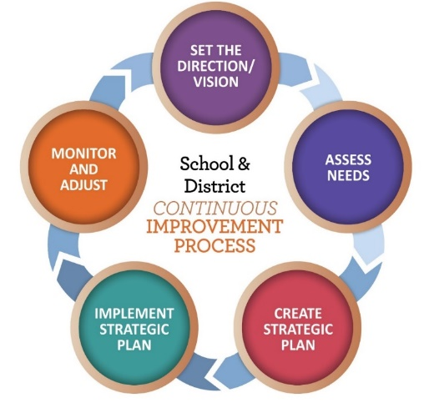
Application Requirements
Needs Assessment*
What does the data tell us?
Budget Narrative
What will we do to meet our needs?
Equitable Services Worksheet
Only for districts with participating schools
*Must include data from district-sponsored charter schools
Notes:
The district applies for Title IIA funds through the CIP Budget narrative on the secure district site. Ideally, the district’s application for Title IIA reflects the larger district plan for improvement. Focusing the Title IIA narrative around district priorities established as part of the overall continuous improvement process will help ensure that the district is using its Title IIA funds “more strategically and for greater impact” as the non-regulatory guidance recommends.
There are 5 components of the Title IIA application. The two main parts are the needs assessment and the budget narrative. If a district has participating private schools then an Equitable Services tab will also appear. The Overview and Spending pages are auto-populated.
It is important to keep in mind that district-sponsored charter schools are a part of the district. The needs of their teachers and students must be included as part of the data that is analyzed when determining prioritized needs.
While charter schools do not get an “allocation” like private schools, they do have unique needs that should be considered. There are several different approaches to supporting charter schools that districts have taken. Ultimately it comes down to good communication between districts and charters.
19

Slide 20
Resources
Title II-A web page
Title II-A Listserv
Federal Non-Regulatory Guidance
Oregon Federal Funds Guide
CIP Budget Narrative User Guide
CIP Budget Narrative Checklists
Standards for Professional Learning
Notes:
There are a wide variety of resources available to support districts with Title IIA. The CIP Budget Narrative User Guide and Checklists are particularly helpful tools when submitting the narrative application.

Slide 21
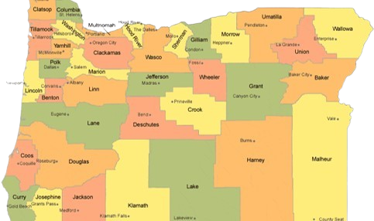
Regional Contacts by ESD
Amy Tidwell
Grant, Harney, High Desert, InterMountain, Jefferson, North Central and Region 18
Jen Engberg
Clackamas, Columbia Gorge, Multnomah and Northwest Regional
Lisa Plumb
Lane, Linn Benton Lincoln and Willamette
Sarah Martin
Douglas, Lake, Malheur, South Coast and Southern Oregon
Notes:
We have divided up the state into four sections. Each of us serves as the primary contact for the districts in these ESDs

Slide 22
Please reach out!
Amy Tidwell amy.tidwell@ode.oregon.gov
Jen Engberg jennifer.engberg@ode.oregon.gov
Lisa Plumb lisa.plumb@ode.oregon.gov
Sarah Martin sarah.martin@ode.oregon.gov
Notes:
Our team has moved from a programmatic model to a regional support model. Each of us has taken a section of the state to support across Titles IA, IIA, IVA and VB.

