Slide 1
Kick-Starting the Mentor-Mentee Relationship
Initial Training to Support New Mentors in Getting Started before School Starts

Slide 2
Session Overview
Building Trusting Relationships
Qualities of a Good Mentor
Your First Conversations
Practice “getting to know you” conversations
New Teacher Identity
Reflecting on your first years
Needs and concerns of new teachers
Mentor-Beginning teacher Conversations
Phases of 1st Year Teachers
Coaching Language and Techniques
Coaching Cycle
Observation and Data Collection
Questioning STEMs and Conversation Tool

Slide 3
Welcome
Purpose
Provide a mindset and guidance for embarking on the mentoring journey with a beginning teacher.
Objectives
Determine important elements for building and maintaining trust.
Understand the roles and responsibilities of a mentor and how to effectively launch your first meetings with your mentees.
Familiarize self with Coaching Conversation, the Collaborative Discussion Guide and Mentor Language/Stems.

Slide 4
Norms for Collaboration
Everyone is able to contribute.
Respect each others' opinions
Participate! Be present and engaged.
Confidentiality - some things shouldn't be repeated outside of this training.
Be conscious of time - help stick to it, or negotiate for more
Mobile phones off to minimize disruptions
Regular breaks- take care of your own needs

Slide 5
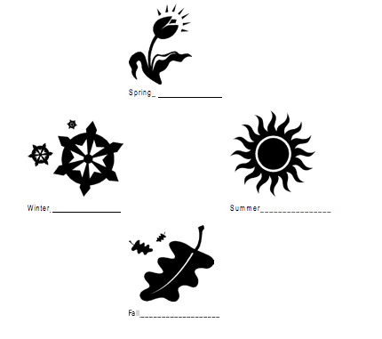
Seasonal Buddies
Make an agreement with four different people. For each season, use the diagram below to record the person with whom you made an agreement. Only make an agreement if the same season is open on both of your diagrams.

Slide 6
Mentor- Beginning Teacher Relationships Activity
Trust is the foundation of mentoring relationships
Learning involves risk-taking and strong relationships encourage risk-taking
Think, Write, Share:
What is trust? What does it look like, sound like in a mentoring relationship?
Which of your own qualities might help or hinder making you a good mentor?

Slide 7
The Good Mentor
What are the qualities of a ”Good Mentor?”
Final Word Protocol
for reading and sharing thoughts on article.

Slide 8
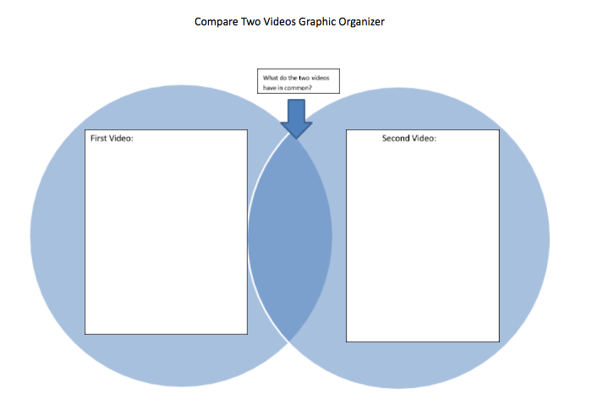
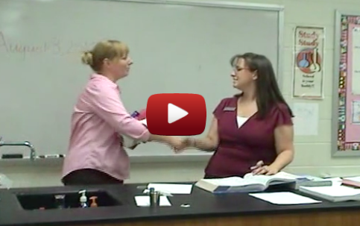
First Interactions- Building Trust in Your Relationships

Slide 9
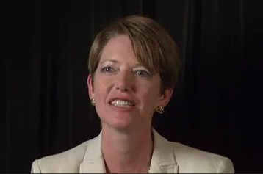
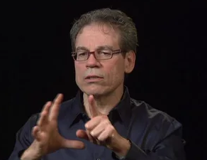
Hear from the Experts:
Nancy Fichtman Dana Professor and Director of the Center for School Improvement, University of Florida Nancy Fichtman Dana, Ph.D., wrote the book mentoring—literally! She’s author of The Reflective Educator’s Guide to Mentoring (2007) and several other books about teachers’ professional learning. She is a Professor at the University of Florida and studies teacher learning.
Steven Athanases Professor, University of California, Davis Steven Athanases, Ph.D., co-authored Mentors in the Making: Developing New Leaders for New Teachers with Betty Achinstein (another expert contributor to MentorModules.com). A former high school English teacher, Dr. Athanases is a Professor at the University of California in Davis and conducts research on diversity and educational equity in literacy teaching and teacher education.

Slide 10
Meet with your Summer Seasonal Buddy to dialogue about the reflection prompts in your packet….

Slide 11
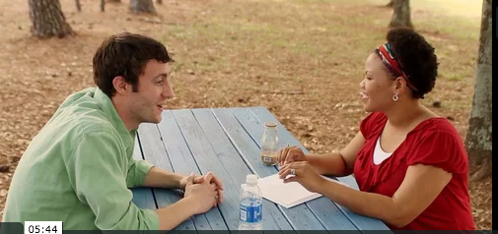
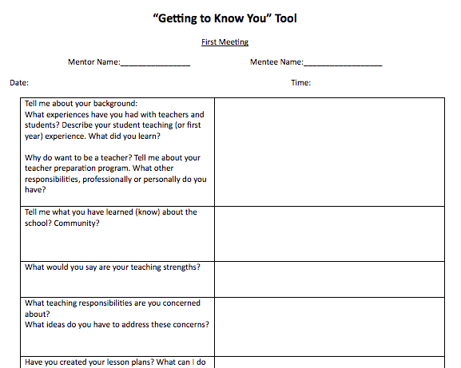
Getting to Know You- 1st Meeting
Watch…..
Practice: Guidelines & Tool….Triads

Slide 12
Think Back…
What were your concerns when you were a beginning teacher?
Meet your Fall Seasonal Buddy and have a “stand-up conversation....

Slide 13
Teacher Identity: Expectations vs. Reality
Leilani has several concerns. As her mentor, where would you begin?
What would you do to support a beginning teacher who feels confident with subject matter knowledge but needs support with adjusting her lessons to meet students’ varied developmental levels?
In addition to classroom management, what other concerns do you think beginning teachers may have?

Slide 14
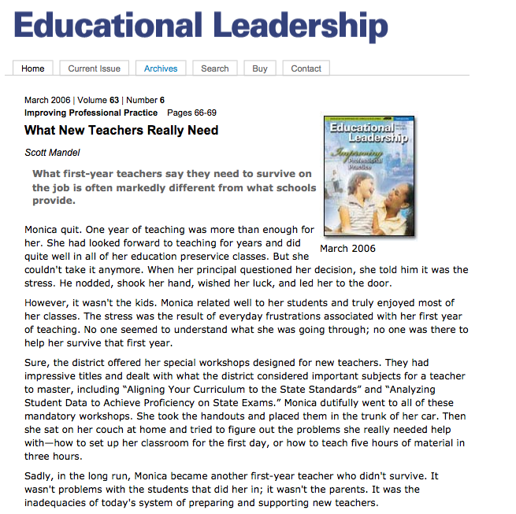
What New Teachers Really Need
What were new teachers 5 top concerns?
What are some strategies the article suggests for mentors?

Slide 15
Hear from the Experts….
After viewing the video, find your Winter Seasonal Buddy and have a ”stand-up” meeting to dialogue about these questions:
With your partner discuss:
What does Nancy say are the 3 biggest, common concerns of beginning teachers?
What strategies does she suggest a mentor begin with, but not stop with?

Slide 16
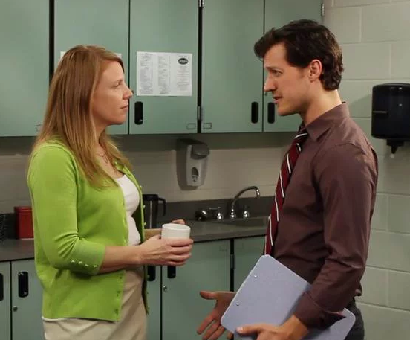
Mentor-Beginning Teacher Conversations
Turning the Conversation Around
In your table groups, discuss:
How did the mentor handle the beginning teacher’s concerns?
What else might she have done or said?

Slide 17
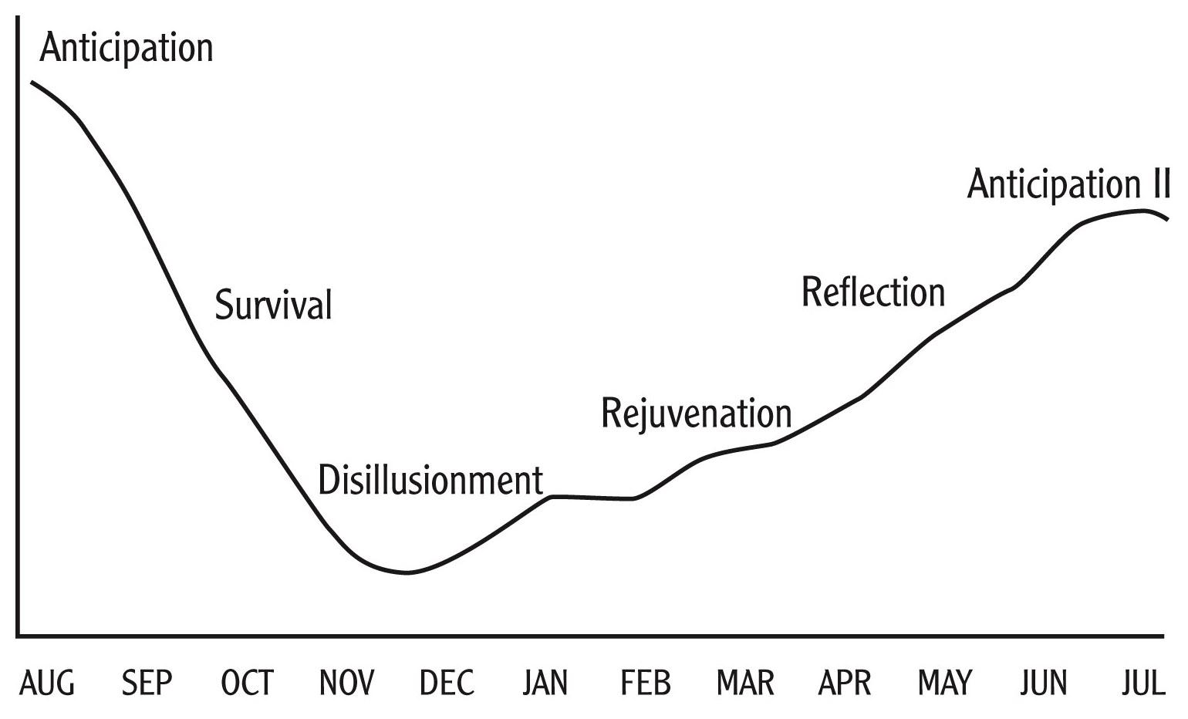
Slide 17
Phases of a New Teacher’s Attitudes
Figure 1: The Phases of a First-Year Teacher’s Attitude Toward Teaching
Note. From “The Stages of a Teacher’s First Year,” by Ellen Moir, in A Better Beginning: Supporting New Teachers, by Marge Scherer (Ed.), 1999, Alexandria, VA: Association for Supervision and Curriculum Development (ASCD). Copyright 1999 by ASCD. Used with permission of the publisher.
Activity 3.4 Slide 1
Notes:
Go through these 5 slides as a mini-lecture and refer to West Ed Handout, OR you may want to show the narrated ppt from DPS

Slide 18
This phase begins before school starts and lasts for the first weeks of school. New educators are ready to change the world and often “don’t know what they don’t know”.

Slide 19
Slide 19
Needs of Beginning Teachers during Anticipation Phase
Suggested Mentor Support
during this phase
Welcome call
Schedule regular meeting times
Building and district logistics (Copies, Keys, reporting absences, getting subs)
Procedures for getting classroom supplies
Curriculum materials and pacing guides
Teacher Editions
Assist with setting up classroom
To feel included
Information about school climate and expectations
School procedures
Supplies and materials
Curriculum
Classroom set-up

Slide 20
Slide 20
During survival new educators feel overwhelmed, presented with a variety of situations that were not expected. There is little time for reflection as new educators are caught off guard with the realities of teaching.

Slide 21
Slide 21
Needs of Beginning Teachers during Survival Phase
Suggested Mentor Support during this phase
Organization
Rituals and routines
Goals
Time management skills
Communication strategies
Use of technology
Materials
Encouragement
Meet with colleagues
Model a positive disposition
Continue regular meetings
Share record keeping strategies
Parent-Teacher conference tips and practice
Help with lesson planning and district resources
Encourage participation

Slide 22
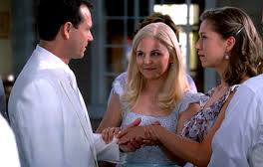
Form Triads: Find two people you have not met with today. Discuss the following:
Do you recall going through these Phases?
How did you get through them?
Why is support the first weeks and months of school so important?
What can mentors do to help beginning teachers develop positive professional identities?
How do the concerns of beginning teachers differ from those of experienced teachers?
Think back to your first year of teaching and some of the feelings you experienced. What advice would you give to a new teacher who confides in you that she feels like she doesn’t know what she is doing?
Thank your group and return to seats.

Slide 23
Mentoring Conversations
Reflect on the prompt in your packet:
“How might mentoring conversations facilitate growth in beginning teachers’ instructional practices?”

Slide 24
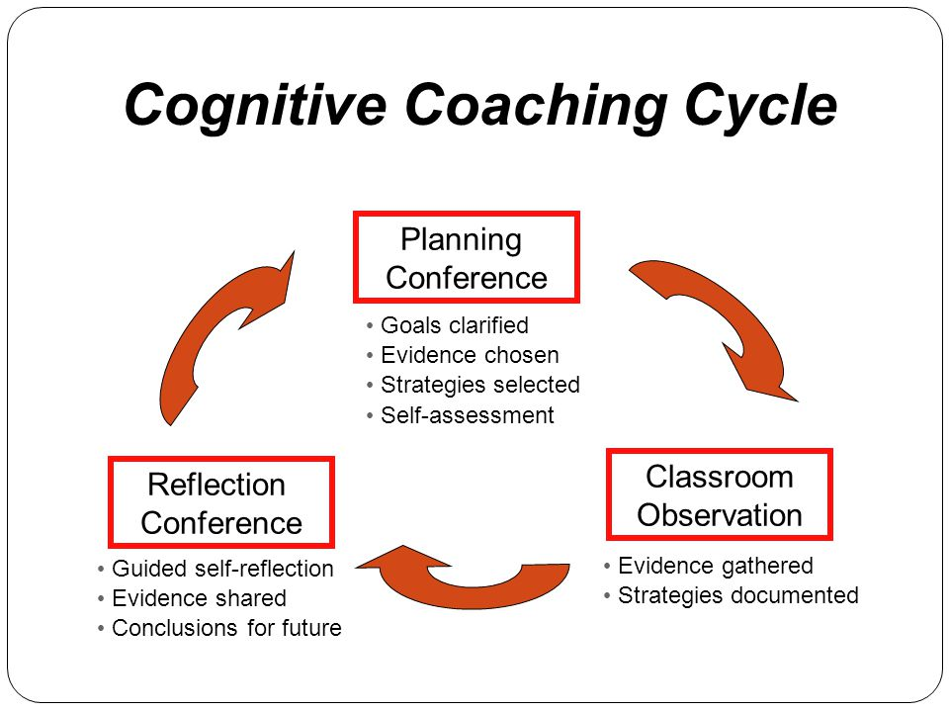
What are the components of a Coaching Cycle in mentoring?
It all starts with a pre-observation conversation between the mentor and the beginning teacher. During this conversation, the beginning teacher sets a goal for the observation.
Then the mentor observes a lesson, taking notes and gathering data related to the beginning teacher’s goal.
After the observation, the two teachers (mentor and mentee) participate in a follow-up conversation to review the data and determine how the goal was reached and/or what changes can be made to reach it in the future.

Slide 25
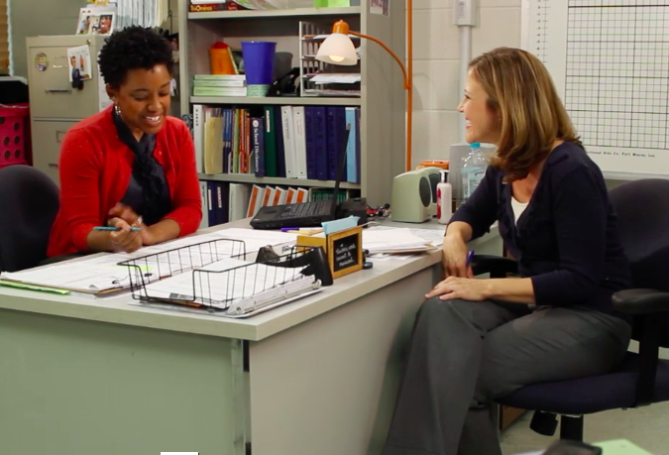
Video Example
After viewing, dialogue in your table groups using the prompts in our packet on p. 18

Slide 26
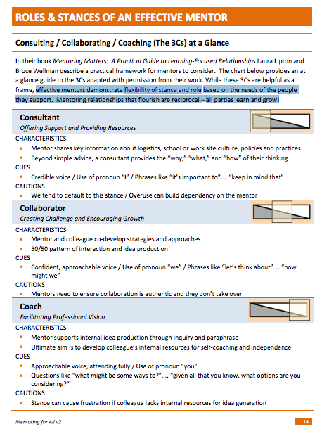
Mentoring Stances: The 3 C’s

Slide 27
What Data to Collect When Observing
Scripting
Anecdotal Record
Free Writing
Focused Scripting
Visual-Auditory Evidence
Proximity Analysis
Verbal Flow
Numeric Data
Video-audio Recording
Portfolio

Slide 28
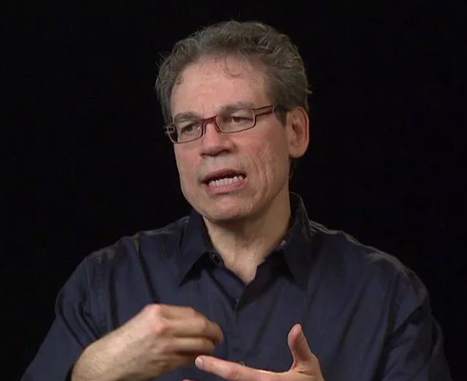
Hear from the Experts
Dr. Steve Anthanases on Coaching Language and Techniques

Slide 29
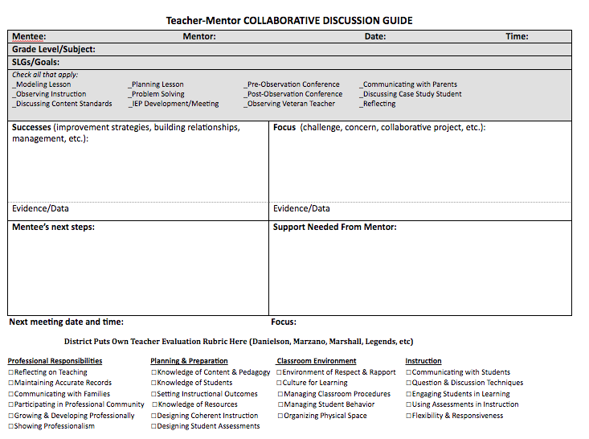
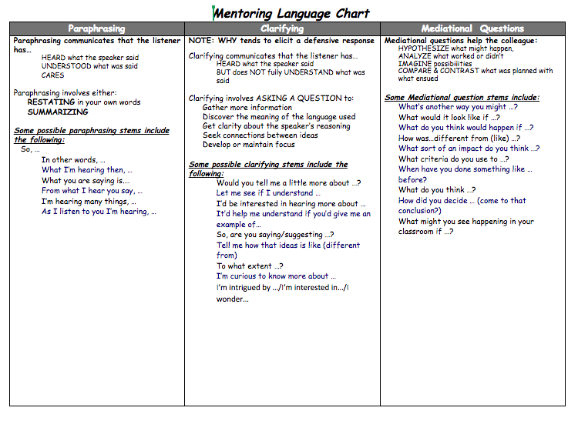
Mentor Tools: Collaborative Discussion Guide and Mentor Language Stems

Slide 30
Mentoring Conversations- Denver Public Schools
Listen for Mentor Language of Support
Practice recording the conversation clips in this video on a CDG form.

Slide 31
Practice a Coaching Conversation
Form triads, directions in packet
Use the CDG tool and refer to Mentor Language stems
Take turns assuming the roles of
Beginning Teacher
Mentor
Observer

Slide 32
Wrap-Up: Reflection Coaching Cycle, Stances, & Mentor Language
Respond to these questions in your table groups.
If a beginning teacher lacks ideas, asks for help or doesn’t recognize the problem, which mentoring stance would you take? What are some possible actions you can take to support her?
During a pre-observation conference, your mentee asks you to help her with pacing her lessons. What kinds of data collection techniques might you suggest to address this goal?
Imagine your mentee makes the following statement about a student during your post-observation conference: “Meghan comes from a very affluent home, so I expected her to come up with many connections to the text. My English learners, however, always have trouble with text connections and that’s really frustrating.” How would you respond? How would you support this beginning teacher in reframing her thinking?
Notes:
Optional Activity of time allows. Otherwise hide slide and remove page from packet.

Slide 33
Summarize and Reflect
Turn and Talk
What are my 2-3 key “takeaways” from today’s session?
What are my next steps in preparing for my first meeting with my mentee(s)?
What ongoing support will I need in this role?

