Slide 1
Required Training for District Testing Coordinators Accountability Reporting
October 2013

Slide 2
ESEA Flexibility Waiver
Overview

Slide 3
ESEA Flexibility Waiver Overview
What is the Elementary and Secondary Education Act (ESEA) Flexibility Waiver?
What are priority, focus and model schools?
What is the Accountability Addendum?
What is the new Accountability System specified by the ESEA Waiver?

Slide 4
What is the ESEA Flexibility Waiver?
Removes requirement for Adequate Yearly Progress (AYP) designation, replacing it with a new rating system.
Annual Measurable Objectives (AMOs) are still required for achievement, cohort graduation rate, participation and attendance, by subgroup.
Priority, focus and model schools were identified in Summer 2012 using the new rating system.
Priority and focus schools will remain on list for three years after implementation of interventions.
Model school list updated on annual basis.
New rating system used for Report Card ratings starting with 2012-13.
For more information on the ESEA Flexibility Waiver see: http://www.ode.state.or.us/search/page/?id=3475

Slide 5
What are priority, focus and model schools?
Priority Schools are high poverty schools that were ranked in the bottom 5% of Title I-A schools in the state based on Oregon’s rating formula. These schools generally have overall very low achievement and limited growth over time. Additional supports and interventions to make improvements are needed.
Focus Schools are high poverty schools that were ranked in the bottom 5% -15% of Title I-A schools in the state with a significant achievement gap based on Oregon’s rating formula. These schools need additional support in closing the achievement gap among historically underserved student populations.
Model Schools are high poverty schools that were ranked in the top 5% of Title I-A schools in the state based on Oregon’s rating formula. These schools serve as models of successful student outcomes.

Slide 6
What is the Accountability Addendum?
Prior to the ESEA Flexibility Waiver, accountability reporting was guided by an Accountability Workbook, which was approved by the U.S. Department of Education (USED).
Under the ESEA Flexibility Waiver, the Waiver itself plus a separate Accountability Addendum take the place of the Accountability Workbook.
The Accountability Addendum addresses details of the accountability reporting system as a supplement to the ESEA Waiver document.
The Waiver has been conditionally approved by USED, and approval is pending on the Addendum.

Slide 7
What is the new Accountability System specified by the ESEA Waiver?
Under the ESEA Waiver, Oregon committed to developing a new accountability system, consisting of the following components:
School Rating System
Report Card Detail for Schools and Districts
Summary Report Card for Schools and Districts
District Achievement Compacts
In addition, Oregon provides supplemental data to ensure that it meets all requirements of the federal non-regulatory guidance on state and local report cards.
Supplemental Data via Education Data Explorer Data Download http://www.ode.state.or.us/apps/BulkDownload/BulkDownload.Web/default.aspx
Supplemental Data on Report Card Web Site http://www.ode.state.or.us/search/page/?id=3881
The federal non-regulatory guidance can be found at: http://www2.ed.gov/programs/titleiparta/state_local_report_card_guidance_2-08-2013.pdf

Slide 8
School Rating System
Overview

Slide 9
School Rating System Overview
What indicators are used in developing the ratings?
What data elements are used?
What demographic subgroups represent the historically underserved population?
What is the minimum amount of data needed to rate a school?
How are the school ratings calculated?

Slide 10
What indicators are used in developing the ratings?
School ratings are based on 6 indicators:
Achievement: percent met in reading and math.
Growth: individual student growth in reading and math.
Subgroup Growth: growth for historically underserved subgroups.
Graduation: cohort graduation rates.
Subgroup Graduation: graduation rates for historically underserved subgroups.
Participation: participation rates in reading and math for all subgroups.

Slide 11
What data elements are used?
Reading statewide assessments in grades 3, 4, 5, 6, 7, 8 and high school.
Mathematics statewide assessments in grades 3, 4, 5, 6, 7, 8 and high school.
Four- and five-year cohort graduation rates.
Participation rates in statewide reading and mathematics assessments.

Slide 12
What demographic subgroups represent the historically underserved population?
Subgroup ratings are based on the performance of each of the following four subgroups:
Economically Disadvantaged
English Learners
Students with Disabilities
Historically Underserved Races/Ethnicities, a combined subgroup consisting of:
American Indian/Alaska Native
Black/African American
Hispanic/Latino
Native Hawaiian/Pacific Islander
The students in these groups match the “Combined Disadvantaged” subgroup found in Achievement Compacts.

Slide 13
What is the minimum amount of data needed to rate a school?
Achievement:
No minimum N-size for rating the all students subgroup.
Schools that do not reach a minimum of 40 tests in a subject when two years of data are combined are rated on four years of data.
Very small schools are subject to additional rules (see slide 38).
Growth: 30 students with a growth percentile and 40 students with assessments.
Subgroup Growth: 30 students with a growth percentile. In addition the subgroup must meet the minimum N-size requirement for being rated against AMOs, which is 40 tests.
Graduation and Subgroup Graduation: 40 students, combined, in the last two four-year cohorts.
Participation: 40 students for subgroups, with no minimum N applied to the all students subgroup.

Slide 14
Report Card Detail
School Rating System

Slide 15
Annual Measurable Objectives
Annual Measurable Objectives (AMOs) still exist, but are folded into the new rating system.
AMOs for Achievement and Graduation:
Meeting Reading or Math means Level 4* or higher
Meeting Grad Rate means Level 3* or higher.
Participation is still 95% and attendance is still 92%. *Note: These levels relate to the indicators, and are not the same as a school’s overall rating level.
Subject | Elem/ Middle | High
Reading | 69% | 82%
Math | 66% | 67%
Graduation Rate | AMO
Four-year | 67%
Five-year | 72%
Details available at: http://www.ode.state.or.us/search/page/?id=3881

Slide 16
Achievement Indicator
Schools are given “Levels” in reading and math, based on the combined percentage meeting for school as a whole.
Cutoffs determined by subject for Elem/Middle schools and for High/Combined schools:
Level 5: Top 10% of schools in the state.
Level 4: Meeting the AMO for the subject and school type.
Level 3: Below average, but not in lowest 15%
Level 2: Lowest 15%, but not in lowest 5%
Level 1: Lowest 5% of schools in the state.

Slide 17
Achievement Indicator (cont'd)
Subgroups
Separate cutoffs are determined for Elementary/ Middle schools and for High/Combined schools.
Subgroup performance is displayed, but not used in the rating.
Cutoffs are applied to all student groups that meet the minimum N of 40 students.
Level 4 or 5 means the subgroup met the AMO.

Slide 18
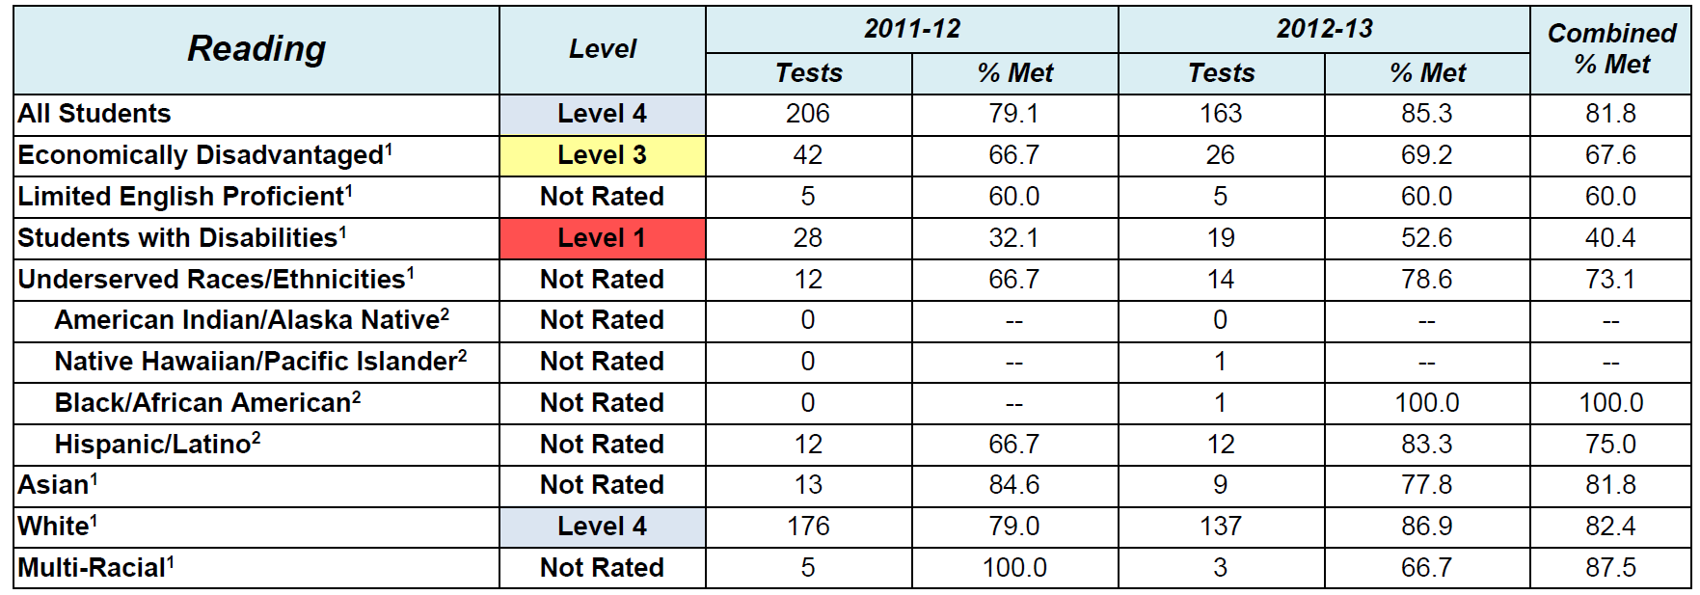
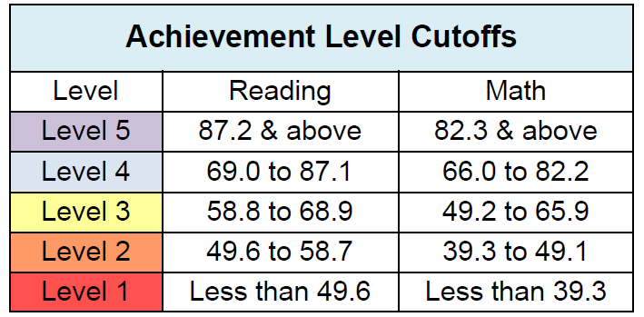
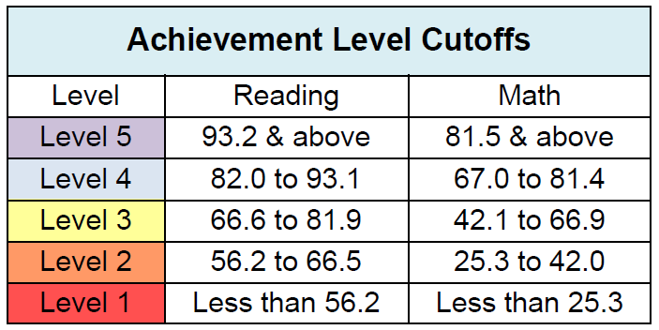
Achievement Indicator Example
Elementary/Middle Cuts
High School Cuts

Slide 19
Oregon’s Growth Model
Logic borrowed from the Colorado Growth Model.
Includes all students having two consecutive years of standard OAKS assessments, regardless of whether or not they are meeting standard.
A student’s growth is compared to the growth of other students in the state having similar prior test scores.
Student Growth is expressed as a percentile.
Computes Growth Targets – growth percentiles that put a student on track to be at standard in three years.

Slide 20
Growth Indicator
Schools are given “Levels” in reading and math growth. These levels do not change from year to year, and can be characterized as:
Level 5: Schools with high growth
Level 4: Average to above average growth
Level 3: Below average, but not low, growth
Level 2: Low growth
Level 1: Very low growth
Reading and math growth are combined into a Growth Rating.

Slide 21
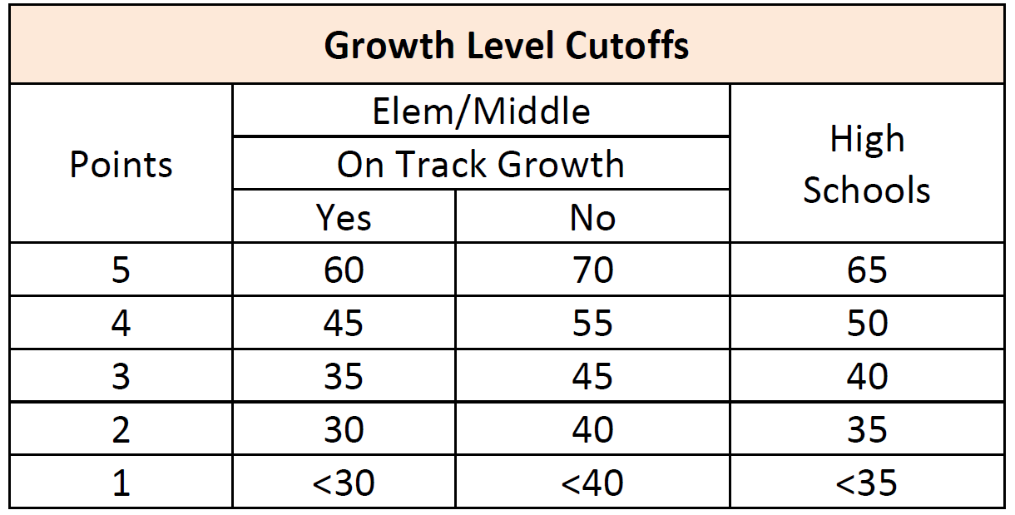
Growth and School Accountability
School accountability uses the median growth percentile.
Median growth is the “middle” growth percentile.
This is the “typical” growth at the school.
Schools where the typical student is meeting his/her growth target may receive a boost to their growth rating.
Requirements to reach
Level 5, Level 4, etc., are
lower for schools where
typical students are
making target growth.

Slide 22
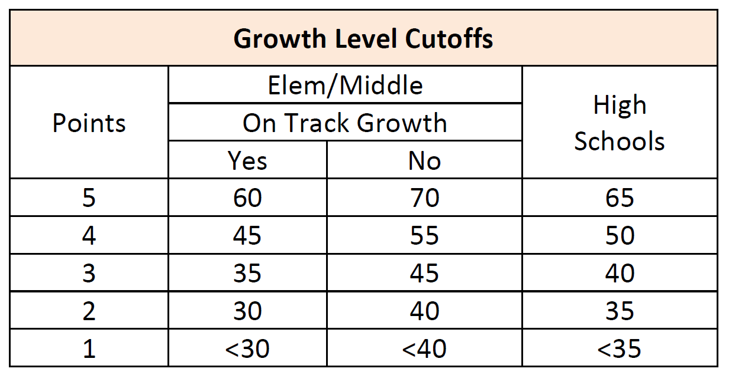
Growth Indicator Examples
High School Example
Elementary School Example
If Combined Median Growth is at least as high as the Combined Growth Target, the school has “Yes” for On-Track Growth

Slide 23
Subgroup Growth
Subgroups are also given “Levels” in reading and math growth.
Subgroup Growth rating is a combination of reading and math growth for the following four subgroups:
Economically Disadvantaged
Limited English Proficient
Students with Disabilities
Historically Underserved Races/Ethnicities – combined subgroup consisting of:
American Indian/Alaska Native
Black/African American
Hispanic/Latino
Native Hawaiian/Pacific Islander

Slide 24
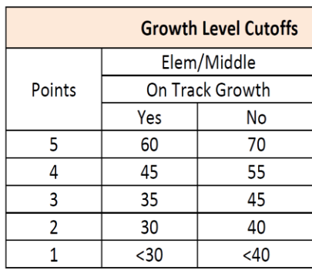
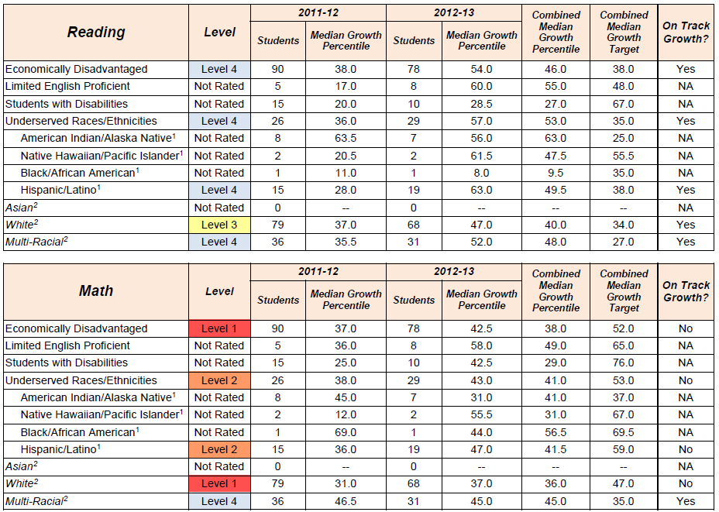
Subgroup Growth Examples

Slide 25
Graduation Indicator
Schools are rated if they have at least 40 students in the combined four-year cohort.
The five-year rate is used if there are at least 40 students in the combined five-year cohort.
Graduation Levels for the 4-year and 5-year rates are determined by the higher of the combined rate or the current rate.
The school’s graduation level is the higher of the 4-year Level and 5-year Level.

Slide 26
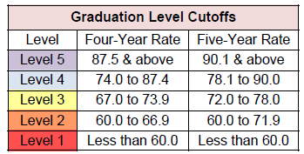
Graduation
This school will receive a Level 4 for graduation
Graduation Cutoffs

Slide 27
Subgroup Graduation
Subgroups are given rating levels for both four- and five-year graduation rates.
Subgroup Graduation rating is a combination of the graduation ratings for the following four subgroups:
Economically Disadvantaged
English Learners
Students with Disabilities
Historically Underserved Races/Ethnicities: a combined subgroup consisting of:
American Indian/Alaska Native
Black/African American
Hispanic/Latino
Native Hawaiian/Pacific Islander

Slide 28
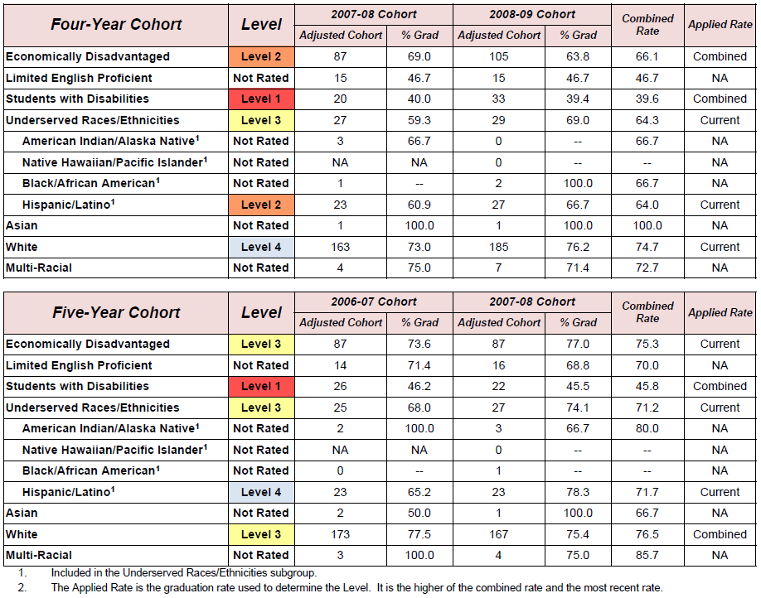
Subgroup Graduation Example

Slide 29
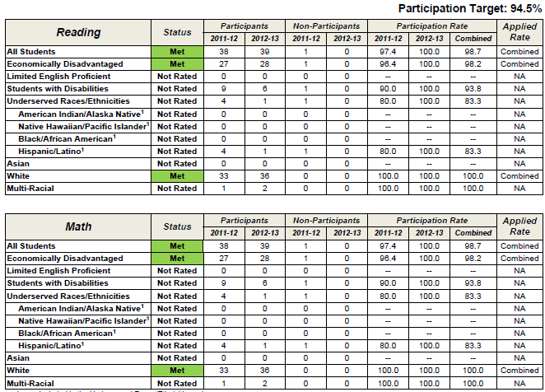
Participation
Missing one or more participation targets lowers the school rating by one level.
Participation rates are rounded to the nearest whole percent, so a participation rate of 94.5% will round up to 95%, thus meeting the 95% target.

Slide 30
Calculating the Rating
Schools earn points and receive a rating of Level 1 to 5 for each of the following indicators*: Achievement, Growth, Subgroup Growth, Graduation, Subgroup Graduation
These points earned for each indicator are combined into an overall score and Level for the school.
Missing one or more participation targets lowers the rating by one level.
A “Level 1” in graduation means the school’s rating can be no higher than Level 2.
* For those indicators where the school met minimum size requirements.

Slide 31
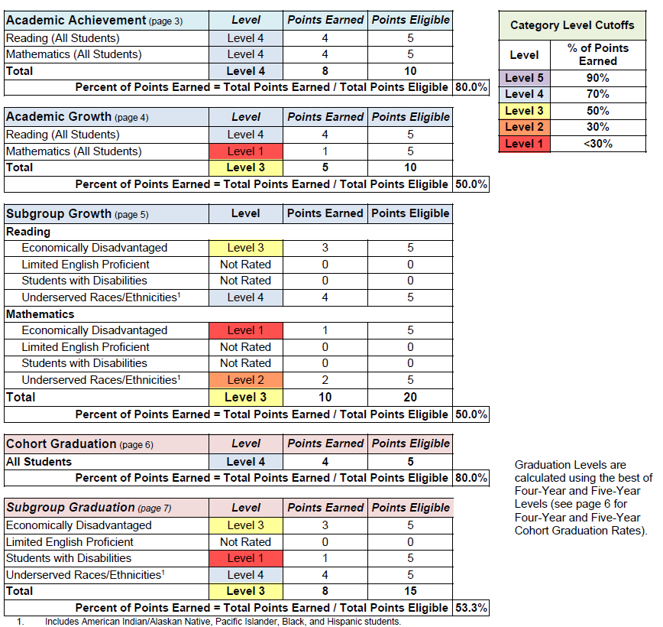
Indicator Summary
Page 2 of the rating details summarizes the points earned and percentage of points earned for each indicator.

Slide 32
Weighting in Overall Rating
Categories are weighted according to the table below:
Category | Elementary and Middle Schools | Combined Schools (e.g., K-12, 6-12) | High Schools
Achievement | 25% | 20% | 20%
Growth | 50% | 30% | 20%
Subgroup Growth | 25% | 15% | 10%
Graduation | -- | 25% | 35%
Subgroup Graduation | -- | 10% | 15%

Slide 33
Overall Rating
Schools are given one of five rating Levels:
Level 5 Falls into the top 10% of schools
Level 4 Falls between 44% and 90% of schools
Level 3 Falls between 15% and 44% of schools
Level 2 Falls between 5% and 15% of schools
Level 1 Falls into the bottom 5% of schools
The statewide average is a low Level 4.

Slide 34
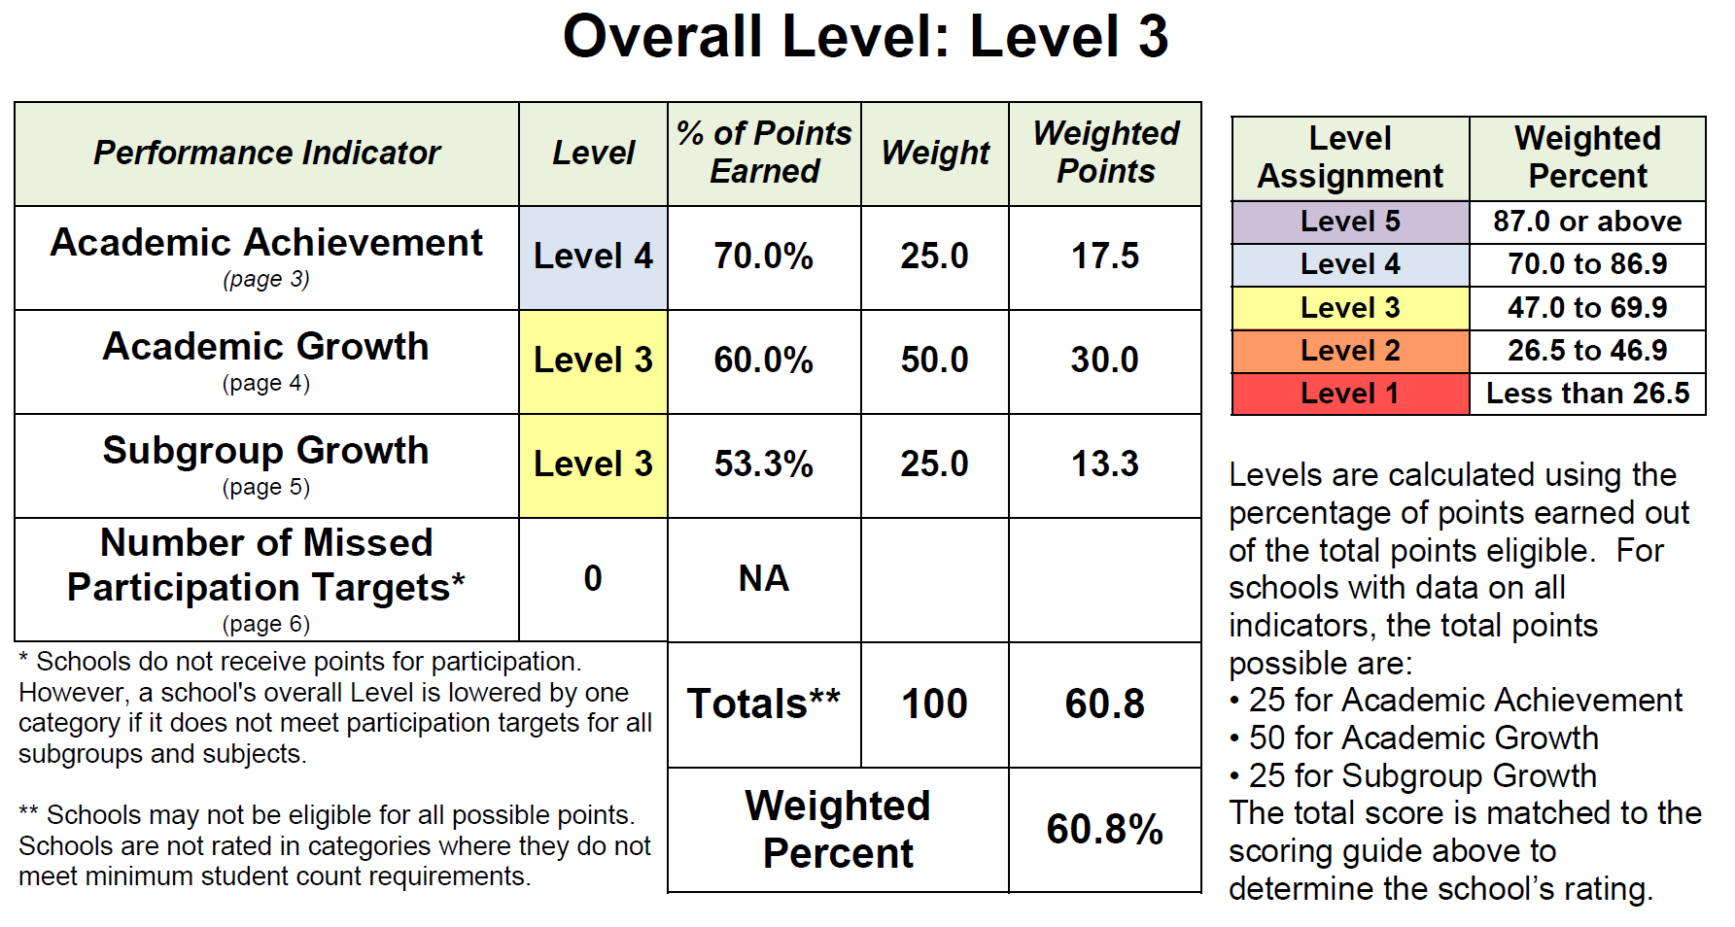
Sample Elementary Rating

Slide 35
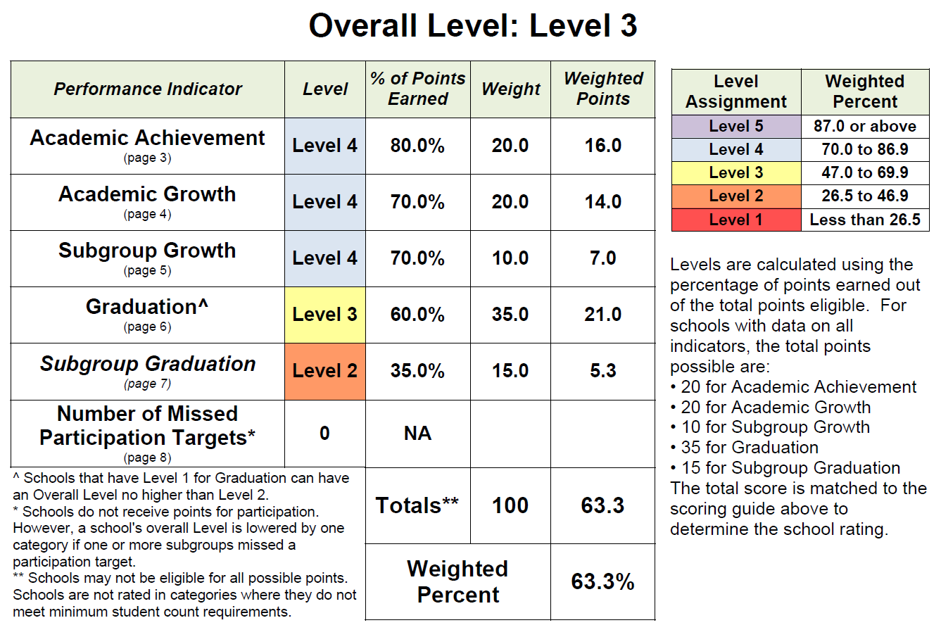
Sample High School Rating

Slide 36
Special Cases
School Rating System

Slide 37
School Rating System Special Cases
What if a school has insufficient data?
What if a school does not have any grade levels that are given assessments?
What if a school serves a wide span of grades (such as K-12, 6-12, etc.)?
How are extended assessments incorporated in the rating?

Slide 38
What if a school has insufficient data? Small School Rules
By default, report card ratings and AMO determinations are based on data from the two most recent school years, combined.
Schools with fewer than 40 total tests in reading and mathematics over the last two school years are rated based on the four most recent school years, combined.
Schools with fewer than 40 total tests in reading and mathematics over the last four school years do not receive a report card rating. However, they are still compared to AMOs based on however many tests have been submitted.

Slide 39
What if a school does not have any grade levels that are given assessments? Schools without Benchmark Grades
Schools without benchmark grades (e.g., K-2 schools) are denoted as sending schools, and are assigned a designated receiving school.
School report card ratings and priority, focus or model school status for these schools are based on the 3rd grade assessment results of the designated receiving school.
Attendance is based on the sending school’s attendance.
Schools that serve only students in grade 1 or lower do not receive a school rating and are not eligible for priority, focus, or model school status. However, they do receive an achievement rating based on the 3rd grade assessment results for the designated receiving school.

Slide 40
How are extended assessments incorporated in the rating? Cap on Extended Assessments
The number of extended assessments meeting the alternate achievement standards can represent no more than 1.0 percent of the total number of reading and math tests within a given district.
Districts may choose one of the following two methods for identifying which alternative assessments will be changed from “met” to “not met” to meet the 1.0 percent cap:
random assignment; or
selections that yield the most advantageous results.

Slide 41
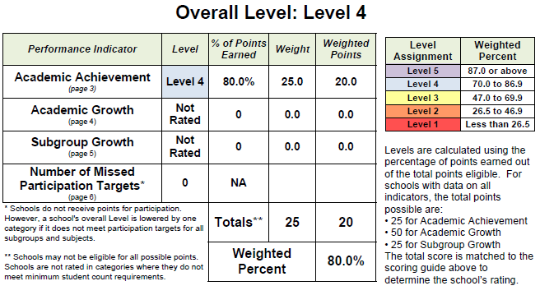
Sample Small School Overall Rating
Schools are only rated on indicators where they meet minimum N-size requirements. In these cases the overall rating is based only on those rated indicators.

Slide 42
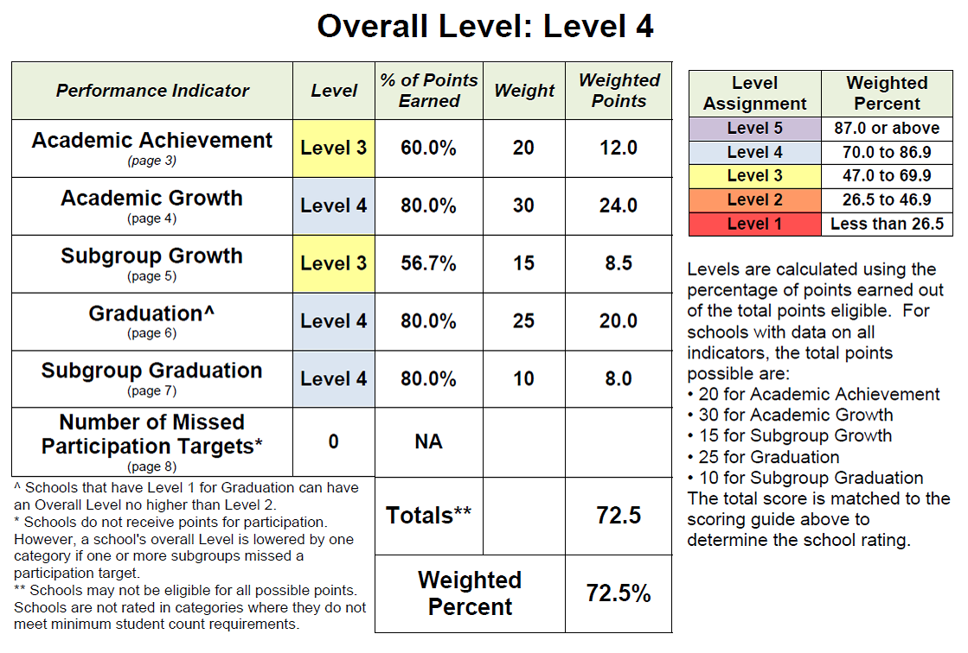
Sample Combined School Rating
A combined school is a school that combines high school grades and any grades 7 or lower: 7-12, K-12, 6-12, etc.

Slide 43
District Report Card Detail
A district’s ratings against Annual Measurable Objectives (AMOs) are determined by consolidating the results for its schools into three grade bands and applying the school rating methodology for each grade band:
Elementary (grades 3-5)
Middle (grades 6-8)
High (grade 11)
Districts receive a rating for each indicator:
Achievement
Growth
Subgroup Growth
Graduation
Subgroup Graduation
Participation
Districts do not receive an overall rating

Slide 44
Summary Report Card
Report Card Redesign

Slide 45
Report Card Redesign
In addition to the new school and district rating system and associated report card detail sheets, Oregon committed to a redesign of the summary level school and district report cards.
The purpose of the Report Card Redesign was to provide the public with a more accessible and user-friendly picture of how Oregon schools are doing.
A Report Card Steering Committee was appointed, consisting of a diverse group of Oregon Stakeholders.
In 2013, the State Board of Education approved the redesign at its May (school version) and June (district version) meetings.
Details are posted at: http://www.ode.state.or.us/search/page/?id=3881

Slide 46
Summary Report Card Overview
Four types of Summary Report Cards:
Elementary School
Middle School
High School
District

Slide 47
School Report Card
School Report Card Sections
Letter from the Principal
School Profile, including demographics
Overall Rating from Report Card Detail
Rating compared to similar schools
Progress on assessment results
Outcomes by subgroup
Curriculum and Learning Environment

Slide 48
District Report Card
District Report Card Sections
Letter from the Superintendent
District Profile
Student Demographics
Student Mobility
Student Wellness
Teacher Proficiency
Racial Equity in Hiring
Student and Staff Racial/Ethnic Diversity
Outcomes related to high school completion and college/career readiness
Progress on assessment results
Outcomes by subgroup
Curriculum and Learning Environment

Slide 49
Key Differences between Summary Report Card and Report Card Detail
English Learners Subgroup Definition
Report Card Detail Assessment Results Students who have been eligible for or participated in a program to acquire academic English in the current or prior two years.
Report Card Detail Graduation Rates Students who were eligible for or participated in a program to acquire academic English any time during the four or five years being measured.
Summary Report Card Students who have ever been eligible for or participated in a program to acquire academic English. (for 2012-13, high school completion data used Graduation Rate definition)

Slide 50
Key Differences between Summary Report Card and Report Card Detail (continued)
Like-School and Like-District Data
Only found on Summary Report Card
Overall rating for schools as above, at or below average based on comparison schools
Like-School and Like-District averages for outcomes
Indicators used to determine comparison schools (or districts):
Percent Economically Disadvantaged
Percent Under-served Race/Ethnicity
Percent English Learners (Summary Report Card definition)
Percent Mobile (changing schools, late entry, early exit, gaps in enrollment)

Slide 51
Achievement Compacts

Slide 52
Achievement Compacts Overview
Requires districts to engage in a process of goal setting on key indicators of student success.
Provides Oregon Education Investment Board (OEIB) and Chief Education Officer with crucial information about the achievement of outcomes across the state.
At present, does not directly impact accountability ratings or district funding.
For more information, see: http://www.oregon.gov/gov/pages/oeib/oregoneducationinvestmentboard.aspx#Achievement_Compacts

Slide 53
Education Data Explorer
Data Download

Slide 54
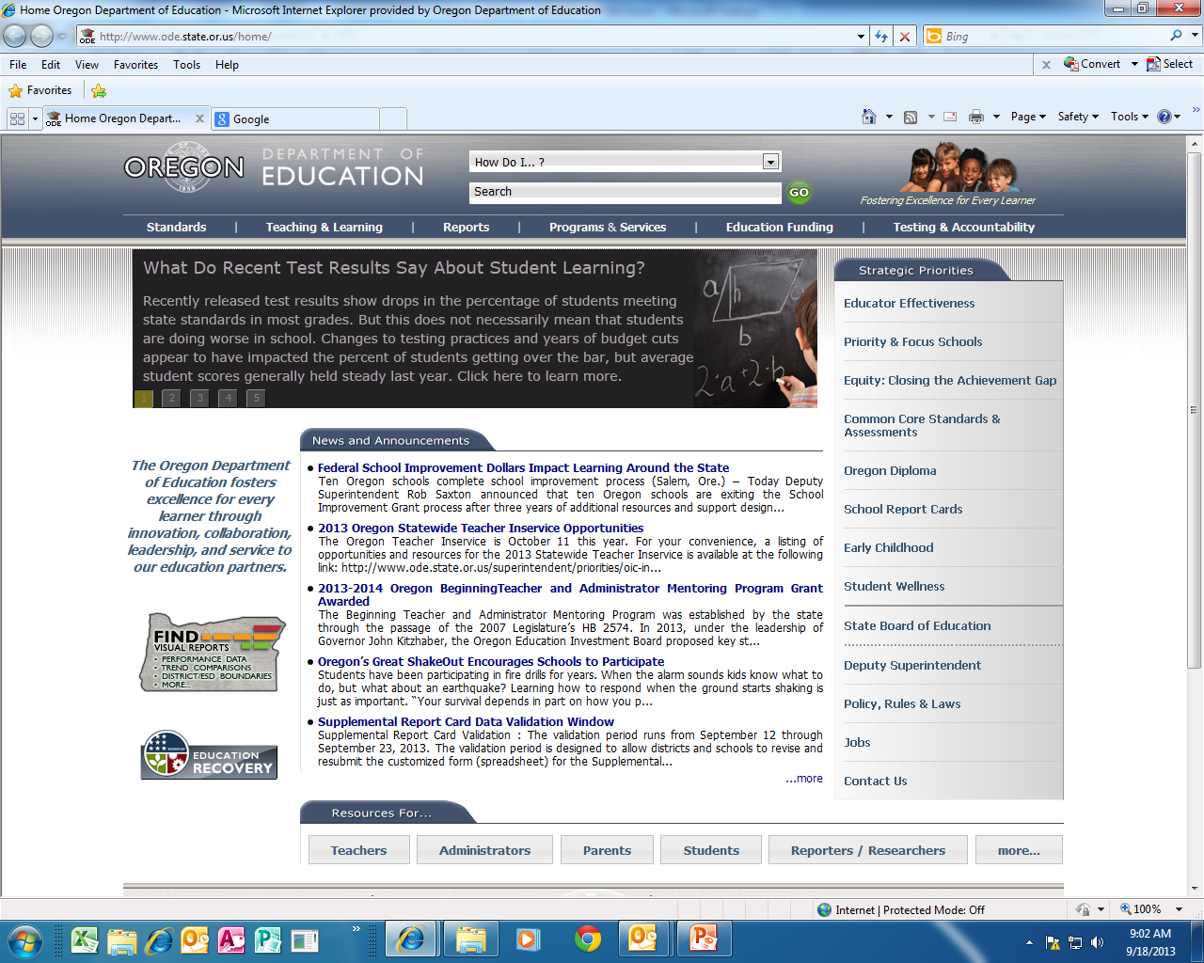
Education Data Explorer Overview
From ODE Home Page, click on map of Oregon icon

Slide 55
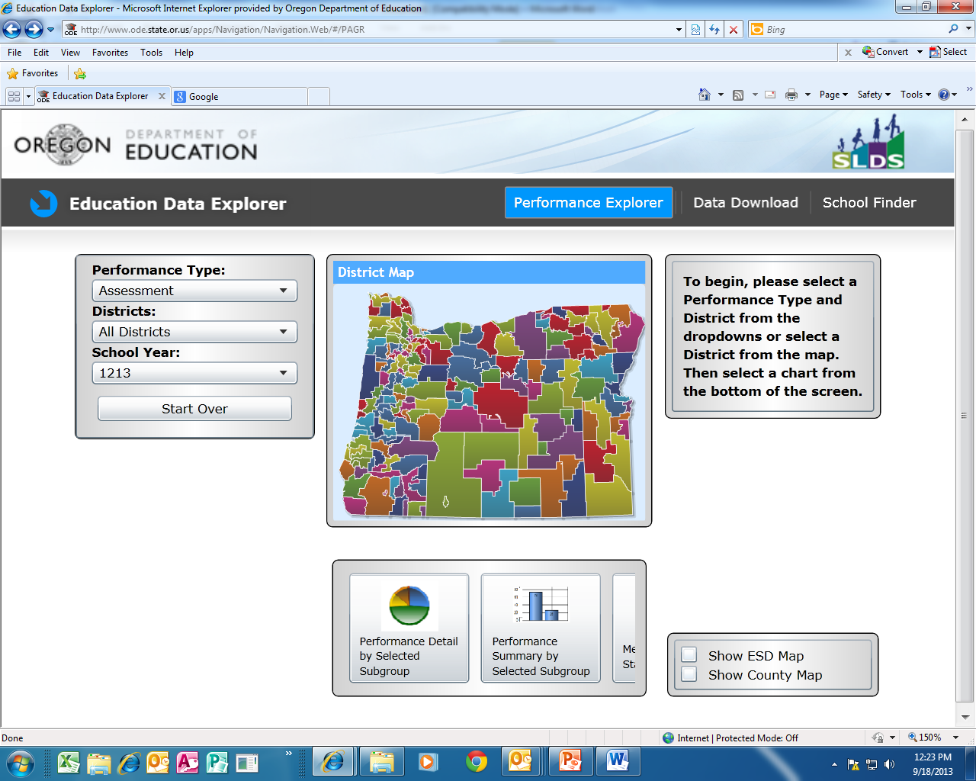
Data Download Application
Select Data Download from Education Data Explorer main page

Slide 56
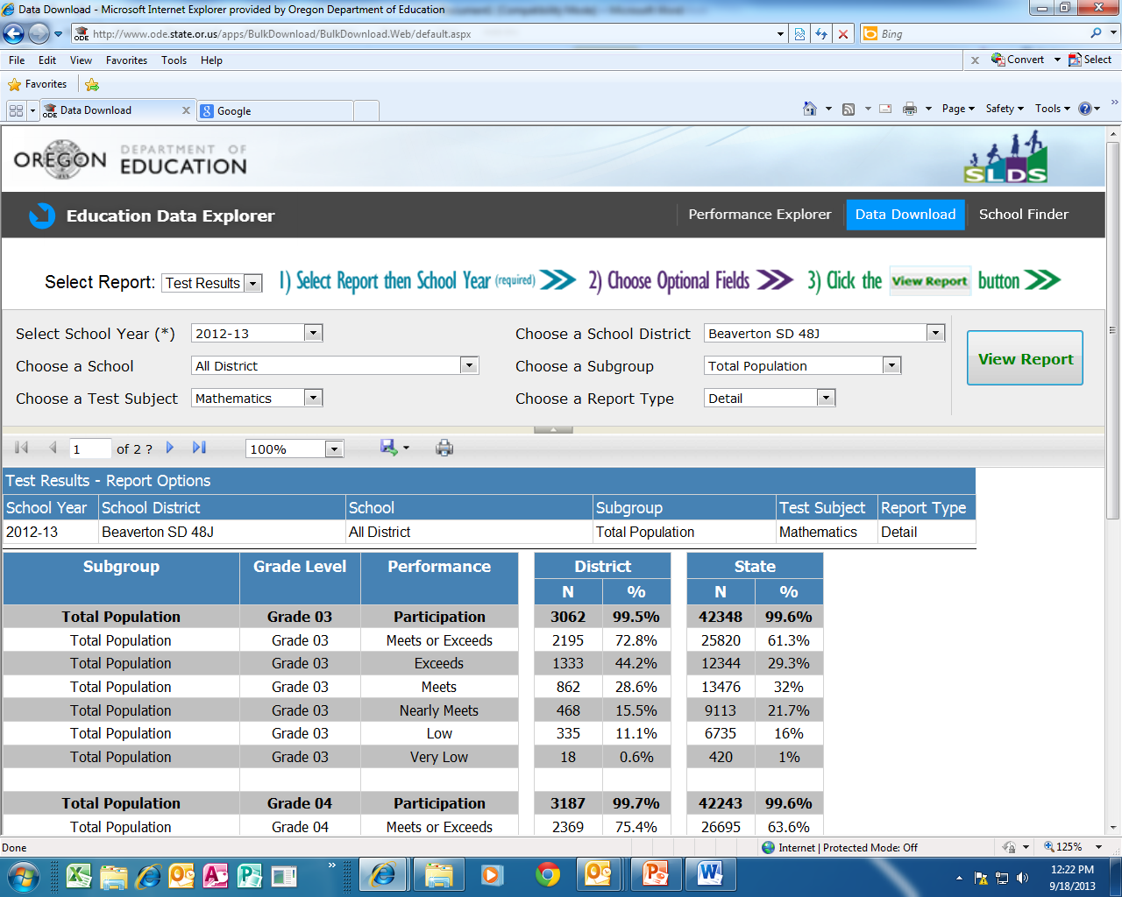
Direct link to Education Data Explorer Data Download: http://www.ode.state.or.us/apps/BulkDownload/BulkDownload.Web/default.aspx

Slide 57
Inclusion Rules and Definitions

Slide 58
Inclusion Rules and Definitions – Assessments
Report Card Detail & Achievement Compact | Summary Report Card | Education Data Explorer
Enrolled in resident school or district as of first school day in May | Enrolled in resident school or district as of first school day in May | Enrolled in resident school or district as of first school day in May
Full Academic Year only | Full Academic Year only | All students (both FAY and Non-FAY)
Extended assessments included as met up to 1% cap | Extended assessments included as met up to 1% cap | Extended assessments included as not met
English Learners in program currently or previous two years counted in EL subgroup | English Learners are students who have ever been eligible for or participated in a program to acquire academic English | Only English Learners currently in program counted in EL subgroup

Slide 59
Inclusion Rules and Definitions (cont'd)
Students excluded from participation calculation
Home Schooled Student, Foreign Exchange Student, or Out-of-State Student.
A student without a valid test score that was enrolled on the first school day in May but not during the school’s testing window.
A student who cannot take the State assessment during the entire testing window, including the make-up dates, because of a significant medical emergency.
Note: First year English Learners who took ELPA count toward participation for reading and writing.
For more information on inclusion rules, see: http://www.ode.state.or.us/data/reportcard/docs/asmtinclusionrules1213.pdf

Slide 60
Achievement Data Insight Application
New ODE validation site

Slide 61
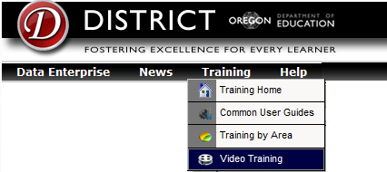
Achievement Data Insight
This is the new site that hosts Report Card Validations.
Permissions are set for each validation by your District Security Administrator https://district.ode.state.or.us/apps/login/searchSA.aspx
ODE hosted a training on June 6, available at the Video Training site: https://District.ode.state.or.us/search/page/?ID=226

Slide 62
Accessing the Application
If you do not see the application, contact your district security administrator.

Slide 63
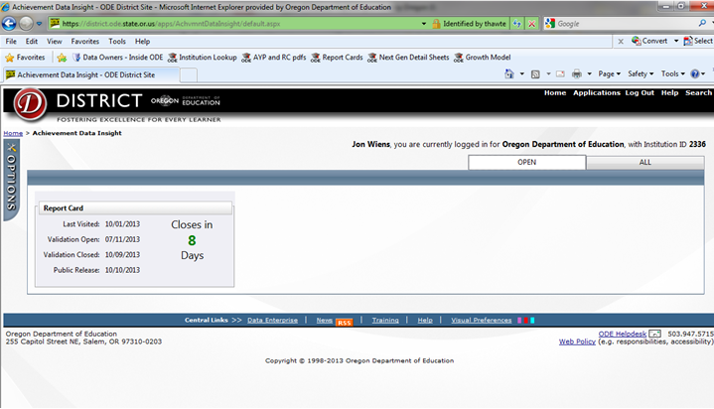
Application Landing Page
Validations tiles
Latest validation information
Status/Count down
Open and All tabs
Options Menu

Slide 64
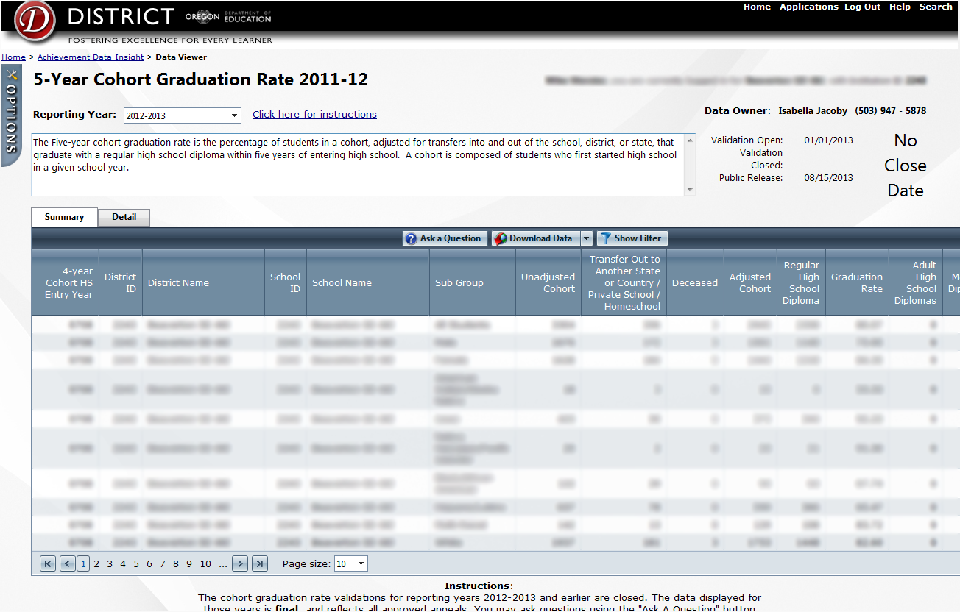
Application Details
Summary and Details tabs
General description
Validation Instructions
Validation dates and status
Ask a Question
Download data (filtered or all)
Filter/Sort
Tool tips with descriptions

Slide 65
Resources

Slide 66
Useful Links
Report Card Page: http://www.ode.state.or.us/search/page/?id=3881
Assessment Inclusion Rules
Report Card Technical Manual
Links to supplemental data collection
District Training Site: https://district.ode.state.or.us/search/results/?id=431
ESEA Waiver: http://www.ode.state.or.us/go/nextgen
Assessment & Accountability Checklist: http://www.ode.state.or.us/wma/teachlearn/testing/admin/asmtacctbltychecklist1314.pdf
Assessment Reporting Schedule: http://www.ode.state.or.us/wma/teachlearn/testing/schedules/testsched_1314.pdf
Application Assistance: ode.helpdesk@state.or.us

Slide 67
Contacts
ESD Partners: http://www.ode.state.or.us/go/assessmenthelp
Report Card and Report Card Validations in general
Jon Wiens: jon.wiens@state.or.us
Josh Rew: josh.rew@state.or.us
Assessment Staging and Reports
Cindy Barrick: cindy.barrick@state.or.us
Graduation Rates
Isabella Jacoby: isabella.jacoby@state.or.us
Cumulative ADM and Institutions
Joy Blackwell: joy.blackwell@state.or.us

