Slide 1
Local Food For Schools
USDA Local Food for Schools Grant
Training Slides
USDA Local Food For Schools (LFS) Cooperative Agreement Program

Slide 2
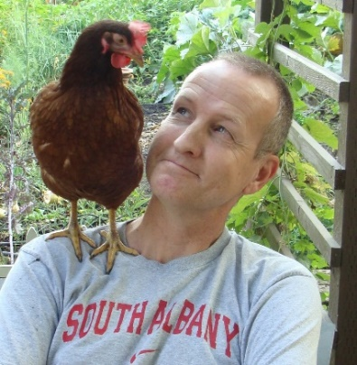
ODE Farm to CNP Team
Rick Sherman
Farm to CNP Program Analyst
Rick.Sherman@ode.oregon.gov
Amy Lahrman
Administrative Specialist
Amy.Lahrman@ode.oregon.gov
Emily Griffith
Office Specialist
Emily.Griffith@ode.oregon.gov
FarmtoCNP@ode.oregon.gov
www.bit.ly/f2sor
Notes:
The LFS Grant is administered by the same team that administers the ODE Farm to CNP Grant Program and the Fresh Fruit & Vegetable (FFVP) Program.

Slide 3
Housekeeping
Please email questions to farmtoCNP@ode.oregon.gov
All emails will be answered, and questions will be added to the FAQ document on the LFS webpage.

Slide 4
Agenda
LFS Grant Overview
Award Calculation
Webpage Navigation
Timeline
Allowable & Unallowable Costs
Claims Procedure
Reporting
Resources

Slide 5
Overview What is the LFS Grant?
And now for something completely different…

Slide 6
Overview What is the LFS Grant?
The USDA made this funding available as part of the “Build Back Better” program so states can start their own reimbursement program for local food. Oregon already has the Farm to CNP Grant Program, so we are designating these funds for reimbursement of items that our State grant does not allow.
The USDA awarded $2,062,715 to Oregon to administer the LFS Grant. These are one-time funds and there are no plans to continue program.

Slide 7
Overview What is the LFS Grant?
USDA wants to target vendors who are socially disadvantaged.
From USDA:
“For the purpose of this program, “socially disadvantaged” is a farmer or rancher who is a member of a Socially Disadvantaged Group. A Socially Disadvantaged Group is a group whose members have been subject to discrimination on the basis of race, color, national origin, age, disability, and, where applicable, sex, marital status, familial status, parental status, religion, sexual orientation, genetic information, political beliefs, reprisal, or because all or a part of an individual's income is derived from any public assistance program. While purchasing from socially disadvantaged farmers and ranchers and small businesses is not a requirement, it is a target…”

Slide 8
Overview What is the LFS Grant?
Administered in addition to State Grant (ODE Farm to CNP Reimbursement Grant)
Sponsors automatically opted-in
Grant period is March 1, 2023-August 30, 2024
Has different allowable and unallowable items
“Local” definition expanded
For NSLP recipients ONLY, to be used on lunches and breakfasts. CACFPs are ineligible.
Can be used for Seamless Summer (NSLP); Cannot be used for CACFP summer meal programs.

Slide 9
Award Calculation
Using the greater number of each Sponsors’ October 2019 vs October 2022 meals (Breakfasts and Lunches)
(Lunches =1 meal; Breakfasts 3=1 meal)
Divided Oregon’s $2,062,715 award by that number of meals to get a factor of ~.14 cents per meal for that timeframe.
Multiplied Sponsor’s individual highest month’s meals by that ~.14 cent factor.
Any award less than $500 was bumped to $500.
All awards above $500 were recalculated to come up with a slightly higher $.14 cent factor (the decimal number goes to 16 places)

Slide 10
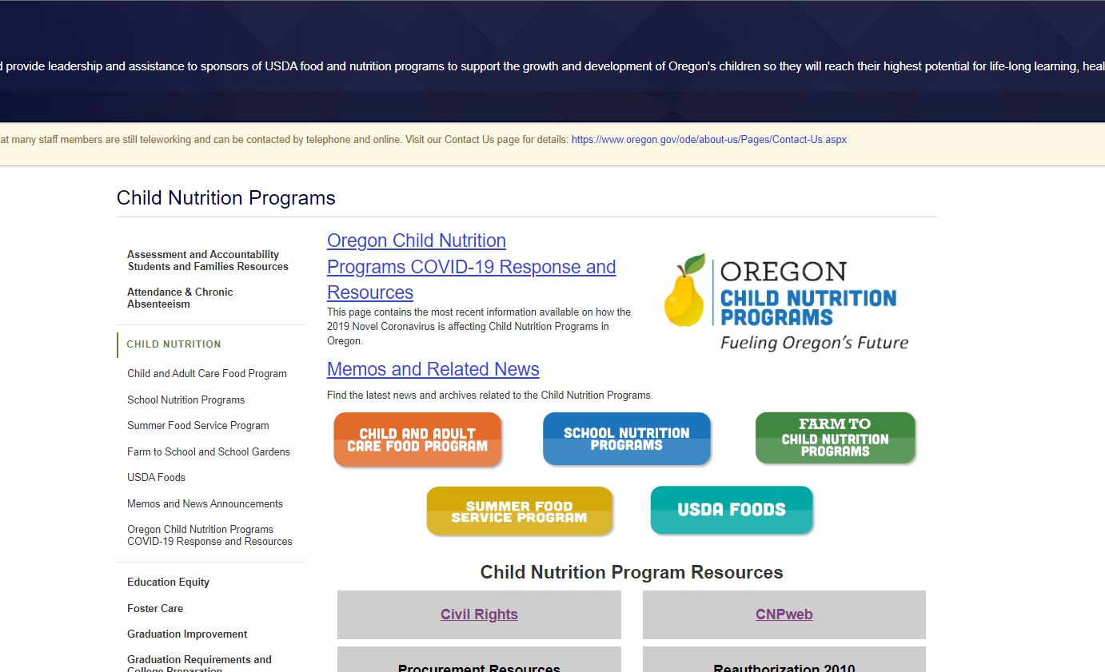
Webpage Navigation
Go to our webpage: Either go to the ODE CNP webpage and click on The Farm to CNP logo, or type in bit.ly/f2sor in your browser

Slide 11
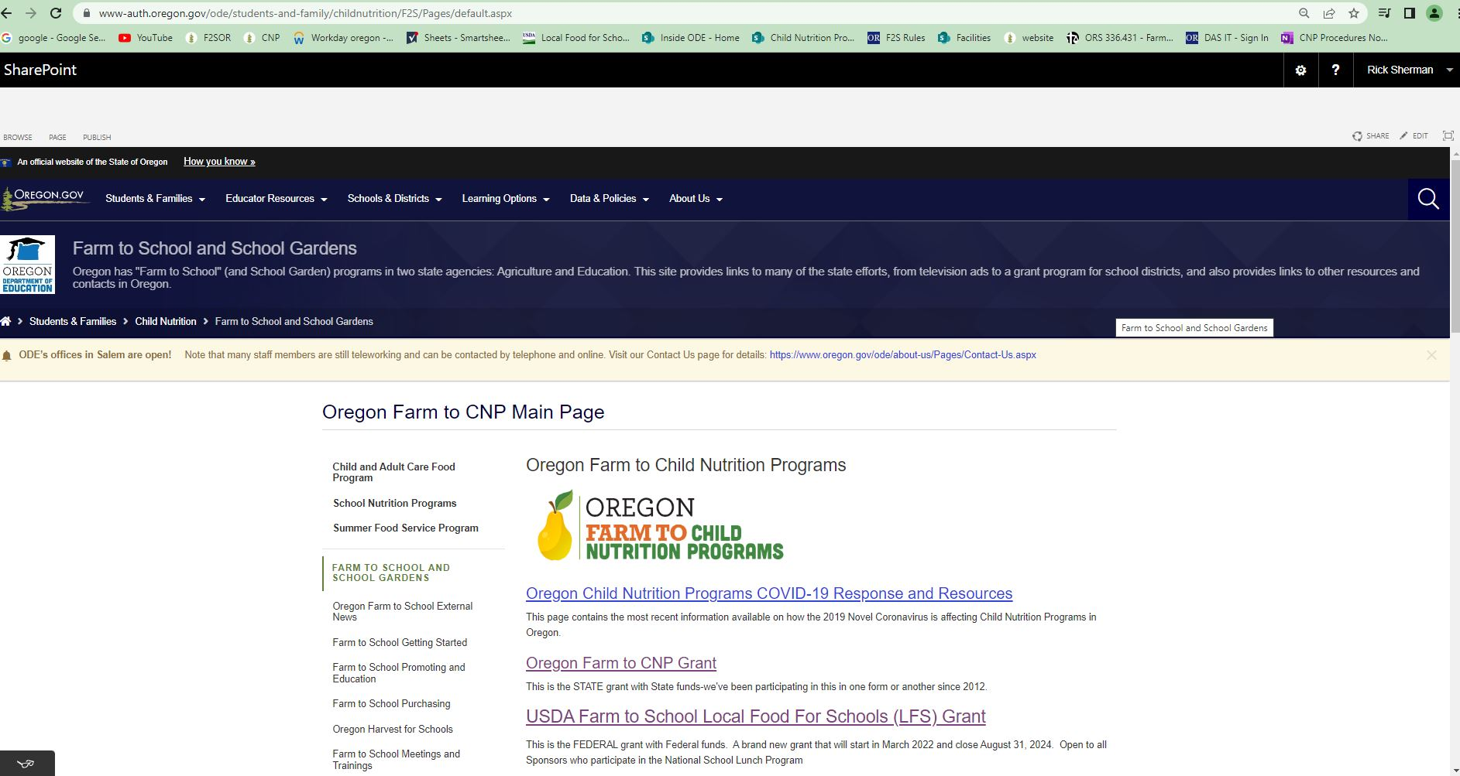
Webpage Navigation
You will be taken to the FarmtoCNP page. Click on the USDA LFS Grant link

Slide 12
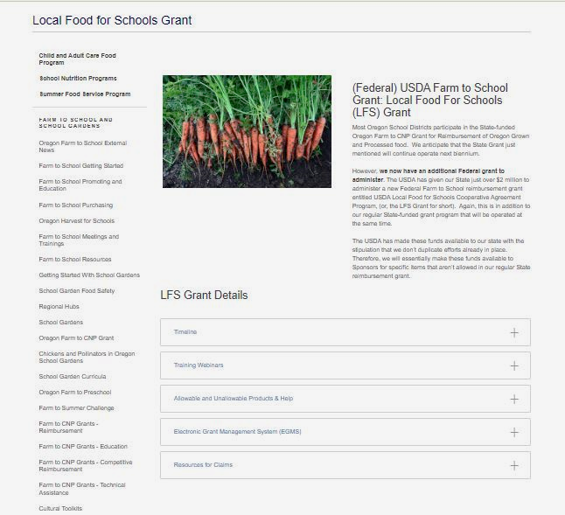
The LFS webpage looks like this:
Notes:
The LFS page looks like this. Next slide will show a close-up of the accordion file:

Slide 13
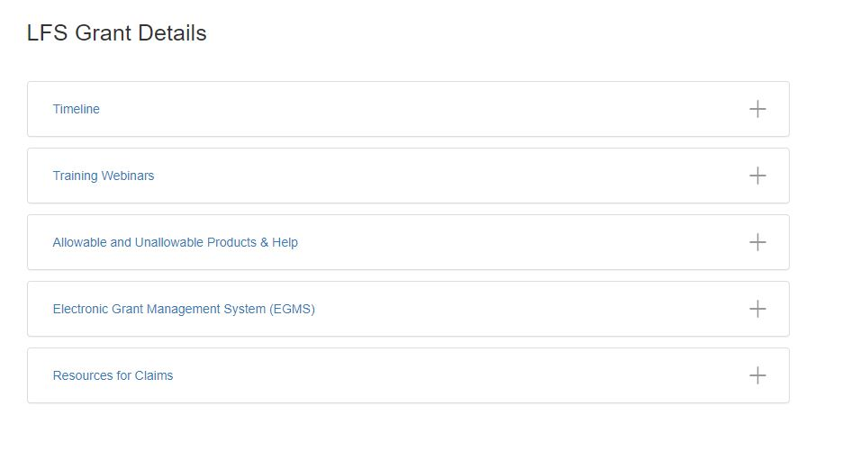
LFS Grant Webpage
Notes:
Here if you expand the boxes, it looks like our other grant pages. Places for the grant timeline, training webinar resources, allowable/unallowable products and general help, EGMS and resources for claims.

Slide 14
Getting Started
New Grantees
*Email FarmtoCNP@ode.Oregon.gov for list ASAP
Institution ID
EGMS Access Request
W-9
Direct Deposit
Returning Grantees
Update EGMS contacts
Including access privileges
All Grantees
View webinar
Submit attestation
Link on LFS webpage under Trainings
Update CNPweb contacts if needed
On CNPweb or through your Specialist
Submit signed agreement ASAP
Notes:
If you are already up and running in EGMS, no action is necessary. If you are a brand-new Sponsor (no Farm to CNP Grants), please email our team as soon as possible.

Slide 15
Timeline
Date | What
March 1, 2023 | Sponsor can submit claims back to this date
As soon as possible | Submit training attestation, signed agreement
 | As soon as the above items are received you can start sending in claims!
Aug. 31, 2024 | Last day to submit claim

Slide 16
Allowable Expenses
Fluid milk ½ pints! Either inside Oregon border or up to 400 mi. outside of Oregon border. Includes flavored milk.
Unprocessed or minimally processed food from inside Oregon border or up to 400 mi. outside of Oregon border, only after your initial Farm to CNP Noncompetitive Reimbursement Grant award is exhausted.
Examples (from USDA):
fruits and vegetables (including 100% juices);
grain products such as pastas and rice;
meats (whole, pieces, or food items such as ground meats);
meat alternates such as unprocessed beans or legumes,
fluid milk and other dairy foods such as cheese and yogurt. Foods in a wide variety of minimal processing states (e.g., whole, cut, pureed, etc.) and/or forms (e.g., fresh, frozen, dried, etc.) are also allowable

Slide 17
Allowable Expenses
USDA says: Local and regional food is raised, produced, aggregated, stored, processed, and distributed in the locality or region where the final product is marketed to consumers, so that the total distance that the product travels between the farm or ranch where the product originates and the point of sale to the end consumer is at most 400 miles, or both the final market and the origin of the product are within the same State or territory.
USDA says “and” not “or” here. This means that food grown outside of the region and minimally processed in the region wouldn’t count.

Slide 18
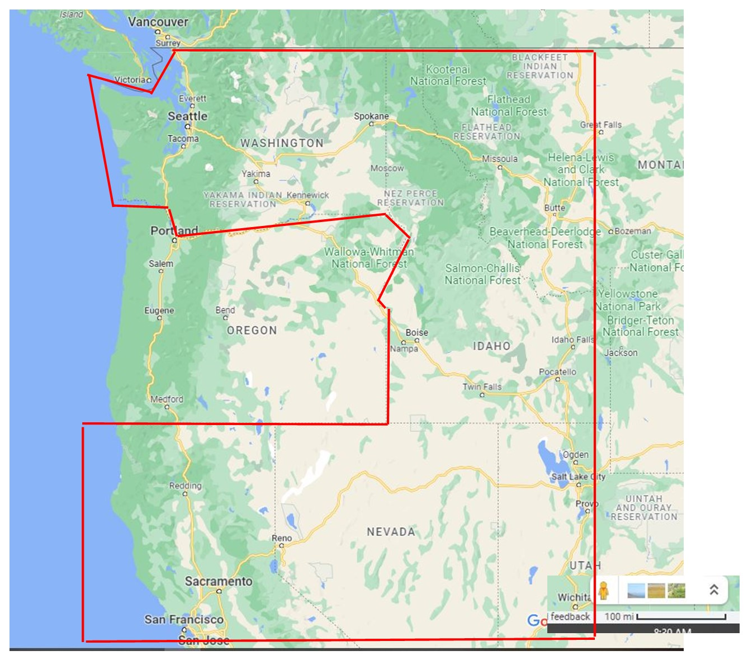
Allowable Expenses
Up to 400 miles outside of Oregon:
Washington
Idaho
Western MT
Sacramento, CA

Slide 19
Unallowable Expenses
Processed food:
Canned food
Ready to eat food such as chicken nuggets, pizza, sandwiches, meals, etc.
Food from farther than 400 miles outside of Oregon Border.

Slide 20
Claims Procedure
Download the Reimbursement Grant Claim Form

Slide 21
Claims Procedure
Save as new file; same format as the other grants
Notes:
Click on the LFS Claim form. Save as a new file. Same format as other grants (1_SchoolDistrict_monthYr)

Slide 22
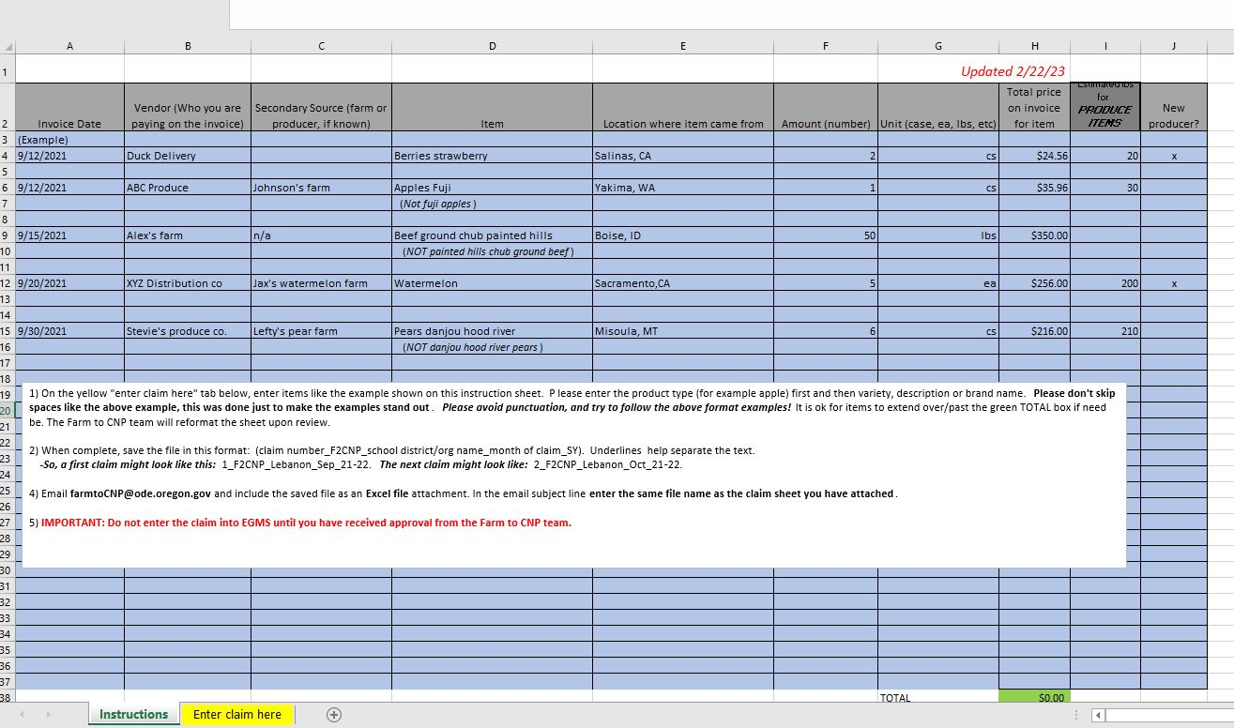
Claims Procedure
Notes:
The first is the instructions tab. Here you will find the guidelines for filling out the template, as well as some sample entries. Please pay special attention to the format we request you use when entering your items on the claim template, and please note the file name and email subject line formats.

Slide 23
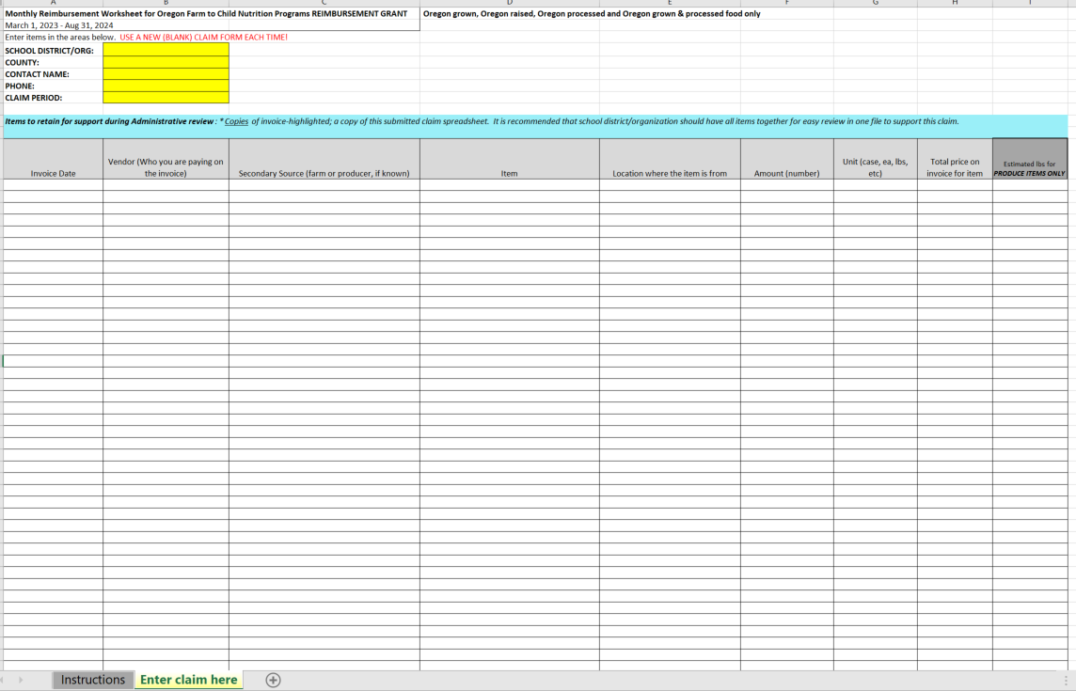
Claims Procedure
Fill out yellow contact fields
Enter invoice date for item
Enter vendor (Sysco, Joe’s farm etc.)
Enter secondary source Company name (example, if item came from Sysco, where did the item originate)
What is the item you bought ex: “apple granny smith”
How many items bought ex: “5”
Unit/pack size ex: “cs” (case)
Total price of items bought on that line
Estimated lbs for produce items only
Notes:
Enter invoice date for item
Enter vendor (Sysco, Joe’s farm etc.)
Enter secondary source Company name (example, if item came from Sysco, where did the item originate)
What is the item you bought ex: “apple granny smith”
How many items bought ex: “5”
Unit/pack size ex: “cs” (case)
Total price of items bought on that line
Estimated lbs for produce items only.
Don’t worry about new producer, I deleted that column.

Slide 24
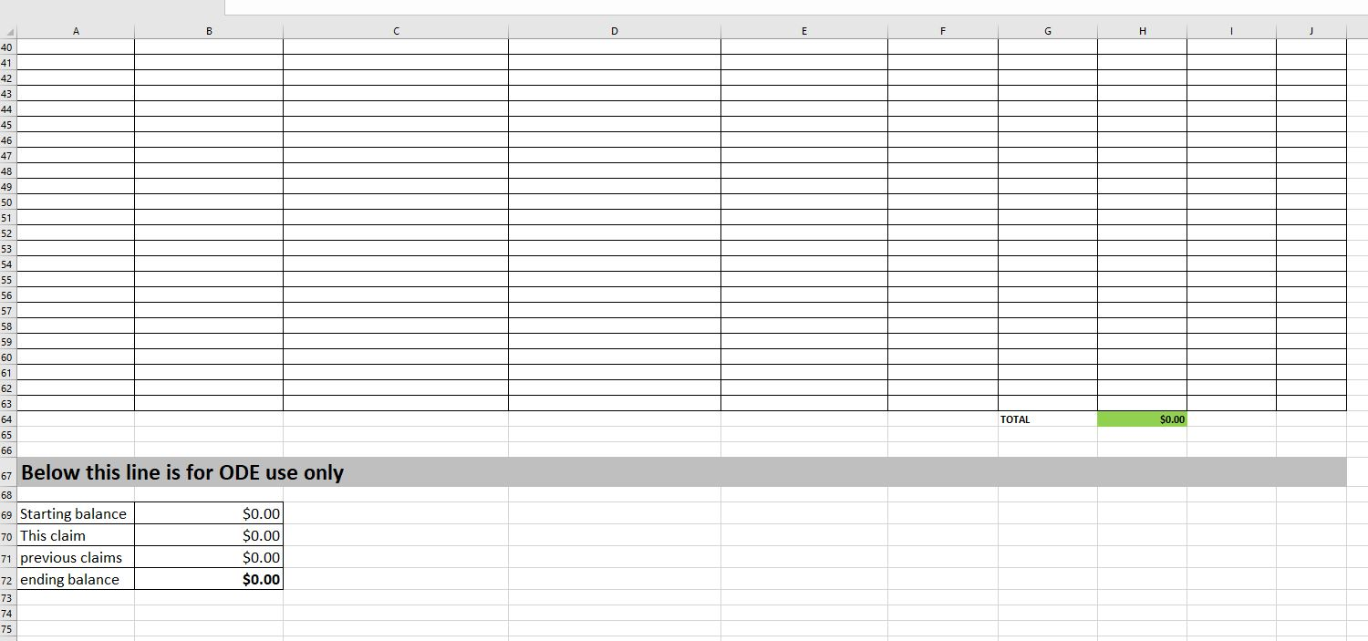
Claims Procedure: Simplified form
Notes:
You can add lines!! If you do add them, add them in the middle of the lines and the total line at the bottom will stay in place and everything will calculate.
We will look over your claim and tell you to enter the amount in EGMS, just like our State grant. We will fill out the bottom portion and send this back to you when we give you the approval to enter in EGMS.

Slide 25
Claims Procedure
Save claim worksheet as requested
Email as Excel file attachment to FarmtoCNP@ode.Oregon.gov
Email subject the same as file name
Do not submit invoices
Retain for records
Random desk audit
Not associated with other CNP reviews
Farm to CNP team will review, update totals, send edited claim sheet back with pre-approval or edit requests
DO NOT ENTER CLAIMS INTO EGMS WITHOUT PRE-APPROVAL
Claims entered into EGMS before they are pre-approved will be automatically rejected
Claims are reviewed in the order in which they are received
Up to two week turnaround
Once you have received the pre-approval email the claim is ready to enter into EGMS
Notes:
Save your claims worksheet using the format requested and submit your claims to farmtocnp@ode.Oregon.gov. You do not need to submit invoices with your claims, but you will need to retain them for your records as we randomly select a handful of Grantees to undergo a desk audit. These are specific to Farm to CNP, and are not associated with other CNP reviews.
Once the claim has been reviewed, the Farm to CNP team will update the totals tab with your year-to-date totals and ending balance and attach the file to the claim pre-approval email for your records. Should there be any errors on the claim submission, we will send it back to you for the necessary edits.
It is important to remember: CLAIMS MUST BE REVIEWED AND PRE-APPROVED BY THE FARM TO CNP TEAM BEFORE THEY ARE ENTERED INTO EGMS. Claims entered into EGMS before they are pre-approved will be automatically rejected. This just makes more work for all of us. Claims are reviewed in the order in which they are received. This can take up to two weeks. Once you have received the pre-approval email the claim is ready to enter into EGMS.

Slide 26
REPORTING
THERE IS NONE!!
All the information we need to report back to USDA we will take from your claim forms!

Slide 27
For Food Service Management Companies
Since FSMCs have a fixed cost per meal, all costs associated with that fixed cost must be in that meal
The FSMC may not bill the costs back to the school district or client

Slide 28
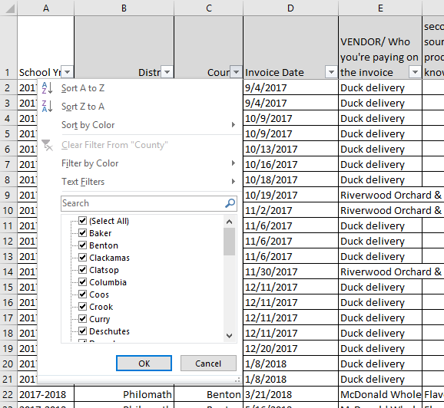
Resources
Contact the distribution company you currently use
Ask for a list of NW regional products
Oregon Farm to School and School Garden Network
www.oregonfarmtoschool.org
Regional procurement hubs
www.oregonfarmtoschool.org/regional-hubs/
ODE Farm to CNP webpage
www.bit.ly/f2sor
Farm to CNP team
FarmtoCNP@ode.oregon.gov
Notes:
Lastly, there are many resources available to assist you in successfully utilizing your LFS Grant funds. For one, you can ask your current distribution company for a list of products available to you.
The Oregon Farm to School and School Garden Network is a local nonprofit dedicated to the success of Farm to School around Oregon. They have many resources on their website, and can put you in touch with your regional procurement hub.
The Farm to CNP webpage also has multiple resources for getting started, promotion and education, purchasing and more, including links to the resources previously mentioned.
On the LFS Grant webpage under Resources for Claims, we have the Combined Claims file. Once data is collected from claims, we will update it with a combined claims form that shows what your neighbors are buying. The data can be sorted by county, district, product, and vendor.

Slide 29
Thank you!
FarmtoCNP@ode.Oregon.gov
Notes:
Thank you for viewing these slides. Please do not hesitate to reach out to the Farm to CNP team, or any of the resources mentioned, if you have additional questions regarding the USDA LFS Grant.

Slide 30
Oregon Department of Education “Our Why”
Equity and Excellence for Every Learner
The Oregon Department of Education works in partnership with school districts, education service districts and community partners;
Together, we serve over 580,000 K-12 students;
We believe every student should have access to a high-quality, well-rounded learning experience;
We work to achieve the Governor’s vision that every student in Oregon graduates with a plan for their future.
Notes:
Equity and Excellence for Every Learner
The Oregon Department of Education works in partnership with school districts, education service districts and community partners;
Together, we serve over 580,000 K-12 students;
We believe every student should have access to a high-quality, well-rounded learning experience;
We work to achieve the Governor’s vision that every student in Oregon graduates with a plan for their future.

Slide 31
Oregon Department of Education Education Equity Stance
Education equity is the equitable implementation of policy, practices, procedures, and legislation that translates into resource allocation, education rigor, and opportunities for historically and currently marginalized youth, students, and families including civil rights protected classes. This means the restructuring and dismantling of systems and institutions that create the dichotomy of beneficiaries and the oppressed and marginalized.
Notes:
Education equity is the equitable implementation of policy, practices, procedures, and legislation that translates into resource allocation, education rigor, and opportunities for historically and currently marginalized youth, students, and families including civil rights protected classes. This means the restructuring and dismantling of systems and institutions that create the dichotomy of beneficiaries and the oppressed and marginalized.

