Slide 1
Diversion/Processing for New Staff
The basics
Notes:
Thank you for joining us today. This webinar is presented by the Oregon Department of Education USDA Foods Distribution Program.
In today’s presentation, we will go over the basics of the Diversion/Processing Program. This is to help new staff better understand what is Diversion/Processing as a USDA Foods entitlement spending option.
This presentation is not recorded and the slides will be posted in the ODE USDA Foods website.
Please feel free to post your questions in the chat as there will be a question and answer session at the end of the presentation.
(Next Slide)

Slide 2
Overview
What is Diversion/Processing?
Value Pass Through
Processing Timeline
ODE USDA Foods Diversion-Processing website
Questions/Answers Session
Notes:
The presentation will begin with explaining what is Diversion/Processing Program and understanding the possible benefits and potential challenges.
Which will lead us to explaining what is the Value Pass through when using your entitlement dollars towards Diversion-Processing.
We will then introduce you to the Diversion-Processing timeline for successful processing.
Then we will show you the ODE USDA Foods Diversion-Processing website, the one-stop website for all diversion-processing resources.
And finally there will be a question and answer session at the end of the presentation.
(Next Slide)

Slide 3
What is ‘Diversion-Processing’?
USDA Foods
Entitlement $
Direct Delivery (commodities)
DoD Fresh
Fruit & Vegetable
Diversion - Processing
Unprocessed Fruit & Vegetable Pilot
Bulk USDA food for further processing
Notes:
What is Diversion/Processing?
Diversion/Processing is one of the 4 USDA Foods Programs for spending your USDA Foods entitlement dollars. Most of you are familiar with ordering USDA Foods Direct Delivery cases, USDA also has bulk material available for making menu items at a processor. So, instead of cases delivery to the schools, with the diversion-processing option, recipient agencies can order pounds of bulk USDA food and send the pounds to commercial processors for further processing. Processors then convert the bulk USDA food into the desired end-products that recipient agencies can then order through the processors or through distributors.
(Next Slide)

Slide 4
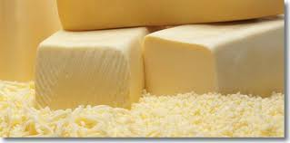
What is ‘Diversion-Processing’: The Pizza example
Bulk USDA mozzarella cheese
Pizza : Processor’s end-product
Notes:
So, Diversion/Processing is using bulk food that is sent to a processor (also called manufacturer) to be made into an end-product. So, for example, converting bulk mozzarella cheese into a more convenient, ready-to-use finished end-product like a pizza.
(Next Slide)

Slide 5
What is ‘Diversion-Processing’: more examples
Examples:
Raw chilled chicken into chicken patties
Raw coarse ground beef into cooked patties
Bulk apples into applesauce cups
40+ processors ODE-approved each year and hundreds of products to select from!
Notes:
So, the idea is to use a USDA food material as one ingredient to be made into a menu item.
Here are some examples of converting bulk USDA food into more convenient forms:
Raw chilled chicken into chicken patties or nuggets
Raw coarse ground beef into cooked patties or meatballs
Bulk apples into applesauce cups
Each year, ODE approves processors to participate in the Oregon Processing Program for the next school year and we currently have over 40 processors offering a wide choice of USDA-approved end-products.
(Next Slide)

Slide 6
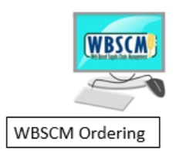
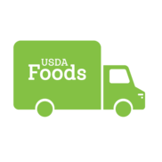
What is ‘Diversion-Processing’: Value Pass Through
Bulk Cheese Pounds
VALUE OF DONATED FOOD
Processor’s plant
END-PRODUCT COSTS LESS
Notes:
The Diversion-Processing program works with a Value Pass Through system.
Let’s go back to the pizza example to illustrate how the value pass through is passed on to the recipient agency through the processor.
So, in the pizza example, the cheese is the material available as a bulk USDA material to be shipped to a processor. The cheese represents a value to you because you can use your entitlement dollars to order pounds of bulk cheese in WBSCM and select the processor to whom you want to send the cheese. This is called diversion. Recipient agencies divert pounds of USDA material to processors in WBSCM. By diverting cheese to a processor you are providing one ingredient to the processor and therefore the processor will receive this ingredient ‘for free’. We say the cheese is a donated food also called DF. So, the bulk cheese you sent to the processor represents value, which is a system called value-pass through.
The value pass through system means the end-product will cost less. Because you give the cheese to the processor to make a pizza, then the processor does not have to incur the cost of the cheese. Therefore, when the pizza is made, the processor can sell it to you at a price less expensive than commercially because the value of the cheese is deducted from the final price of the pizza.
The concept of the value pass through system is key to the Diversion-Processing Program. The reason why you would want to divert USDA food to a processor, is to get a value-added product at the end and cheaper than commercially.

Slide 7
Subtracting USDA Donated Food Value
Example: 1 case of Cheese Pizza (72 servings)
USDA Foods Pounds
Draw Down per Case
USDA Foods Value
per Pound
USDA Foods Value per Case
(entitlement used)
Case Price
Undiscounted Case Price
9.00 lbs.
X
$1.92
=
$17.30
+
$57.60
=
$74.90
Your Savings!
Notes:
Here is an example of how the value of the USDA donated food is subtracted.
Let’s calculate a case of cheese pizza. Each case of pizza contains a quantity of cheese called the USDA Foods Pounds Draw Down per Case – in this example, 9.00 pounds per case. Then multiply the pounds per case by the USDA Foods Value per pound, in this example, $1.92. Which equals $17.30 value per case – this is the entitlement amount spent on 9 pounds of USDA cheese for one case of pizza. This is also your savings. The net case price to pay is then only $57.60 instead of $74.90, the undiscounted price.
The value of USDA Foods deducted from the case price should make food products more affordable. However, you will still need to check if this is true by comparing with actual commercial prices and make sure you can get value out of your entitlement dollars.

Slide 8
5 approved Value Pass Through Systems
Processors use one or more systems
RRA Refund or Rebate to Recipient Agency
DS Direct Discount to Recipient Agency
NOI Indirect Discount to Recipient Agency
FSP Fee for Service - billed by Processor
FSD Fee for Service - billed by Distributor
Depending on the Value Pass Through,
processors ship to:
- the recipient agency,
- through a distributor,
- or, through the state warehouse (Gold Star)
Notes:
We just talked about the Value Pass Through that is key to the Diversion-Processing program. It is a federal regulation to ensure that the value of the USDA Donated Foods and finished end-products are properly credited to recipient agencies. Simply, it is the system used to credit the value of USDA Foods to the recipient agency. However, it depends on the processor to offer one or more value pass through systems.
As you can see in the table, there are 5 Value Pass Through systems approved by ODE.
- RRA, Refund or Rebate to Recipient Agency is when you pay the commercial price and processor issues a refund check for the value of the USDA Foods.
- DS, Direct Discount to Recipient Agency is when you place an order directly with the processor at a net price (in this case distributors are not involved and there is an order minimum to meet).
- NOI, Indirect Discount to Recipient Agency or Net Off Invoice is when end-products are sold to a distributor at a commercial price. The price is reduced by the value of the USDA Foods to eligible recipient agencies and reflected in the final net invoice.
- FSP, Fee For Service billed by Processor, is when a processor’s cost of ingredients is identified separately from the value of the donated USDA Foods on the final invoice, and processor’s delivery fee must be added.
- FSD, Fee For Service billed by Distributor, is when recipient agency procures end-products from the processor and also separately procures storage from a distributor.
When selecting a processor to whom you will divert pounds of USDA Foods during WBSCM ordering, you will need to know what Value Pass Through systems they offer. Processors can explain to you how each works so you can then let them know which option you want to use.

Slide 9
What is Diversion-Processing?
Possible Benefits
Increase Participation
Wide variety of end-products
Meet the needs of students
High Quality products throughout the year
Save Money
Easy/Fast Preparation
Donated Food Value
Potential Challenges
Time and effort
Planning and proper procurement
Forecast menu and communicate volume to processor to meet product lead times.
Checking pounds usage within same school year
Markets and demands changes
Product shortage due to supply interruption
Products may be discontinued
Notes:
Now let’s talk about why process and deciding to process. Why would you want to get ready-to-use products from processors? Why would you want to do diversion/processing?
Some possible benefits include: increase participation by offering more variety and high quality products throughout the year. An example could be processing chicken to be made into whole muscle chicken strips, something you might not be able to afford commercially but the diverted cost makes it affordable.
Another benefit is to save money by using a product already assembled that requires minimal labor and the food is more affordable because the USDA Foods donated value is subtracted from the price of the product. We talked earlier about the value pass through that will reduce the price of the end-product.
There are also potential challenges if you do diversion-processing, especially for the first time. You will need to invest the time and effort into planning and forecasting your menu items, conducting proper procurement. You will need to establish a process for checking that all the pounds diverted in WBSCM are used up within one school year and properly drawn down each time your purchase the end-products through the processor or through the distributor.
Also there may be unforeseen market and demand changes with product shortage and discontinuation.
You should weigh the benefits and challenges before deciding.
(Next Slide)

Slide 10
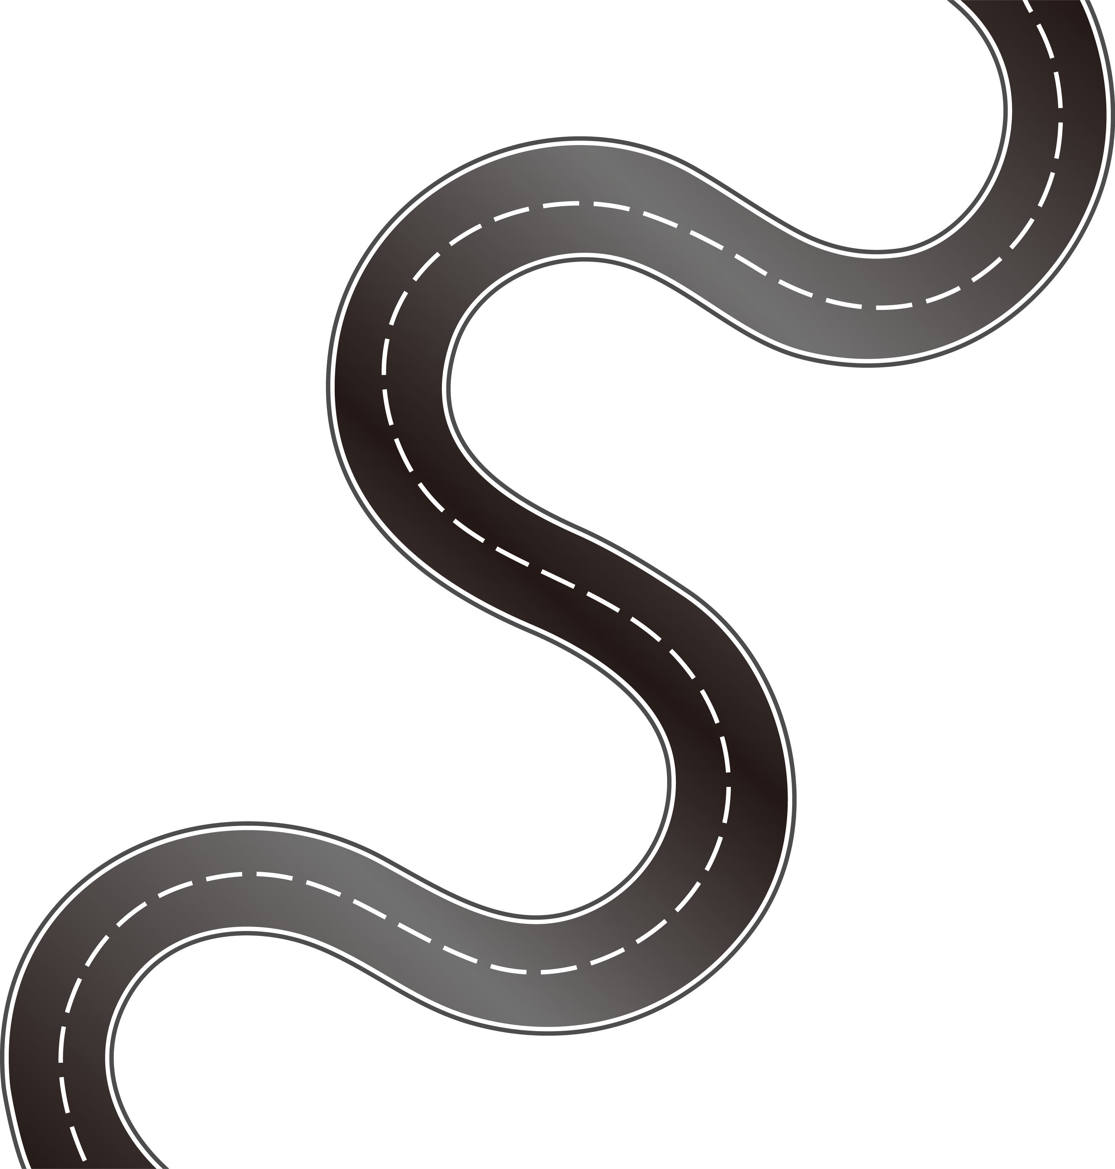
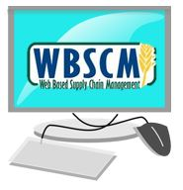
USDA ships to Processor
PLANNING
End-Product
Ordering
PROCUREMENT
WBSCM Ordering in the Spring
MANAGE CONTRACTS
Processing Timeline
Notes:
When doing diversion-processing you will need to plan a timeline. It is like a road with several stops. Using the example of the cheese converted into a pizza, if you decide to divert cheese to get pizzas as a finished end-product, you will start with the Planning phase and ask yourself questions (how many times will it be on the menu? Which processors offer pizzas? Will it be less expensive than buying it commercially?)
After Planning comes the procurement phase (so a contract or agreement between you and a processor and/or a distributor is required).
Then, when procurement is done, you will divert bulk food to a processor in WBSCM during the USDA Foods Ordering Period in the Spring – mark your calendar so you don’t miss it. When your orders are confirmed, ODE will allocate your bulk food pounds to the processor and USDA will ship the bulk food to the processor. Then, the processor will set up a pounds bank for you and use the donated food to make the end-products you planned on ordering throughout the year.
And, finally you will need to manage your contract with your processor and make sure you receive your value pass through and also draw down the pounds bank you have with the processor throughout the school year.
(Next Slide)

Slide 11
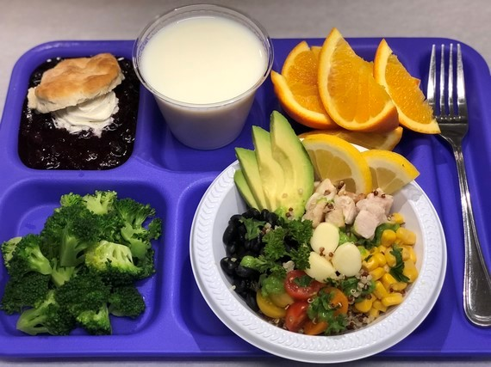
It all begins with the menu!
Choose what items to menu
Servings per day x Number of days on menu:
100 students x 45 days = 4,500 total servings
Forecasting is needed before completing procurement
Notes:
Diversion/Processing starts with the Planning phase. It all begins with the menu and choosing what items to menu. While attending food shows and networking will definitely help you choose food products, you will need to plan your menu for the next school year and plan for usage, this is called forecasting. So, if you can plan a cycle menu in advance, you are more likely able to accurately forecast what you will need and when.
Remember processors will be making these end-products for you so you will need to work out a usage plan so that processors can also plan their own production for the whole school year.
You will need this information before you complete procurement.
(Next Slide)

Slide 12
Select Your Processor(s) for next SY
ODE Diversion-Processing Website
Oregon-Approved Processors List
SEPDS
Summary End Product Data Schedule
Consult with selected Processor/Broker
Select your processors
Identify processor’s end-products
Notes:
Once you have a menu item and have done your forecasting, you will go the ODE Diversion-Processing website to select a processor from the Oregon-Approved Processors List. Then review the selected processor’s Summary End Product Data Schedule also known as ‘SEPDS’. The SEPDS allows you to see what products a processor can make from different bulk USDA Foods items. Think about the SEPDS as the processor’s catalog to look at. It is a special document approved by USDA and it will help you identify the end-product you are looking for as a menu item and the USDA food material to divert to the processor to make that end-product.
Please take the time to understand a processor’s SEPDS.
We recommend you consult with your selected processors or their brokers to better understand what they offer and their Value Pass Through systems.
(Next Slide)

Slide 13
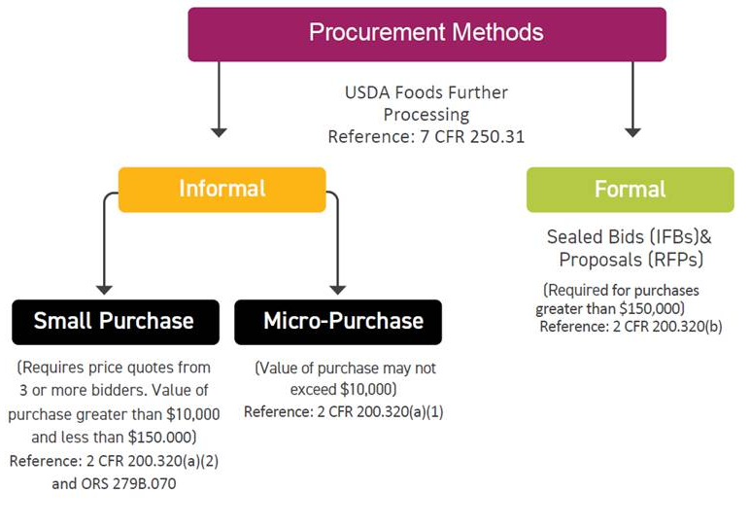
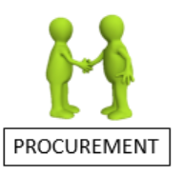
Procurement must be done before ordering pounds in WBSCM
Visit the Procurement Resource webpage: https://www.oregon.gov/ode/students-and-family/childnutrition/Pages/Procurement.aspx
Notes:
After the planning phase comes the procurement phase.
Recipient agencies diverting USDA bulk foods for further processing are required to complete proper procurement. This procurement flow chart shows the different procurement methods.
Please note that all USDA Foods processed end-products must be procured in compliance with all State and Federal regulations prior to diverting the pounds to the processor in WBSCM.
If procurement is new to you, you will need to see with your school district if procurement is your responsibility or the responsibility of the business manager, purchasing department, or superintendent. The school district should reference their procurement procedures to determine who is responsible. Or visit the Procurement Resources webpage for procurement training and resources.
(Next Slide)

Slide 14
ODE Statewide Processing Agreements
Use ODE Price Agreements in your ordering instrument (or purchase order)
Available in the ODE Diversion Processing website.
Notes:
A competitive procurement process must be completed prior to diverting pounds to a processor in WBSCM. USDA Foods processed products are not treated any differently than other CNP purchases. Each year, ODE renews state pricing agreements with participating processors. ODE Price Agreements meet all applicable Federal/State procurement requirements and are available for all Oregon RAs to use to simplify life and save time. They are posted in the ODE Diversion-Processing website. There is also an Ordering Instrument Template and instructions available in the ODE Diversion-Processing website.
(Next Slide)

Slide 15
Hold on!
Is the USDA Food item a better deal than Commercial?
You need to check!
Notes:
Before you get to far into the process, please remember to always check whether the USDA processed/diverted product is actually cheaper than what you can buy commercially. Usually it will be, but not always, so you need to check! Only you will know the answer to this question. It will depend if your procurement includes your own price agreements or if you will be using a distributor commercial price or using a coop that has price agreements or using ODE Price Agreements. Also, check if you will have handling fees, storage cost and shipping costs to add to the net price per case.
(Next Slide)

Slide 16
Order your pounds in WBSCM
1- Processor’s Commodity Calculator
2- ODE Diversion/Processing Planner
3- Enter pounds quantity in WBSCM and divert pounds
to correct processor’s destination location
Attend a WBSCM Ordering Training Webinar!
Notes:
Once procurement is completed and you have awarded your contract or attached yourself to an ODE price agreement, it’s time to order your pounds in WBSCM during the USDA Foods Ordering Period in the Spring. Everyone that has processed in prior years will have access to the WBSCM processing catalog. Anyone new to the program should contact us so we can give you access to the diversion-processing catalog in WBSCM.
During Planning, you’ve already done the work to determine the amount of servings you expect to serve the next school year. So, you will now need to find out the pounds of bulk food that will be used.
You will need to use two ordering tools – this tools are posted in the ODE Diversion-Processing website.
The first tool is called a Commodity Calculator. It is provided by the processor to calculate how many pounds of bulk USDA food you need to order based on how many cases of finished products you will order with the processor or through a distributor (depending on the Value Pass Through you will use).
Once you know how many pounds for one school year you need you will use the ODE Diversion/Processing Planner. This is the second tool you need to use to find out the details for the destination and estimated entitlement cost associated with those pounds.
So, one you have the total pounds and the processor’s destination location to divert your pounds to then you are ready to enter your order in WBSCM through the Diversion-Processing catalog.

Slide 17
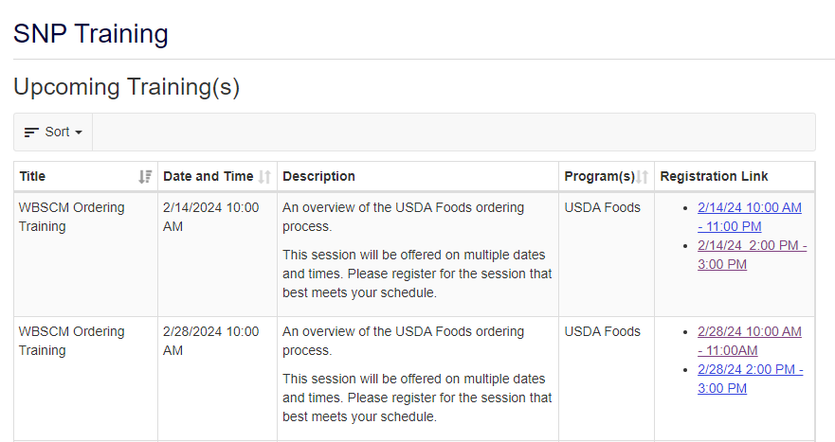
Attend WBSCM Ordering Training Webinar
Learn how to use the ordering tools and place an order in WBSCM
Notes:
If you are not familiar with ordering pounds in WBSCM, you can attend one of the live WBSCM Ordering Training webinars that will be offered during WBSCM ordering period between Feb 12 and March 15. You can register through the SNP Training / Upcoming Trainings webpage.

Slide 18
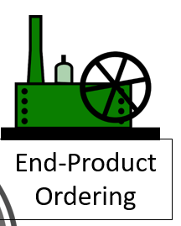
Placing orders for finished end products
Communicate orders to all impacted parties.
Processor
Distributor
Broker
Communicate your order plan for the full school year (before it begins)
Notes:
We just talked about the ordering process in WBSCM and the commodity calculators. Processors also call them commodity planners. These calculators double as order forms for most processors. Your brokers will certainly want them. Most of them list a contact person for ordering end-products.
If you are receiving your orders via a distributor as NOI (the Net Off Invoice value pass through system), they need to know to add your banks in their system as well as your planned orders so the food you need is there when you need it and you get the right price.
As plans are never perfect, it is necessary to keep these same people aware of changes as soon as possible: communicate with all impacted parties.
After you have diverted the pounds and received confirmation that they were actually ordered in WBSCM (WBSCM will tell you status of all foods), then at the beginning of the new school year you can go ahead and place orders with the processor/broker that you completed a procurement with.

Slide 19
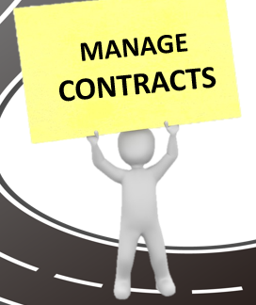
Manage Contracts
Manage processing banks
Check value-pass-thru method and correct DF credit received
Monitor balances with processor(s) monthly (K12, Processor Link, WBSCM)
Plan to use all of your diverted pounds in the year
Notes:
The last phase is Manage Contracts. When you are doing diversion/processing with a processor, ODE will confirm your pounds allocation to the processor. Then, the processor will set you up with a pounds bank. In order to manage your processing banks, you will need to get a K12 or ProcessorLink login. Both are free to use for us because processors pay for their services.
Check to make sure the price matches what you agreed to, that you are getting the exact item you planned and that the discount (or value pass through) is correct. The SEPDS, also posted to our website shows what credit should be taken off of the item. Immediately address the issues so that they are corrected quickly.
ODE is here to support you. If you have too much or too little pounds, please reach out.
And, last, plan to use all your diverted pounds in the year. Unused pounds will be redistributed to other recipient agencies.

Slide 20
Your One-Stop Website!
The ODE Diversion-Processing Website is the one-stop website for all USDA Foods Diversion-Processing Program resources.
or copy/paste: https://www.oregon.gov/ode/students-and-family/childnutrition/USDAFoods/Pages/Processing-Diversion.aspx
Notes:
Now let’s visit the ODE USDA Foods Diversion-Processing website to see where to locate all diversion-processing resources we mentioned during this presentation.

Slide 21
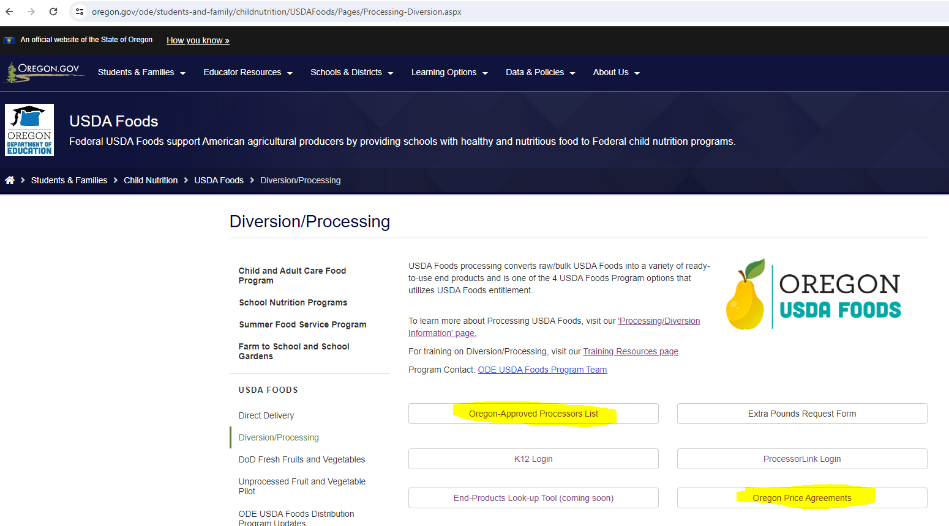
Notes:
In the ODE Diversion-Processing website, there are several quick-links buttons to access useful information – highlighted above in yellow:
-the Oregon-Approved Processors List for current school year and when posted next school year.
- the Oregon Price Agreements

Slide 22
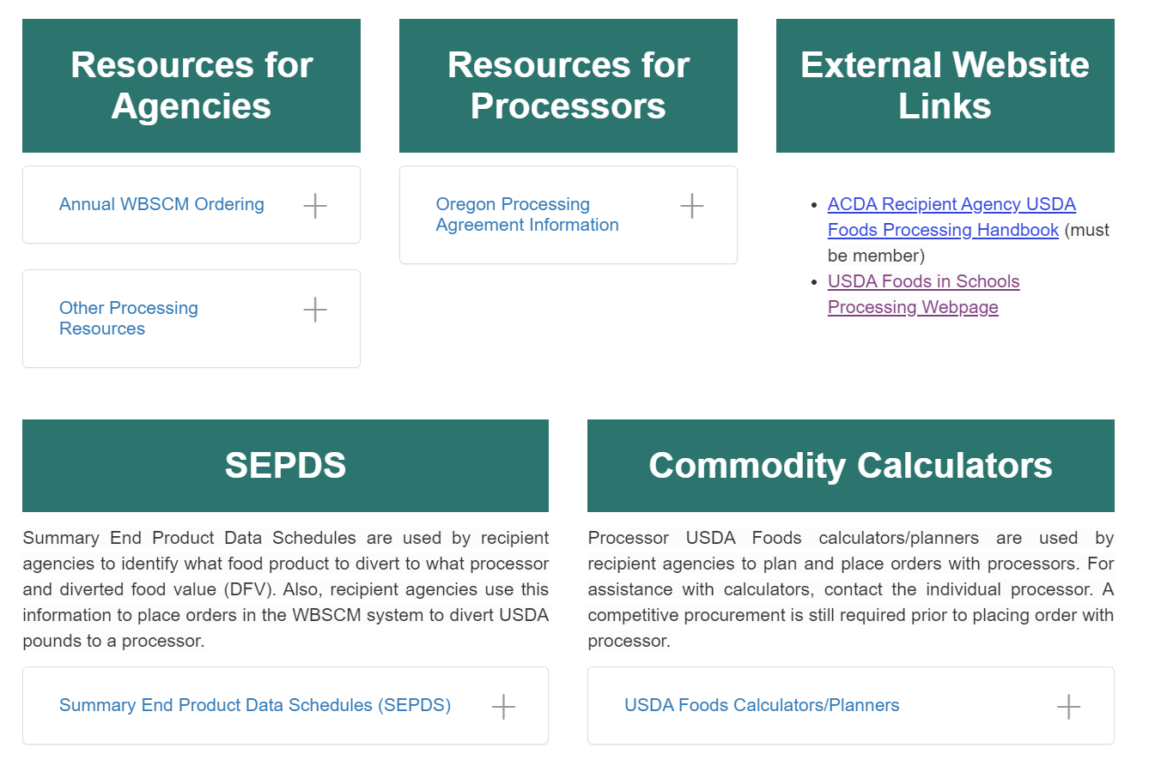
Scroll down…
ODE USDA Foods Diversion-Processing Website
Notes:
In the ODE Diversion-Processing website, scroll down to access the green boxes drop down list:
- SEPDS and Commodity Calculators.

Slide 23
If you are new to processing and wish to participate for next school year, please e-mail ode.fooddistribution@ode.oregon.gov
before USDA Foods Ordering Period
opens on Feb 12th
Notes:
Thank you for attending the Diversion-Processing webinar.

Slide 24
Oregon Department of Education “Our Why”
Equity and Excellence for Every Learner
The Oregon Department of Education works in partnership with school districts, education service districts and community partners;
Together, we serve over 580,000 K-12 students;
We believe every student should have access to a high-quality, well-rounded learning experience;
We work to achieve the Governor’s vision that every student in Oregon graduates with a plan for their future.
Notes:
You will notice that all ODE trainings have this slide and the following at this time. We are in an exciting time in Oregon Education with the Student Success Act. We are all charged with keeping our mission in mind as we work towards implementation

Slide 25
Oregon Department of Education Education Equity Stance
Education equity is the equitable implementation of policy, practices, procedures, and legislation that translates into resource allocation, education rigor, and opportunities for historically and currently marginalized youth, students, and families including civil rights protected classes. This means the restructuring and dismantling of systems and institutions that create the dichotomy of beneficiaries and the oppressed and marginalized.
Notes:
We know that every day you are working to support those marginalized youth. Nourishing them so that that have a chance at success. Thanks for all you do.

Slide 26
Non-Discrimination Statement
In accordance with Federal civil rights law and U.S. Department of Agriculture (USDA) civil rights regulations and policies, the USDA, its Agencies, offices, and employees, and institutions participating in or administering USDA programs are prohibited from discriminating based on race, color, national origin, sex, disability, age, or reprisal or retaliation for prior civil rights activity in any program or activity conducted or funded by USDA. Persons with disabilities who require alternative means of communication for program information (e.g. Braille, large print, audiotape, American Sign Language, etc.), should contact the Agency (State or local) where they applied for benefits. Individuals who are deaf, hard of hearing or have speech disabilities may contact USDA through the Federal Relay Service at (800) 877-8339. Additionally, program information may be made available in languages other than English. To file a program complaint of discrimination, complete the USDA Program Discrimination Complaint Form, (AD-3027) found online at: USDA Link, and at any USDA office, or write a letter addressed to USDA and provide in the letter all of the information requested in the form. To request a copy of the complaint form, call (866) 632-9992. Submit your completed form or letter to USDA by: (1) mail: U.S. Department of Agriculture Office of the Assistant Secretary for Civil Rights 1400 Independence Avenue, SW Washington, D.C. 20250-9410; (2) fax: (202) 690-7442; or (3) email: program.intake@usda.gov This institution is an equal opportunity provider.

Slide 27
Questions?

