Slide 1



African American/Black Student Success Plan Advisory Group Meeting
Oregon Department of Education
November 4, 2016 | 9:00 a.m. – 2:00 p.m.

Slide 2


Welcome

Slide 3


Old & New Business
Review 8/12 Meeting Minutes
Plan Update – Metrics
Overview of the evaluation model
Update on Oregon Educator Equity Report
FACT Oregon presentation
Steps for completing the Plan/Metrics

Slide 4
African American/Black Student Success Plan Evaluation Model
Dr. Karen Drill
RMC Research

Slide 5

2016 Oregon Educator Equity Report and Advisory Group Recommendations
African American/Black Student Success Plan
Advisory Group
Dr. Markisha Smith
Notes:
Setting the stage for presentation and introduction of any members or presenters.

Slide 6

Why critical to the work group?
Field of education has a moral and social imperative to lead by example and deed in the area of equity
Shared belief that ensuring equity and diversity in education is a critical step in enriching the lives of all students in Oregon, and improving educational outcomes for students who are typically marginalized and underrepresented
Potential alignment of work group plan and other state plans.
2
Notes:
1.5 min
There is an urgency to this work in our state. Discussion of why this is critical for TSPC.
Could also read Secretary King’s quote:
“We’ve got to understand that all students benefit from teacher diversity. We have strong evidence that students of color benefit from having teachers and leaders who look like them as role models and also benefit from the classroom dynamics that diversity creates. But it is also important for our white students to see teachers of color in leadership roles in their classrooms and communities. The question for the nation is how do we address this quickly and thoughtfully?”

Slide 7

Annual Report and Advisory Group
Per HB 3375 and SB 755:
Requires an annual report from Chief Education Office on state’s progress in diversifying educator workforce
22 member Educator Equity Advisory Group oversees the annual report and drives change
3
Notes:
30 sec
Reminder of the Oregon Educator Equity Law and the role and membership of the Advisory Group

Slide 8

Annual Report
The 2016 Educator Equity Report provides:
Data on diversity in Oregon’s educator
  workforce
Promising practices for recruiting, preparing, hiring and retaining culturally and linguistically diverse educators;
Strategies being undertaken by public teacher education programs; and
Recommendations for achieving an educator workforce mirroring Oregon’s K-12 student demographics.
4
Notes:
1 min
The law speciifes what the annual Educator Equity Report must include as indicated on this slide.

Slide 9
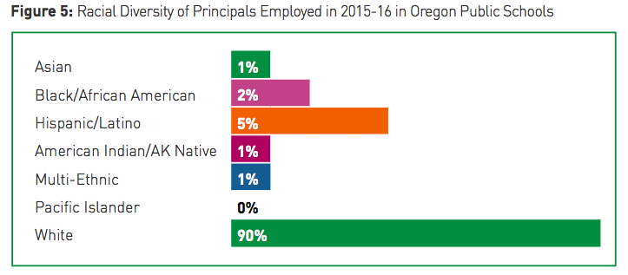

A Visual Look at the Data
5
Notes:
1 min
We have provided you with an Infographic summarizing some of the key findings and recommendations as well as a link to the full report.
One irony worth calling out: One out of every 4 educational Assistants that a student encounters is a person of color; yet less than 1 in 10 of Oregon’s teachers are likely to be a teacher of color.
And we are not seeing any significant change in the diversity of our school and district leaders over time, a trend that is equally disturbing.
Segue to Hilda

Slide 10
The Gap is not closing…
Oregon Students of Color and Teachers of Color
Source: ODE Department of Education Fall Membership and Staff Position Collections
6
Notes:
1 min
This past year the percentage of racially diverse teachers increased from 8.5 percent in 2014-15 to 9.2 percent in 2015-16.
Although that percentage has almost doubled since 2005 (4.8 percent), the gap is still not closing as the diversity of Oregon’s student body increases at almost one percent each year.

Slide 11
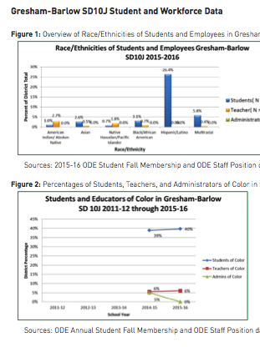
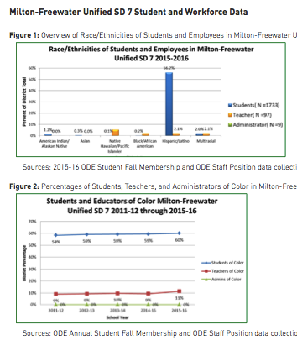
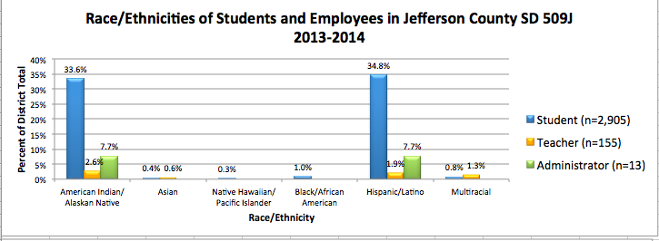
What State Averages Hide
The racial diversity of students in 31 of Oregon’s school districts— ranges between 40 to 82 percent of the overall K-12 student body.
The racial diversity of teachers in those same 31 districts ranges from zero to 27% with most less than 10%.
7
Notes:
1.5 min
However, state averages hide a lot of data. Oregon has 31 districts with more than 40 percent students of color.
The Educator Equity Report includes five years of data that we are tracking on each of Oregon’s most diverse school districts.
Significant disparities between the diversity of students and educators continue to exist in nearly all of these 31 districts and four school districts have a gap of more than 60 percentage points between the racial/ethnic diversity of student and that of teachers.

Slide 12
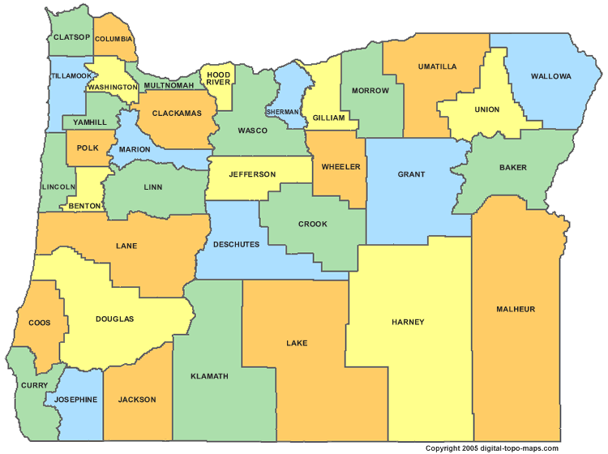
Where are these districts?
4
6
1
1
4
1
1
5
1
1
3
1
1
1
8
Notes:
30 sec
These 31 districts with more than 40 percent students of color are both urban and rural and are located in geographically diverse areas of the state.
.

Slide 13
Current Oregon Data
2015-16 Data Unless Otherwise Indicated | Number | Percent | Change From 14-15
Culturally and Linguistically Diverse Students | 210,814 | 36.6% | ↑
Culturally and Linguistically Diverse Teachers | 3,059 | 10.2% | ↑
Culturally and Linguistically Diverse Administrators | 226 | 10.9% | ↑
Culturally and Linguistically Diverse Counselors | 166 | 14% | ↑
Culturally and Linguistically Diverse Educational Assistants | 2,260 | 16.98% | ↑
Culturally and Linguistically Diverse Teacher Candidates Enrolled (2014-15) | 386 | 18% | ↑
Culturally and Linguistically Diverse Teacher Candidate Completers (2014-15) | 179 | 10.34% | ↓
Source: ODE Staff Position Data Report and TSPC Data System
9
Notes:
1 min
Overall this chart summarizes statewide data that is explained more fully n the report.
The good news: Almost all of these metrics improved from last year. And although candidate completer data is down slightly, we believe it is a lagging indicator reflecting when district hiring of teachers declined due to budget constraints. Also, we have numbers of students in the pipeline for the next two years that are quite promising.

Slide 14
Educator Equity Advisory Group Recommendations to the Governor’s Council on Educator Advancement
10
Notes:
1 min
Explain role of Council and Governor’s Executive Order and why the Ed Equity Advisory Group’s recommendations have been shared with the Council.

Slide 15
Recommendation
Provide state-funded scholarships for culturally and linguistically diverse Oregon Promise students seeking to become teachers.
11
Notes:
2 min
One of the most persistent barriers for any student pursuing a career in education, particularly first generation state, is the cost of a college degree. Even with the help of PELL and Oregon Opportunity grants, teachers graduate from their programs with debt that can easily range from $20,000 to $50,000. In addition to college coursework, candidates incur additional costs for both required licensure tests and edTPA, estimated at well over $1,000. AND candidates complete at least 15 weeks of unpaid supervised experiences in a classroom during which they have limited opportunities to work even part-time.

Slide 16
Address Financial Needs
Six states designate funds to support scholarships for candidates (CT, FL, IL, IN, NY, TN)
Oregon could leverage PELL, OOG, Oregon Promise, to reduce student debt
OSAC office at HECC willing to manage grants
Suggested amount = $750,000 for 2017-19
  2017-18--$250,000 for 50 candidates (up to $5 K @)
  2018-19--$500,000 for 100 candidates (up to $5 K @)
Oregon Opportunity Grant
Oregon Promise Funding
2 Year Teacher Preparation Scholarship at University
Degree and Preliminary Teacher License
Pell Grant
12
Notes:
2 min
The Educator Equity Advisory Group researched six other states that provide specific state scholarship funding.
They also examined other funding streams to determine how PELL grants, Oregon Promise funding, and Oregon Opportunity Grants could be leveraged among with state scholarships to help with the high costs of college.

Slide 17

Recommendation
Seed funding for a phased-in expansion of university/district partnerships in communities where students of color exceed 40 percent of the student population
13
Notes:
1 min
Value of district/university partnerships
….e.g. strong clinical placements for teacher candidates with skilled teachers, help in recruiting future educators, sharing of follow-up data on graduates with educator preparation staff to refine and update curriculum and field experiences, and ultimately improving processes for recruiting, hiring and giving graduates a strong start when they enter their first teaching jobs

Slide 18
Suggested Foci of Partnerships
School districts, community colleges, and universities can work collaboratively on priorities and practices proven to recruit, support, and retain a more diverse teacher workforce.
  Support for Grow your Own programs starting with K-12 students
  Use of cultural brokers to help identify potential educators
  Improved articulation between High Schools, Community Colleges, and 4 year institutions to streamline coursework
  Program interview practices that reduce implicit bias
  Career pathways for school and district employees
  Clinical placements of culturally and linguistically diverse candidates in settings that can lead to employment
  Early intent to interview and hire commitments from districts
  Affinity groups and social networks that support candidates of color
14
Notes:
2 min
Preparation partnerships like TeachOregon, partially funded by the Network for Quality Teaching and Learning have focused goals to recruit, prepare, and hire more diverse and culturally responsive educators.
Segue to Markisha

Slide 19
Recommendation
Fund mentors for two years for every teacher hired in an Oregon school and provide continued networking and retention support for culturally and linguistically candidates who have been recently hired.
15
Notes:
1 min
And of course once teachers are prepared, we know that mentoring for all new teachers is important. But what we have learned is that there is a need for continued networking opportunities and retention supports for candidates of color who may be facing institutional racism in their new employment contexts.

Slide 20

It’s Retention Too!
Recruitment
Preparation
Interview Process
Hiring
Retention
16
Notes:
30 seconds
As you can see from this illustration, it’s about retention al the way along the continuum and once teachers are hired as the data shows on the next slide

Slide 21

Recruitment & Hiring Lessons
Provide early interviewing opportunities and “intent to hire” offers to candidates
Conduct anti-bias training for interview teams
Create a system to connect candidates of color with jobs
Provide guidance for how schools and districts can analyze recruitment pools for racial disparities
Develop collaborative strategies to help small and rural communities hire and retain more educators of color
17
Notes:
2 min
Over the past year, the Advisory Group has studied the research, examined Oregon initiatives, and talked with leaders at the state and local level to develop this list of recommendations that we know can improve the initial recruitment and hiring process.

Slide 22
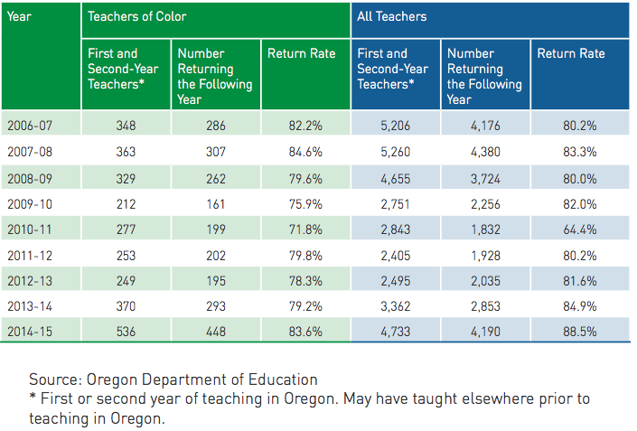
What about Retention?
18
Notes:
1 min
An analysis of return rates of first and second year teachers shows that in six out of the nine years of available data, teachers of color were less likely to return when compared to all teachers as a group as show in Table 9.
This is something we are also monitoring for Oregon’s Federal Equity Plan.

Slide 23
Retention Lessons Learned
Provide culturally responsive cultural brokers (navigators) and affinity groups to connect candidates through first two years of teaching
Adopt contract language to help retain bilingual teachers during reductions in force
Conduct exit interviews to understand why educators leave
19
Notes:
2 min
And these recommendations speak to needs of teachers once they are hired.

Slide 24
Educator Workforce emphasis in Oregon Plans
Equitable Access to Educator Plan
Plan to address educator equity gaps for students of color and students experiencing poverty
Key strategies: Human capital management, ongoing professional learning, and collaboration with educator preparation programs
Oregon Educator Equity Report
Report that uses data to support the need to find solutions for diversifying the educator workforce in Oregon
Funding support for diverse students seeking to become educators (human capital management) and funding to support university and district partnerships (collaboration with EPP’s)
ESSA: Educator Effectiveness
Plan to address educator development, retention, advancement, and educator equity in Oregon
Key strategies and recommendations from the Federal Equitable Access to Educator Plan and the Oregon Educator Equity Report are braided into this portion of the ESSA Plan
Strong focus on diversifying the educator workforce to address equity gaps
Strong focus using Oregon data (qualitative and quantitative) to make practical recommendations for diversifying the workforce
Strong focus on how we support educators at various stages of their career and provide authentic feedback on their performance
20
Notes:
1 min
Discuss opportunities to leverage the work of these plans to make a difference in how we do business.

Slide 25
Oregon Federal Plan
Defining an effective educator…
Defining an excellent educator…
21
Notes:
2 min
We have been asked to define “effective” educator in the ESSA Plan and “excellent” educator in the Federal Plan. This is opening up the opportunity to dialogue about what it means to be an educator with more than just HQT identified traits and provides space to support and develop mechanisms for educators to be culturally responsive.

Slide 26
Alignment of State Plans
Areas of Alignment Around Educator Workforce and Professional Learning for All Educators
African American/Black Student Success Plan
American Indian /Alaska Native Education State Plan
English Learners State Strategic Plan
Federal Plan for Equitable Access to Excellent Educators
Oregon ESSA Plan
22
Notes:
2 min
Good time to acknowledge that we have a variety of plans that have some identified areas of overlap and natural alignment…how should we leverage that alignment?

Slide 27
Discussion points
What steps can the work group take to contribute to plans, policies and efforts around diversifying Oregon’s educator workforce at each step of the pipeline…recruitment, preparation, hiring, mentoring, support, and advancement?
How should all existing work groups work together to support efforts to align and drive change via the American Indian Alaska Native Education State Plan, English Learners Strategic Plan and African American Student Success Plan?
23
Notes:
2 min
Possible discussion points

Slide 28

Comments, Feedback, and Questions
Never doubt that a small group of thoughtful, committed citizens can change the world; indeed, it's the only thing that ever has.
Margaret Mead
24
Notes:
30 seconds
Thank you for this opportunity. The Advisory Group welcomes any additional questions, feedback, etc.
Reminder of upcoming Community Conversation in November (see flyer)
The Ed Equity Advisory Group meetings are held monthly and are open to the public if you are interested in attending.

Slide 29
Family and Community Together
(FACT) Oregon
Paulina Larenas
Multicultural Outreach Specialist

Slide 30
Networking Lunch

Slide 31
African American/Black Student Success Plan Metric Development/Timeline
Dr. Markisha Smith

Slide 32
Public Testimony

Slide 33

Wrap-up and Next Steps

Slide 34

Thank you.

