Slide 1
Three Sovereign Powers Within the Boundaries of the United States
United States Government
State Governments
Federally Recognized Tribes*
Counties#
Cities#
*574 as of November 2020
#Counties and cities are chartered by states

Slide 2
Individual Native Americans Must Pay Federal Income Taxes
“. . . Indians are [U.S.] citizens and
. . . in ordinary affairs of life, not governed by treaties or remedial legislation, they are subject to the payment of income taxes as are other citizens.”
Source: Internal Revenue Service. (July 1967). Revenue Ruling 67-284. [Online]. Retrieved May 4, 2020,
from https://www.irs.gov/pub/irs-tege/rr67_284.pdf
Image source: Public domain

Slide 3
. . . But Native American TRIBES Are Exempt from Federal Income Taxes . . .
“Income tax statutes do not tax Indian tribes. The tribe is not a taxable entity.”
Source: Internal Revenue Service. (July 1967). Revenue Ruling 67-284. [Online]. Retrieved May 4, 2020,
from https://www.irs.gov/pub/irs-tege/rr67_284.pdf
Image source: Public domain

Slide 4
. . . And State Income Taxes
“As an American Indian you are required to file an Oregon personal income tax return. However, you may be able to subtract all or part of your income if all of the following are true:
You are an enrolled member of a federally recognized American Indian tribe.
Your income is earned in Indian country.
You live in federally recognized Indian country.”
Emphasis added
Source: Oregon Department of Revenue. (n.d.). American Indian filing information. [Online]. Retrieved May 4, 2020,
from https://www.oregon.gov/dor/programs/individuals/Pages/american-indian.aspx
Image source: Public domain

Slide 5
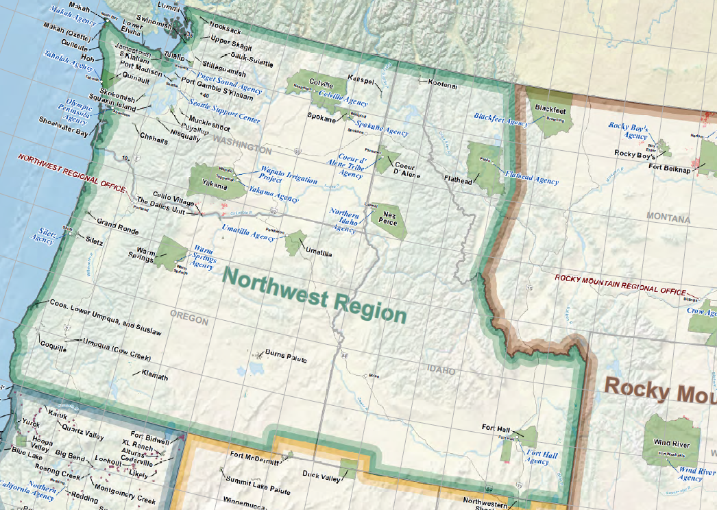
Indian Country in the Pacific Northwest
Image source: Public domain; excerpt from Bureau of Indian Affairs (June 2016). “Lands of federally recognized tribes of the Unites States.” [Online].
Retrieved May 4, 2020, from
https://www.bia.gov/sites/bia.gov/files/assets/bia/ots/webteam/pdf/idc1-028635.pdf

Slide 6
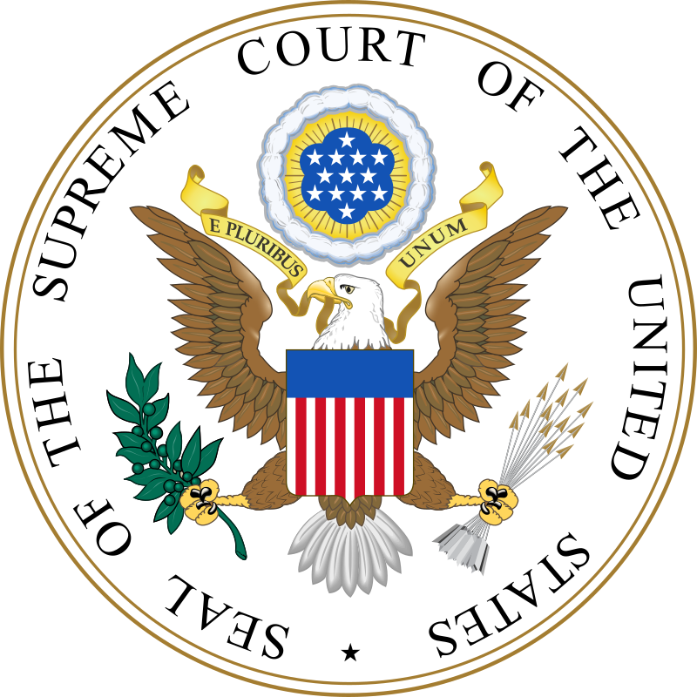
Tribes Can Levy Taxes in Indian Country
“The power to tax transactions occurring on trust lands and significantly involving a tribe or its members is a fundamental attribute of sovereignty.”
– U.S. Supreme Court
Source: Washington v. Confederated Tribes, 447 U.S. 134 (1980).
Image source: Public domain

Slide 7
Income Tax Rates (for Single Filers)*
Federal (2020)
Income (Single Filers) | Rate
$0–$9,875 | 10%
$9,876–$40,125 | 12%
$40,126–$85,525 | 22%
$85,526–$163,300 | 24%
$163,301–$207,350 | 32%
$207,351–$518,400 | 35%
$518,401 or more | 37%
Oregon (2019)
Income (Single Filers) | Rate
$0-$3,550 | 5%
$3,351–$8,900 | 7%
$8,901–$125,000 | 9%
Over $125,000 | 9.9%
*IRS and Oregon Department of Revenue rates as current/published in June 2020.
Sources: a) Internal Revenue Service. (November 6, 2019). IRS provides tax inflation adjustments for tax year 2020. [Online.] Retrieved May 4, 2020, from https://www.irs.gov/newsroom/irs-provides-tax-inflation-adjustments-for-tax-year-2020; b) Oregon Department of Revenue. (April 30, 2020). 2019 Oregon publication OR-17: Individual income tax guide. Retrieved May 4, 2020, from https://www.oregon.gov/dor/forms/FormsPubs/publication-or-17_101-431_2019.pdf

