Slide 1

SOCIAL STUDIES
Sovereignty

Slide 2
Sentence Stems
After you put your puzzles together use these stems to talk
about the pictures.
I see …
I notice …
I think this is …
This reminds me of …
The date of this is …
I think this relates to the history and geography of Oregon because …
A question I have about this picture is …
I think this is a primary source because …
I think this is a secondary source because …
I think this picture is from …
Information that would help us to identify
this document is …

Slide 3
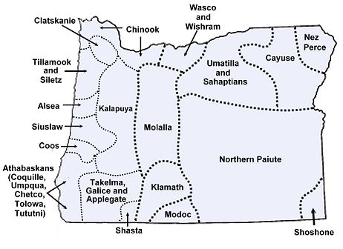
Maps
The next two maps show the many tribal nations (or Indigenous language groups) that existed in Oregon and across the American West prior to the U.S. government’s westward expansion.
Both maps are incomplete. There were many more individual tribal nations and bands than are shown.
Notes:
https://legacy.lib.utexas.edu/maps/united_states/early_indian_west.jpg
http://www.native-languages.org/oregon.htm
https://legacy.lib.utexas.edu/maps/united_states/early_indian_west.jpg
http://www.native-languages.org/oregon.htm

Slide 4
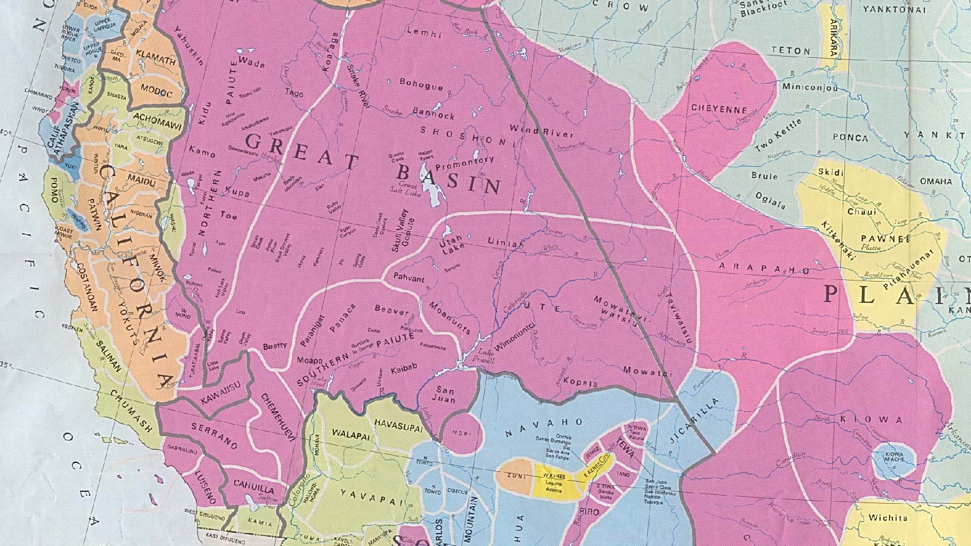
The western United States

Slide 5
1846 Map
In the early 1800s the United States and Great Britain struggled for control of the Pacific Northwest, which was then known as the Oregon territory.
The Oregon Treaty of 1846 established the boundary between the United States and what is now Canada.
Neither Great Britain nor the United States acknowledged the sovereignty and land rights of the Native American who already lived in these areas.
The state of Oregon, which is outlined in black, gained its statehood in 1859.
Notice how different the shapes of the U.S. territories were in 1846 compared to today.

Slide 6
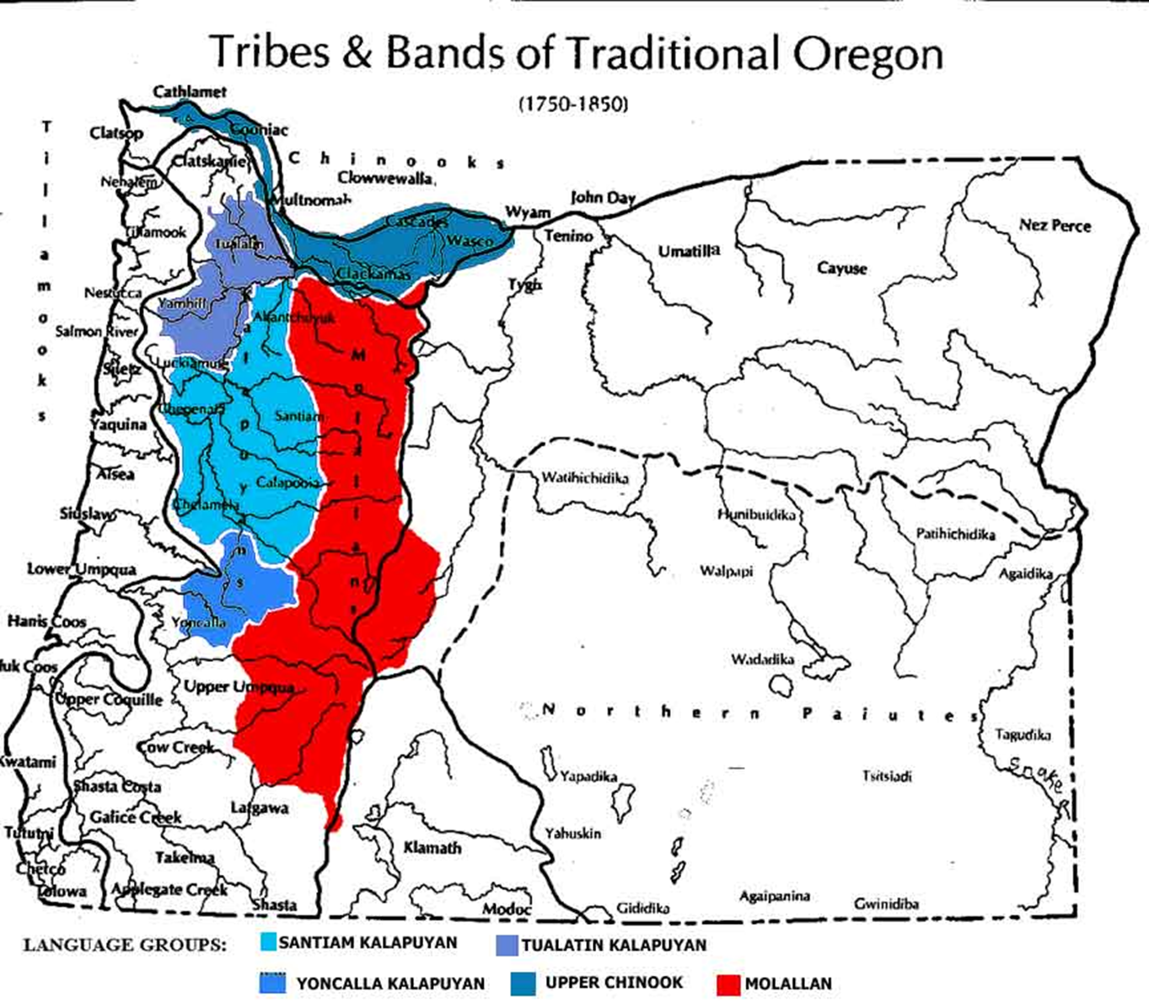
Map
Thousands of people lived in the area we now call Oregon. They had lived here since time immemorial, meaning for longer than we have written record.
Indigenous people were part of large tribal nations and of smaller bands within those nations. These bands were similar to extended families.
Each band had its own rules for how to live, work, and take care of each other.
This map shows the tribal nations and bands that populated Oregon just prior to the Donation Land
Act of 1850.

Slide 7
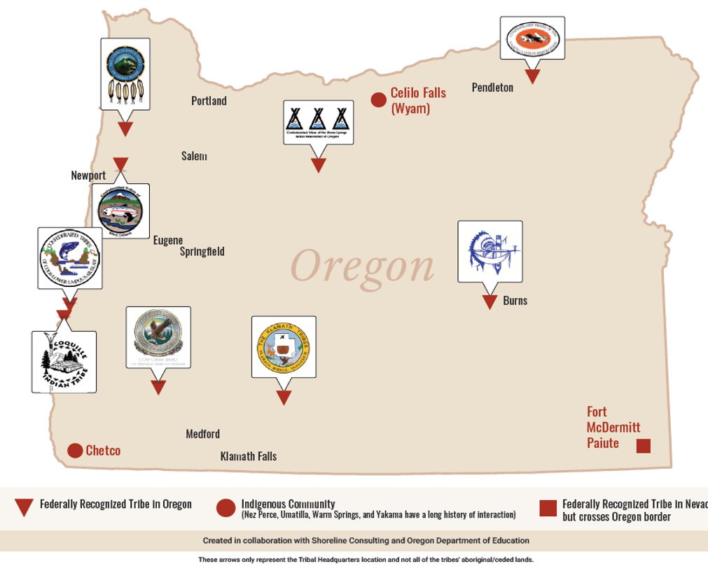
Map of Tribal Lands
There are currently nine federally recognized tribes in Oregon.
Burns Paiute Tribe
Confederated Tribes of the Coos, Lower Umpqua
and Siuslaw Indians
Confederated Tribes of the Grand Ronde Community of Oregon
Confederated Tribes of Siletz Indians
Confederated Tribes of the Umatilla Indian Reservation
Confederated Tribes of Warm Springs
Coquille Indian Tribe
Cow Creek Band of Umpqua Indians
Klamath Tribes
Notes:
Fort McDermitt Paiute has 19,000 acres in Oregon and 16,354 acres in Nevada.

Slide 8
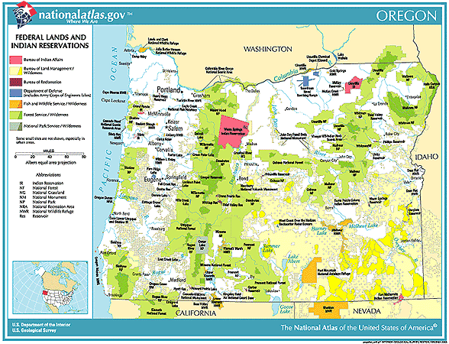
Map of Federal and Tribal Lands
This map shows the lands that are owned by the U.S. government and those owned by tribal nations.
Much of the land is administered by the U.S. Forest Service or the Bureau of Land Management
What else do you notice?
Notes:
https://nationalmap.gov/small_scale/printable/images/pdf/fedlands/OR.pdf

Slide 9
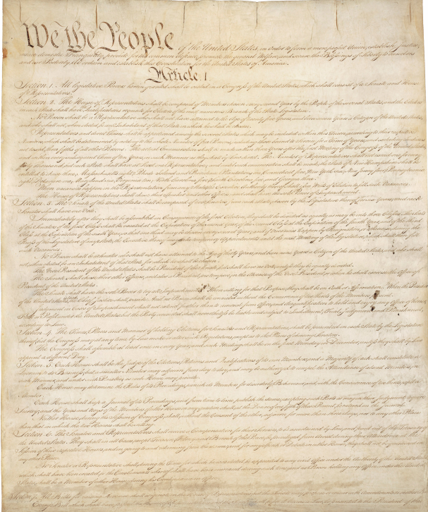
The United States Constitution
Article I; Section 8 says: “Congress shall have the power to regulate Commerce with foreign nations and among the several states, and with the Indian tribes.”
Tribal nations are recognized as having their own government. The tribes have a government-to-government relationship with the United States, not states, counties or cities.
Tribal governments are unique within all the types of government in the United States.
Tribal governments maintain the power to determine their own structure, pass laws and enforce laws through their own police departments and court systems.

Slide 10

Tribal Sovereignty
How long have tribal nations had sovereignty?
What does sovereignty mean?
Why is sovereignty important?

Slide 11
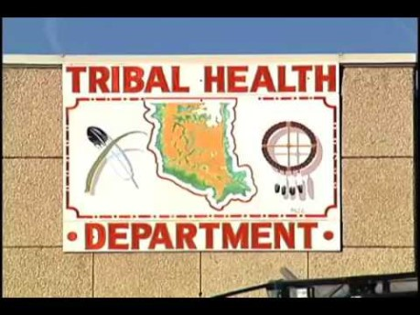
While You Watch
What are the types of government?
Why is the 1823 federal court case Johnson v. McIntosh important?
What are the three big ideas to come out of Worchester v. Georgia?
Notes:
https://www.youtube.com/watch?v=bDzVPRHVMuY

Slide 12
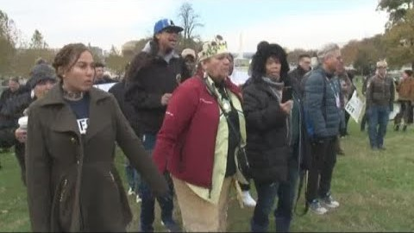
Before Watching
What is the name of the tribe that helped keep the pilgrims from starving—the inspiration for the Thanksgiving Day tradition?
Do you think that tribe is still
here today?
How does the U.S. government support the tribe that helped
those first immigrants?
Notes:
https://www.wusa9.com/article/news/local/dc/government-rules-to-strip-native-american-tribe-of-their-land/65-614593849

Slide 13
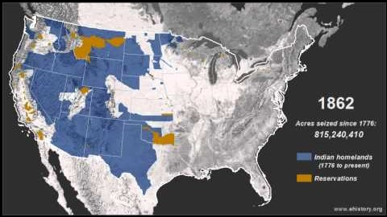
Tribal lands seized since 1862
Notes:
https://www.youtube.com/watch?v=pJxrTzfG2bo

