Slide 1
Ready Schools, Safe Learners
Ready Schools, Safe Learners
GUIDANCE FOR SCHOOL YEAR 2020-21
June 10, 2020

Slide 2
Today’s Topics
Today’s Topics
Guidance Overview
Critical Steps
“Operational Blueprint for Reentry”
Statewide Guidelines - Local Planning
Instructional Models & Review Processes
Roll-out & Guidance Updates
Resources
Notes:
Note: Critical Steps are noted throughout the deck in Purple

Slide 3
Grace & Patience
Grace & Patience
We are learning together to move powerfully on behalf of children and communities.
Notes:
Reiterate that we are leading through unprecedented times:
Global Pandemic
Black people being killed
Civil unrest, riots, curfews
Disheartening impact on school funding after spending months planning a reinvestment in schools
Deeply held and Widely differing hopes and opinions
Now we are leading communities through intense change and hardship and confusion:
We carry a heavy responsibility to ensure the safety of our children, our staff and the families they return home to each day
We also carry a responsibility for an equitable, high quality education and we have never attempted to deliver one with barriers like this before.
We also have those we serve leaning on us with their expectations for how we should be operating schools or how we should address public health.
This is a time to come together around solutions that work across our diverse communities.
It is time to recognize difference and develop deeper understanding.
Each of you hold a unique position in your community, and meetings like this are the only time you can come together with other colleagues that have some understanding of what you are experiencing.
This is a time when we can lead through demonstrating patience with one another, and ask that each of us try to hear as much as we each try to be heard.
Recognize each one of us is struggling AND at the same time, each one of us is leading in amazing ways.

Slide 4
Guiding Principles
Guiding Principles
Critical Step – Preparation
Ensure safety and wellness
Cultivate connection and relationship
Center Equity
Innovate
Notes:
ODE remains committed to the guiding principles introduced in spring 2020 to generate collective action and leadership for efforts to respond to COVID-19 across Oregon. These principles are updated to reflect the current context:
Ensure safety and wellness. The decision to return to school settings must be driven by health and safety considerations. In planning, prioritize basic needs such as food, shelter, and wellness and create the conditions to support mental, social, and emotional health of students and staff.
Cultivate connection and relationship. Quality learning experiences require deep interpersonal relationships and a learning environment where people are seen, known, and loved. Especially in the midst of returning to school settings from an extended school closure, supporting students and families should begin with connection and relationship.
Center Equity. In Oregon, based on data released by OHA, all racial and ethnic groups are disproportionately impacted by COVID-19 as compared to their white peers. Recognize the disproportionate harm and impact that COVID-19 has caused for certain communities. Apply an equity-informed, anti-racist, and anti-oppressive lens to promote culturally sustaining and revitalizing educational systems that support every child.
Innovate. The complex circumstances in which learning is currently situated requires ongoing reflection and iteration to assure deep learning for every student.

Slide 5
Critical Steps
Critical Steps
Preparation
Read the Ready Schools, Safe Learners guidance in its entirety.
Consult your Local Public Health Authority and familiarize yourself with the disease management metrics within your health region.
Assemble appropriate personnel within the school/district and any community partners to create a planning team.
Note: The guidance applies to public schools, public charter schools, private schools, and alternative education programs

Slide 6
Guidance Overview
Guidance Overview
Critical Step – Preparation
Ready Schools = Safe Learners
Provides clear statewide requirements and recommendations for health, safety, equity, and instruction
Places the design and decision-making at the local level
Delineates process for local and state submission of Operational Blueprints
Assures a plan is in place prior to opening
Allows it to be shared with interested local and state stakeholders and partners
Provides for quick resolution of concerns and complaints
Notes:
Ready Schools and Safe Learners – goal of safe reentry of staff and students to our schools, because our state’s future depends on the education, health, and wellbeing of today’s children.
clear statewide requirements and recommendations for health, safety, equity, and quality instruction across the state
adheres to state guidelines for building a safe and strong Oregon
Requirements for maintaining public health
Planning considerations for equity, instruction, engagement, mental/social-emotional health, and staffing and personnel
local planning and transparency - to assure your families, staff, and community you are ready to keep them safe
Oversight through collection of operational blueprints

Slide 7
Guidance Format
Guidance Format
Critical Step – Preparation
8 sections
Graphics and tools
Operational Blueprint template
Sample plans
Resources and research
Communications tools
Updates schedule and process
Notes:
A guidance document
8 sections (3 with requirements, 5 with primarily considerations)
Some graphics and tools
A template for your Operational Blueprint and sample plans based on real Oregon schools
Additional resources & research (future)
Communication tools (future)
Schedule and process for updates

Slide 8
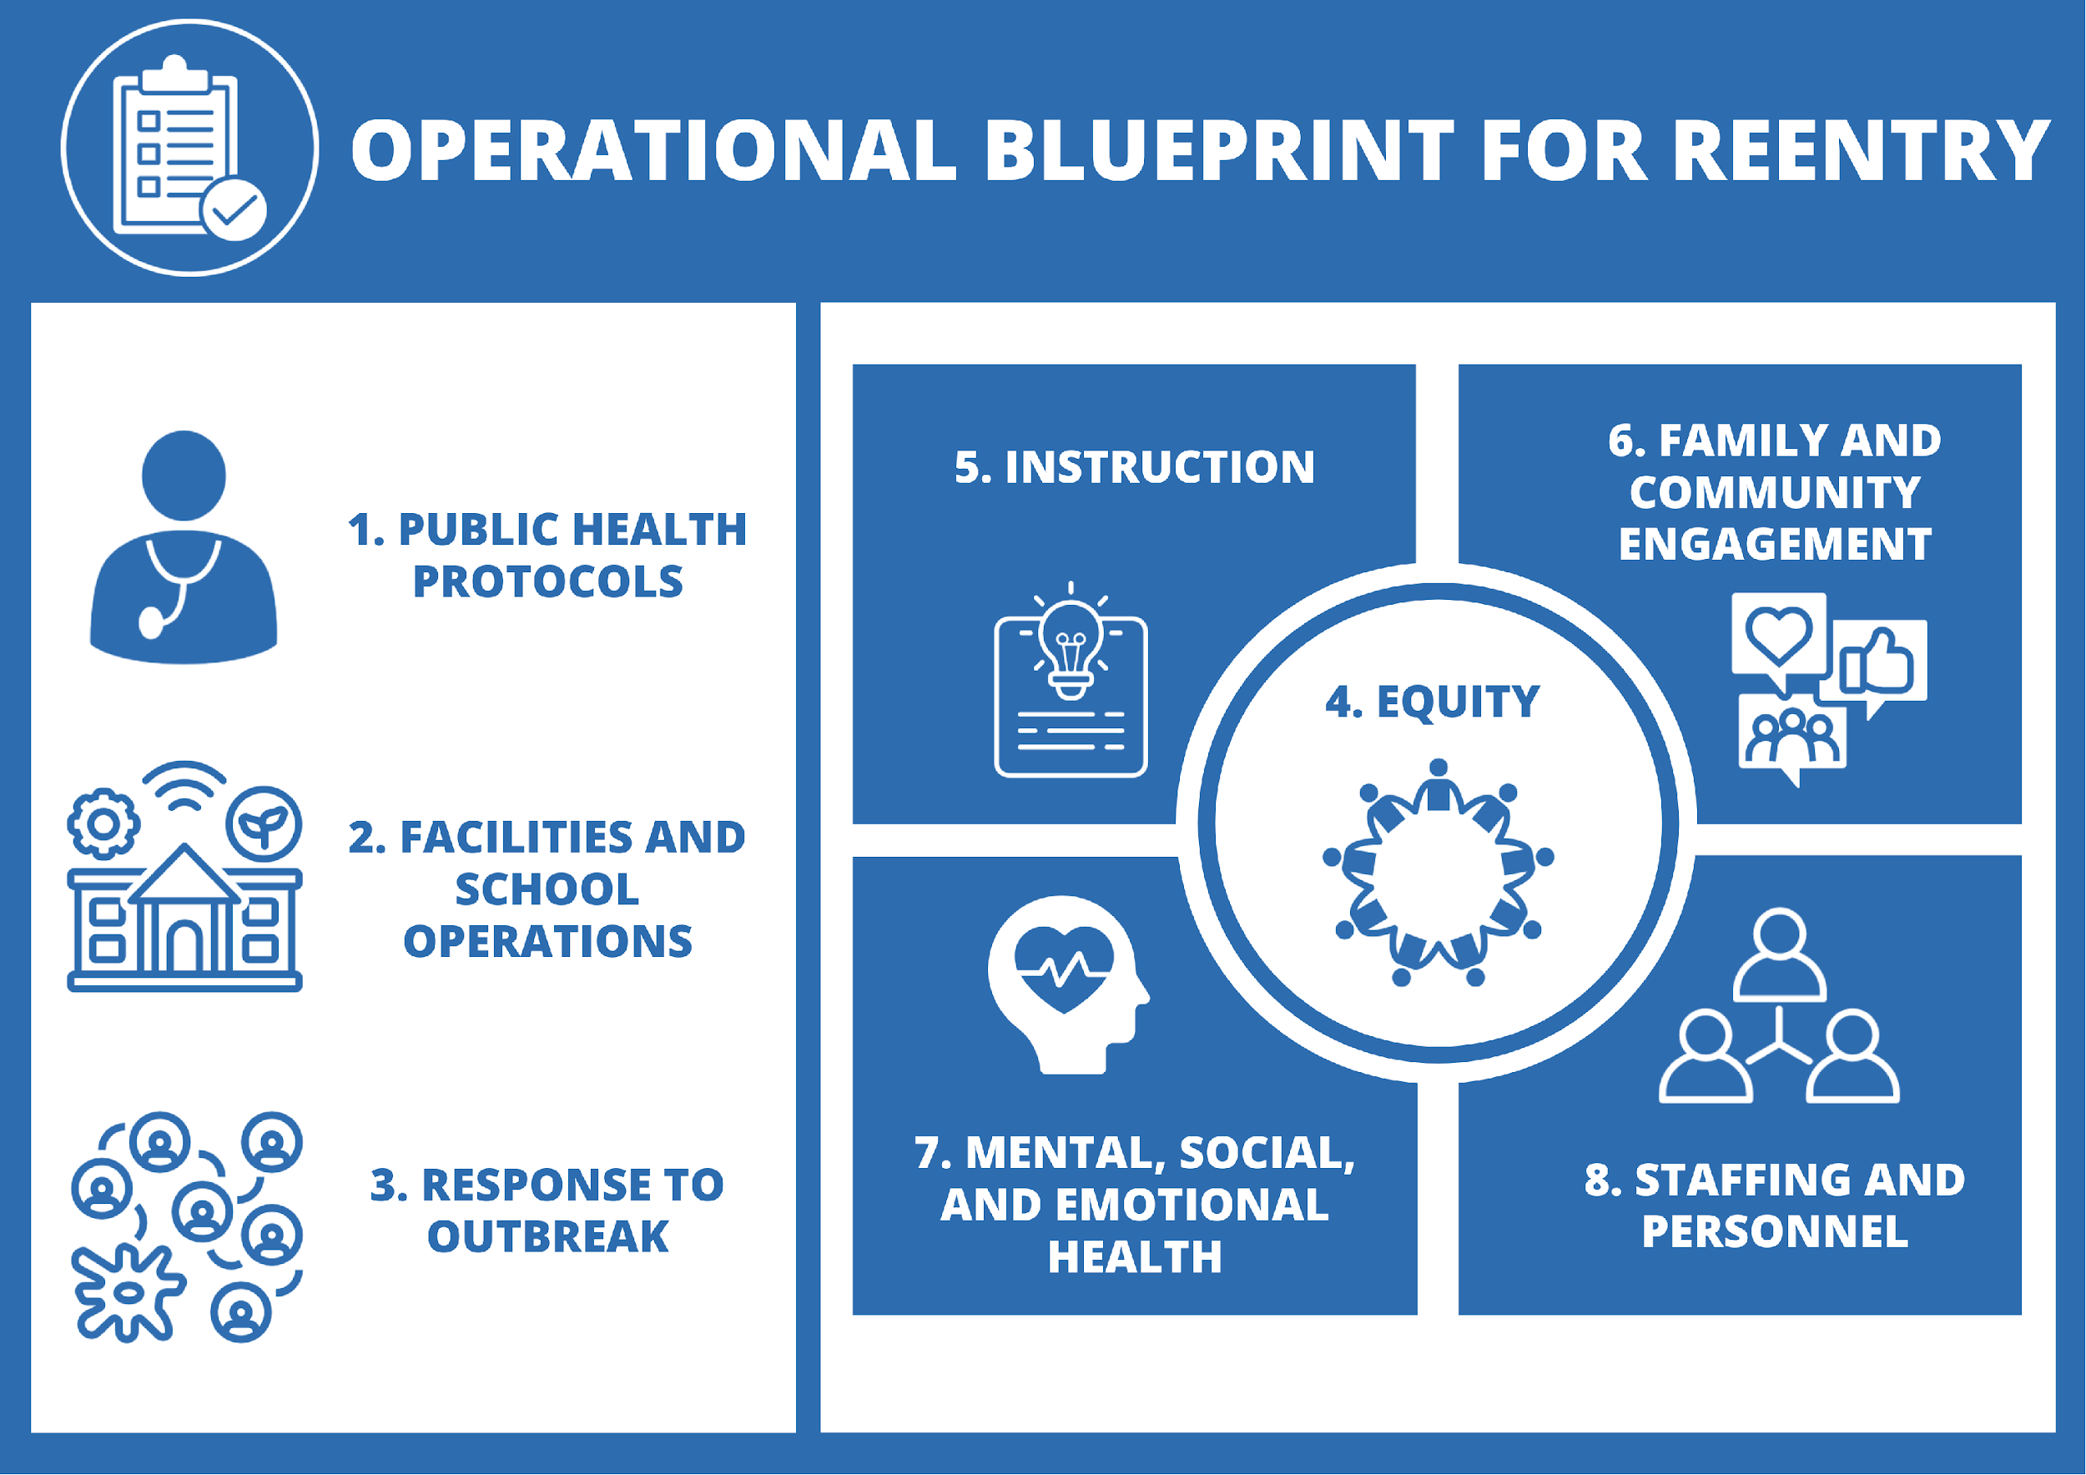
Operational Blueprint
Operational Blueprint
Critical Step – Preparation
Due August 15th, 2020
Notes:
slow

Slide 9
More Critical Steps
Critical Steps
Plan Development
Work with the planning team to complete the Operational Blueprint template for your school. Private schools are required to complete sections 1-3.
Consult with key partners (see section 6, including Tribal Consultation) to complete the Operational Blueprint for Reentry.
Submit the Operational Blueprint for Reentry to your local school board.

Slide 10
Local Flexibility & Responsibility
Local Flexibility & Responsibility
Critical Step – Plan Development
“You don’t make the timeline. The virus makes the timeline.” – Dr. Anthony Fauci
We will be living with the virus until there is immunity, which is many months off.
The primary tools we have are physical distancing and hygiene.
Every restriction we lift increases the opportunity for transmission and will increase cases.
Individual plans should be responsive to local public health and build on the distinct strengths and needs of each district and community
Notes:
Straight Talk
Inconsistencies
You are going to see some, they are easy to find. - 3 feet on a bus, how many people in a room based on guidance from some other sector (time in contact)
The inconsistency is there because you asked for them for reasons of practicality and they are also less safe.
Order of safety – 6 feet, limited time contact, less interaction with others, hygiene and cleanliness, masks/coverings (to protect others)
When you drop one, recommend others
Choice: As a leader you lean into the risk level issue and help others understand or you can attack it and use it as a reason to say none of it makes sense and do what you choose. If you do you will put your community at risk
Local flexibility
Leeway in implementation considerations vs requirements
requirements “where feasible” “to the greatest extent possible”
Cohorts, riskier classes like choir and band, visitors and masks
And considering other ways to introduce flexibility
Responsibility
Understand it is all about levels of risk
The farther you stray from guidance (Physical distancing, hygiene, small groups, multiple interactions, etc) the more risk you are creating for those you serve
You, like the state, is trying to determine how to practically operate school and maintain a safe risk level
From the guidance:
Maintaining Health and Safety
The Ready Schools, Safe Learners guidance focuses on health and safety requirements with provisions for flexibility that honor and recognize the uniqueness of communities across Oregon, to support schools in designing plans to meet community-specific needs and strengths. As schools plan, it is important to remember:
“You don’t make the timeline. The virus makes the timeline.” – Dr. Anthony Fauci.
Our state will be living with the virus until there is immunity, which is many months off.
The best tools to protect individuals are physical distancing and hygiene.
Every health restriction lifted increases opportunity for transmission and will increase cases.
As districts plan and implement the requirements and recommendations included in this guidance, personnel should try to implement as written and will necessarily need to consider a continuum of levels of risk when some requirements/recommendations cannot be fully accommodated. For example, maintaining physical distance (6 feet apart from others) is best. There will be times when this is not possible based on an interaction or a physical space limitation. When it is necessary to adjust implementation of this guidance, take other steps to mitigate the close proximity. Steps could include ensuring it is for a very short duration, ensuring hand washing before and after, avoiding touching your face, teaching safe etiquette for coughing and sneezing, and/or using a facial covering.

Slide 11
Local Flexibility & Responsibility 2
Local Flexibility & Responsibility
Critical Step – Plan Development
KEY PRINCIPLES for Reducing Potential Exposures
The mainstays of reducing exposure to the coronavirus and other respiratory pathogens are:
Physical distancing — minimizing close contact (<six feet) with other people.
Hand hygiene — frequent washing with soap and water or using hand sanitizer.
Cohorts — conducting all activities in small groups that remain together over time with minimal mixing of groups.
Protective equipment — use of face shields, face coverings, and barriers.
Environmental cleaning and disinfection — especially of high-touch surfaces.
Isolation of sick people and quarantine of exposed people.
With the above considerations foremost, outdoor activities are safer than indoor activities.

Slide 12
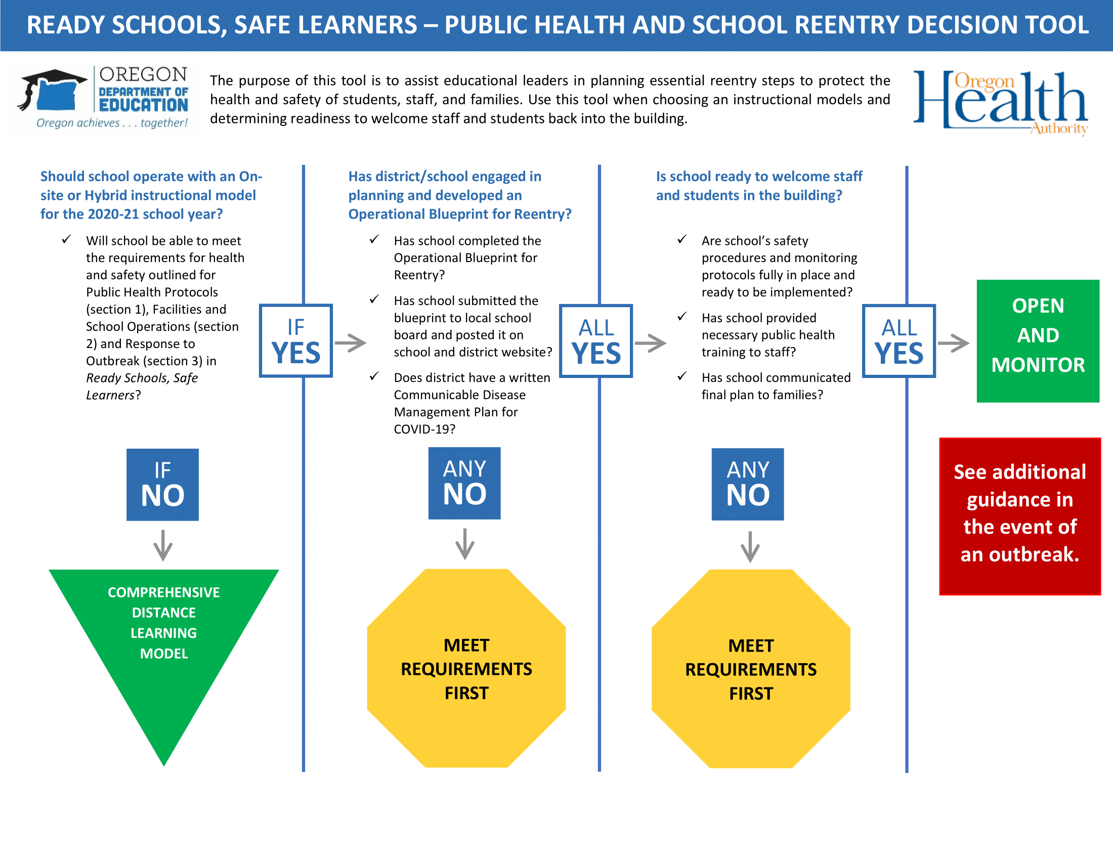
Public health and school reentry decision tool
Notes:
Draft
read

Slide 13
Instructional models
Instructional Models
Critical Step – Plan Development
Notes:
This slide shows full design

Slide 14
Requirements and Recommendations

Slide 15
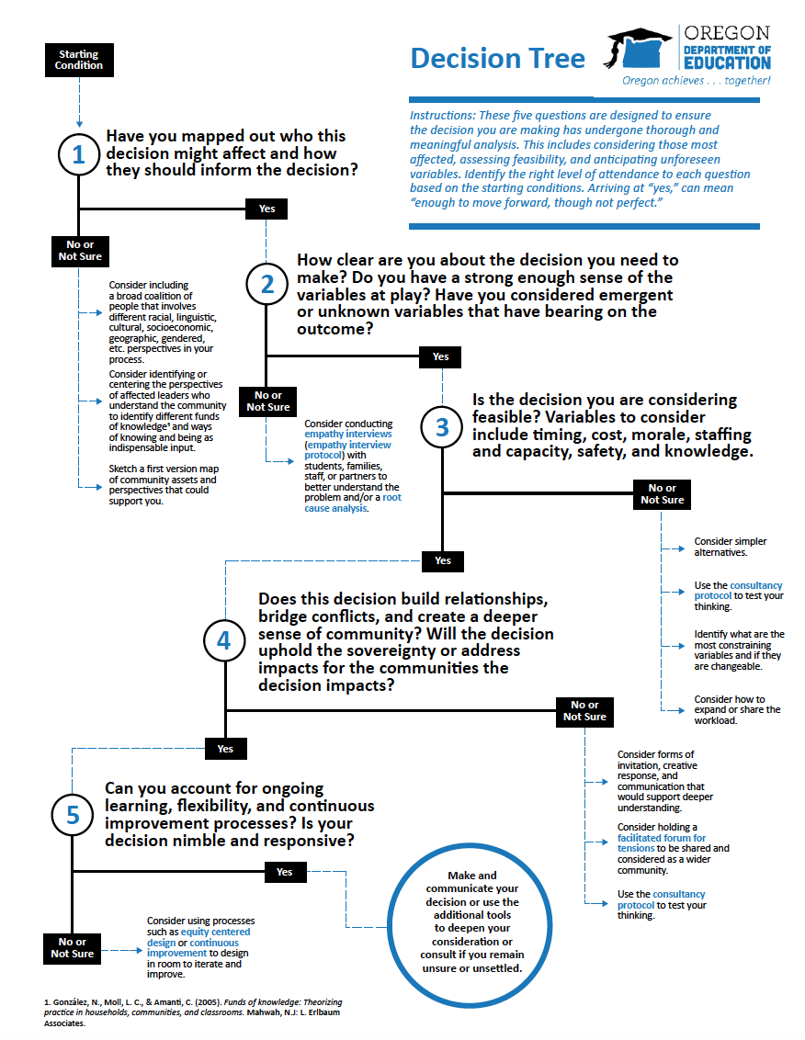
Decision Tools
Decision Tools
Critical Step – Plan Development
Resources:
Decision Tools
Resource Library
Blueprint Template
Sample Plans
Communication Toolkit
Notes:
What tools and resources are included – start thinking about what else you might need for later in the conversation???

Slide 16
ESD Support Possibilities
ESD Support Possibilities
Critical Step – Plan Development
Ways ESDs can provide regional assistance:
Connections to Local Public Health Authority
Development of communicable disease plans
School nurse support in planning
Support in template completion (small districts)
Group purchasing
Communications support
Development of social-emotional supports
Technology and online learning supports
Professional Learning and Training supports

Slide 17
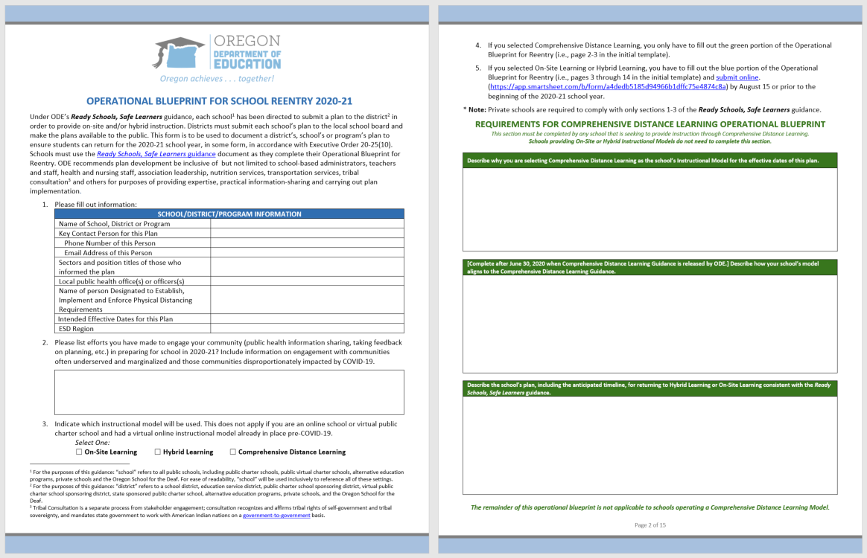
Operational Blueprint
Operational Blueprint
Critical Step – Plan Development
Notes:
Operational Blueprint has four sections-
Cover elements:
Who – school, contact, who helped by sector/title, ESD, LPHA,
Which model
Comprehensive distance learning:
Describe why you are selecting Comprehensive Distance Learning as the school’s Instructional Model for the effective dates of this plan.
Describe the steps taken to ensure the school meets the guidance criteria and requirements for Comprehensive Distance Learning, once released by ODE no later than June 30, 2020.
Describe the school’s plan, including the anticipated timeline, for returning to Hybrid Learning or On-Site Learning consistent with the Ready Schools, Safe Learners guidance.

Slide 18
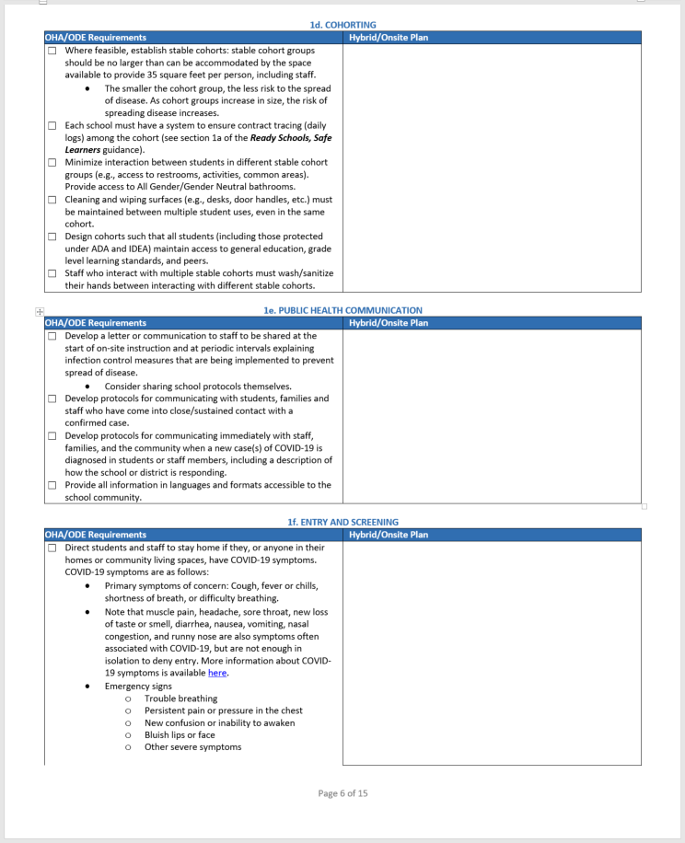
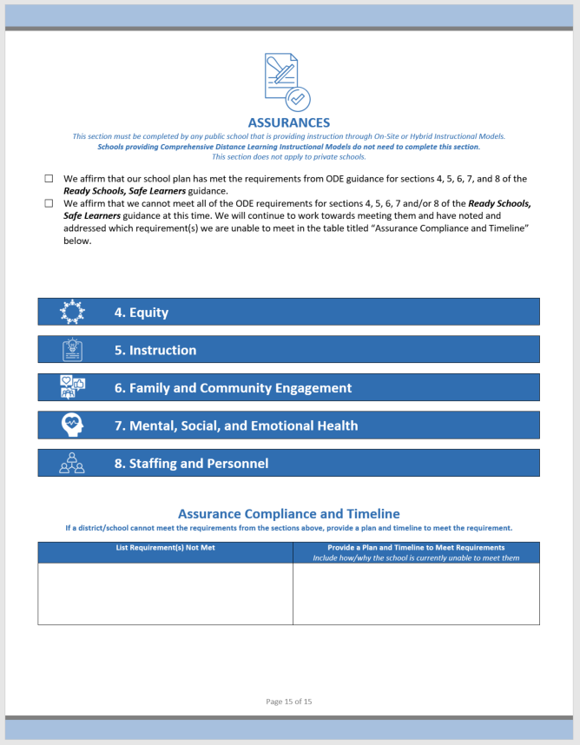
Operational Blueprint 2
Operational Blueprint
Critical Step – Plan Development
Notes:
Operational Blueprint has four sections-
Sections 1-3:
Public Health related implementation
Sections 4-8:
Assurance that you are planning for equity, instruction, engagement, social/emotional/mental health, and staffing and personnel

Slide 19
Face Coverings
Face Coverings
What’s in the Guidance: Key Concepts to Highlight
Critical Step – Plan Development
Notes:
Required
Face coverings or face shields for:
Staff who are regularly within six feet of students and/or staff
This can include staff who support personal care, feeding, or instruction requiring direct physical contact.
Staff who will sustain close contact and interactions with students.
Bus drivers.
Staff preparing and/or serving meals.
Face shields or clear plastic barriers for:
Speech Language Pathologists, Speech Language Pathology Assistants, or other adults providing articulation therapy.
Front office staff.
Face masks for school RNs or other medical personnel when providing direct contact care and monitoring of staff/students displaying symptoms. School nurses should also wear appropriate Personal Protective Equipment (PPE) for their role.
Students who choose not to wear face coverings must be provided access to instruction.
ADA accommodations: If a staff member requires an accommodation for the face covering or face shield requirements, districts and schools should work to limit the staff member’s proximity to students and staff to the extent possible to minimize the possibility of exposure.
Recommended
Face coverings for:
All staff (in accordance with local public health authority and CDC guidelines).
Staff who interact with public (e.g., mail deliveries, varied support personnel).
Staff who interact with multiple stable cohorts.
Students in 6th-12th grade and especially in circumstances when physical distancing cannot be maintained.
If face coverings are worn, they should be washed daily or a new covering worn daily.
Encourage students who wear face coverings to follow recommendations for the CDC Face Coverings.
Children of any age should not wear a face covering:
If they have a medical condition that makes it difficult for them to breathe with a face covering;
If they experience a disability that prevents them from wearing a face covering;
If they are unable to remove the face covering independently; or
While sleeping.

Slide 20
Higher Risk Activities
Higher Risk Activities
What’s in the Guidance: Key Concepts to Highlight
Critical Step – Plan Development
Notes:
We support a well-rounded education
Opportunities to engage students in a well-rounded education often requires hands-on, interactive and physical activities (e.g., laboratory activities, band, choir, theater, career and technical education (CTE), physical education). As such, these activities may put students and staff at a higher risk for COVID-19 spread and may require modifications or specific health and safety protocols to protect staff and students.
Required
For any course, learning experience, or school activity that falls under this category, districts must carefully consider Public Health Protocols (see section 1) and Facilities and School Operations (see section 2). To the extent possible, modifications to the learning experience, course, or physical space should be made.
Follow Instrument Cleaning Guidelines for any music course where instruments are used.
Recommended
Use markings on the floor and/or a student workstation to reinforce physical distance requirements.
Host class or portions of a class outside to increase physical distancing.
Develop safe alternatives or substitutes for live performances, science labs, CTE performance assessments, etc.

Slide 21
Transportation
Transportation
What’s in the Guidance: Key Concepts to Highlight
Include transportation departments (and associated contracted providers, if used) in planning for return to service.
Buses and transit stations are cleaned frequently. Conduct targeted cleanings between routes, with a focus on disinfecting frequently touched surfaces of the bus.
Develop protocol for loading/unloading that includes visual screening for students exhibiting symptoms and logs for contact-tracing.
Consult with parents/guardians of students who may require additional support (e.g., students who experience a disability and require specialized transportation as a related service) to appropriately provide service.
Drivers wear facial shields, or their equivalent.
Inform parents/guardians of practical changes to transportation service (i.e., physical distancing at bus stops and while loading/unloading, potential for increased route time due to additional precautions, sanitizing practices and facial coverings).
Notes:
We have a meeting with OHA tomorrow
Would like to get your thoughts on clarity and practicality of some public health requirements
Remember that clarity is important, specificity may not help with practicality across the state.
Enter thoughts in the chat as I share, then I’ll ask the COSA Team to share a few after each slide and ask questions

Slide 22
Critical Steps 2
Critical Steps
Public Health Review
Submit the Operational Blueprint for Reentry to your Local Public Health Authority.
Your Local Public Health Authority will attest to receiving the blueprint, carefully reviewing sections 1-3, and supporting your ongoing efforts towards ongoing COVID-19 mitigation efforts.

Slide 23
Partnership
Partnership
Critical Step – Public Health Review
Our state’s future depends on the education, health, and wellbeing of today’s children.
Notes:
Partnership between
The district and its schools – the local public health authority – the state health authority – the department of education
Each has public accountability
Each has a role in ensuring safety and health for every student staff member, and the families they return home to each day
Each has a responsibility for ensuring access to an equitable and quality education

Slide 24
Critical Steps 3
Critical Steps
Final Plan Submission
Post the Operational Blueprint for Reentry on your school and district websites. If there is no school or district website, it can be posted to the ESD website.
Submit final plan for each school to the Oregon Department of Education.

Slide 25
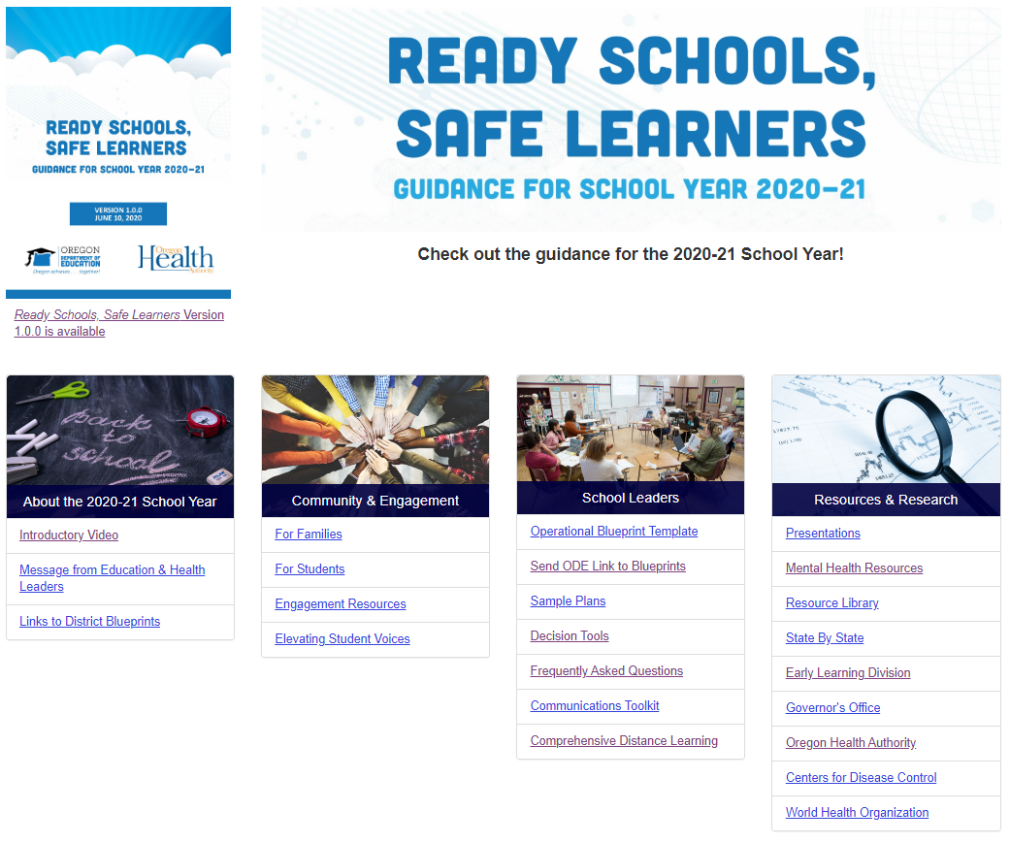
Submissions & Sample Plans
Submissions & Sample Plans
Critical Step – Final Plan Submission
Notes:
(this slide can be updated when website in final)
Post the Operational Blueprint for Reentry on the school and district website. If there is no school or district website, it can be posted to the ESD website.
Submit the link to the Operational Blueprint for Reentry no later than August 15, 2020.
Public charter schools must make their Operational Blueprint for Reentry available to the community on the school’s website, the plan must be reviewed by the school’s board, submitted to the school’s sponsor, and submitted to ODE via the link. Private school also must share links to their plans with ODE

Slide 26
Guidance Roll-out
Guidance Roll-out
Critical Step – Final Plan Submission
Communicating with Families & Community:
Families are essential partners in this planning and need a clear understanding regarding the preparations
The guidance describes what we know now, and there will be updates
There are still opportunities for input
Public school will work under the direction of the school district to develop an Operational Blueprint for Reentry
By August 15 or before the beginning of the school year, submit to local school board and make it available to the community on the school/district website.
Notes:
Charters work with sponsors
Privates work with their community and leadership

Slide 27
Guidance Roll-out 2
Guidance Roll-out
Critical Step – Ongoing Efforts
Communicating with Students:
People everywhere in Oregon are thinking about how to make sure school is safe for you so you can learn.
School leaders have been given information and guidance to design how your schools will open this fall.
Your teachers and districts benefit from your ideas, imagination, and your patience.
As we learn more, the requirements for how your school learning is organized might keep changing.
You can learn more at this ODE website or reach out to your teachers or school counselors for more information.

Slide 28
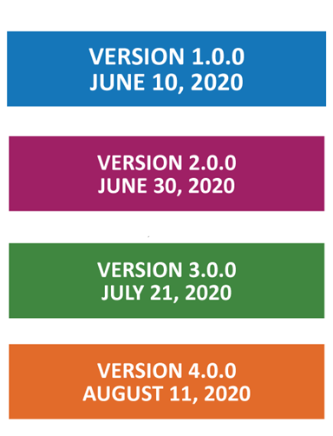
Guidance Updates
Guidance Updates
Critical Step – Ongoing Efforts
The continuing impacts of COVID-19 and the state’s evolving mitigation efforts
Input from educators, students, families, and community partners
Continued review of equity impacts
Learnings from efforts in other states and countries
Notes:
pre-kindergarten programs, Comprehensive Distance Learning, safety drills, athletics and activities, boarding programs, and more are not currently included
Other items like instructional time and attendance may need to evolve after receiving input

Slide 29
Guidance Updates 2
Guidance Updates
Critical Step – Ongoing Efforts
The 2020-21 School Year Guidance is designed to take us through the school year. It will necessarily be updated through the summer and into the school year:
All updates will be dated and replace the previous version. Updates to new version will be named at the top of the document.
1.0.2
Major
Minor
Patch
Major changes
Examples: adding a new section on athletics, changing square footage or physical distancing numbers, etc.
Minor content changes Examples: adding to FAQs, library book protocols as part of guidance on shared items, etc.
No content changes.
Examples: fixing typos, adding an index, moving an item from one section to another, etc.
Notes:
1.0.1 changes will signify minor changes and no content changes (fixing typos, adding an index, moving an item from one section to another, etc.)
1.1.0 changes will signify minor content changes (adding to FAQs, library book protocols as part of guidance on shared items, etc. )
2.0.0 changes will signify major changes (adding a new section on athletics, changing square footage or physical distancing numbers, etc.)

Slide 30
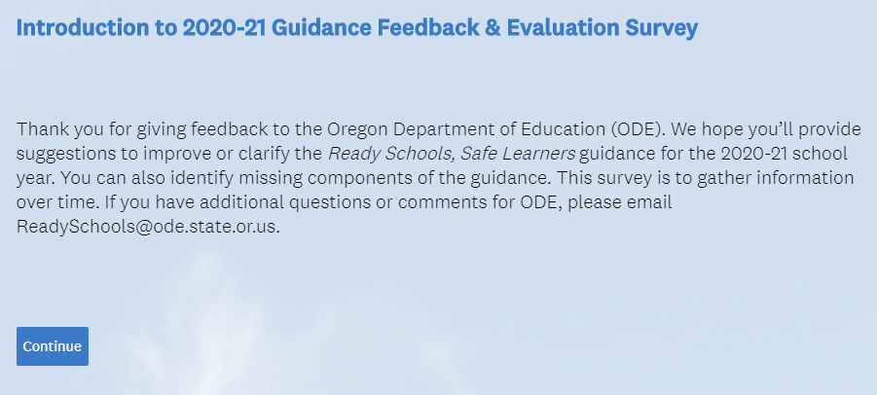
Continuing Engagement
Continuing Engagement
Critical Step – Ongoing Efforts
Input Tool Available on Website

Slide 31
The Next 90 Days…
The Next 90 Days…
Critical Step – Ongoing Efforts
Ready Schools, Safe Learners guidance updates
Professional learning: Partnering on webinars and workshops
Technology and online learning supports
Comprehensive Distance Learning guidance
Statewide procurement/contracting supports
Guidance for specific populations
Communication supports
Complaint/concern processes
Executive Order update
Ready Schools, Safe Learners Education and Health Advisory Panel

Slide 32
Conclusion
We can provide ready schools that are safe places for learners, staff, and their families.

Slide 33
Questions?
Questions?
ReadySchools@ode.state.or.us
Notes:
Colt

