Slide 1
Medication Administration
A Training for School Personnel
2018 Update
Notes:
Welcome and introduce yourself. Provide an explanation of the purpose of the training.
Remind participants to close and silence all electronic devices, and that they must be in attendance for the entire class to be certified in medication administration.
NOTE TO TRAINERS:
Reference specifics from the local school district JHCD and JCSD-AR policies.
Use your district medication forms (medication administration, self-medication agreement, and medication incident form) when discussing documentation procedures
Consider creating an assessment tool (quiz) to assess participants’ competency prior to ‘certifying’ the participant
Review the Introduction on PAGE 2 on training manual

Slide 2

LEGAL BACKGROUND
ORS 339.866-339.874
OAR 581-021-0037
Designated school personnel
District procedures must address how to handle field trips and other events that occur outside the usual school setting.
Notes:
Discussion points: (page 2/3 of manual)
Personnel must receive training before administering medications
This class only teaches about non-injectables
Glucagon, epinephrine and medication to treat an adrenal crisis are discussed in other trainings. Participants will be contacted if those are necessary within their job duties.
There must be district level policies for administration, including self-administration
(page 3 of manual) This training is required for school personnel that are designated to administer any medication to students.
- Initial training in-person. Every 3rd annual training thereafter must be in-person.
Discussion points: (page 3 of manual)
District policy must address how personnel are to be designated to be trained to administer medications.
For consistency and safety, it is best to have one primary person who is familiar with the student and the task– the more people involved, the more room for miscommunication and errors. However, there should always be enough backups trained and available in case the primary person is absent or cannot accompany the student on an off-campus activity.

Slide 3

POLICIES & PROCEDURES
Each school district shall adopt policies and procedures that provide for:
    Administration of medications to students by trained personnel;
    Student self-medication
Notes:
Page 3 in manual:
Explain the requirement that local school boards must enact policies to meet the requirements of the law. This can contribute to some local variation in practice and associated medication forms.
Direct participants to your/their district policies and forms (online or on paper).

Slide 4
POLICIES & PROCEDURES
Must include a process to designate, train and supervise appropriate personnel for medication administration that takes into account when a student is:
  in school
  at a school sponsored activity
  under the supervision of school personnel
  in transit to or from school or school-sponsored activities.
Notes:
These rules apply the entire time a student is under the supervision of school personnel, including overnight trips or extended residential programs such as Outdoor School. (page 2 in manual)
ENGAGEMENT STRATEGY:
- ASK – what school settings or activities do districts have to worry about in relation to medications?
- ASK – take 2 minutes with a partner to think about challenges with these requirements. Have each pair share out with the group.

Slide 5
POLICIES & PROCEDURES
When a student has a diagnosis of severe allergies, adrenal insufficiency, and/or asthma, district policy must also address when a student is:
  In before-school and after-school care programs on school-owned property
Notes:
These rules apply the entire time a student is under the supervision of school personnel, including overnight trips or extended residential programs such as Outdoor School. (page 2 in manual)

Slide 6
MEDICATION
Definition
Notes:
Have participants read the definition (on page 4 in manual)
ASK the participants if they have any questions about the definition
If personnel are asked to administer any injectable medications to a student, they will require additional state-approved training by a qualified trainer on that particular medication.

Slide 7
PRESCRIBER
Doctor of Medicine or Osteopathy (MD/DO)
Physician Assistant
Nurse Practitioner
Dentist
Optometrist
Naturopathic Physician
Pharmacist
Notes:
Discussion Points: (page 4 of manual)
Prescription medication administered in Oregon schools must be given under the direction of one of these prescribers (on slide). These prescribers must be licensed to practice in Oregon. There is an exception for students new to Oregon to accept orders from an out of state MD/DO for up to 90 days. This allows the family to establish care in Oregon and allows the student to continue getting the medication they need.
Describe the difference between a ‘prescriber’ and ‘physician’
Physician – only a MD/DO – narrow definition
Prescriber – all on the list
We will refer to a ‘prescriber’ in the following slides.
If asked, a Pharmacist is allowed, in Oregon, to prescribe oral birth control and naloxone.

Slide 8
NON-PRESCRIPTION
Definition
Written permission form
Dosage consistent with manufacturer’s guidelines
Necessary for student to remain in school
Original container
Transport of medications to/from school
Notes:
(page 4 of manual) Only FDA-approved non-prescription medications can be given in schools unless the parent gets a written order for the over-the-counter drug from the student’s provider, verifying its safety.
A non-prescription medication is a medication “that under federal law doesn’t require a prescription from a prescriber”.
Requirements:
Instructions consistent with manufacturer’s guidelines
Necessary for the student to remain in school
In original container
Parent, or student under specific situations, must transport
Signed consent from parent, or student in specific situations
Written order from physician to address inconsistency with manufacturer’s guidelines
Various Oregon laws allow for minors to consent to medical, dental, and birth control information and treatment, diagnosis or treatment for mental/emotional disorders, and diagnosis and treatment of chemical dependency, without the consent or knowledge of their parents or guardians. The ages for each are as follows:
ANY age – ORS 109.610 - Birth control information and services or sexually transmitted infection testing and treatment
Minors 14 years of age or older – ORS 109.675 - Outpatient diagnosis and treatment of mental/emotional disorders or chemical dependency (however, parents must be involved before the end of treatment as appropriate, barring sexual abuse by parent or emancipated status of minor)
Minors 15 years of age or older – ORS 109.640 – Hospital care, medical, dental, vision, and surgical diagnosis and treatment

Slide 9
NON FDA-APPROVED
NON-PRESCRIPTION
Requires signed parent permission, but also a prescriber order that includes:
  Name of the student
  Medication name
  Dose
  Method of administration
  Frequency
  Special instructions
  Reason why it is necessary for the child to receive during school hours
  Prescriber signature
Notes:
(page 4 of manual) Medications and supplements that are not FDA-approved have not been tested for efficacy or safety, particularly for the pediatric population. If a prescriber is willing to sign off on the safety of a medication for the student however, it will then be treated as a prescription medication and the prescription label or provider’s orders may be followed.
Requirements – listed on slide

Slide 10

PRESCRIPTION
Prepared and labeled by a registered U.S. pharmacist
Original prescription bottle.
Requires written instructions from an Oregon prescriber. A prescription label meets this requirement.
Requires written permission from parent (or from student, pursuant to ORS 109.610, ORS 109.640, and ORS 109.675).
Verbal orders/out of state.
Only administered if required to be given during school hours or at school-sponsored activities (based on prescribed frequency).
Age of consent.
Notes:
(page 4/5 of manual)
Prescription medication are those that require, under Federal law, a prescription from a prescriber (list of prescribers in previous slides)
Requirements - on slide +:
Brought to school by parent/guardian or student based on ORS 109.610, ORS 109.640, and ORS 109.675
Consent for medication and prescriber prescription must be consistent
Verbal and out of state orders are only allowed to be taken by the RN

Slide 11
THE SIX RIGHTS OF MEDICATION ADMINISTRATION
Right Student
Right Medication
Right Dose
Right Time
Right Method of administering the medication
Right Documentation
These must all be ‘RIGHT’ before any medicine is administered
Notes:
(page 6 of manual)
These are the six things personnel should triple-check EVERY time they administer a medication to a student.
Personnel should do an initial check as they remove the medication container and the student’s medication administration record (MAR) from the cupboard and compare the label to the signed parent permission/instructions.
Perform a second check of all six rights as they dispense the medication and administer it to the student.
Perform a final check as they place the medication container and the MAR back into the secured storage area.

Slide 12
RIGHT TIME
Parent written authorization for any medication must include a time for the medication to be given.
Ideally the medication is to be administered at the time specified. However, medicine may be given up to 30 minutes before or after the time specified and still be the Right Time.
Notes:
It is common practice in Oregon schools that a medication administered within 30 minutes of its scheduled time is still the ‘right time’. Anything beyond 30 minutes is a medication error.

Slide 13

HANDLING
Water source
Hand washing
Avoid touching the medication
Gloves
Notes:
(Page 7 of manual)
If personnel administer medications in their health room and only have one sink which is used as the first aid sink for cleaning wounds and body fluid exposures etc., an option is to have a separate, large water dispenser, or to fill a covered pitcher with water from a clean source each day.
School personnel and student should wash hand before and after administering medications.
If possible, it is best to have the touch the medication after you have retrieved it from the original container by using the cap or a tissue to avoid contact.
- Wear gloves if you must assist the student take the medication

Slide 14

HANDLING
Cutting tablets
Pill crushing
Parent responsibility to provide calibrated measuring device for measuring any liquid medications.
Notes:
These requirements will be discussed in the video coming up shortly
Page 7 in manual:
Tablets that need to be cut must be sent to school already cut
Crushing – pill crusher
Equipment required for liquid medication
Household utensils such as teaspoons are not accurate for medication measurements.

Slide 15

ADMINISTRATION METHODS
Oral (by mouth)
  Tablet
  Capsule
  Syrup, Elixir, Suspension
Notes:
(page 8 of manual)
Medication comes in many forms and is administered in various ways.
One method of administration is oral (by mouth).
ASK – what common forms of medications are administered by mouth?

Slide 16


ADMINISTRATION METHODS
Topical
  Skin
  Eyes
  Ears
  Nose
Notes:
(page 8 of manual)
ASK - What are some of the locations on the body that are considered ‘topical’?
ASK – What are common types of medication are administered topically?

Slide 17
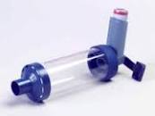
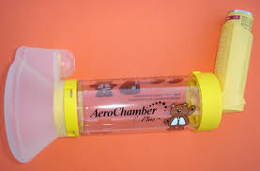
ADMINISTRATION METHODS
Inhalers
    Nasal
    Oral
      Each Metered Dose Inhaler (MDI) has different use and care, priming, shaking, and cleaning directions.
      Review insert instructions before use.
Notes:
Page 9 in manual

Slide 18
ADMINISTRATION METHODS
Not covered in this training:
  Rectal medications
  Inhaled medication by nebulizer
  Nasal medication for seizure disorders
  Injectable medications
  Oxygen therapy
If a student requires medication by these methods, your school nurse will initiate an individualized procedure and train appropriate personnel.
Notes:
(page 9/10) Personnel cannot legally administer medications through routes/procedures that they have not been trained on. To do so could be considered practicing nursing without a license which is against the law.

Slide 19
SAFE STORAGE & HANDLING
Original container
Secure, locked storage
Never administer medications from an unlabeled container.
Never accept medication in a bag or unmarked container.
Notes:
(page 10 of manual) It is preferable to store medications, particularly the potentially emergency/life-saving medications (such as inhalers, epinephrine, and glucagon), in containers or locations which allow them to be quickly removed and transported in the event of a drill or emergency.
Parent must bring medication to school and pick up medication to take it home. The only exception is for medication that a student is taking legally without parental consent.
DO NOT: empty medication from its original container into any other storage device.

Slide 20
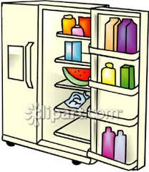
SAFE STORAGE AND HANDLING
Refrigeration
Emergency plans
Notes:
Page 10 in manual
Some medication require refrigeration
Single use
Locked box in refrigerator
Refrigerator temperature
It is best-practice to practice the plan for medication removal in the event of an emergency, during school emergency drills, so that personnel can be designated and trained on the procedure in advance of an actual emergency.
Life-saving medications in particular should be brought out and kept in close proximity to students during drills and emergencies.

Slide 21
SAFE STORAGE AND HANDLING
Transport of medication
Medication changes: we cannot accept verbal requests
End of school year
  Medication disposal
Notes:
When any medication is brought in for personnel to administer, whether it is a prescription or nonprescription med, the parent (or student) must fill out a Medication Form. You will see an example of this form in the following slides. Personnel will also establish a Medication Administration Record (also known as a MAR) for the student at this time, upon which all administrations and comments will be documented.
Personnel should be sure to check expiration dates on medications as they are brought in – Do not accept expired medications. If a medication is to be used throughout the school year, and you see that it will expire part-way through the year, make note of this on the MAR and remind the parent that they will need to replace the medication before it expires. For the student’s safety, school personnel can not administer expired medications.
If the medication needs to be counted, this should be done at this time, and documented on the MAR, by the trained personnel accepting the medications from the parent (or student).
Changes in medication instructions requested throughout the school year must be consistent with manufacturer’s guidelines, and/or reflected by a new prescription label or prescriber’s note with signature.
Any medications not picked up will be disposed of appropriately by school personnel.
Most schools send several notices to parents, beginning in the spring, reminding them that they will need to pick up their student’s medication within two days of the last day of school or the medication will be destroyed.
Medication Disposal: Page 11 of manual
Personnel should follow their district’s policy on medication disposal if they have one. If they do not, follow disposal instructions on www.FDA.gov
It is no longer acceptable practice to flush down the toilet or pour down the drain.
Take-back/collection programs; or
Remove from container, mix with undesirable substance such as pencil shavings or used coffee grounds, and place in an impermeable plastic sealable bag. Discard in trash as close to pickup day and time as possible.
Student information should be removed or thoroughly concealed with marker before discarding bottle or container.

Slide 22
COUNTING PILLS
Some pills require counting by 2 people upon sign-in and sign-out, and additionally as required by district policy
  Any controlled substance:
    Sedatives
    Stimulants
    Anti-convulsive
    Narcotic analgesics
    Pyschotropics
  May count with parent & staff, or 2 staff members
Notes:
(page 10 of manual) If personnel are unsure of whether or not a medication being brought in is a controlled substance that requires counting, they should go ahead and count it. There is no harm in counting any medication – better to be safe than to miss something important.
Medication counting should be done at the time that the trained personnel is accepting the medications from the parent (or student), and should be documented on the MAR.
Discrepancies should be reported to the school nurse or building administrator and parent/guardian immediately.

Slide 23
CHARTING FORMS
Notes:
Authorization for Medication Administration by School Personnel:
This is an example of the form that needs to be signed by parent (or student under certain circumstances) for any medication being administered by school personnel.
The parent (or student) must fill out the medication information, and the personnel accepting the medication must check the parent instructions and information provided against what is on the prescription label, or in the case of a nonprescription drug, against the manufacturer’s recommended dosing guidelines for the age of the student.
If a parent wishes to have their student self-administer and carry their own medication, with no assistance or documentation by school personnel, they will need to fill out a different form, which will be discussed in the following slides.

Slide 24
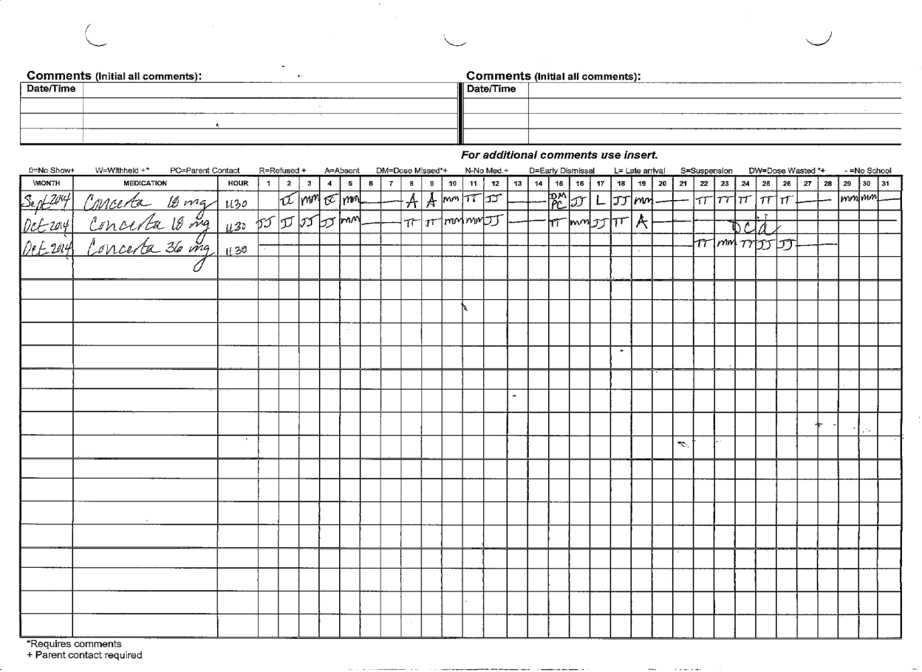
CHARTING FORMS
Notes:
This is an example of an official Medication Administration Record (MAR).
The MAR must include: Full name of student, Date of birth (DOB), name of medication, dose, method of administration(route), and frequency
When any medication is brought in for personnel to administer, whether it is a prescription or nonprescription med, the parent (or student) must fill out a Medication Form, and the trained school personnel accepting the medication must establish a Medication Administration Record (also known as a MAR) for the student at this time, upon which all administrations and comments will be documented.
Personnel should be sure to check expiration dates on medications as they are brought in – Do not accept expired medications. If a medication is to be used throughout the school year, and you see that it will expire part-way through the year, make note of this on the MAR and remind the parent that they will need to replace the medication before it expires. For the student’s safety, school personnel can not administer expired medications.
If the medication needs to be counted, this should be done at this time, and documented on the MAR, by the trained personnel accepting the medications from the parent (or student).
Changes in medication instructions requested throughout the school year must be consistent with manufacturer’s guidelines or reflected by a new prescription label or prescriber’s note with signature, and a new parent permission for medication form must be signed by the parent.
Each row on the MAR represents one month of administration on one particular medication and dosage, and has 31 days in which to sign verification of administration, or to enter a code for any circumstances/events that resulted in NOT administering the medication as directed. In such a case, there is a list of codes to choose from along the top of the table. Personnel should enter the appropriate code and write a short, dated and signed comment in the spaces provided throughout the MAR.
For clarity, there should be no blank spaces on the monthly row for a daily medication.
Cross out any weekends and non school days for that month.
The initials of the personnel administering the medication should be in the corresponding box for that day once the medication has been given.
If the medication is not given for any reason or the student is absent, this should be documented in the box for that day, using the appropriate code from the list provided on the MAR.
If a medication is discontinued part way through the month, or if the parent does not bring it in until part way through the month, a simple line should be drawn, midway through the date boxes, up until the date that administration will begin, or starting on the day after the last dose was administered.

Slide 25
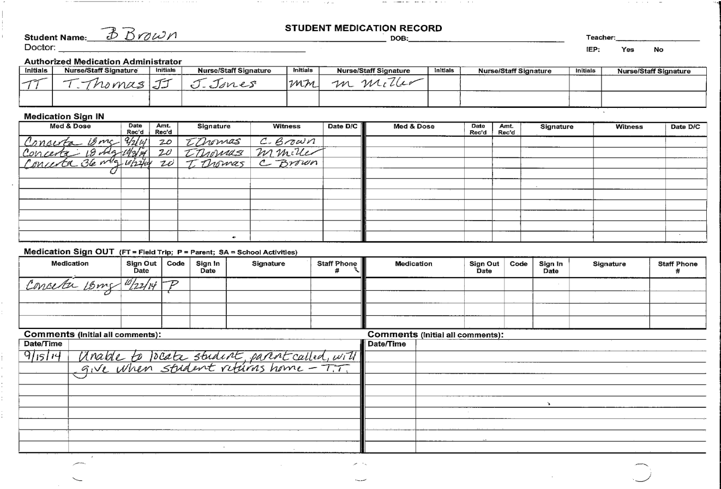
CHARTING FORMS
Notes:
There should be an area on any medication administration record (MAR) for trained personnel to sign the medication in and out, and to document the pill count as necessary when the medication is initially brought in.
All personnel administering medication should also indicate their name next to their initials on this page of the MAR so that it is clear whose initials are entered on each day of administration on the official record.

Slide 26

DOCUMENTATION
Personnel must document every time a medication is given. Documentation must be accurate, legible, and completed at the time of the administration.
Document in blue or black ink only - No pencil.
If a mistake is made in charting, cross out with a single line and mark “ME” (mistaken entry); do not use white out.
Notes:
Page 11 of manual:
It is best practice to keep all medication administration records (MARs) locked up in the same secure location where the medications are kept. These should not be in a separate location from the medications, or personnel will be unable to triple-check the six rights of medication administration while administering a med, nor be able to immediately document their administration.

Slide 27
STUDENT SELF-ADMINISTRATION
No assistance required
No documentation required
Self-administration form
School Nurse/Administrator approval
Notes:
Page 5 of manual:
If a student is permitted to self-administer medications it means that no assistance and no documentation by school personnel is necessary beyond obtaining the initial parent or student signature on a self-medication agreement.
To self-administer, the student must be able to demonstrate the ability, both developmentally and behaviorally, to self medicate with written permission from parent (or from student, pursuant to ORS 109.610, ORS 109.640, and ORS 109.675), building administrator, and prescriber or registered nurse practicing in the school setting.
Check with your school district for a self-administration policy and written agreement for all parties to sign.
This agreement may be revoked at any time if the student is unable to comply with the agreement.

Slide 28
STUDENT SELF-ADMINISTRATION
Notes:
This is an example of a Self-Medication Agreement/Form. It should have a signature line for:
parent/student
school administrator
Prescriber or RN practicing in the school setting.

Slide 29

CONFIDENTIALITY
Student medication records are confidential.
Files should be locked with the medications and access limited to authorized school personnel.
Parent written authorization is required for release of protected student information.
Notes:
Page 11 of manual
Once students reach the age of 18, consent for release of information transfers to them.

Slide 30

RECORDS RETENTION
Medication records should be filed at the end of the school year. Place record in student’s health folder in the cumulative file.
If medication administration is included as a related service on an IEP, the medication record is placed in the Special Education file for the student.
Notes:
Page 11 of manual
IEP: Individualized Education Plan

Slide 31
ERRORS & UNEXPECTED SITUATIONS
Report medication errors immediately to the parent, building administrator, and the school nurse.
The following actions constitute an error:
    Medication not given
    Medication administered to wrong student
    Wrong medication or wrong dose given to student
    Medication given at wrong time
    Medication given the wrong way or route
Notes:
Page 11/12

Slide 32
ERRORS & UNEXPECTED SITUATIONS
If student does not receive medication within a half hour of the scheduled time: document, and notify parent and school nurse.
If student refuses medication: ask for reason, encourage, document, notify parent and school nurse.
If student vomits or spits out medication: document, notify parent, send home if ill.
All medication has the potential for side effects. Report any unusual symptoms or behaviors to school nurse and parent immediately.
Notes:
Most districts have a form to document medication administration errors or a “near-miss.” - Check with your district.
Do not be afraid to report a medication error. For the student’s safety, the sooner you let the appropriate people know what has happened, the sooner they can begin to rectify the situation and monitor the student for effects.
*Emphasize the potential for life-threatening side effects and proper response – epi by someone trained?, EMS, CPR*

Slide 33
FIELD TRIPS OR OFF-CAMPUS ACTIVITIES
If a medication is to be administered when students are on a field trip or off-campus activity, personnel trained in medication administration must accompany the student group.
Any/all medications taken on the activity must be kept in their original container.
Medication-trained personnel will sign the medications out, and then back in, and document any administration upon return to school.
Notes:
Page 13 of manual
Teachers, administrators, and office staff should be mindful of students with scheduled medication needs and emergency/life-saving medications.
School offices should have procedures in place to coordinate fieldtrip requests with a check for any students who take medications during the time that they will be under the supervision of school personnel.
Districts must be sure to arrange, well in advance, the training of an appropriate amount of personnel to adequately accompany students with medication needs.
Medication Administration Records are generally not taken on field trips and activities. School personnel accompanying a student needing medications should be fully aware of the student’s condition and medication treatment, including possible side effects and reactions to watch for. The personnel will then document administration on the MAR when they return to school.
In the event that a district has not planned in advance for the health or medication needs/accommodations of a student, and there are not appropriately trained personnel available to accompany the student on the day of the trip, the district must cancel the entire trip or activity – it is a violation of ADA to remove only the student with medical needs due to inadequate district planning.
As a last option, the parent may be invited to attend the trip and provide care to the student.

Slide 34
QUESTIONS?
THANK YOU
Notes:
Be sure that certificates of completion for the course have been signed.
Remind attendees that they need to update their training online before today’s date next year, or they will be locked out of the system and will have to attend an in-person class again.

