Slide 1
Forest Carbon Basics:
Accounting Concepts
Mark E. Harmon
Richardson Chair and Professor in Forest Science
Oregon State University

Slide 2
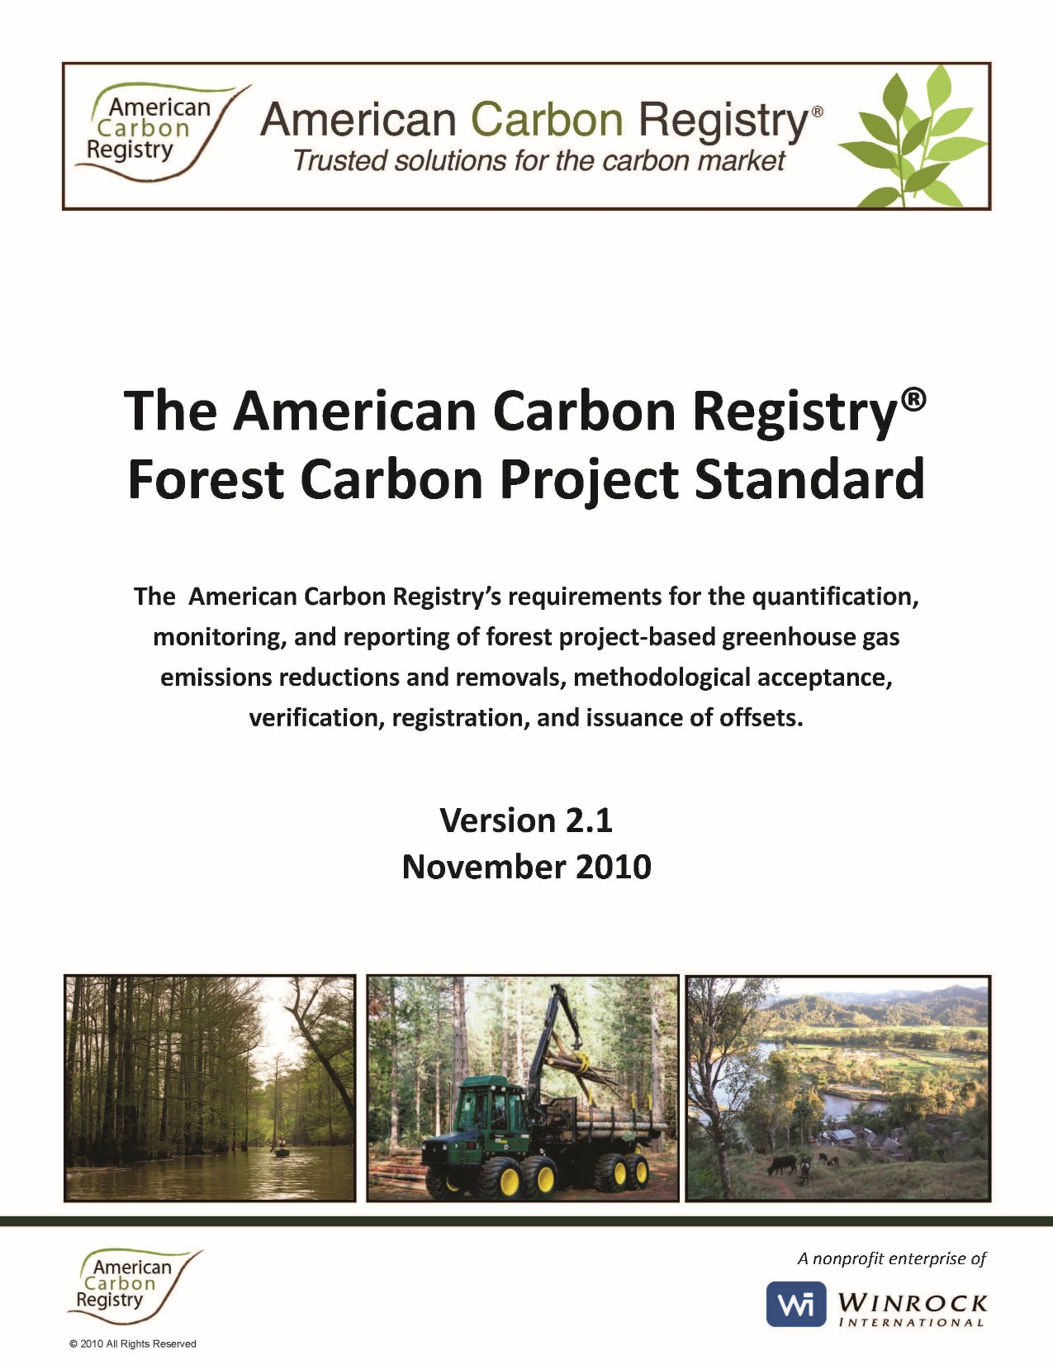

Slide 3
General Accounting Principles
Additionality: the action must result in carbon benefits that are in addition to business as usual (BAU)
Permanence: the action must result in a “permanent” change in carbon stores
Leakage: actions in one location/time can be countered by actions in another place that are indirectly caused by the initial action
Notes:
To work accounting rules need to be agreed to. Here are three aspects that are part of almost any accounting scheme. In the next slides we will look at each in turn.

Slide 4
Additionality-1
Action
Starts
Carbon gain=+
Carbon store→
BAU
Time→
Notes:
Here is a simple case to illustrate the concept. The red line is business as usual (BAU) and in this example it maintains a constant store of carbon. Suppose at some point an action is taken to increase carbon stores, the increase is shown by the black line. The carbon that is gained is the value at any time minus the baseline. So the baseline of BAU is very important to determine additionality. It is in the interest of parties to set the baseline as low as they can. For example, some have suggested that the baseline should be zero, which given the fact that we can’t have negative carbon is as low as one could go in theory. But almost any terrestrial ecosystem will have more than zero carbon, so the BAU is usually either the current/past practice or the legally mandated one.

Slide 5
Additionality-2
Action
Starts
Carbon gain=0
Carbon store→
BAU
Time→
Notes:
Here is an example of an action that does not increase the store in carbon. There is no additional carbon stored so the gain would be scored as zero.

Slide 6
Additionality-3
Action
Starts
BAU 1
Carbon gain=?????
Carbon store→
BAU 2
Time→
Notes:
Unfortunately additionality creates perverse incentives. If a forest has been managed to maximize carbon stores (e.g., old-growth) then there can be no additionality, which means these forests have no value in a offset program. Ironically the forests gain value if the carbon amount is depleted. If the old-growth forest is the BAU baseline, then cutting the forest down does not result in any additionality. But if the baseline is moved to BAU2, then there can be an apparent gain. In some systems baselines can be reset, which can lead to gaming of the system.

Slide 7
Additionality-4
Action
Starts
Carbon store→
Carbon gain=????
BAU
Time→
Notes:
What if the baseline is not horizontal. In this case the forest is projected to decline in stores over time, but the action prevents that from occurring. Does that count as a carbon gain? It would be additional in a sense, but it really would not lower the carbon in the atmosphere. It would just prevent it from getting worse. Is less worse a gain?

Slide 8
Additionality-5
Action
Starts
Carbon store→
Carbon gain= 0????
BAU
Time→
Notes:
What if the baseline is assumed to be horizontal (dashed line), but in fact is not. In this case the forest is projected to increase in stores over time, but the action slows the rate of increase. Does that mean no carbon is added to the atmosphere? I suppose. It would be true that the forest carbon is not lower than it started, but wouldn’t that mean more carbon is in the atmosphere than BAU?

Slide 9
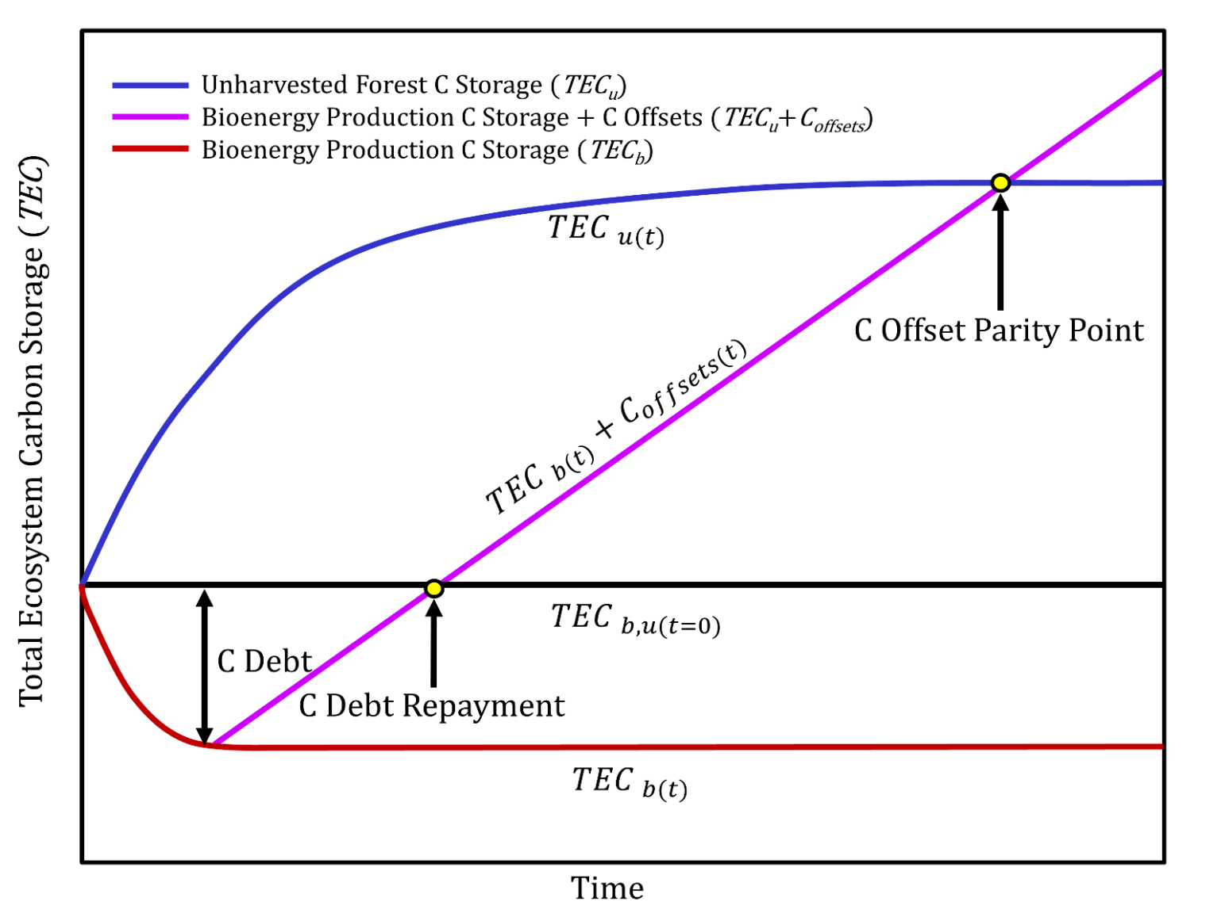
Carbon Debts versus Carbon Parity
After Mitchell et al 2012
Notes:
In some cases one might need to consider two baselines. Here we have two: one if the system continued without change (black line) and one in which there is a second alternative: letting the forest just grow. This shows that one can repay a carbon debt, but still not reach parity with an alternative system. What therefore is the carbon cost of the new system? The difference between the lower red line and the middle black line or the difference between the lower red line and the upper blue line?

Slide 10
Additionality Summary
Additionality is necessary, but
Baselines may be hard to either predict or justify
It can create perverse incentives
  to reduce carbon in high carbon systems
  to manipulate the baseline
Notes:
So in summary…

Slide 11
Permanence-1
Action
Starts
Long-term store
Carbon store→
Carbon gain
Time→
Notes:
Under the notion of permanence one has to maintain the carbon store once it is created. This means you can only count the gain once.

Slide 12
Permanence-2
Action
Starts
Carbon gain= 3 X or 1X?
Carbon store→
Time→
Notes:
In a system without permanence the store can be increased, then depleted, then increased, and then depleted allowing the carbon manager to accumulate a very large and non-existent carbon store. We can see this sort of behavior in the current accounting being proposed for wood product substitution.
The need to address permanence has created incentives to have managers pay back carbon credits if they allow the carbon to drop. But this creates a significant disincentive, because losing carbon is a major liability. It might be caused by the managers actions or someone or something (nature’s) actions beyond the managers control.

Slide 13
One view of how product substitution works: no losses
Displacement from harvest 3
Displacement from harvest 2
Displacement from harvest 2
Displacement from harvest 1
Displacement from harvest 1
Displacement from harvest 1
Notes:
For one thing this implies the displacement is never lost, degraded, or otherwise altered. This does not seem reasonable. Clearly if the house was not replaced by wood at harvest 2, then the displacement from harvest 1 would be lost.

Slide 14
Alternative view of how product displacement works
Displacement from harvest 1
Displacement from harvest 1
renewed
Displacement from harvest 1
Renewed again
OR
Displacement from harvest 1
Notes:
A more reasonable view in my mind is that if the house built after harvest 1 is replaced by harvest 2 that the displacement is renewed and extended. Ditto for harvest 3. If the wooden house is not replaced then the displacement is lost because fossil fuels are used to replace the wooden house with concrete and steel.
14

Slide 15
The fact buildings don’t last forever has real consequences
Notes:
In some cases assumptions in product substitution are being made that implies a permanence in forest products that does not exist. If product substitution is not related to the longevity of forest products such as buildings, then it implies that building last forever.

Slide 16
Permanence-3
Action
Starts
Long-term average store
Carbon store→
Carbon gain
Time→
Notes:
To counter the payback disincentive, schemes have been offered in which carbon gains are credited up to the point of the average permanent store. In this case the system gains and loses carbon, but the average is quite stable.

Slide 17
How does one deal with permanence in the real world?
Define time limits
  Minimum project term (ACR=40 years)
  Crediting period (ACR=40 years)
Bundle projects to reduce risk
  More projects, less total risk
  Creation of a bank for small players

Slide 18
Influence of scale on apparent permanence
Notes:
Permanence is often discussed as an all or nothing proposition. Since forests gain and lose carbon as they are disturbed, they are considered by some to be temporary carbon stores and not permanent carbon stores. But since most carbon stores on Earth are dynamic, this view is not particularly useful or realistic. As we considered scaling we saw that stands can gain and lose carbon over time. The permanent store is clearly not the peak. But then again the permanent store is not the valley either. If a system is managed so that one has many stands that are harvested asynchronously, then we can have a pretty permanent store at the landscape level. It happens to be the average of all the stand ages.
An implication of this scaling feature is that large land owners will appear to have permanent carbon stores, whereas small land owners will not even if they practice the exact same kind of management! To counter this some have proposed that small land owners form cooperatives or banking systems to gain the stability of large land owners.

Slide 19
Permanence Summary
Permanence is necessary, but it is
Scale dependent (space and time)
Not an all or nothing proposition (part can be permanent and part not)
a disincentive for many (hard to make something truly permanent)
Notes:
So in summary…

Slide 20
Leakage-1
Action
Starts
Carbon gain
Carbon store→
BAU
Reaction
Starts
Time→
Carbon store→
BAU
Carbon loss
Time→
Notes:
Leakage is basically a reaction to an action that counters the benefit of the action. Here we see the increases in Greenland offset by the reaction of Brownland. These are silly names, but one often hears the leakage argument presented as “our management is good (green) and their management is bad (brown) so we should be the ones harvesting”—perhaps the names are appropriate after all.
While leakage is an issue, it can be hard to quantify because there is not necessarily a direct causal link. But if timber is needed and one region does not supply that timber, then it makes sense that another region might step in. If that timber harvest leads to the loss of carbon, then there might be no net gain globally.

Slide 21
Sensitivity of substitution to leakage
Notes:
We also talked about leakage when we examined forest products. When fossil carbon is not used because of biofuel or product substitution, it does not mean that it is never used. By not using the fossil fuel, the fuel becomes more available, leading to decreases in price that might increase use!
Here is what would happen if we added a unit of substitution benefit per year and the fossil carbon gets used over various timelines. Even if it takes 200 years, the benefit is substantially reduced to about a third of the optimistic estimate.
Frankly this is the awful reality of leakage, one parties good act is countered by another parties not so good act. To avoid this behavior policies need to include all the parties.

Slide 22
Leakage 3
Leakage is a pain, but
It will likely counter projected gains
May require policies to counter it
  Fossil carbon reserves the size of substitution benefits
  Use resource more wisely so you need less of it
Notes:
So in summary…

Slide 23
Discounting
Measurement uncertainty
Disturbances
Leakage
Timing of the action
Value of action→
Time of action→
Notes:
In some carbon accounting schemes there is a discounting for various factors. This makes the estimate conservative. The reason to be conservative is that it causes less damage to underestimate carbon mitigation than it does to overestimate it.
First three on the list have been covered, so they should be apparent. But the last one is something that we have not discussed but it is currently being explored.
The idea is that an action today counts more than an action tomorrow as the graph in the lower right illustrates. Also an action that is effective today is more valuable than one that becomes effective tomorrow. The latter covers actions that have temporal lags before they become effective. I am not sure what the values of discount rates that have been used, but something on the order of 0.03 to 0.06 per year might make sense. This would say that if something is done 50 to 100 years from now, that the action will have little effect on the climate.

Slide 24
Accuracy and Precision
Accuracy: how close to the true value?
  Need a standard of true value
  Related to systematic errors or bias
  Can be improved with better technology
Precision: how variable is the estimate?
  Related to “random” errors
  Can be improved with
    better sampling schemes
    More samples
Measured value
1:1
True value
mean→
less precise
more precise
Notes:
This slide reviews the concepts of accuracy and precision.

Slide 25
How accuracy influences accounting
If there is a known positive bias (estimate is too high), then a discount can be made
If there is a known negative bias, then adjustments upward could be made, but these are usually associated with omissions on the part of those making the measurements or calculations

Slide 26
Biases can be introduced by omissions
Since one is trying to reduce the cost of measurements for accounting one may:
Use models which have the relative trend correct, but may be biased high or low
Not measure certain pools and depending on the system this could introduce biases that are either high or low depending on the situation
Notes:
To reduced costs one can do several things.
First, one might not make any measurements at all and use a model. Models are usually parameterized for a general condition, so it would not be unusual for a model to correctly estimate a trend, but depending on the particular site, the model predictions might be systematically biased low or high.
Second, one could make measurements, but exclude certain pools that are expensive to measure. But this can also lead to bias.

Slide 27
Case 1: Afforestation
Live only 182 MgC/ha
Live and dead 225 MgC/ha
All 218 MgC/ha
Notes:
In this case let’s consider afforestation on ag land with a depleted soil C store. If we just count the live we find the system gained 182 MgC/ha over a 100 year period. If we added the dead to the live we would have an increase of 225 MgC/ha over the 100 years. If we consider all the pools then we would have a slightly smaller gain of 218 MgC/ha. That is because in these model runs (using our previously developed process spreadsheet model) soil C declines slightly in the first 100 years. That is probably not realistic, however, the point is that if we just considered the live then we would underestimate the gain. This means we have a larger impact than planned, which is a good result for the atmosphere.

Slide 28
Case 2: Old-growth conversion
Live only 182 MgC/ha
Live and dead 142 MgC/ha
All 142 MgC/ha
Notes:
In this case let’s consider the conversion of an old-growth forest to a managed system with a 100 year interval between harvests. If we just count the live we find the system gained 182 MgC/ha over a 100 year period. If we added the dead to the live we would have an increase of 142 MgC/ha over the 100 years. That is because we created a great deal of dead carbon at the time of conversion and the new system could not maintain it. So the net gain is 22% less that by just considering the live. If we consider all the pools then we would have a gain of 142 MgC/ha. That is because soil C was fairly constant during the 100 year period. In this case if we just considered the live then we would overestimate the carbon gain. This means we have a smaller impact than planned, which is a bad result for the atmosphere.

Slide 29
Measurement Precision and Accounting
Fixed standard approach
Does not count
Counts
Counts
Mean estimate→
Fixed
standard
Entity 1
Entity 2
cost
Notes:
There are two contrasting approaches to measurement precision and accounting.
In this slide we will consider having measurements have to be within some fixed standard. If they do not meet that standard they are not accepted.
This is one way quality control is implemented, if the parts delivered for manufacture are too variable, then they are not accepted because the performance can not be counted on. So the idea is that if the precision of carbon estimate is too low, that value can not be trusted to perform so to speak. Note that they all have the same mean estimate.
This system can be quite costly. If one makes measurements and does not meet the standard, then money is wasted if there is no gain in carbon that can be traded. If one greatly exceeds the standard, then money is also wasted because carbon was oversampled and that cost is not going to show up as a profit.

Slide 30
Measurement Precision and Accounting
Variable discount approach
Mean estimate
Amount credited
Entity 3
Entity 4
Entity 2
Entity 1
Cost
Measurement imprecision
Notes:
The second system is considered here. One establishes a variable discounting approach based on measurement precision. The amount of carbon credited depends on the precision achieved. If the entity wants more carbon “credit” then they can increase the rigor of their sampling effort to match the cost/benefit ratio they want to achieve. A logical discount would be 2 standard errors of the mean. This would give a 95% chance that this level of carbon has been stored.

Slide 31
EPA’s Biogenic Accounting Factor (BAF)
BAF: Biogenic accounting factor
NEB: Net biogenic emissions
PGE: Potential gross emissions
T: time at which NEB ceases to change
t: value at a particular year
Δ: difference between years
Σ: sum of the differences over a period

Slide 32
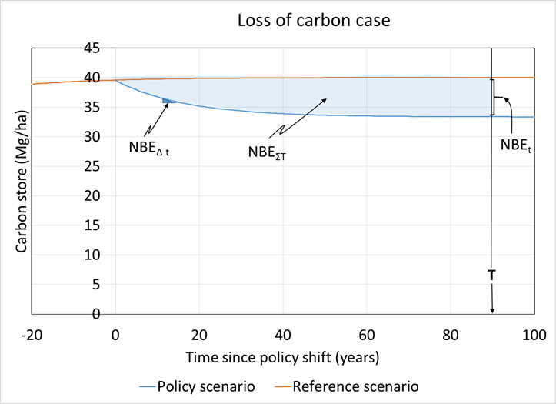
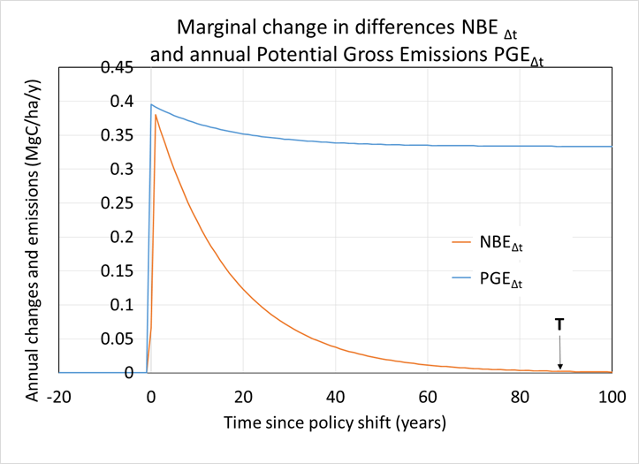
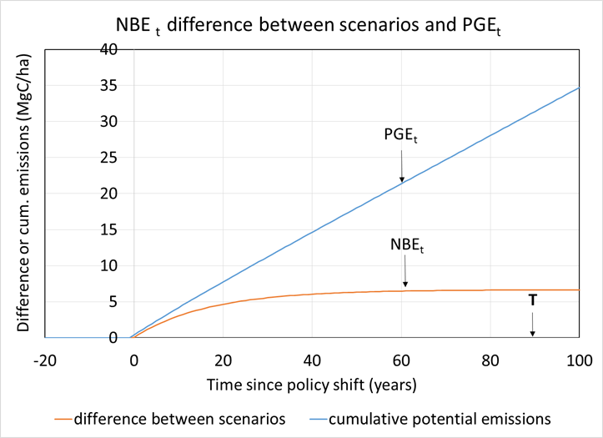
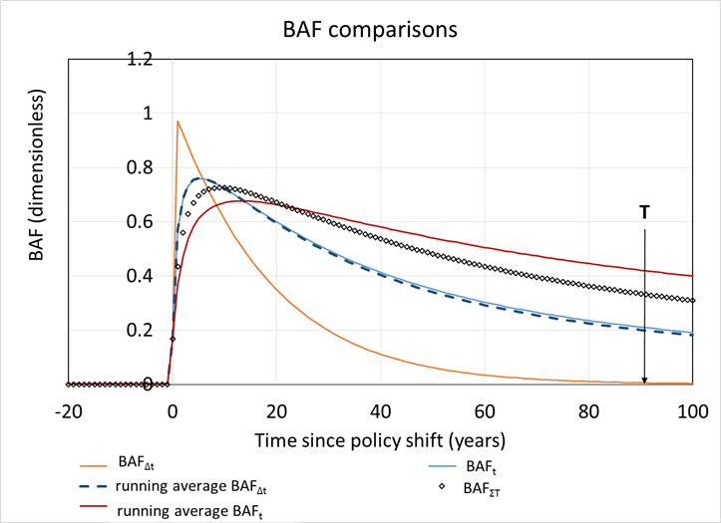
EPA BAF: Case when carbon is lost
Notes:
Let’s examine a case in which carbon is lost from the system when the biogenic carbon harvest begins. For example, we start harvesting small trees and slash.
The upper left compares two cases the policy and the reference scenarios. We see the two curves diverge and the difference is shown in the upper right panel. It increases for a time and then does not increase much. The right panel shows the annual change in the difference. In a way this indicates how much of the currently harvested carbon is being recycled back into the system. When it reaches zero, then all the carbon that is harvested is “recovered” by the system.
The reason a loss from the system is viewed as a positive number is that the reference point is the atmosphere. A loss from the ecosystem is a gain for the atmosphere. This comes from conservation of mass.
The lower left shows the net biogenic emissions and the potential gross emissions. PGE increases with time, but NBE reaches a constant. Therefore a greater and great share of the PGE is recycled in the harvested system.
The lower right shows how various BAF’s change over time. The delta term is the value in any given year, the instantaneous rate. The BAFt looks at the cumulative value at time t. The sigma value examines the difference over the entire period up to time t.

Slide 33
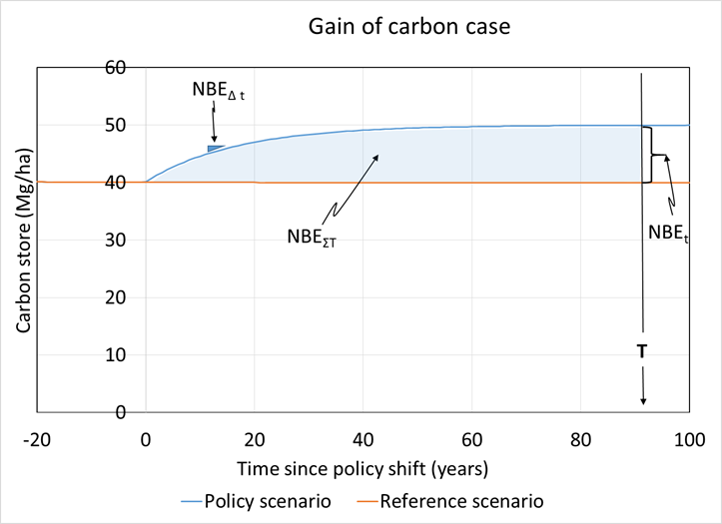
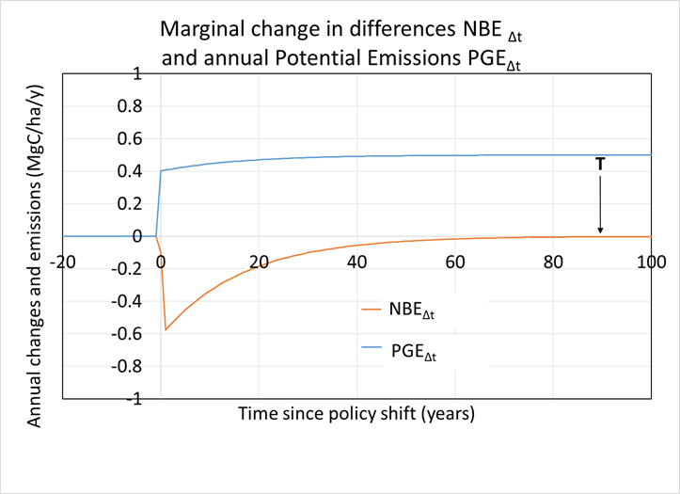
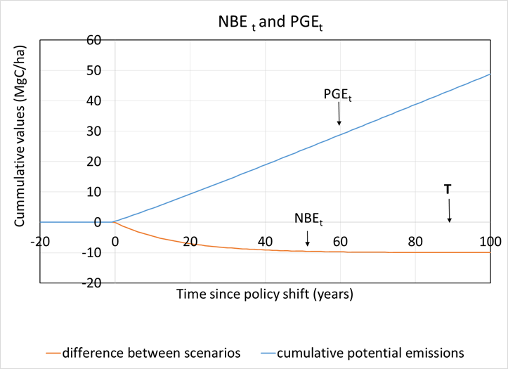
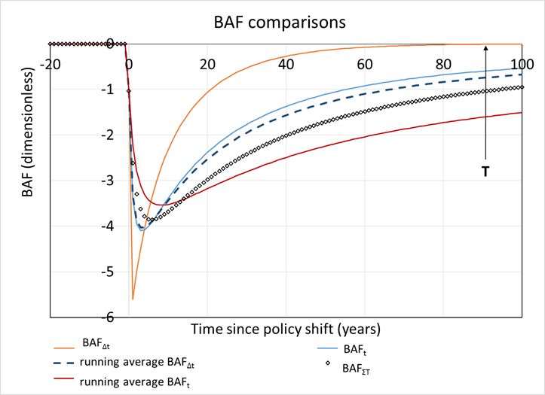
Case when carbon is gained
Notes:
We don’t always loss carbon to the atmosphere. Suppose we planted a forest on an old field that was not being used for crop production. This would lead to an increase in ecosystem carbon stores. However, that increase does not go on forever and just like in the loss case reaches a new balance.

Slide 34
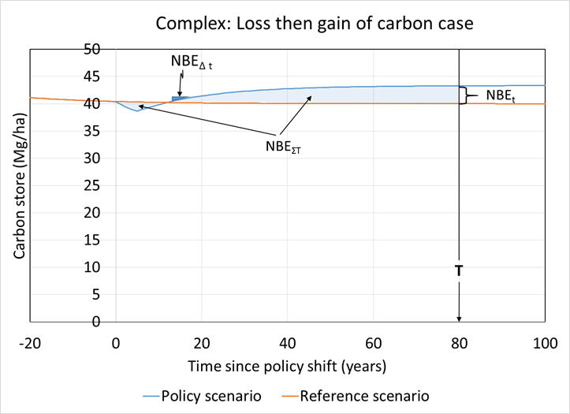
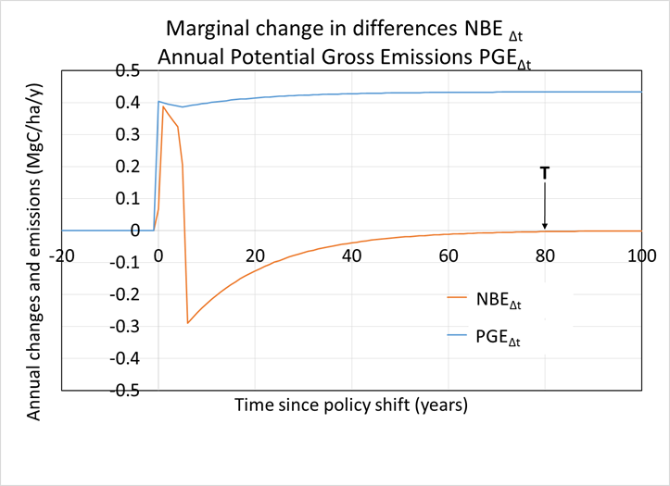
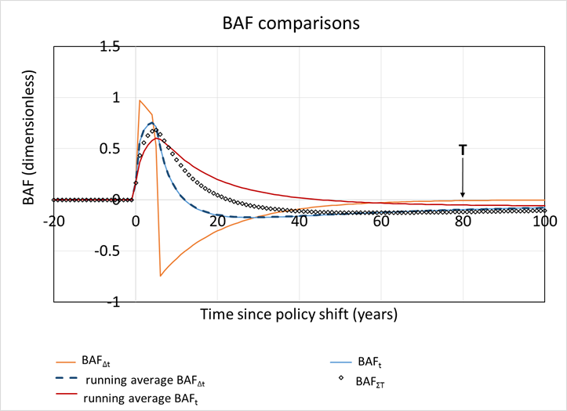
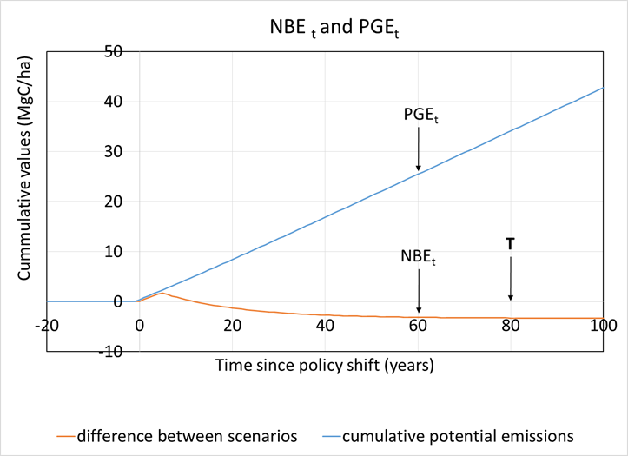
Case when carbon is lost then gained
Notes:
We can have more complex time trends. Here we have an initial loss from the ecosystem, but eventually a gain. This might because some action is taken to make the system inputs greater (say fertilization or improved growing stock).

Slide 35
Current issues with EPA’s BAF
Can a scientifically based assessment time be determined?
How will feedstocks with very different time dynamics be integrated/reconciled?
How will regions with different time dynamics be integrated/reconciled?

