Slide 1
Collaboration within Employment first teams
Employment First community of practice webinar
May 9th, 2017

Slide 2
Today’s community of practice panelists
Jenny Crook, Wise Program Manager, jenny@gowise.org
Michelle Furman, Shangri-La Community Employment Services Manager, michelle.furman@shangrila-or.org
Nicholas Van Pless, Community Access Services Supported Employment Manager, NVP@cas-dd.org
Melissa Miller, UCP Employment Solutions Program Manager, mmiller@ucpaorwa.org

Slide 3
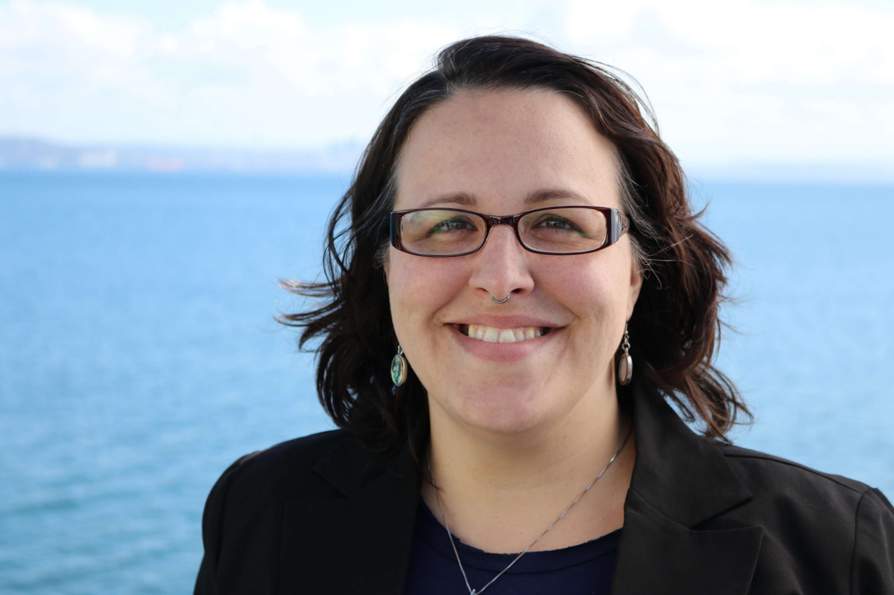
Introducing Jenny
Jenny Crook has experience as a Competitive Integrated Employment Program Manager, an Employment Specialist, and a Job Coach in Oregon. She became a Certified Employment Support Professional through APSE in 2014 and received her BS in Sociology from Portland State University. Jenny's interests and strengths are in collaborating with supported employment programs and teams to create and implement best practices. She is passionate about the tenets of Employment First and achieving equitable employment for all people experiencing intellectual and developmental disabilities. When not in the office she enjoys reading dystopian novels, thrift shopping for treasures, and cats.

Slide 4
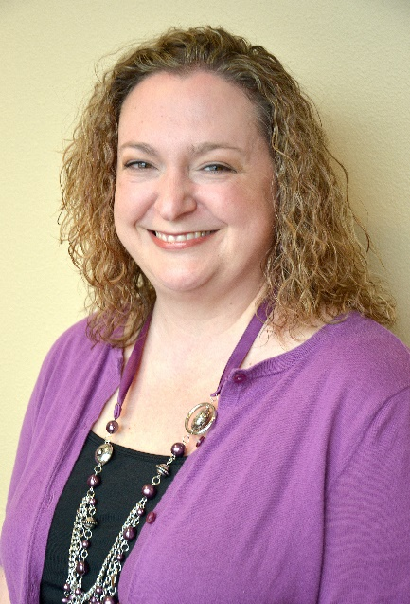
Introducing Michelle with Marion and Polk employment first network
Michelle Furman is the Community Employment Services Project Manager at Shangri-La. Michelle is excited for opportunity to help move our communities and individuals forward into integrated employment. She is a Certified Employment Support Professional with APSE and is a member of the Oregon APSE Board. Michelle is actively involved in her community through facilitating the Marion & Polk Employment First Network and is also involved in the Lincoln Employment First teams. She is currently a trainer for Introduction to Supported Employment, Discovery and Person Centered Employment Planning for the Oregon Employment Learning Network (OELN). She is a strong advocate for integrated community employment and has been developing Shangri-La's Community Employment Services since July 2014. Michelle holds a Bachelor's Degree in Health Sciences from Linfield College.

Slide 5
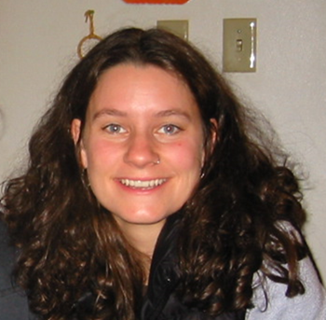
Introducing Melissa with Multnomah county employment first team
Melissa Miller has been nationally certified in the art of Job Development and Job coaching since 2006, when she started the community-based employment program at United Cerebral Palsy of Oregon and SW Washington. Melissa obtained her Master’s degree in 2008 and believes her skills in mediation help her to advocate for and secure employment for adults with disabilities. Melissa is currently the Program Manager of Employment Solutions, whose mission is to assist adults with disabilities to identify, obtain and maintain meaningful employment. Melissa attributes her success to having excellent mentors, and an amazing team of Job Developers and Job Coaches.

Slide 6
introducing Nicholas with the Washington county employment first team
Nicholas started at a very young age supporting people with disabilities in recreational activities, and since 2003 has been working in Supported Employment. He is currently the Supported Employment Manager with Community Access Services, serving customers from Astoria to The Dalles, including the Portland metro area. Nicholas specializes in customized employment, seamless transition, program development, Discovery, and working with individuals on the autism spectrum. In addition to service with Oregon APSE, Nicholas also serves on the board of PHAME, an education and performance academy serving people with disabilities. In his spare time, Nicholas enjoys playing guitar, bicycling, and adventure seeking, near and far, with his wife Alana.

Slide 7
Who is at the table?
Employment first team stakeholders

Slide 8
Employment first team Stakeholders
City representatives
Employment Provider Agencies
Vocational Rehabilitation Counselors
County DD Service Coordinators
Brokerage personal agents
Self-advocates
Family members
State representatives
Employers
Transition Educators
Community & Agencies with similar missions

Slide 9
Marion and Polk Employment First Network
Who is at the table?
VRC’s (VR Counselors)
Provider Organizations
County Service Coordinators
Brokerage Personal Agents
Family Members
Provider Organization Board Member
Transition Teachers and Supervisors

Slide 10
Marion and polk employment first network cont.
Transition Network Facilitator
ODDS Regional Employment Specialist
Training organizations
Who else should be at the table?
Advocates
Individuals that are employed
Employers

Slide 11
Multnomah County Employment First team
Stakeholders from all sectors of employment:
County I/DD Managers and Case Managers
Brokerage Personal Agents
Providers: Agencies and Independent Contractors
Community Partners: Incight, Ridewise, etc…
Who do we need:
Self Advocates
Parents
Teachers
Employers

Slide 12
Multnomah County employment first team cont.
How do we attract who we need?
Hold meetings during days and times that…
Self Advocates and Employers can attend (various)
Parents (after work, weekends)
Teachers (after 3:30pm)
We want you! Consider bringing your voice to the Multnomah County Employment First Team.

Slide 13
Washington County Employment First Team
Steering Committee –
represents as many partners as possible
General Meetings –
make sure to reach out to all parties
identify topics that will have wide appeal

Slide 14
programming
the when, how, and what of team meetings

Slide 15
The meet of the meeting
Roles of the Team Members
What is expected from participants?
Leads for agenda items
Note taker, minute maker
Progressing the mission
How is success measured? Objectives
Events
Timelines

Slide 16
Marion and Polk County Employment First Network
MEETING AGENDA
Date
Introductions
Goals
Announcements
Training
State Transmittals or Action Requests
Discussions:
what’s working?
what’s not working?
challenges
Transition Team Updates
Future topics
Job leads
Placements and Retention
Next meeting:

Slide 17
Multnomah County Employment First Team
STRUCTURE:
Team is comprised of Members and Steering Committee Members
40 members, approximately
Members attend and contribute voluntarily and to the best of their abilities
Members are encouraged to attend regularly (monthly meetings), with the level of commitment and contribution that they are able
Team is guided by a steering committee of 6 members currently
Steering committee members have committed to attend the monthly meetings
Our focus has been on creating events that get people hired

Slide 18
Multnomah County Employment first team cont.
Pros: volunteer, grassroots membership lends itself to many great ideas and new energy from new members often.
Cons: Turnover is high, many great ideas can mean it’s hard for a dynamic group to make decisions and pull off events – with everyone sharing the load.
Currently using a Training and Technical Assistance grant from WISE to help guide our group on how to run productive meetings and set up effective events.

Slide 19
Washington County Employment First Team
Quarterly:
allows for more topic generation,
easier for business, state, and school employees to schedule
Structure:
15-20 mins of big questions
Coffee and pastries
Main presentation
Provider updates
Topics covered – cycle through interests as they reflect membership

Slide 20
Collaboration
agencies working together to increase team outcomes

Slide 21
Stop, Collaborate, and Listen
Collaboration
Networking- exchanging information
Coordination- join efforts for mutual benefit
Cooperation- sharing resources to create something new
Communication
Fostering community
Monthly if meeting quarterly
Bi-weekly if meeting monthly

Slide 22
Marion and Polk County Employment first network
Collaboration:
Meeting agenda is fluid, so there is plenty of time for conversation around what is working/what’s not working
Sharing challenges that the network can help brainstorm
Share recent transmittals or other big news that might affect the work that we are doing
Share job leads and work experience opportunities
We celebrate new jobs during the month and retentions

Slide 23
Multnomah County Employment First Team
Ideally: everyone has unique skills and wisdom – put together we have the answers and solutions to many problems that arise in the field.
Practically: such a diverse group of individuals brings many challenges:
How to meet everyone’s needs?
Many changes to employment over past 7 years has also changed the membership of our team.
Changes to the employment field have brought members to our group for many reasons (confusion – wanting clarity about policies or procedures; fear – about what to expect from the executive order; purpose – wanting to make the system better; and inspiration – wanting to get more jobs for people with disabilities.

Slide 24
Multnomah County Employment First Team cont.
Room for Improvement
Steering committee is relatively new – allows steering members to make decisions vs consensus voting
Focus on one great event that can be repeated annually
Better collaboration with state officials
Purpose
Information sharing
Meeting employment goals

Slide 25
Washington County employment first team
Collaboration within the Team:
Sharing job candidates with provider agencies
Sharing state resources
Look at what works vs what’s not been working

Slide 26
Engaging the wider community
Taking it to the streets

Slide 27
Community Engagement
What is the message?
Listen and Learn
Refined delivery of your message- target and context
Know your mission
Invite people to join you
Who else is out there?
Networking or Professional Meet Ups
Chamber of Commerce
Business Associations
Family Networking

Slide 28
Marion and polk county employment first network
Engaging the Community:
A sub-committee is working on the Transition Fair for Salem-Keizer schools.
The network or representation from the network attends all of the local support fairs and transition fairs.
There has been interagency collaboration for the EF Innovative Grants and outcomes of some of those will be in our communities.

Slide 29
Multnomah county employment first Team
Mission
The Multnomah County Employment First Team endeavors to:
Design projects that increase employment prospects for individuals with I/DD and other disabilities;
Advance the Oregon Employment First Policy utilizing the group’s collective knowledge and wisdom;
Provide support, resources and guidance to self-advocates, providers, parents, Personal Agents, VR counselors, County DD Service Coordinators, teachers and any others who are seeking assistance in understanding employment procedures.

Slide 30
Multnomah county employment first team cont.
Major Projects to Date:
Created a resource list for community members
Get a Job! Portrait of Competence workshop for job seekers
Job Development Skills training (day-long training with community based exercises)
Networking event (targeted hiring event: 5 job seekers and 5 employers)
Subcommittee projects: Discovery (improving the tool), collaborating with Oregon Business Leadership Network, and Self-Employment

Slide 31
Washington county employment first team
Engaging the wider community
Make sure we invite employers to the table
Welcome all providers
Encourage openness

Slide 32
Questions?
Thank you for joining us!

