Slide 1
Oregon County Roads
Legislative Updates
Local Program Advisory Committee (LPAC) September 6, 2023
Brian Worley, County Road Program Director, Association of Oregon Counties

Slide 2
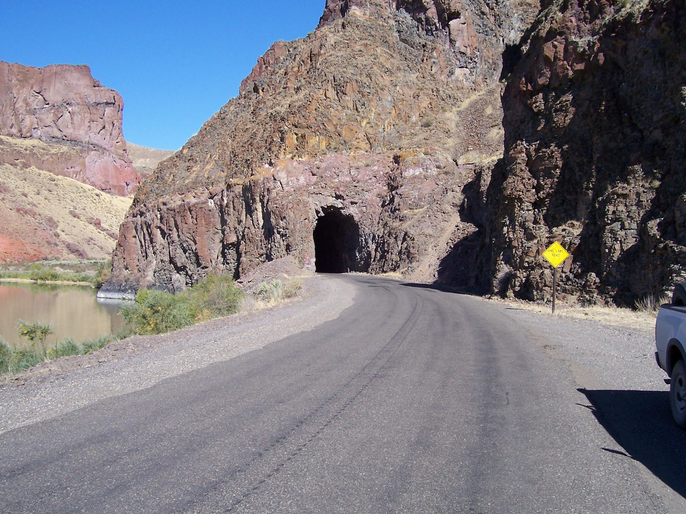
Overview
Revenue Update
State
HB 2101 STBG Fund Exchange
2023-24 Sessions: Other Bills and Issues
2025 Session: Revenue Package
AOC/OACES Outreach and Meeting Dates
Notes:
Brian

Slide 3
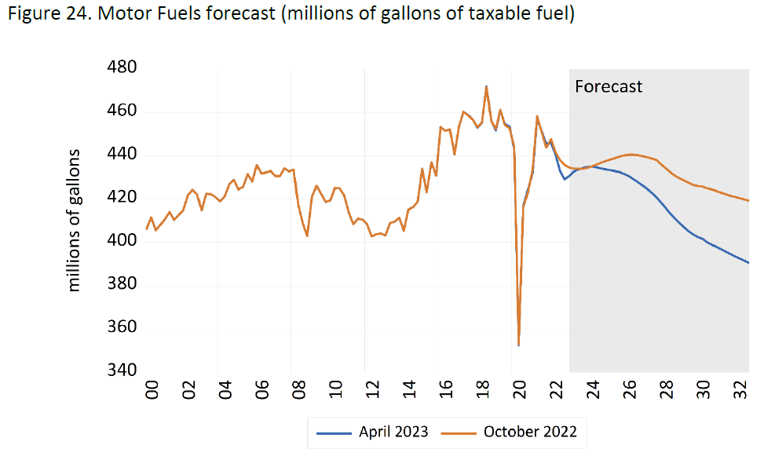
County Revenue Overview Update
Forecast Update:
January – April, FY 23 - FY 24
SHF Total: $350.8 million (-1%)
STBG / Fund Exchange Total $21.0 (0%)
Secure Rural Schools Total:
$31.7 (-2.1%)
Notes:
Brian
Last Three Mos. & Year-to-Date FY 22 Apportionment
Source: “FY22-23 ​Highway Revenues & Apportionments” (July Through Nov= $148,834,584.62)
Subtotal - Distribution to Counties - Year-to-date
Future Sources: https://www.oregon.gov/odot/about/pages/financial-information.aspx
Pre-COVID FY22 Forecast Total
Source: City County Apportionment with Triggers_1910
October 2020 FY22 Forecast Total
Source: City County Apportionment with Triggers_2010
April 2021 FY22 Forecast Total
Source: City County Apportionment with Triggers_2104
Source: FY 2021- 2022 County Road Revenue Forecasts May Update
October 2021 FY22 Forecast Total
Source: City County Apportionment with Triggers_2110
Source: FY 2021- 2022 County Road Revenue Forecasts November Update
Note: October 2019 Pre Covid Forecast for FY23 is $354,709,009 (+2.9 M)
October 2022 FY22 Forecast Total
Source: City County Apportionment with Triggers_2110
Source: FY 2022- 2023 County Road Revenue Forecasts November Update

Slide 4
Revenue Update
By 2035, all new passenger cars, SUVs, and light-duty pickup trucks must either be battery electric or plug-in hybrid electric.
Inflation has a sizable impact on fuel purchases and tax revenue
Notes:
Brian
Last Three Mos. & Year-to-Date FY 22 Apportionment
Source: “FY22-23 ​Highway Revenues & Apportionments” (July Through Nov= $148,834,584.62)
Subtotal - Distribution to Counties - Year-to-date
Future Sources: https://www.oregon.gov/odot/about/pages/financial-information.aspx
Pre-COVID FY22 Forecast Total
Source: City County Apportionment with Triggers_1910
October 2020 FY22 Forecast Total
Source: City County Apportionment with Triggers_2010
April 2021 FY22 Forecast Total
Source: City County Apportionment with Triggers_2104
Source: FY 2021- 2022 County Road Revenue Forecasts May Update
October 2021 FY22 Forecast Total
Source: City County Apportionment with Triggers_2110
Source: FY 2021- 2022 County Road Revenue Forecasts November Update
Note: October 2019 Pre Covid Forecast for FY23 is $354,709,009 (+2.9 M)
October 2022 FY22 Forecast Total
Source: City County Apportionment with Triggers_2110
Source: FY 2022- 2023 County Road Revenue Forecasts November Update

Slide 5
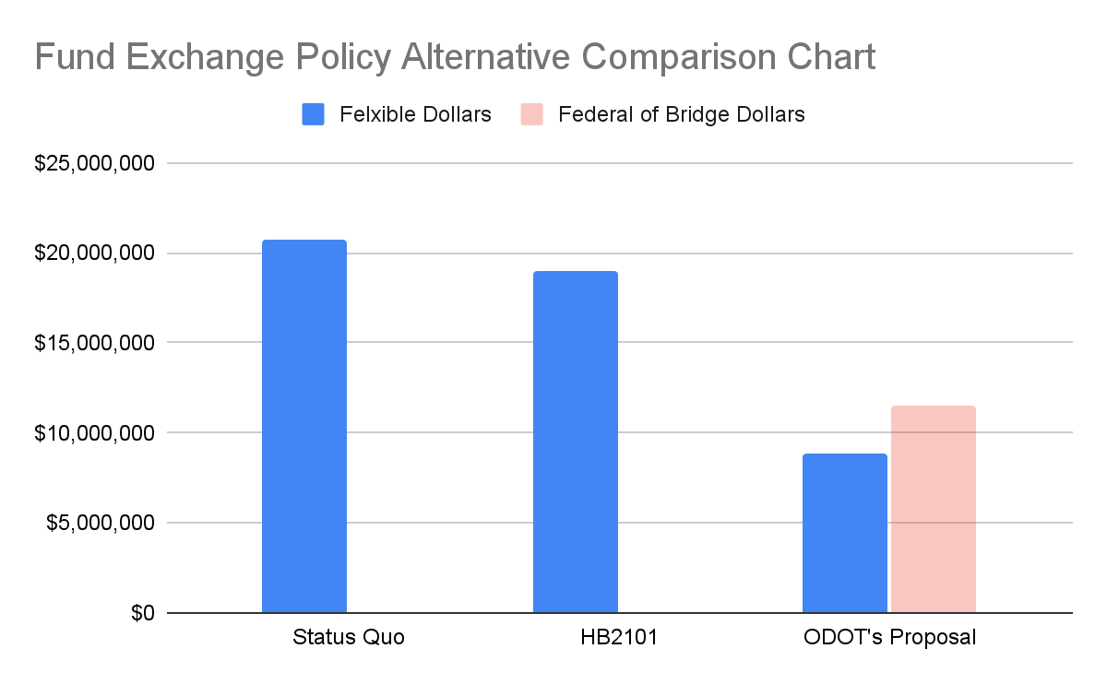
Fund Exchange Program House Bill 2101 and Previous Proposal
HB 2101
Provides $21 million in flexible funding to Oregon Counties
Equivalent amount compared to average IIJA funding levels over five years
Provides consistency and longevity for the program

Slide 6
2023 Session
Passed Bills:
HB 2101: Fund Exchange
HB 5005: Interstate 5 Bridge Funding
HB 5030: Lottery Bond Authorization, Local Project Funding, Burnside Bridge
HB 2095: City Photo Radar Authority
HB 2099: Omnibus, Safe Routes to School Program
HB 2793: Jurisdictional Transfer Advisory Committee
HB 3188: Marion County Speed Delegation Authority
2023 Unpassed Bills
SB 635: County ROW Utility Permit Cost Recovery
HB 3556: Abandoned RV Program:
HB 3297: Mandatory Road Usage Charge
2025 Session
Transportation Revenue Package

Slide 7
Upcoming OACES Meeting Dates
Regular OACES meetings Fourth Thursday of the month 9:30 am – 11:00 am
September 21, Klamath Falls, Oregon Tech
October 23 – 24, OACES Fall Conference, Hood River
November 14 – 16, AOC Fall Conference, Eugene
December 14, OACES Virtual
AOC/LOC Local Transportation Forum, Aug 23/Oct 2/monthly
AOC Transportation Committee, monthly
More info at: or-oaces.org/conferences-meetings
Notes:
Brian

Slide 8
More Information:
AOC Road Program:
1212 Court Street NE
Salem, OR 97301
Phone: (855) 843-5176
crp.oregoncounties.org
or-oaces.org
Brian Worley
County Road Program Director
Association of Oregon Counties
bworley@oregoncounties.org
Mallorie Roberts
Legislative Director
Association of Oregon Counties
mroberts@oregoncounties.org
Jordan Cole
County Road Program Policy Analyst
Association of Oregon Counties
jcole@oregoncounties.org

