Slide 1
INSTRUCTIONS 1
PURPOSE FOR USING THE MOBILITY TEMPLATES
The templates are intended to standardize mobility presentations so that information is provided in an efficient way that makes the best use of everyone’s time during the meetings. Using these templates ensures the stakeholders have all the necessary information to make their recommendation to the agency.
WHICH TEMPLATE SHOULD I USE?
Work Zone Temporary Impacts Presentation Template: Used to communicate work zone safety impacts and temporary restrictions during project development, construction (for updates) and maintenance. Use this template to seek support for sign-off of the Mobility Considerations Checklist
ORS 366.215 Presentation Template: Used for Stakeholder Forum presentations, required under OAR Chapter 731, Division 12. Each slide is designed to present the required information listed in the ORS 366.215 Guidance Document. If your reduction includes a roadway reconfiguration (e.g. travel lane reductions and other striping changes) this template includes slides for those changes as well.
Delete this and all INSTRUCTION slides before beginning your presentation.
Notes:
Delete this and all INSTRUCTION slides before beginning your presentation.

Slide 2
INSTRUCTIONS 2
WHICH TEMPLATE SHOULD I USE? (Cont’d)
Permanent (NON-ORS 366.215) Impacts Template: Used for sharing new permanent size and/or weight restrictions that are considered "high" impact for permanent impacts that are NOT subject to ORS 366.215, per the Project Review Criteria in Appendix C of the Mobility Advisory Committee Charter.
Intersection Improvements Template: Used for early communication with the Mobility Advisory Committee/ Stakeholder forum. The intent of the slides are to share issues/problems with the current intersection, and seek early input on options for potential solutions before a final treatment is decided.
Roundabout Template: Used for proposed roundabouts that are subject to freight industry input, per Highway Directive DES-02. Each slide is designed to present the required information needed for Stakeholder Forum Support (for roundabouts located on Reduction Review Routes) and freight industry support on roundabout sizing.
Roadway Reconfiguration Template: Used for projects proposing a roadway reconfiguration only (not in conjunction with a proposed reduction in vehicle-carrying capacity on a Reduction Review Route subject to ORS 366.215). These include road diets, travel lane reductions, lane width changes, etc. If the roadway configuration is included with a Reduction in Vehicle Carrying Capacity, use the ORS 366.215 presentation template instead (the template includes roadway reconfiguration slides).
Delete this and all INSTRUCTION slides before beginning your presentation.
Notes:
Delete this and all INSTRUCTION slides before beginning your presentation.

Slide 3
INSTRUCTIONS 3
HOW DO I KNOW WHICH SPECIFIC INFORMATION TO INCLUDE IN EACH SLIDE?
Instructions are provided, where appropriate, in the Notes section at the bottom of each slide. The Notes should display by default when you open the template. If not, select “View” from the top ribbon and toggle the “Notes” button in the “Show” section. Delete the instruction notes and replace them with your own, as appropriate.
WHAT IF I NEED ADDITIONAL SLIDES TO COVER ALL OF MY PLANNED CONTENT?
Keep your content as concise as possible. However, if you need additional slides (e.g. to display multiple stages of a large project), duplicate the appropriate slides provided in the template. If you need an additional slide that is not included in the, template, contact the Mobility Services Team for suggestions on how best to provide the information.
HOW DO I SEND MY COMPLETED PRESENTATION TO THE MOBILITY TEAM?
Submit your presentation using the Agenda Request/Meeting Materials Form on the Mobility Program internal SharePoint site. The form will prompt you to answer some questions about your agenda topic and the meeting date you would like to present. Documents must be submitted at least three weeks prior to the meeting. (Outside consultants should provide their presentation to the appropriate Region Mobility Liaison, who can submit your presentation on your behalf. Contact information for the Region Mobility Liaisons can be found on the Statewide Mobility Program website.)
Delete this and all INSTRUCTION slides before beginning your presentation.
Notes:
Delete this and all INSTRUCTION slides before beginning your presentation.

Slide 4
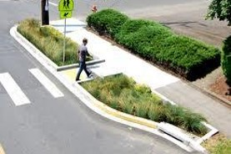
PROJECT NAME Potential ORS 366.215 Impact
Presenter(s) Name(s):
Other Notes: (e.g. HB 2017 project, Intersection Improvement, etc.)
Replace with your own project photo
Mobility Advisory Committee Meeting Date: MM/DD/YYYY
Notes:
Cover Page:
Update this slide with your own information and photo/image that represents your project or Proposed Action.
This presentation template should be used for projects that have the potential to Reduce Vehicle Carrying Capacity on a Reduction Review Route.
“Reduction of Vehicle-Carrying Capacity” means a permanent reduction in the horizontal or vertical clearance of a highway section, by a permanent physical obstruction to motor vehicles located on useable right-of-way subject to Commission jurisdiction, unless such changes are supported by the Stakeholder Forum. Street markings such as bike lane striping or on street parking are not considered a reduction of vehicle-carrying capacity.
“Reduction Review Routes” means identified state highways that require a review under this rule prior to a Reduction of Vehicle-Carrying Capacity. For the purposes of this rule, the Reduction Review Routes will be the routes subject to ORS 366.215.

Slide 5
AGENDA
Topics:
Location
Problem/Issues & Proposed Action(s)
Existing & Proposed Cross-sections
Urban Design Guidance (if applicable)
Over Dimension Permit Data (if necessary)
Pinch Point Information
Summary of Proposed Changes
Objective: Seeking Stakeholder Forum Support for Proposed Action subject to ORS 366.215.
Replace with your own project photo
Notes:
Remove or update the photo as appropriate to match your project
The agenda should have, at a minimum, the following topics (per the ORS 366.215 Guidance Document on the Mobility website:
1. Location map, highway name and mile points.
2. Description of the problem or issues
3. Description of the proposal (what is the potential proposed action?)
4. A diagram of the existing and proposed roadway cross section including existing structures
5. Design guidance from the Highway Design Manual (for reductions that also propose a roadway reconfiguration (e.g. road diet, travel lane reduction, striping changes, etc.). Otherwise remove this section.
6. Over-dimension permit data to show stakeholders the size and type of permitted loads that use the route (remove this section if OD permit data is not needed for your project presentation).
7. Pinch point information if located near the proposed project
6. A summary of all the proposed reductions in vehicle-carrying capacity in the project area.
Objective should be to seek Stakeholder Forum Support for the Proposed Action identified in the presentation.

Slide 6
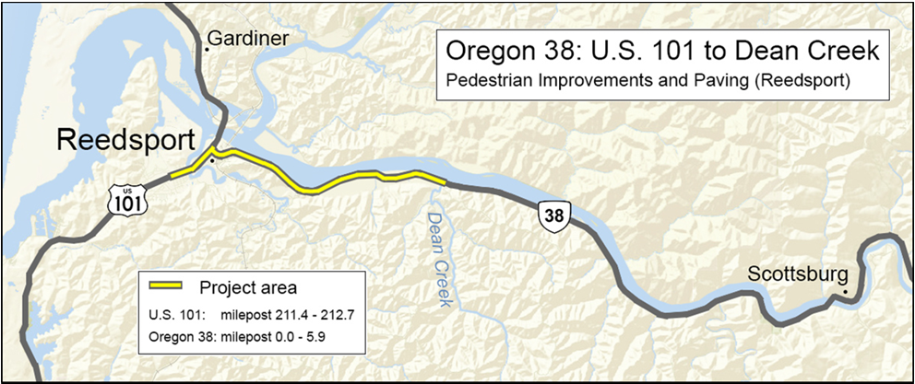
PROJECT NAME Location (including mile points & nearest city/landmark)
Replace with your own project map
Notes:
Update this slide with your own information.
Project Location:
Include a map of the project location, and provide a brief description at the top of the slide that includes the nearest city or landmark.
Make sure map image has Alt Text added for accessibility. (Right Click on photo →Format Picture → Size and Properties)

Slide 7
PROJECT NAME Location Details
Roadway Characteristics
Type of roadway & number of lanes
Grade type (flat, hills, both)
Straight, curved, or both
Traffic Conditions
ADT:
Truck Count:
Annual Over-Dimension Permits
Annual Width allowed daytime: ## feet
Annual Width allowed nighttime: ## feet
Single Trip Permits
Width allowed daytime without District Approval: ## feet
Width allowed nighttime without District Approval: ## feet
Notes:
Update this slide with your own information.
Roadway Characteristics:
Provide the type of roadway (e.g. interstate/multilane highway, 2-lane highway); indicate the grade type; and indicate if the roadway straight or if are there curves.
Traffic Conditions:
Provide ADT and truck counts.
Update this slide with your own information.
Roadway Characteristics:
Provide the type of roadway (e.g. interstate/multilane highway, 2-lane highway); indicate the grade type; and indicate if the roadway straight or if are there curves.
Traffic Conditions:
Provide ADT and truck counts.
Annual Over-Dimension Permits:
Indicate the allowable daytime and nighttime widths for the route. Refer to the following maps (or contact the Mobility Services Team if you need assistance finding this information):
Daylight Width Map: https://www.oregon.gov/odot/ProjectDel/Mobility/DaylightWidthMap.pdf
Nighttime Width Map: https://www.oregon.gov/odot/ProjectDel/Mobility/NighttimeWidthMap.pdf
Single Trip Over-Dimension Permits
Indicate the maximum width allowed to be issued by CCD OD Permits Staff without having to seek District Approval. This information can be found in the State and District Guidelines document (or contact the Mobility Services Team if you need assistance finding this information): https://www.oregon.gov/odot/MCT/Documents/pilotcarguide.pdf

Slide 8
PROJECT NAME Project Purpose, Scope, Issues
Scope:
Provide a brief summary of the project purpose and scope.
Issues & Concerns to be addressed (including Safety & Access considerations):
Issue/Concern
Detail
Detail
Issue/Concern
Detail
Detail
Issue/Concern
Detail
Detail
Notes:
Provide a brief summary of the purpose and scope of the project, and list issues and concerns that the project will address.

Slide 9
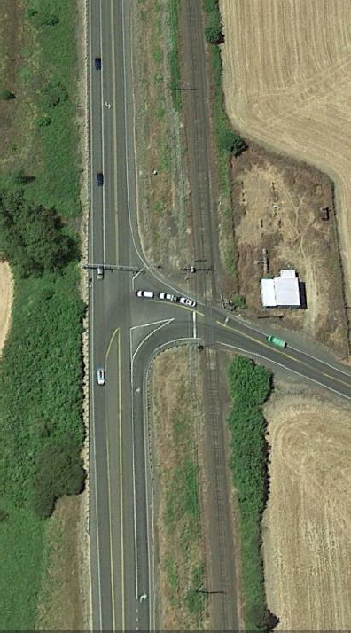
PROJECT NAME Proposed Changes
Proposed Safety Improvements:
Left Turn Acceleration Lanes
Replace with your own project photo
Sight Distance
Signing & Striping
Notes:
Update this slide with your own information / photos and customize as appropriate.
Per OAR 731-012-0020
“Proposed Action” means any activity that will alter, relocate, change or realign a state highway including those proposed in planning documents approved by a public agency.
“Permanent Reduction” means a reduction subject to OAR 731-012-0010 be considered permanent if the reduction is intended to be permanently left in place after installation and is not easily removable for short-term expansion of Vehicle-Carrying Capacity. (Permanent structures could include, but are not limited to, traffic signals, signposts, stationary bollards, curbs, trees, raised or depressed medians, roundabouts, streetlights and overhead wiring.) If there is uncertainty as to whether or not a structure is permanent, the Department will provide an opportunity for Stakeholder Forum input.
If the Region is considering more than one alternative, describe them all and list the pros and cons of each. This will prevent having to schedule a separate meeting.

Slide 10
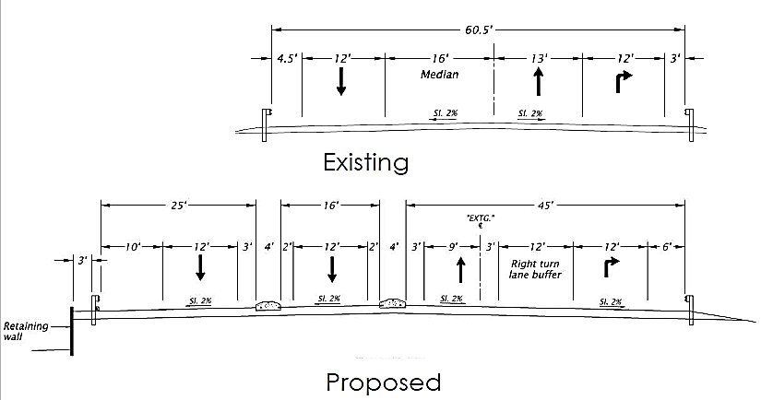
PROJECT NAME Existing & Proposed Roadway Cross Sections
Add some details, if necessary.
Notes:
Update this slide with your own information / photos and customize as appropriate.
Cross Sections need to include the overall vertical clearance (if applicable) and/or horizontal clearance (curb to curb), and include lane widths, median widths, bicycle lane widths, shoulder widths, etc.
If possible, provide both existing and proposed on the same slide. Otherwise, provide them on separate slides if it makes the cross sections easier to see.

Slide 11
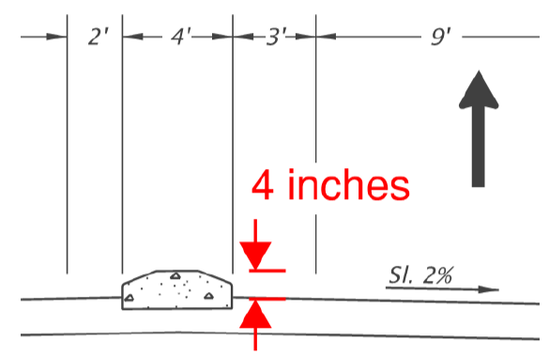
PROJECT NAME Additional Cross Sections
Mountable traffic separator cross section:
Notes:
Update this slide with your own information / photos and customize as appropriate.
Provide additional cross sections for your project, as necessary (or remove this slide, if not needed).

Slide 12
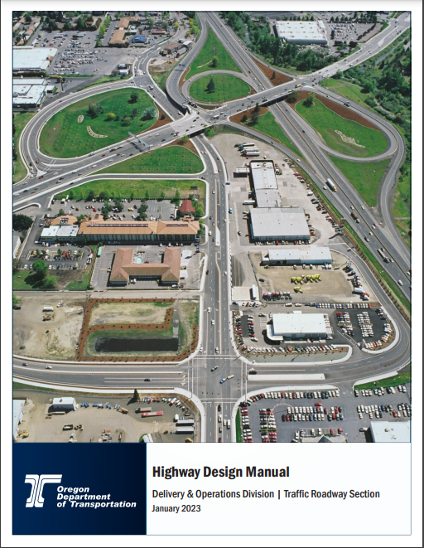
ODOT Highway Design Manual Guidance for <<Insert Urban Context>>
Target Traffic Speed: ## - ## MPH
Design Element | HDM Guidance
Travel Lane
Two-Way-Left-Turn Lane
Right Turn Lane (Including shy distances)
On Street Bicycle Lane (not including buffer)
Bicycle/Street Buffer
On-Street Parking
Curb/Gutter
Raised Median - No Turn Lane (incl. shy distances)
Notes:
REMOVE THIS SLIDE IF YOUR PROPOSED REDUCTION IN HORIZONTAL CLEARANCE DOES NOT INCLUDE A ROADWAY RECONFIGURATION (E.G. ROAD DIET, LANE REDUCTIONS, LANE WIDTH REDUCTIONS, ETC.).
Use this slide to describe the Highway Design Manual (HDM) Guidance that applies to the urban context for your particular project area, so that the committee understands the standards that were used for the proposed roadway reconfiguration that is included with the proposed reduction in horizontal clearance.
Indicate the appropriate urban context in the title at the top. Urban contexts include:
Traditional Downtown/Central Business District
Urban Mix
Commercial Corridor
Residential Corridor
Suburban Fringe
Rural Community
Change/replace/add the design element categories in the table as appropriate to match the relevant design elements planned for the project (for example, remove On-Street Parking Width if that is not a planned element for your project).

Slide 13
PROJECT NAME Bicycle Facility Recommendation
Urban Context: | ADT: | Traffic Speed: | Recommended Bike Facility:
Notes:
REMOVE THIS SLIDE IF YOUR PROPOSED REDUCTION IN HORIZONTAL CLEARANCE DOES NOT INCLUDE A ROADWAY RECONFIGURATION (E.G. ROAD DIET, LANE REDUCTIONS, LANE WIDTH REDUCTIONS, ETC.).
Update this slide with your data.
If the roadway reconfiguration includes adding bicycle lanes, use this table to show the type of bicycle facility that is appropriate for the project location, based on ODOT’s Highway Design Manual Guidance.
If bicycle lanes are not planned as part of the roadway reconfiguration or striping changes, remove this slide.

Slide 14
PROJECT NAME Single Trip Over-Dimension Permit Summary
Analysis duration: __ years
Total STPs issued (including trips): ____ permits
District Guidelines for Over-Dimension Loads:
Daytime Width Allowed (without district approval) | Daytime Width Allowed (without district approval) | Overall Length Allowed (without district approval) | Other Comments
___ feet | ___ feet | ___ feet
Notes:
Update this slide with your data.
Remove this slide if OD Permit Data is not needed
Use this slide to summarize Single-Trip Over-Dimension Data and District Guidelines.
Single-Trip Over-Dimension Data can be requested from the Mobility Team (please note that requests can take two weeks or longer, depending on the amount of data that needs to be analyzed). Use the information from the report provided by the Mobility Services Team to complete this slide.
Single Trip Permit Data helps stakeholders understand the types and frequency of over-dimension freight that uses the route where the project is located.
Remove this slide if you do not need to present permit data.

Slide 15
PROJECT NAME Single Trip Over-Dimension Permit Summary: Wide Loads
Most wide loads were issued for <insert load type from permit report>
Widest load was for a <insert load type from report> at ___ wide.
Majority of permits were between ____ and ____wide.
Overall Width | Number of single-trip permits issued
Notes:
Update this slide with your data.
Remove this slide if OD permit data is not necessary to share with stakeholders
Use this slide to present Single-Trip Over-Dimension Data for wide loads. Single-Trip Over-Dimension Data can be requested from the Mobility Team (please note that requests can take two weeks or longer, depending on the amount of data that needs to be analyzed). Use the information from the single trip permit report provided by the Mobility Services Team to complete this slide.
Single Trip Permit Data helps stakeholders understand the types and frequency of over-dimension freight that uses the route where the project will be located.
Remove this slide if you do not need to present permit data.

Slide 16
PROJECT NAME Single Trip Over-Dimension Permit Summary: Long Loads
Most wide loads were issued for <insert load type from permit report>
Longest load was for a <insert load type from report> at ___ long.
Majority of permits were between ____ and ____long.
Overall Length (incl. overhang) | Number of single-trip permits issued
70’ or less
71’ to 80’
81’ to 90’
91’ to 100’
101’ to 110’
111’ to 120’
Over 120’
Notes:
Update this slide with your data.
Remove this slide if OD permit data is not necessary to share with stakeholders
Use this slide to present Single-Trip Over-Dimension Data for long loads.
Single-Trip Over-Dimension Data can be requested from the Mobility Team (please note that requests can take two weeks or longer, depending on the amount of data that needs to be analyzed). Use the information from the single trip permit report provided by the Mobility Services Team to complete this slide.
Single Trip Permit Data helps stakeholders understand the types and frequency of over-dimension freight that uses the route where the project will be located.
Remove this slide if you do not need to present permit data.

Slide 17
PROJECT NAME Single Trip Over-Dimension Permit Summary: Vehicle Combinations
Vehicle Combinations | Number of single-trip permits issued
Truck (Solo Vehicle) or Self Propelled Units (like cranes)
Doubles
Truck-Tractor + Semitrailer or Truck-Tractor +Tow-Away Unit
Truck + Trailer
Log Truck + Pole Trailer
Heavy Haul Combination (Truck-Tractor/Jeep/Semitrailer/Booster)
Toter + Mobile Home
Pickup Truck + Trailer
Notes:
Update this slide with your data.
Remove this slide if OD permit data is not necessary to share with stakeholders
Use this slide to present Single-Trip Over-Dimension Data for vehicle combinations.
Single-Trip Over-Dimension Data can be requested from the Mobility Team (please note that requests can take two weeks or longer, depending on the amount of data that needs to be analyzed). Use the information from the single trip permit report provided by the Mobility Services Team to complete this slide.
Single Trip Permit Data helps stakeholders understand the types and frequency of over-dimension freight that uses the route where the project will be located.
Remove this slide if you do not need to present permit data.

Slide 18
PROJECT NAME Single Trip Over-Dimension Permit Summary: High Loads
Tallest load was for a <insert load type from report> at ___ high.
Majority of permits were between ____ and ____high.
Overall Height | Number of single-trip permits issued
14’00” or less (legal height)
14’01” to 14’06”
14’07” to 15’00”
15’01” to 15’06”
15’07” to 16’00”
16'01" to 17'00"
17'01 to 17'06"
Over 17’06”
Notes:
Update this slide with your data.
Remove this slide if OD permit data is not necessary to share with stakeholders
Use this slide to present Single-Trip Over-Dimension Data for High Loads (if appropriate for the project).
Single-Trip Over-Dimension Data can be requested from the Mobility Team (please note that requests can take two weeks or longer, depending on the amount of data that needs to be analyzed). Use the information from the single trip permit report provided by the Mobility Services Team to complete this slide.
Single Trip Permit Data helps stakeholders understand the types and frequency of over-dimension freight that uses the route where the project will be located.
Remove this slide if you do not need to present permit data.

Slide 19
PROJECT NAME Single Trip Over-Dimension Permit Summary: Heavy Loads
The heaviest load was issued for <insert load type from permit report> at ___lbs.
Most of the loads were between ______ lbs and __________ lbs.
Gross Weight | Number of single-trip permits issued
80,000 lbs. or less (legal weight)
80,000 lbs. to 98,000 lbs.
98,001 lbs. to 120,000 lbs.
120,001 lbs. to 140,000 lbs.
140,001 lbs. to 160,000 lbs.
160,001 lbs. to 180,000 lbs.
180,001 lbs. to 200,000 lbs.
200,001 lbs. to 250,000 lbs.
Over 250,000 lbs.
Notes:
Update this slide with your data.
Remove this slide if OD permit data is not necessary to share with stakeholders
Use this slide to present Single-Trip Over-Dimension Data for Heavy Loads (if appropriate for the project).
Single-Trip Over-Dimension Data can be requested from the Mobility Team (please note that requests can take two weeks or longer, depending on the amount of data that needs to be analyzed). Use the information from the single trip permit report provided by the Mobility Services Team to complete this slide.
Single Trip Permit Data helps stakeholders understand the types and frequency of over-dimension freight that uses the route where the project will be located.
Remove this slide if you do not need to present permit data.

Slide 20
PROJECT NAME Annual Over-Dimension Permit Data
Widths Allowed | Overall length Allowed: Long logs/ poles/piling permit, w/out steerable axles | Overall Length Allowed: Mobile/ modular unit permit | Overall Length Allowed: Unladen heavy haul combination permit | Overall Length Allowed: 1/2 wheelbase rear overhang permit for truck tractor and semitrailer combos)
Daytime annual width: Nighttime annual width:
Notes:
Update this slide with your data.
Use this slide to present information about annual over-dimension permits that can (or cannot) use the routes where the project is located. This information can be requested from the Mobility Services Team (please note that requests can take two weeks or longer, depending on the amount of data that needs to be analyzed). Use the information from the report provided by the Mobility Services Team to complete this slide.
Annual Permit Data helps stakeholders understand the types and frequency of over-dimension freight that uses the route where the project will be located.
Remove this slide if you do not need to present permit data.

Slide 21
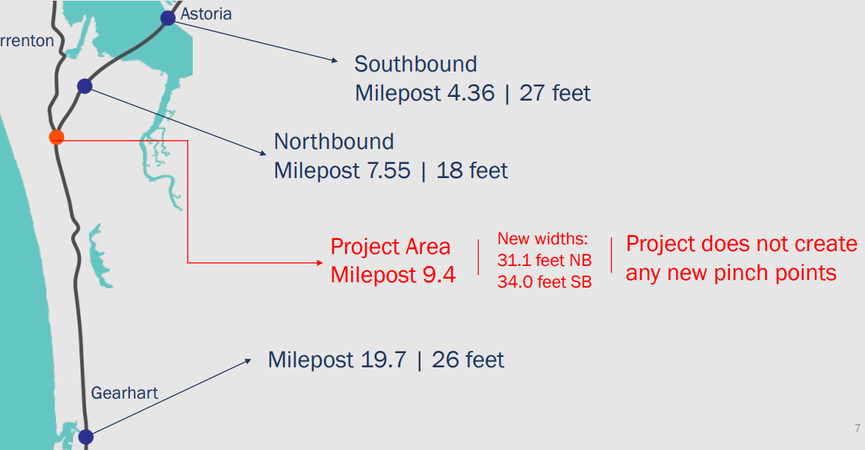
PROJECT NAME Pinch Point Information
EXAMPLE
Pinch point
Pinch point
Pinch point
Notes:
Update this slide with your own information / photos and customize as appropriate.
Provide Information about pinch points on the highway(s) near the project area. Include the width (and vertical clearance, if applicable) of the pinch point and mile point. You may also include a map that illustrates the pinch points in relation to the project location.

Slide 22
PROJECT NAME Summary of Changes
Summarize your changes in either sentence, bulleted list, or use the follow chart. Customize your information as appropriate.
Location | Existing Width (ft) | Proposed Width (ft) | RVC (ft)
200’ E of Granger Ave (EB) | 67 | 23 | 44
200’ E of Independence Hwy (EB) | 60.5 | 25 | 34.5
750’ E of Independence Hwy (WB) | 43 | 23 | 20
Local Rd to Median Acceleration Lane (EB) | 24 - 25 | 16 | 8-9
Notes:
Update this slide with your own information customize as appropriate.
Remind the committee what the existing and proposed clearances are, and provide the resulting reduction.
Use the best format that works for your project (e.g. table, bulleted list or map/graphic, etc)

Slide 23
NEXT STEPS
Address any questions or concerns with proposed ORS 366.215 impacts
Seeking Mobility Services Team to write a Record of Support.
Replace with your own project photo
Notes:
Next steps might also addressing any questions or concerns that were brought up during the discussion.
Once the Stakeholder Forum provides its support, the Mobility Services Team will need to write a Record of Support for the project.
Add any other relevant next steps that are appropriate for the project (e.g. return to the MAC to present temporary work zone impacts, etc.)

Slide 24
THANK YOU
Notes:
Replace this picture with your own image or diagram if you’d like.
HOW TO CHANGE THE BACKGROUND PICTURE
Go to the DESIGN tab on the ribbon.
In the Customize section, choose the icon with the paint bucket called FORMAT BACKGROUND.
The FORMAT BACKGROUND menu will open on the right side of your page. Make sure to select the radial button next to PICTURE OR TEXTURE FILL. Under the “Insert Picture from” section, choose FILE, CLIPBOARD, or ONLINE as appropriate.
Select a picture that fits the background space. Preferably in a landscape orientation.
Select your image, and press open.
Your picture will appear in the background!

