Slide 1
Walk With Ease
Allison Harris, MPH
Walk With Ease Program Coordinator
Ellen Radcliffe, MPH
WWE Program Support Specialist
Notes:
Hi everyone, thank you so much for inviting Thomas and I to share today about the evidence-based physical activity programs that OSU offers.
Introduction – I’m Allison Harris and I’m the Walk With Ease program coordinator through OSU Extension. I’ll be sharing some information on the WWE program today and then I’ll pass it over to Thomas to talk about some of our other PA programs.

Slide 2
Walk With Ease (WWE) program
Evidence-based physical activity program
Proven to:
Increase physical activity
Decrease pain and fatigue
Increase physical abilities and walking endurance
Helps make lifestyle changes
Notes:
This program was developed by the Arthritis Foundation for people with arthritis and other chronic pain conditions but the program is available to everyone and can be beneficial to everyone! Anyone who is hoping to be more physically active can benefit from this program. There is information in the program about arthritis and symptom management but this is just a piece – there’s a lot of information that will be helpful even if you don’t have experience with arthritis!

Slide 3
Four Key Program Components
Health education
Exercises – stretching & strengthening
Motivational Strategies
Walking
Notes:
There are four key components of the program

Slide 4
WWE in Oregon
Three versions of the program:
Instructor led in-person classes
Online virtual classes
Self-directed program
OSU Extension serves as the “hub” for WWE in Oregon!
Notes:
In Oregon, there are three versions of the program. [List formats]. I’m going to go through each of these formats in the following slides.
OSU Extension serves as the “hub” for WWE in Oregon. We partner with the Oregon Health Authority and have CDC Arthritis Funds to support implementation of the program. We also have Administration for Community Living grant money in partnership with Comagine Health to support this work.
We deliver in-person classes throughout the state through local Extension offices and faculty/staff and we also support community organizations that lead the program. (Such as churches, community centers, senior centers, healthcare clinics, hospitals and more).

Slide 5
Instructor-Led In-Person Classes
18 sessions, held over six or nine weeks
Health education and group walking
Led by a trained leader
All participants receive WWE books
Notes:
Original format of the program
Taught by OSU Extension AND community organizations
Sessions are broken into lecturettes and group walking
Starts with a lecturette that covers topics like goal setting, creating a walking plan and walking contract, overcoming barriers, and health education for symptom management.

Slide 6
Virtual Classes
Live, webinar-based classes with a trained instructor
Six-week program with sessions held over Zoom
Includes:
health education on symptom management, overcoming barriers, and stretching and exercising safely
facilitated discussion
Participants walk independently throughout the week
Everyone receives a workbook by mail
Notes:
We’ve operated a virtual classes through OSU Extension since 2017 – they were originally supported by a mini-grant from the OAAA. Picked up in 2020.
Most groups meet once per week for six weeks. These sessions include health education on symptom management, establishing a walking program, stretching and strengthening exercises, and more. There is also time allotted for social connection.
Because the program is meeting virtually, participants walk independently throughout the week.
A WWE guidebook is mailed to all registered participants.
Benefits… social connection, trained leader, structure and accountability.

Slide 7
Self-Directed Program
Participants register online and create an account
Everyone receives a free workbook (paperback or eBook)
Portal includes walking diary, weekly videos, and resources
Weekly support emails
Rolling registration
Completely independent study!
Available FREE to all Oregonians
Notes:
This is an entirely online and self-paced program.
Register online and create an account in the portal – they can choose to receive their workbook digitally or by mail.
Once participants register, they are encouraged to visit their portal account regularly to track their goals and walking minutes/time. The portal serves as a one-stop-shop for the WWE self-directed program. It has links to audio lecturettes, weekly videos, and other resources like self-tests, the walking contract, and class handouts.
Participants will also receive weekly support emails that remind them to track their minutes and provide additional links and resources, as well as homework and weekly challenges.
Some benefits of the program…
Rolling registration – you can sign up at any time and you will be automatically enrolled in the program! Once they receive their book the program starts.
Completely independent study! It’s structured as a six week course but can be done at your own pace and on your own time. There’s no in-person meet up – the physical activity portion is also entirely independent.

Slide 8
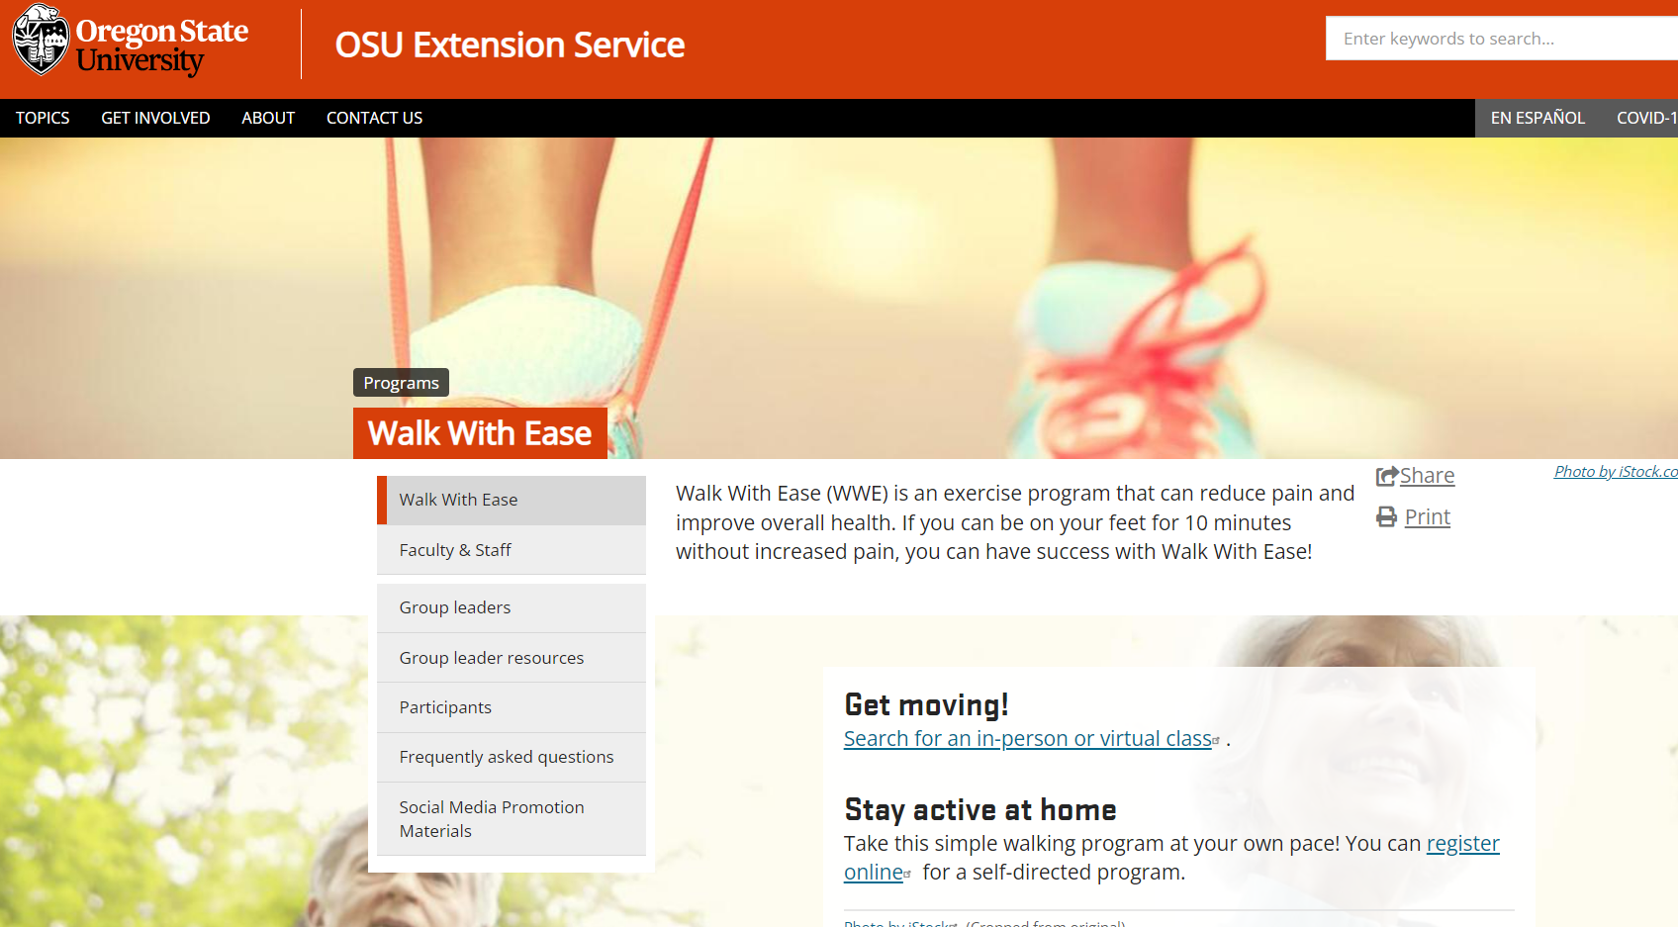
walk.oregonstate.edu
Notes:
WWE website/landing page… where you can find WWE forms, FAQs, etc.

Slide 9
Osteoarthritis Action Alliance Portal Walk-Through

Slide 10
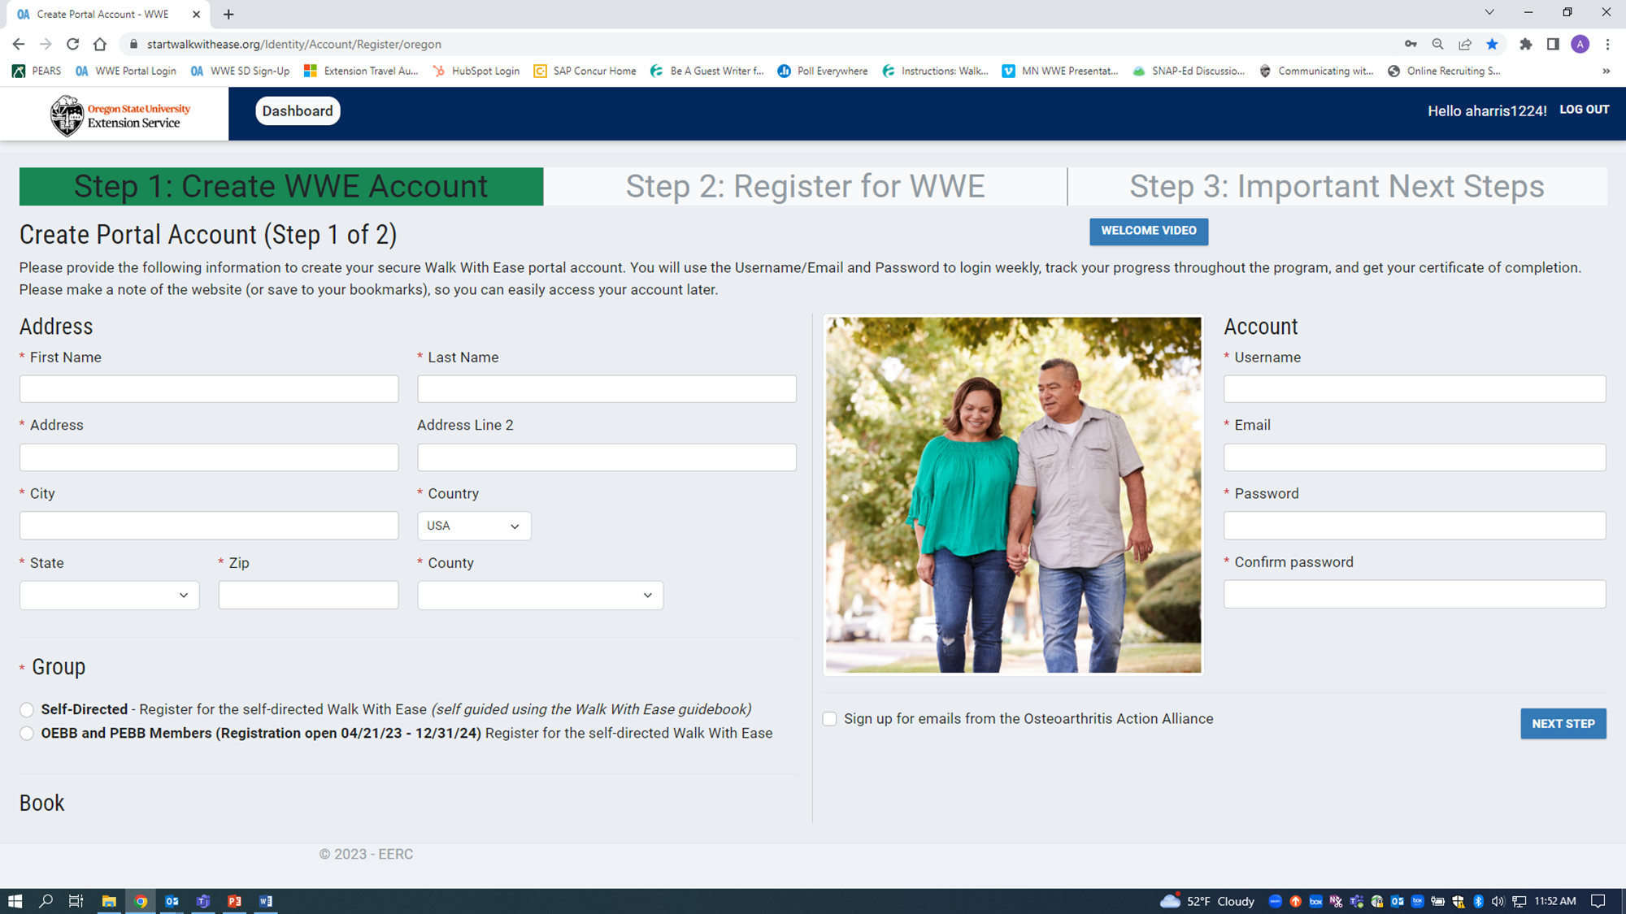
www.startwalkwithease.org/Oregon
Notes:
This is a screenshot of the WWE portal registration page. Participants have the opportunity to create an account and select what format they’d like the book in (paperback or eBook). They also can select which “group” they are a part of (for instance, OBBB and PEBB participating members)

Slide 11
Osteoarthritis Action Alliance Portal Walk-Through
After a person has completed the registration, they will return to the OSU Portal URL each time to login and access their account. They should click on the Login button in the top right corner of the page.

Slide 12
After a participant has clicked “START PROGRAM” on the Welcome Page, the program will start with Week 1. Participants can enter their goals and tracking their days and minutes of walking. They can also indicate if they took part in a live event, such as a group walk. Participants can move forward and backward in the weeks as needed, allowing them to re-start the program if they aren’t able to complete it all at once.
If participants choose to receive the eBook, they can access it from the top right of their screen.

Slide 13
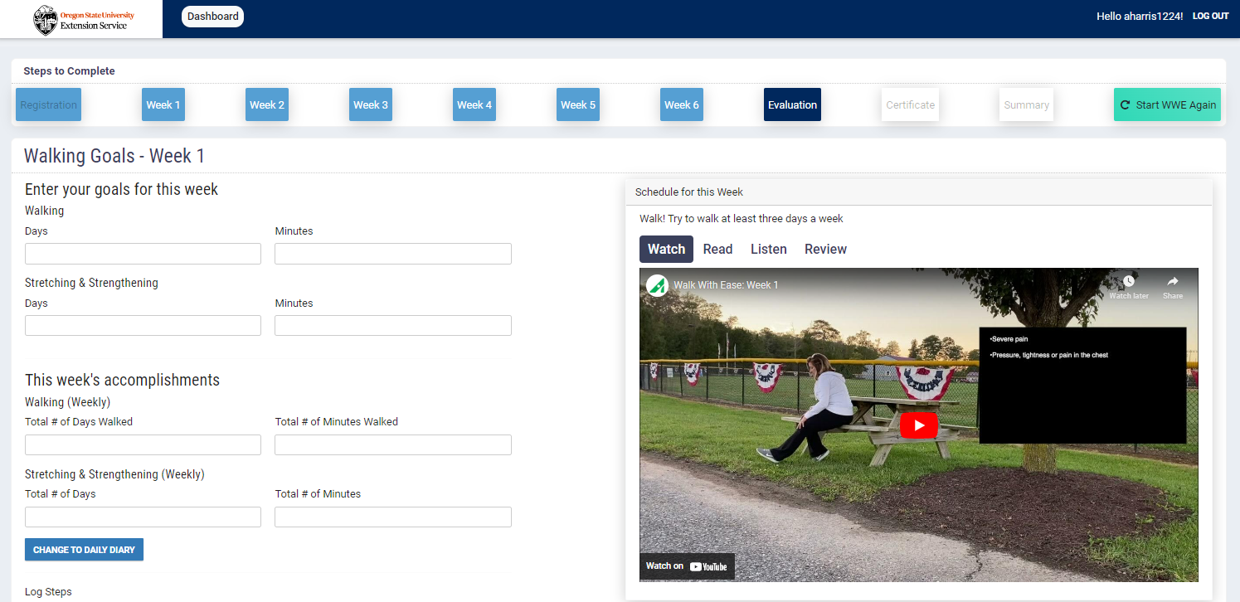
In addition to walking, participants can track stretching and strengthening goals and accomplishments.

Slide 15
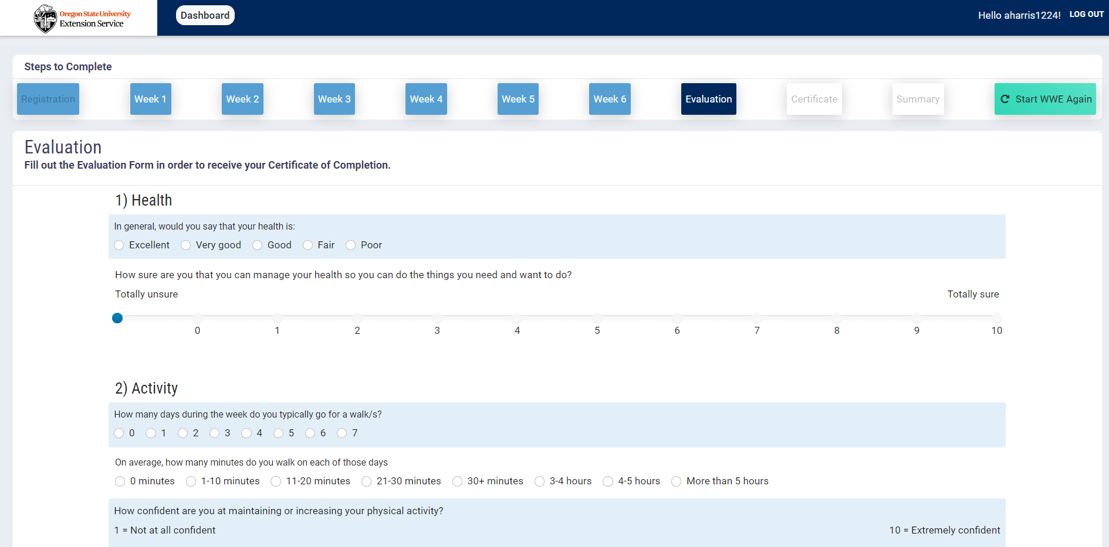
1
2
3

Slide 16
Discussion:
How could Walk With Ease fit into your workplace?

Slide 17
Contact Information
Ellen Radcliffe, MPH
Walk With Ease Program Support Specialist
Allison Harris, MPH
Walk With Ease Program Coordinator
Visit our website to learn more about WWE in Oregon!
walk.oregonstate.edu
Email us at walk@oregonstate.edu

