Slide 1
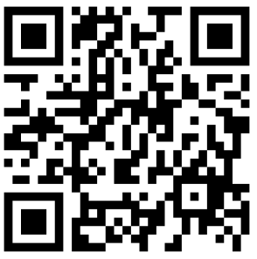
OEBB Wellness Champion Survey
https://form.jotform.com/213347873066057

Slide 2
Were you able to attend Wellness Champion meetings during the ‘22-23 school year?
Once
A few times
All of them (October through May)
No, I didn’t attend any meetings

Slide 3
If you attended any meetings, did you find them useful?
Yes
No
Somewhat

Slide 4
If you shared “No” or “Somewhat” please share why

Slide 5
How can OEBB Wellness Champion meetings be improved?
Make them shorter
Make them longer
Offer them at a different time or on a different day

Slide 6
If you selected “Offer them at a different time or on a different day”, please indicate your preferred day(s) and time(s)

Slide 7
Through the champions network, what is currently missing or where do you need more support?

Slide 8
As an OEBB Wellness Champion do you feel confident in your understanding about
OEBB’s health wellness programs, and that you can share that information with co-workers?
For example, Weight Watchers, programs, resources or grant opportunities at Moda Health
and Kaiser Permanente, etc.

Slide 9
OEBB sends a newsletter to wellness champions each month during the school year.
Did you find these newsletters useful?
Yes
No
Somewhat
Other

Slide 10
If you selected “Other” please describe.

Slide 11
What topics would you like to see covered in the newsletter and monthly wellness champion meetings?
Nutrition
Fitness
Health equity/social health
Chronic conditions
Mental health
Stress management
Self care
Quitting smoking/tobacco
Preventive health
Community Involvement
Other

Slide 12
How can OEBB and partners (Kaiser Permanente and Moda Health) best support you
in your role as a Wellness Champion?

