Slide 1
Health & Wellness Community Conversation
DATE
VENUE
PRESENTER NAME, TITLE

Slide 2
Roadmap for Today
Worksite Wellness: A Worthwhile Investment
Oregon’s Commitment to Wellness@Work
Notes:
Wellness@Work Quiz – as warm up

Slide 3
If Food Were Health Care
If food prices had risen at the same rates as medical inflation since the 1930’s:
1 dozen eggs $80.20
1 roll toilet paper $24.20
1 dozen oranges $107.90
1 pound bananas $16.04
1 pound of coffee $64.17
Total for 5 items $292.51
Source: American Institute for Preventive Medicine 2007

Slide 4
Health Insurance Premium Increases Outpace Inflation and Growth in Workers’ Earnings 1999-2010
Source: Kaiser/HRET Survey of Employer-Sponsored Health Benefits, 1999-2010. Bureau of Labor Statistics, Consumer Price Index, U.S. City Average of Annual Inflation (April to April), 1999-2010; Bureau of Labor Statistics, Seasonally Adjusted Data from the Current Employment Statistics Survey, 1999-2010 (April to April).
Notes:
Since 2000, employment based health insurance premiums have increased by 87%. Out pacing the rate of inflation and worker’s earnings over the past 2 decades.*
*Source: Making the case for workplace wellness programs, WELCOA
The Health and Economic Implications of Worksite Wellness Programs, American Institute for Preventive Medicine Wellness White Paper, 2008

Slide 5
Medical Costs: Tip of the Iceberg
Direct Medical Costs
Medical
Pharmaceutical
Visible
Costs
Indirect Medical Costs
Missed Work
Presenteeism
Short-term Disability
Long-term Disability
Workers’ Compensation
Non-Visible
Costs
Indirect Medical Costs = 2-3 times Direct Medical Costs
Source: William B. Baun, EPD, CWP, FAWHP
University of Texas MD Anderson Cancer Center
Notes:
Research consistently shows that the costs to employers from health-related lost productivity dwarf those of health insurance.

Slide 6
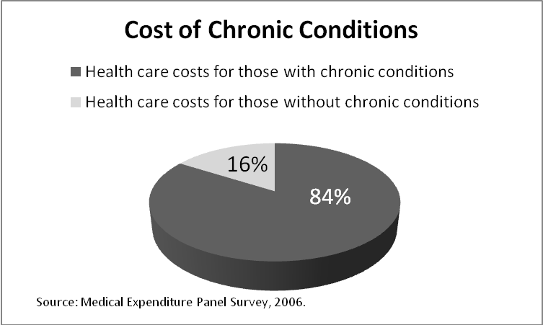
Annual Toll of Chronic Disease in Oregon
19,000 lives
$16 billion in health care costs
Countless hours of missed work
Notes:
If predictions hold for national health care costs, by 2015 a family of four will spend nearly $64,000 annually on healthcare.
Since 2001, wages have risen 19%, inflation has risen 17% and health care coverage has increased 78%
Almost 66% of the increase in health care spending can be attributed to increasingly unhealthy lifestyle behaviors, most prominent is obesity.
Some 28 percent of Americans have two or more chronic conditions and they are responsible for two-thirds of health care spending.
Workers’ compensation and Obesity : Obese workers, compared with average workers, file twice as many workers’ compensation claims; the cost of the average claim is five times greater; and lost workdays are 13 times higher
Over 1 in 4 people have multiple chronic disease conditions.
As a nation, we spend 85 percent of our health care dollar on people

Slide 7
Top two causes of preventable disease & death
Tobacco Use
Every year, 7,000 Oregonians die from smoking
For every tobacco-related death, another 20 people are sick
Cost: $2.4 billion in health care costs and lost productivity
Obesity
Nearly two-thirds of Oregon adults are overweight or obese
Cost: $781 million in direct medical costs
One-third of the increase in Oregon’s health care spending between 1998 and 2005 due to obesity epidemic
Source: “Reversing the trends of obesity and diabetes: A Report to the 2009 Oregon Legislature,” Oregon State DHS
Thorpe KE, Florence CS, Howard DH, Joski P. The rising prevalence of treated disease: effects on private health insurance
spending. Health Affairs, W5-317-25, 27 June 2005.
2009-2010 BRFSS Survey
Emory University. Northwest Health Foundation Press Release: http://nwhf.org/images/files/Obesity_Report_Press_Release.pdf
Oregon Behavioral Risk Factor Surveillance System, 2009. (Actual number 60.2 percent).
Notes:
Almost 66% of the increase in health care spending can be attributed to increasingly unhealthy lifestyle behaviors, most prominent is obesity.
Some 28 percent of Americans have two or more chronic conditions and they are responsible for two-thirds of health care spending.
Workers’ compensation and Obesity : Obese workers, compared with average workers, file twice as many workers’ compensation claims; the cost of the average claim is five times greater; and lost workdays are 13 times higher
Over 1 in 4 people have multiple chronic disease conditions.
As a nation, we spend 85 percent of our health care dollar on people with
chronic conditions.
70% of all deaths in the US can be attributed to cardiovascular disease, cancer, and diabetes. They are also the leading causes of disability and illness. The risk factors for these causes of death are tobacco use, poor eating habits, inadequate physical activity, and overweight – the good news these risk factors are preventable and modifiable!
Chronic disease accounts for 70% of all death and estimated 85% of total healthcare spending
7

Slide 8
Oregon’s Young People: Our Future Workforce
Diagnosis of childhood chronic diseases almost quadrupled over past four decades
Childhood obesity more than tripled in past 30 years
1 in 3 children will develop diabetes over their lifetime, given current trends
If the trend continues, today’s young people could be first generation to live shorter lives than parents.
Source: Prevalence of obesity/overweight data source is 2007 Oregon Healthy Teens Survey
Daniels SR, Arnett DK, Eckel RH, et al. Overweight in children and adolescents: pathophysiology, consequences, prevention, and treatment. Circulation. April 19 2005; 111 (15): 1999-2012
Notes:
1960 – 1.8% children dx with chronic disease. 2004 7% dx
23.2% of 11th grade students are overweight/obese ~ representing a 13% increase since 2001*
Health Topics Childhood Obesity
ON THIS PAGE Data & Statistics Science-based Strategies Policy Guidance National, State, and Local Programs References SEE ALSO Nutrition Publications and Links Physical Activity Publications and Links SPOTLIGHT Federal campaign launched against childhood obesity Connect With Kids: The Biggest Generation
Childhood obesity has more than tripled in the past 30 years. The prevalence of obesity among children aged 6 to 11 years increased from 6.5% in 1980 to 19.6% in 2008. The prevalence of obesity among adolescents aged 12 to 19 years increased from 5.0% to 18.1%.^{1,2}
26% of 8th grade students are overweight/obese – representing a 17% increase since 2001*
2003-2023 Projected Rise in Chronic Disease
Cancer 62%
Mental Disorders 54%
Diabetes 53%
Heart Disease 41%
Hypertension 39%
Pulmonary Disorders 31%
Stroke 29%
CDC / World Health Organization

Slide 9
Why Wellness at Work?
Employees spend nearly half their waking hours at work.
Environment shapes habits.
Most Oregonians want to be healthy!
Did you know that…
80% of Oregon smokers want to quit.
90% of overweight and obese Oregon adults want to lose or maintain weight.

Slide 10
What is Worksite Wellness?
Health
A state of complete physical, mental and social well-being and not merely the absence of disease or infirmity.
Wellness
A lifelong journey and an active process of making choices and commitments to be healthy
and well.
Worksite Wellness
An organized, employer-sponsored initiative designed to support employees (and their families) to adopt behaviors that reduce health risks, improves quality of life and maximizes personal effectiveness and benefits the organization’s bottom line.
Notes:
Worksite Wellness – an organized program designed to assist employees and their family in behavior change that reduces health risks, improves quality of life and maximizes personal potential and impacts the bottom-line.

Slide 11
Can you make it easier for employees?
To Be Tobacco Free
Eat Well
Move More
Take Charge of their Health
YES!

Slide 12
How others have done it…
Boeing adopted tobacco-free policy and turned smoking shelter into bicycle parking
City of Albany rented garden plot for $20; spent another $20 for vegetable starts for healthier eating and physical activity
Duckwall Pooley cut workers’ compensation costs in half by incorporating stretching into workday

Slide 13
Wellness@Work: An Economic Imperative
A comprehensive, strategically designed investment in employees’ health pays off.
Source: Chapman LS. The Art of Health Promotion: Meta-evaluation of worksite health promotion economic return studies: 2005 update. Am J Health Promotion, 19 (6), July/Aug 2005
Lowers health care costs by 26%
Reduces sick leave by 27%
Reduce workers’ compensation costs by 32%
Return on Investment
For every $1 spent on wellness programs, an average of $5 (range of $2-19) is saved.

Slide 14
A comprehensive, integrated worksite wellness program
Personal Responsibility
Health Benefit Design
Supportive Environment
Culture of Health
Source: NGA Center of Best Practices

Slide 15
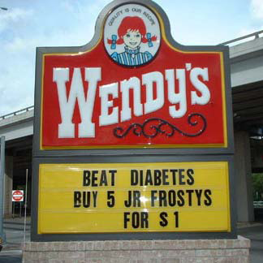
Policy, Environment & Systems Change
“It is unreasonable to expect that people will change their behavior easily when so many forces in the social, cultural, and physical environment conspire against such change.”
– Institute of Medicine

Slide 16
An Economic Imperative
Attract and retain healthy employees
Boost employee productivity
Chip away at rising health care costs
Notes:
Chipping away: Health care cost per person decrease about $153 with every decrease in the number of risk factors, and increase close to $350 with every increase in the number of risk factors.

Slide 17
Oregon’s Commitment to
A statewide initiative to create healthier worksites guided by leaders from business, public health, health care, and education
Contributes to Oregon’s Triple Aim to:
Improve lifelong health of all Oregonians
Lower or contain cost of care
Increase the quality, reliability and availability of care
Notes:
17
We launched the Governor’s Wellness Initiative in 2008 with public and private partners who are committed to making the healthy choice the easy choice in Oregon.
17

Slide 18
Join Wellness@Work Movement!
Center for Disease Control
Community Guide: http://www.thecommunityguide.org/obesity/workprograms.html
Preventing Chronic Disease: www.cdc.gov/pcd/issues/2009/apr/08_0195.htm
Healthier Worksite Initiative: http://www.cdc.gov/nccdphp/dnpa/hwi/
U.S. Chamber of Commerce’s Health Workforce Program: http://www.uschamber.com/assets/labor/2010hwforce.pdf
Small Business Wellness Initiative: http://www.sbwi.org/employers.asp
National Business Group on Health: www.businessgrouphealth.org/
Wellness Councils of America (Welcoa): http://www.welcoa.org/
American Heart Association: http://startwalkingnow.org/start_workplace.jsp
Employment Law Information Network: www.elinfonet.com

Slide 19
Visit www.healthoregon.org/wellness@work

Slide 20
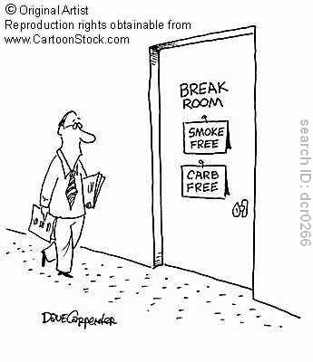
What is a Culture of Health? “The way we do things around here”
“In a culture of health, employee well-being and organizational success are inextricably linked.”
http://www.centervbhm.com/lb/workset.html

