Slide 1
Tobacco Prevention and the Oregon Tobacco Quit Line
Tobacco & Chronic Disease Prevention
Douglas County Public Health Division

Slide 2
Make Tobacco-Freedom part of a Health & Wellness Initiative
Approach the tobacco-free policy as a health and wellness initiative in which employees and clients are supported in making healthy choices.
Image Source: www.healthoregon.org/wellnessatwork

Slide 3
Craft the Message
To promote the health and well‐being of our clients, employees, and visitors, our campuses will be tobacco‐free starting ...
We have a responsibility to take a leadership role on this major health issue by creating a safe, healthy and tobacco‐free environment for our clients, employees, and visitors.
This policy does not require that individuals stop using tobacco products; rather, that tobacco use is not permitted on our campus.
If you’re ready to quit, we want to support your efforts.
Image Source: www.betterworldadvertising.com

Slide 4
Communicate Message Early, Often, Prominently, System-wide
Letter to all employees
Letter to health care providers
Letters to community agencies
Letter to all referral sources
Letters to all vendors
Signage, e.g., parking entrance, lot, benches, access points
Website and Email
FAQ
Newsletter articles
Policy handouts
Notice boards
Posters or banners
Appointment cards
Agency forms and documents
Brochure statement
Counter tents
Employee scripts
Employee orientation/evaluation
Launch activities
Central registration
Vendor notice
Include Quit Line information in ALL agency communications.

Slide 5
Engage Help of Partners
Supply community partners with easy-to-use collateral materials to help communicate the policy change
Mental health providers
Health care providers and clinics
Employers
DHS Programs
Head Start and other child development programs
Food Pantries
Affordable Housing
Homeless Shelters
Disabilities Services
Where are the touch points for the individuals and families you serve?

Slide 6
Policy Considerations
Compliance
Shared responsibility
Training for employees
Smoke residue on clothing
Locations & Signage
All properties leased, owned and/or intended for agency use
Parking lots
Personal vehicles
Definition of Tobacco Use
Cigarettes, cigars, pipes, dip, chew, snuff, snus and any other smokeless tobacco product
Nicotine delivery devices, such as e-cigarettes, excluding FDA-approved nicotine replacement therapy products
Notes:
For starters, remove smoking shelters and ashtrays. Even the most addicted visitor is not likely to question the absence of these vestiges of smoking in a health care facility. It’s also a good idea, particularly during the initial stages of your tobacco-free initiative, to sweep up cigarette butts as you find them.

Slide 7
Anticipate Concerns
Concerns about enforcement
Self-enforcing
Hot spots
System-wide education
Public sidewalks
Employee Concerns
Right to smoke
Smoking in car
Quit help
Provider Concerns
Clients don’t want to quit
No time to do brief intervention
No training to assist
Tobacco-free policies do not restrict people; rather, they make public places safer and more accessible for all.
80% of adult smokers in Oregon would like to quit.; people with mental illness are about as likely as the general population to want to quit.

Slide 8
By the Numbers
Douglas County . . .
27% adults smoke
25% pregnant women use tobacco
15% adults use spit tobacco
Oregon . . .
37% Medicaid/OHP
62% with high school education or less
Nationally . . .
44% of all cigarettes produced in U.S. are smoked by people with mental illnesses
~50% of the 435,000 tobacco-related deaths in the U.S. each year are among people with mental illnesses

Slide 9
Tobacco & Other Substance Use
Tobacco-related diseases account for 50% of deaths among individuals treated for alcohol dependence (Hurt et al., 1996)
Death rate 4-xs greater for cigarette smoking vs. nonsmoking long-term drug abusers (Hser, 1994)
Health consequences of tobacco and other drug use synergistic: 50% greater than sum of each individually (Bien & Burge, 1990)
Judith J. Prochaska, PhD, MPH, UCSF Department of Psychiatry

Slide 10
But People Can Quit!
Tobacco users who receive effective treatment are 2 - 3 times more likely to quit and remain quit.
Treating Tobacco Use and Dependence: 2008 Update Clinical Practice Guideline. U.S. Department of Health and Human Services. Public Health Service. http://www.surgeongeneral.gov/tobacco/
Notes:
80% of Oregonians who smoke say they want to quit. Sometimes it take several attempts, but each attempt is important and valuable.
Evidence-based ways to help people – what are some of the other things you think would help?

Slide 11
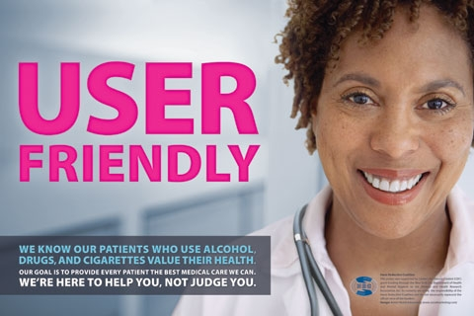
Create a Culture of Wellness & Support
Assess tobacco as part of routine assessment & screening
Include treatment plan with goals and objectives specific to tobacco
Provide educational materials related to tobacco
Incorporate tobacco directly and indirectly into group topics
Address tobacco use in individual and group sessions
Promote wellness breaks
Image Source: www.betterworldadvertising.com

Slide 12
2As & R Brief Intervention
ASK:
Determine tobacco use status
ADVISE:
“Quitting is very important to improving your health. I can refer you to people who can help.”
REFER:
To Quit Line
To Cessation Class
To Peer Support Group
Make a commitment to incorporate
brief tobacco assessment and counseling
at each client encounter.
Fiore et al. (2008), Treating Tobacco Use and Dependence: 2008 Update

Slide 13
Why a Tobacco Quit Line?
It works:
Quit Lines significantly increase quit rates compared to minimal or no counseling
Quit Lines + medication significantly increase quit rates compared to use of medication alone.
It fits the need:
Increase a caller’s chance of quitting
Offers a variety of services according to individual need.
Can be adapted to fit unique clinical environments

Slide 14
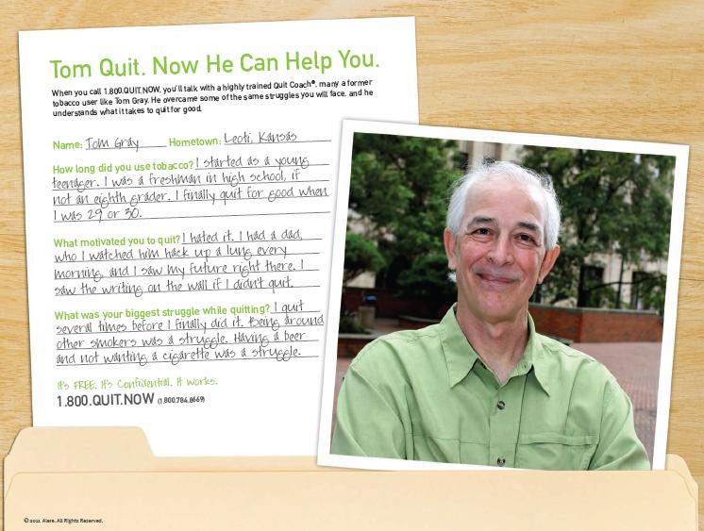
How does the Quit Line Work?
Registration
Available to all Oregonians regardless of income or insurance status
Coaching in 170+ languages
Counseling Calls with Quit Coach
Motivational Interviewing
Problem-solving and coping skills
Personalized Quit Plans
Nicotine Replacement Therapy (patch or gum) mailed directly to participant’s residence
Quit Guide and other materials
Notes:
The process is really similar for the online program: registration, then going through creating a personalized quit plan online.
This is self-directed, but covers much of the same topics that counseling calls over the phone would. An online participant can email or start an online chat with a quit coach at any point. These emails or chat conversations are much shorter (about 5 minutes) than a counseling call over the phone, which would take 20 or 30 mins.

Slide 15
What services are available?
Uninsured
4 counseling calls
2 weeks of Nicotine Replacement Therapy
Insured – with Quit Line benefit
Whatever their own health plan covers, typically 4-5 counseling calls.
Insured – without Quit Line benefit
1 counseling call
2 weeks of Nicotine Replacement Therapy
Notes:
Quit Line benefits are based on insurance status. They ask about insurance status and insurance plan during registration. Many people with insurance, including many covered by Medicaid plans, have Quit Line benefits through their own health plans and are not covered under the state Quit Line.
Some groups have larger benefits – for example, Medicaid Fee For Service members (also referred to as Medicaid Open Card) get 8 weeks of NRT through the Quit Line!
Insurance status is tricky. Everyone who calls the Quit Line receives at least one counseling call and information about other resources.

Slide 16
Tobacco Cessation Coverage
OHP coverage varies across plans
All cover some form of tobacco use assessment
All plans cover some form of cessation counseling
All plans cover pharmacotherapy
www.oregon.gov/oha/healthplan/data_pubs/reports/cessation2012.pdf
Oregon Health Benefit Plans required to pay $500 in payment, coverage or reimbursement (ORS 734)—with some limitations, e.g., student or short-term

Slide 17
Referring to the Quit Line
Fax Referrals
Simple form (English or Spanish)
Download and fill out with patient
Fax or (snail) mail to Quit Line
Clinician may serve as proxy
The Quit Line calls client directly and asks if they would like to enroll in services. If they accept, they can begin counseling immediately.
Notes:
Anyone can use the fax referral process

Slide 18
Sample Quit Line Report by County
This report gives you the quick and dirty: how many callers from your county in any given month.
Just knowing the number of callers and tracking trends from month to month may be sufficient.

Slide 19
Sample Quit Line Report by Mental Health Condition
What are the 3 most frequently reported conditions?
Quit Line Reports --11/1/2012 through 11/30/2012

Slide 20
Sample Quit Line Report by Mental Health Condition

Slide 21
Questions, Comments
Training Needs
AMH Regional Support Networks
Other
We’re Available to Help
Marilyn Carter and Laura Siltanen
Tobacco Prevention & Healthy Communities
Douglas County Public Health Division
541-440-3563

