Slide 1
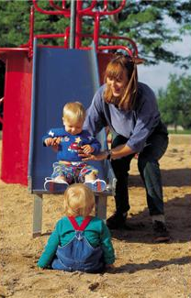
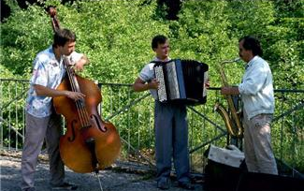
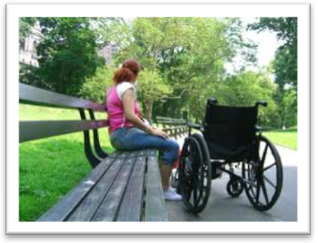
Tobacco-Free Parks Healthy Kids Healthy Families Healthy Communities

Slide 2
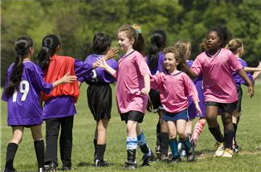
What We’ll Talk About
Why Tobacco-Free Policies: Health, Environment & Livability
Definitions: Smokefree, Tobacco-free, Designated Areas
What’s Happening in Oregon
Steps to Implementation
Enforcement
Resources to Quit

Slide 3
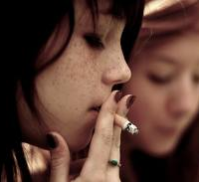
Why Tobacco-Free Policies?
Health
Most people don’t smoke
Adult smoking is significantly higher in Douglas County (27%) than among adults statewide (17%).
Spit tobacco use is significantly higher among Douglas County adults (15%) than among adults statewide (6%).
Modeling tobacco use behavior is one of the best advertisements to recruit new smokers
Smoking is higher among Douglas County 8th graders (13%) as compared to 8th graders statewide (9%).
Spit tobacco use is significantly higher among Douglas County 8th graders (9%) than among 8th graders statewide (5%).
Tobacco-free environments are more family-friendly
Tobacco use during pregnancy is significantly higher in Douglas County (25%) than statewide (12%). (About one in four infants is born to a woman who used tobacco while pregnant.)
Notes:
Tobacco use is a children’s disease: 90% of adult smokers start to smoke before the age of 18.
Kids are influenced by their parents, siblings, friends and the environment they grow up in.

Slide 4
Quiz
Why do you think tobacco use is a problem in Douglas County?

Slide 5
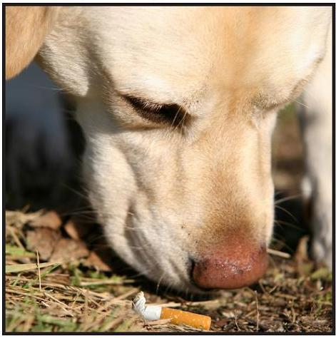
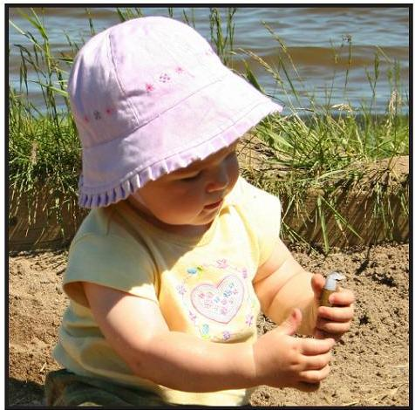
Why Tobacco-Free Policies?
Environment & Livability
Fire Risk
1 in 10 Oregon fires is started by cigarettes (Oregon Fire Marshall, 3/2011).
Fires are often caused by dropping cigarettes in planting areas, bark mulch and trash receptacles.
Butt Litter
One of the most common forms of litter
Toxic to children, pets and wildlife in ingested
Not biodegradable and take decades to decompose
Butts and package litter cost money and man-power to clean up
Livability & Quality of Life
Parks are places where people go to recreate, relax and get healthy
Parks programs contribute to the health of children and adults
A healthy park system attracts residents and visitors to the area
Parks are a tangible reflection of the quality of life in a community
Notes:
Kids aspire up – kids learn from their environment – seeing people smoking is the greatest advertisement for the tobacco industry.

Slide 6
Definitions
Definitions
Smokefree = inhaling/exhaling lighted, burning product
Tobacco-free = use of any form of tobacco product, including spit tobacco
Designated Areas
Smoking is prohibited in or set back from playgrounds, picnic areas, sports fields and other outdoor areas or facilities
100% Smokefree
Smoking is prohibited on park properties
100% Tobacco-free
All forms of tobacco use are prohibited on park properties

Slide 7
Smoke/Tobacco-Free Designated Areas
No confusion about location
Consistent
Cleaner (no butts, no spit)
No SHS exposure
Easier to communicate
Supports mission of parks & recreation
Public image of community
Easier to enforce
Location unknown, smoke anywhere
Location too far, not used
Location too close, smoke drifts, people exposed to SHS
Models unhealthy behavior (kids aspire up)
Public image of community
Enforcement issues (50 ft or 51’)

Slide 8
What’s Happening in Oregon
City, County | Type of Policy
Ashland, Jackson | 100% smoke-free
Bandon, Coos | 100% smokefree
Bend, Deschutes | 100% tobacco-free
Corvallis, Benton | 100% smokefree
Happy Valley, Clackamas | 100% tobacco-free
Lincoln City, Lincoln | 100% smoke-free
Pendleton, Umatilla | 100% tobacco-free
Prineville, Crook | 100% tobacco-free
Rainier, Columbia | 100% tobacco-free
Roseburg, Douglas | 100% tobacco-free
Stayton, Marion | 100% tobacco-free
About 21 Oregon cities and over 260 parks
. . .and the list goes on

Slide 9
Steps to Implementation
Convene a task group
Identify partnerships
Identify reasons, e.g., values statement
Identify challenges
Gather information, e.g., other communities, conduct survey
Develop rule or ordinance proposal
Implementation, e.g., timeline, communication, enforcement
Evaluation

Slide 10
Identify Partnerships
Community groups
Event organizers
Schools
Faith community
Youth-serving organizations (4H, FFA, Scouts)
Healthcare providers
Law Enforcement
Fire District
Youth
Businesses
Sports leagues
Fitness/Walking groups
Parents
Senior citizen groups
Vendors
Local government
Media
Douglas County Tobacco Prevention & Education
Who else has an interest in tobacco-free parks?
In Oregon, 80% of adult current smokers would like to quit.

Slide 11
Identify Reasons
Health impacts (e.g., improve health, reduce health risks for people who use parks, esp. those with chronic conditions)
Environmental impacts (e.g., butt litter, green spaces, fire hazard, protect habitat)
Social impacts (e.g., kids aspire up, parks enhance quality of life, most people don’t use tobacco)
Economic impacts (e.g., location, location, location; parks help fuel economic health, maintenance)
In your opinion, why would community members
support smoke/tobacco-free parks?

Slide 12
Identify Challenges
Tobacco-free park rules are similar to rules about fires, litter, and vandalism on park properties.
Lack of local support
Concern about lower usage
Lost revenue for park events
Belief that it will restrict tobacco users from parks
Concerns about enforcement
What are some challenges that might
need to be addressed?
Tobacco-free park rules do not restrict people; rather, they make parks safer and more accessible to all people.

Slide 13
Quiz
About how much is spent on medical care for tobacco-related illness in Douglas County?
$60 million
Oregon Tobacco Facts, 2011

Slide 14
Gather Information
Gather information about other parks policies
Hold community meetings
Parks officials
Law enforcement
Park user groups (e.g., sports leagues, schools)
Community-at-large
Conduct community survey
Park event survey
Survey parks user groups
Butt collection (e.g., pre/post implementation)
Paper or electronic survey (e.g., online or PDA)
Include questions as part of existing survey

Slide 15
Develop Proposal
Add rule statement to parks rules and regulations
Develop Proposal
Rationale
Scope (Who it will cover)
Locations
Clear Definition
Cigarettes, cigars, pipes, and any other smoking product
Dip, chew, snuff, snus and any other smokeless tobacco product
Nicotine delivery devices, such as e-cigarettes, excluding FDA-approved nicotine replacement therapy products
Enforcement
Signage
How rule will be communicated
Handled as for other parks rule violations

Slide 16
Implementation
Timeline
Work backwards from effective date, e.g., Jan 1 or other community event or observance
Promote It!
Communicate early, often and continuously
Communicate in coordination with events and at high park usage times
Include language in parks use agreements and vendor contracts
Provide announcement “scripts” for park user groups
Earned and paid media
Websites, newsletters, brochures, social media
Include Oregon Tobacco Quit Line info in all communications

Slide 17
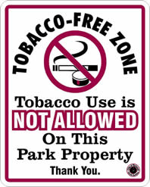
Communication Strategies
Post signs, e.g., entrances , parking lots, trails, bike racks, skate park, fields, picnic areas, info boards
Banners
Trash can wraps
Park user group pledges
Game schedules & rules
Parks activity guide
Event registrations
Event flyers
Vendor notice
Public Service Announcements
Volunteer & seasonal parks staff

Slide 18
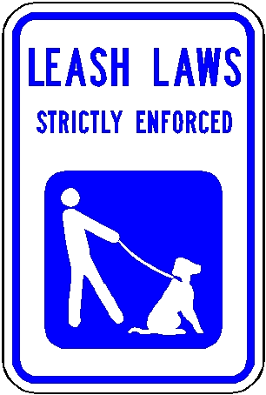
Enforcement
Self-enforcing
Clear, positive signage
Consistent messaging, e.g., community leaders, sports leagues, schools, event announcements
Violations may be handled as with other park rules and regulations, e.g., warning, escort off property, fine
Like all park rules, tobacco-free parks rules are posted in all parks.
The primary goal is voluntary compliance.
Sometimes, however, enforcement may be necessary.
Notes:
Tobacco-free environments law are easily implemented, are well accepted by the public, reduce nonsmoker exposure to secondhand smoke, and contribute to a reduction in overall cigarette consumption.

Slide 19
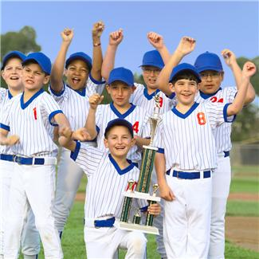
Evaluation
To celebrate accomplishments
To identify and respond to ‘hot spots’
To get community feedback, e.g., event survey
To report back to community and city leaders
To help monitor community change, e.g., health improvements
To demonstrate community leadership and commitment to community health

Slide 20
Parks are a tangible reflection of quality of life in a community. What do your parks say about the quality of life your community?
Your City

Slide 21
Resources to Quit
Oregon Tobacco Quit Line
1-800-QUIT-NOW (1-800-784-8669)
Español: 1-877-2NO-FUME (1-877-266-3863)
TTY: 1-877-777-6534
Online at: www.quitnow.net/oregon/
Seven days a week
5:00 AM to 12:00 AM (Pacific time)
Oregon Law
All private insurance required to pay $500 for cessation counseling and/or medication

Slide 22
Contact
Marilyn Carter, Program Manager
Health Promotion & Chronic Disease Preventoin
Douglas County Public Health Division
541-440-3563
mjcarter@co.douglas.or.us
Smokefree Oregon
http://www.oregon.gov/DHS/
Notes:
Bring business cards!

