Slide 1
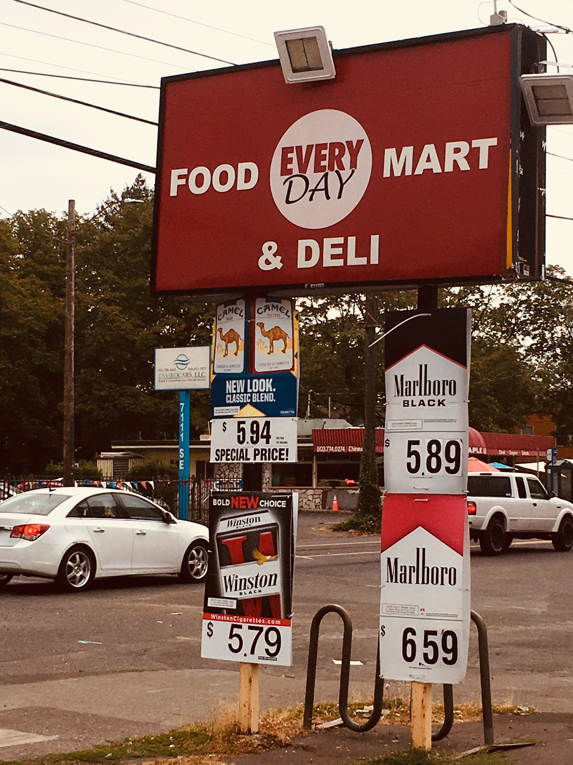
2018 Tobacco and Alcohol Retail Assessment
Shining a Light on Tobacco Industry Tactics in Oregon
[insert name of presenter]
[insert date + other relevant information]
[insert local photo, if available]

Slide 2
Presentation overview
Overview of the 2018 Tobacco and Alcohol Retail Assessment
Tobacco findings
What we can do
Related materials
Additional resources and support

Slide 3
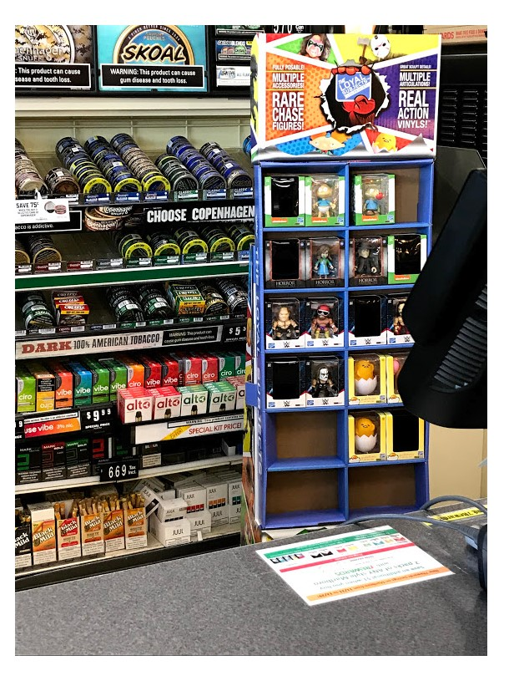
2018 Tobacco Retail Assessment: Goals
Gain a comprehensive understanding of the tobacco industry’s presence in retail environments in Oregon.
Understand the tactics the tobacco industry uses to target Oregon residents, particularly youth, communities of color and people living with lower incomes.

Slide 4
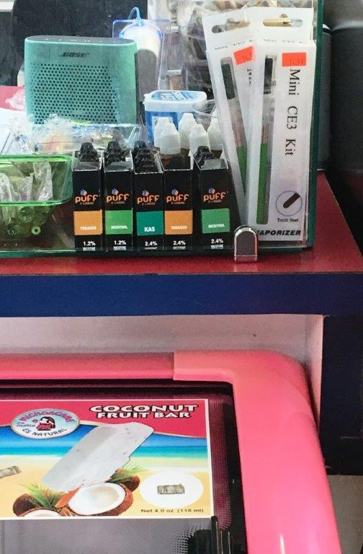
2018 Tobacco Retail Assessment: Background/overview
Statewide assessment of tobacco advertising, marketing and promotion in tobacco retail locations
Oregon Health Authority (OHA) trained teams:
  County health department staff
  Community volunteers
2,000 tobacco retail locations accessible by youth:
  Grocery stores, convenience stores, gas stations, etc.
  We visited X stores in X County
36 counties and two tribes
Used a standard assessment tool

Slide 5
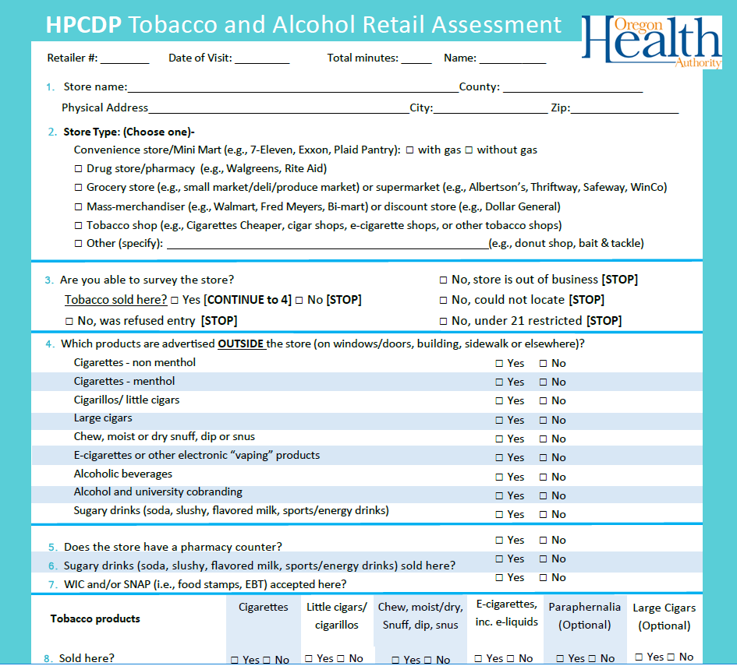
Standard assessment tool

Slide 6
Findings: Advertising is prominent
Nearly 50 percent of tobacco retailers had outside advertising for at least one type of tobacco product:
  Advertising for at least one type of tobacco product appeared on the outside of X percent of (insert county)’s stores.
Attractive images of products were placed alongside ads for kid-friendly snacks and treats, such as sodas, hot dogs and chips.
20 percent placed tobacco products within a foot of candy or toys:
  In (insert county), X percent of retailers placed tobacco products directly next to kid-attracting treats.
Over 75% of promotion and advertising dollars are at the point of sale

Slide 7
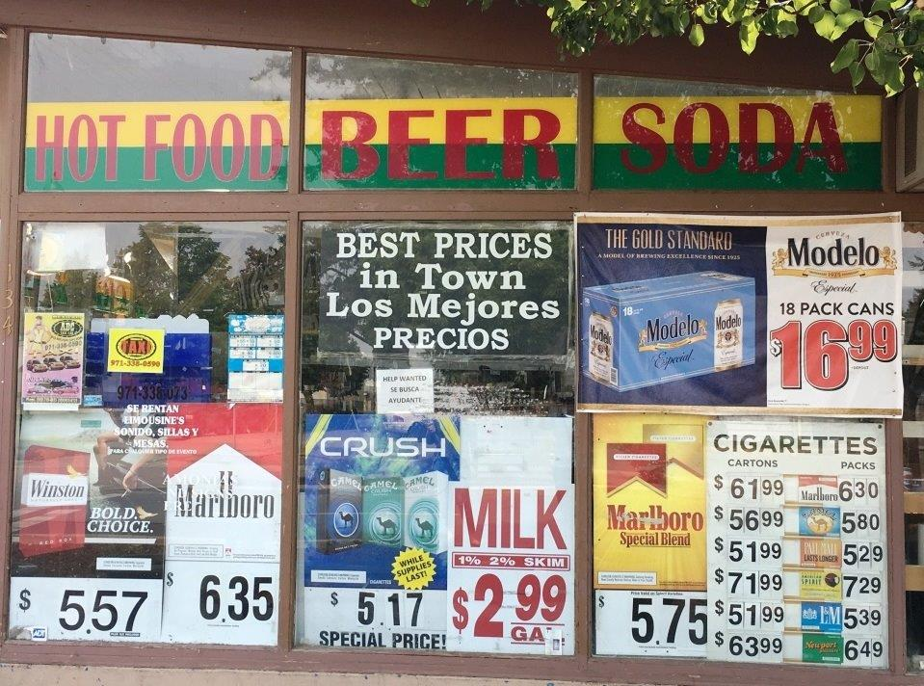
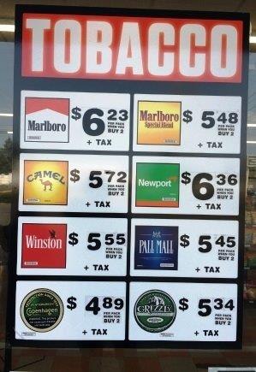
Findings: Price discounts are everywhere
Discounts and coupons were frequently offered, as well as “single servings” that could be sold for $1 or less.
64 percent had a price discount on at least one tobacco product:
  Discounted tobacco prices, through coupons and other discounts, were offered by X out of X of retailers in (insert county).
53 percent of tobacco retailers that sold cigarillos advertised them for less than $1.

Slide 8
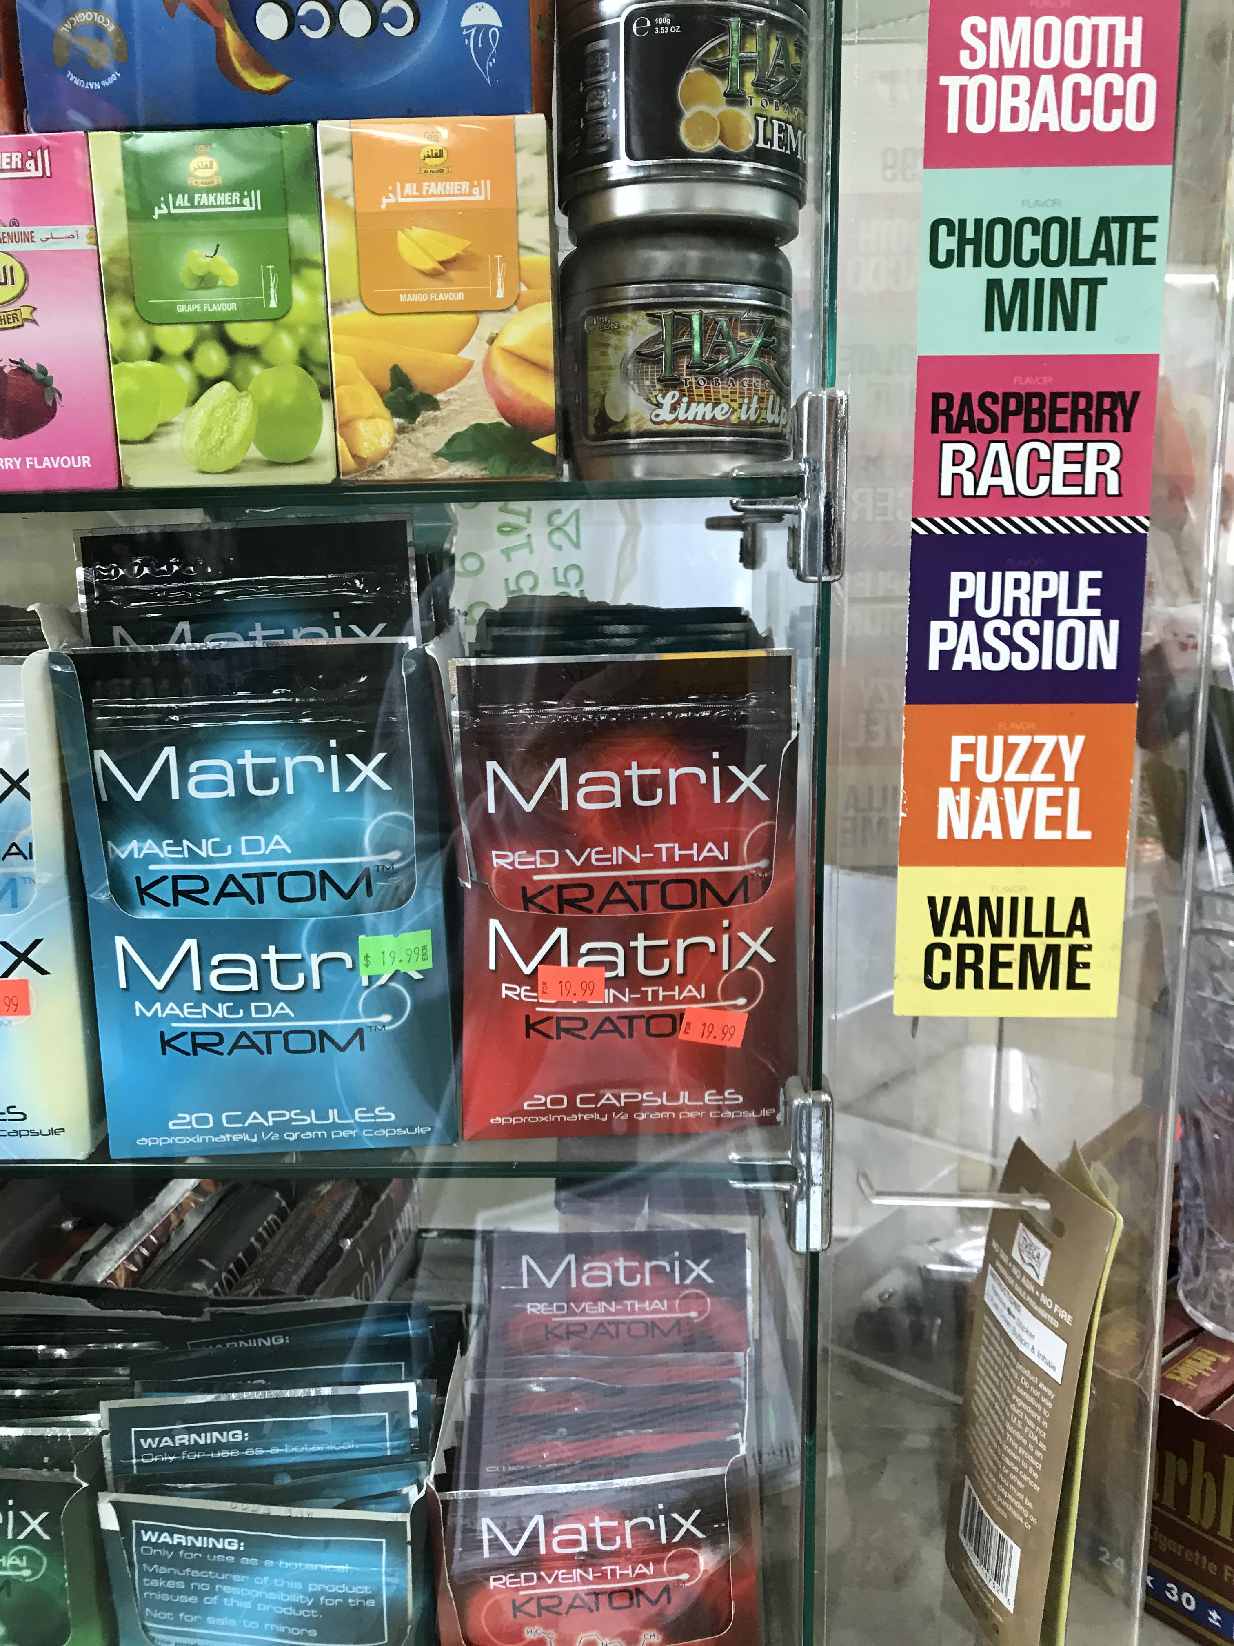
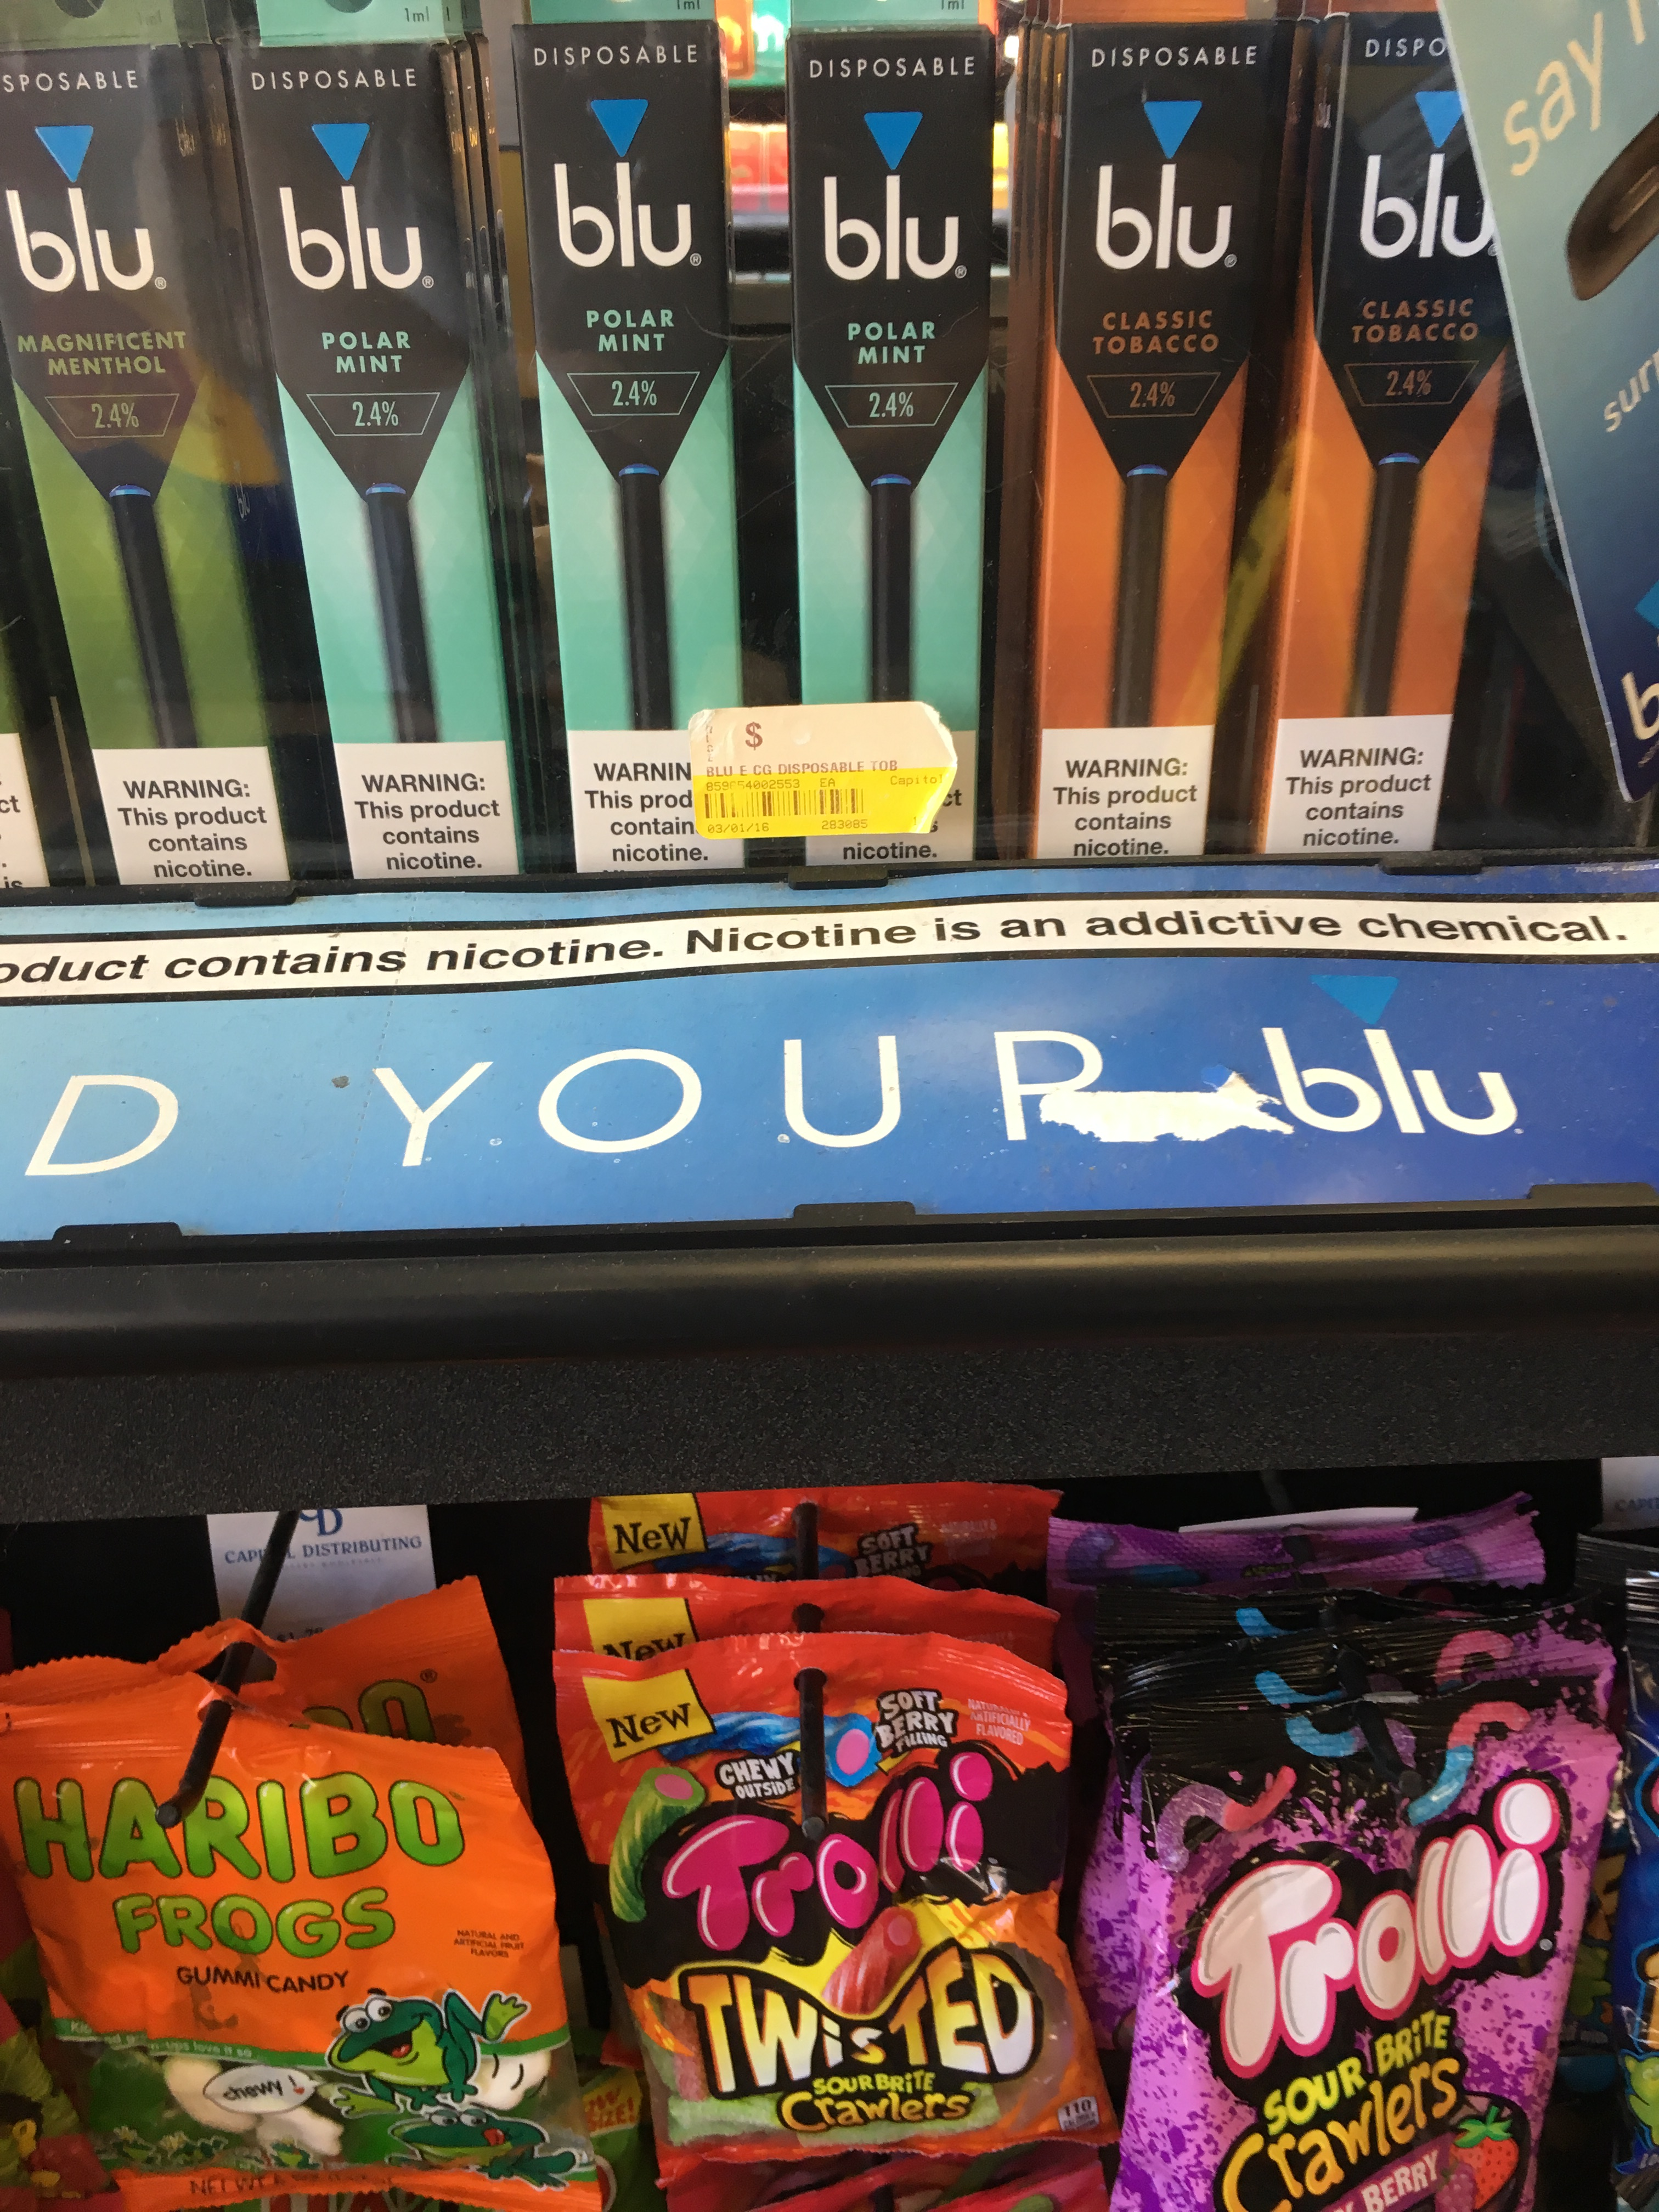
Findings: Fruit and candy flavors hook youth
93 percent sold flavored products designed to appeal to underage consumers:
  X percent of retailers sold flavored tobacco products in (insert county).
E-cigarette use among 11th graders was approximately 13 percent as of 2017 and was rising:
  E-cigarette use among 11th graders in (insert county) was X percent.
4 out of 5 youth who have used tobacco started with a flavored product.
Notes:
Source: Villanti, A. C., Johnson, A. L., Ambrose, B. K., Cummings, K. M., Stanton, C. A., Rose, S. W., Hyland, A. (2017). Flavored Tobacco Product Use in Youth and Adults: Findings From the First Wave of the PATH Study (2013-2014). American Journal of Preventative Medicine, 53(2), 139-151.

Slide 9
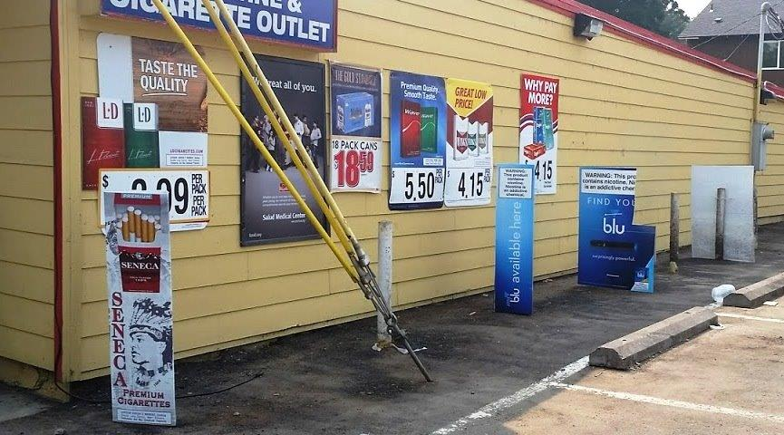
Findings: Targeting of specific communities
96 percent carried menthol products:
  X percent of retailers carried menthol products in (insert county).
Menthol products have been marketed heavily within African American communities.
60 percent of African American youth preferred Newport (menthol) cigarettes, compared with 22 percent of white youth.
Commercial tobacco companies also have targeted American Indians and Alaska Natives with promotions, events and giveaways.
Notes:
Source: CDC MMWR data. https://countertobacco.org/resources-tools/evidence-summaries/menthol.
Source: Commercial tobacco. (2015). National Native Network: Keep It Sacred. Retrieved from http://keepitsacred.itcmi.org/tobacco-and-tradition/commercial-tobacco.

Slide 10
What we can do!
Policy avenues that protect youth and adults from tobacco:
  Tobacco retail licensure
  Raising price of tobacco
  Regulating flavored tobacco products
  Proximity and density
  Tobacco-free pharmacies
  Raising minimum legal age of access

Slide 11
Tobacco retail licensure (TRL)
It would require businesses to obtain a license to sell tobacco.
Oregon is 1 of only 9 states that doesn’t require tobacco retailers to get a license.
It would hold retailers accountable to the minimum legal sales age (Tobacco 21).
Nearly 3 in 4 Oregon adults support requiring stores that sell tobacco to get a license:
  66 percent aren’t aware that Oregon doesn’t have a state tobacco license.
Several Oregon counties are implementing tobacco licenses:
  Benton, Klamath, Multnomah, portions of Lane
Notes:
Source: Oregon Health Authority. Smokefree Oregon Ad Recall Survey. November 2018. Unpublished data.

Slide 12
Raising the price of tobacco
Helps people quit and keeps youth from starting
Methods:
  Increasing state tobacco tax
  Prohibiting coupons
  Implementing tobacco minimum price standard
  Requiring minimum pack size
  Prohibiting promotional samples
Notes:
Source: Center for Public Health Systems Science. Point-of-Sale Strategies: A Tobacco Control Guide CDC-pdf[PDF–15.6 MB] External. St. Louis: Center for Public Health Systems Science, George Warren Brown School of Social Work at Washington University in St. Louis and the Tobacco Control Legal Consortium, 2014.

Slide 13
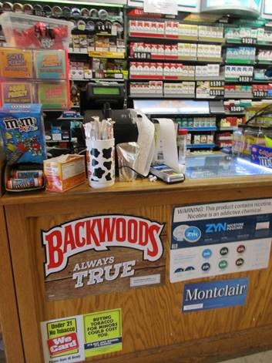
Regulating flavors
  Federal law bans flavored cigarettes, but…
  Flavored e-cigarettes, vaping products like Juul and other tobacco products are legal and easily accessible.
  Policies could ban fruit flavors, candy flavors and menthol (mint).

Slide 14
Proximity and density
Exposure to tobacco ads increases the likelihood kids will try tobacco
Policy: TRL + zoning restrictions:
  Cap number of retailers in geographic area.
  Cap number of retailers relative to population size.
  Require minimum distance between retailers.
  Prohibit retail locations near schools or other places youth frequent.

Slide 15
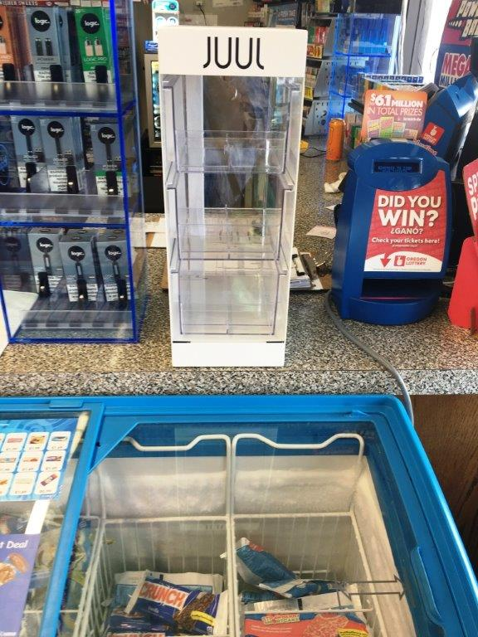
Tobacco-free pharmacies
National movement is growing to prohibit the sale of tobacco products in pharmacies.
Example: In 2014 CVS Pharmacy stores nationwide removed tobacco products. The chain’s success demonstrates that pharmacies can flourish without selling tobacco products.

Slide 16
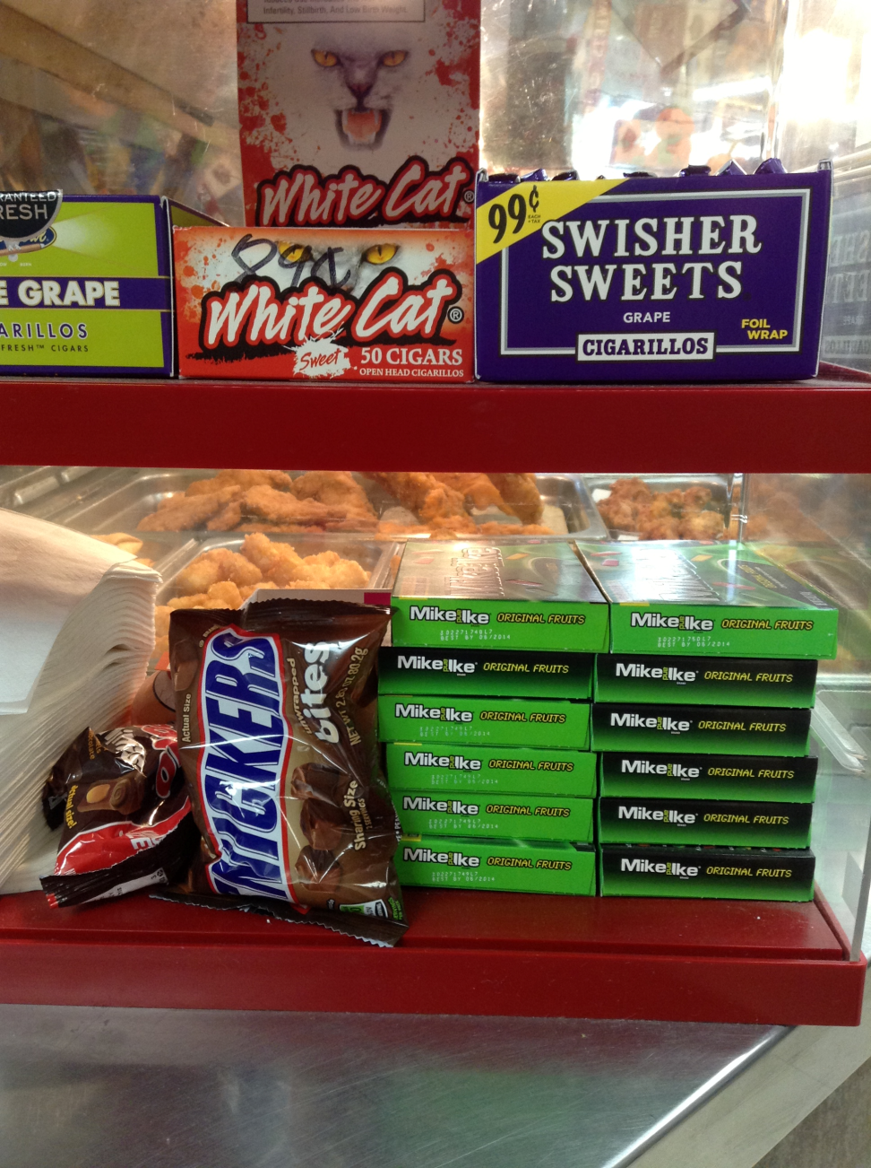
Raising minimum age
Oregon’s minimum legal sale age is 21:
  Oregon Legislature raised the minimum sales age from 18 in 2017.

Slide 17
Related Tobacco Retail Assessment materials
Full statewide report
County and statewide finding summary fact sheets
County fact sheets

Slide 18
THANK YOU!
Questions or concerns?
Contact: [insert name]
[insert email]
[insert phone number]

