Slide 1
Change is in the Air:
Tobacco Free Worksites
David Visiko M.S.
Tobacco Prevention & Control Coordinator
Deschutes County Health Services

Slide 2
100% Tobacco Free Policy:
To be implemented Sept. 4, 2012
Tobacco-free: Tobacco is neither smoked, ingested, nor used in any manner on Deschutes County owned or used property.
Tobacco: Cigarettes, cigars, pipes, and any other smoking product; dip, chew, snuff, snus, and any other smokeless tobacco product; and nicotine delivery devices, such as electronic cigarettes, excluding FDA-approved nicotine replacement therapy products for the purpose of tobacco cessation.
Public road rights of way: All lands owned by the county or dedicated to the public for road and utility purposes.

Slide 3
Deschutes County History
Smoking prohibited 30 feet of any county building entrance or facility.
Smoking and tobacco use is not allowed in any County building, facility or automobile
October, 2009: OAR requires addiction outpatient programs to be 100% tobacco free facilities and grounds.
  Health Services Campus, Courthouse Annex, Downtown Health Center, and Wall Street Services Building affected.
  Community Development Building and Mike Maier County Services Building (proximity to child care center and health services).

Slide 4
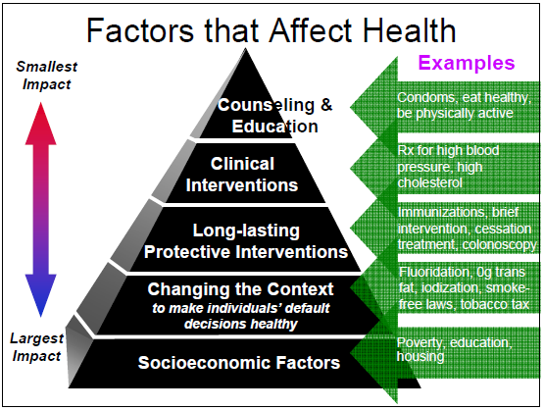
Source: Dr. Tomas R. Frieden, Director, U.S. Centers for Disease Control & Prevention
Notes:
A comprehensive approach- addressing all levels of the pyramid and the SEM are important. With limited resources prioritizing initiatives and public health efforts are critical. Focus on where the great number of people are impacted by the outcome.

Slide 5
Notes:
This figure shows the sales of packs of cigarettes in Oregon and in the U.S. over time. Between 1996 and 2010, cigarette pack purchases dropped 52%.
The percentage of adults who smoke decreased by 26 percent, from 23.7 percent in 1996 to 17.5 percent in 2009.

Slide 6
86% of Deschutes County Adults Currently Do Not Use Tobacco
133,924 Adults in Deschutes County
18,883
14%
115,041
86%
70% of Deschutes County tobacco users want to quit

Slide 7
Positive Impacts of Proposed Policy
Can positively impact 95% of our adult population
Can positively impact Deschutes County residents who do not smoke by reducing their exposure to secondhand smoke and eliminating smoking triggers.
AND
Can assist tobacco users who want to quit, reducing chronic disease and its impact on health care costs.

Slide 8
Public Opinion Survey Results Feb.2012

Slide 9
Survey Results at a Glance:
91% visit Deschutes County Offices
86% try to avoid Second Hand Smoke
91% think Second Hand Smoke is harmful
84% think tobacco free buildings important
804 survey respondents

Slide 10



Enforcement

Slide 11
It Is Important Because….
The Surgeon General recognizes there is no safe level of SHS, even outdoors, and enforcement helps protect health
Our county properties are family-friendly, enforcement is necessary for safety
SHS can be detected up to 23 feet away from source – even outdoors
  Stanford Study
Enforcement holds the public accountable to comply with a policy
Enforcement makes a smokefree policy sustainable

Slide 12

A few Myths about Enforcement
It costs too much money
It takes too much time away from other efforts
Causes conflict between citizens
No one pays attention to signs

Slide 13
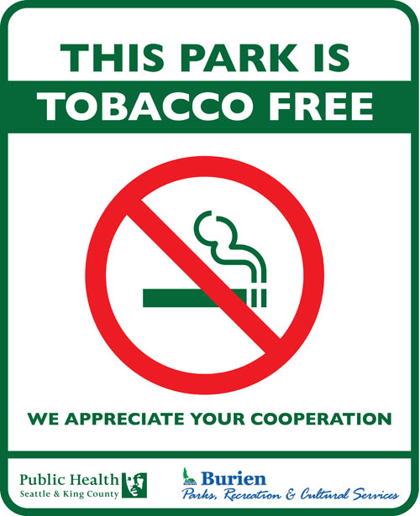
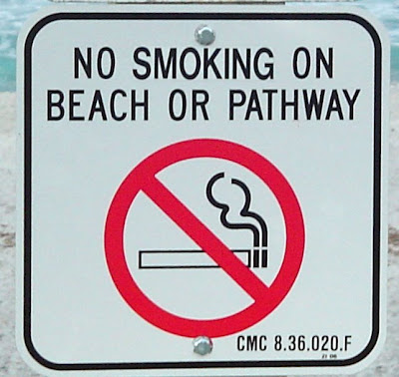
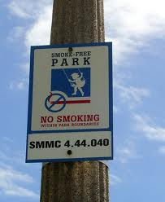
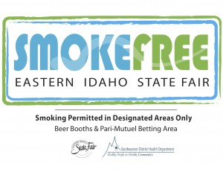
Signage is Key!
Signage is a visual cue of the no smoking policy
Discourages people from smoking
Serves as a point of reference
Demonstrates it is a policy
Serves as the main enforcement tool

Slide 14

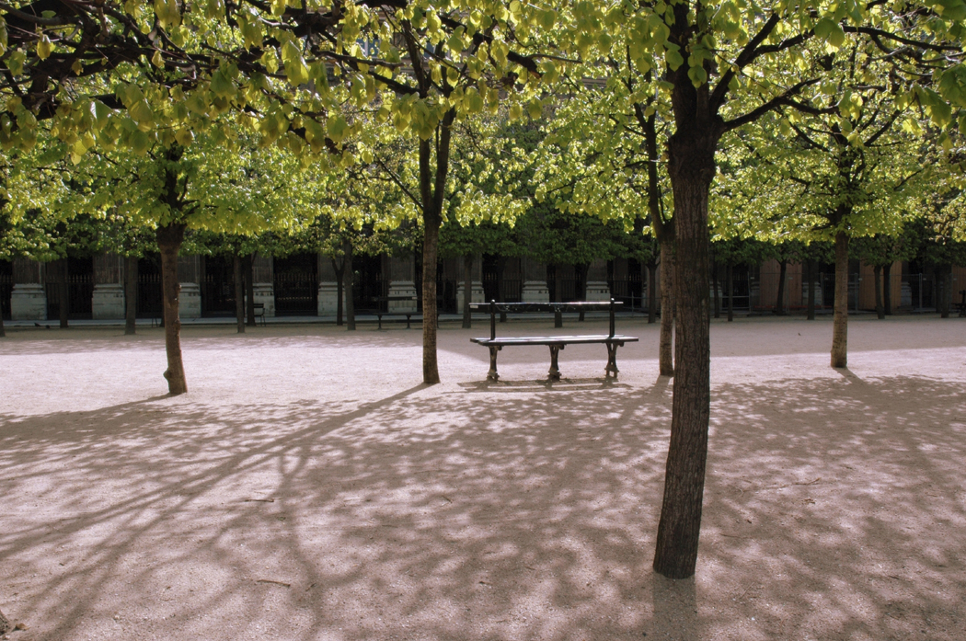
Steps for Success!
Discuss Enforcement early on in the process – it is a main concern of decision-makers
Communication is essential – announce the policy early, distribute notices, engage public before policy is implemented. This makes enforcement run smoother
Post signage

Slide 15
Plan early for enforcement
Encourage coordination before policy is drafted.
Establish implementation task force to develop enforcement plan.
  Public health
  Organizational leadership
  Enforcement/ public safety
  Communications
Consider enforcement when drafting policy.
  Avoid exemptions
  Penalties and enforcement mechanism
  Complaint response process
  If a policy does not have 100% compliance right out of the box, this does not mean that the policy is a failure.
Notes:
No need to reinvent the wheel.
Enforce tobacco-free policies the same as any other health and safety policy

Slide 16
Focus on education and communication
Focus on compliance, not punishment.
Offer resources for quitting tobacco.
Notes:
Citations issued to only 24 businesses since Jan. 2009.
Most voluntarily comply with laws and policies.

Slide 17
The Oregon Tobacco Quit Line
The program is free and confidential
The best news: Quit Line services are proven to be 6 times more effective than going ‘cold turkey’
Is available to anyone, regardless of income or insurance coverage. Call 1-800-QUIT-NOW or 1-877-2NO-FUME for Spanish, or visit www.oregonquitline.org
Offers an online, live chat coaching service for those who would prefer to receive help to quit via their computer.

Slide 18
Quit Resources for Deschutes County Employees and County Dependents
Deschutes County Health Benefits
TOBACCO QUITLINE 1-888-244-9100
The Deschutes County Health Benefits program offers online and telephone tobacco recovery/treatment programs.
These programs are at no cost to employees and dependents. Members will have access to personalized strategies to assist their recovery from tobacco dependence.
The tobacco recovery program offers free nicotine replacement therapy (NRT), as well as reduced costs for the prescription treatment, Chantix.
For more information on how to get started, contact Ronda Connor at ronda_connor@deschutes.org or 541-385-3215.

Slide 19
Summary of EAP Benefit
3 Face-to-Face Counseling Sessions
Completely Confidential
Family Members are eligible
24/7 Access to Counselors
E Support (online sessions)
Phone Counseling

Slide 20
Talking points
1. This is about making our Deschutes County campus properties more accessible for all our clients, staff and visitors.
2. The air will be healthier for everybody who comes to campus for services or work.
3. A no-smoking rule is not a “no-smoker rule.” We are not judging or excluding people who choose to smoke; we’re just asking them not to use tobacco on the campus where it can impact others.
4. If a smoker is ready to quit, free resources include the Tobacco Quit Line at 1-800-QUIT-NOW (1-800-784-8669).
5. This policy is part of broader efforts to create a campus culture of mutual respect, wellness and sustainability.
6. We are leaders in our community…
Notes:
Use messages that align with mission of the organization and will be well-received by community members.

Slide 21
Thank You
If you would like a presentation and/or training with your department staff…
Please contact:
David Visiko MS
David.Visiko@deschutes.org
541-322-7481

