Slide 1



Drug Courts: Some Answers to Our Burning Questions
Oregon Tobacco Prevention and Education Program:
Characteristics and Successes of County Programs
How Drug Court Practices Impact Recidivism and Costs
NADCP
May 2008

Slide 2
Monitoring
Monitoring well means consistently measuring performance and providing ongoing feedback to key stakeholders on progress toward goals.
Notes:
Continuous Quality improvement (CQI) is the process-based, data-driven approach to improving the quality of a product or service. It operates on the belief that there is always room for improving operations, processes, and activities to increase quality.
When it comes to quality performance, context matters. With local and statewide TPEP, there are a number of things that can affect the effectiveness and success of programs in achieving measurable community change to improve health.

Slide 3
Introduction
NPC Research contracted with Oregon Public Health Division, 2010-2015
Conduct studies & develop tools for supporting and improving TPEP
  Community-based participatory research
  Utilization-focused evaluation

Slide 4
TPEP Characteristics & Successes
Purpose was to examine specific characteristics of local TPEPs to better understand what works to achieve success:
  Time spent on TPEP
  External funding
  Program infrastructure
  Staffing
  Attitudes toward TPEP and tobacco

Slide 5
Survey and Interview
Completion Rate
 | Total Number of Persons | Surveys or Interviews Completed | Response Rate
Survey
Administrators | 34 | 22 | 65%
Managers | 11 | 8 | 73%
Coordinators | 36 | 33 | 92%
Total | 81 | 63 | 78%
Interview
Administrators | 34 | 12 | 35%
Managers | 11 | 2 | 18%
Coordinators | 36 | 14 | 39%
Total | 81 | 28 | 35%

Slide 6
Findings: Time Spent on TPEP
Average years in current position
  8 years for administrators
  4 years for coordinators & managers
Time spent per month
  Administrators: 50% spend 0-4 hours/mo
  Managers: 50% spend 4-16 hours/mo
Coordinator time
  20% of time spent “Engaging partners, building coalitions, and finding/developing local champions
Notes:
I cleaned up and abbreviated the text heavy slide, and led with numbers
Years in current position:
Administrators m=7.6 years
Managers m=3.7 years
Coordinators m=4.0 years
Administrators: 50% spend 0-4 hours per month, 23% spend 4-16 hours on TPEP
Managers: 25% spend 0-4 hours per month, 50% spend 4-16 hours on TPEP

Slide 7
Findings: External Funding
50% of counties at some time applied for external funding
27% applied for funding in last fiscal year
66% ever successful in obtaining external funding
Majority of funding came from foundations or nonprofit organizations
Notes:
I cleaned up the text heavy slide, and led with numbers
50% administrators & 49% coordinators at some time applied for external funding
32% administrators & 27% coordinators were ever successful in obtaining external funding
Majority of funding came from foundations or nonprofit organizations, & was used toward 8 categories of activities including program quality improvement

Slide 8
Findings: Program Infrastructure
If TPEP funding was unavailable:
41% of administrators did not think tobacco prevention activities would continue
Nearly 50% of administrators would continue some TPEP-related activities
  Gather local data
  Coordinate with other community programs
  Assist with policy implementation
Notes:
I cleaned up the text heavy slide, and led with numbers
If TPEP funding was unavailable:
41% of administrators did not think tobacco prevention activities would continue
50% of administrators would continue to gather local data
46% would coordinate with other community programs
41% would assist with policy implementation specific to TPEP

Slide 9
Findings: Staffing
Many Administrators said:
  Staffing for TPEP was supported via other sources
  were happy with TPEP staffing success & retention
Many TPEP coordinators shared funding responsibilities with other community programs
Notes:
Many administrators indicated that staffing for TPEPs was funded in part by outside sources, shared with other community programs, & insufficient to maintain a successful TPEP
Many coordinators shared funding responsibilities with other community programs, which had positive aspects (e.g., building skills across areas) & negative aspects (e.g., tobacco policy is less of a focus)

Slide 10
Findings: Staffing
TPEP staff members are often included in LPHA structures & activities
About two thirds of LPHAs had a strategic plan or guiding document
  About 50% of the plans contain tobacco prevention activities
Notes:
91% of coordinators & 100% of administrators indicated that TPEP staff are included in LPHA structures & activities
67% of coordinators & 73% of administrators indicated that their LPHA had a strategic plan or guiding document
- 61% of coordinators & 55% of administrators indicated that plan contains tobacco prevention activities

Slide 11
Findings: Staffing
Most local TPEPs have access to administrative staff, e.g., managers, office support, IT, fiscal staff, public health staff, & county personnel
Slightly less access across counties to legal consultants
Much less access to data analysts, grant writers, and epidemiologists

Slide 12
Findings: Attitudes
According to coordinators
  Public is aware of TPEP
  public is moderately to highly supportive of tobacco prevention activities
  individuals that are aware and supportive were likely involved in organizations exposed to TPEP activities
Notes:
Coordinators indicated that individuals that were highly aware & supportive were likely involved in organizations or groups that had exposure to TPEP activities (e.g., parks department)

Slide 13
Findings: Attitudes
Survey participants
  believed that attitudes of administrators impacted success of TPEP
  generally held high opinions of and provided support for tobacco prevention
  believed that Boards of Heath and county administrators placed tobacco activities as moderately low priority
Notes:
Nearly all interview participants (96%) believed that attitudes of administrators impacted success of TPEP
Administrators, managers, & coordinators generally held high opinions of & provided support for tobacco prevention

Slide 14
Recommendations
Explore ways to strengthen capacity of local TPEP to pursue external funding
Pursue opportunities to strengthen local TPEP sustainability
Clarify local TPEP access to skills & specializations & identify opportunities to strengthen local resource sharing
Notes:
Explore ways to strengthen capacity of local TPEP to pursue external funding (e.g., county funds) to expand & sustain TPEP activities
Pursue opportunities to strengthen local TPEP sustainability by including TPEP goals & objectives in LPHA strategic plans or guiding documents
Clarify local TPEP access to skills & specializations (e.g., data analysts, public information officers, grant writers), & identify opportunities to strengthen local resource sharing to fulfill TPEP activities

Slide 15
Recommendations
Explore opportunities to increase or improve communication between LPHA administrators and TPEP coordinators
Consider ways to describe and promote TPEP activities to increase knowledge of & support for tobacco prevention work
Notes:
Explore opportunities to increase or improve communication between LPHA administrators & TPEP coordinators to ensure common understanding about the availability of & access to skills & specializations
Consider ways to describe & promote TPEP activities to increase knowledge of & support for tobacco prevention work among county officials, community partners, & communities at large

Slide 16
Full Report Location
https://public.health.oregon.gov/PreventionWellness/TobaccoPrevention/Documents/tpep-characteristics-and-successes-report.pdf

Slide 17
Slides containing additional detail follow

Slide 18
Contact Information
This presentation was prepared by:
  Colleen Kidney (kidney@npcresearch.com)
  Eric Einspruch (einspruch@npcresearch.com)
For more information on OHA’s TPEP evaluation, contact Shaun Parkman (shaun.w.parkman@state.or.us)

Slide 19
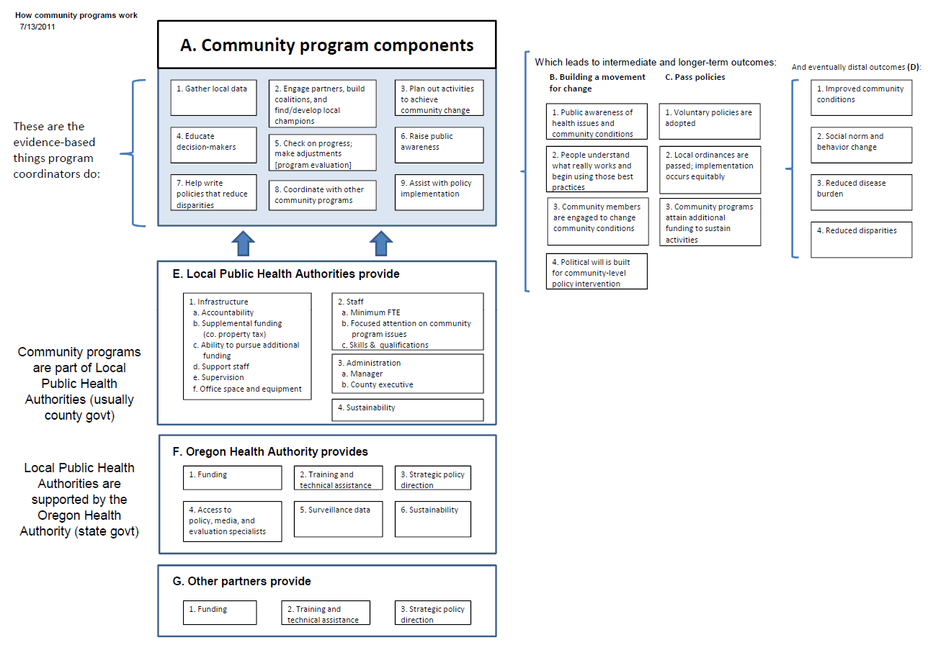
How Community Programs work
Notes:
Omit slide

Slide 20
Acknowledgements
OHA Health Promotion & Chronic Disease Prevention Section
Conference of Local Health - Healthy Communities
Community Programs Initiative & Evaluation Work Group
Local public heath administrators and TPEP managers and coordinators
Notes:
Shaun Parkman, Evaluation Specialist, Health Promotion & Chronic Disease Prevention, and Luci Longoria, Community Programs Lead, Health Promotion & Chronic Disease Prevention Section, for their leadership on this project
Daniel Morris, Sarah Bartelmann, and Kati Moseley, former liaisons to this project
Conference of Local Health Officials, Chronic Disease Committee, Healthy Communities members; Community Programs Initiative members; and particularly the Evaluation Work Group members (Steven Blakesley, Marilyn Carter, MaiKia Moua, and Amanda Garcia- Snell) for offering valuable feedback and suggestions to improve the data collection instruments and the report
Local public health administrators and Tobacco Prevention and Education Program managers and coordinators, who volunteered their time to complete the surveys and interviews

