Slide 1
Salt, Fat, and Sugar from Science to Policy
August 15, 2012
Kimberly W. La Croix, MPH, RD
Nutrition Coordinator: Oregon Public Health Division & State Unit on Aging

Slide 2

Agenda
Review of the Science
  sodium, trans fats, sugar
Chronic Disease Implications
Public Health Opportunities

Slide 3
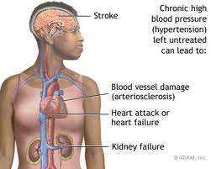
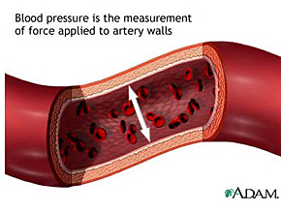
Sodium and HTN (silent killer)
Notes:
When you consume too much salt, the body retains water in an attempt to balance out the salt and fluid in the body. The retention of water increases the volume of the blood. When blood volume is increased, it does not flow through the blood vessels as smoothly and easily. Hypertension was defined as mean systolic blood pressure ≥140 mm Hg, mean diastolic blood pressure ≥90 mm Hg

Slide 4
Usual Sodium Intakes Compared with Current Dietary Guidelines
Population Group | Recommendation | % NOT compliant w/recommendation
HTN, DM, kidney disease >51, AA | 1500 mg | 98.6%
General Population > 2 | 2300 mg | 88%
Adolescents < 18 years | 2300 mg | 99.4%
Source: Centers for Disease Control and Prevention. Usual Sodium Intakes Compared with Current Dietary Guidelines --- United States, 2005—2008. MMWR. 2011; 60(41);1413-1417

Slide 5
Sodium Intake Exceeds Recommendations
Source: Centers for Disease Control and Prevention. Sodium intake among adults-United States, 2005-2006.
MMWR. 2011; 60(41);1413-1417
Notes:
Recent MMWR showed that 1500 recommendation is really only 47.6% population. 98.6% of those persons who should limit sodium to >1,500 mg consume more than 1500 mg/day. 88.2% of the remaining U.S. population, daily sodium intake was greater than the recommended <2,300 mg. including 95.0% of those aged ≥18 years

Slide 6
Oregon numbers
1500 mg
Population Groups | % | Estimated N
With hypertension and without diabetes, aged >20 years | 21.5% | 559, 000
Without hypertension and without diabetes, aged >50 | 22.0% | 571, 000
Diabetes | 6.9% | 180, 000
Without Hypertension and without diabetes, AA, aged 20-50 | .5% | 14, 000
Total | 50.9% | 1, 324, 000
2004-2005 BRFSS Race Oversample.
Sample size for HTN was 15, 265
Notes:
Does not include DM and kidney disease

Slide 7
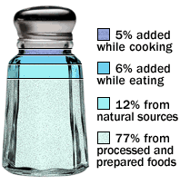
Primary Sources of Sodium in the Average U.S. Diet
Where Does All That Salt Come From?
Mattes, RD, Donnelly, D. Relative contributions of dietary sodium sources. Journal of the
American College of Nutrition. 1991 Aug;10(4):383-393.
Notes:
Dairy Products

Slide 8
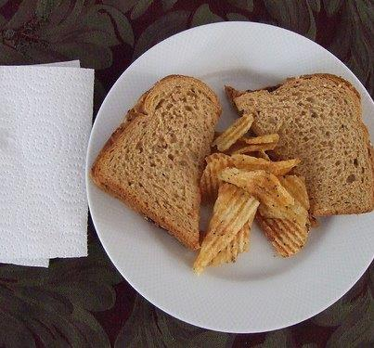
Which Food Has More Sodium?
A. 2 Slices of bread
B. Two slices of bacon
C. Grab size bag of chips made with sea salt
D. Grab bag of chips with standard salt
E. Mixed Nuts (1/4 cup)
Notes:
2 slices Franz 100% stone ground whole wheat (420 mg)
Two slices of bacon (320 mg)
Chips…262 mg
Mixed Nuts (230 mg)

Slide 9
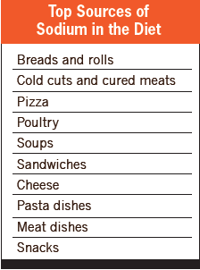
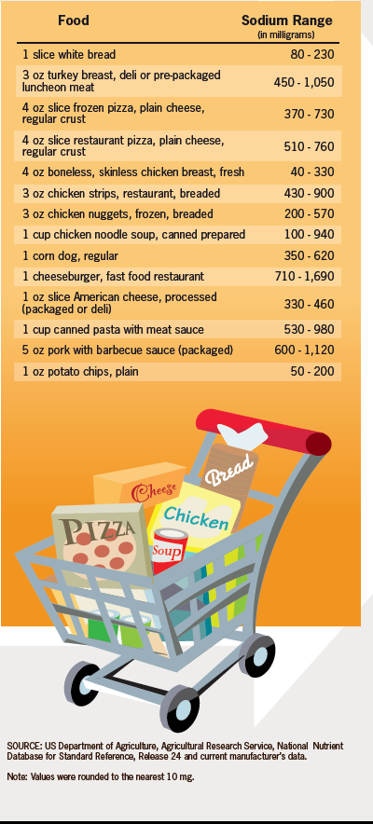
Notes:
More than 40% of sodium comes from the following 10 types of foods: Breads and rolls, cold cuts and cured meats such as deli or packaged ham, or turkey, pizza, fresh and processed poultry, soups, sandwiches such as cheeseburgers, cheese, pasta dishes*, meat-mixed dishes such as meat loaf with tomato sauce, and snacks such as chips, pretzels, and popcorn.

Slide 10
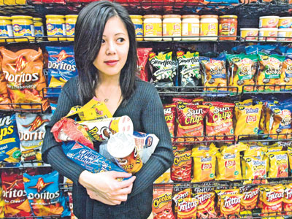
Why so much salt?
Flavor enhancer
Food preservative
Increases shelf life
Inexpensive food additive
Competition for market share
Retains food moisture during cooking
Increased consumer preference
Yeast Inhibitor

Slide 11
Excessive Salt Intake Is a Serious Problem
Related to heart disease and stroke
  Heart disease and stroke are the #1 and #3 causes of death in US and account for >1/3 of deaths
  Hypertension is a major contributor to these deaths
    69% of strokes, 49% of heart disease attributable to hypertension
Salt intake correlates with hypertension at the population level
9/10 Americans will develop HTN in their lifetimes
.
IOM (2010). “Strategies to Reduce Sodium Intake in the United States,” Washington DC: The National Academies Press.
BMJ 2009; 339:b4567doi:10.1136/bmj.b4567 “Salt intake, stroke, cardiovascular disease: meta-analysis of prospective studies
Vasan RS. Beiser A., et al., Residual lifetime risk for developing hypertension in middle-aged women and men: The Framingham Heart Study. JAMA. 2002; 287:100 3-1010.

Slide 12
Good News!
Reducing sodium intake reduces blood pressure: for most people in only days to weeks
Reducing the average population systolic blood pressure by just 5 mm Hg can have a major impact
Reducing average population sodium intake to 1500 mg/day may
  Reduce cases of hypertension by 16 million
  Save $26 billion health care dollars
Source: Sacks FM, et al. N Eng J Med 2001; 344:3-10; Stamler R. Hypertension 1991; 17(suppl1): 16-20;
Palar K, et al. Am J Health Promot 2009; 24(1): 49-57

Slide 13
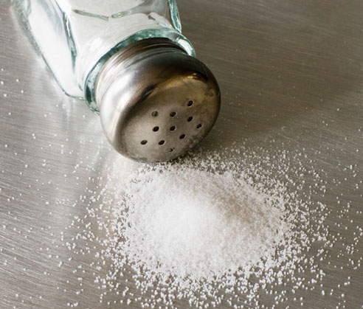
More Good News!
Even reducing sodium intake to 2300 mg/day could
  Reduce cases of hypertension by 11 million
  Save $ 18 billion health care dollars
Source: Palar K, et al. Am J Healthy Promot 2009; 24(1): 49-57

Slide 14
Enough evidence to act
Large body of strong scientific evidence
  Increasing sodium intake increases blood pressure
  Reducing sodium intake reduces blood pressure
  Current sodium intake far exceeds safe and healthy levels
Numerous organizations support sodium reduction
  American Public Health Association
  Institute of Medicine
  Dietary Guidelines for Americans
  American Heart Association
  World Health Organization
  National Institute of Health
  American Medical Association
Institute of Medicine. Dietary reference intakes for water, potassium, sodium chloride and sulfate. Washington, DC: National Academies Press; 2004; Institute of Medicine. Strategies to reduce sodium intake in the United States. Washington, DC: National Academies Press; 2010

Slide 15

Institute of Medicine Report
IOM (2010). “Strategies to Reduce Sodium Intake in the United States,”
Washington DC: The National Academies Press.
Released April 2010
FDA Regulation
Salt categorized as Generally Recognized as Safe (“GRAS”)
  No standards in place to ensure amount of salt in food is safe
Establish incremental limits on salt content
Consumers cannot detect up to a 10-25% decrease in sodium.
.
Notes:
Reliance on voluntary efforts to lower sodium levels in processed and restaurant foods has not worked over the past 40 years
Consumers deserve more choices and more control of the sodium levels in the foods they eat
Competition between manufacturers makes it difficult for individual producers to decrease sodium (Campbell's)

Slide 16
National Salt Reduction Initiative (NYC)
  Modeled on successful program in United Kingdom
  Goal to reduce intake by 20% in 5 years
  Developed feasible two- and four-year targets for packaged and restaurant foods
    62 categories of packaged food and 28 categories of restaurant food
    Database linking national sales and nutritional information for 80% of sales in each category
Participation is voluntary
  28 large national businesses committed to standards
  Includes methods to monitor progress
  Oregon PHD is signed on
Notes:
While it’s fantastic that 28 companies have committed to NSRI targets, achieving broad scale reductions will require commitments from many more food manufacturers and restaurants. If it doesn’t lead to meaningful industry wide reductions it justifies the call for regulation.

Slide 17
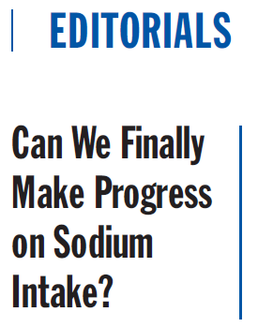
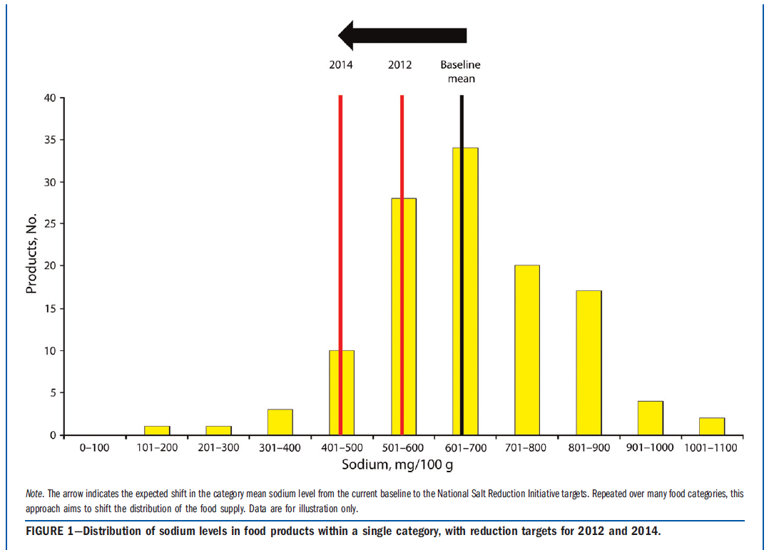

Notes:
Editorial on the National Salt Reduction Initiative (NSRI) that was co-authored by NYC Health Commissioner Farley scheduled for publication in The American Journal of Public Health in September.
FDA has not taken action on IOM recommendation of regulation of sodium levels in processed foods, leaving little besides the NSRI to address this health imperative.
In the UK, the government was central to address structured, voluntary industry reductions.
The gov’t and food industry should broadly endorse and join the NSRI effort now to reduce sodium consumption now and prevent tens of thousands of needless deaths.

Slide 18
Successes in Other Countries
Japan
United Kingdom
Finland
Ireland
Multi-pronged approach
  Regulation
  Labeling
  Public Education
  Collaboration with Industry
  Journal of Hypertension 2011, 29: 1043-1050.
  http://www.foodnavigator.com/Legislation/UK-salt-intake-Consumption-falling-but-still-some-way-off-targets
Notes:
UK: salt consumption fallen from 9.5g/day to 8.1 (goal from WHO). UK has the lowest salt consumption of any developed country in the world. Fascinating because they have a reputation for “bland” food which you would think would encourage people to add salt!
Japan: Non gov’t initiative. Some of the highest salt consumption in the world. Public ed campaign 13.5 to 12. g/day. Indications salt intake is on the rise
Ireland: reduced salt in bread by 10%, sauces 15% and soups 10%. Mandatory limits for salt content of food established
Finland: 1978-2002 3 g reduction in pop. Salt intake. Decreased from 12 to 9 g/day. Mandatory warning labels which drove many high salt foods from supermarket shelves.

Slide 19
Public Health Opportunities
We can promote or require changes in sodium content of foods through food
  Comprehensive Nutrition Standards
    Procurement policies
    Healthy meeting policies
    Vending Machines
    Retail outlets
  Reformulations: work with manufacturers
  National Efforts:
    NSRI
    FDA docket
http://www.gsa.gov/graphics/pbs/Guidelines_for_Federal_Concessions_and_Vending_Operations.pdf
http://www.cdc.gov/salt/pdfs/DHDSP_Procurement_Guide_Summary.pdf
Notes:
Important not to focus on education…better to work with manufacturers because people don’t have a lot of control over the amount of salt in their foods. UNDECTECTABLE APPROACH!

Slide 20
Oregon efforts
Bread
  Largest sodium contribution to diet
  Bread is still largely made in Oregon
  Studies show you can reduce sodium in bread up to 25% without consumer detection
Nutrition Standards
Retail Opportunities
Notes:
A single slice can have 130-220 mg sodium per slice! Working with Oregon FIC on product development, sensory and consumer acceptance data to be published. No data exists for Oregon or national work on sodium reduction in bread. Would like to have new buns on ODE procurement list.

Slide 21
Trans Fat Overview
Million Hearts
Food Science
Trans fat in our food supply
Trans fatty acid intake and Health
Regulation/Reformulations
Menu Labeling

Slide 22

DHHS led public/private initiative to prevent 1 million heart attacks and strokes over the next 5 years in the United States
Implement proven, effective, and inexpensive interventions in both clinical and community settings
Clinical: Improve management of the ABCS (aspirin use for high risk patients, blood pressure control, cholesterol management and smoking cessation)
Community: Enhance efforts to reduce smoking, improve nutrition and reduce high blood pressure.

Slide 23
Million Hearts strives to achieve the following specific goals:
Indicator | Baseline | 2017 goal
Aspirin use for people at high risk | 47% | 65%
Blood pressure control | 46% | 65%
Effective treatment of high cholesterol (LDL-C) | 33% | 65%
Smoking prevalence | 19% | 17%
Sodium intake (average) | 3.5g/day | 20% reduction
Artificial trans fat consumption (average) | 1.3 g(1% of calories/day) | 50% reduction
http://www.hhs.gov/news/press/2011pres/09/20110913a.html
Notes:
Estimated to save 250, 000 from trans fat goal and 110,000
The average consumption of trans fat has done from 4.6 grams in the 1990s to 1.3 grams in 2010.

Slide 24
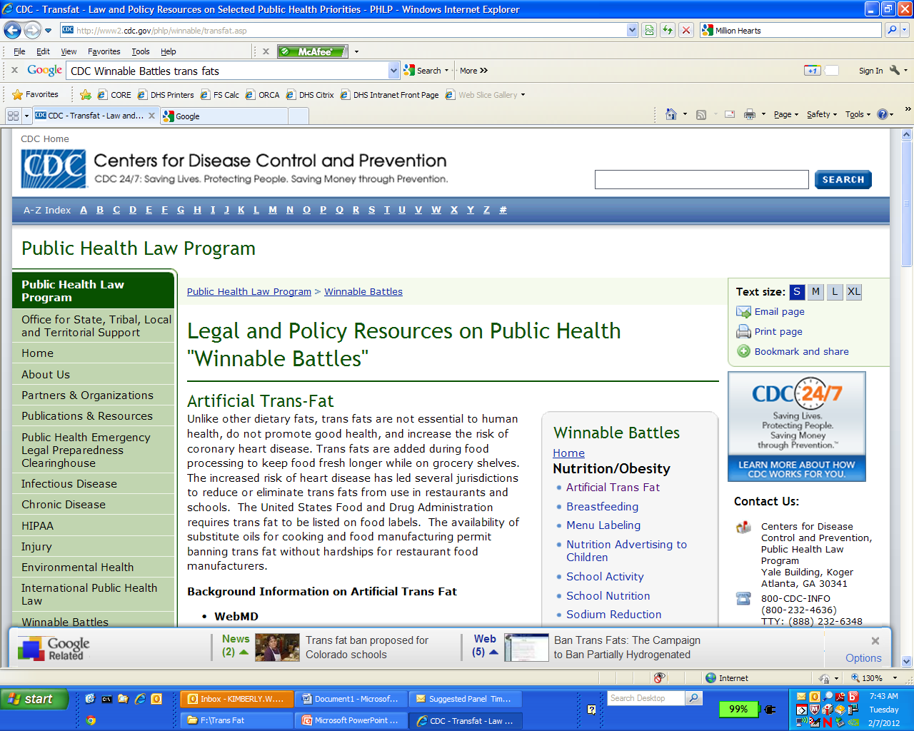

Slide 25
Good Fats vs. Bad Fats
Saturated Fats | Trans Fats | Mono unsaturated Fats | Poly unsaturated Fats
(Mainly from animals) Beef, lamb, pork, poultry with the skin, beef fat, lard, cream, butter, cheese, other whole or reduced-fat dairy products • (Some from plants) Palm, palm kernel and coconut oils | Baked goods – pastries, biscuits, muffins, cakes, pie crusts, doughnuts and cookies • Fried foods – French fries, fried chicken, breaded chicken nuggets and breaded fish • Snack foods – popcorn, crackers. • Traditional stick margarine and vegetable shortening | Vegetable oils – olive, canola, peanut and sesame • Avocados and olives • Many nuts and seeds – almonds and peanuts/ peanut butter | High in Omega-6 and Omega-3 (ALA) vegetable oils – soybean, corn and safflower Many nuts and seeds – walnuts and sunflower seeds • High in Omega-3 (EPA and DHA) Fatty fish – salmon, tuna, mackerel, herring and trout
• Raise bad cholesterol level • Foods high in saturated fats may also be high in cholesterol • Increase risk of heart disease | Raise bad Cholesterol level •Lowers good cholesterol • Increase risk of heart disease | Reduce bad cholesterol • May lower risk of heart disease | Reduce bad cholesterol • May lower risk of heart disease

Slide 26
Food Science
Creation of Synthetic or Industrial Trans Fats
  Hydrogenation: during food processing when liquid oils are converted into semi-solid fats.
  Used by food manufacturers to make products containing unsaturated fatty acids solid at room temperature (more saturated) and therefore more resistant to becoming spoiled or rancid
  Partial hydrogenation means that some, but not all, unsaturated fatty acids are converted to saturated fatty acids.
Notes:
When introduced, it was believed that artificial trans fats were a viable healthy alternative to saturated fats

Slide 27
Natural vs. Synthetic/Artificial
Complete elimination of all trans-fats is not possible due to their natural presence in dairy and meat products.
  Formed naturally by bacteria present in the rumens of ruminant animals.
  Dairy and meat products from these animals contain small amounts of trans-fats.
  There is limited evidence to conclude whether synthetic and natural trans fatty acids differ in their metabolic effects and health outcomes.
  Regardless, we consume far more commercial trans-fats than those of natural origin
  United States Department of Agriculture & Health and Human Services (2010). Dietary Guidelines for Americans.
Notes:
Rumens= The first division of the stomach of a ruminant animal, in which most food collects immediately after being swallowed and from which it is later returned to the mouth as cud for thorough chewing. Cows eat a lot of grass very quickly and then it’s spit up and held in the mouth for thorough chewing.

Slide 28
Trans fatty acid intake and CVD
Significant risk factor for cardiovascular events
  Raises low density lipoprotein (LDL) “bad cholesterol”
  Lowers high density lipoprotein (HDL) “good cholesterol”
2% increase in energy intake from TFA is associated with a 23% increase in the incidence of coronary heart disease.¹
Nutritionally Unnecessary
Academy of Nutrition and Dietetics, IOM, US DGA, & NCEP
all recommend limiting dietary trans-fat intake from industrial sources as much as possible. ²
1. Mozaffarian D, Katan MB, Asherio A, Stampher MH, Willett WC. Trans fatty acids and Cardiovascular disease. N Eng J Med. 2006; 354: 1601-1613.
2. Remig V, Franklin B, Margolis S, Kostas G, Nece T & Street J (2010). Trans Fats in American: A Review of Their Use, Consumption, Health Implications and Regulation. J Am Diet Assoc. 2010; 110:585-592.
Notes:
Double whammy
Both synthetic and natural

Slide 29
Obesity and Diabetes
Conflicting evidence about the propensity of TFAs to cause obesity and insulin resistance.
All fats are equally high in calories relative to carbohydrate and protein (9 kcal/gram vs. 4 kcal/gram)
Linked in the context of consuming too many calories
  Reduce
  Eliminate
Replace with MUFAs and PUFAS
Kavanagh K, Jones K, Sawyer J, Kelly K, Carr J. Trans Fat Diet Induces Abdominal Obesity and Changes in Insulin Sensitivity in Monkeys. Obesity. 2007; 15: 1675-1684.
Salmeron J, Hu FB, Manson JE, et al. Dietary fat intake and risk of type 2 diabetes in women. Am J Clin Nutr. 2001; 73: 1019-26.
Hu FB, van Dam RM, Liu S. Diet and risk of Type II diabetes: the rle of types of fat and carbohydrate. Diabetologia. 2001; 44:805-17.
Notes:
The Health Professionals' Follow up Study and the Iowa’s Women’s Health Study showed that there was no increase in risk of T2DM with increasing TFA intake when total energy intake, all fats consumed and body weight were factored into analysis.
Animal Studies: A 6 year experiment revealed that monkeys fed a trans fat diet gained 7.2% of their body weight as compared to 1.8% for monkeys on a mono-unsaturated fat diet. Although obesity is frequently linked to trans fat in popular media, this generally in the context of eating too many calories.

Slide 30
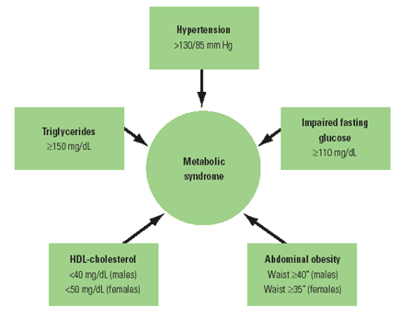
Metabolic Syndrome
Name for a group of risk factors that occur together and increase the risk for coronary artery disease, stroke, and type 2 diabetes
Researchers are not sure whether the syndrome is due to one single cause, but all of the risks for the syndrome are related to obesity.
Pro inflammatory (state CRP)
1 out of 5 Americans!
Notes:
According to he AHA and the NHLBI, metabolic syndrome is present if you have three or more of the listed signs. A pro inflammatory state also contributes to the syndrome. Trans fat (and maybe sugar) may contribute to inflammatory mechanisms and interference with fat metabolism.

Slide 31
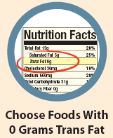
Food Label
Decreased since 2006
Societal pressure and legislative regulations also have contributed to the reformulations
A product can claim to be “Trans-Fat Free” and list 0 grams of trans fat as long as it has less than .5 g of trans fat.
An individual may ingest significant quantities of trans fats while believing they have consumed none.
Must look at ingredient list!
  Partially hydrogenated, vegetable shortening, margarine
  Coffee creamer
  http://www.huffingtonpost.com/michael-f-jacobson/trans-fat_b_1196439.html#s602452&title=Marie_Callenders_Lattice
Notes:
Important for added sugar!

Slide 32
Reformulations
No national database exists of product-specific changes in trans-fat and saturated fat over time.
Concerns exist that in reformulating the foods manufacturers may replace the trans-fat with saturated fat.
Reformulations that increased levels of unsaturated fats over saturated maximize health benefits.
According to an analysis at Harvard School of Public Health, major brand name reformulations generally reduced the trans-fat content substantially without making equivalent increases in saturated fat content.
Mozaffarian, 2010. Food Reformulations to Reduce Trans Fatty Acids N Engl J Med 2010; 362:2037-2039.
Notes:
Didn’t happen with NYC

Slide 33
Regulations
In 2004, Denmark banned all commercial sources of trans-fats. The ban along with simultaneous advances in the prevention and treatment of CVD played a role in the 60% decline in cardiovascular disease.
New York City, Philadelphia and California have banned the use of trans-fat in foods prepared in restaurants
Strong Trans Fat Regulations
  National School lunch and Breakfast program
  HHS/GSA Healthy and Sustainable Food Guidelines
Notes:
It is important to note that all of these regulations exempted packaged or manufactured foods because these products fall under the jurisdiction of the Federal Food and Drug Administration (FDA). ⁶

Slide 34
Change in Trans Fatty Acid Content of Fast-Food Purchases Associated With New York City's Restaurant Regulation: A Pre–Post Study
Design: Cross-sectional study that included purchase receipts matched to available nutritional information and brief surveys of adult lunchtime restaurant customers conducted in 2007 and 2009, before and after implementation of the regulation.
Setting: 168 randomly selected NYC restaurant locations of 11 fast-food chains.
Results: 7000 purchases in 2007 and 8000 purchases in 2009.
  mean trans fat per purchase decreased by 2.4 g
  saturated fat showed a slight increase of 0.55 g
  Mean trans plus saturated fat content decreased by 1.9 g overall
  Mean trans fat per 1000 kcal decreased by 2.7 g per 1000 kcal
  Purchases with zero grams of trans fat increased from 32% to 59%.
  The poverty rate of the neighborhood in which the restaurant was located was not associated with changes.
Notes:
Assesses whether the regulation that took effect in 2009 was making a difference for diners. Few than 4.5 grams of trans fats can increase the risk of coronary heart disease by 23%. Fast food restaurants have nutrition info readily available. Limitation: Fast-food restaurants that were included may not be representative of all NYC restaurants.
The introduction of a local restaurant regulation was associated with a substantial and statistically significant decrease in the trans fat content of purchases at fast-food chains, without a commensurate increase in saturated fat. Restaurant patrons from high- and low-poverty neighborhoods benefited equally. However, federal regulation will be necessary to fully eliminate population exposure to industrial trans fat sources.

Slide 35
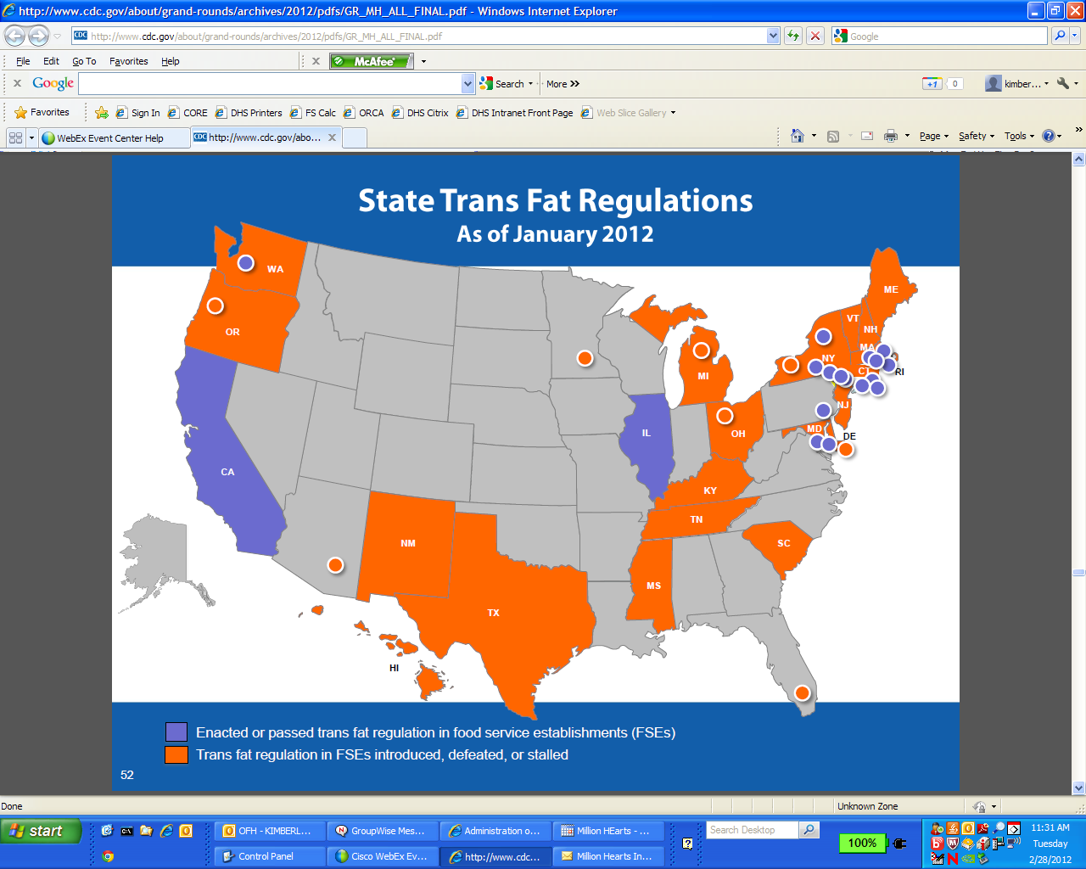
http://www.ncsl.org/issues-research/health/trans-fat-and-menu-labeling-legislation.aspx
Notes:
The County Board of Commissioners voted down a proposal that would ban trans fats. There are 29 states that have considered legislation to limit or ban artificial trans fats in various locations including restaurants and schools. California and Vermont have pioneered state-wide artificial trans fat bans in restaurants, but many other states have proposed similar legislation, proposed or enacted artificial trans fat bans in schools, reduced artificial trans fat use in schools to less than 0.5 grams per serving, or enacted legislation to review the economic impact of an artificial trans fat ban at the state level.
OR HB 2726 (2009, enacted, Section 1. ORS 336.423) - Requires chain restaurants to disclose certain nutritional information regarding menu items and post total calorie information in specified manners and locations, including trans fat. Directs the Department of Human Services to adopt rules to administer and enforce the requirements and directs the department to create an exception for drive-through areas under specified circumstances.
OR HB 2650 (2007, enacted, Chapter 455) - Among other provisions specifying school food standards, prohibits the sale of snack items at school that contain more than 0.5 grams of trans fat per serving.

Slide 36
Economic
Several large food outlet chains have removed trans-fat from their offerings since 2006 (Starbucks, Dunkin Brands, IHOP, Panera).
  Did not suffer any earnings lost
  Alternatives are available at comparable prices and tasty
    Healthy trans-fat-free oils, such as soy, corn, canola, safflower, and sunflower oils, are available and can easily replace partially hydrogenated frying oil.
    When harder fats are needed to make piecrusts and other baked goods, trans-fat-free margarines and shortenings can be used.
    Some are slightly more expensive than partially hydrogenated oils, many restaurants have found that they have a longer fry-life.
Notes:
Even Crisco, the quintessential solid shortening made with partially hydrogenated oil, now contains less than 0.5g of trans fat per serving
Cinnabon has 5 grams of trans fats!, Burgerville= corn syrup and HFCS but natural transfats. PARTIALLY HYDROGENATED SOYBEAN AND COTTONSEED OILS,

Slide 37
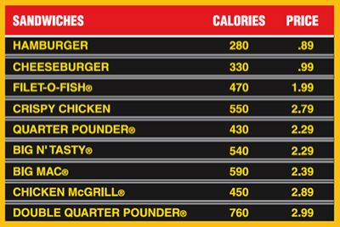
Menu Labeling
The FDA has included fat, saturated fat, and trans-fat in their proposed rules for national menu labeling.
Calories are the only requirement that needs to be posted.
Supplemental nutritional information must be available to consumers upon request

Slide 38
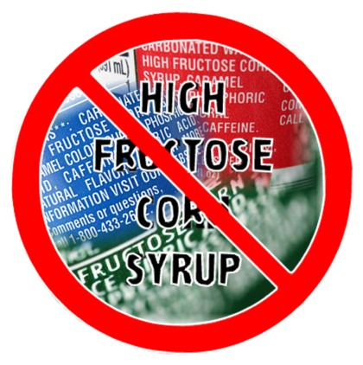
Sugar
Science: sugar/HFCS
Added Sugars
Opportunities: Sugary Drinks
Notes:
manmade sweetener that’s found in a wide range of processed foods. after HFCS began to be widely introduced into the food supply 30-odd years ago, obesity rates skyrocketed.

Slide 39
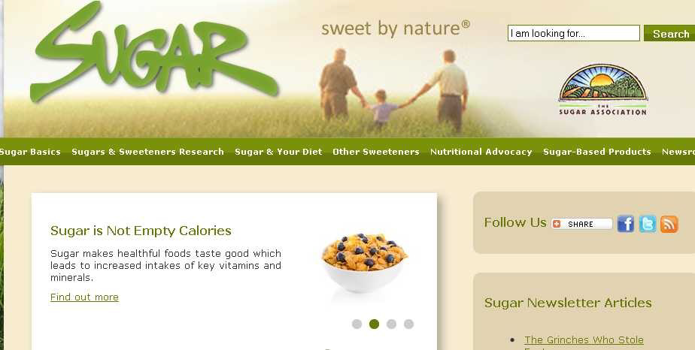
Sugar
Sugar is not empty calories
http://www.youtube.com/v/KVsgXPt564Q
Notes:
Rudd Center has their cereal studies that show that when kids eat unsweetened cereals they actually eat the right portion for their age and eat more fruit than when eating sugary cereal.

Slide 40
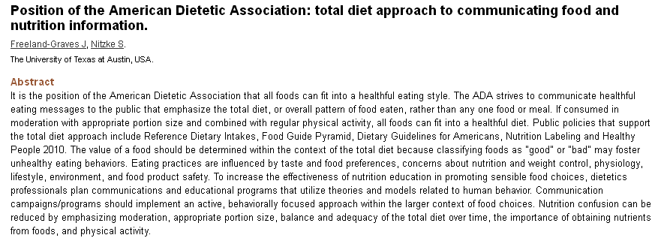
All foods can fit into a healthful diet.

Slide 41

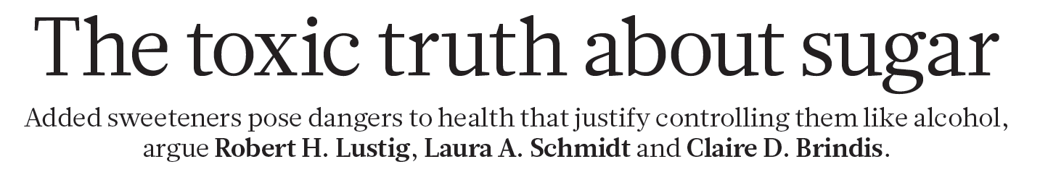
Notes:
Sugar and Heart Disease…more than just sugar and weight gain. Not just HFCS. Sugar and triglycerides. You Tube video.
Emerging…work has not been replicated.

Slide 42
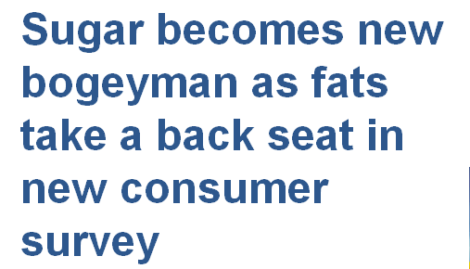
Sugar most likely to cause weight gain:
2011: 11%
2012: 20%

Slide 43
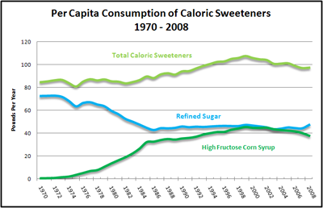
High Fructose Corn Syrup (HFCS)
Notes:
sugars from all sources have become so prevalent in our food supply, especially in our beverages. High Fructose Corn sweetener usage increased over 1,000% between 1970 and 1990. In 2000 it represented 17.9% of total energy intake (98.6 g). Recent NHANES data (2007-2008) indicate the average intake decrease to 14.5% of total energy intake.
This exceeds the change in intake more than any other food in that time span
55% of all sweeteners today are derived from corn. Coincides with obesity rates.
Since the 1970s, sugar consumption has gone down nearly 40 percent, but high fructose corn syrup has more than made up the difference. Dr. Lustig says they are both toxic because they both contain fructose -- that's what makes them sweet and irresistible.

Slide 44


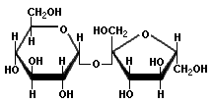
High Fructose Corn Syrup is 42-55% Fructose; Sucrose is 50% Fructose
Fructose
Glucose
Sucrose (table sugar)
Notes:
Called glucose-fructose syrup in the UK
Table sugar is made of one glucose molecule joined to one fructose molecule, so it contains glucose and fructose in equal proportions. High-fructose corn syrup also contains glucose mixed with fructose, with just slightly more fructose than glucose (or, in some varieties, slightly more glucose than fructose). Since table sugar and corn sweeteners are made up of the same "raw materials"—glucose and fructose—and these raw materials are used in roughly similar proportions, it is likely that table sugar and corn sweeteners have the same physiological impact on blood sugar, insulin, and metabolism.

Slide 45
HFCS: 2012
“Added sugars—whether they come from sucrose, high-fructose corn syrup, or fruit juice concentrates—all have equal adverse effects metabolically.”
–Vasanti Malik, Harvard School of Public Health

Slide 46
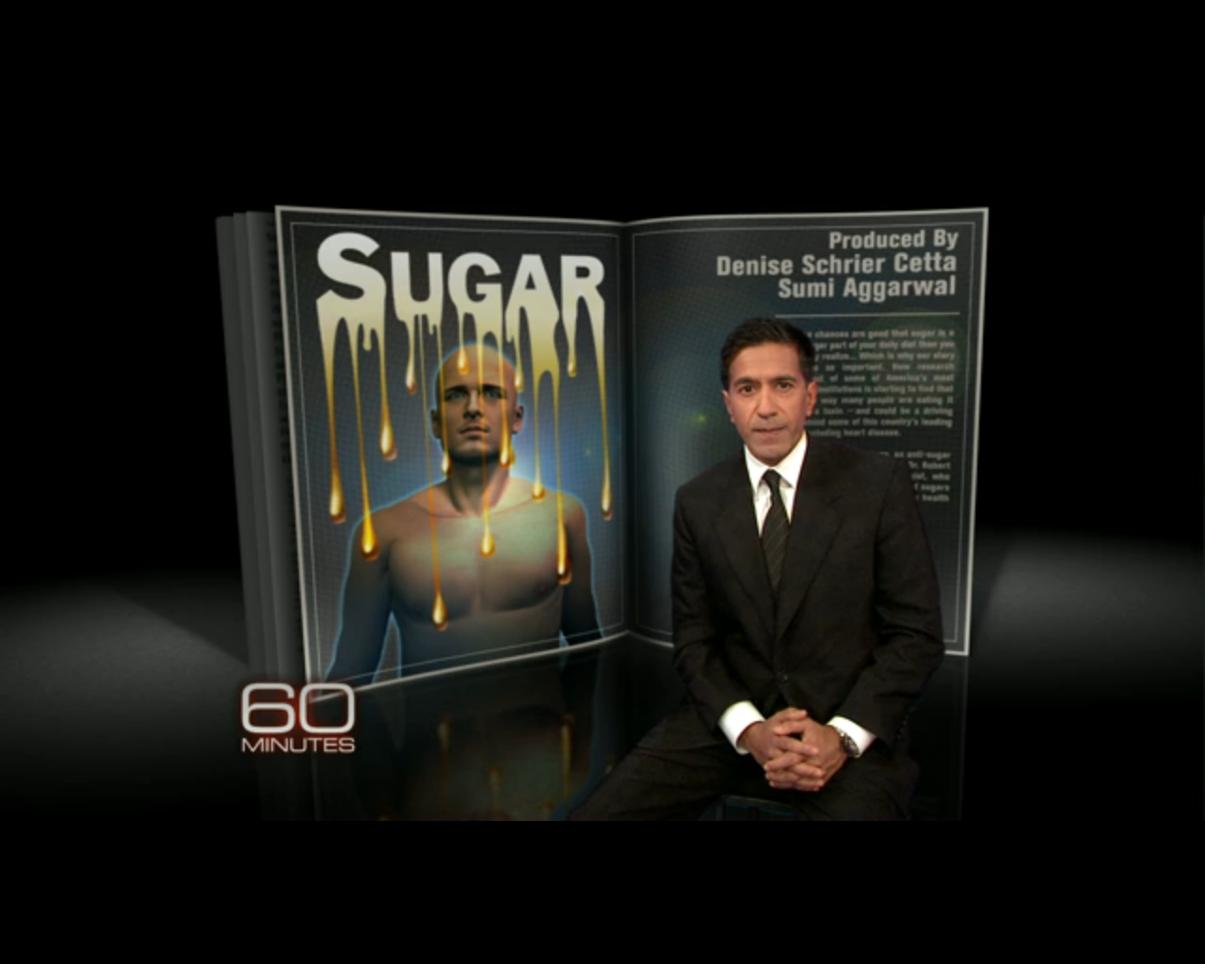
http://www.cbsnews.com/video/watch/?id=7403942n&tag=contentBody;storyMediaBox
Notes:
Studies done by Kimber Stanhope, a nutritional biologist at the University of California, Davis are starting to back up Lustig’s work. She's in the middle of a groundbreaking, five-year study which has already shown strong evidence linking excess high fructose corn syrup consumption to an increase in risk factors for heart disease and stroke. That suggests calories from added sugars are different than calories from other foods.
Her study suggests that when a person consumes too much sweet stuff, the liver gets overloaded with fructose and converts some of it into fat. Some of that fat ends up in the bloodstream and helps generate a dangerous kind of cholesterol called small dense LDL. These particles are known to lodge in blood vessels, form plaque and are associated with heart attacks.

Slide 47
Added Sugar: Today
Emerging science: not all sugar is same
–fructose may be culprit in obesity & metabolic effects (circulating glucose, insulin, postprandial triglycerides, leptin and ghrelin) & subjective effects (hunger, satiety, energy intake)
  Havel PJ. Dietary fructose: implications for dysregulation of energy homeostasis and lipid/carbohydrate metabolism Nutr Rev. 2005; 63(5): 133-157.
  Nguyen S, Lustig RH. Just a spoonful of sugar helps the blood pressure go up. Expert Rev Cardiovas Ther. 2010; 8(11):1497-1499
  Lim JS, Mietus-Snyder M, Valente A, Schwarz JM, Lustig RH. The role of fructose in the pathogenesis for NAFLD and the metabolic syndrome. Nat Rev Gastroenterol Hepatol. 2010; 7(5): 251-264.
Notes:
At least for now, high-fructose corn syrup doesn't seem to be any better or any worse than any other kind of added sugar. Animal studies show it might be metabolized differently.
Limit intake of all added sugars

Slide 48
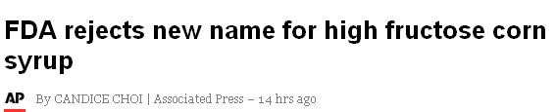
Notes:
Corn refiners Association wanted to change the name to corn sugar…The FDA said the corn-refining group didn't provide sufficient grounds for a name change. The agency said it defines sugar as "a solid, dried and crystallized food," while syrup is a "liquid food."

Slide 49
Regulating Sugar
Not required on nutrition label
FDA:
–no recommended limit
AHA limit of 5 tsp/ (80 cals) per day for women
9 tsp/day (144 cal) for men
4 g = 1 tsp
12 oz can of soda = 8 tsp = 130 kcal from sugar
–no way to distinguish added from naturally-occurring
FDA and ADA: no evidence that body distinguishes added from naturally-occurring

Slide 50
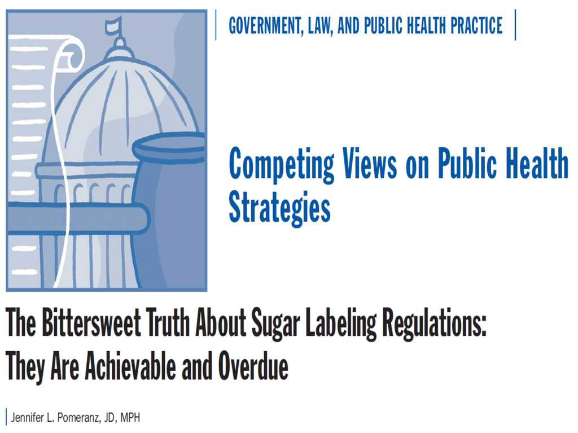
Notes:
Require disclosure of added sugar on nutrition facts panel
Similar effects as trans fats-create and advertise products with less added sugar.
Revise requirements for health claims
Establish a daily ref. value for sugar (AHA, USDA, WHO) have issued strong standards that can guide the gov’t. There are no longer any viable reasons to maintain outdated nutrition labeling standards for sugar.
Foster informed choice and results in improved health for the wider population if positive reformulation results.

Slide 51

Dietary Guidelines 2010
Clear limits on added sugar
–“empty calories”
Can distinguish added from naturally-occurring
US diet contains too much added sugar
Current regulations don’t adequately address
Notes:
2010 DGA provided clear recommendations for added sugar consumption and an approach to evaluate added sugar content in foods. The lack of a perfect scientific method for determining added sugar is no different from that in the food allergen area. Manufacturers know how much sugar is added to their products. The FDA can require manufacturers to confidentially submit the food recipe to thea gency for verification w/o invoking concerns of proprietary info (like tobacco products). Possibly allow more lenient disclosore such that the number may not be w/in the same% of other nutrient disclosures.

Slide 52
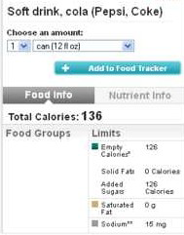
Choosemyplate.gov
Added Sugars
Notes:
The USDA has determined the amount of added sugar in more than 8000 food products, and the results are available online.

Slide 53
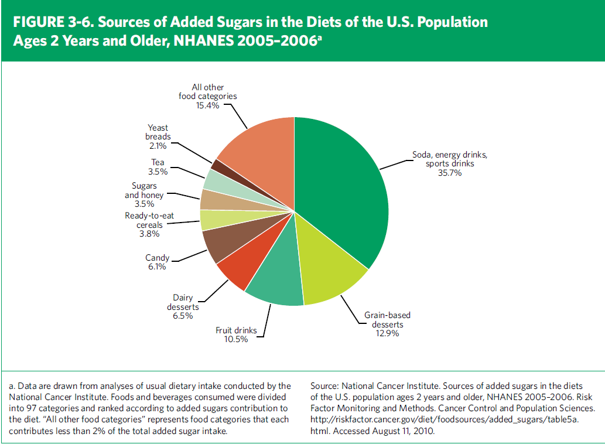
Source: Dietary Guidelines for Americans, 2010
Notes:
The mamor source of added sugar in the American diet is dervied from commercially sweetened products, including calorically sweetened beveragess, grain and dariy based desserts, syrups, candy and RTE cereals. Noteworthy, that including other sweetened beverages such as sweetened tea, coffee, and milk drinks, in the category brings the percentage of added sugar from sweetened beverages in the American diet to 47.1% (Wels JA, Sharma AJ, Grellinger L, Vos MB. Consumptio of added sugars in decreasing in the United States. Am J Clin Nutr. 2011; 94(3); 726-734.

Slide 54
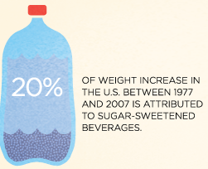
Consumption: 45 gal/yr
Soda
SPORTS ENERGY
RTD TEAS
slightly

Slide 55
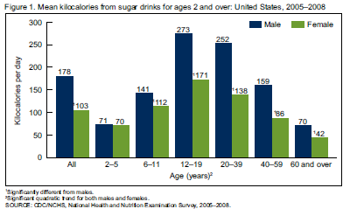
Avg. Calories from Sugar drinks
Notes:
Obesity epidemic has been attributed to an increase in just 100 calories!

Slide 56
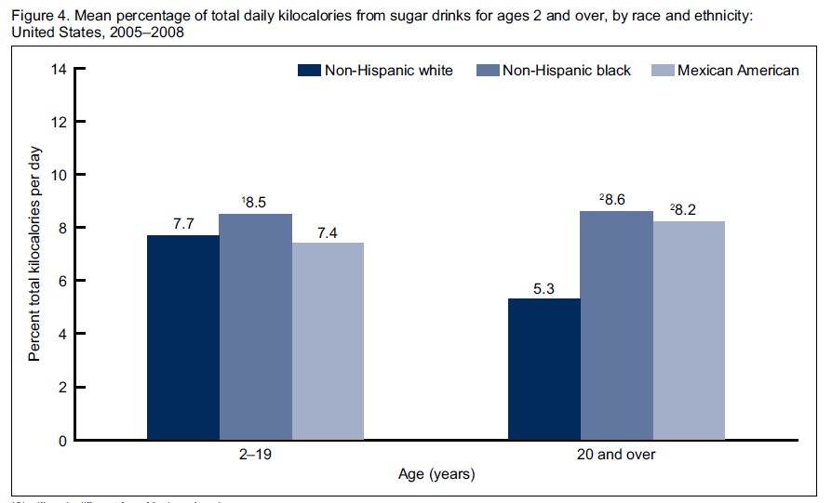
By Race/Ethnicity

Slide 57


Restrict Marketing
Science & News
Schools
Municipal Facilities
Litigation
Regulate Practices
Educational Campaigns
Hospitals
Taxes
Reduce
Sugary
drinks
Notes:
Reduce Consumption of Sugary Drinks: Consumption trends
Soda: single greatest source added sugar Solid science correlating it with obesity and other metabolic diseasese.
Empty calories
Restrict Marketing in schools to youth
Municipal Facilities: Boston-ban sugary drinks in public buildings
Regulate Practices: Bloomberg Proposal, Nutrition Standards, Marketing Regulations (schools, buses)
Hospitals: ban sugary drinks and marketing of soda in hospitals
Educational campaigns: soda free summer-Boston & California, Multnomah county
Litigation: CSPI sued coke for deceptive and unsubstantiated claims that vitamin H20 is a healthful alternative to soda by labeling its several flavors with such health buzz words as "defense," "rescue," "energy," and "endurance." go far beyond even the loose, so-called "structure/function claims“ allowed by the FDA
Taxes: 1 cent/oz results in a 20% increase in price and 24% decrease in consumption. Follow Richmand California and El Monte this Fall.

Slide 58

One piece of the puzzle
Healthy Food Environments
  More than just salt, fat or sugar
  Increase fruits and vegetables
  Increase whole grains, decrease refined grains
  Less Calories, Trans Fat and Saturated Fat
  Less added sugars esp. from SSBs
  Lean protein and low fat dairy
  Increase access to healthy foods
  Decrease access to unhealthy foods

Slide 59
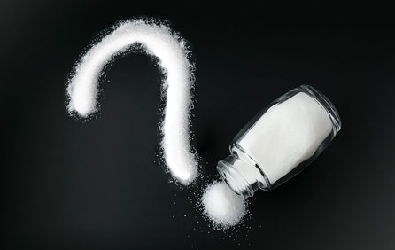
Questions?

